Slide 1
USGS Agency Report to GSICS March 20, 2017
Tom Stone, USGS-Flagstaff (GRWG)
Ron Morfitt, USGS-EROS Data Center (GRWG)
Greg Stensaas, USGS-EROS Data Center (GSICS EP)

Slide 2
Overview
Landsat Mission Status
Spacecraft status
Instrument performance and anomalies
Landsat 7 end-of-mission considerations
GSICS-related Actions and Activities
CGMS Working Paper on requirements for absolute lunar calibration
Radiometric comparison of Landsat-8 OLI and Sentinel-2A MSI
Cal/Val Center of Excellence
JACIE
Other Activities

Slide 3
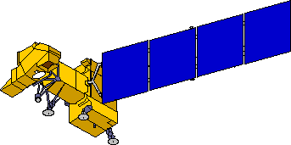
Landsat 7 Observatory Status
On orbit since April 1999
Electrical System
Attitude Control System
•10/18/2014 Clock Generator Circuit failure
•Battery performance nominal
•05/05/2004 Gyro 3 Shut Off
•1-gyro control system in development
Solar Array
5/14/2002 Circuit #14 Failure
5/16/2005 Circuit # 6 Failure
8/13/2008 Circuit #14 recovery
14 circuits remain operating
no impact to ops
Enhanced Thematic Mapper +
•5/31/2003 SLC Failure
•4/01/2007 Bumper mode
Reaction Control System
1/07/04 Fuel line #4 thermostat #1a failure
2/24/05 Fuel line #4 thermostat failure;
Primary heater circuit disabled
4/25/13 Fuel line #2 thermostat failure;
Redundant heater circuit disabled
Remote Tlm Cmd (RTC) Box
•09/27/2014 RTC A Failover
Solid State Recorder
11/15/1999 SSR PWA #23 Loss
02/11/2001 SSR PWA #12 Loss
12/07/2005 SSR PWA #02 Loss
08/02/2006 SSR PWA #13 Loss
03/28/2008 SSR PWA #22 Loss
09/03/2008 SSR PWA #23 Recovered
10/12/2013 SSR PWA #11 Loss
Each PWA is 4% loss of launch capacity
Boards are likely recoverable
X-band System
Performance nominal
S-band System
Performance nominal

Slide 4
Landsat 7 — Mission-Limiting Factors
Final delta–inclination maneuver executed on 07 February 2017
crossing time expected to drift to 09:45 (nom. 10:00) by early 2020
Component Anomalies: Mission status that prompts consideration of decommissioning
End of science mission: A critical failure of either the ETM+ or supporting bus subsystem
Imminent failure of critical sub-system component capability that is considered necessary to execute the decommission plan
Loss of critical subsystem redundancy may not be an exit trigger and would be evaluated on a case-by-case basis
Examples include ACS gyro or C&DH S-band transponder
Fuel Reserves
Sufficient fuel must be maintained to meet mission decommissioning requirements

Slide 5
Landsat 7 — Mission Extension Options
Place Landsat 7 in a disposable orbit appx 8 km below 705 km
EOM estimate late 2020 — coincides with L9 launch
May be extended to mid 2021 if L9 is delayed
Participating with NASA’s Satellite Servicing Projects Division
https://sspd.gsfc.nasa.gov/restore-L.html
L7 identified as client to be captured and refueled
Would commence after the end of the science mission
Several options for fuel use (dependent upon health of the spacecraft)
Must meet 25 year re-entry
Could be used to raise the inclination (MLT) if desired
Potential for underflights of L8 and L9 for calibration purposes
Could return to 705 km if L9 fails to reach orbit
Could potentially perform science off of WRS

Slide 6
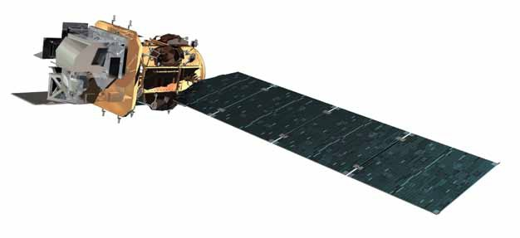
Landsat 8 Observatory Status
On orbit since Feb. 2013
Operational Land Imager
RF Communications
Thermal Control System
-Reaction Wheel 4 Heater erratic cycling
Propulsion Subsystem
Attitude Control System
- CSS-9 current spikes
Electrical Power System
Thermal Infrared Sensor
- TIRS Alt Con Ops developed and has been used since Nov. 2015
Command & Data Handling System

Slide 7
Landsat 8 Satellite Status
All spacecraft subsystems are nominal
Instrument special ops:
One TIRS DS/BB calibration, in addition to those bracketing other TIRS cals per TIRS Modified Con Ops Calendar, was performed on Dec. 30 to maintain the two week interval for TIRS cals. This was the first instance of just a TIRS DS/BB being scheduled.
TIRS Alternative Con Ops. developed and has been in use since Nov 2015.

Slide 8
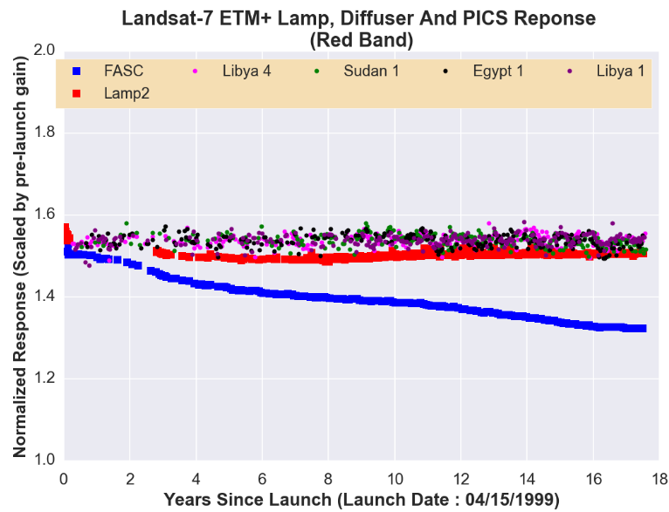
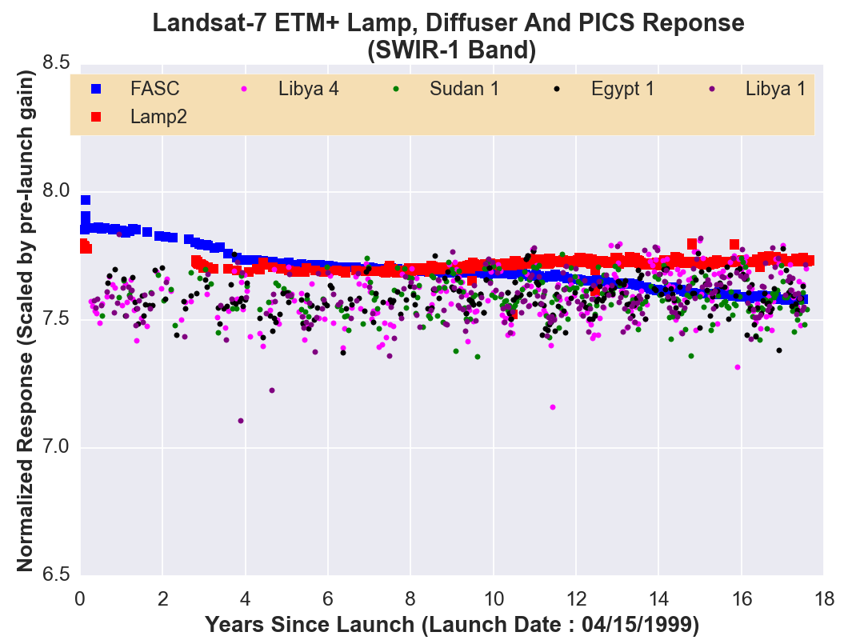
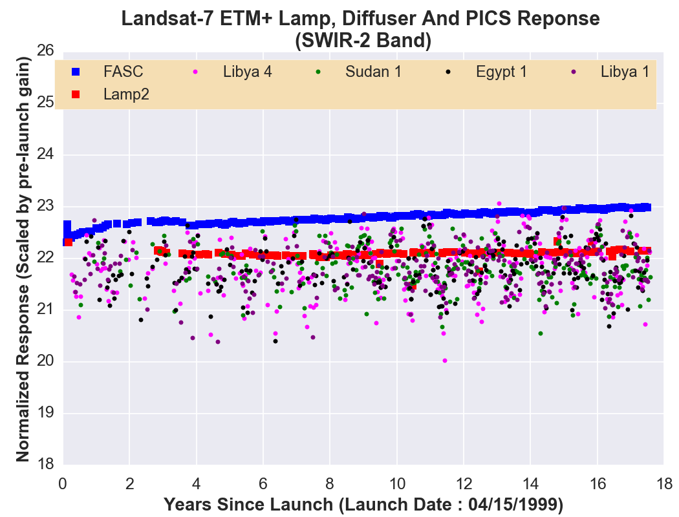
Landsat 7 ETM+ Radiometric Trending
ETM+ stability primarily monitored using PICS
On-board calibrators (2- lamps and a diffuser) were deemed unreliable after few years since launch

Slide 9
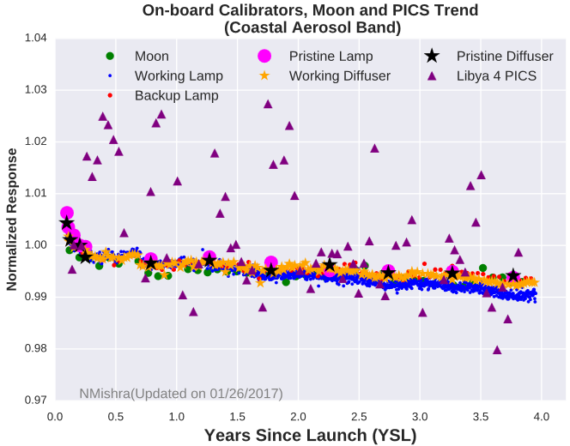
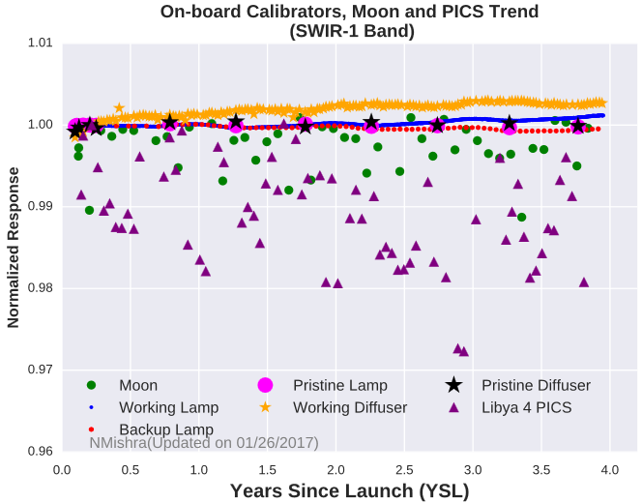
Landsat 8 OLI Radiometric Trending
On-board calibrators and lunar observations are much more precise than PICS
PICS tend to indicate larger drift than on-board calibrators and moon across all the bands
OLI and ETM+ show similar behavior across PICS, indicating more changes in site behavior than the sensors

Slide 10
GSICS-related Activities
CGMS Working Paper on requirements for absolute lunar calibration
In response to CGMS action on GSICS: CGMS-43 A43.01
“GSICS to establish the requirements for absolute lunar calibration and prepare a white paper describing the tentative way to meet those requirements in case they go beyond current capabilities.”
Working Paper prepared by T. Stone
sent to GRWG members for review; revised based on comments received
delivered to CGMS secretariat, presented at CGMS-44, WG-II (Thanks Dohyeong !)
Recommendations to CGMS:
Satellite instrument operators should adopt requirements to view the Moon with solar band sensors.
Satellite operating agencies should support proposals and programs to acquire the necessary measurements of the Moon to develop a new, high-accuracy, SI-traceable lunar reference standard for reflected solar wavelengths.
Long-term continuity of absolute solar spectral irradiance measurement with SI-traceable accuracy should be ensured.

Slide 11
GSICS-related Activities
Radiometric comparison of Landsat-8 OLI and Sentinel-2A MSI
Analysis conducted by Md. Obaidul Haque, SGT/USGS-EROS
Methodology:
Use near-simultaneous collection of Sentinel-2A MSI and Landsat-8 OLI over Pseudo Invariant Calibration Site (PICS)
Libya 4 WRS2 Path 181 Row 40, S2A Tile 34RGT (~98x48km)
Three sets of data were used for radiometric cross calibration
Same day collection of S2A and L8 data on 12Aug15
S2A and L8 data collected 4 days apart, 30Dec15 and 03Jan16
S2A and L8 data collected 6 days apart, 29Jan16 and 04Feb16
Hyperion data for spectral adjustment collected 28Jul15, 7Sep15, 30Dec15 and 03Feb16
Apply spectral band adjustment factor (SBAF)
Compute TOA reflectance from selected ROIs
Compare TOA reflectance only for similar S2A/L8 bands

Slide 12
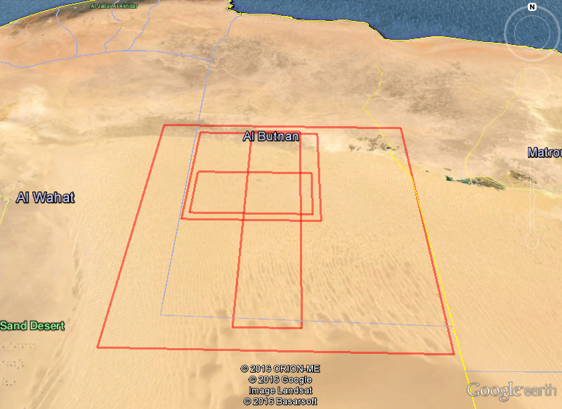
Radiometric comparison of Landsat-8 OLI and Sentinel-2A MSI
Footprints over Libya 4
MSI
ROI
OLI
HYP

Slide 13
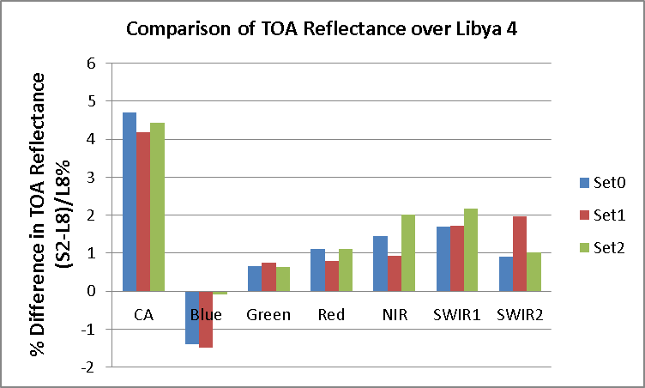
Radiometric comparison of Landsat-8 OLI and Sentinel-2A MSI
Difference in TOA Reflectance
Cross calibration using near simultaneous acquisitions
%Difference in TOA Reflectance (S2-L8)/L8%
Band | CA | Blue | Green | Red | NIR | SWIR1 | SWIR2
Set0 | 4.692 | -1.386 | 0.654 | 1.101 | 1.443 | 1.709 | 0.910
Set1 | 4.182 | -1.478 | 0.740 | 0.804 | 0.935 | 1.721 | 1.979
Set2 | 4.430 | -0.078 | 0.633 | 1.104 | 2.024 | 2.183 | 1.020

Slide 14
GSICS-related Activities
Calibration/Validation Center of Excellence
Currently under development, a part of USGS Earth Resources Observation and Science (EROS) Center
To consolidate broad expertise within USGS on on-orbit cal/val
Strategic plan formulated
Initial implementation set for June 2017
Calibration workshop being planned for Fall 2017

Slide 15
GSICS-related Activities
Joint Agency Commercial Imagery Evaluation (JACIE) program
Consists of representatives from USGS, NASA, NOAA and the U.S. Dept. of Agriculture
Performs product analysis of commercial and other remote sensing data and information products
Provides independent characterizations of image and image-derived end products
Provides independent verification of commercial imagery data quality
Provides Earth scientists with awareness of commercial imagery
Annual Workshop
2017 JACIE workshop to be held at USGS Headquarters in Reston, Virginia, September 19–21, 2017
https://calval.cr.usgs.gov/jacie

Slide 16
Other Activities
Preparing for Landsat 9 launch (est. December 2020)
Planning for Landsat 10
Continue on-orbit calibration and validation efforts
RadCalNet
PICS
Lunar
Joint agency efforts
MOU between USGS and NOAA
Requirements Capabilities and Analysis for Earth Observations
http://remotesensing.usgs.gov/rca-eo
Land Product Characterization System
http://landsat.usgs.gov/lpcs.php

Slide 17
Thank You!

