Slide 1
GRWG Microwave Sub-Group Briefing
Ralph Ferraro (and entire MW Subgroup)
NOAA/NESDIS

Slide 2
Outline
Scope of MW Subgroup
Membership
Focus for past/upcoming year
Quarterly Meetings/Highlights
Contributions to 2016 GUW
Outcome of joint CEOS/GSICS joint session
Summary of Accomplishments & Ongoing Endeavors

Slide 3
Scope of Microwave Sub-Group
Understanding the users’ requirements for inter-calibration products for microwave instruments
Imagers + sounders – passive only (initially, but eventually consider active if there is a need…)
Retrospective calibration (CDR’s and their components like geolocation, scan biases, inter-satellite)
Forward looking calibration (near-real time uses)
Identifying existing products that could meet those requirements, but first….
Need to define criteria…Reference standards (sensor(s), models, calibration methodologies….)
And then a process that adheres to GSICS principles
We should also focus on tools/algorithms like SNO, Double Difference, RTM, etc.
Might be something more feasible in near term?
Define data standards (jointly with GDWG)
Encourage the creators of those products to submit them to the GSICS Procedure for Product Acceptance (GPPA), once its defined for MW
Candidates include Cheng-Zhi Zou (MSU-AMSU), Karsten Fennig (SSMI), GPM X-Cal LUT’s
Coordination with other groups (e.g., CEOS WGCV MW, GPM X-Cal) would also be required to generate standards and best practices

Slide 4
Membership Signed up as of January 2017 – We continue to grow!
NOAA (and affiliates) - Ralph Ferraro (Chair), Huan Meng, Cheng-Zhi Zou, Tony Reale, Manik Bali (Univ. Maryland), Isaac Moradi (Univ. Maryland), Hu (“Tiger) Yang (Univ. Maryland), Wenze Yang (Univ. Maryland), Johnny Luo (City College New York)
EUMETSAT (and affiliates) – Tim Hewison, Karsten Fennig, Viju John, Jörg Ackermann, Sabatino DiMichele, Sante Laviola, Vinia Mattoli, Sreerekha Thonipparambil, Christophe Accadia, Martin Burgdorf (Hamburg Univ.), Imke Hans (Hamburg Univ.), Ralf Bennartz
NASA (and affiliates) – Ed Kim (GSFC), Tanvir Islam (JPL), Linwood Jones (Univ. of Central Florida), Rachael Kroodsma (Univ. of Maryland), Wes Berg (Colorado State Univ.), Thomas Holmes
NIST – Derek Houtz, David Walker
CMA (and affiliates) – Songyan Gu, Qifeng Lu, Lin Chen, Hu Yang, Xiaolong Dong, Shengli Wu
KMA (and affiliates) – Jun Park, Dong-Bin Shin (Yonsei University, South Korea), Dohyeong Kim, Minju Gu
JAXA (and affiliates) - Misako Kachi, Takashi Maeda
IISC – Ram Ratan

Slide 5
Focus Topics for 2016-2017
Defining CLEAR PATH for GSICS MW products and algorithms (formed sub-topical leaders; just getting started)
Methodologies (Jun Park, Rachel Kroodsma)
SNO, Double difference, etc.
Reference Standards (Manik Bali, Isaac Moradi, David Walker)
A particular sensor? Likely to be wavelength dependent (e.g., window, O₂, H₂0); A RTM?
LUT/Correction Tables (Karsten Fennig, Cheng-Zhi Zou, Viju John)
Near real-time and climate; they will be different
Tying together other groups/opportunities
Engaging more closely GPM X-Cal (Wes, Rachel)
Participation our 2016 GUW; Participation at this meeting!
Formalizing linkages to CEOS MW subgroup (Cheng-Zhi, Xiaolong Dong)
CEOS-GSICS Microwave Coordination Meeting – 2016 July 5-6, Beijing, China
Expanding active participation (Manik, Ralph)
Continued participation by subgroup at meetings of relevance:
GSICS; CEOS;CALCON, Microrad 2017, AMS Sat. Met, EUMESAT Satellite, etc.

Slide 6
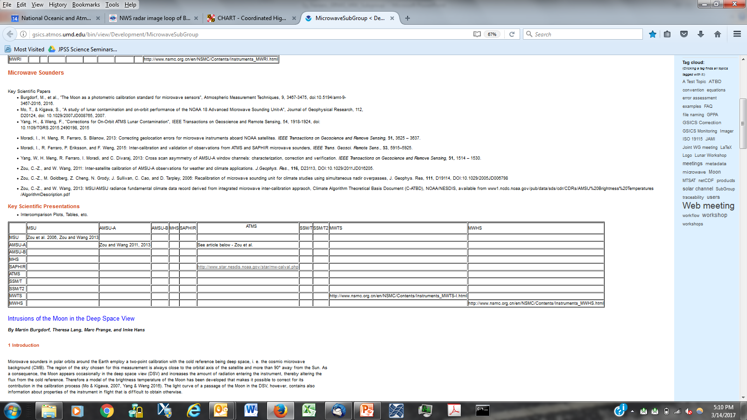
MW Workspace http://gsics.atmos.umd.edu/bin/view/Development/MicrowaveSubGroup

Slide 7
Recent Meetings of Microwave Sub-Group
Mostly web meetings
Max 2.5hr; try to hold in the 1100 – 1400 UTC timeframe
Materials and minutes always posted on Wiki
21 April 2016
26 July 2016
25 October 2016
11 January 2017
Some side-bar meetings:
GRUAN
GPM X-Cal
In orbit reference standards

Slide 8
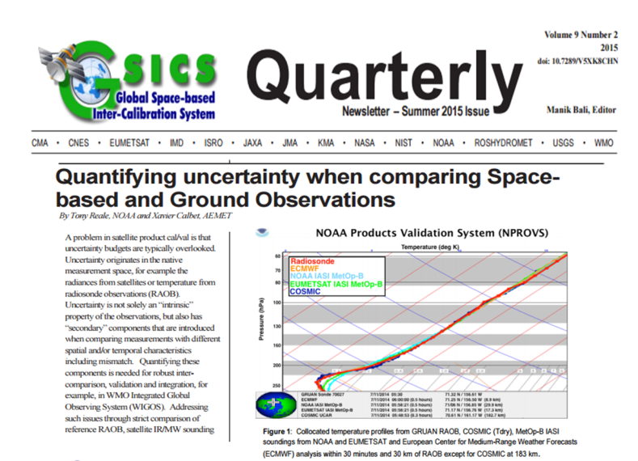
Sample Presentations (1/2)
Shengli Wu, 21 Apr 2016
Tony Reale, 26 Jul 2016
GRUAN collocations with high quality satellite derived
Sounding (NUCAPS, AIRS and ECMWF)
23 H

Slide 9
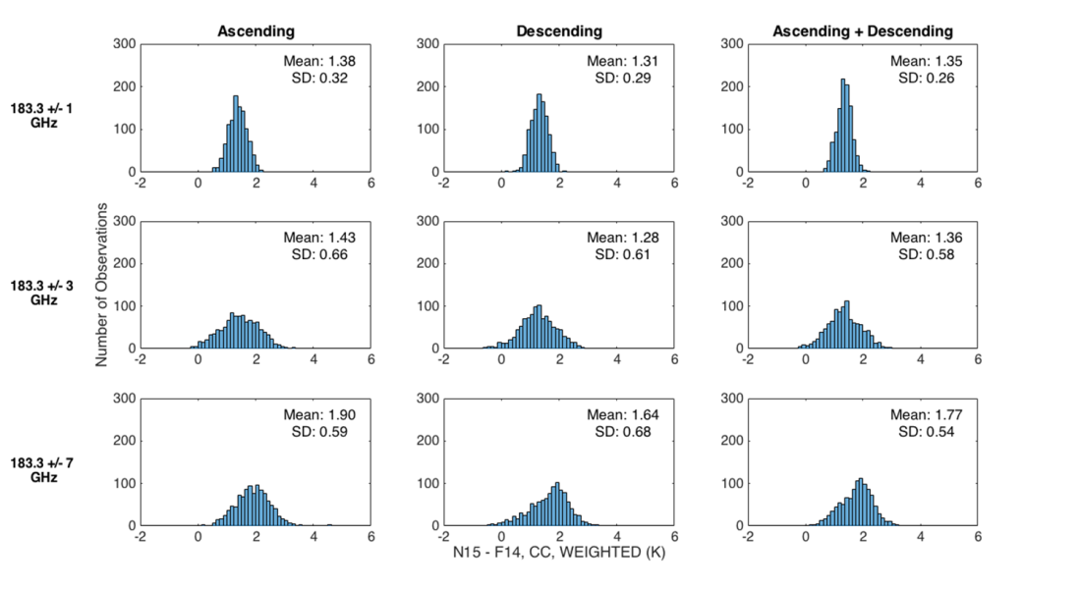
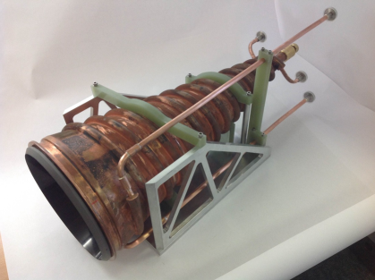
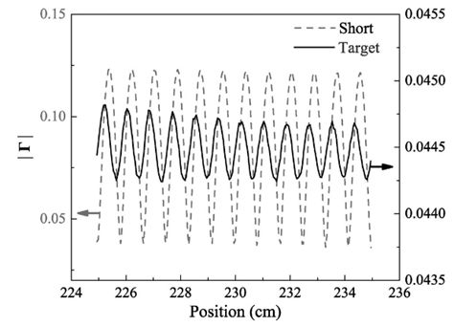
Sample Presentations (2/2)
David Walker, 25 Oct 2016
Johnny Luo and Viju John, 11 Jan 2017
SSMT/2 Geolocation Errors
18 GHz ε Verification

Slide 10
Highlights from Aug 2016 GUW – Microwave Session
Wes Berg - Better RTM components needed to close loop on MW sensor calibration. Water vapor absorption and ocean surface emissivity highest priority. Use of high quality in-situ like ocean buoys and GRUAN raobs should be preferred over NWP model fields. From the GPM X-Cal perspective, GMI and MHS could be good reference instruments.
John Forsythe - Blended water vapor (TPW and layered WV) require good sensor calibration on both weather and climate scales. A L1C CDR would be useful for developing a better TPW climatology; dating back to SSM/T2 would be even better. He also stressed the importance of "image validation" where several LEO MW TPW products are put together and would demonstrate success/failure of calibrations/intercalibrations.
George Huffman - Global precipitation products use both GEO IR and LEO MW; both require a variety of calibrations and other GSICS tools (like a unified parallax correction). Going back to the SMMR era would enhance the global precipitation climatology. MW accuracy of 1 K or less needed.
Cheng-Zhi Zou - Much work done to develop the longest microwave time series for temperature monitoring - SSU/MSU to AMSU. Calibration and intersatellite calibration requires various methods to get at full dynamic range. Will continue forward with ATMS and MWS.

Slide 11
CEOS/Joint Session Summary July 6-7, 2016 – Beijing, China
Session co-chaired by C-Z. Zou (NOAA) and Xialong Dong (NSSC/CAS); 15 participants
Collaboration between CEOS and GSICS MW subgroups; not to overlap effort
CEOS/WGCV microwave subgroups is focusing on
Guidelines for prelaunch calibration of microwave radiometer
Guidelines for scatterometer calibration and data quality control
GSICS is focusing on defining reference instrument
Observations from instrument are widely used in operations and research
Calibration theory should be well established and documented
Pre-launch calibration meets specifications
Once in space, performance is well characterized and meets specifications

Slide 12
Past year accomplishments and ongoing endeavors
Continued expansion of group
More ideas and new collaborations
Sub-topical leads/formation
Develop tasks, move forward with them
References, Methods, Correction Tables….
Wiki collaboration pages
Still a work in progress….
GUW MW Session
Ideas from users leading to some new directions…
Joint CEOS/GSICS meeting
Building blocks for future collaborations
Annual issue of Newsletter/MW Focus
First dedicated MW parallel session here…
Hope to report on “true” accomplishments in 1-year

