Slide 1
4.b. Vicarious calibration by using statistical properties for ozone, reflectivity and aerosol index products in a latitude/longitude box over the equatorial Pacific
By L. Flynn, Z. Zhang, E. Beach, Y. Pachepsky

Slide 2
Outline
Project Background
Version 8 Total Ozone Algorithm Description
Target area, cross-track segregation, weekly
Reflectivity Results (1-percentile)
Aerosol Index Results (average)
Total Column Ozone (average)

Slide 3
Background: Effective Reflectivity Project
The aim is to produce over-pass comparisons of UV/Vis sensors for specific target sites or regions in use by the community. As a first step, summaries of methods and results for target sites currently in use will be collected. We will compare measurements at reflectivity channels from 330 nm to 500 nm.
Ice, desert and open ocean targets.
Absolute Radiance/Irradiance check; Track variations over time.
Reflectivity range/distribution, 1-percentile, Deep Convective Clouds (DCC)
Wavelength Dependence – Aerosol Indices, Clean atmospheres
Complications
Viewing and Solar angle considerations
Sun Glint
Surface pressure
Partially cloudy scenes
Polarisation
Inelastic Scattering
Turbidity, chlorophyll
Compare Global monthly surface reflectivity data bases
Goals
Agreement at 1% on cloud free scene reflectivity for 340 nm. Desert, Equatorial Pacific, Polar Ice.
Agreement at 1% on aerosol index – wavelength dependence of reflectivity.
Long-term reflectivity channels at 0.5% stability

Slide 4
Version 8 Total Ozone Algorithm
The algorithm makes two key assumptions about the nature of the BUV radiation. Firstly, we assume that the BUV radiances at wavelengths greater than 310 nm are primarily a function of total O3 amount, with only a weak dependence on O3 profile that can be accounted for using a set of standard profiles. Secondly, we assume that a relatively simple radiative transfer model that treats clouds, aerosols, and surfaces as Lambertian reflectors can account for most of the spectral dependence of BUV radiation, though corrections are required to handle special situations. The algorithm uses measurements at 12 channels to estimate the effective reflectivity and create absorbing aerosol and SO2 indices. A radiative transfer lookup table created using standard ozone profiles is used to match the viewing conditions and an ozone absorbing channel measurement.

Slide 5
Pacific Box Statistics
The lines on the next slide show weekly 1-percentile effective reflectivity, total column ozone and aerosol index values (measurement residuals for wavelengths in the 360-nm range using effective reflectivity calculated for the 331-nm range) for the V8 algorithm for all the data in a latitude/ longitude box in the Equatorial Pacific versus cross-track view position. We expect the reflectivity minimum to be between 4% and 6% for open ozone, and we expect the aerosol index values to be approximately zero N-values for this region of the globe. The cross-track variations for positions around position #10 are related to sun glint effects. Consistent variations versus cross-track are due to calibration biases across the instrument CCD array.

Slide 6
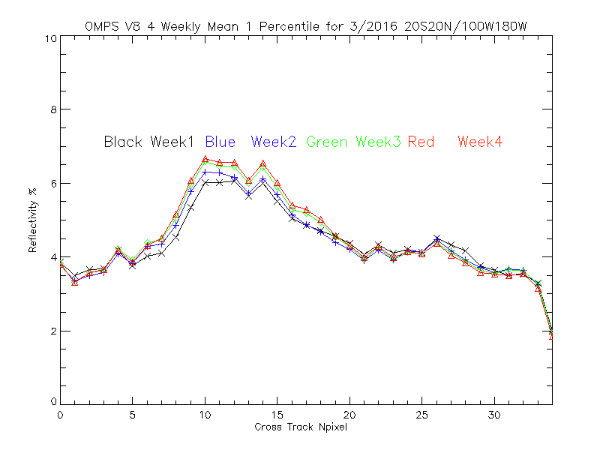
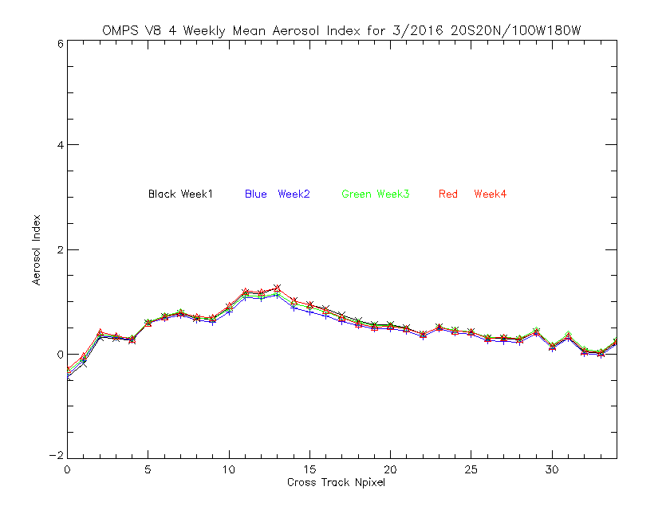
Cross-Track Internal Consistency for OMPS
← Weekly Effective Reflectivity values for the V8 algorithm for March2016 for all the data in a latitude/ longitude box in the Equatorial Pacific versus cross-track view position, 17 is nadir. We expect the values to be approximately 5% for this region of the globe. The cross-track variations for positions 8 to 15 are related to sun glint effects.
Weekly Aerosol Index values for the V8 → algorithm for March 2016 for all the data in a latitude/ longitude box in the Equatorial Pacific versus cross-track view position, 17 is nadir. We expect the aerosol index values to be approximately zero N-values for this region of the globe. The cross-track variations for positions 8 to 15 are related to sun glint effects.

Slide 7
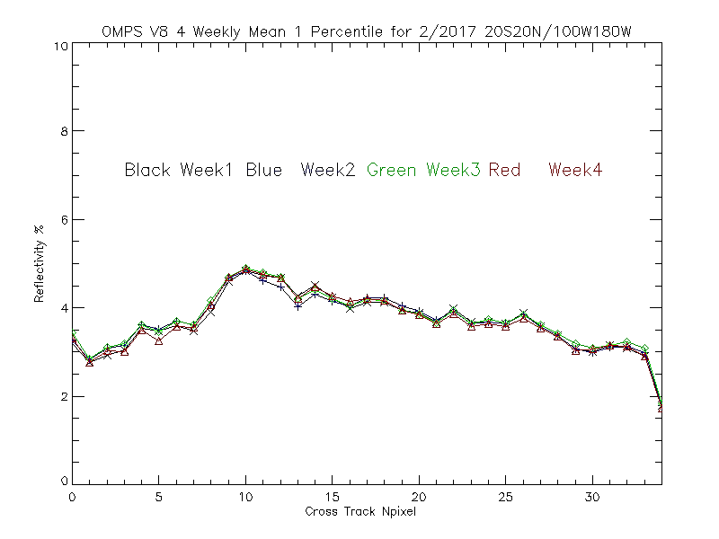
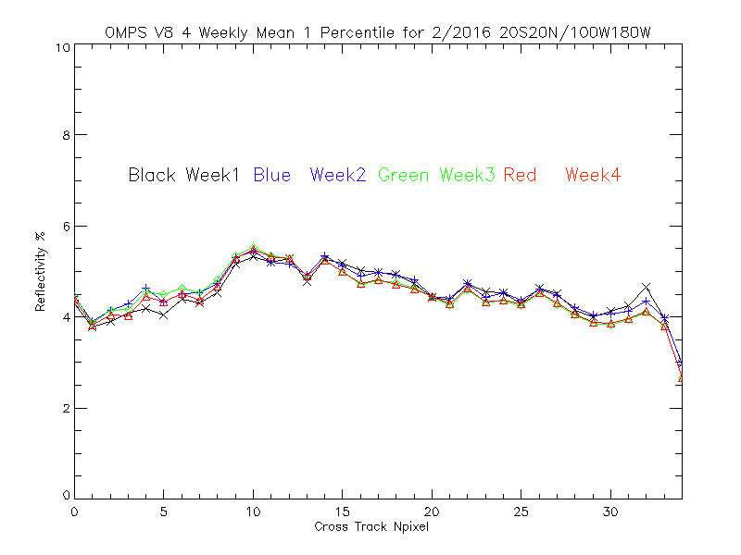
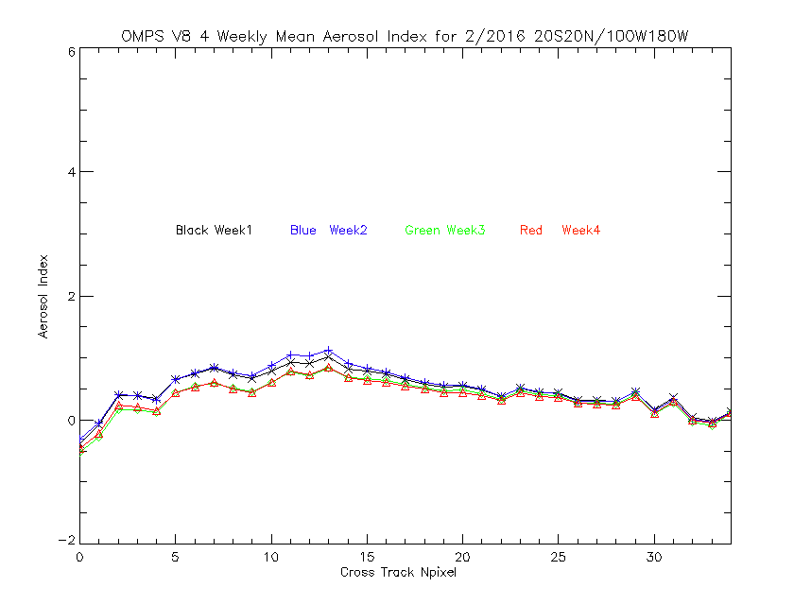
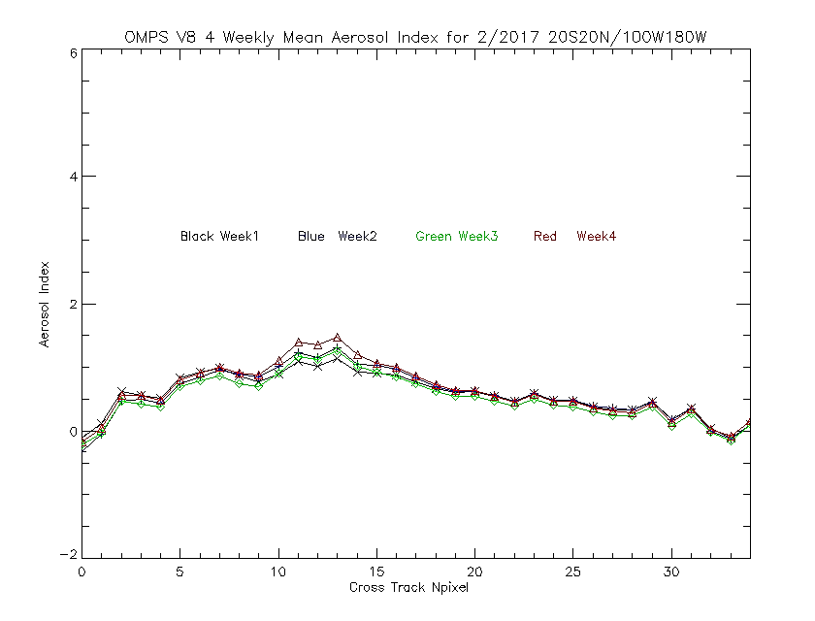
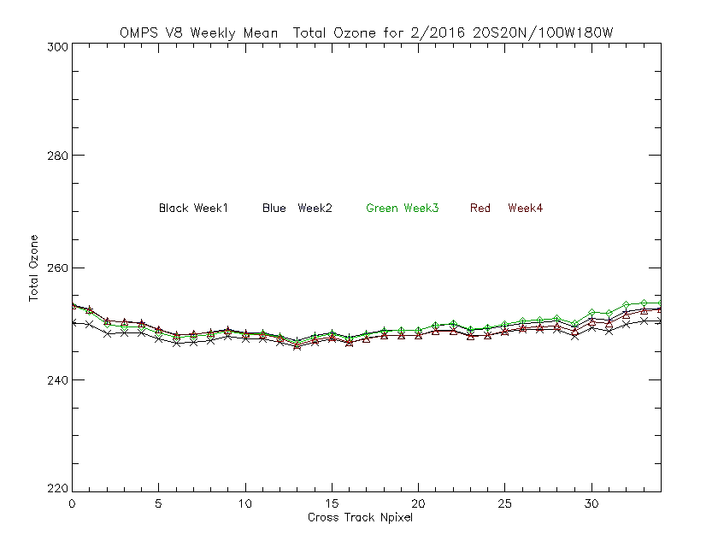
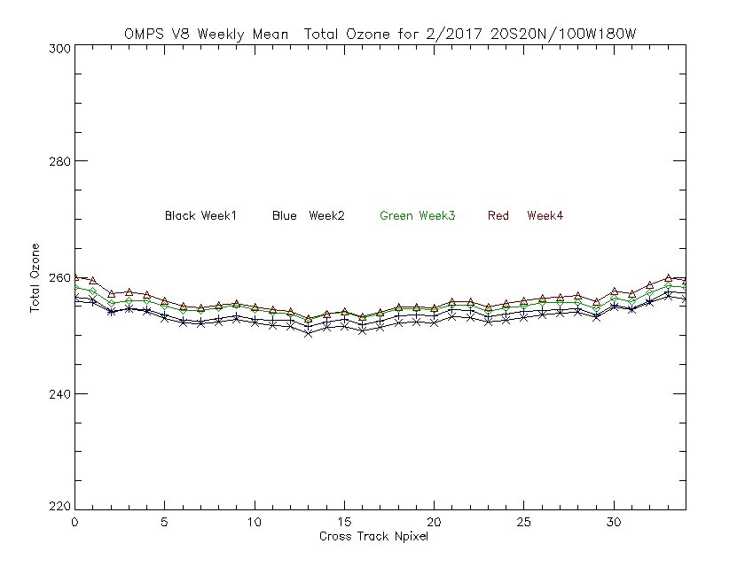
Weekly Averages over the Target Area
Weekly values for February 2017 for OMPS V8 Total Ozone algorithm products fading to weekly values for February 2016. We need to use the reprocessed SDR data and redo these figures.

Slide 9
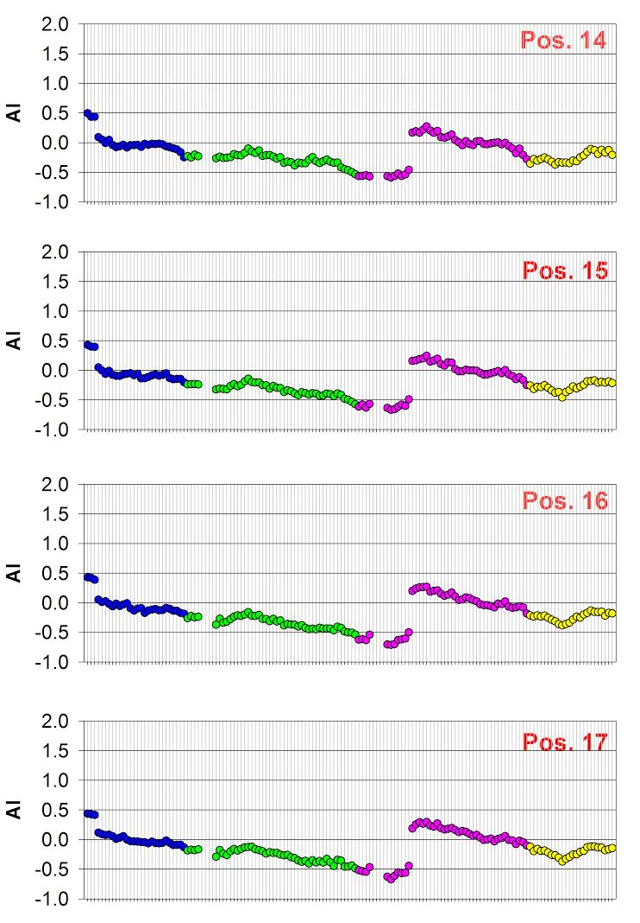
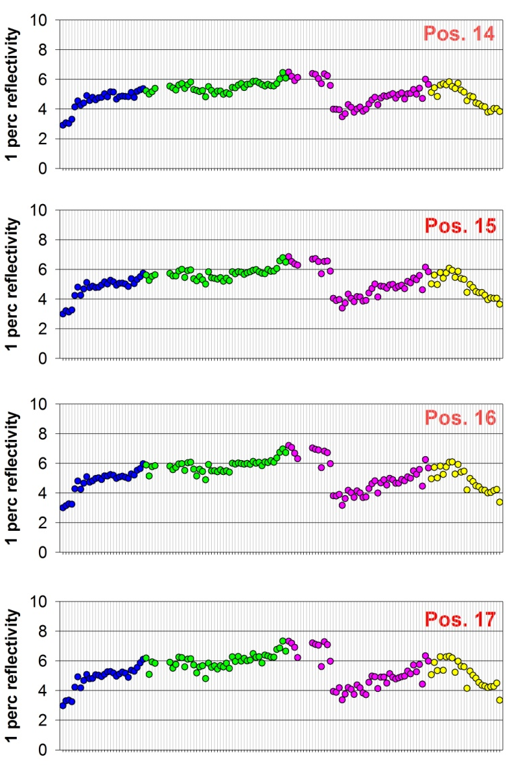
We are examining the V8 TOMS algorithm reflectivity and Aerosol Index Values for an Equatorial Pacific Region for OMPS, OMI and GOME-2
Time Series of GOME-2 Aerosol Index
(360 nm vs 331 nm)
Equatorial Pacific
Time Series of → GOME-2 1-percentile Reflectivity Equatorial Pacific
Jumps are from NOAA-applied soft calibration adjustments to the operational products.
GOME_2 MetOP-B

Slide 10
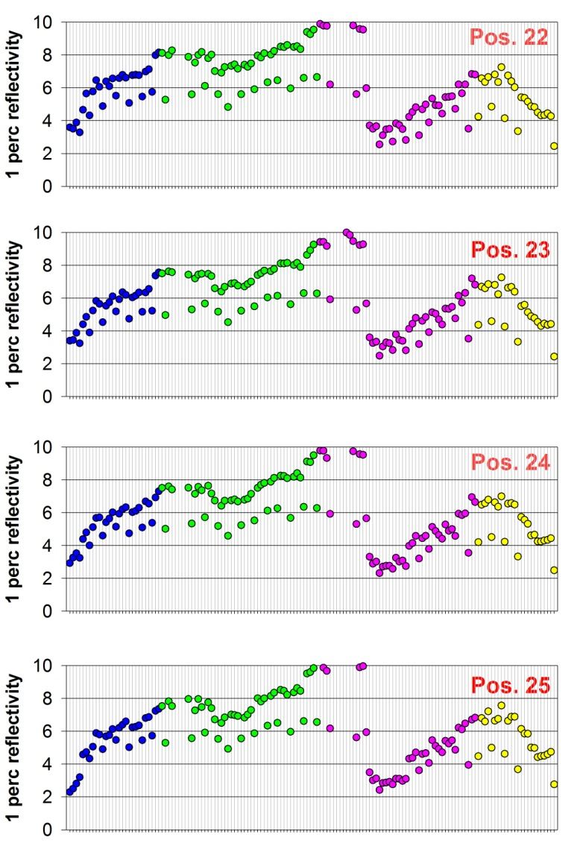
Time Series of GOME-2 1-percentile Reflectivity Equatorial Pacific

Slide 11
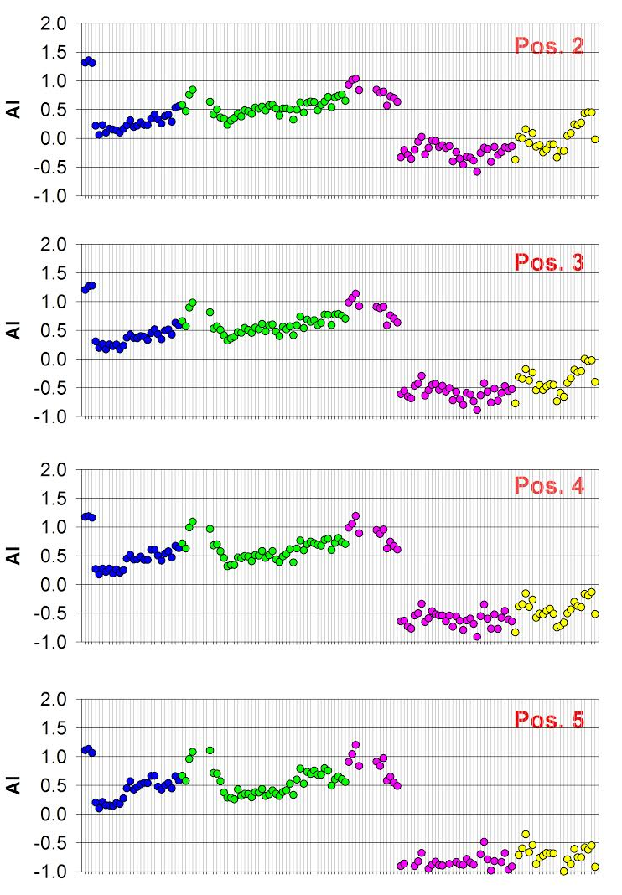
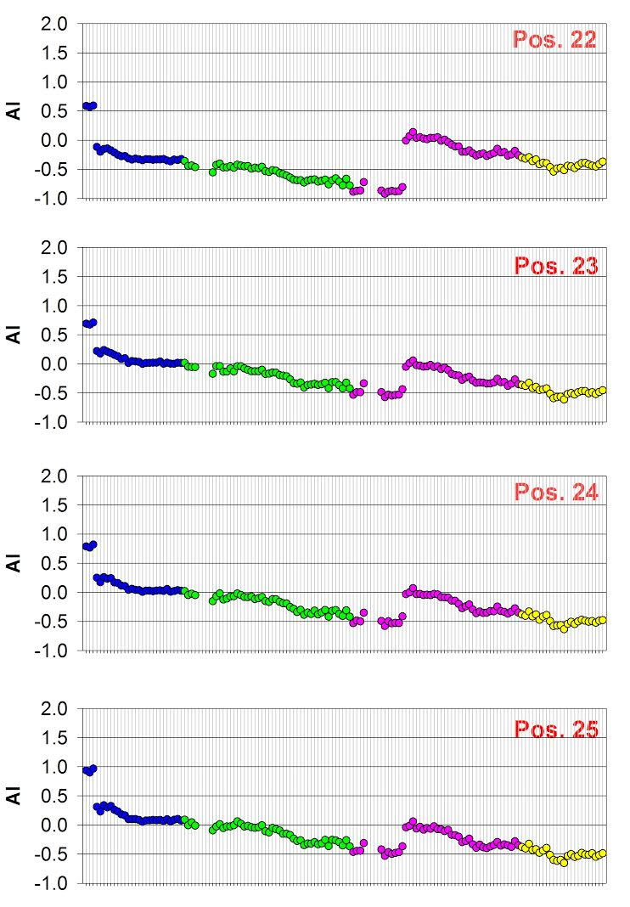
Time Series of GOME-2 Aerosol Index (360 nm vs 331 nm)
Equatorial Pacific

Slide 12
Adjustments and Layer Efficiencies using V8TOz dN/dR, dN/dxi and dN/dΩ
If you want to increase R and Ω by ΔR and ΔΩ then increase the N-values by
ΔN318 = ΔR dN318/dR + ΔΩ dN318/dΩ = ΔR A1 + ΔΩ B1
ΔN331 = ΔR dN331/dR + ΔΩ dN331/dΩ = ΔR A2 + ΔΩ B2
If you increase the N values by ΔN318 and ΔN331, then the R and Ω increase by
ΔR = [C1 * B2 – C2 * B1] / [A1 * B2 – A2 * B1]
ΔΩ = [C1 * A2 – C2 * A1] / [A2 * B1 – A1 * B2]
A1 = dN318/dR, B1 = dN318/dΩ, C1 = ΔN318
A2 = dN331/dR, B2 = dN331/dΩ, C2 = ΔN331
D = [A1 * B2 – A2 * B1] –D = [A2 * B1 – A1 * B2]
Given an ozone profile X = {xi} (i=1,N), and sensitivities dN318/dxi and dN331/dxi, the relative layer efficiencies, Ei, for B-pair are computed as follows:
C1i = ΔN318i = dN318/dxi C2i = ΔN331i = dN331/dxi
ΔΩi = [A2 * C1i – A1 * C2i ] / [A2 * B1 – A1 * B2]
Ei = ΔΩi / [SUM(ΔΩi) / N]
This assumes all ozone changes are absolute (e.g., in DU). These values should blend the clear and cloudy results appropriately by using the radiative fractions.
One can check the consistency of alternative profile, Xf = {xfi}, by computing
SUM[Ei * (xi – xfi)]
Ω is total ozone in DU, R is effective reflectivity, and N is -100*log10(I/F)
Notes:
H. J. Eskes and K. F. Boersma, (2003) Averaging kernels for DOAS total-column satellite retrievals, Atmos. Chem. Phys., 3, 1285–1291, 2003, www.atmos-chem-phys.org/acp/3/1285/.
X. Liu et al., (2009) Ozone profile retrievals from the Ozone Monitoring Instrument, Atmos. Chem. Phys. Discuss., 9, 22693–22738, 2009, www.atmos-chem-phys-discuss.net/9/22693/2009/.

Slide 13
Version 8 331-nm Reflectivity for a box in the Equatorial Pacific.
The unadjusted values in the top plot reach a minimum of 8% (higher than expected for the open ocean) for the Nadir scan position.
A single calibration adjustment lowers this value to 4% and also flattens out the scan dependence for West-viewing positions. The East-viewing results are not as good but there could be sun glint contamination for those angles.
|Lat|<5
Lon<-100
EAST
WEST
Notes:
Close up of minimum values.
Note Narrow swath data confirms that this is scan angle dependent, not scan timing dependence, that is the narrow swath has 8% minimums for all scan positions.

Slide 14
Summary, Questions & Future
How stable are the values year-to-year? What factors produce the most instability?
What should the 1-percentile values be? Can the method be used for absolute calibration?
Can minimum reflectivities over land be used for sunglint FOVs? Do we need to screen for aerosols?
We plan to generate and compare Equatorial Box time series for OMI, OMPS and GOME-2.
Can we develop a V8TOz tool to allow similar computations for other instruments’ measurements?
Notes:
For the Comparisons of Effective Reflectivity and Aerosol Indices project, we have continued to use the Equatorial Pacific box as a region to generate our soft calibration adjustments. We are using minimum land reflectivities and comparisons to other products to check these adjustments especially for sun glint contaminated FOVs. We will be reprocessing all of the OMPS Nadir Mapper Version 8 Total Column Ozone products for the first five years and we will use the Pacific region to check the stability of the products. Talk 4.b in this meeting will cover these topics.

Slide 16
IV. Match-Up Comparisons
We would also like to expand the use of matchup comparisons for UV instruments. Current approaches include:
Chasing Orbits (Opportunistic Formation Flying)
S-NPP and EOS-Aura have 16-day repeat cycles but one makes 227 orbits and the other 233 so every 64 hours they are flying with orbital tracks within (360/14)*110*3/(14*8*2) ~ 40 km of each other, 15 minutes apart.
For NOAA-19 and S-NPP, the matchups are every 12 days – (360/14)*110/(14*12*2) ~ 9 km.
LEO vs LEO Simultaneous Nadir Overpass (and its non-simultaneous No-Local-Time-Difference zonal means)
LEO underflights of GEO and L-1 instruments – Coincident Line-of-Sight Observations. (GOME-2 vs. SEVIRI, OMPS vs. TEMPO)
Zonal Means (including ascending/descending repeat coverage – S1*α1 = S2* α2)

Slide 17
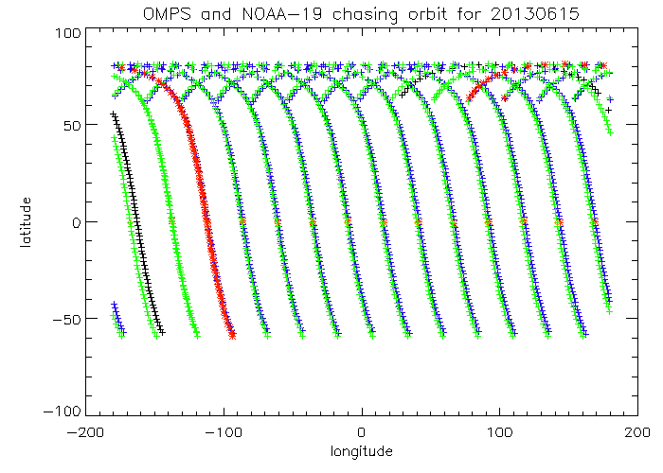
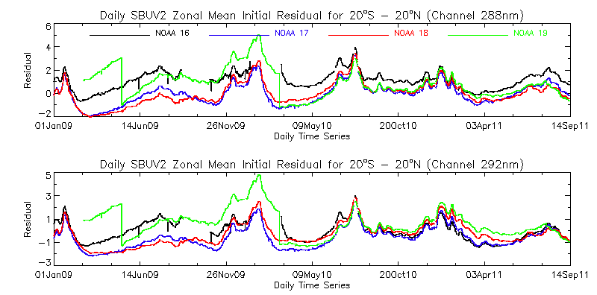
Well-matched Orbits for 6/15/2013
Comparison of Initial V6 Measurement Residuals for S-NPP OMPS NP and NOAA-19 SBUV/2
Latitude, Degrees North
Longitude, Degrees East
Operational Initial Residuals for SBUV/2
Daily Means
Equatorial Pacific Box
20S – 20N Latitude
100W to 180W Longitude

Slide 18
Match for viewing
geometry
Schematic for L-1 & LEO matched viewing conditions at Equinox. Matches shift north or south seasonally “following” the sun.
To L1
and
the
Sun
or
LEO Orbital
Track
Local
Solar
Noon
Equator
LEO Cross
Track FOV
Great Circle aligned
with Cross-track FOV
Sunlit side of
the Earth
Simultaneous View Path (SVP) match up between DSCOVR EPIC at 0º offset with the Earth/Sun line and S-NPP OMPS. Matches will be present for any BUV instrument on a GEO platform with one in a LEO orbit as the LEO orbital tracks pass near the GEO sub-satellite point.

Slide 19
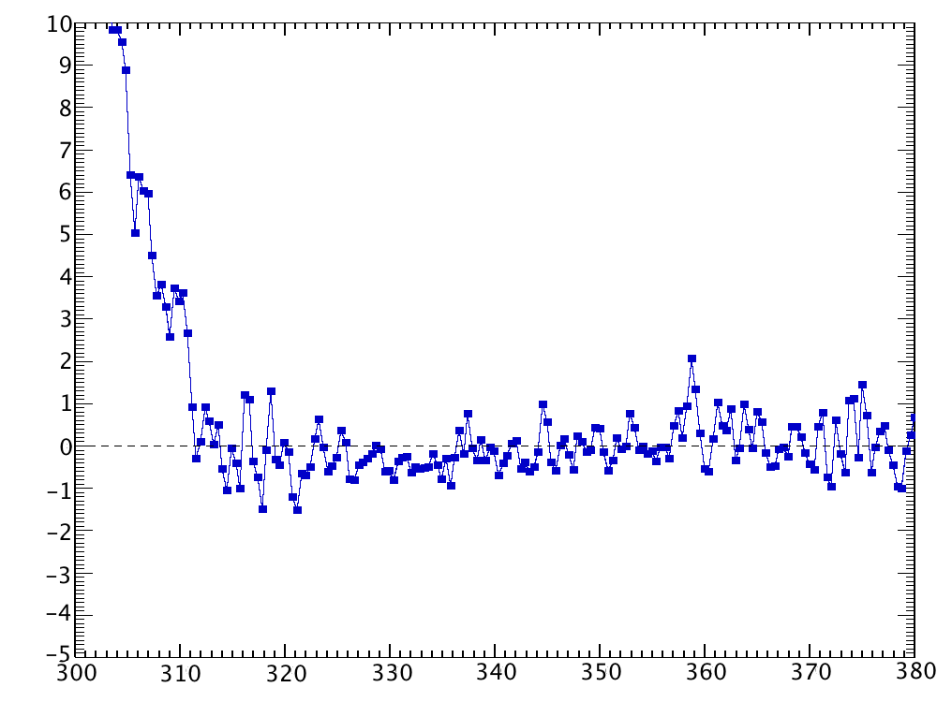
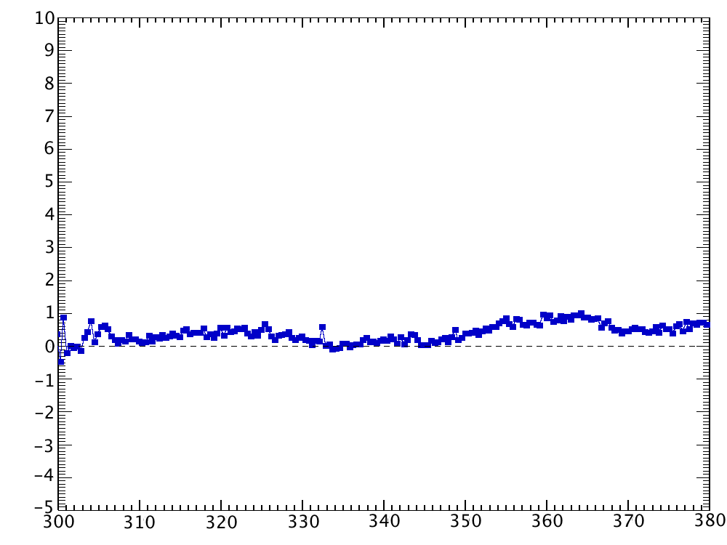
OMPS TC comparisons with modeled Top-of-atmosphere reflectances using MLS ozone retrievals as truth are quite good
Co-locate MLS temperature and ozone profiles to OMPS TC measurements
Reflectivity < 0.10
-20 < latitude < 20 degrees
June 2012
Calculate TOA reflectances (radiance / solar flux) from TC viewing conditions, MLS profiles using radiative transfer code (TOMRAD)
Compare measured OMPS TC reflectance with calculated reflectance
Agreement seen to within 1% for wavelengths > 312 nm
Stray light seen for wavelengths < 312 nm
Consistent with pre-launch sensor characterization
Stray light
2%
Position 19 (nadir looking)
Percent reflectance difference (meas – calc)
Some structure seen in spectrum
repeats in all swath positions,
taken out through dividing by
position 18 combination of wavelength shift and Ring Effect.
2%
Position 19 / Position 18
MLS results from C. Seftor, SSAI for NASA GSFC
Wavelength (nm)
Notes:
MLS results from C. Seftor, SSAI for NASA GSFC
Some comments altered by L. Flynn.

Slide 20
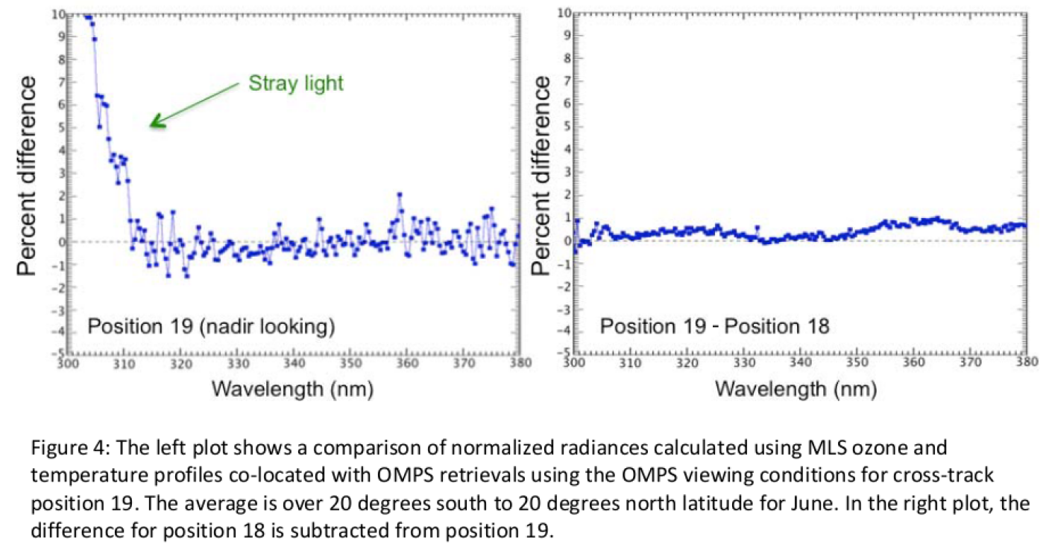
Results from C. Seftor, SSAI for NASA GSFC
Notes:
MLS results from C. Seftor, SSAI for NASA GSFC

Slide 21
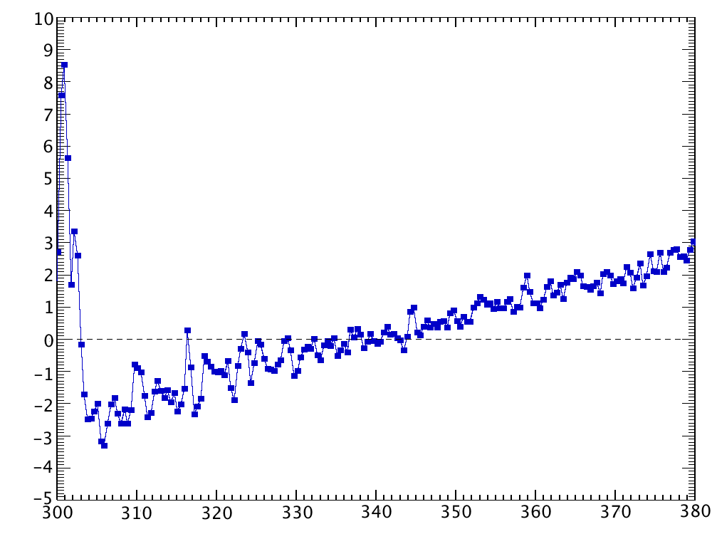
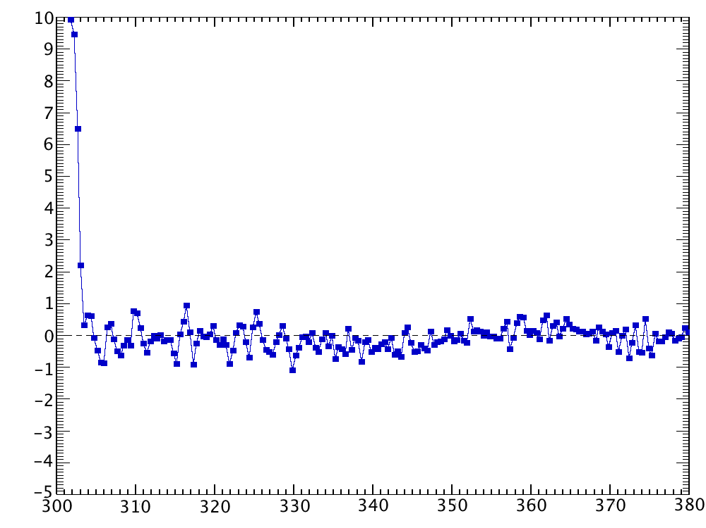
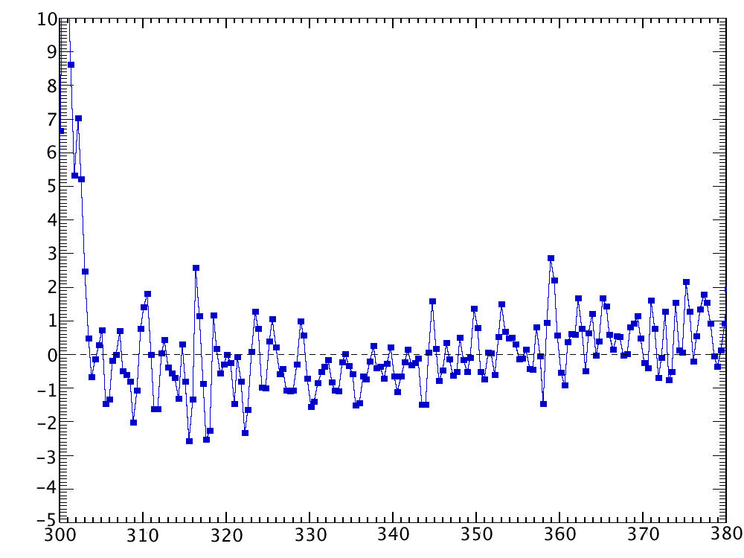
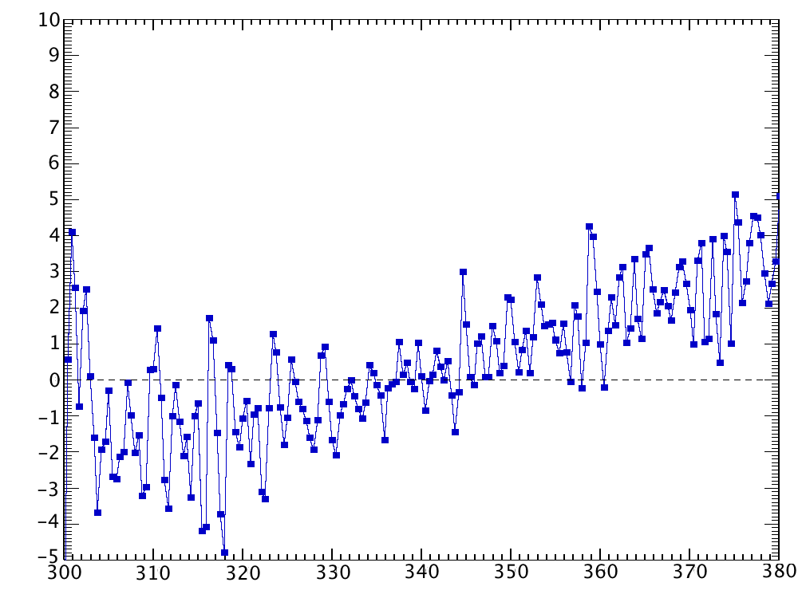
OMPS TC cross-track calibration is typical;
Will require soft calibration adjustments.
Position 1 / Position 18
Position 4 / Position 18
2%
Difference indicates possible inconsistency
with MLS ozone profile, will lead to
different total column ozone amounts
Problems at the far off-nadir positions lead to swath dependent ozone effects
Not unusual but should be corrected.
Difference indicates
calibration issue
Percent NR difference (meas – calc)
Position 33 / Position 18
Position 36 / Position 18
2%
Difference indicates inconsistency
with MLS ozone profile, will lead to
different total column ozone amounts
Differences indicates
calibration and wavelength scales issues
MLS results from C. Seftor, SSAI for NASA GSFC
Wavelength (nm)
Notes:
MLS results from C. Seftor, SSAI for NASA GSFC
Some comments and conclusions altered by L. Flynn.

Slide 22
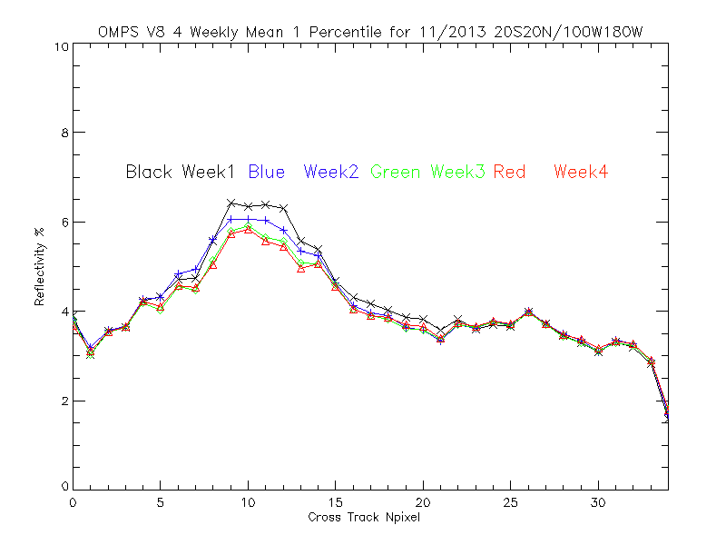
The lines show the S-NPP OMPS weekly, one-percentile effective reflectivity values for the Version 8 algorithm (331-nm channels) for November 2013 for all the data in a latitude/ longitude box in the Equatorial Pacific versus cross-track view position. (17 is the nadir position and 0 and 34 are the extreme viewing angles.) We expect the one-percentile effective reflectivity values to be approximately 4% for this region of the globe from climatological measurements made by other instruments. The cross-track variations for positions 5 to 15 are related to sun glint effects. Consistent deviations by position are from imperfections in calibration coefficients across the CCD array and intra-orbit wavelength scale shifts.
Notes:
Results from http://www.star.nesdis.noaa.gov/smcd/spb/OMPSDemo/proOMPSbeta.TOZ_V8.php

Slide 23
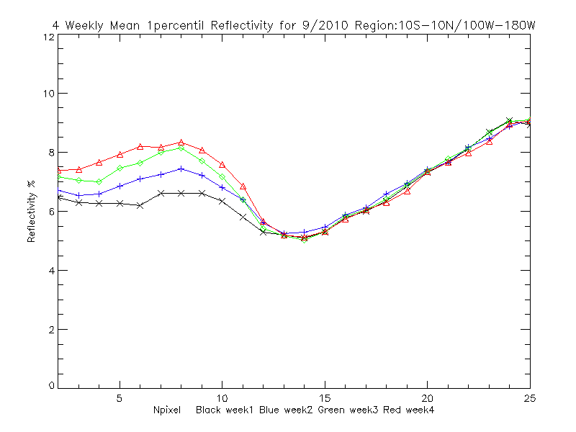
Reflectivity for GOME-2 on METOP-A

Slide 24
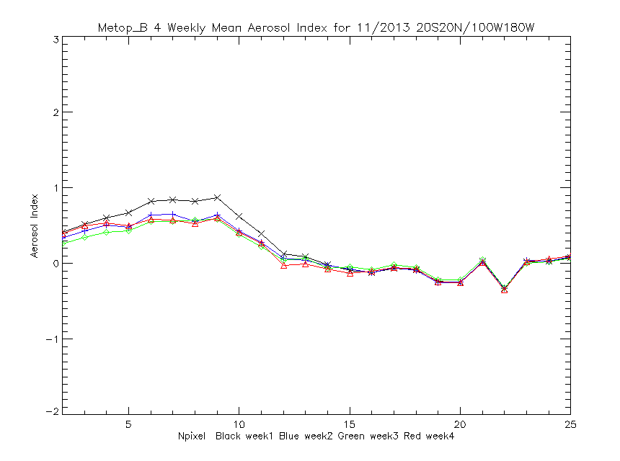
The lines show the MetOP-B GOME-2 weekly aerosol index values for the V8 algorithm (measurement residuals for wavelengths in the 360-nm range using effective reflectivity calculated for the 331-nm range) for November 2013 for all the data in a latitude/ longitude box in the Equatorial Pacific versus cross-track view position. (12/13 are the nadir position and 2 and 25 are the extreme viewing angles.) We expect the aerosol index values to be approximately zero N-values for this region of the globe. The cross-track variations for positions 4 to 10 are related to sun glint effects. Consistent deviations by position are probably from calibration imperfections but are surprising given the scanning nature of GOME-2.

Slide 25
Possible Goals/Topics for the UV Subgroup
1. Exchanges and traceability of standards
NIST and SIRCUS
Integrating Spheres, diffusers, lamps, lasers, etc.
2. Establish a library of solar measurements
Reference high resolution solar (SOLSTICE, SIM, Kitt Peak, etc.)
Mg II Index time series, Scale factors at resolution (new OMI)
3. Establish a library of instrument data bases
Bandpasses, calibration constants, wavelength scales
Day 1 solar, time series with error bars
Mg II Indices and scale factors
FOVs, Polarization sensitivity,
Reference papers, ATBDs, validation, Shift & Squeeze,
4. Establish a library Absorption data bases
O3 in the UV with wavelength and temperature dependence
at instrument resolution – from DOAS?
UV compared to Visible and IR
other species -- SO2, NO2, etc.
5. Standard climatologies; vicarious calibration & residual studies
Ozone and temperature profiles, covariances
Neural net, with tropopause information
Averaging kernels or efficiency factors, measurement contribution functions, and Jacobians
6. Analysis of on-board systems
Diffusers, stable orbits
White lights, spectral lamps, LEDs
Moon views
Stray light, linearity, gains, offsets, mirrors, polarisation, λ-scale, bandpass
7. Considerations for comparisons
Complications from diurnal variations, SZA, SVA, RAA
Zonal means
Simultaneous nadir overpass (Rad/Irrad or products)
Formation flying / Chasing orbits
No-local-time differences
Ice, desert and open ocean targets
Pacific Box
LEO to GEO to L1
8. Internal consistency techniques
Ascending/descending -- Langley methods
Pair justification
DOAS (and EOF analysis) (Closure polynomials)
Stray light correlation
Wavelength scale, shift and squeeze, etc.
Measurement Residuals, reflectivity range/distribution
9. Forward model and measurements
Rayleigh
Absorption
Spherical geometry
Inelastic scattering (Ring Effect), Stray light, solar activity
Aerosols
Polarization
TOMRAD, VLIDORT, SCIATrans, CRTM, etc.
V8 SBUV/2 and A Priori as transfer for Viewing conditions…
10. Reflectivity
Surface (database and snow/ice forecasts), Variations in surface reflectivity with season, sza and sva.
Surface pressure
Clouds (Cloud top pressure)
Cloud-optical-centroids (Ring Effect, 02-02, O2 A band)
11. Aerosols
Climatology/Type, height
Wavelength or polarization dependence (Aerosol Indices)
12. Nadir Instruments LEO
TropOMI, GOME(-2), OMPS, TOU/SBUS, OMS,
SCIAMACHY, OMI, TOMS, SBUV(/2)
12. Nadir Instruments GEO or L1
TEMPO, GEMS, UVN and EPIC
13. Limb instruments
SAGE III, ACE/MAESTRO, OSIRIS, MLS,
GOMOS, SCIAMACHY, OMPS-LP
14. Ground-based
WOUDC, Dobson, Brewer, Lidar, MW and Ozonesondes
Notes:
http://www.nesdis.noaa.gov/news_archives/dscovr.html
http://science.nasa.gov/media/medialibrary/2012/03/01/Nguyen-DSCOVR-Mission-Briefing-HPS-v01b.pdf

