Slide 1
4e. Modeling OMPS Nadir Profiler solar measurements and comparisons to reference measurements
By L. Flynn, J. Niu, M. Bali, Y. Li, D. Liang & C. Pan
Notes:
For the Solar Spectra project, the collaborative work is off to a very good start with participation growing to include more instruments and solar modelers. There are several talks in Session 4 at this meeting. My talk (4.e) will focus on a model to explain the OMPS NP solar measurements and an initial comparison to a synthetic spectrum. In the coming year we'll use both of these to support intercomparisons with other solar measurements.

Slide 2
Outline
UV Solar Spectra Project
OMPS NP Solar Measurement Analysis and Model
Proxy Comparison
Summary

Slide 3
Solar Spectra Project
The purpose of the is project is to compare solar measurements from BUV (Backscatter Ultraviolet) instruments.
The first step is to catalog high spectral resolution solar reference spectra and agree on a common one to use for the project.
For each instrument, participants should provide the following datasets:
  Solar measurement for some date (wavelength scale, irradiance)
  Wavelength scale and bandpass (Δλ, # of points, bandpass centers, normalized bandpass weights)
  Synthetic spectrum from common reference (wavelength scale, irradiance)
  Synthetic for wavelength scale perturbations (±0.01 nm) from common reference (wavelength scale, irradiance)
  Synthetic from alternative reference spectra (wavelength scale, irradiance)
  Solar activity pattern (wavelength, relative change)
  Mg II index (if 280 nm is covered) Mg II 279.6 Mg I 285.2 (date, index)
  Ca H/K index (if 391 nm to 399 nm is covered) CA II 393.4 and 396.8.
Goals:
  Agreement at 1% on solar spectra relative to bandpass-convolved high resolution spectra as a transfer after identifying wavelength shifts and accounting for solar activity
  Long-term solar spectra drift and instrument degradation by using OMI solar activity pattern (with internal confirmation from Mg II Indices and scale factors)

Slide 4
Analysis of Time Series of Solar Spectra
The OMI, GOME-2 and OMPS teams have generated models of their time series of solar measurements by using
Solar activity
  With proxies (e.g., Mg II Indices)
  Directly estimating pattern over solar rotations
Wavelength shifts
  With proxies (e.g., optical bench temperatures)
  Directly from fits of solar features
Diffuser and instrument degradation
  With proxies (e.g., diffuser exposure times)
  From working and reference diffuser measurements
  From residual changes after identifying activity and wavelength changes
  Considering albedo changes over targets or compared to other sensors
Notes:
Many UV solar spectra can be modeled well with three terms
Solar activity (Mg II Index with Scale factors)
Wavelength shifts (wavelength shift patterns)
Diffuser and instrument degradation
Linear Regression or EOF analysis can help to identify these patterns.

Slide 5
OMPS NP Solar Measurement Schedule
* Reference Diffuser (biannual)
+ Working Diffuser (biweekly)

Slide 6
Range of Measurements
Reference/Working
Bias

Slide 7
Double Difference Estimate of Working Diffuser Degradation over two Years
Wavelength Shift
REF2/WORK2 – REF6/WORK6

Slide 8
Degradation Fit Residual Versus
Wavelength Scale Shift Pattern
0.03-nm Wavelength Shift Pattern for OMPS NP from Proxy
Notes:
Proxy from Lang version of Dobber reference.

Slide 9
Relative Variation of Mg II Index over five Years
(Core to Wing from local Quadratics)
Measurements every two weeks

Slide 10
Wavelength Shift from Mg II Core
Vertex of Quadratic Fit
1 Pixel ~ 0.42 nm

Slide 11
Mg II Relative Scale Factors
from 4-week up/down excursions

Slide 13
Change in Reference Solar over two Years
after Removing Solar Activity
REF7/REF3 – Solar Activity changes

Slide 15
Change in Reference and Working Solar
over two Years

Slide 16
Relative Bias between same Day
Reference and Working Solar Measurements

Slide 18
Variations after Removing
Degradation and Solar Activity
0.03-nm Wavelength Shift Pattern for OMPS NP from Proxy

Slide 19
-0.03-nm Wavelength Shift Pattern for OMPS NP from Proxy

Slide 22
First six EOF Wavelength Patterns

Slide 23
First six EOF Coefficient Time Series

Slide 24
Residual noise after removal of two EOF patterns

Slide 25
All residuals after removal of two EOF patterns

Slide 26
Wavelength shift pattern (dotted) compared to pixel shift pattern (solid)

Slide 27
Effect of pixel based radiance coefficients – gradients due to dichroic – and wavelength shifts
0.002
EOF1(waveshift)-Finite Diff, 1/(0.01 nm)
0.001
0.000
-0.001
-0.002
-0.003
-0.004
250
260
270
280
Wavelength, nm
290
300
310

Slide 28
Effect of pixel based radiance coefficients – gradients due to dichroic – and wavelength shifts

Slide 29
Daily Mg II Index
from Tied Interpolation of GOME-2

Slide 30
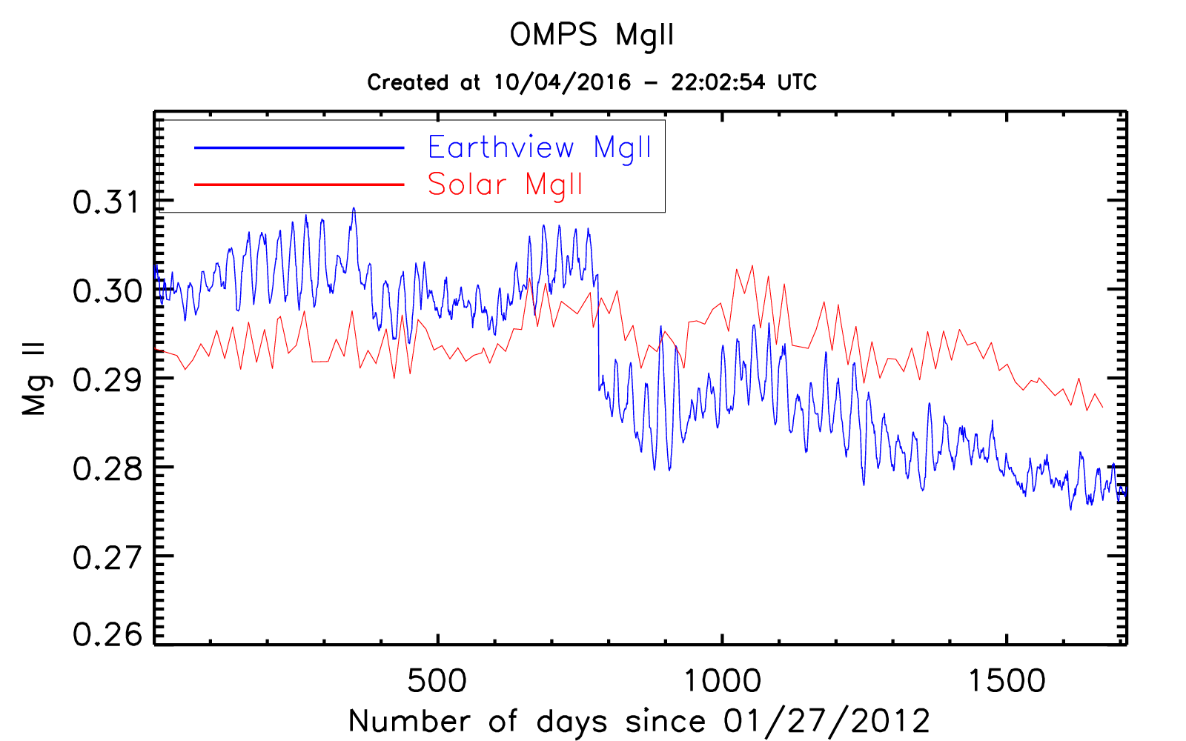
Creation of a daily OMPS Mg II Index from Earth-View Spectra
Biweekly
Stray Light Correction
Implemented
Daily
Notes:
http://www.star.nesdis.noaa.gov/icvs/status_NPP_OMPS_NP.php

Slide 31
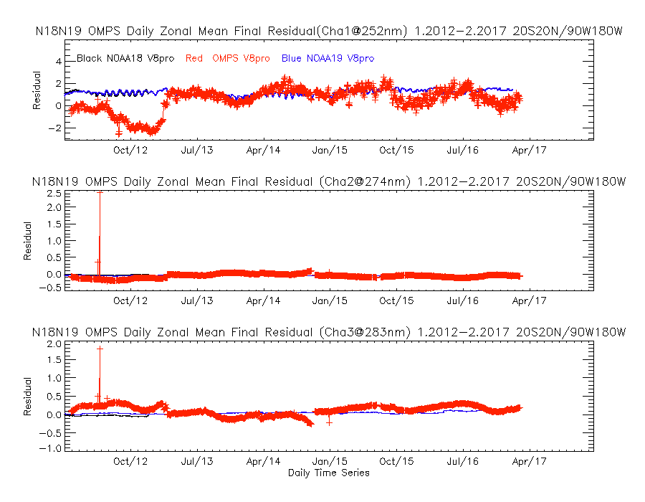
Real Earth Radiance divided by Fixed Solar

Slide 32
Daily Wavelength Shift
from Interpolation of Mg II Results
Wavelength Shift, nm

Slide 33
OMPS NP Solar versus Proxy
Notes:
Model for OMPS NP for 2/10/2013 vs Proxy Dobber from Lang.

Slide 34
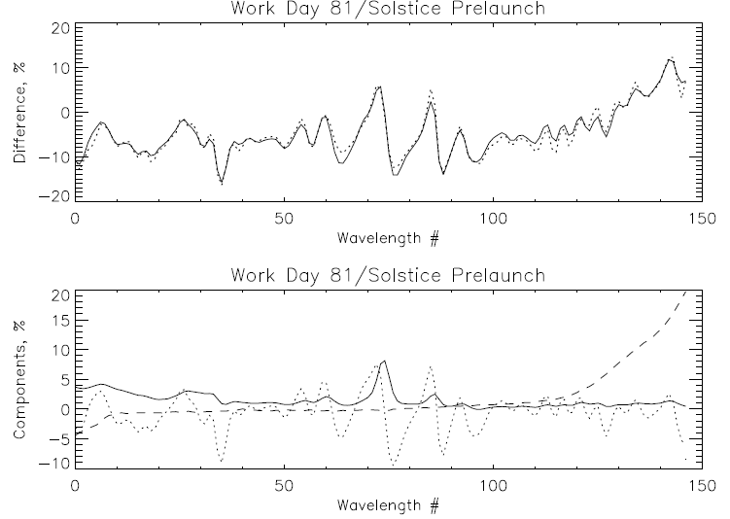
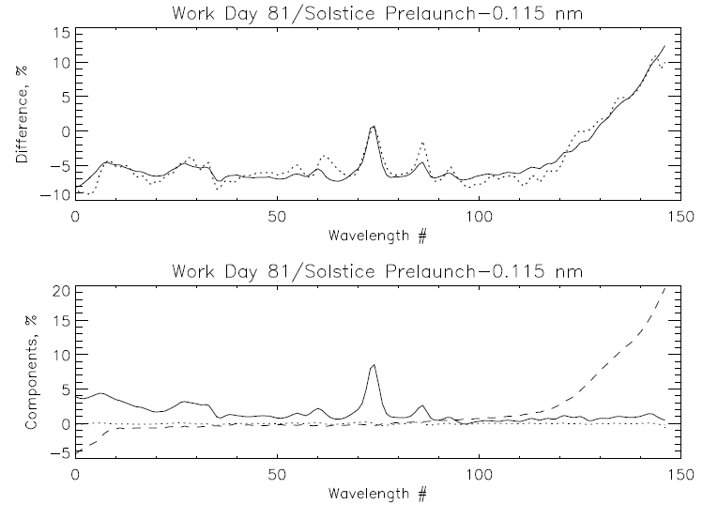
Comparison of OMPS NP Solar spectrum to synthetic from Solstice and prelaunch data. Fits of the differences with a model using three patterns of the form:
Meas/Synth = a0 + a1*WavelengthShift + a2*SolarActivity + a3*DihroicShift
Model
Measurement
Model
Measurement
250 nm 310 nm
250 nm 310 nm
Solar Activity
Dichroic Shift
Wavelength Shift
Solar Activity
Dichroic Shift
Wavelength Shift
250 nm 310 nm
250 nm 310 nm
Working Day 81 vs Solstice Synthetic (1.1% rmsr)
%offset %Mg II Shift nm Dich nm
-7.3 7.3 -0.127 -0.349
Working Day 81 vs Solstice Synthetic (1.1% rmsr)
%offset %Mg II Shift nm Dich nm
-7.5 7.7 -0.004 -0.347

Slide 35
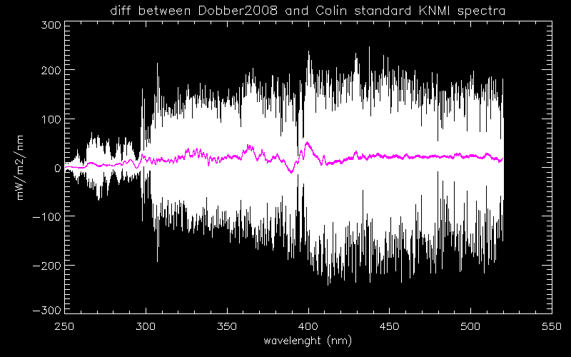
Comparison at NOAA of reference spectra provided by NASA C. Seftor; EUMETSAT R. Lang

Slide 36
Summary, Questions & Future
Do we have the tools needed to compare solar spectra from different instruments?
Do we need to separate radiance and irradiance variations?
Collect reference spectra including solar activity patterns
Collect wavelengths, banpasses and “Day 1” solar for instruments
Share models of solar activity, degradation and wavelength shift patterns and time series
Compare and inter-compare references and operational instruments

Slide 37
Backup Slides

Slide 38
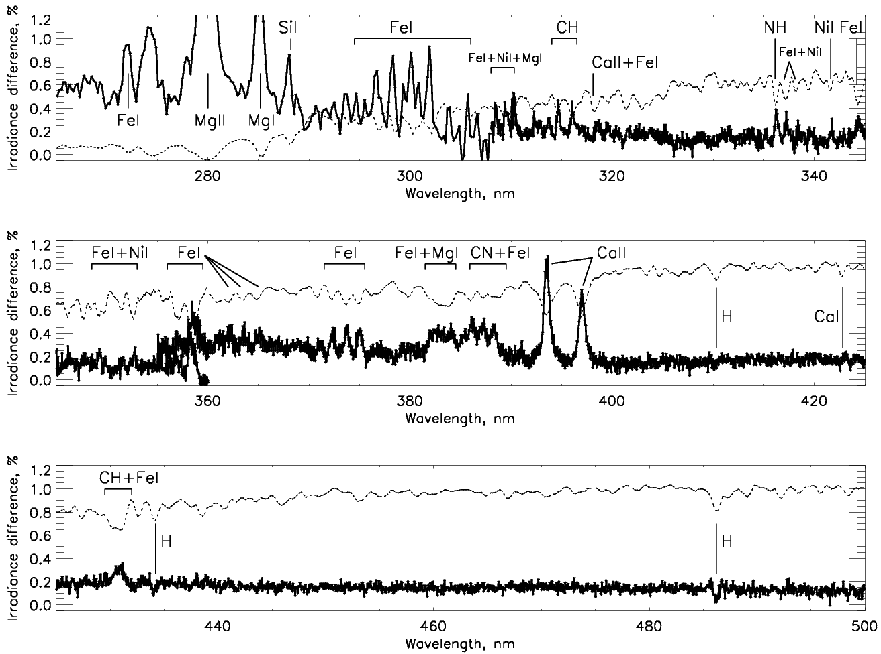
Time-averaged irradiance differences: (mid-y2012+y2013) vs.
(mid-y2007+y2008+mid-y2009)
Sun as a star Aura OMI: spectral irradiance changes in Cycle 24, S. Marchenko, M. DeLand
Dotted line: scaled Solar spectrum
Notes:
38

Slide 39
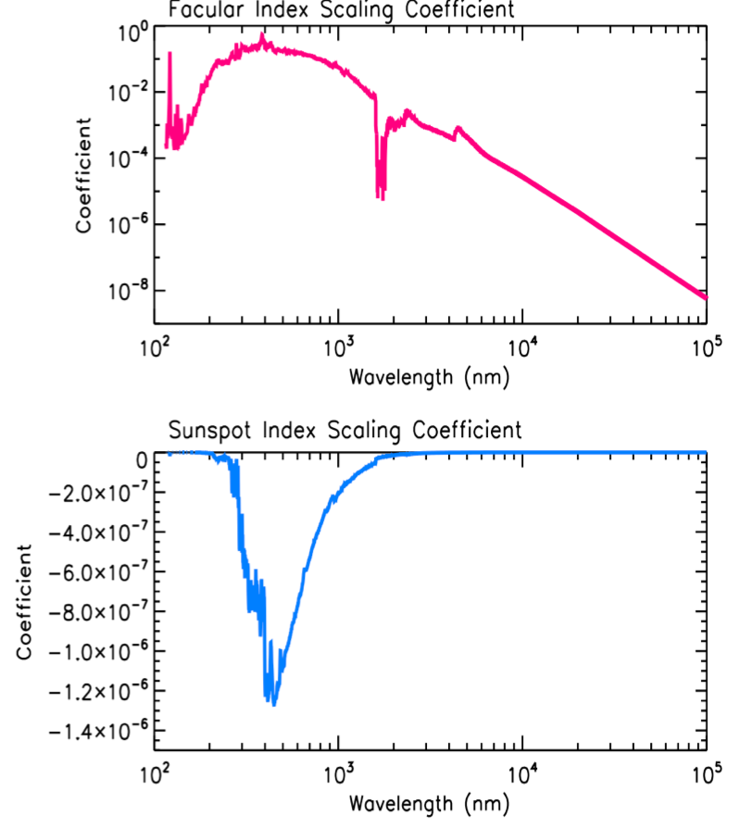
From Odele Coddington,
You also asked how much of the solar variability between 250-400 nm could be explained by the Mg II index along. My answer would be quite good up to nearly 300 nm and then dropping off fairly rapidly long of that because of the influence from sunspot darkening. The attached plots show the scaling coefficients derived from a regression of SORCE SSI observations against Mg II and sunspot area information.
These coefficients scale an incremental change in facular brightening or sunspot darkening into a delta irradiance change that would be a net result from these competing effects. If you look at the 115 nm to near 300 nm range, you will see essentially zero influence from the sunspots and a linear Mg index model should do quite well.

Slide 40
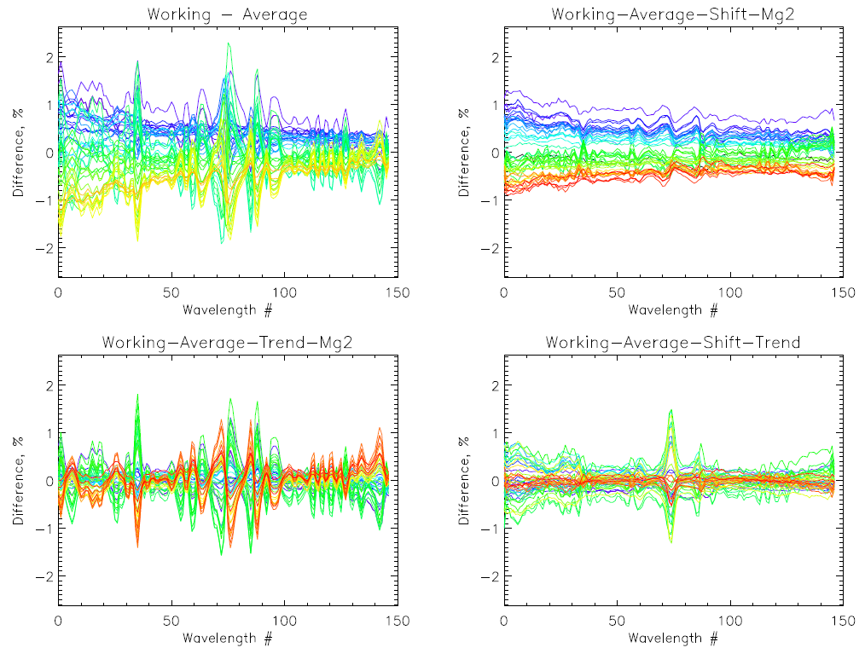
OMPS Nadir Profiler
Degradation
250 nm 310 nm
Wavelength Shift
Solar Activity

Slide 41
Project to Compare Solar Measurements
High resolution solar reference spectra
  Reference high resolution solar Spectra (SOLSTICE, SIM, Kitt Peak, etc. – Everybody has a favorite. How do they compare?)
  Mg II Index time series, Scale factors at high resolution
Instrument data bases
  Bandpasses, wavelength scales (Shift & Squeeze codes)
  Day 1 solar, time series with error bars (new OMI product) (Formats, Doppler shifts, 1 AU adjustments)
  Mg II Indices and scale factors at instrument resolution
  Reference calibration and validation papers
Using the information from above we can compare spectra from different instruments and times
Notes:
Composite Mg II solar activity index for solar cycles 21 and 22
Matthew T. DeLand, Richard P. Cebula
DOI: 10.1029/93JD00421
Creation of a composite solar ultraviolet irradiance data set
Matthew T. DeLand, Richard P. Cebula
DOI: 10.1029/2008JA013401

Slide 42
Possible Goals/Topics for the UV Subgroup
1. Exchanges and traceability of standards
  NIST and SIRCUS
  Integrating Spheres, diffusers, lamps, lasers, etc.
2. Establish a library of solar measurements
  Reference high resolution solar (SOLSTICE, SIM, Kitt Peak, etc.)
  Mg II Index time series, Scale factors at resolution (new OMI)
3. Establish a library of instrument data bases
  Bandpasses, calibration constants, wavelength scales
  Day 1 solar, time series with error bars
  Mg II Indices and scale factors
  FOVs, Polarization sensitivity,
  Reference papers, ATBDs, validation, Shift & Squeeze,
4. Establish a library Absorption data bases
  O3 in the UV with wavelength and temperature dependence
    at instrument resolution – from DOAS?
  UV compared to Visible and IR
  other species -- SO2, NO2, etc.
5. Standard climatologies; vicarious calibration & residual studies
  Ozone and temperature profiles, covariances
  Neural net, with tropopause information
  Averaging kernels or efficiency factors, measurement contribution functions, and Jacobians
6. Analysis of on-board systems
  Diffusers, stable orbits
  White lights, spectral lamps, LEDs
  Moon views
Stray light, linearity, gains, offsets, mirrors, polarisation, λ-scale, bandpass
7. Considerations for comparisons
  Complications from diurnal variations, SZA, SVA, RAA
  Zonal means
  Simultaneous nadir overpass (Rad/Irrad or products)
  Formation flying / Chasing orbits
  No-local-time differences
  Ice, desert and open ocean targets
  Pacific Box
  LEO to GEO to L1
8. Internal consistency techniques
  Ascending/descending -- Langley methods
  Pair justification
  DOAS (and EOF analysis) (Closure polynomials)
  Stray light correlation
  Wavelength scale, shift and squeeze, etc.
  Measurement Residuals, reflectivity range/distribution
9. Forward model and measurements
  Rayleigh
  Absorption
  Spherical geometry
  Inelastic scattering (Ring Effect), Stray light, solar activity
  Aerosols
  Polarization
  TOMRAD, VLIDORT, SCIATrans, CRTM, etc.
  V8 SBUV/2 and A Priori as transfer for Viewing conditions…
10. Reflectivity
  Surface (database and snow/ice forecasts), Variations in surface reflectivity with season, sza and sva.
  Surface pressure
  Clouds (Cloud top pressure)
  Cloud-optical-centroids (Ring Effect, 02-02, O2 A band)
11. Aerosols
  Climatology/Type, height
  Wavelength or polarization dependence (Aerosol Indices)
12. Nadir Instruments LEO
TropOMI, GOME(-2), OMPS, TOU/SBUS, OMS,
SCIAMACHY, OMI, TOMS, SBUV(/2)
12. Nadir Instruments GEO or L1
TEMPO, GEMS, UVN and EPIC
13. Limb instruments
SAGE III, ACE/MAESTRO, OSIRIS, MLS,
GOMOS, SCIAMACHY, OMPS-LP
14. Ground-based
WOUDC, Dobson, Brewer, Lidar, MW and Ozonesondes
Notes:
http://www.nesdis.noaa.gov/news_archives/dscovr.html
http://science.nasa.gov/media/medialibrary/2012/03/01/Nguyen-DSCOVR-Mission-Briefing-HPS-v01b.pdf

