Slide 1
GRWG MW-SubGroup
Evaluation of the AMSU-A FCDR after 6 Years of Recalibration
Cheng-Zhi Zou and Xianjun Hao
NOAA/NESDIS/Center for Satellite Applications and Research

Slide 2
Purpose
To evaluate the performance of the AMSU-A FCDR after 6 years of recalibration
The GSICS community has an interest in using the AMSU-A FCDR as reference for microwave observations (Bali et al. 2017)
Recalibration of the AMSU-A sounding channels was completed in 2011 (Zou and Wang 2011). All recalibration coefficients were obtained using overlaps before 2011
It is desirable to understand how the recalibrated data perform after 6 years of recalibration
Are calibration coefficients still working well in terms of minimizing inter-satellite biases?
Only channels 4-9 are examined
NPP ATMS is available since 2011--preparation of inter-satellite calibration for ATMS with similar channels
Notes:
Mitch provided long time support for project from the program side, such as leveraging funding.
And Fuzhong also provides program support and coordinate the CRTM team to work with our product development team. You may notice that most of my SDS science team members are from his Branch.
I also want to thank Changyong for his long time support from scince side. I can always count on his support when I need a discussion on science. even when I need support from his team members.

Slide 3
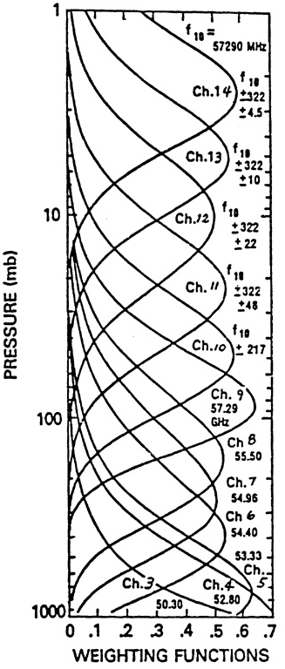
MSU/AMSU-A Instruments
MSU; 1978-2007 AMSU; 1998-present
MSU/AMSU covering time period from 1979-present
Have a total of 19
channels
Generally, each
channel has its own
characteristics for
calibration
Involving 15+ satellites
SSU
AMSU-A
MSU
Left: Weighting functions for the MSU and SSU instruments, where the black curve represent the MSU weighting functions and the dashed and red curves are the SSU weighting functions for different time period, showing a shift due to an instrument CO₂ cell pressure change; Right: Weighting functions for AMSU-A. All weighting functions are corresponding to nadir or near-nadir observations.

Slide 4
Operational Calibration Versus Recalibration/Inter-calibration
  Operational calibration of MSU/AMSU provides quality controlled level-1b data to produce level-1c radiance data. These activities includes, but are not limited to, lunar contamination correction, antenna pattern correction, determining nonlinearity using pre-launch lab testing data, quality assurance. Calibration coefficients from operational calibration are saved in level-1b files
  Operational calibrated MSU/AMSU radiances were widely used in NWP and climate renalaysis data assimilation
  Post-launch recalibration examines long-term satellite biases left over from operational calibration, and then develops algorithms to remove these biases
  Post-launch inter- and re-calibration support FCDR development
  It replaces operational calibrated radiances in climate applications
Notes:
And also, for temperature channels, we don’t have the dynamic range problem. Which means the SNO ranges covers 80% of the global temperature, which is not bad at all compare to the water vapor channels.

Slide 5
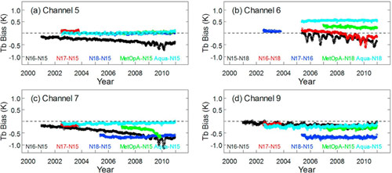
Examples of the Operational Calibrated AMSU-A Data in L1b Files
Time varying inter-satellite biases are up to 0.5–1 K
Notes:
This project focus on developing MSU/AMSU atmospheric temperature CDRs. The window channels will be addressed by another NOAA group.
In summary, we work on 15 atmospheric temperature channels, involving 15 satellites, with tempral coverage from late 1978 to present.
Each channel needs to be intercalibrated seperately.
With that, let me first talk about the MSU atmospheric temperature CDR development. The MSU started from 1978 on TIROS-N and ended on NOAA-14 in May 2007. So we don’t have MSU observations now. We have already completed the MSU CDR development and gained a lot of experiences. We have developed many new techniques for various bias correction procedure. So I am going to talk with more details on this instrument.

Slide 6
Integrated Microwave Inter-Calibration Approach
(IMICA, Zou et al. 2006, 2011)
Physically based approach to remove satellite biases
Use simultaneous nadir overpass (SNO) as applicable
Use global ocean mean differences as applicable — when diurnal drift effects are small and thus calibration biases emerge
Use CRTM simulations as applicable
Develop consistent swath radiance FCDRs for climate applications

Slide 7
Calibration Equation—The same as operational calibration except for allowing inter-calibration
Nonlinear Calibration: one set of calibration coefficients for all scan positions
(C_{w}, R_{w})
(C_{e}, R_{e})
R_{L} is the linear calibration term
Radiance (R)
{
μZ
(C_{e}, R_{L})
S
Slope
(C_{c} , 2.73K)
Z is the quadratic nonlinear term
Digital Counts (C)

Slide 8
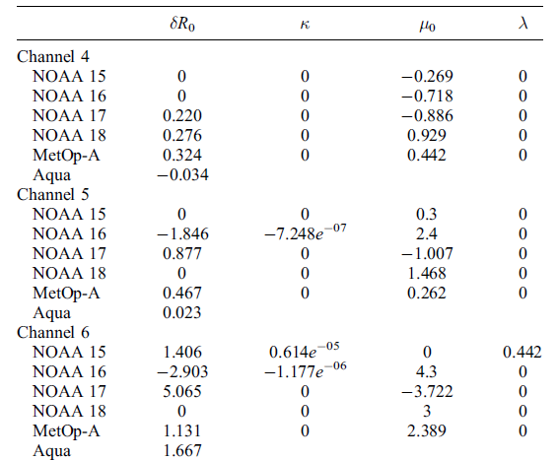
Calibration Coefficients obtained from Post-Launch IMICA
Calibration coefficients are a set of fixed parameters obtained from overlap observations using IMICA approach (Zou et al. 2006, 2009, Zou and Wang 2011)
: constant offset
κ : rate of changes in the offset
: constant non-linear coefficient
λ: the rate of changes of the
non-linear coefficient

Slide 9
Data Availability
FCDR data are routinely produced at NOAA/STAR and then delivered to NOAA/NCEI for archiving
NCEI data distribution website:
http://www.ncdc.noaa.gov/cdr/operationalcdrs.html
Data name: AMSU Brightness Temperature--NOAA
Use Agreement, FTP, Algorithm Description, Data Flow Diagram, Maturity Matrix
Data name: MSU Brightness Temperature--NOAA
Use Agreement, FTP, Algorithm Description, Data Flow Diagram, Maturity Matrix

Slide 10
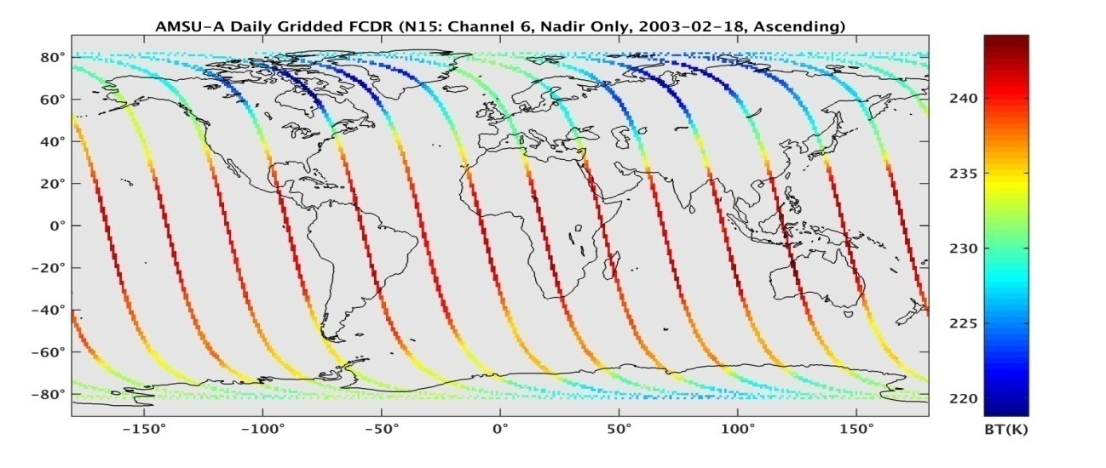
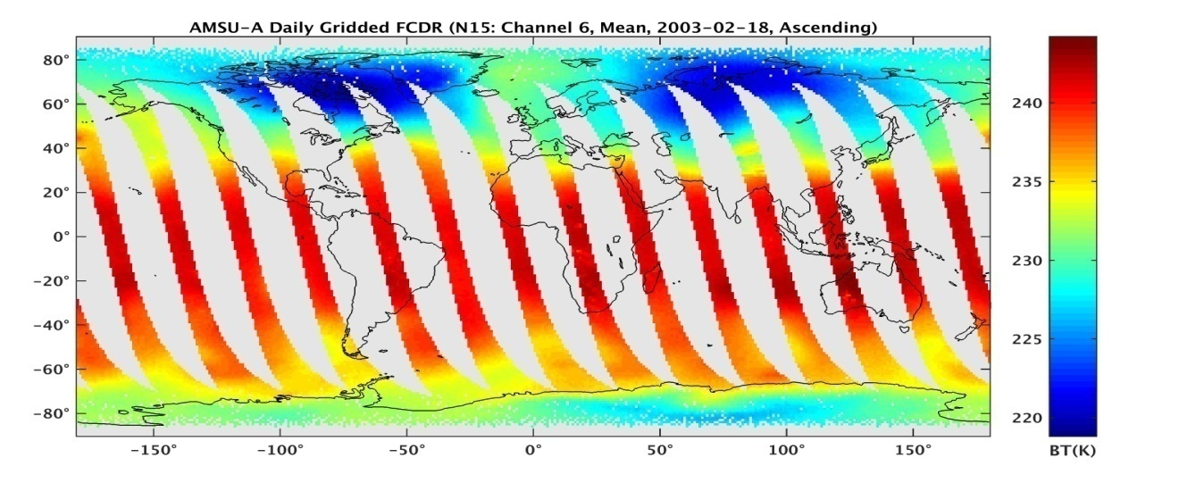
Data Processing Approach
Generate daily gridded map for
both near-nadir only scan
positions and means of
limb-adjusted data from multiple
scan positions
Grid resolution is 1° by 1° lat/lon
Long-term daily and monthly time
series were generated from
these maps
Near nadir data has larger noise,
limb-adjustment sometimes
not working well; so both time
series were examined for a
better judgment of the data
performance
Upper Panel: AMSU-A FCDR daily gridded map for near nadir data only
Lower Panel: AMSU-A FCDR daily gridded map for limb-adjusted multiple
scan positions

Slide 11
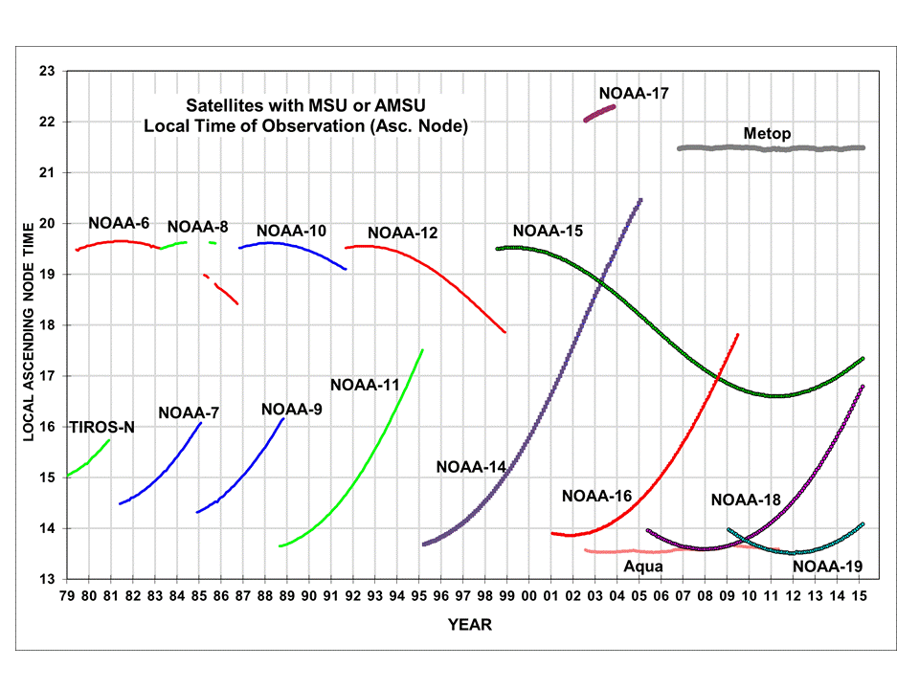
POES Satellite Orbital Drifts

Slide 12
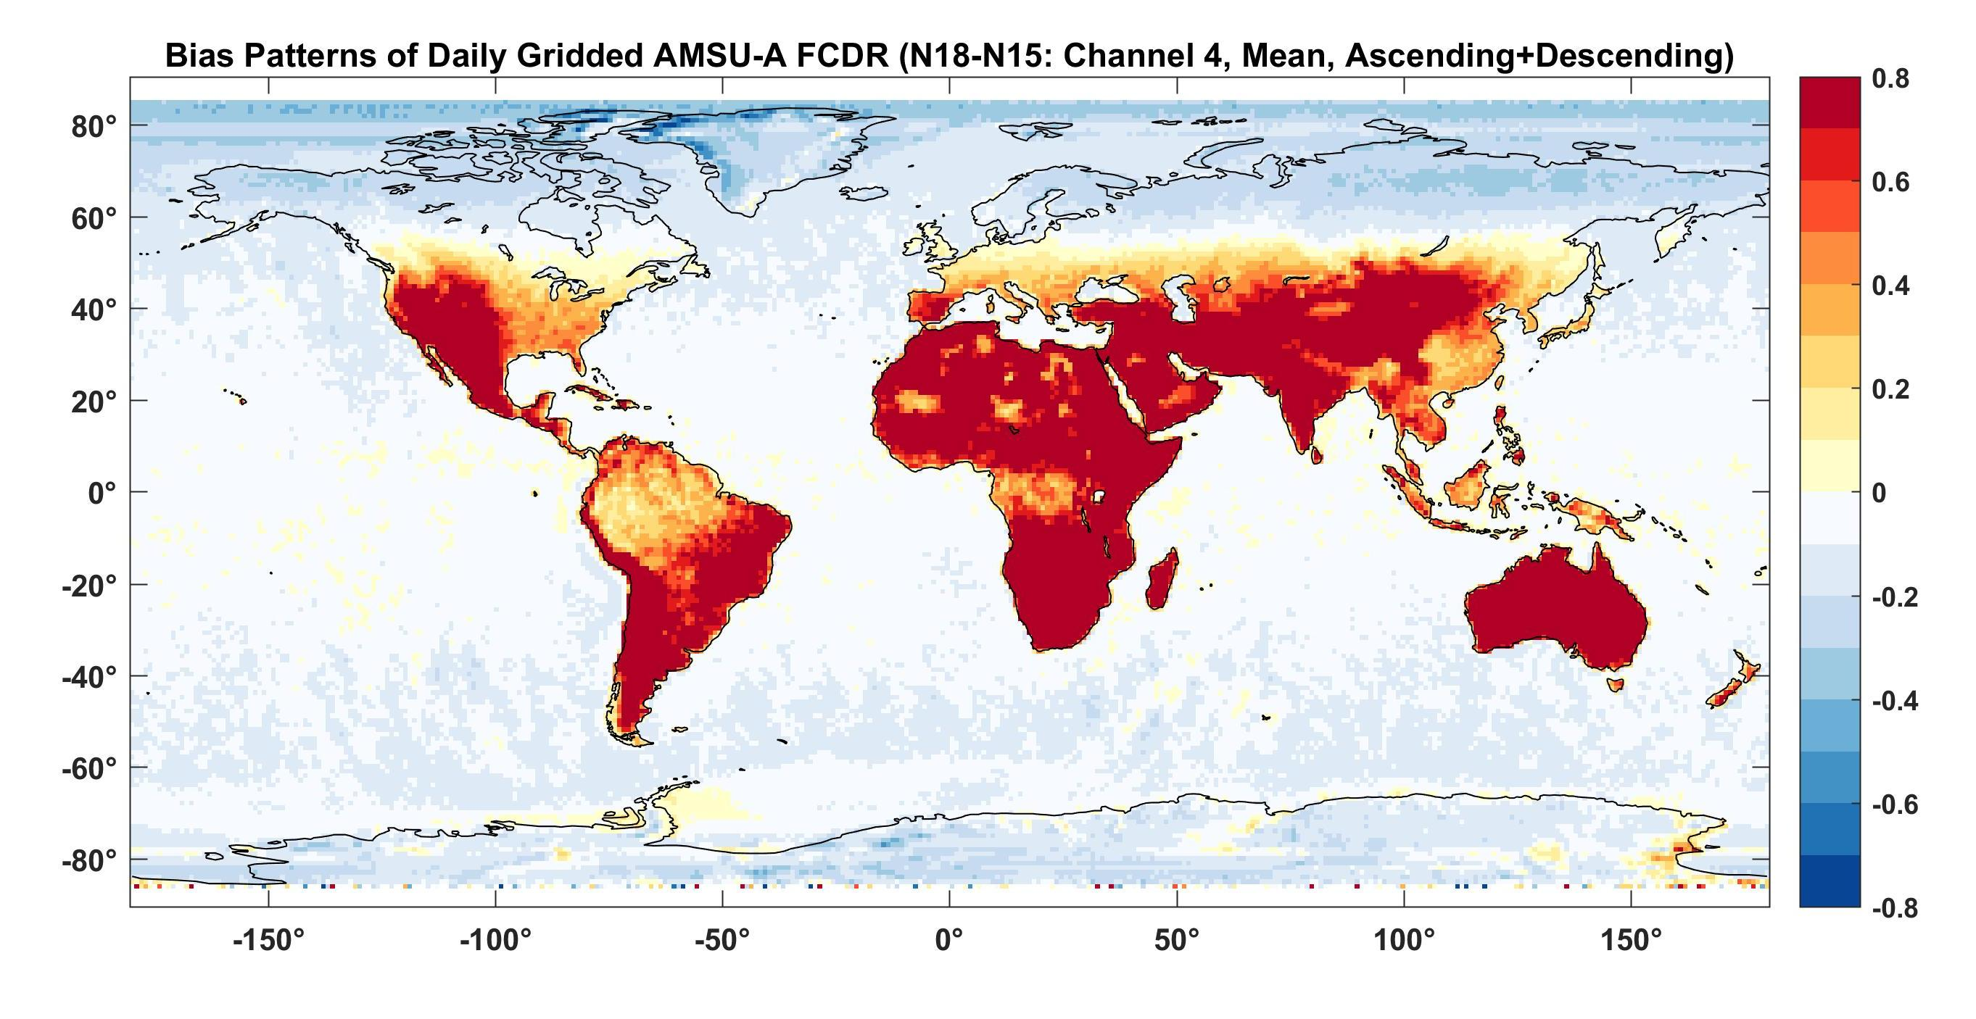
Inter-Satellite Biases of the AMSU-A FCDR – Channel 4
Long-term mean bias pattern between NOAA -18 and NOAA-15 for channel 4
Notes:
With that, let me first talk about the MSU atmospheric temperature CDR development. The MSU started from 1978 on TIROS-N and ended on NOAA-14 in May 2007. So we don’t have MSU observations now. We have already completed the MSU CDR development and gained a lot of experiences. We have developed many new techniques for various bias correction procedure. So I am going to talk with more details on this instrument.

Slide 13
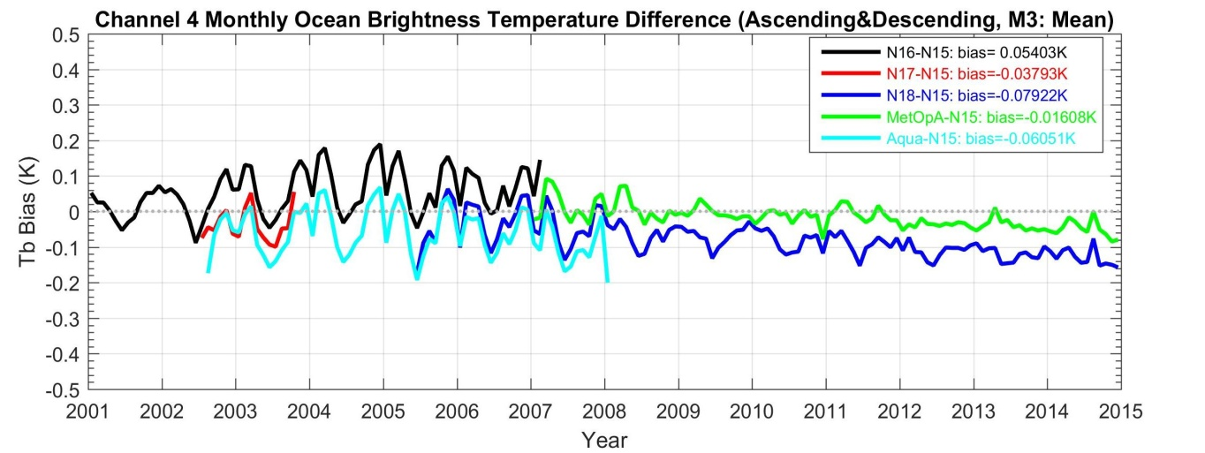
Inter-Satellite Biases of the AMSU-A FCDR—Channel 4
All biases are within 0.1K
NOAA -18 had a bias drift
about 0.1K/Dec
Channel 4 of NOAA-16 and AQUA
failed since 2007 and 2008,
respectively
Notes:
This project focus on developing MSU/AMSU atmospheric temperature CDRs. The window channels will be addressed by another NOAA group.
In summary, we work on 15 atmospheric temperature channels, involving 15 satellites, with tempral coverage from late 1978 to present.
Each channel needs to be intercalibrated seperately.
With that, let me first talk about the MSU atmospheric temperature CDR development. The MSU started from 1978 on TIROS-N and ended on NOAA-14 in May 2007. So we don’t have MSU observations now. We have already completed the MSU CDR development and gained a lot of experiences. We have developed many new techniques for various bias correction procedure. So I am going to talk with more details on this instrument.

Slide 14
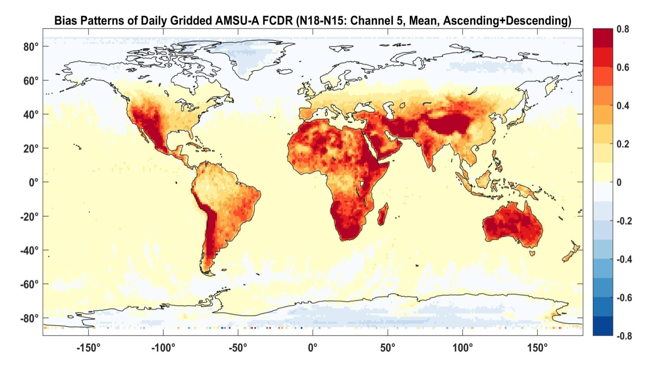
Inter-Satellite Biases of the AMSU-A FCDR—Channel 5
Biases over land are about 1K
Diurnal drifts are large over land
Biases over ocean are within 0.1K
Biases become smaller over the
polar land region due to average
of multiple orbits between the two
satellites
Diurnal drifts are negligible over
ocean
Long-term mean bias pattern between NOAA -18 and NOAA-15
for channel 5
Notes:
This project focus on developing MSU/AMSU atmospheric temperature CDRs. The window channels will be addressed by another NOAA group.
In summary, we work on 15 atmospheric temperature channels, involving 15 satellites, with tempral coverage from late 1978 to present.
Each channel needs to be intercalibrated seperately.
With that, let me first talk about the MSU atmospheric temperature CDR development. The MSU started from 1978 on TIROS-N and ended on NOAA-14 in May 2007. So we don’t have MSU observations now. We have already completed the MSU CDR development and gained a lot of experiences. We have developed many new techniques for various bias correction procedure. So I am going to talk with more details on this instrument.

Slide 15

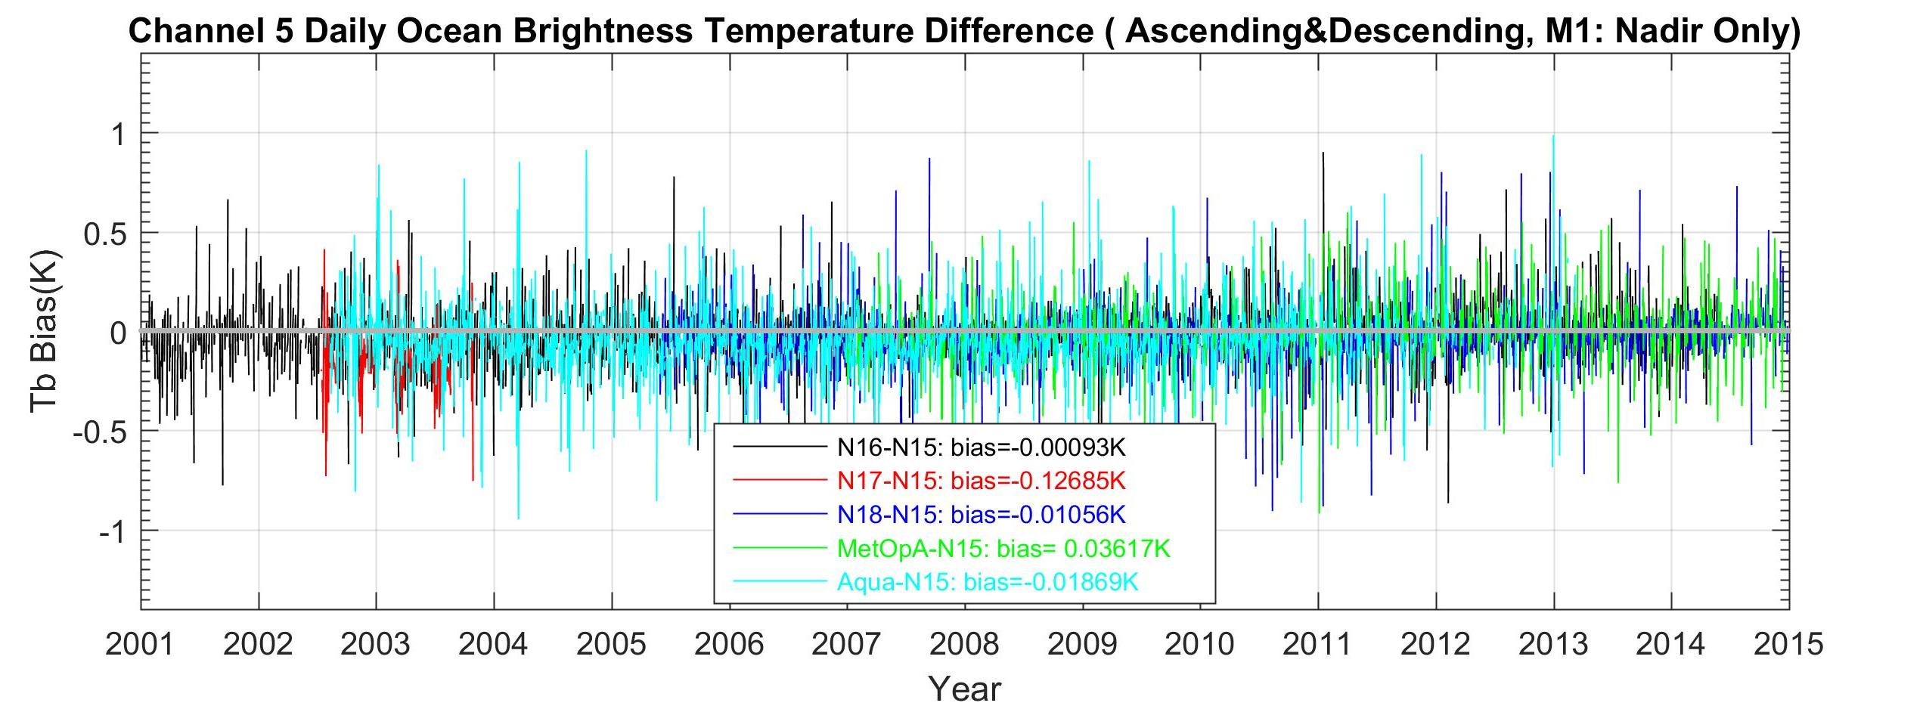
Inter-Satellite Biases of AMSU-A FCDR — Channel 5
All inter-satellite biases
are within 0.03K except
for short–lived NOAA-17
Bias drifts are
negligible
NOAA-17 had a bias
of 0.13K before its
failure in 2003
Aqua showed problem
and larger bias drift after
2013; data were
removed afterwards
Notes:
This project focus on developing MSU/AMSU atmospheric temperature CDRs. The window channels will be addressed by another NOAA group.
In summary, we work on 15 atmospheric temperature channels, involving 15 satellites, with tempral coverage from late 1978 to present.
Each channel needs to be intercalibrated seperately.
With that, let me first talk about the MSU atmospheric temperature CDR development. The MSU started from 1978 on TIROS-N and ended on NOAA-14 in May 2007. So we don’t have MSU observations now. We have already completed the MSU CDR development and gained a lot of experiences. We have developed many new techniques for various bias correction procedure. So I am going to talk with more details on this instrument.

Slide 16
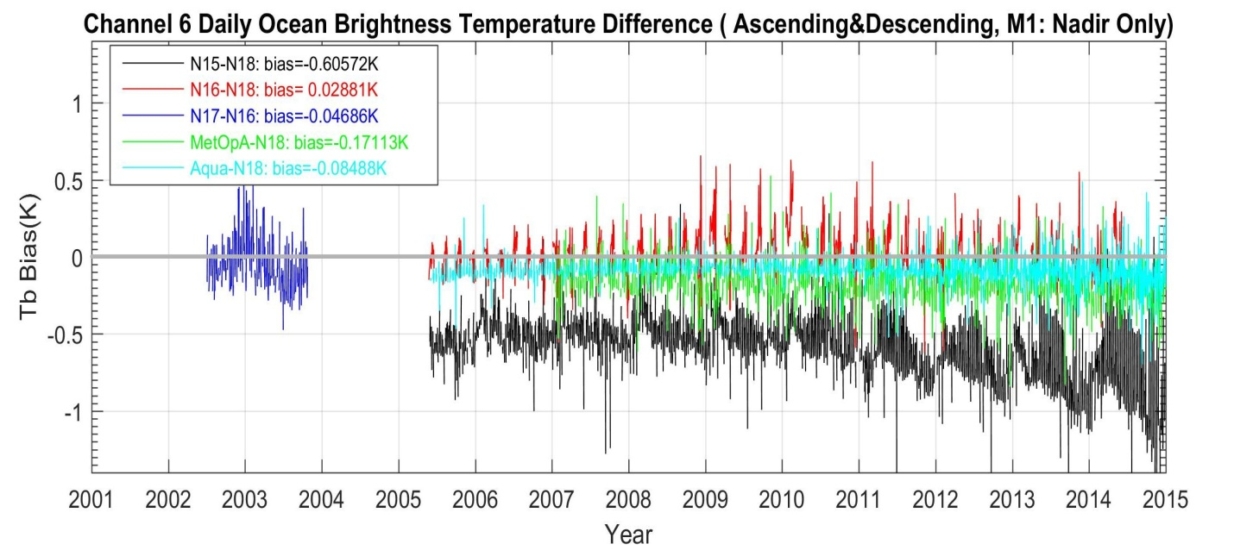
Performance of AMSU-A FCDR—Channel 6
Most inter-satellite
biases are within 0.1K
Biases between MetOp-
A and NOAA-18 are
within 0.2K
NOAA-15 channel 6 had a
frequency shift after
launch (Zou and Wang
2011); as a result, it had
large biases relative to
other satellites
Aqua became noisier
after 2011
Notes:
This project focus on developing MSU/AMSU atmospheric temperature CDRs. The window channels will be addressed by another NOAA group.
In summary, we work on 15 atmospheric temperature channels, involving 15 satellites, with tempral coverage from late 1978 to present.
Each channel needs to be intercalibrated seperately.
With that, let me first talk about the MSU atmospheric temperature CDR development. The MSU started from 1978 on TIROS-N and ended on NOAA-14 in May 2007. So we don’t have MSU observations now. We have already completed the MSU CDR development and gained a lot of experiences. We have developed many new techniques for various bias correction procedure. So I am going to talk with more details on this instrument.

Slide 17
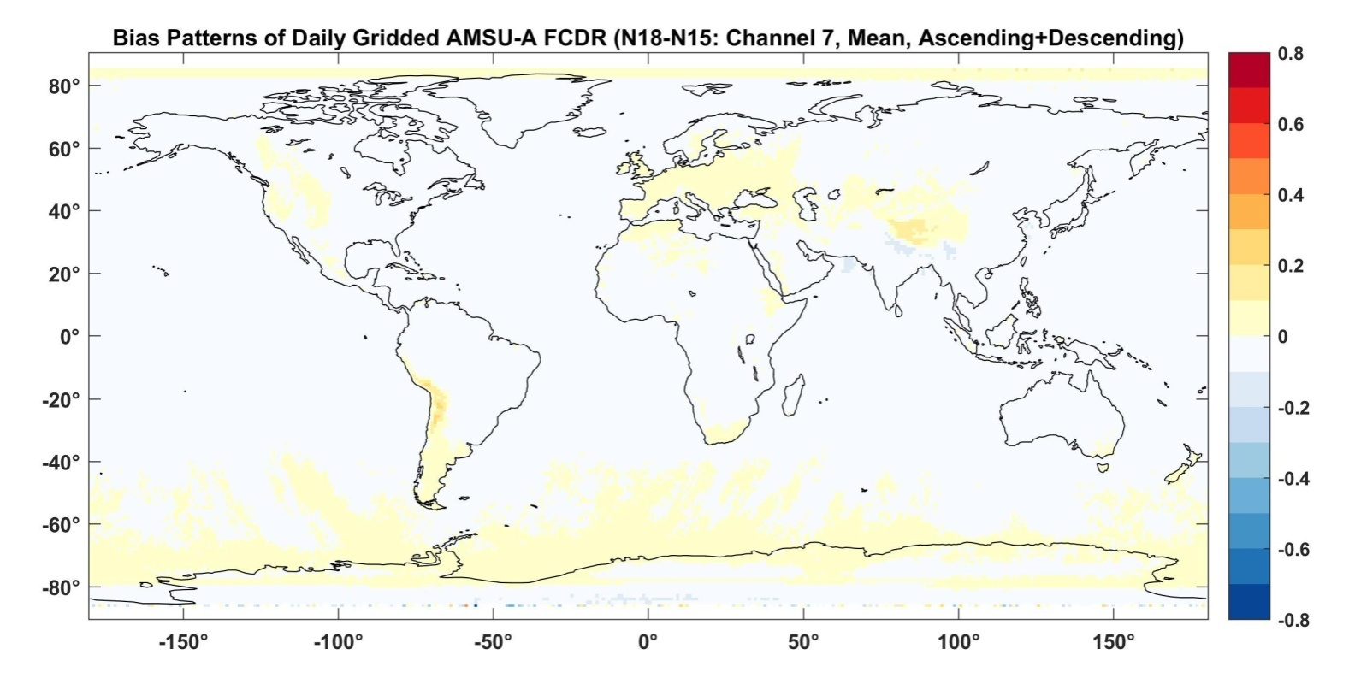
Performance of AMSU-A FCDR—Channel 7
Near zero biases
globally
Channel 7 diurnal
drift effect is negligible
globally
Long-term mean bias pattern between NOAA -18 and NOAA-15
for channel 7
Notes:
This project focus on developing MSU/AMSU atmospheric temperature CDRs. The window channels will be addressed by another NOAA group.
In summary, we work on 15 atmospheric temperature channels, involving 15 satellites, with tempral coverage from late 1978 to present.
Each channel needs to be intercalibrated seperately.
With that, let me first talk about the MSU atmospheric temperature CDR development. The MSU started from 1978 on TIROS-N and ended on NOAA-14 in May 2007. So we don’t have MSU observations now. We have already completed the MSU CDR development and gained a lot of experiences. We have developed many new techniques for various bias correction procedure. So I am going to talk with more details on this instrument.

Slide 18
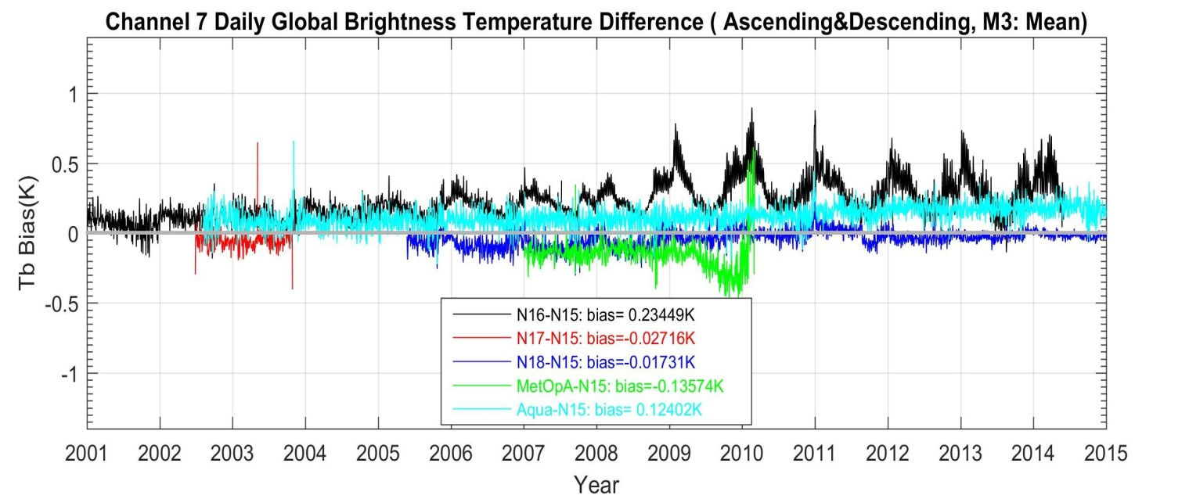
Performance of AMSU-A FCDR—Channel 7
NOAA-16 nonlinearity became
larger after 2009
NOAA-15 and NOAA-18 nearly
identical
Aqua showed small bias drift
MetOp-A failed after 2010
All inter-satellite biases are
within 0.2K
Notes:
This project focus on developing MSU/AMSU atmospheric temperature CDRs. The window channels will be addressed by another NOAA group.
In summary, we work on 15 atmospheric temperature channels, involving 15 satellites, with tempral coverage from late 1978 to present.
Each channel needs to be intercalibrated seperately.
With that, let me first talk about the MSU atmospheric temperature CDR development. The MSU started from 1978 on TIROS-N and ended on NOAA-14 in May 2007. So we don’t have MSU observations now. We have already completed the MSU CDR development and gained a lot of experiences. We have developed many new techniques for various bias correction procedure. So I am going to talk with more details on this instrument.

Slide 19
Comparison with GPSRO—
Evaluation of Absolute Accuracy
channel 9 biases for AMSU-GPSRO(COSMIC) for randomly selected period
January-July, 2007
NOAA-15 NOAA-16 NOAA-18
For all three satellites, biases between the FCDR and GPSRO (blue) were consistently small;
while those between operational calibrated and GPSRO (Brown) are different for different
satellites and sometimes very large (NOAA-18)

Slide 20
Conclusion
Biases for most satellite pairs are within 0.2K. Agreement between NOAA-15 and NOAA-18 are extremely well (within 0.05K) for all channels 4-9
Aqua became noisier for channel 6 after 2011 and unusable for channel 5 after 2013
NOAA-16 needs further recalibration to remove its nonlinear signals for channels 7 and 8
The excellent agreement between NOAA-15, NOAA-18, and AQUA provides evidence that these satellites can be used as reference satellites (Bali et al. 2017)
Notes:
In this talk, I’ll be focusing on the intersatellite biases and warm target temperature contamination; but also touch a little bit on other problems.

Slide 21
Backup slides

Slide 22
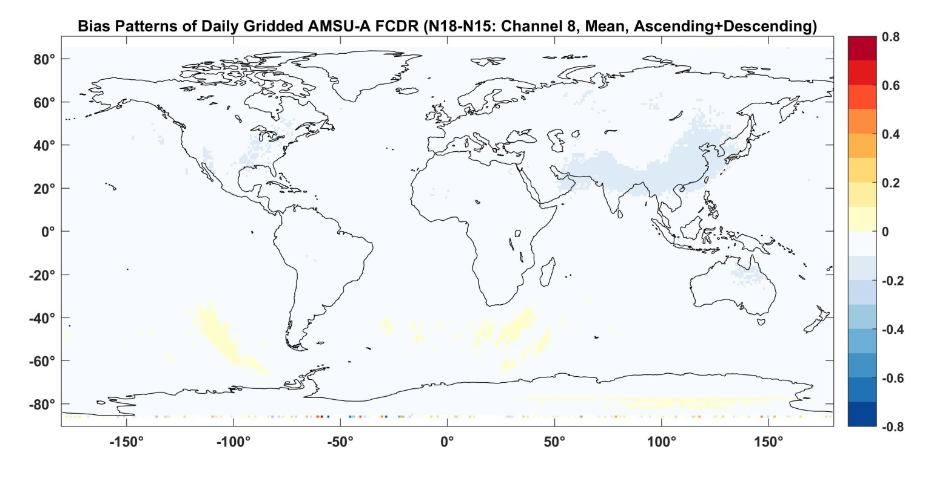
Performance of AMSU-A FCDR—Channel 8
Channel 8 diurnal
drift effect is negligible
globally
Long-term mean bias pattern between NOAA -18 and NOAA-15
for channel 8
Notes:
This project focus on developing MSU/AMSU atmospheric temperature CDRs. The window channels will be addressed by another NOAA group.
In summary, we work on 15 atmospheric temperature channels, involving 15 satellites, with tempral coverage from late 1978 to present.
Each channel needs to be intercalibrated seperately.
With that, let me first talk about the MSU atmospheric temperature CDR development. The MSU started from 1978 on TIROS-N and ended on NOAA-14 in May 2007. So we don’t have MSU observations now. We have already completed the MSU CDR development and gained a lot of experiences. We have developed many new techniques for various bias correction procedure. So I am going to talk with more details on this instrument.

Slide 23
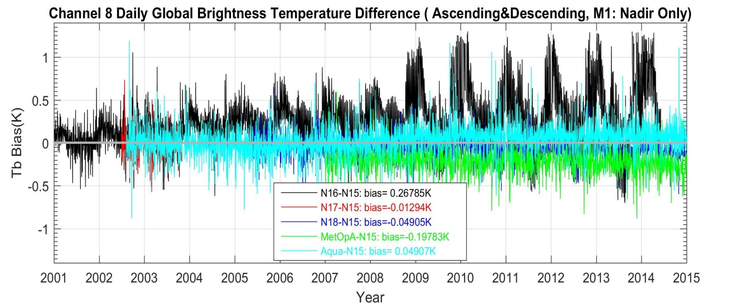
Performance of AMSU-A FCDR—Channel 8
NOAA-16 nonlinearity became
larger after 2009
Biases between NOAA-15 and
NOAA-18 are small (0.04K)
Aqua showed small bias drift
All inter-satellite biases are
within 0.2K except for
NOAA-16 (0.3K)
Notes:
This project focus on developing MSU/AMSU atmospheric temperature CDRs. The window channels will be addressed by another NOAA group.
In summary, we work on 15 atmospheric temperature channels, involving 15 satellites, with tempral coverage from late 1978 to present.
Each channel needs to be intercalibrated seperately.
With that, let me first talk about the MSU atmospheric temperature CDR development. The MSU started from 1978 on TIROS-N and ended on NOAA-14 in May 2007. So we don’t have MSU observations now. We have already completed the MSU CDR development and gained a lot of experiences. We have developed many new techniques for various bias correction procedure. So I am going to talk with more details on this instrument.

Slide 24
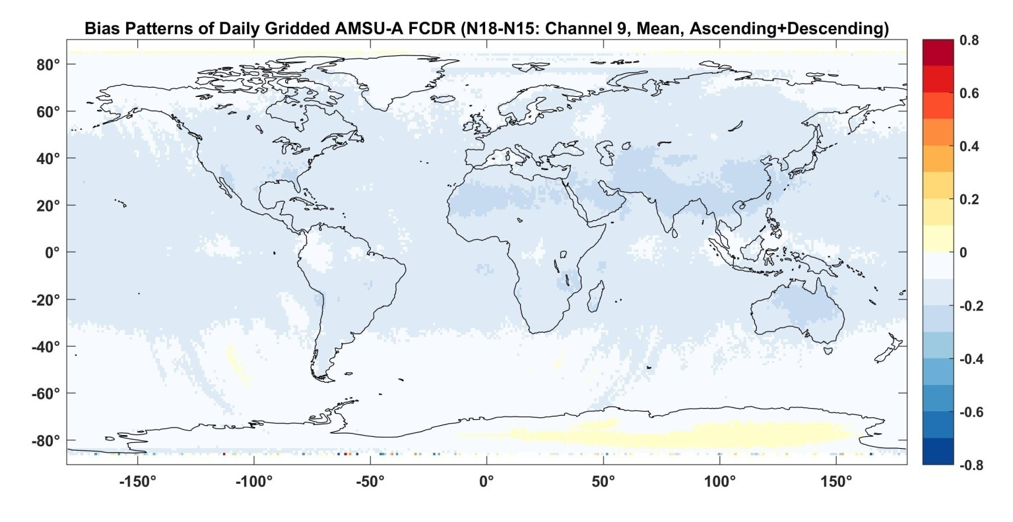
Performance of AMSU-A FCDR—Channel 9
Channel 9 diurnal
drift effect larger than
Channels 7 and 8, but
is still small globally
(0.2K)
Long-term mean bias pattern between NOAA -18 and NOAA-15
for channel 9

Slide 25
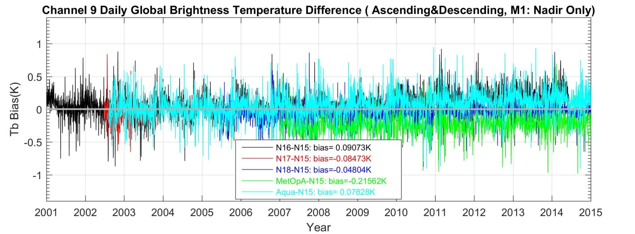
Performance of the AMSU-A FCDR C—Channel 9
All inter-satellite biases are
within 0.1K except for
MetOp-A (0.2K)
Notes:
With that, let me first talk about the MSU atmospheric temperature CDR development. The MSU started from 1978 on TIROS-N and ended on NOAA-14 in May 2007. So we don’t have MSU observations now. We have already completed the MSU CDR development and gained a lot of experiences. We have developed many new techniques for various bias correction procedure. So I am going to talk with more details on this instrument.

