Slide 1
Traceability and Uncertainty of GSICS Infrared Reference Sensors
Tim Hewison

Slide 2
IR Reference Sensor Traceability & Uncertainty Report
Aims
To support choice of reference instruments for GSICS and Metop-A/IASI as Anchor
To provide traceability between reference instruments (IASI, AIRS, CrIS)
By consolidating pre-launch test results and various in-flight comparisons
To seek consensus on uncertainties in absolute calibration of reference sensors
Limitations
No new results, just expressing results of existing comparisons in a common way,
reformatting where necessary, to allow easy comparisons
Error Budget & Traceability
Focus on radiometric and spectral calibration – for AIRS, IASI, CrIS
Inter-comparisons
Introduction: Pros and Cons of each method
Direct Comparisons: Polar SNOs, Tandem SNOs (AIRS+CrIS), Quasi-SNOs,
Double-Differencing: GEO-LEO, NWP+RTM, Aircraft campaigns
Other Methods: Regional Averages (“Massive Means”), Reference Sites (Dome-C..)

Slide 3
IR Reference Sensor Inter-Comparisons
Form consensus on relative calibration
Re-binning results of existing comparisons
to make them comparable:
Biases with respect to Metop-A/IASI
With standard uncertainties (k=1)
At full spectral resolution
In CrIS channel-space
– or in 10cm-1 bins within AIRS bands
Averaged over specific spectral bands
Or average results over broad-band channels
With specific SRFs - rectangular?
Converted into Brightness Temperatures
For specific radiance scenes
i.e. 200K, 210K, … 300K
For all viewing angles
and/or for specific ranges - e.g. nadir ±10°
Over specific period - e.g. at least 1 year
Common 3 year period from IASI-B start
 |  |  |  |  | Mean Difference dTb [K]
 |  | Pseudo Channel [cm-1] | Min Freq [cm-1] | Max Freq [cm-1] | 200 | 220 | 240 | 260 | 280 | 300
Start date |  | 655 | 650 | 660
End date |  | 665 | 660 | 670
Start time |  | 675 | 670 | 680
End time |  | 685 | 680 | 690
Min Latitude [°] |  | 695 | 690 | 700
Max Latitude [°] |  | 705 | 700 | 710
Min Longitude [°] |  | 715 | 710 | 720
Max Longitude [°] |  | 725 | 720 | 730
Min Scan Angle [°] |  | 735 | 730 | 740
Max Scan Angle [°] |  | 745 | 740 | 750
 |  | 755 | 750 | 760
Collocation method: |  | 765 | 760 | 770
Collocation dist [km] |  | 775 | 770 | 780
Collocation time [s] |  | 785 | 780 | 790
Collocation sec(theta) |  | 795 | 790 | 800
Filtering applied |  | 805 | 800 | 810
 |  | 815 | 810 | 820
Algorithm Ref |  | 825 | 820 | 830
Dataset Ref |  | 835 | 830 | 840
Monitored Instrument |  | 845 | 840 | 850
Processing Version |  | 855 | 850 | 860
Dataset Ref |  | 865 | 860 | 870
Reference Instrumemt |  | 875 | 870 | 880
Processing Version |  | 885 | 880 | 890
Dataset Ref |  | 895 | 890 | 900

Slide 4
Summary of Previous Web Meeting (2016-06-21)
The proposed structure of the report was agreed,
with the addition of a sub-section in the introduction to address the need for continuous monitoring of the reference instruments' calibration.
Additional sub-sub-sections were also identified to briefly address
a) radiometric noise,
b) spectral calibration and
c) geometric factors (navigation accuracy etc) in the error budget
Although these need not be treated in a fully rigorous approach,
given their negligible impact on the inter-calibration products [for a) and b)] and
the difficulty of assessment [for c)].
The contributor authors to each sub-section were identified
- either as firm, or tentative.
The spectral resolution of the comparisons was discussed at length and different spectral conversion methods described.
It was felt that 10cm-1 bins would be sufficient.
It seems the most difficult issue is dealing with AIRS' gap channels.
It was agreed that further discussion on this topic is needed,
so another web meeting will be set up to discuss this in mid-August 2016.

Slide 5
Action GRWG.20160621.1
Action GRWG.20160621.1: Tim Hewison (EUMETSAT) to check with NIST/NPL and confirm the recommended coverage factor to be used for error budgets and comparisons.
Action completed 2016-08-03, with the following response from Emma Woolliams (NPL) - and agreed by Dave Walker (NIST):
“The uncertainty analysis should all be performed with standard uncertainties.
Any uncertainty budget (table) should definitely be full of standard uncertainties.
The adding in quadrature (applying the Law of Propagation of Uncertainties) must be done with standard uncertainties.
But the final result may be quoted as an expanded uncertainty.
In which case the k value must be provided and if it’s not 2, the number of degrees of freedom should be provided too.
That means that other people can divide by the right number when including your uncertainty analysis into their budgets.”

Slide 6
Action GRWG.20160621.2
Action GRWG.20160621.2: Denis Jouglet (CNES) to distribute spectral averaging coefficients and documentation describing their application by early July. - Action completed 2016-06-21 - See next slide sent by email.

Slide 7
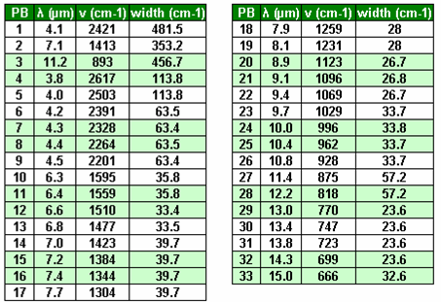
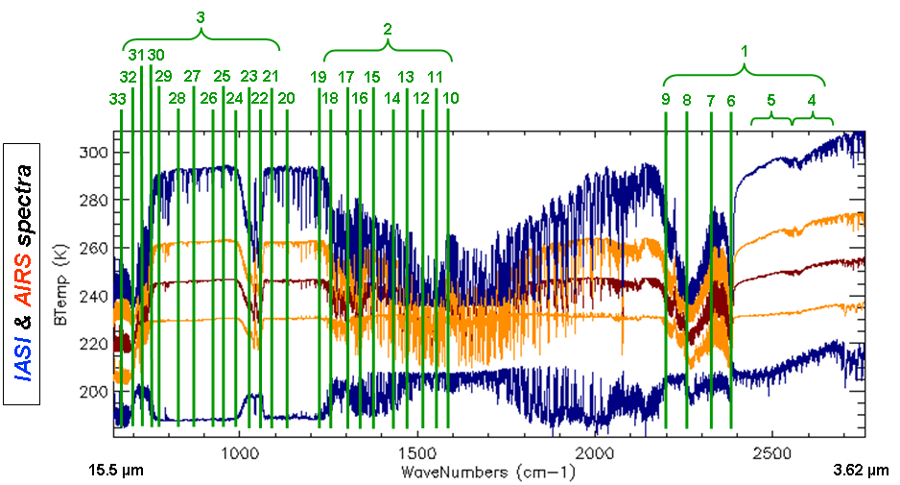
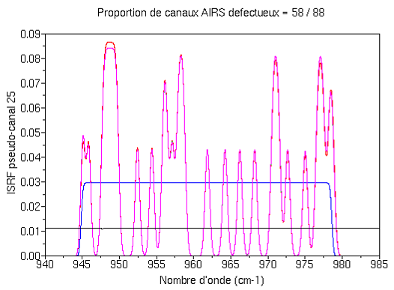
IASI / AIRS : methodology – Denis Jouglet
Spectral match:
Work with IASI L1C, AIRS L1B
Method: 33 broad pseudo-bands (PBs) from GSICS
1 PB = summation of ~100s of elementary channels (most widths between 23 and 63 cm-1)
Reduces noise and spectral resolution differences
AIRS spurious channels: taken into account through a weighted summation of the IASI channels
(weighs are computed to make the resulting PB response functions similar in IASI and AIRS)
Comparison of ΔT = T_{IASI} - T_{AIRS} in each PB
Other methods under progress
similar channels (statistical similar behavior)
convolved channels
Instrumental functions of one PB for AIRS (including spurious channels), for IASI without weighting in the channels summation and for IASI with weighting

Slide 8
Summary of Previous Web Meeting (2016-09-08)
Spectral averaging methods were reviewed by Denis Jouglet
Action GIR.20160908.1: Denis Jouglet (CNES) to apply spectral averaging method to calculate static weightings for generating 10cm-1 pseudo channels for AIRS-IASI comparison over 3 year period (2013-03-01/2016-03-01) - and consider application for CrIS -IASI comparisons.
Inter-comparison database was introduced by Tim Hewison
It was agreed that the proposed 10cm^-1 spectral binning is adequate
It was agreed that finer radiance binning is needed to ensure results are comparable (linear)
Action GRWG.20160908.3: Dave Tobin (SSEC) to regenerate comparison results in 10K bins over 3 year period (2013-03-01/2016-03-01), describe method and share raw SNO results.
Action GRWG.20160908.4: Tim Hewison (EUMETSAT) to regenerate comparison results in 10K bins and redo double-difference analysis, expressing results in BT, radiance and % radiance – done see next slides.
Comparisons of AATSR and IASI were introduced by Manik Bali
Recommendation: Manik Bali (NOAA) to investigate adding incidence angle matching to AATSR-IASI comparison, with weighting according to the variance of the SNO radiances.
Recommendation: Manik Bali (NOAA) to review outline for report on Traceability and Uncertainty of GSICS Infrared Reference Sensors and propose how his AATSR-IASI analysis could be included/referenced.

Slide 9
How to compare different spectral resolutions
Double differences with GEO imagers
Broad spectral channels ~100cm⁻¹
Issues
Non-linear Planck function
Accounting for Spectral Response
Options to account for non-linearity:
Integrate DDs of Tb in 20K bins
Use smaller Tb bins
Convert to/from radiance before/after spectral integration
Using mid Tb bin as reference
Options to account for Spectral Response:
Flat box-car average of spectral bins over FWHM bandwidth
Average spectral bins, according to uncertainty in each
Weighted average of spectral bins, according to SRF

Slide 10
Start Simple – (SEVIRI-IASIA)-(SEVIRI-IASIB)
 |  |  | Mean Difference dTb [K] |  |  |  |  |  | Uncertainty on Mean Difference u(dTb) [K] k=1
Channel | 50% [cm-1] | 50% [cm-1] | 200 | 220 | 240 | 260 | 280 | 300 | 200 | 220 | 240 | 260 | 280 | 300
IR13.4 | 714 | 782 | -0.35 | -0.22 | -0.13 | -0.06 | -0.01 | 0.04 | 0.13 | 0.07 | 0.04 | 0.01 | 0.01 | 0.03
IR12.0 | 800 | 870 | 0.01 | 0.00 | -0.01 | -0.01 | -0.02 | -0.02 | 0.18 | 0.11 | 0.06 | 0.03 | 0.01 | 0.01
IR10.8 | 885 | 971 | -0.10 | -0.07 | -0.04 | -0.03 | -0.02 | -0.01 | 0.16 | 0.09 | 0.06 | 0.03 | 0.01 | 0.01
IR9.7 | 1018 | 1047 | -0.19 | -0.10 | -0.06 | -0.03 | -0.01 | 0.01 | 0.11 | 0.06 | 0.03 | 0.01 | 0.01 | 0.02
IR8.7 | 1124 | 1177 | -0.11 | -0.06 | -0.03 | -0.01 | 0.00 | 0.01 | 0.26 | 0.14 | 0.07 | 0.03 | 0.01 | 0.01
IR7.3 | 1316 | 1409 | -0.12 | -0.05 | -0.01 | 0.01 | 0.02 | 0.03 | 0.11 | 0.05 | 0.02 | 0.00 | 0.01 | 0.01
IR6.2 | 1493 | 1724 | -0.20 | -0.06 | -0.01 | 0.02 | 0.04 | 0.06 | 0.11 | 0.04 | 0.01 | 0.01 | 0.02 | 0.03
IR3.9 | 2385 | 2751 | 1.51 | 0.37 | 0.11 | 0.03 | 0.00 | -0.01 | 0.96 | 0.25 | 0.08 | 0.02 | 0.01 | 0.01

Slide 11
Start Simple – (IASIB-CrIS)-(IASIA-CrIS)|SEVIRI
 |  |  | Mean Difference dTb [K] |  |  |  |  |  | Uncertainty on Mean Difference u(dTb) [K] k=1
Channel | 50% [cm-1] | 50% [cm-1] | 200 | 220 | 240 | 260 | 280 | 300 | 200 | 220 | 240 | 260 | 280 | 300
IR13.4 | 714 | 782 | -0.12 | -0.09 | -0.07 | -0.06 | -0.06 | 0.03 | -0.12 | -0.03 | -0.01 | -0.02 | -0.05 | -0.54
IR12.0 | 800 | 870 | -0.11 | -0.09 | -0.07 | -0.06 | -0.04 | 0.01 | -0.11 | -0.04 | -0.03 | -0.02 | -0.03 | -0.55
IR10.8 | 885 | 971 | -0.09 | -0.08 | -0.06 | -0.05 | -0.03 | -0.03 | -0.12 | -0.04 | -0.03 | -0.02 | -0.03 | -0.53
IR9.7 | 1018 | 1047 | -0.23 | -0.14 | -0.08 | -0.05 | 0.13 |  | -0.06 | -0.02 | -0.01 | -0.02 | -0.59
IR8.7 | 1124 | 1177
IR7.3 | 1316 | 1409 | -0.13 | -0.01 | 0.01 | 0.01 | 0.02 |  | -0.29 | -0.03 | -0.01 | -0.02 | -0.40
IR6.2 | 1493 | 1724 | -0.26 | 0.00 | 0.01 | 0.00 |  |  | -0.87 | -0.02 | -0.01 | -0.05
IR3.9 | 2385 | 2751 | 0.62 | 0.04 | 0.01 | 0.01 | -0.01 | -0.03 | -2.38 | -0.10 | -0.03 | -0.04 | -0.03 | -0.45
Both show significant differences @ 13.4µm
Tobin uncertainties smaller – significant differences in all LW channels
Erratic results at low Tb – especially for SW

Slide 12
2013-03/2017-03 (SEVIRI-IASIA)-(SEVIRI-IASIB) - Tb
 |  |  | Mean Difference dTb [K]
Channel | 50% [cm-1] | 50% [cm-1] | 200 | 210 | 220 | 230 | 240 | 250 | 260 | 270 | 280 | 290 | 300 | K
IR13.4 | 714 | 782 | -0.30 | -0.24 | -0.19 | -0.15 | -0.12 | -0.09 | -0.06 | -0.04 | -0.02 | 0.00 | 0.02 | K
IR12.0 | 800 | 870 | -0.16 | -0.13 | -0.11 | -0.09 | -0.07 | -0.06 | -0.05 | -0.04 | -0.04 | -0.03 | -0.02 | K
IR10.8 | 885 | 971 | -0.27 | -0.21 | -0.16 | -0.13 | -0.10 | -0.08 | -0.06 | -0.05 | -0.04 | -0.03 | -0.02 | K
IR9.7 | 1018 | 1047 | -0.19 | -0.14 | -0.11 | -0.08 | -0.06 | -0.05 | -0.04 | -0.03 | -0.02 | -0.01 | -0.01 | K
IR8.7 | 1124 | 1177 | -0.09 | -0.07 | -0.05 | -0.04 | -0.03 | -0.02 | -0.01 | -0.01 | -0.01 | 0.00 | 0.00 | K
IR7.3 | 1316 | 1409 | 0.01 | 0.00 | 0.00 | 0.00 | 0.00 | 0.00 | 0.00 | 0.00 | 0.00 | 0.00 | 0.00 | K
IR6.2 | 1493 | 1724 | -0.14 | -0.08 | -0.05 | -0.03 | -0.01 | 0.00 | 0.01 | 0.01 | 0.02 | 0.02 | 0.03 | K
IR3.9 | 2385 | 2751 | 0.02 | 0.01 | 0.00 | 0.00 | -0.01 | -0.01 | -0.01 | -0.01 | -0.01 | -0.01 | -0.01 | K

Slide 13
2013-03/2017-03 (SEVIRI-IASIA)-(SEVIRI-IASIB) - rad
 |  |  | Mean Difference dL [mW/m2/sr/cm^-1]
Channel | 50% [cm-1] | 50% [cm-1] | 200 | 210 | 220 | 230 | 240 | 250 | 260 | 270 | 280 | 290 | 300 | K
IR13.4 | 714 | 782 | -0.19 | -0.17 | -0.16 | -0.14 | -0.12 | -0.10 | -0.08 | -0.06 | -0.03 | 0.00 | 0.03 | mW/m2/sr/cm⁻¹
IR12.0 | 800 | 870 | -0.08 | -0.08 | -0.08 | -0.07 | -0.07 | -0.07 | -0.06 | -0.06 | -0.05 | -0.05 | -0.04 | mW/m2/sr/cm⁻¹
IR10.8 | 885 | 971 | -0.11 | -0.10 | -0.10 | -0.09 | -0.09 | -0.08 | -0.07 | -0.06 | -0.05 | -0.04 | -0.03 | mW/m2/sr/cm⁻¹
IR9.7 | 1018 | 1047 | -0.05 | -0.05 | 0.05 | -0.05 | -0.04 | -0.04 | -0.03 | -0.03 | -0.02 | -0.02 | -0.01 | mW/m2/sr/cm⁻¹
IR8.7 | 1124 | 1177 | -0.02 | -0.02 | 0.02 | -0.02 | -0.01 | -0.01 | -0.01 | -0.01 | -0.01 | 0.00 | 0.00 | mW/m2/sr/cm⁻¹
IR7.3 | 1316 | 1409 | 0.009 | 0.008 | 0.007 | 0.007 | 0.005 | 0.004 | 0.002 | 0.002 | 0.005 | 0.009 | 0.01 | mW/m2/sr/cm⁻¹
IR6.2 | 1493 | 1724 | 0.003 | 0.003 | 0.002 | 0.002 | 0.001 | 0.001 | 0.003 | 0.005 | 0.008 | 0.011 | 0.02 | mW/m2/sr/cm⁻¹
IR3.9 | 2385 | 2751 | 0.0002 | 0.0002 | 0.0002 | 0.0002 | 0.0002 | 0.0002 | 0.0002 | 0.0002 | 0.0001 | 0.0001 | 0.0001 | mW/m2/sr/cm⁻¹

Slide 14
2013-03/2017-03 (SEVIRI-IASIA)-(SEVIRI-IASIB) - rad
 |  |  | Mean Difference dL/L [%]
Channel | 50% [cm-1] | 50% [cm-1] | 200 | 210 | 220 | 230 | 240 | 250 | 260 | 270 | 280 | 290 | 300 | K
IR13.4 | 714 | 782 | -0.81 | -0.59 | -0.43 | -0.31 | -0.22 | -0.15 | -0.10 | -0.06 | -0.03 | 0.00 | 0.02 | %
IR12.0 | 800 | 870 | -0.48 | -0.35 | -0.26 | -0.20 | -0.15 | -0.12 | -0.09 | -0.07 | -0.05 | -0.04 | -0.03 | %
IR10.8 | 885 | 971 | -0.89 | -0.63 | -0.45 | -0.33 | -0.24 | -0.18 | -0.13 | -0.09 | -0.06 | -0.04 | -0.02 | %
IR9.7 | 1018 | 1047 | -0.70 | -0.47 | -0.33 | -0.23 | -0.16 | -0.12 | -0.08 | -0.05 | -0.04 | -0.02 | -0.01 | %
IR8.7 | 1124 | 1177 | -0.38 | -0.25 | -0.17 | -0.11 | -0.08 | -0.05 | -0.04 | -0.02 | -0.01 | -0.01 | 0.00 | %
IR7.3 | 1316 | 1409 | 0.03 | 0.02 | 0.01 | 0.01 | 0.01 | 0.01 | 0.01 | 0.00 | 0.00 | 0.00 | 0.00 | %
IR6.2 | 1493 | 1724 | -0.79 | -0.42 | -0.22 | -0.11 | -0.04 | 0.00 | 0.03 | 0.04 | 0.06 | 0.06 | 0.07 | %
IR3.9 | 2385 | 2751 | 0.21 | 0.06 | 0.00 | -0.02 | -0.04 | -0.04 | -0.04 | -0.05 | -0.05 | -0.05 | -0.05 | %

Slide 15
Conduct Analysis as ∆Tb, ∆L, ∆L/L?
All three methods give consistent results
All long-wave channels show similar trend
Only IR13.4 difference is significant at cold end
Radiance is more difficult to compare inter-channel
Radiance Percentage (L/∆L) very similar to ∆Tb
How well do they compare with other methods?

Slide 16
Thank You!

