Slide 1
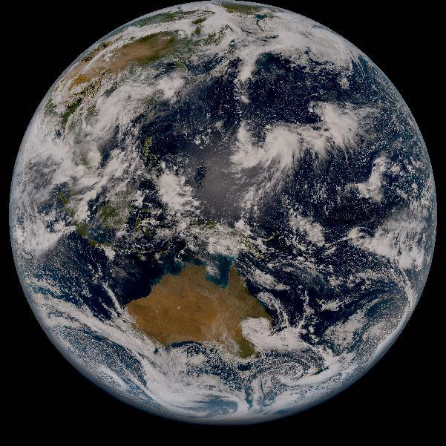
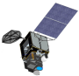
Himawari-8/AHI Lunar Calibration Updates
Masaya Takahashi and Arata Okuyama
Meteorological Satellite Center, Japan Meteorological Agency
2017 GRWG/GDWG Annual Meeting, 20-24 March 2017, Madison, USA
2014 HIMAWARI-8
1
2016 HIMAWARI-9

Slide 2
Contents
Himawari-8/AHI Lunar Observation
Lunar Calibration Results using GIRO
  Phase Angle Dependence on Lunar Irradiance Ratio between AHI and GIRO
  Correction of AHI Radiance and its Impacts on Lunar Irradiance Ratio
  Lunar Inter-calibration w.r.t. Aqua/MODIS
  Summary and Future Plans
Acknowledgement:
AHI lunar calibration has been done in collaboration with EUMETSAT (Sebastien Wagner), USGS (Tom Stone) and NOAA (ABI calibration team)

Slide 3
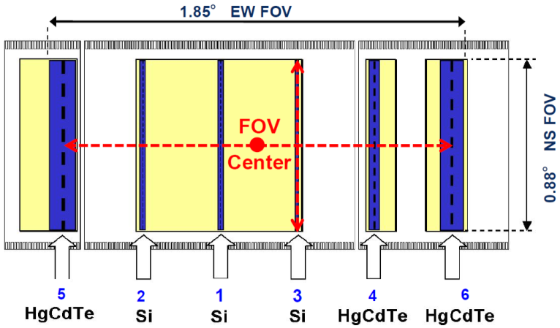
Advanced Himawari Imager (AHI) on Himawari-8
Band | Central Wavelength [μm] | Spatial Resolution [km] | # of detectors (*) | Levels of digital count [bit]
1 | 0.47 | 1 | 676 (3) | 11
2 | 0.51 | 1 | 676 (3) | 11
3 | 0.64 | 0.5 | 1460 (3) | 11
4 | 0.86 | 1 | 676 (6) | 11
5 | 1.6 | 2 | 372 (6) | 11
6 | 2.3 | 2 | 372 (6) | 11
7 | 3.9 | 2 | 332 (6) | 14
8 | 6.2 | 2 | 332 (6) | 11
9 | 6.9 | 2 | 332 (6) | 11
10 | 7.3 | 2 | 332 (6) | 12
11 | 8.6 | 2 | 332 (6) | 12
12 | 9.6 | 2 | 332 (6) | 12
13 | 10.4 | 2 | 408 (6) | 12
14 | 11.2 | 2 | 408 (6) | 12
15 | 12.4 | 2 | 408 (6) | 12
16 | 13.3 | 2 | 408 (6) | 11
AHI Field of View Center (VNIR)
ITT EXELIS(2013): AHI-8 EQUIPMENT MANUAL 2
CALIBRATION AND ALIGNMENT HANDBOOK Rev. J
*Number of redundant detector columns per side

Slide 4
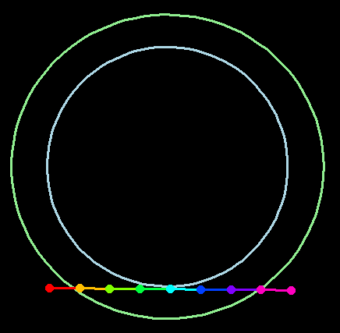
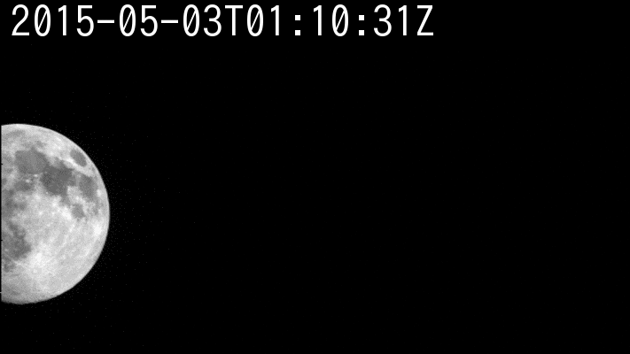
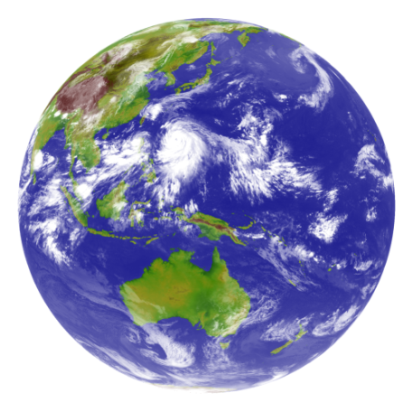






Full Disk / Regional Observation in 10 minutes Repeat Cycle
AHI FoR
Region 4, 5: mainly used for landmark observation, but region 5 is also used for lunar observation
Earth edge
Lunar observations
Band5 (1.6μm)
Pre-defined area
Flexible observation area
Full Disk Observation
every 10 min. (23 swaths)
Region 1
2000 x 1000km
(NE Japan)
Every 2.5 min.
Region 2
2000 x 1000km
(SW Japan)
Every 2.5 min.
Region 3
1000 x 1000 km
(Target Area)
Every 2.5 min.
Region 4
1000 x 500 km
(Landmark Area)
Every 30 sec.
Region 5
1000 x 500 km
(Landmark Area)
Every 30 sec.

Slide 5
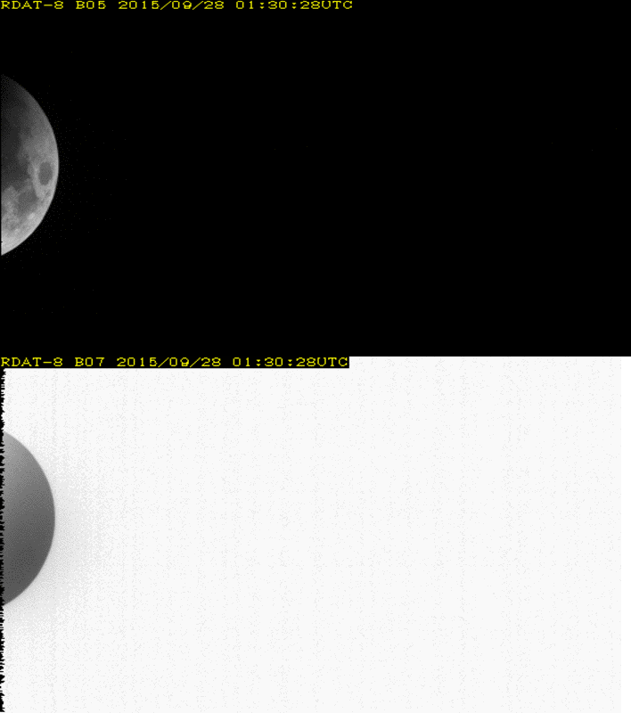
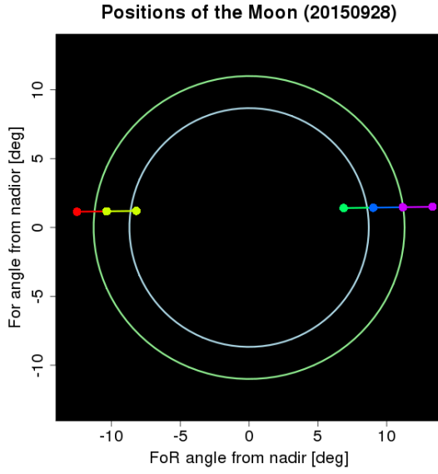
2015-09-28
Band05 (1.6 μm)
A day of total lunar eclipse
and super moon
Band07 (3.9 μm)

Slide 6
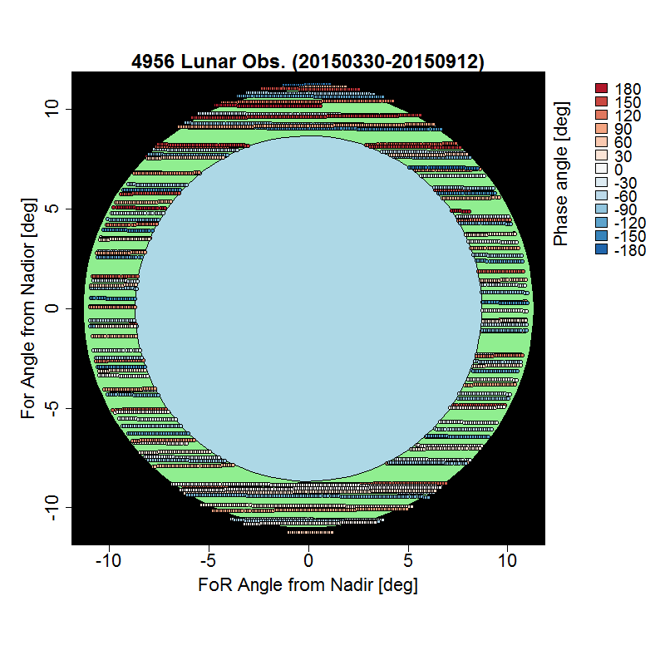
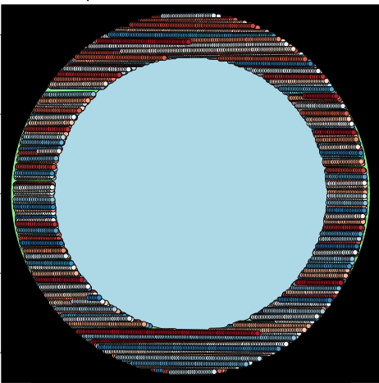
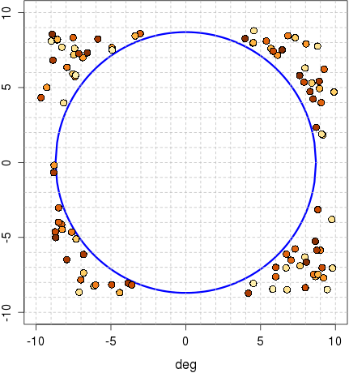
AHI Lunar Observation
Lunar phase angle [deg]
-180 -120 -60 0 60 120 180
Performed using Region 5 (1000x500km for the earth scene) flexible observation
Just one scan to observe the Moon
1 observation / 30 seconds
-> huge number of observations
Full moon
Himawari-8/AHI
(4 Mar. 2015 – 30 Oct. 2016)
26167 Obs. / 20 months
Earth disk
MTSAT-2/Imager
(Jul.2010 – Dec.2013)
98 Obs. / 3.5 years
Earth disk
AHI FoR

Slide 7
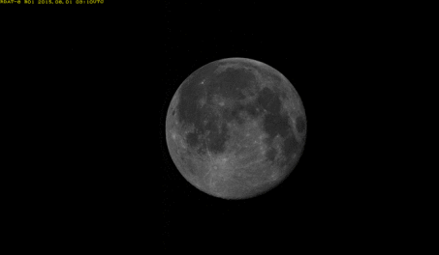
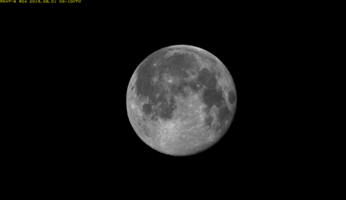
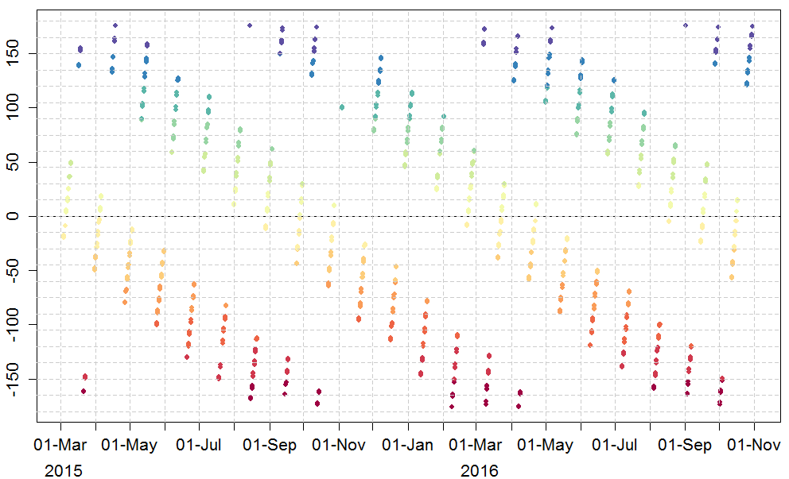
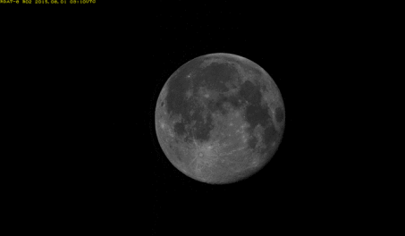
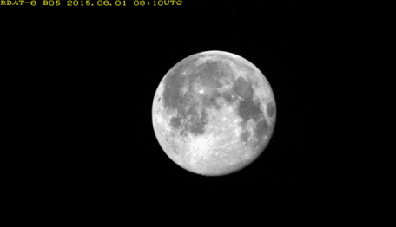
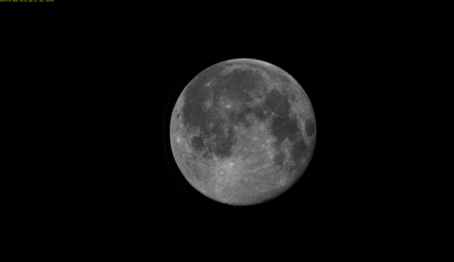
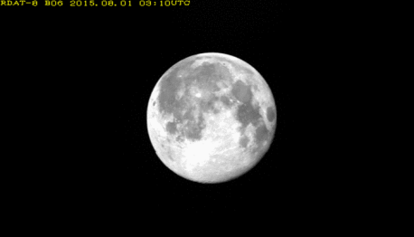
AHI Lunar Observation for GIRO
More than 7000 (150 days) useful lunar obs. for GIRO within the applicable phase angle:
2 deg <= |phase angle| <= 92 deg
2015-08-01T03:03:26Z (phase angle: 10.5deg)
B01 (0.47μm)
B04 (0.86μm)
[deg]
Time series of AHI lunar phase angle [deg]
B02 (0.51μm)
B05 (1.6μm)
B03 (0.64μm)
B06 (2.3μm)

Slide 8

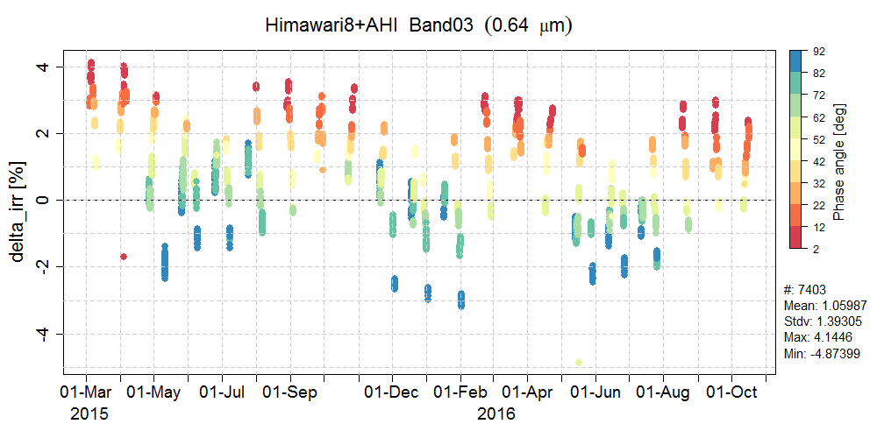
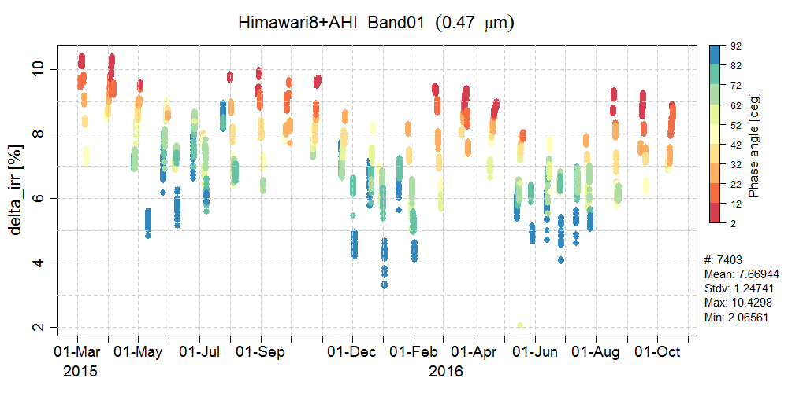
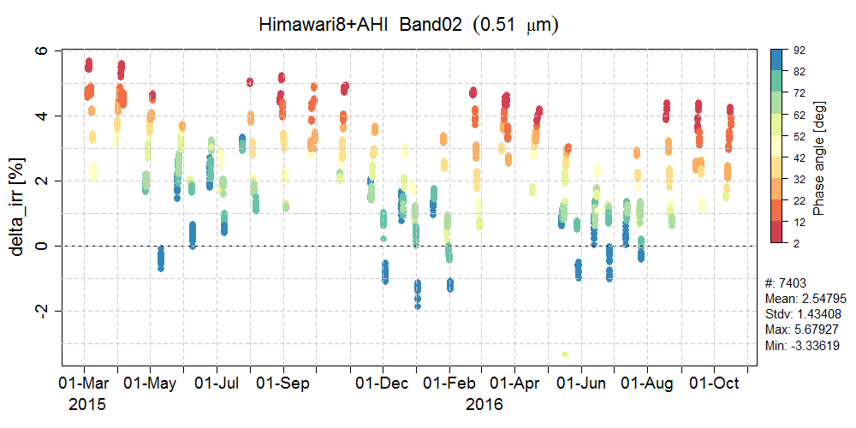
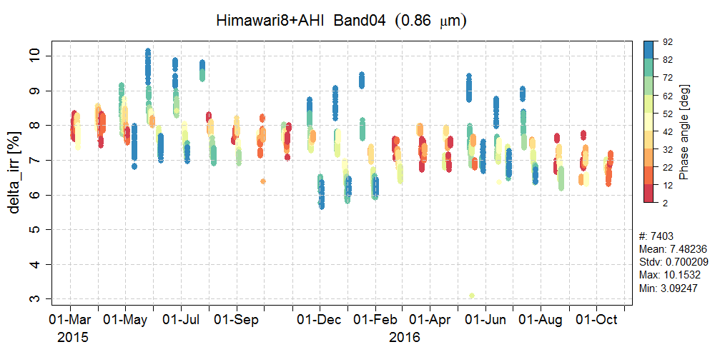
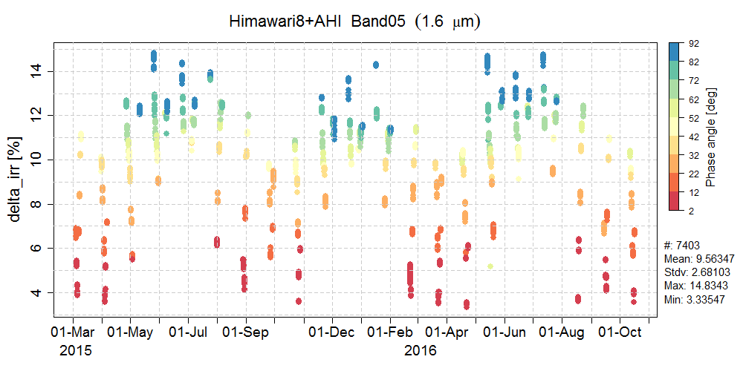
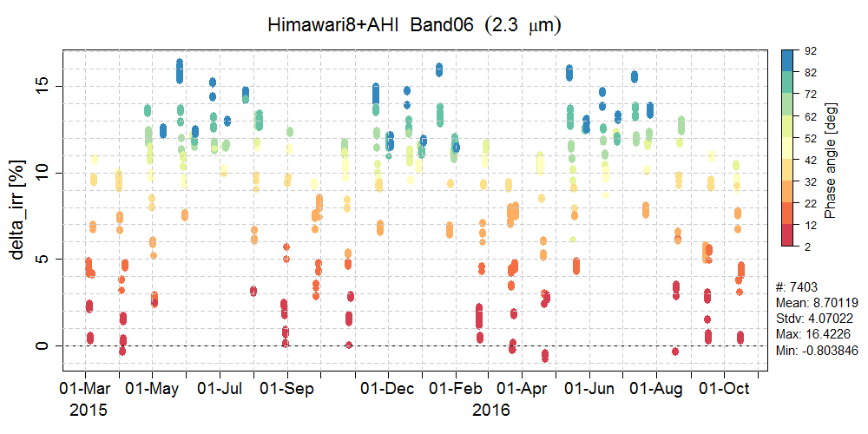
Time Series of ΔIrr in AHI VNIR Bands
Pre-launch determined Cal. Coeffs. are used for whole period of time
Difference of lunar irradiance between the observation and GIRO [%]
Phase angle dependence in Band1-3
Suggests possible issues in AHI VNIR calibration, but
Trends are good agreements with other Cal/Val methods (next slide) when specific phase angle is focused
Phase angle dependence in Band4-6
Seems to be reasonable because similar results are derived in SEVIRI (shown later)
2 12 22 32 42 52 62 72 82 92
Phase angle [deg]
Band1 (0.47μm) Band2 (0.51μm) Band3 (0.64μm)
Band4 (0.86μm) Band5 (1.6μm) Band6 (2.3μm)

Slide 9
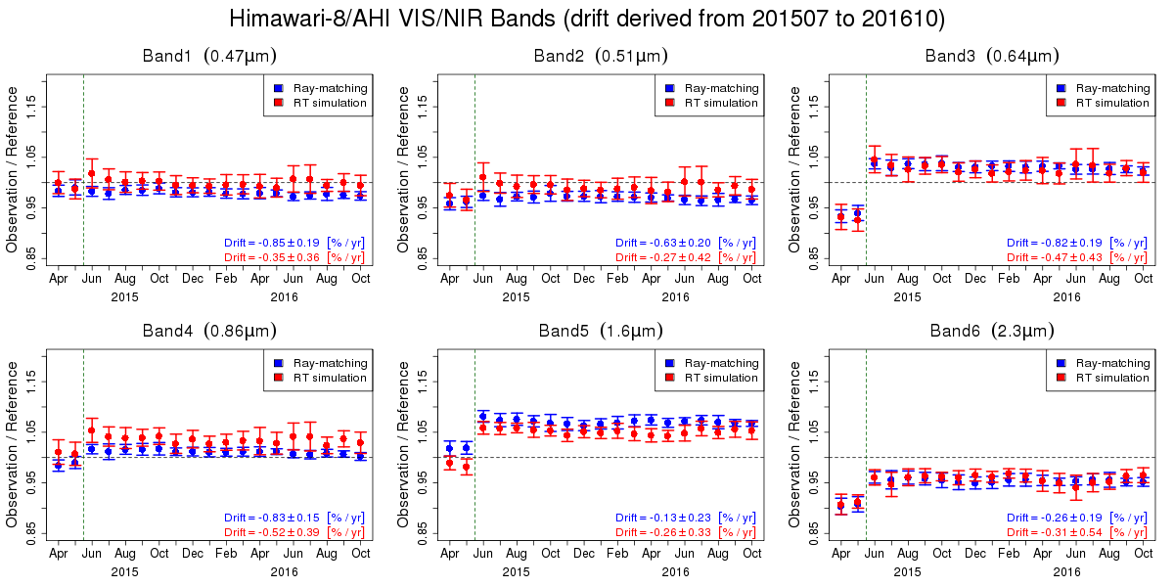
Validation of On-board Calibration Slope
Improvement of accuracy after updating calibration slopes based on SD observation
~0.5%/year of degradation trend in band 1-4
+6.1% bias for band 5, -4.3 % bias for band 6 based on ray-matching validation
Time series of ratios between AHI observations and reference values
Band1 (0.47μm) Band2 (0.51μm) Band3 (0.64μm)
Updates of Cal. slope
Band4 (0.86μm) Band5 (1.6μm) Band6 (2.3μm)
Error bar: stdv. of slopes

Slide 10
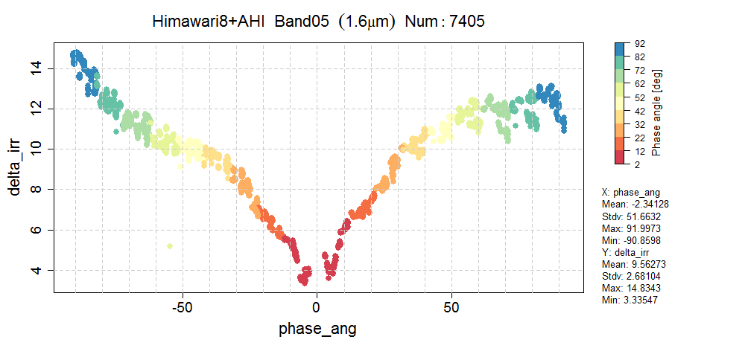
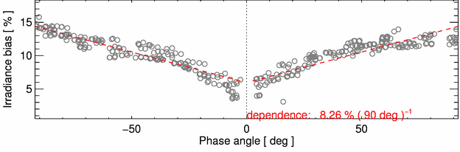
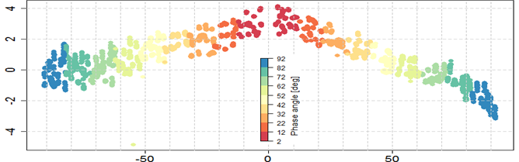
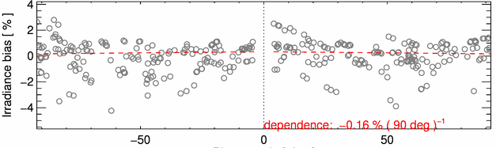
AHI Lunar Calibration
– Lunar Phase Angle Dependence
Difference of lunar irradiance between the observation and GIRO [%]
10
Good agreement with SEVIRI NIR1.6, but not with SEVIRI VIS 0.6
Possible issues in AHI calibration
Himawari-8/AHI Band5 (1.6 μm)
2015-03-04 to 2016-10-17 (7405 Obs. )
MSG1/SEVIRI NIR1.6
ΔIrr (%)
Phase angle (deg)
Himawari-8/AHI Band3 (0.64 μm)
MSG2/SEVIRI VIS 0.6
ΔIrr (%)
SEVIRI results from B. Viticchie at the Lunar Calibration Workshop in Dec. 2014

Slide 11
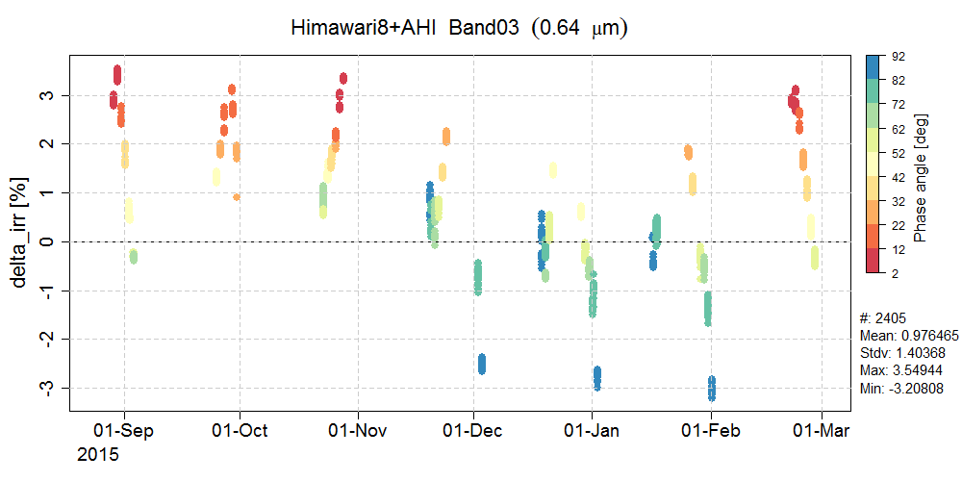
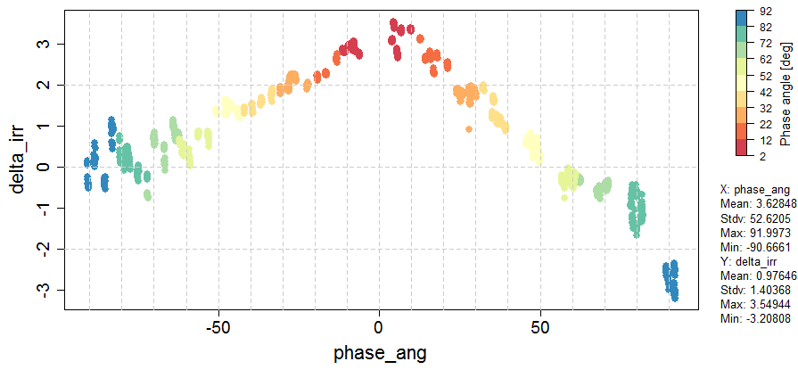
Impact study of correcting observed lunar irradiance using VIIRS ray-matching inter-cal approach
Motivation:
Phase angle dependence on ΔIrr in 0.47, 0.51 and 0.64 μm bands
might be caused by AHI calibration
nonlinearity which is seen in ray-matching VIIRS (next slide)?

Slide 12
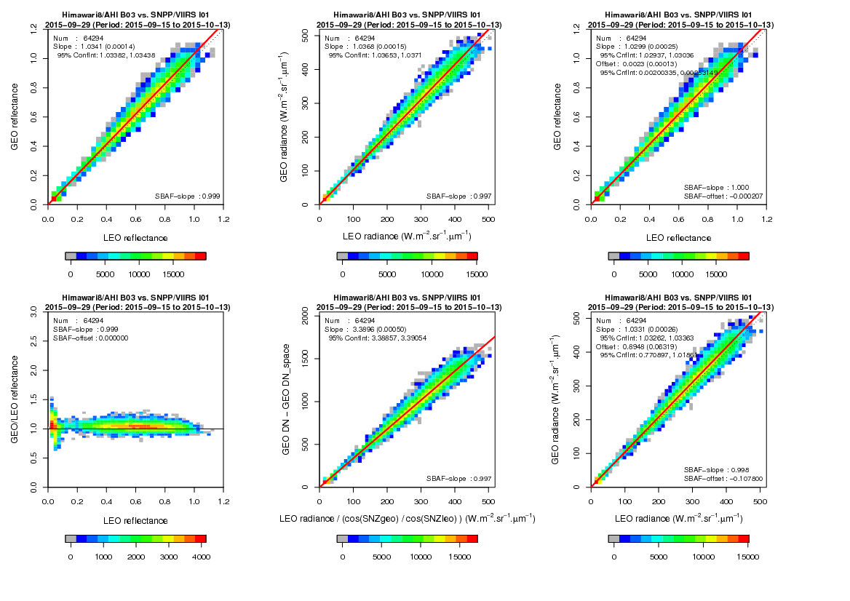
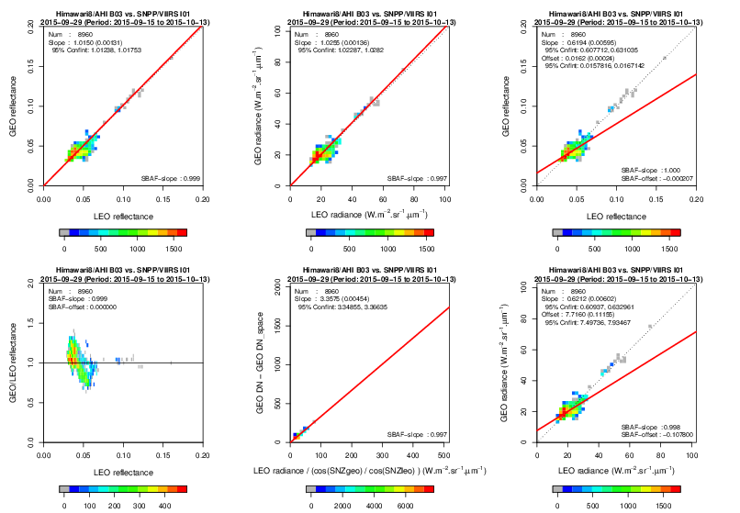

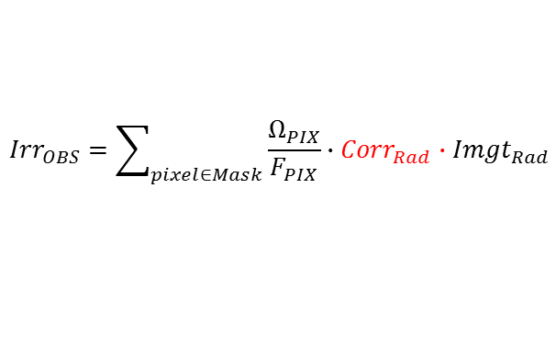
Correction of AHI radiance using VIIRS ray-matching results
AHI Band3 (0.64 μm) –VIIRS I01 (0.64 μm) ray-matching
1. Extract dark scene
(i.e. TB@10.4 μm > 295 K）
2. Derive radiance correction slope by linear regression (force fitting) of GEO/LEO radiances
3. Correct observed lunar irradiance and re-compute ΔIrr: (irrObs/irrRolo-1)*100
$${AHI}_{Rad}=slope∙{VIIRS}_{Rad(w/ SBAF correction)}$$
Nonlinearity in AHI calibration?
$${Irr}_{OBS}=\sum_{pixel∈Mask}{\frac{Ω_{PIX}}{F_{PIX}}}∙{{Corr}_{Rad}∙Imgt}_{Rad}$$
$${Corr}_{Rad}=\frac{1}{slope}$$

Slide 13
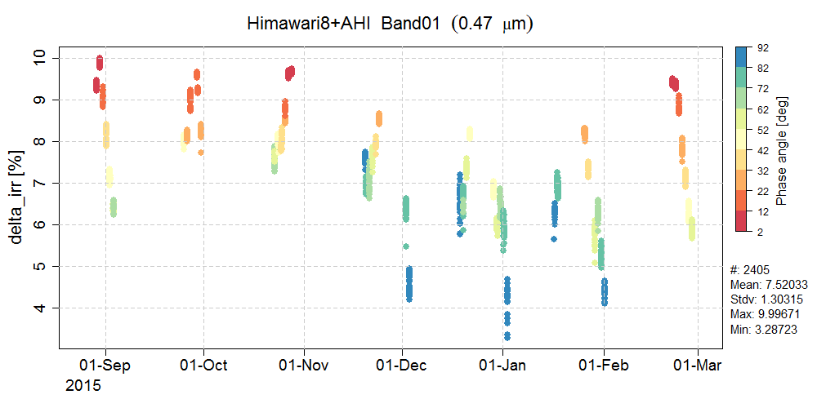
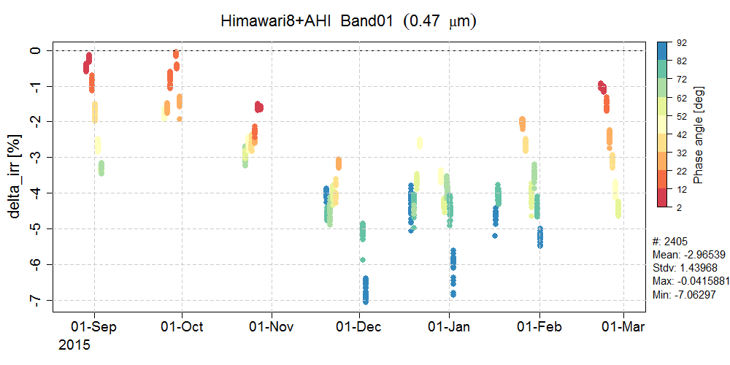
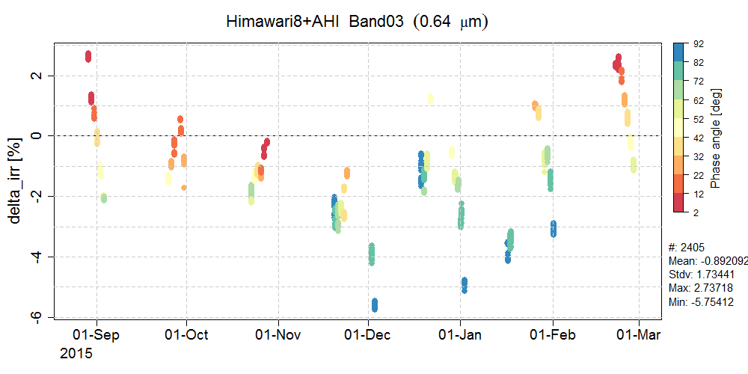
Impacts of observed lunar irradiance correction on ΔIrr
Main Impacts: ΔIrr shift to negative value
Reduction of ΔIrr variation: at some periods of time, but not enough
Nonlinearity may not be the root cause
Need for other investigations (e.g. stability of deep space counts)
w/o irradiance correction w/ irradiance correction
+10
0
+4
0.47 μm
-7
0.47 μm
+3
+2
-3
0.64 μm
-6
0.64 μm

Slide 14


Inter-calibration (proposed by S. Wagner in 2016)
Compute lunar irradiances using:
SRF of monitored instrument (i.e. AHI)
Observation time and satellite position of reference instrument (i.e. Aqua/MODIS)
and compare with observed lunar irradiance by MODIS (SBAF is also taken into account)
2. Take an average of the results of 1
Assumption : well calibrated (no degradation), no phase angle dependence
3. Take difference between monitored/reference instruments and derive inter-calibration result

Slide 15
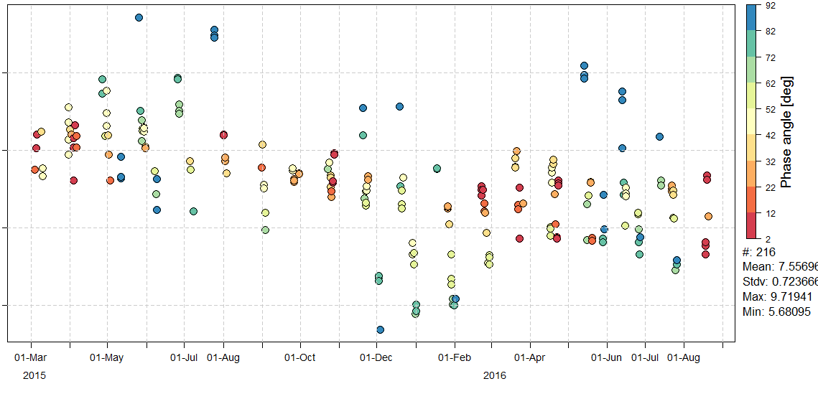
ΔIrr of Himawari-8/AHI Band4 (0.86 μm)
Relative difference of AHI lunar irradiance vs. GIRO: ~7.5% +/- ~2%
Pre-launch calibration coefficients are used
6 7 8 9 [%]

Slide 16
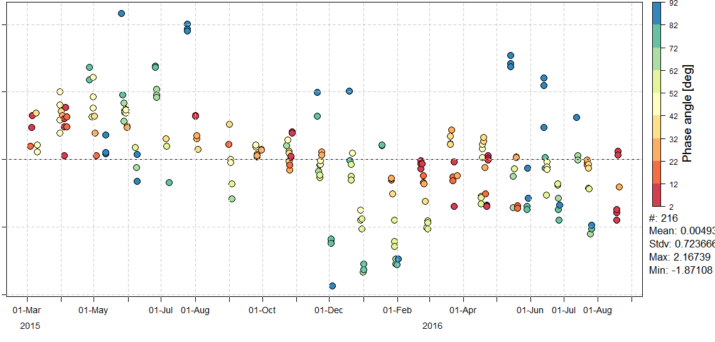
Inter-calibrated ΔIrr of Himawari-8/AHI Band4 (0.86 μm)
with reference to Aqua/MODIS Ch2 (0.858 μm)
ΔIrr: shifted from 7.5 (+/- 2) [%] to ~0 [%] (SBAF is currently not considered)
Inter-calibration w/ other instruments (e.g. SEVIRI) is underway in collaboration with S. Wagner
-2 -1 0 1 2 [%]

Slide 17
Summary and Future Plans
More than 7000 Himawari-8/AHI lunar observations from March 2015 to November 2016 were used
Lunar irradiance ratio between AHI and GIRO
  Phase angle dependence in Band 1, 2, 3 (0.47, 0.51, 0.64 μm)
  Possible issue in AHI calibration was found, but need further investigations to figure out the root cause
  Keep a collaboration with USGS
  Phase angle dependence in Band 4, 5, 6 (0.86, 1.6, 2.3 μm)
  Good agreements with SEVIRI lunar calibration results
  Lunar inter-calibration w.r.t. Aqua/MODIS
  Just started in collaboration with EUMETSAT
  Similar approach for S-NPP/VIIRS is also planned

Slide 18
Thanks for your attention

Slide 19
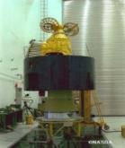
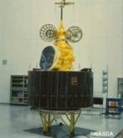
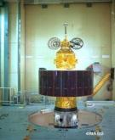
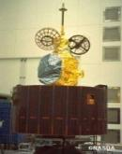
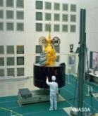
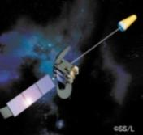
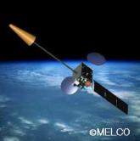
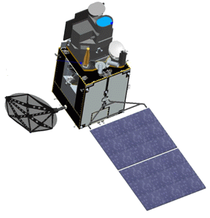
JMA geostationary satellites
GMS (Geostationary Meteorological Satellite)
GMS
GMS-2
GMS-3
GMS-4
GMS-5
(GOES-9)
Satellite | Operation period
GMS | 1978 – 1981
GMS-2 | 1981 – 1984
GMS-3 | 1984 – 1989
GMS-4 | 1989 – 1995
GMS-5 | 1995 – 2003
GOES-9 | 2003 – 2005
MTSAT-1R | 2005 – 2010
MTSAT-2 | 2010 – 2015
Himawari-8 | 2015 – 2022
Himawari-9 | 2022 – 2029
(Himawari)
(Himawari-2)
(Himawari-3)
(Himawari-4)
(Himawari-5)
Back-up operation of GMS-5 w/ GOES-9 by NOAA/NESDIS:
2003/05/22-2005/06/28
ⒸNASDA
ⒸNASDA
ⒸNASDA
ⒸNASDA
ⒸNASDA
Jul 1977
Aug 1981
Aug 1984
Sep 1989
Mar 1995
MTSAT (Multi-functional Transport SATellite )
MTSAT-1R
MTSAT-2
(Himawari-6)
(Himawari-7)
Himawari
Himawari-8
launched on 7 Oct. 2014
Operation started on 7 July 2015
Himawari-9
2014
2016
ⒸSS/L
ⒸMELCO
launched on 2 November 2016
Became back up of Himawari-8 on 10 March 2017
Feb 2005
Feb 2006

Slide 20

Typical Observation Schedule in 10 minutes Repeat Cycle
Full Disk | Region 1 (NE Japan)
BB Obs. | Region 2 (SW Japan)
Space Look | Region 3 (Target Area)
 | Region 4 (Landmark Area)
 | Region 5 (Landmark Area)
Blackbody Obs.
[sec]
[sec]

Slide 21
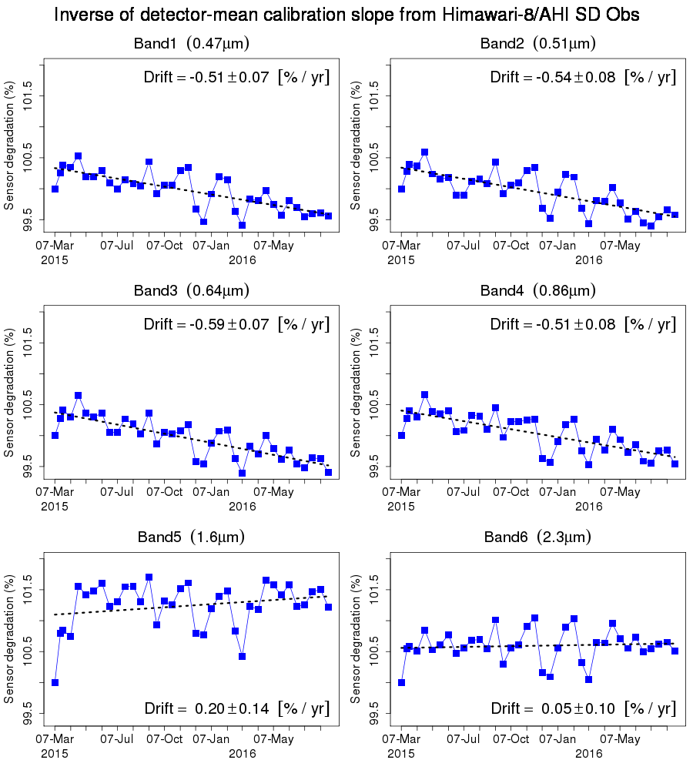
Calibration Slope from SD observation
8 June 2015: averaged calibration slope from 7 March to 22 May (7 obs.) was applied
Late February 2015: big change in L1 equiv. data processing
~0.5% degradation trend in band 1-4 (no degradation of SD is assumed)
Time series of detector-averaged inverse of calibration slope from SD observation
7 Mar
Band1 (0.47μm) Band2 (0.51μm) Band3 (0.64μm)
22 May
Inverse of calibration slope [W/m²/sr/μm/count]⁻¹
Band4 (0.86μm)) Band 5 (1.6μm) Band6 (2.3μm)
Band 4 (0.86μm) Band5 (1.6μm) Band 6 (2.3μm)

Slide 22
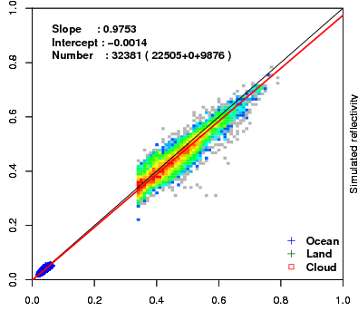
Validation of On-board Calibration
Method 1) Vicarious Calibration using RT Simulation
Method: Comparison of observed and simulated radiance for multiple targets (collaboration research with the University of Tokyo and JAXA/EORC [Prof. Nakajima])
Targets:
Cloud-free ocean (rayleigh scattering) , liquid water cloud, *cloud-free land and *deep convective cloud
Radiative transfer calculation:
RSTAR (Nakajima and Tanaka [1986,1988])
Input data: Independent from GEO data
JMA Re-Analysis atmos. profiles (JRA-55/JCDAS)
Aerosol/Cloud optical thickness retrieved from MODIS L1B (M[O,Y]D02SSH)
MODIS BRDF (MCD43C2) for land target
Aura/OMI total column ozone, …
August 2015
Simulated reflectivity
Observed reflectivity
*Under investigation for Himawari-8/AHI as of Oct. 2016

Slide 23
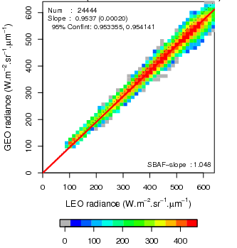


Validation of On-board Calibration
Method 2) Ray-matching with S-NPP/VIIRS
Inter-calibration based on AHI-VIIRS collocation
Calibration target: cloud pixels
Introduction of dark target (e.g. cloud-free ocean) : under investigation
Spectral Band Adjustment Factor (SBAF) accounting for the spectral mismatch
Band1-5: from NASA Langley SBAF based on SCHIAMACHY (http://cloudsgate2.larc.nasa.gov/SBAF)
Band6: computed using RSTAR simulation
Band1 Band3 Band5
(0.47 μm) (0.64 μm) (1.6μm)
Stats from 17 to 31 Oct. 2016

Slide 24
Lunar Calibration using GIRO
Comparison of observed/predicted disk-integrated lunar irradiance
Robotic Lunar Observatory (ROLO) model: calibration reference developed by USGS
  Empirical model to derive disk-integrated lunar irradiance (Kieffer & Stone 2005, AJ, 129, 2887)
  Based on more than 8 years of lunar observations at Flagstaff, AZ
  Applicable spectral range: 0.35-2.5 µm
  Has been used for many satellite instruments: SeaWiFS, MODIS, MSG/SEVIRI, GOES/Imager, ...
  Accuracy of the reference irradiance
  5 – 10 % uncertainty in absolute irradiance scale
  ∼ 1 % relative accuracy
GSICS Implementation of the ROLO model (GIRO)
Implemented in 2014, lead by core agencies (USGS, EUMETSAT, NASA, CNES)
Standard reference model for the lunar calibration community

Slide 25





Web monitoring system of AHI lunar observations (JMA intranet page)
Lunar images of VIS/NIR + SWIR (3.9 μm) bands
Observation time, relative lunar positions and lunar phase angle

Slide 26



AHI Lunar Calibration - Case Study
Difference of lunar irradiance between the observation and GIRO [%]
26
ΔIrr (%)
29 August 2015
Phase angle: from -11.5 to -9.0 [deg]
100 observation / ~90 minutes
AHI FoR
Band2 (0.51μm)
Earth edge
Does the trend related with deep space counts?
Lunar observations
~0.4% variation
Lunar Phase Angle [deg]
Averaged deep space counts
Band2 (0.51μm)
~2% increase
~0.3 count variation
Digital counts: after detector equalization (e.g. equivalent to counts in L1B)

Slide 27

Deep Space Counts (C_{sp}) for Calibration Equation
Full Disk | Region 1 (NE Japan)
BB Obs. | Region 2 (SW Japan)
Space Look | Region 3 (Target Area)
 | Region 4 (Landmark Area)
 | Region 5 (Landmark Area)
[sec]
Moon
Moon
Moon
Moon
Moon
Moon
Moon
Same (constant) values observed at the East (or West) of each Full-disk swath are applied to regional observations including lunar obs.
$$R_{{obs}_{n}}=\frac{q_{n}{(C_{A_{n}}−C_{{sp}_{n}})}^{2}+m_{n}(C_{A_{n}}−C_{{sp}_{n}})}{ρ_{ns}{\left(θ\right)ρ}_{ew}(φ)}$$
R_{obs}: Observed radiance
C_{A}: Raw digital count
C_{sp}: Deep space raw digital count
q_{n}, m_{n}: Coefficients
n: Detector ID
ρ : Scan mirror reflection coef.
θ, φ : Incidence angle to SM
[sec]

Slide 28


Use of Deep Space Counts at each Lunar Observation in the Calibration Process
Compute C_{sp_moon} for each lunar observation and each detector
Replace nominal C_{sp} with the C_{sp_moon} and re-compute radiance
Convert re-computed radiance to digital counts (equivalent to L1B)
Take average of deep space counts
$$R_{{obs}_{n}}=\frac{q_{n}{(C_{An}−C_{spn})}^{2}+m_{n}(C_{An}−C_{spn})}{ρ_{ns}{\left(θ\right)ρ}_{ew}(φ)}$$
Calibration process in which C_{sp} is used
Calibration process in which C_{sp_moon} is used
Mean deep space counts
~0.3 count variation
~0.15 count variation

Slide 29

Reduction of ΔIrr trend
Calibration equation w/ C_{sp_moon} reduces the up/down trend in ΔIrr
Need for further investigation of remaining ΔIrr trend depending on lunar phase angle
Calibration process in which C_{sp} is used
Calibration process in which C_{sp_moon} is used
ΔIrr (%)
~0.4% variation
~0.3% variation

Slide 30




Phase Angle Dependence Correction of Lunar Irradiance
Himawari-8/AHI Band5 (1.6 μm)
w/o phase angle correction w/ phase angle correction

Slide 31


A possible scheme for inter-calibration
Reference instrument = Aqua MODIS
Phase angle range = [-56,54]
λ, ϕ = Reference wavelength, Phase
ϕ = “50” = MODIS range
λ’, ϕ’ = Monitored wavelength, Phase
By definition:
MODIS is the truth ➔ we re-projected in the irradiance space of the monitored instrument:
From GLOD/NASA data, we derive the mean
If MODIS is perfectly calibrated and there is no phase dependence:
Consequently:
Wagner (2016)

