Slide 1
GSICS Quarterly www.star.nesdis.noaa.gov/smcd/GCC/newsletters.php
Manik Bali and Larry Flynn
GSICS Coordination Center, NOAA
GSICS Annual Meeting 2017, CIMSS UW-Madison

Slide 2
Outline
Introduction
GSICS Newsletter-Past year
Newsletter Readers across the world
Article Review Process
Types of articles accepted
GSICS Newsletter at center of Inter-cal journals
Editorial Board
Conclusion

Slide 3
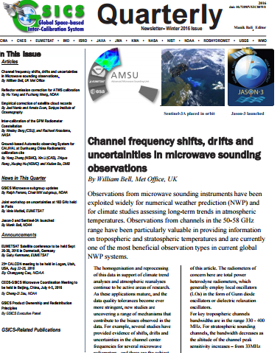
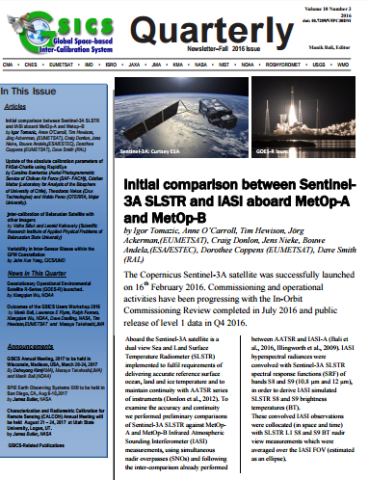
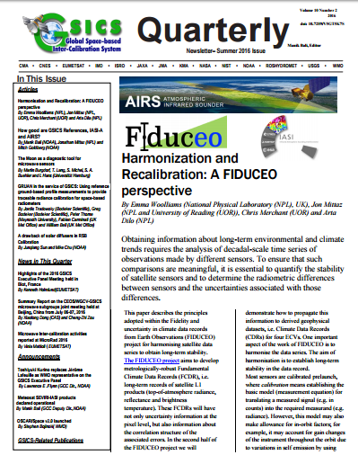
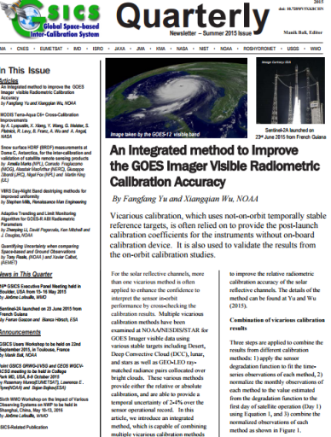
GSICS Newsletter-Past Year
Last four quarters we published four new Issues of GSICS Newsletter
Over 22 Research Articles, 15 Topics of News to which
Over 70 Scientists contributed as Authors & Co-Authors.
Reviewed contemporary journal policy on content sharing.
Contributions from non-GSICS members has increased.
Replaced MailChimp with NOAA-Email for distribution.
Since Fall 2013, brand new format .
A robust review process.
Since Winter Issue for 2014, the Newsletter has a doi.
Accepts articles on topics related to calibration (Pre- and Post-launch).
New Landing page on the GCC website.
Rate and Comment section: readers and authors can interact.
Articles are reviewed by subject experts.
Help available to non-native English speaking contributors.
Since Fall 2014, new navigation features added to the Cover Letter.
Released directly via NOAA Email.
The Newsletter is included in SCOPUS and extensively cited by agencies and friends of GSICS (on google scholar, twitter, facebook).

Slide 4
Newsletter Readers across the world
WMO
Subscribed to by over 320 members across the world

Slide 5
Newsletter Article Review process
Author
Reviewer
Editor
Editor has a preliminary look at the article and checks.
If the article falls within the scope of GSICS/WMO/CGMS /GPM-X or scope of its partners including the 3G
Article falls within the 700-800 word limit with 2 Figures and 1 table.
If the article is a lead article it fulfils lead article criterion
Articles are solicited round the year however call is sent out every quarter via the GSICS Dev.
Articles are sent to the Newsletter Editor directly or via GSICS Correspondents or Chairs of GSICS Groups/Subgroups.
Newsletter review
Guiding Principal
If the editor decides to publish the article, the article is sent to a proof reader or/and a subject expert reviewer.
Editor may decide to send the article directly to a reviewer or via a proof reader.
Editor procures doi number from NOAA library and pastes it into the Newsletter and gives the final copy of the newsletter to the technical expert for release via mailcimp. The technical expert releases I and also makes a web version of the lead article.
Editor forwards the Comments from the reviewer to the author who makes changes and re-submits the article to the editor who forwards them back to the reviewer for his final go ahead.
Editor facilities communication between Author and Reviewer to get GSICS/peer reviewed article.

Slide 6
Type of articles accepted.
Experimented with several types of articles.
Articles on brand new work, not peer reviewed earlier (GCC does not have the resources to review such work adequately)
Articles based on already published work (replication of text and key result figures need to be avoided)
Mainly review articles accepted. Articles should be 800-1000 words long with at most two figures and one table

Slide 7
GSIC S Newsletter at Center of Inter-Calibration journals
Atmospheric Measurement Techniques (AMT)
Transactions On Geosciences And Remote Sensing (TGRS)
Journal of Geophysical Research (JGR).
GSICS
Newsletter
Journal of Remote Sensing (JRS)
As a result of decision to publish review article
Newsletter sits at the center of Inter-calibration research.
Journals considering advising authors to write review articles for GSICS Newsletter
Mainstream journals provided copyrights for figures and text

Slide 8
Newsletter-Editorial Board
Editorial Board
Manik Bali, Editor
Lawrence E. Flynn, Reviewer
Lori K. Brown, Tech Support
FangFang Yu, Americas Correspondent.
Tim Hewison, European Correspondent
Yuan Li, Asian Correspondent
Wish to thank, Authors, Reviewers, Members of the Editorial Board and Tech Support for their immense contributions to the GSICS Newsletter.
Nominations accepted for the Editorial Board.

Slide 9
Conclusions
The GSICS Newsletter has evolved into an effective tool for sharing GSICS research with the global scientific community.
The Newsletter has been recognized as one of the main platforms for exchanging satellite inter-calibration ideas.
An editorial board has been formed – accepting recommendations for new members.
Using a NOAA Email ID (Lori K. Brown) to avoid spam classification and rejection.
Newsletter included in SCOPUS and newsletter articles cited in various journals, reports and social media (Twitter, Facebook).
Four quarterly issues of the Newsletter were produced during the last year as planned.

Slide 11
ACTION
GSICS Quarterly Special Issues/Editors
People are concerned about the formalism currently adopted by the newsletter, where it could prevent researchers to publish their work. It prevents possible contributors to send papers.
Action: GCC takes this feedback on-board and will propose an approach more like conference proceedings
GCC: GCC took the following steps
Looked at Copyright clauses of major journal publication.
Took views from NOAA library.
Neal Kaske - NOAA Federal <neal.kaske@noaa.gov>
Apr 20 (1 day ago)
to me, Stanley, Anna
Manik, Yes, this can be seen as infringing on the journal's copyright. Most journals will permit you to use a figure - all you need to do is ask the publisher for permission. As for text from an article - as always use quotation marks and provide a full reference to the source.
Neal

Slide 12
ACTION
Articles written by NOAA Federal Employees are exempt from Copyright restrictions. Their research is public.
Journals that are Open Access : Allow publication provided credit is given ( Sensor, EGU-Atmos-Chem-Phys, AMS -JTECH).
Articles published by the EGU come under Creative Commons Attribution 3.0 ( for example www.atmos-chem-phys.net )
Mausam, IMD Journal gave permission to copy content if credit is given.
GCC would advice authors to give due credit to journals and if required seek permission from journals wherever necessary, while submitting articles for the GSICS Newsletter.
Do we need a Copyright verse for the Newsletter ?

Slide 13
THANK YOU

