Slide 1
Lunar Calibration Workshop Date and Preparation Timeline
X. Hu (CMA), T. Stone (USGS),
X. Wu (NOAA), S. Wagner (EUMETSAT)
With the support of B. Fougnie (CNES)
T. Hewison (EUMETSAT)

Slide 2
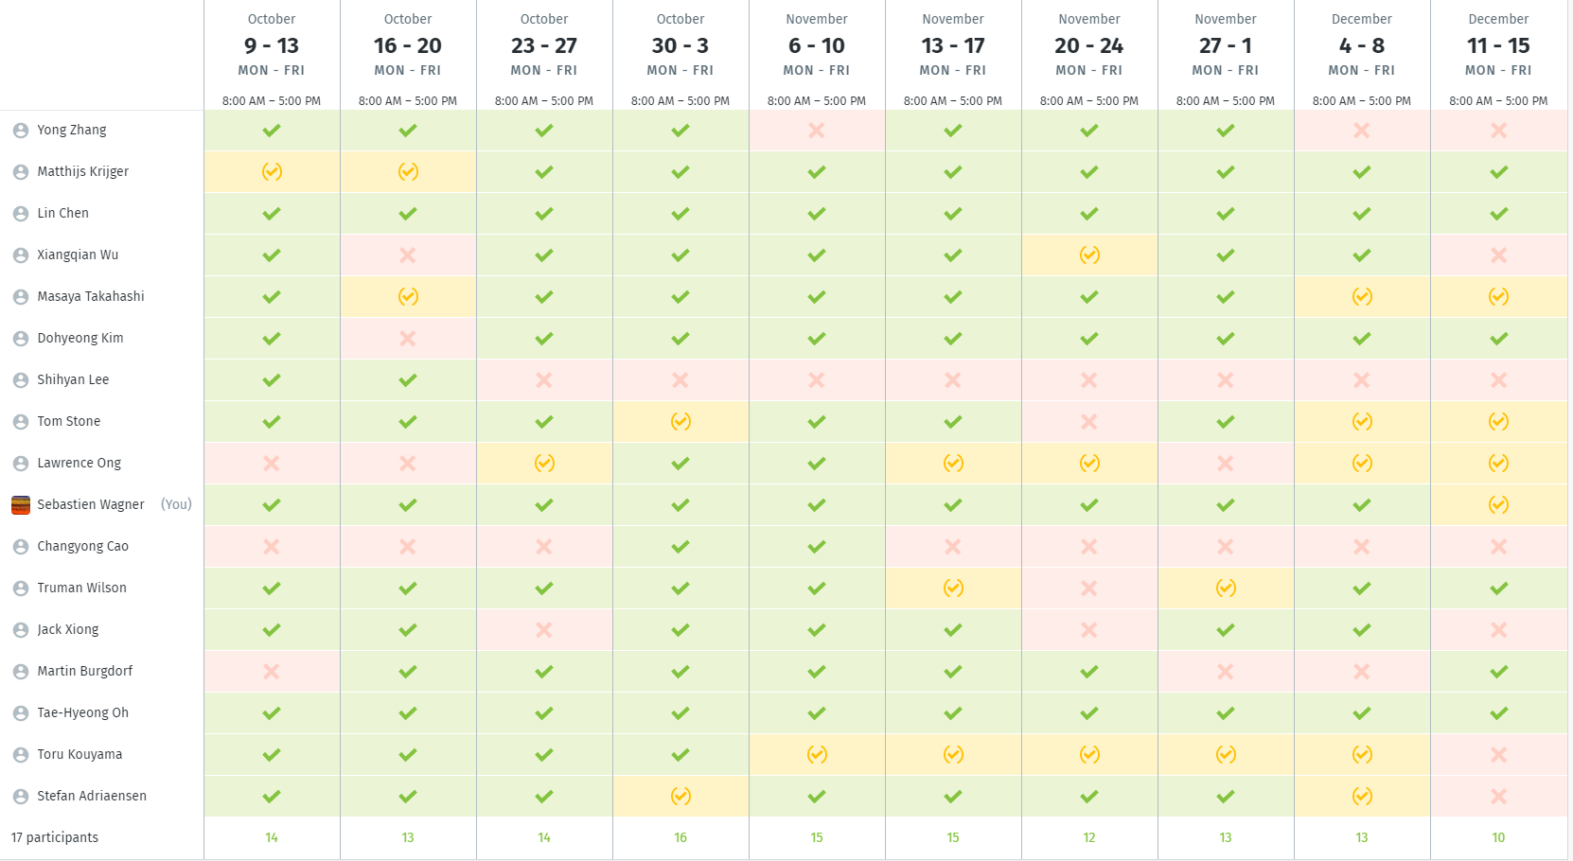
Date

Slide 3
Basic roll out…
Result of the Doodle ➔ LCWS last week of October / first two weeks of November
Till then:
Survey to know where participants want/can contribute
At least 2 web meetings (dates TBC)
Templates for presentations ➔ end of May
Homework…

