Slide 1

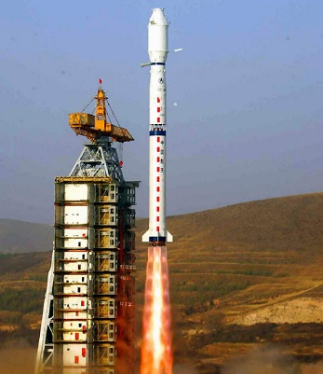
Lunar Observation with
an FTIR Imaging Spectrometer:
Recent Progress and Beyond
Geng Zhang
Key Laboratory of Spectral Imaging Technology CAS
Xi’an Institute of Optics and Precision Mechanics of CAS

Slide 2
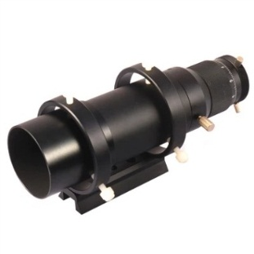
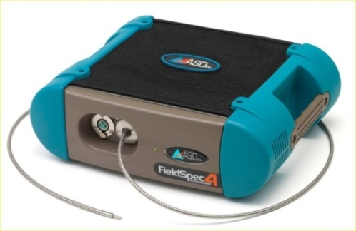
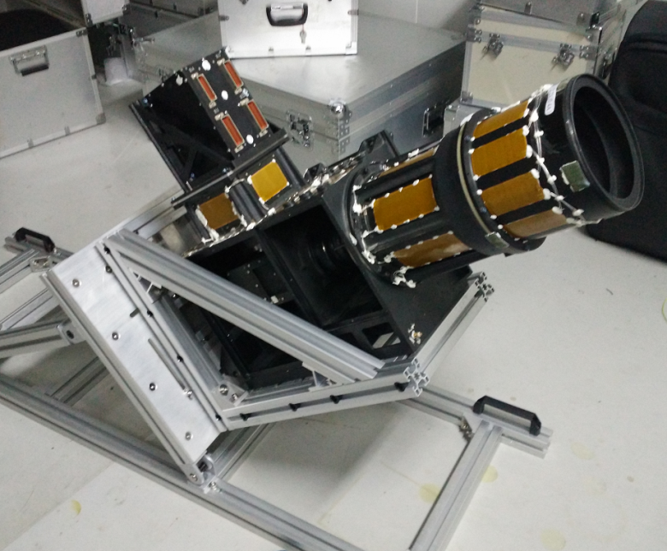
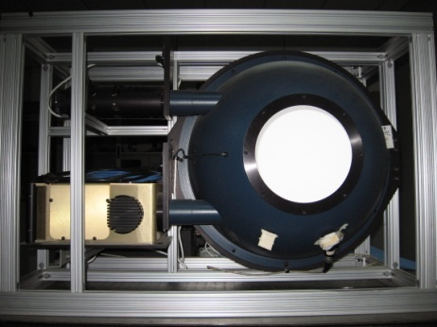
Equipment Introduction
Main Equipment
Guiding Telescope
ASD Spectral Radiometer
SWIR Interference Spectral Imager
(Modified From an Existing Prototype)
Integrating Sphere

Slide 3
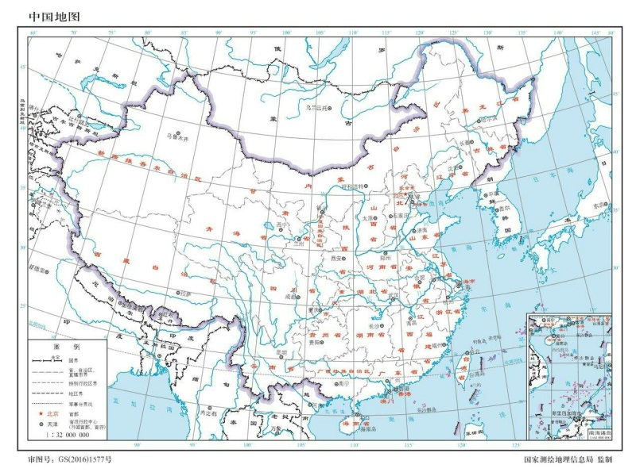
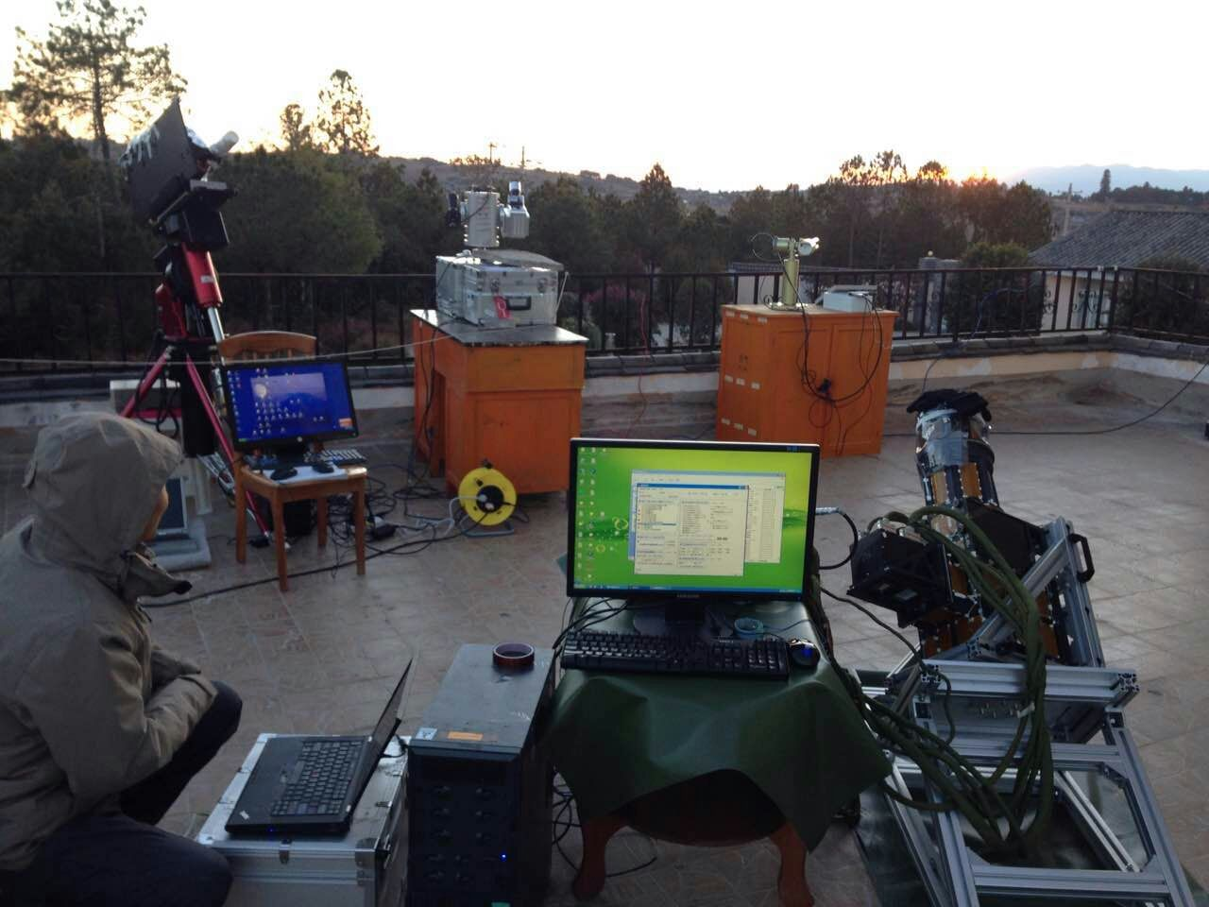
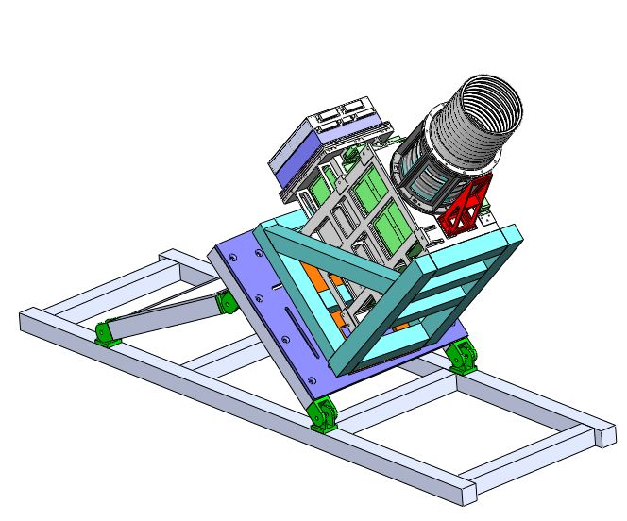
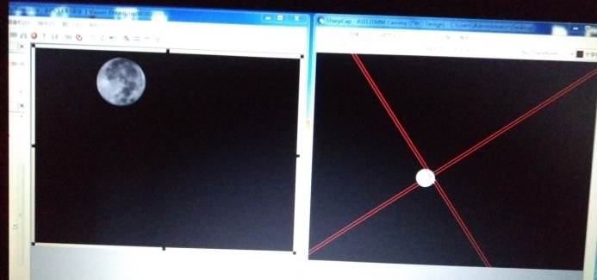
Equipment Introduction
Lijiang,
Yunnan Province

Slide 4
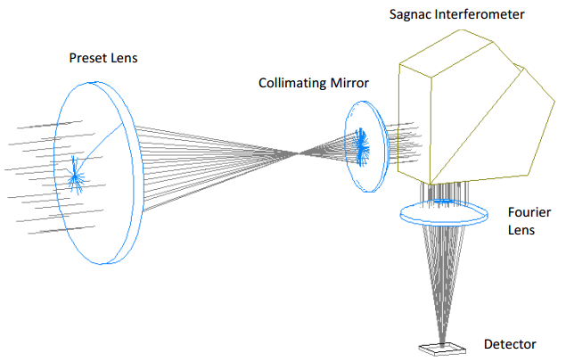
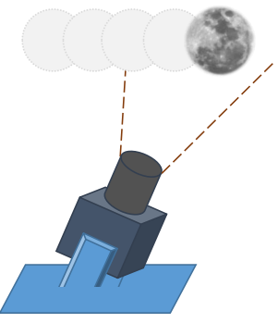
Equipment Introduction
FTIR Imaging Spectrometer
Parameters
Spectral Range：900nm~2500nm
Bands：60
FOV：1.2°x 0.61°
Detector：500(spatial) x 256(spectral)
Focal Length：720mm
Dark Current：0.9DN
SNR：≥1000（50x DTDI）

Slide 5
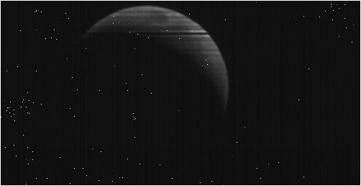
Data Achieved
14th Jan 2016（2016-01-14-19-59-19）

Slide 6
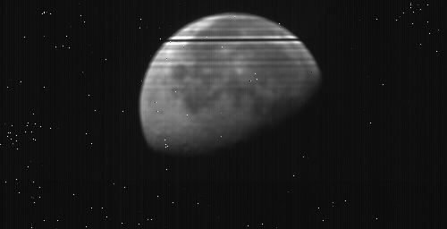
Data Achieved
30th Jan 2016（2016-01-30-06-30-02）

Slide 7
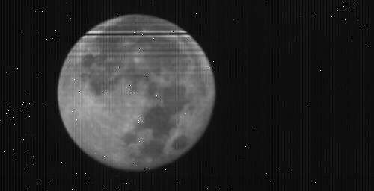
Data Achieved
24th Feb 2016（2016-02-24-00-02-42）

Slide 8
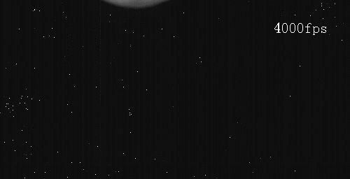
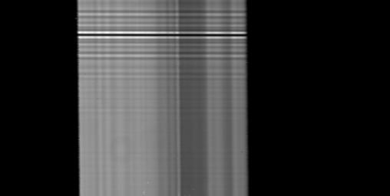
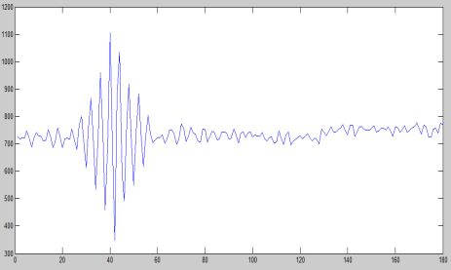
Data Achieved
Each line corresponds to an fixed OPD
Original Fames
Target Points: 1,2,3,4,5……
Scanning Direction
5
4
3
2
3
3
Interferogram
4
3
2
1
4
4
Frame
Interferogram
Consists of lines from 256 original frames

Slide 9
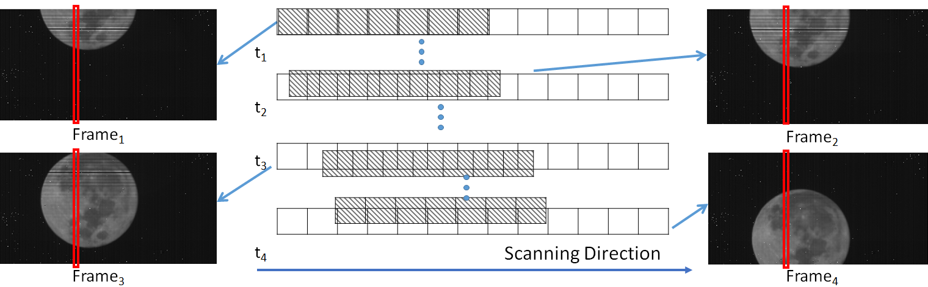
Problems and Solutions
Problems
Moon’s orbiting speed Desired observation speed
Moon’s orbiting direction Interference direction
Image “shaking” caused by atmosphere turbulence
Bad pixels
Correct the moon’s image to the desired position
Moon’s Image
Sensor

Slide 10
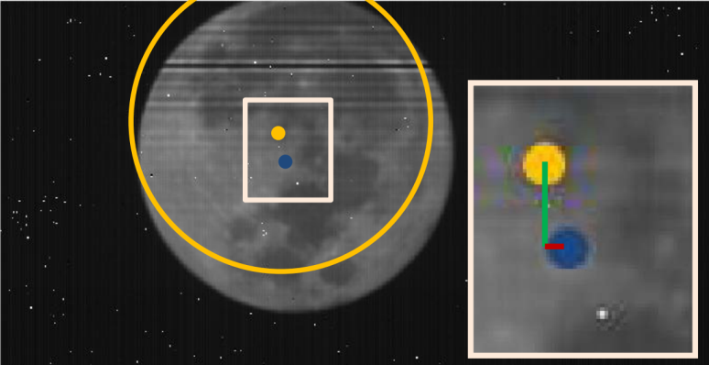
Problems and Solutions
Solutions
Matching current frame to the reference frame to estimation the horizontal and vertical translations w.r.t. desired position.
Most of the image is black
Moon is low textured
Traditional patch based image registration does not work!
Alg.1 Use moon boundary to match the frames to the reference one.
Alg.2 Estimate center positions full moon.
Background is black,
Textures are weak,
Boundary is reliable!
Displacement to the desired position

Slide 11
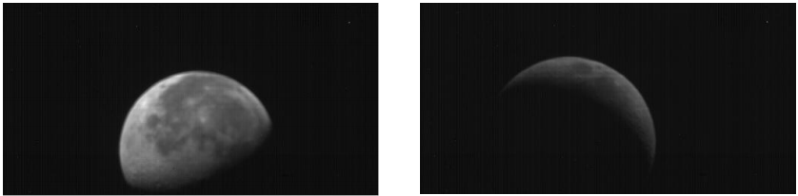
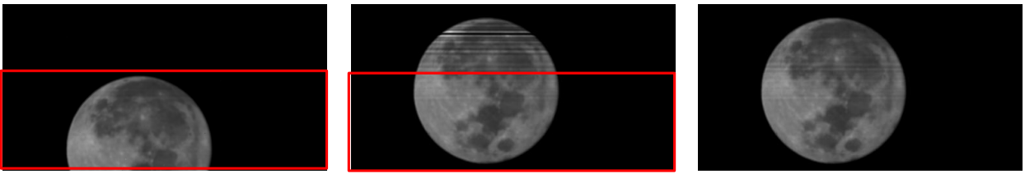
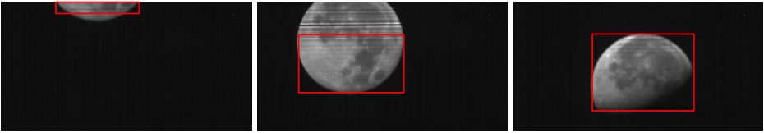
Translation Estimation
Boundary Matching
Generate fringe-free reference frame
Non-full Moon
(Near) Full Moon
Automatically choose the clean part (lines of high OPD) to match

Slide 12

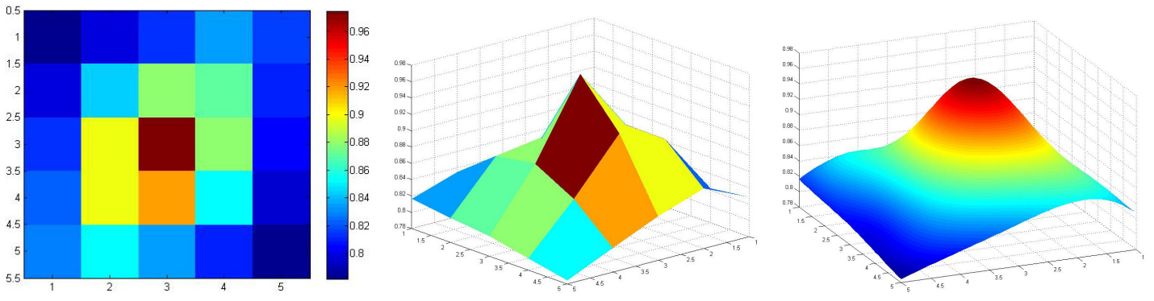
Translation Estimation
Boundary Matching
Compute cross correlation between matching frame and reference frame under different translations.
Correlation Map
Peak indicates best matching
Sub-pixel accuracy achieved through interpolation.
Peak location
5x5 50x50

Slide 13
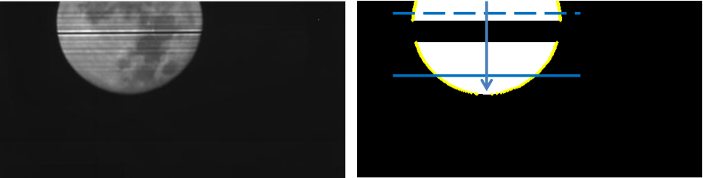
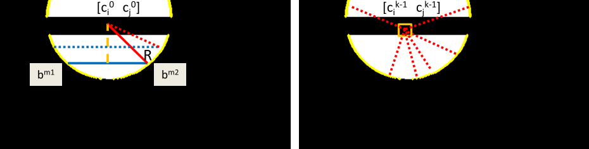
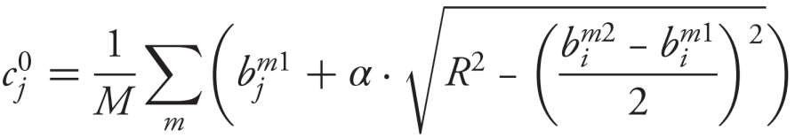
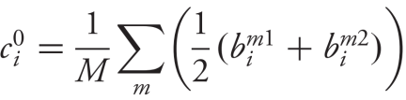

Translation Estimation
Center Matching
Locate boundary points of the moon
Valid boundary points
End points of the scan lines
Scan Line Searching
Estimate circle center using boundary points
Using chords to estimate the center.
Pyramid searching for subpixel accuracy
Chord Voting
Radius Restriction

Slide 14
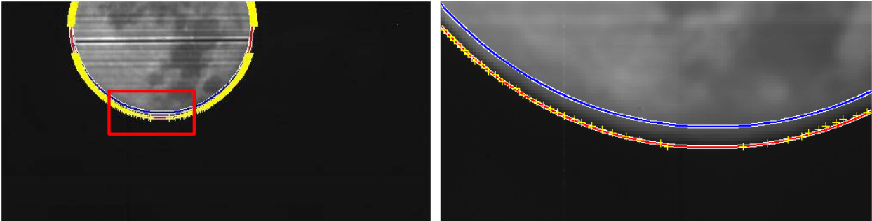
Translation Estimation
Center Matching
Contains Error
Why pyramid searching?
Chord voting method: Approximated radius is used.
Pyramid searching method: Not only accurate center position,
But also a better radius estimation.
Circle fitting using estimated center and radius
Blue line: chord voting method
Red line: after pyramid searching

Slide 15
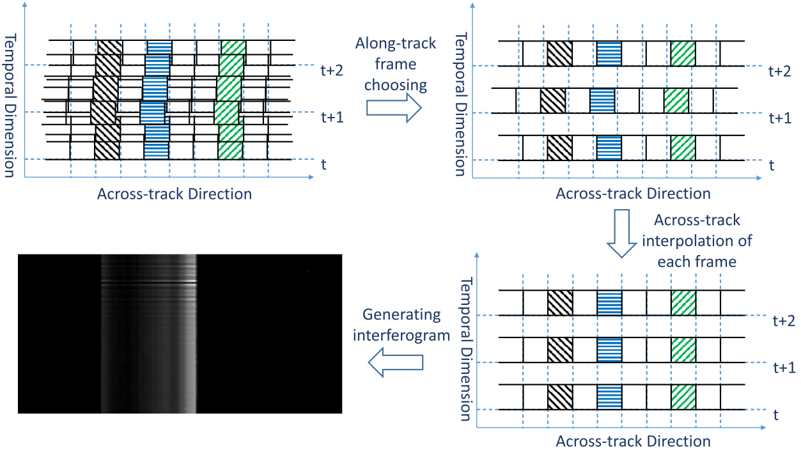
Interferogram Extraction
Processing Overview
Along-track translation w.r.t. the first frame Integers
Across-track translation w.r.t the first frame Zero

Slide 16
Data Rectification
Temporally over-sampled
Along-track translation correction
The frame rate of our equipment is about 200 times higher than the desired frame rate.
Choose the frames whose along-track translation w.r.t. the first frame are closest to the nearest integral numbers.
Inter-frame interpolation is not needed!
Residual error: 0.005 pixel
…
…
…
Frame 1
Frame 198
Frame 395
Frame 794
0 pixel
0.998 pixel
2.003 pixel
2.9999 pixel
Along-track translation w.r.t Frame 1

Slide 17
Data Rectification
Along-track translation correction (low frame-rate case)
Achieved by inter-frame interpolation (temporal interpolation)
t1
t2
Along track translation
3.52
4
4.21

Slide 18
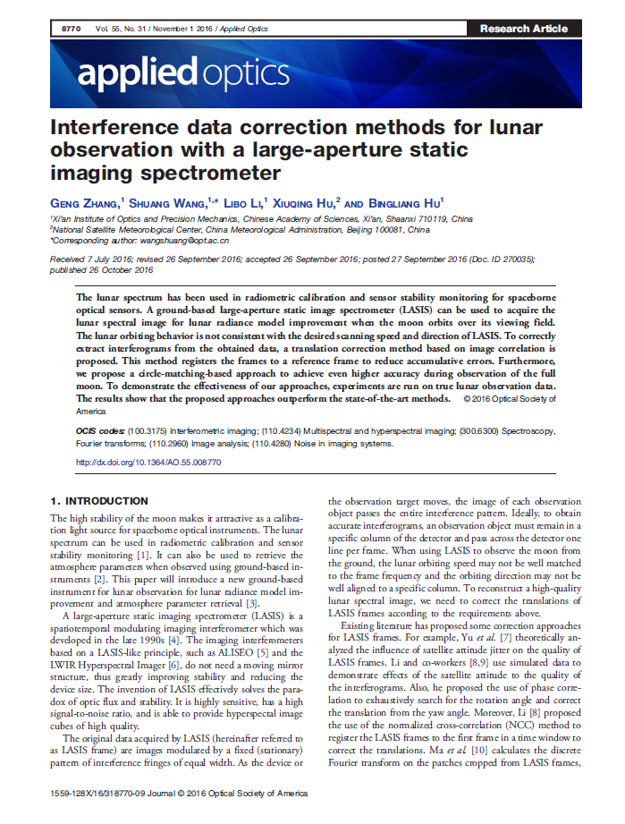
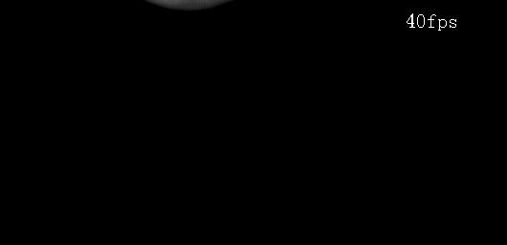
Data Rectification
Original
Rectified

Slide 19
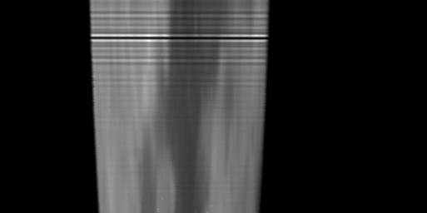
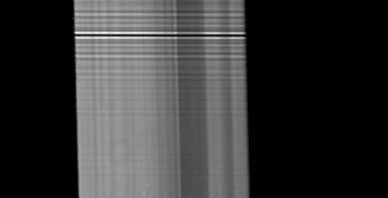
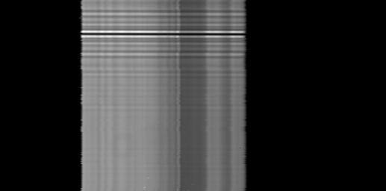
Data Rectification (Compared to other methods)
C1
C2
C3
ours
Extracted Interferograms. (Distortions are rectified)

Slide 20
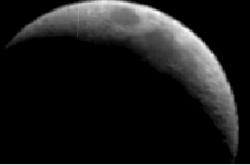
Spectrum Reconstruction
Following standard FTIR spectrum reconstruction pipeline
Sample Point 4
Sample Point 3
Sample Point 2
Sample Point 1
(a) Spectral curves generated from the new moon data

Slide 21
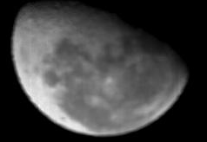
Spectrum Reconstruction
Following standard FTIR spectrum reconstruction pipeline
Sample Point 2
Sample Point 3
Sample Point 1
Sample Point 4
(b) Spectral curves generated from the gibbous moon data

Slide 22
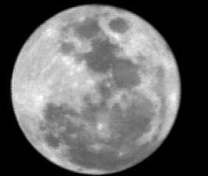
Spectrum Reconstruction
Following standard FTIR spectrum reconstruction pipeline
Sample Point 4
Sample Point 2
Sample Point 3
Sample Point 1
(c) Spectral curves generated from the full moon case

Slide 23
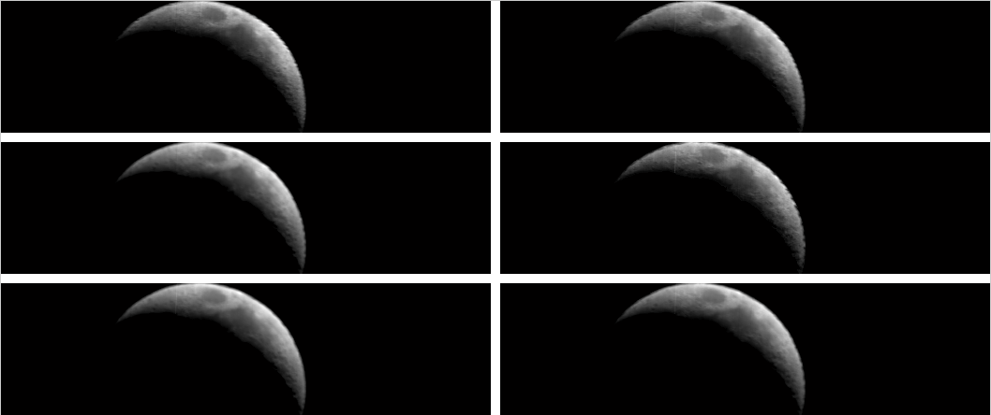
Spectrum Reconstruction
1008.5 nm
1252.5 nm
1605.1 nm
1740.7 nm
2039.0 nm
2147.5 nm
(a) Spectral bands reconstructed from the new moon data

Slide 24
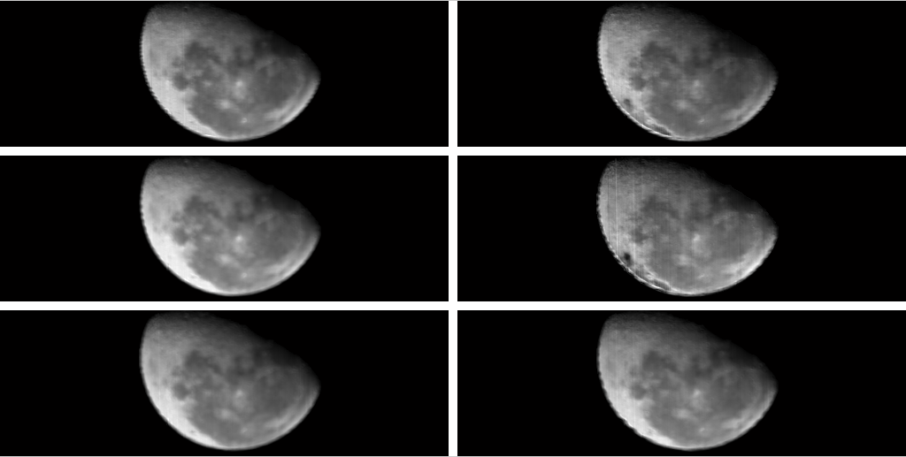
Spectrum Reconstruction
1008.5 nm
1252.5 nm
1605.1 nm
1740.7 nm
2039.0 nm
2147.5 nm
(b) Spectral bands reconstructed from the gibbous moon data

Slide 25
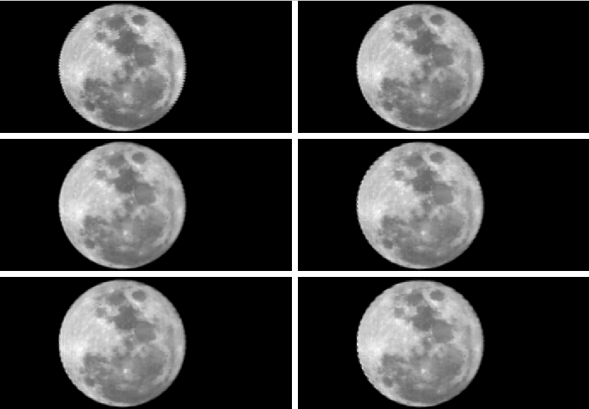
Spectrum Reconstruction
1008.5 nm
1252.5 nm
1605.1 nm
1740.7 nm
2039.0 nm
2147.5 nm
(c) Spectral bands reconstructed from the full moon

Slide 26
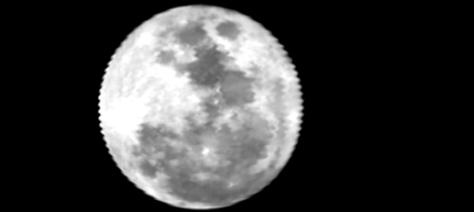



Lunar Radiance Estimation
Smoothest boundary
Proposed approach rectifies the data accurately.
C1
C2
C3
ours

Slide 27
Lunar Radiance Estimation
Radiance achieved by absolute calibration using simulated atmosphere transmittance from MODTRAN，Error: 10.7%
Data: 24th Feb 2016（2016-02-24-00-02-42）

Slide 28
Future Work
FUTURE WORK
Aiming
Develop an automatic moon observing equipment which is able to achieve spectral and spatial data simultaneously.
Requirements
1）Acquiring both spatial and spectral data
2）Automatically following the moon, storing and processing the data
3）Self calibration

Slide 29
Future Work
Parameters
  Spatial Resolution：≥200×200 (Full Moon)
  Spectral Rage：900~2500nm
  Band MTF：≥0.2
  Band SNR：≥500:1（Full Moon）
  Spectral Resolution：≤10nm

Slide 30
Future Work
Using two kinds of imaging spectrometers to compensate each other.
FTIR spectral imager base on Sagnac interferometer
Dispersive spectral imager using Offner principle
Pros:
Pros:
high optical sensitivity
stable spectral positions
no spectral mixing
high radiance consistency
Low requirement to the platform
uniform wavelength
Cons:
Cons:
low radiance consistency
non-uniform wavelength
(uniform wave number)
spectral mixing
unstable spectral position

Slide 31
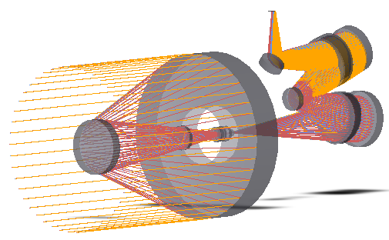
Future Work
SPECIFICATION
Spectral Range：1um~2.5um
Spectral bands：150
MAX SNR：>1000
Smile distortion：≤10% of a pixel
Keystone distortion: ≤10% of a pixel
Spatial resolution: 0.002°
Field of view: 0.64°
Accuracy of spectral calibration：≤1nm
Accuracy of radiometric calibration：≤5%

Slide 32
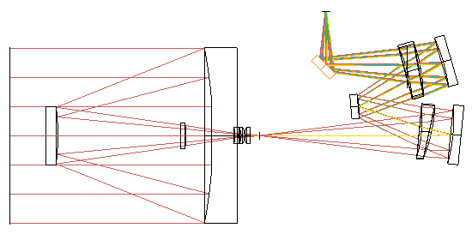
Future Work
The telescope is Ritchey-Chretien Telescope with fore-Lens Corrector, has a focal length of 860mm and an F-number of 4.0. The exit pupil is located near infinity giving a telecentric image, which is required for a proper pupil matching with the spectrometer.
The spectrometer consists of three spherical mirrors and two Féry prisms made from fused silica.

Slide 33
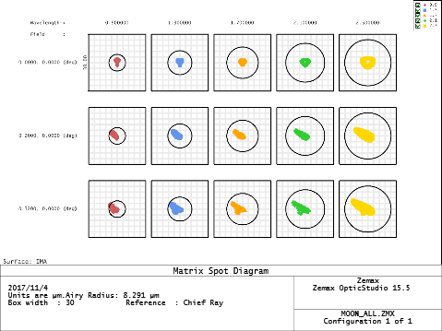
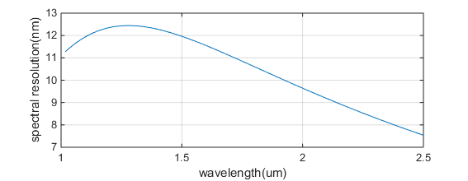
Future Work
Spot diagram matrix
The spot diagrams are given for five wavelengths from1000 to 2500 nm and at three field points covering the whole field of view. All boxes are 30 µm matching the pixel pitch of the SWIR detector.
Bandwidth of a single pixel
The width of the spectral response function varies between 7.5 and 12.4 nm. The mean bandwidth is 10 nm

Slide 34
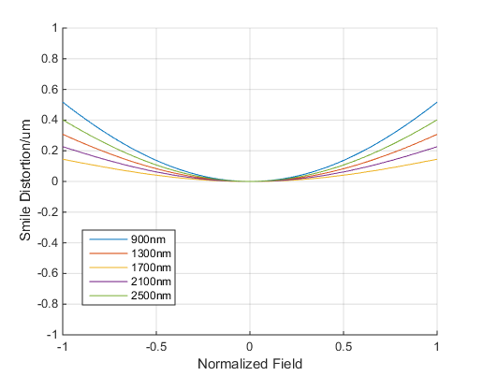
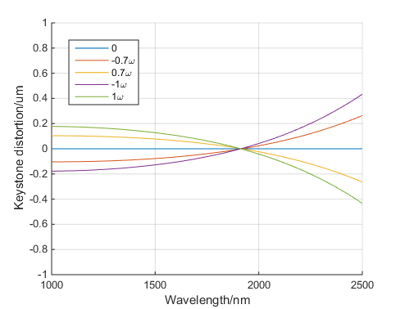
Future Work
Smile distortion
Smile distortion is less than 0.5um, about 0.02 pixel pitch.
Keystone Distortion
Keystone distortion is less than 0.5um, about 0.02 pixel pitch.

Slide 35
Future Work
The thermal response has been checked for temperatures between 16 and 24°C. The optical performance degradation is negligible. The thermally induced shift of the spectrum on the detector is 1.15 nm/K on the average.
An inner-calibration system based on an integrating sphere will be used to create repeatable and smooth spectral radiance for assessing the spectral and radiometric properties of the spectrometers. This facility allows the monitoring of the instrument at small time intervals.

Slide 36

XI’AN INSTITUTE OF OPTICS AND PRECISION MECHANICS OF CAS
KEY LABORATORY OF SPECTRAL IMAGING TECHOLOGY CAS
Thank You For Listening !
Geng Zhang gzhang@opt.ac.cn
Shuang Wang wangshuang@opt.ac.cn
Libo Li lilibo@opt.ac.cn

