Slide 1
Lunar irradiance measurement and modelling for absolute radiometric calibration of EO sensors
M. Bouvet (ESA), Emma Woolliams (NPL), Claire Greenwell (NPL), Maria Garcia Miranda(NPL), Carlos Toledano (Univ. Valladolid), Alberto Berjón (Univ. Valladolid), África Baretto (Univ. Valladolid), Stefan Adriaensen (VITO)

Slide 2
Objective of the study
Define a strategy for the measurement of the lunar spectral irradiance variation from the ground
Demonstrate the feasibility of such measurements
Compile a database of such measurements and on that basis improve the modelling of the lunar disk irradiance variations through its cycles (targeting sub-2 % absolute radiometric accuracy)
Compare the improved lunar disk irradiance model to various independent sources of lunar observations from space

Slide 3
Planning
KO of activity in Sept. 2017
KO+2 months: definition and procurement of lunar photometer
KO+6 months: instrument characterisation (spectral, geometric and radiometric), calibration and derivation of measurement uncertainties.
KO+6 months to end:
Lunar data collection at Pico Teide / Izana (Spain)
Development of a model of lunar irradiance
KO+12 month to end: comparison of the model of lunar irradiance to:
lunar observations: from Proba-V, PLEIADES and a subset of the GLOD
Other lunar model(s): GIRO
Duration: 21 months

Slide 4
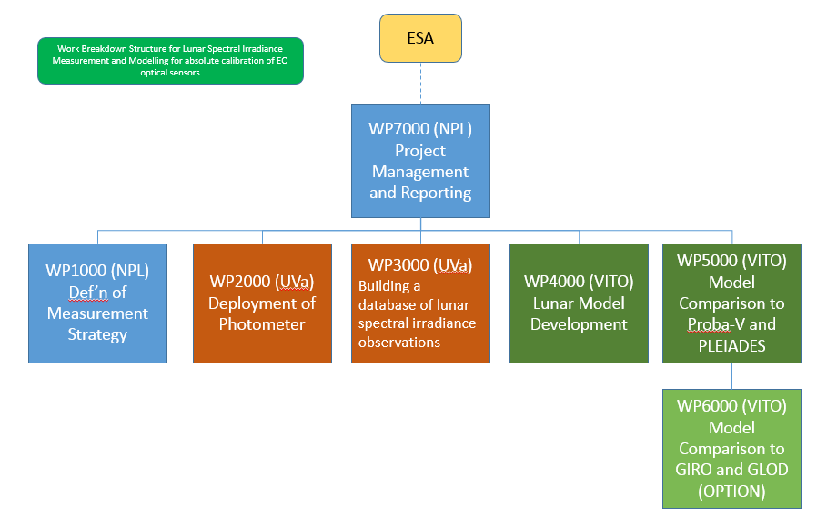
Project team

Slide 5
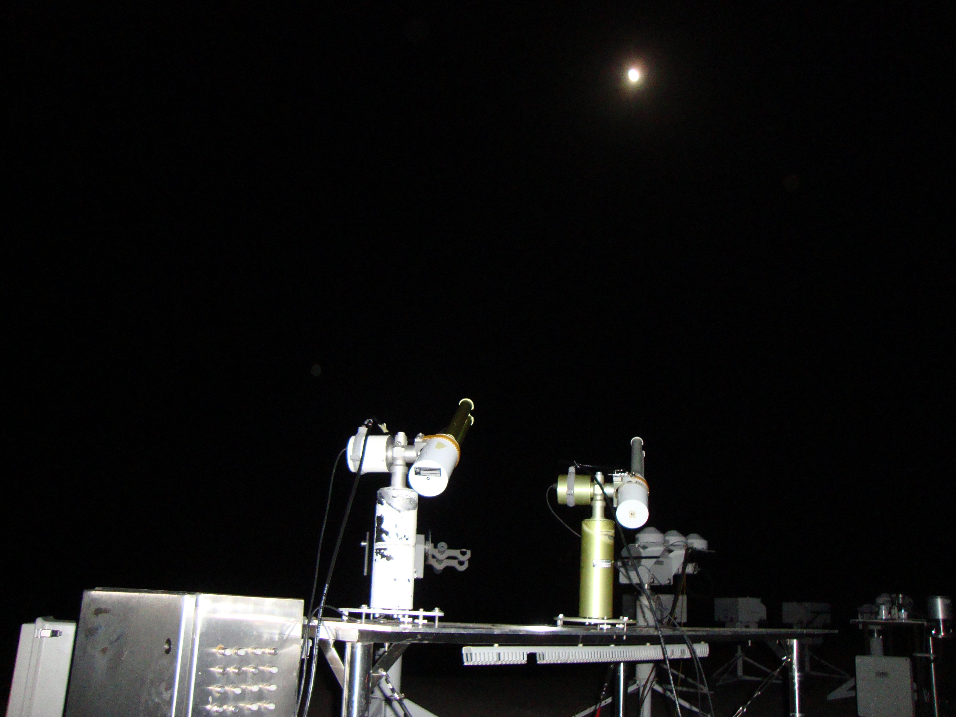
WP 1000: Instrument specification, characterisation, calibration and uncertainty budget
Instrument selected is the Sun-Sky-Lunar photometer CE318 from CIMEL:
Spectral channels: 340, 380, 44, 500, 670 870, 936, 1020, 1640 nm
Double filter wheel for polarimetric measurements
Modification of firmware for polarimetric capabilities in direct lunar observation configuration

Slide 6
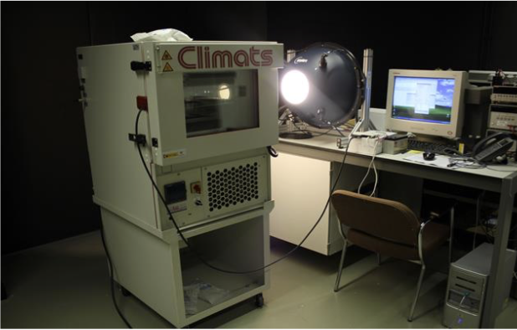
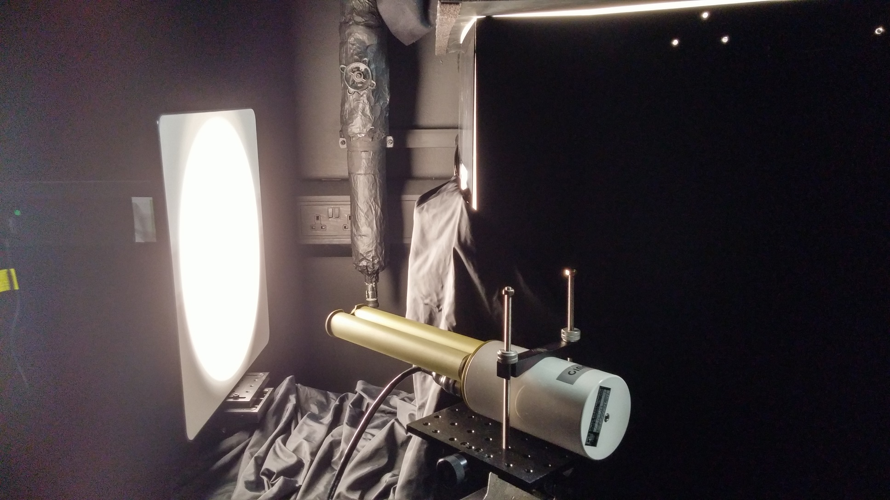
WP 1000: Instrument specification, characterisation, calibration and uncertainty budget
Temperature characterization (UVa)
Irradiance responsivity (NPL)
Linearity of the instrument (NPL)
Effective Wavelength of the instrument (NPL)
Polarisation (NPL)
Final tests at Izana Observatory

Slide 7
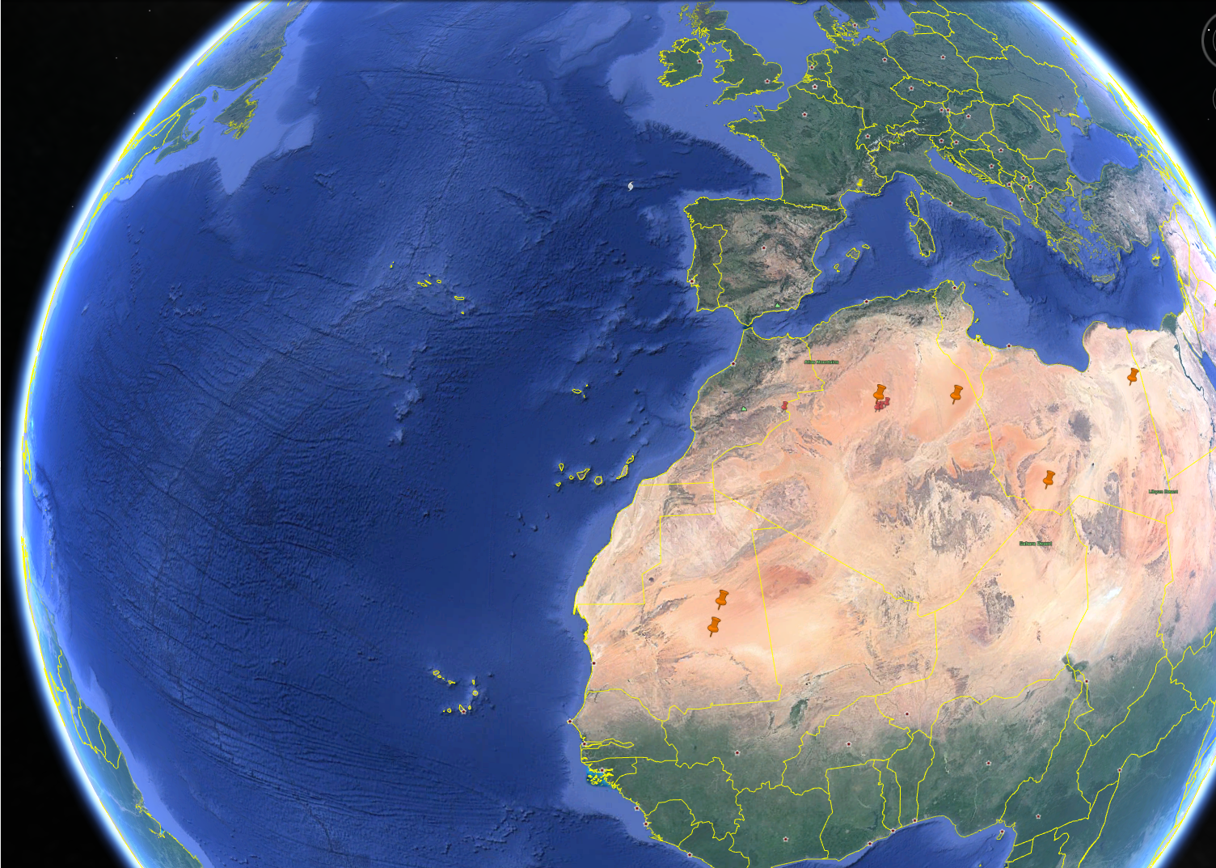
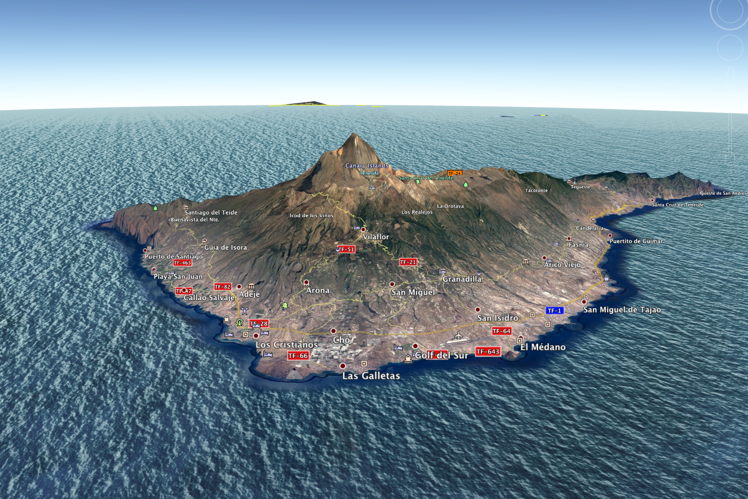
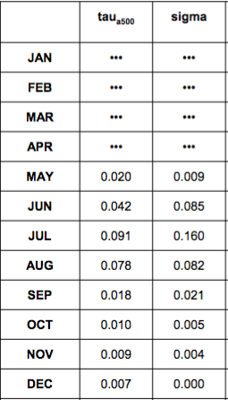
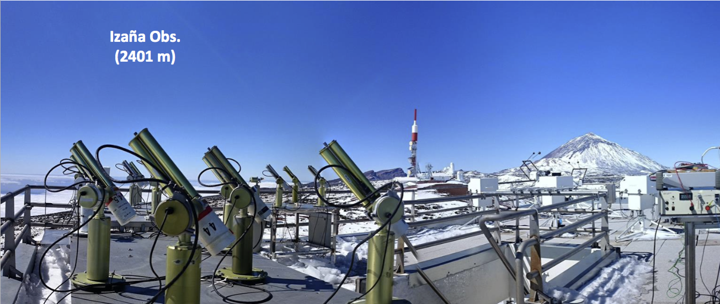
WP 2000: Deployment

Slide 8
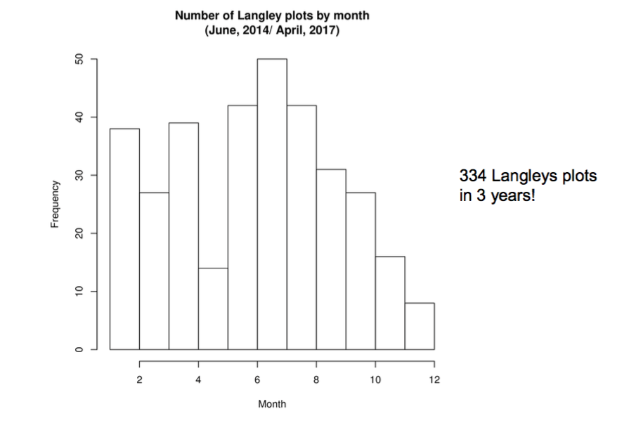
WP 2000: Deployment

Slide 9
WP 2000: Deployment
Additional instrument (already previously) deployed will include:
Standard lunar photometer CIMEL (no polarimeteric capabilities)
ASD spectrometer
Pandora-2S

Slide 10
WP 3000: Building a database of quality controled measurements
Develop an automated processing scheme for the derivation of lunar spectral irradiance measurements
Archive the raw data
Process the raw data into lunar spectral irradiance measurements
Build a database of lunar spectral irradiance measurements

Slide 11
WP 3000: Building a database of quality controlled measurements

Slide 12
WP 4000: Lunar spectral irradiance model development
Define a strategy to derive the model regression coefficients (ROLO based) from the lunar measurements
Derive regression coefficients from database of measurements
Measurements uncertainty propagation in to the model parameters / regression coefficients

Slide 13
WP 5000/6000: Comparison of the lunar spectral irradiance model to space borne observation and other models
Lunar observations:
Proba-V (ESA mission operated by VITO)
PLEIADES (through an agreement with CNES)
GLOD: access requested via EUMETSAT
Other lunar model(s):
GIRO: access requested via EUMETSAT

Slide 14
Thank you for you attention

