Slide 1
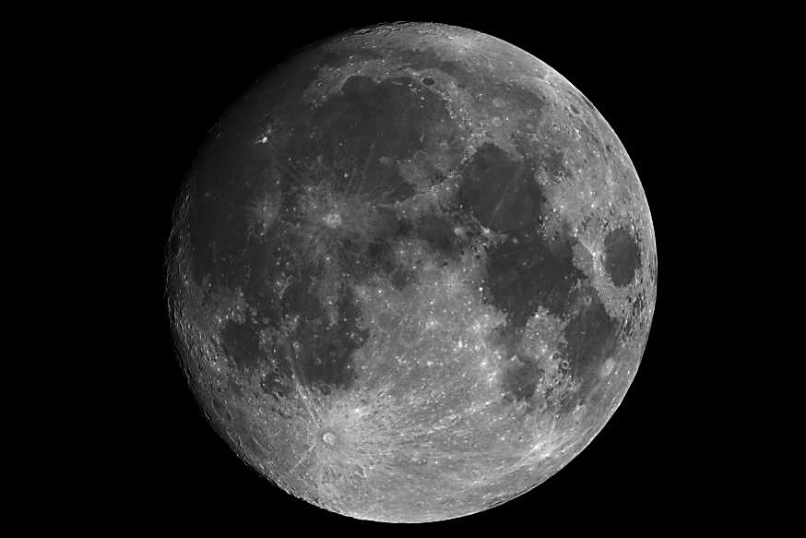
Current Status of ROLO and Future Development
Thomas C. Stone
U.S. Geological Survey, Flagstaff, AZ USA
GSICS/IVOS 2nd Lunar Calibration Workshop
Xi’an, China
13-16 November 2017

Slide 2
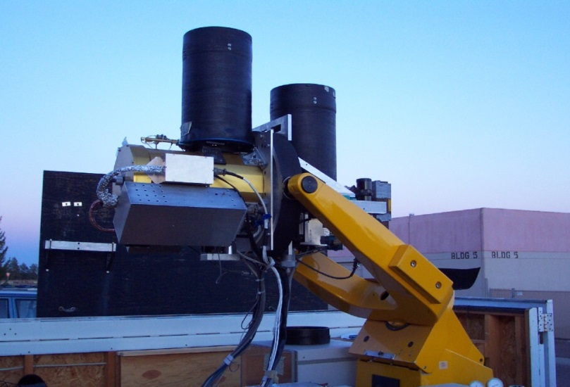
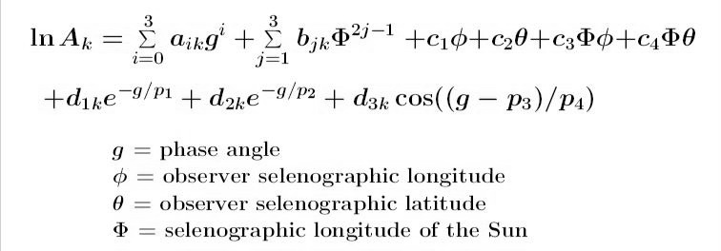
Introduction to ROLO
A dedicated ground-based telescope facility — the Robotic Lunar Observatory (ROLO):
Lunar disk reflectance model
• empirically derived formulation
• a function of only the geometric variables of phase and the lunar librations:
• located at Flagstaff, AZ 2143 m altitude
• operated more than 8 years, acquired >110 000 images in 32 multispectral bands
‒ 23 VNIR bands, 350−950 nm
‒ 9 SWIR bands, 950−2450 nm
• phase angle range from eclipse to 90°
ROLO telescopes zenith-pointed at dusk

Slide 3
ROLO Current Status
Telescope facility is dormant; no additional images being acquired
ROLO model is actively used by spacecraft instrument teams, typically for relative calibrations:
to monitor changes in sensor response with time
e.g. SeaWiFS achieved 0.13% stability for water-leaving radiances
for sensor inter-calibration, using the Moon as a common reference
Currently the Moon is not typically used for absolute calibration
the absolute scale uncertainty for the ROLO model is ~5-10%
estimate based on comparisons of Moon measurements made by many different instruments
this level of accuracy is insufficient for a primary on-orbit cal reference
this is a limitation of the current lunar model, not the Moon
the Moon potentially can provide an absolute calibration reference with uncertainty ≤1% (k=2)

Slide 4
Refinement of the ROLO Model
First steps: revise the ROLO data reduction system and reprocess the ROLO dataset
The basis data for lunar modeling are ground-based Moon images
requires image processing to irradiance, similar to space-based imagers
requires correcting for atmospheric transmission of the observations
using extinction measurements from star observations
Refinements to the ROLO system currently completed:
algorithm for stellar irradiance measurements (from ROLO images)
stellar extinction analysis: multi-variate Langley fits
Refinements still needed:
algorithm for Moon irradiance measurements from images
includes sensor characterization analysis, especially the SWIR camera
applying updated stellar irradiance measurements for absolute scale
including Vega, potentially other absolute reference stars

Slide 5
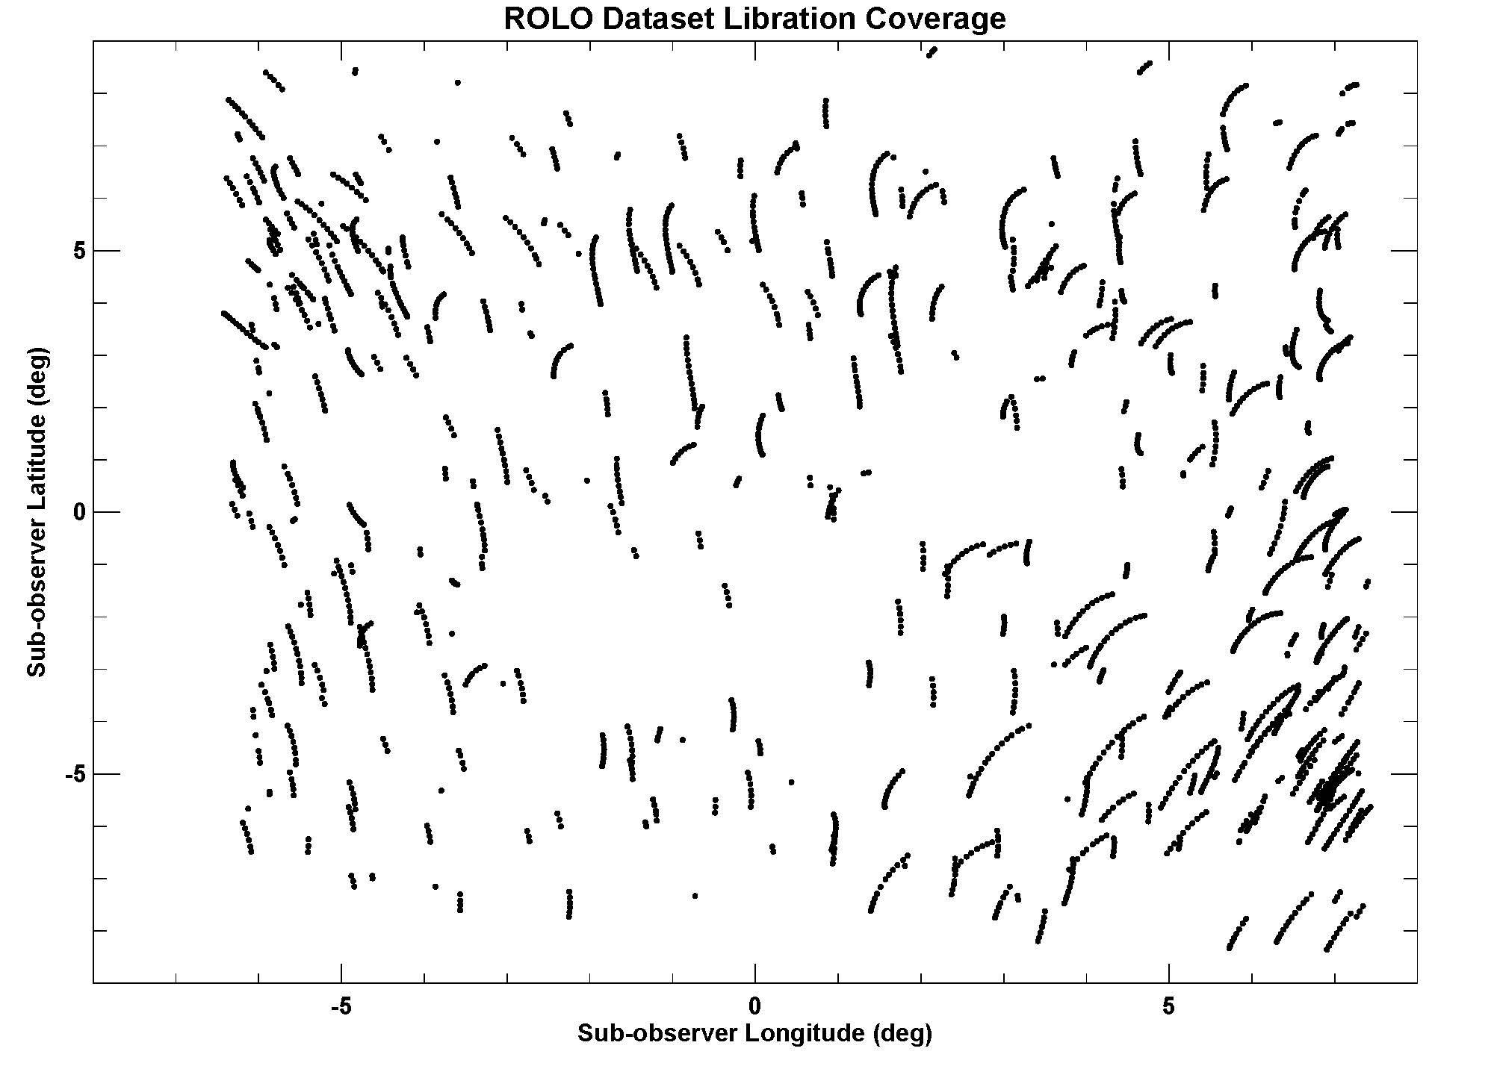
ROLO Dataset Phase and Libration Coverage
These plots show a subset of the ROLO archive, ~2300 Moon observations in the 555 nm band.
The phase and libration parameter space is substantially covered.

Slide 6
Refinement of the ROLO Model
Next steps: develop a new empirical formulation for the lunar model and fit the reprocessed ROLO dataset
Utilize knowledge gained from current and past lunar calibration accomplishments, e.g.:
SNPP VIIRS time series shows a libration dependency effect
instruments with large phase angle coverage (GEOs, PLEIADES) show phase dependency effects
but lunar irradiance measurements from spacecraft must first be validated !
Develop constraints for fitting the ROLO dataset based on reliable new lunar measurements
Monday session, GLOD, …
Update the ROLO absolute calibration based on improved knowledge of lunar and stellar irradiances

Slide 7
Summary and Way Forward
Reprocessing the ROLO dataset and reformulating the ROLO model are necessary, but improving absolute accuracy is essential
a lunar reference with ≤1% (k=2) accuracy is technically achievable
ROLO absolute accuracy may be limited by airmass coverage of the star observations
New high-accuracy measurements to characterize the Moon are needed to advance an absolute lunar calibration reference
tentative requirements for collecting a new lunar measurement database outlined in CGMS Working Paper: CGMS-44 GSICS-WP-02 (2016)
includes above-atmosphere measurement component
to achieve the full potential for accuracy, must consider polarization aspects

