Slide 1
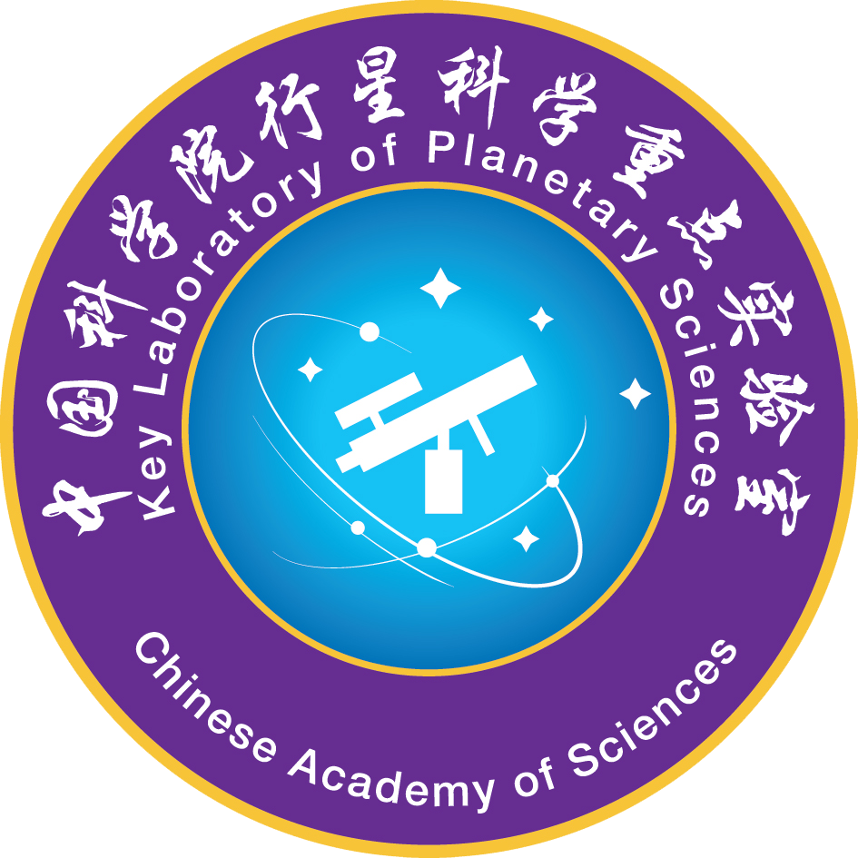
A New Lunar Radiometric Model and Its Irradiance Based on China’s Lunar Orbiter and in situ Data
YunZhao Wu
wu@pmo.ac.cn
Key Laboratory of Planetary Sciences, Purple Mountain Observatory, Chinese Academy of Sciences, Nanjing 210008
1
Notes:
1

Slide 2
History of observing the Moon’s absolute photometry
Velikodsky et al., 2011; Kieffer and Stone, 2005
The Sytinskaya–Sharonov photometric system uses visual photometry data and calibration with a white screen illuminated by the Sun (Sharonov, 1939; Sytinskaya and Sharonov, 1952; Sytinskaya, 1964). Note that the Shorthill et al. (1969) and Akimov et al. (1986) catalogs both are based on the Sytinskaya–Sharonov absolute system.
The Wildey–Pohn photometric system uses photoelectric photometry and calibration by stars (Wildey and Pohn, 1964). Studies of Akimov and Olifer (1986) have shown good agreement between these and the Sytinskaya–Sharonov data for average albedo, but there is some discordance for mare-highland contrast (within 10%).
Two systems of Gehrels et al. (1964) use photoelectric photometry data and calibration by stars. One system (1956/57) agrees with those of Sytinskaya–Sharonov and Wildey–Pohn, but albedo in another dataset (1963/64) is 20% lower.

Slide 3
History of observing the Moon’s absolute photometry
Velikodsky et al., 2011; Kieffer and Stone, 2005
Irradiance observations of the unresolved Moon covering a wide range of phase angles were made in the UBV and nine narrower bands covering 359–1064 nm by Lane & Irvine (1973), who report 33 observations over 29 nights covering all but two lunations from 1964 July to 1965 November. That paper is a landmark in absolute photometry of the Moon calibration by stars. They found that the Moon becomes redder with increasing phase angle: phase reddening. Their work does not cover the opposition effect or libration
Dobber et al. (1998) have obtained lunar geometrical albedo at phase angle 79.7°in spectral range (240–800 nm) from ESAERS2 satellite data. They used calibration with a screen illuminated by the Sun.
Clementine spacecraft UVVIS data have been calibrated using laboratory measurements of Apollo-16 samples (Pieters, 1999; McEwen et al., 1998), and found albedo approximately two times greater than that of the Sytinskaya–Sharonov system (Hillier et al., 1999; Shkuratov et al., 2001).

Slide 4
History of observing the Moon’s absolute photometry
Velikodsky et al., 2011; Kieffer and Stone, 2005
ROLO (RObotic Lunar Observatory of US Geological Survey) has produced a large database of Earth-based lunar CCD observations, which have been calibrated using measurements of the star Vega (Stone and Kieer, 2002; Kieffer and Stone, 2005). These observations cover a wide range of phase angles and librations.
Saiki et al. (2008) used Earth-based CCD photometry data and calibration by the star Vega. The measurements were carried out at a phase angle near 7º. These observations show systematically higher albedo (13%) as compared to ROLO measurements.
Velikodsky et al. (2011) performed a 2-month series of quasi-simultaneous imaging photometric observations of the Moon and the Sun at Maidanak Observatory (Uzbekistan) at phase angles 1.7–73° at wavelength 603 nm.

Slide 5
Orbiting observation
SELENE SP data acquired by Japan covers a wide wavelength range (VIS: 513–1010 nm, NIR1: 884–1676 nm, and NIR2:1702–2588 nm) and solar phase angles between 5º and 85º . The SP obtained continuous spectral reflectance data for more than 68 million points from Nov. 2007 to Jun. 2009 (Yokota et al., 2011).
LROC WAC acquired global images of the Moon at phase angles 0–120º and wavelength 320–689 nm with two UV bands and five visible bands (Sato et al., 2013).
Chang’E-1 IIM acquired observations of the lunar surface which covers 84% of the ±75º lunar surface with a wavelength range of 522–900 nm and phase angle 0–80º during its 485 days (20071206- 20081204) in flight (Wu et al., 2013).
M³ onboard Chandrayaan-1 obtained lunar images (~95%) which had a wide range of viewing geometries (0–100º) and wavelength of 460–3000 nm during its nearly ten-month period from Nov. 2008 to Oct. 2009 (Besse et al., 2013).

Slide 6
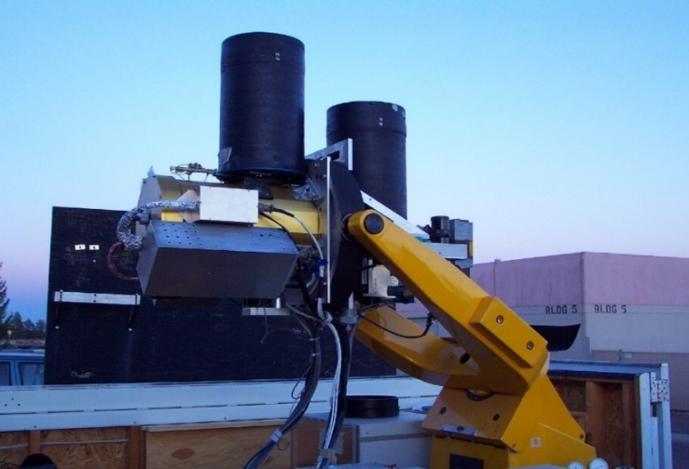
History of observing the Moon’s absolute photometry
Stone et al., 2003; Kieffer and Stone, 2005
ROLO: Dedicated observatory, located at USGS in Flagstaff, AZ (Altitude 2143 m）
Dual telescopes boresighted to the same pointing direction
  23 VNIR bands, 350-950 nm
  9 SWIR bands, 950-2500 nm
Empirically-derived function of phase and lunar libration
disk-integrated lunar irradiance
4 and 8 arcsec/Pixel (-7.4 and 15 km/pixe1)
A NIST-traceable 1000 W FEL lamp and a 31 cm square flat Spectralon plate system is used only to generate flat-fielding images. The radiance scale is derived from observations of Vega and published absolute flux measurements.
The absolute flux measurements of Hayes (1985) and Strecker et al. (1979) were used to scale a model stellar spectrum (Castelli & Kurucz 1994) for Vega.
Spatially resolved radiance images
  8+ years in operation, >85000 lunar images
  phase angle coverage from eclipse to 90°
Operations emphasized extinction
  >800,000 star images
Dormant since Sept. 2003
The Moon is imaged at half-hour intervals during the Moon is above the 60 ° zenith angle.

Slide 7
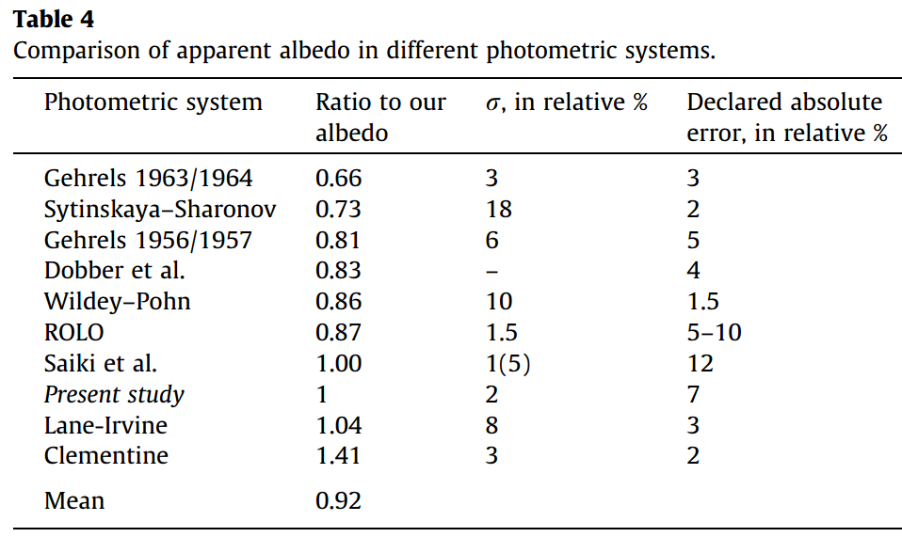
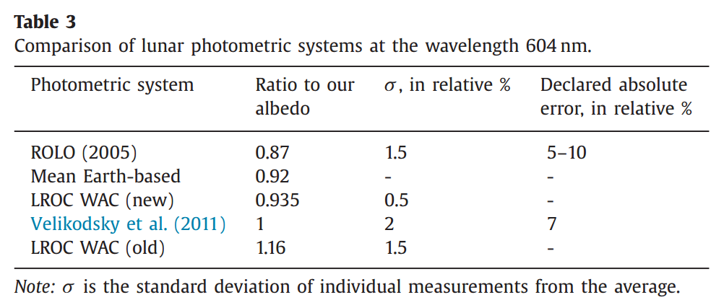
History of observing the Moon’s absolute photometry
The absolute reflectance of the Moon among these studies are substantially different!
The lunar irradiance modeled using these data also are substantially different!
Velikodsky et al., 2011
Which observation is accurate?
Velikodsky et al., 2016

Slide 8
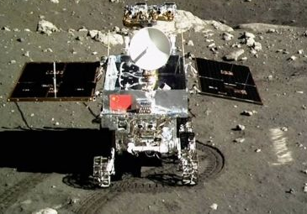
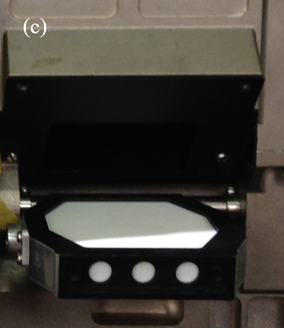
Objective
We performed large amounts of comparison covering various types of terrains to assess the accuracy of these observations.
Chang’E-3 (CE-3) “Yutu” rover accomplished in situ measurement with a calibration panel on the surface of the Moon, which is crucial for obtaining the accurate absolute reflectance and resolving the debate.
We built a new model using Chang’E-1 Interference Imaging Spectrometer (IIM)data.

Slide 9
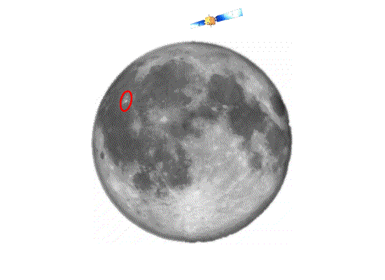
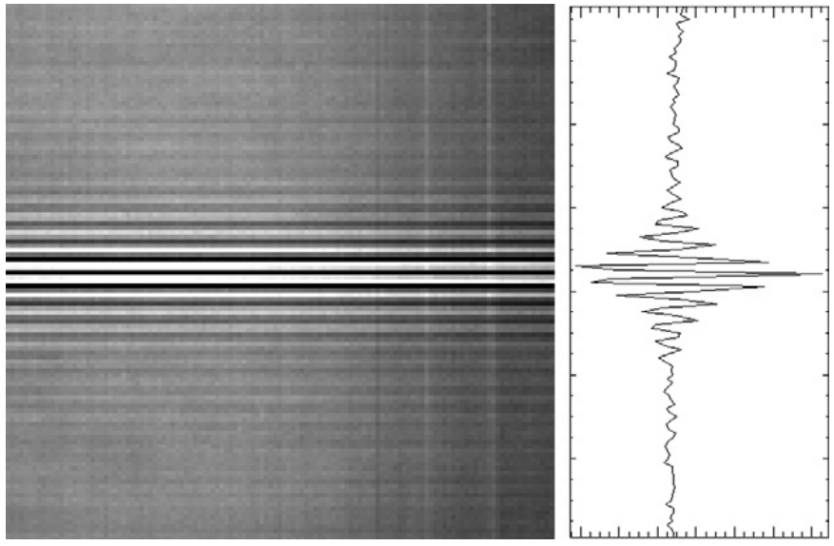
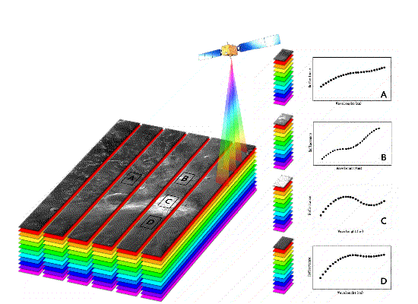
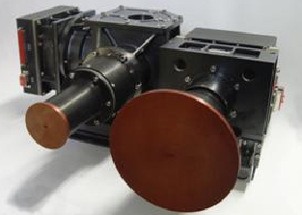
Data
Chang’E-1 Interference Imaging Spectrometer (IIM)
first planetary application of Interference technology
9
Notes:
9

Slide 10
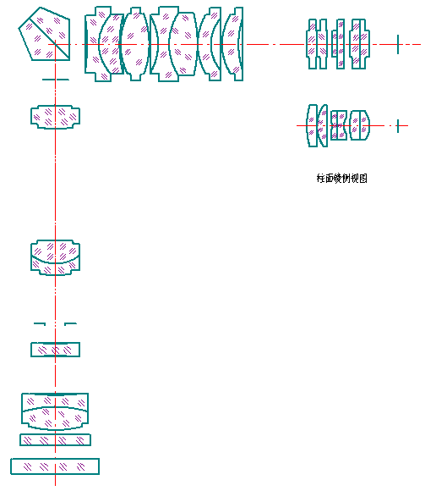
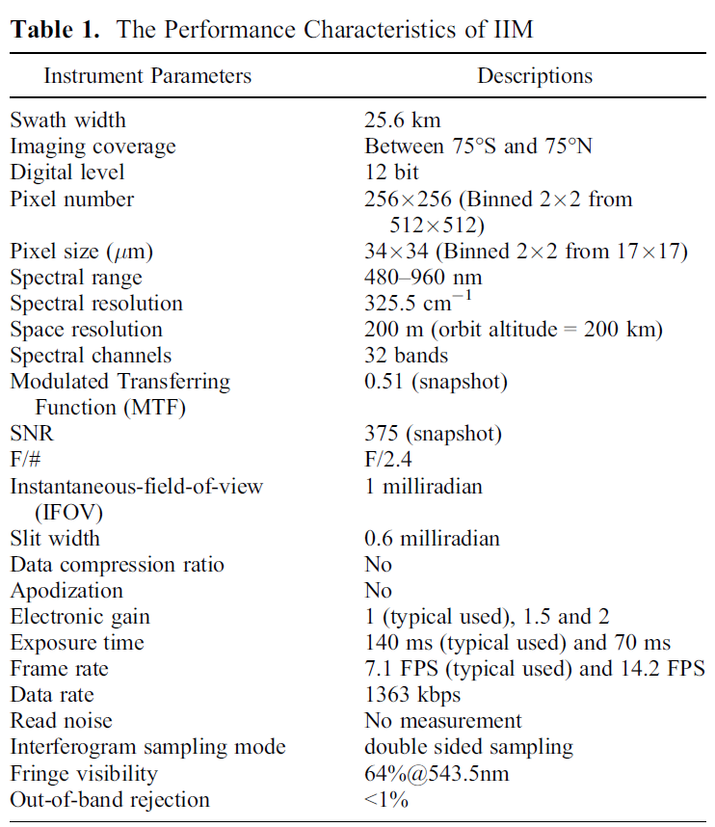
 | focal length（mm） | F/# | FOV
Fore lens | 104.6 | F/7.34 | 7.34°
Fourier lens | 80 | F/7.34 | 9.56°
Cylinder lens | 26 | F/2.4 | 9.56°
Total system | 34 | F/2.4 | 7.34°

Slide 11
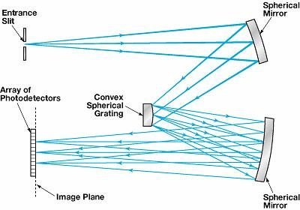
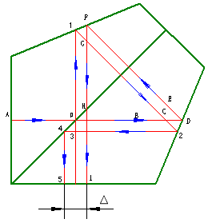
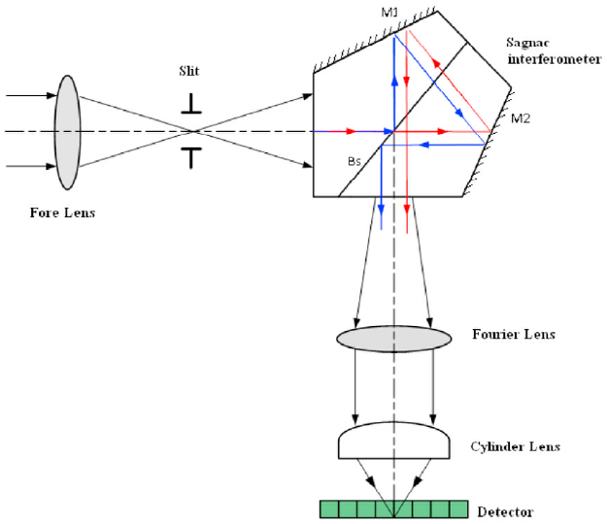
Prism
Grating
Interference
d=0.5467mm

Slide 12
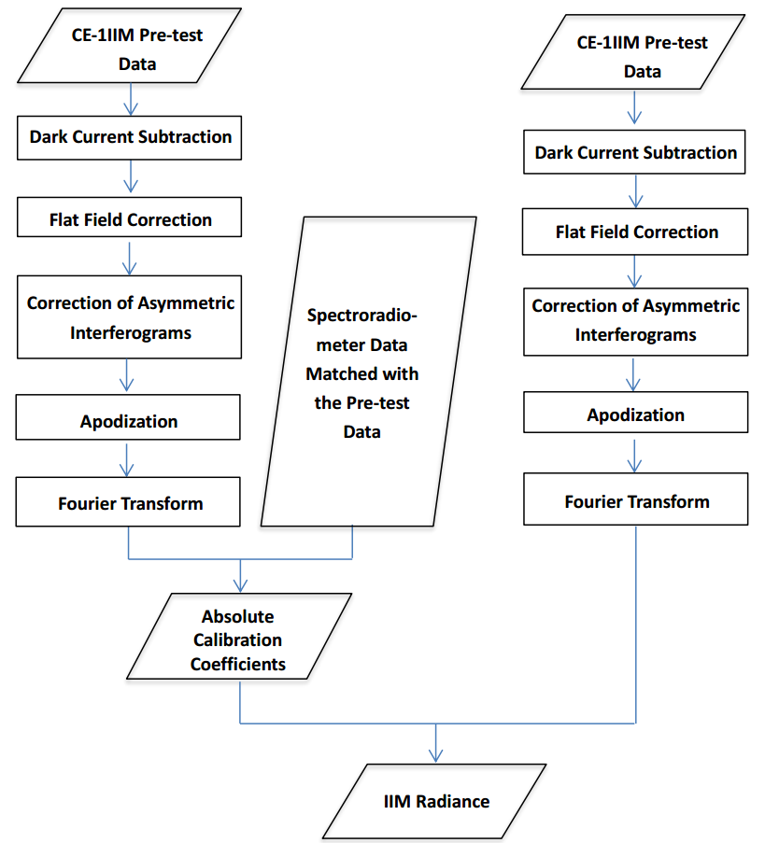
Flow chart for IIM

Slide 13
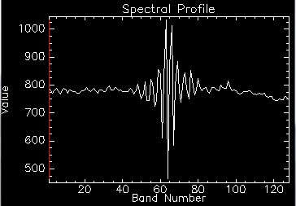
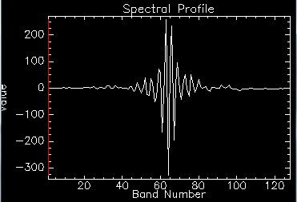
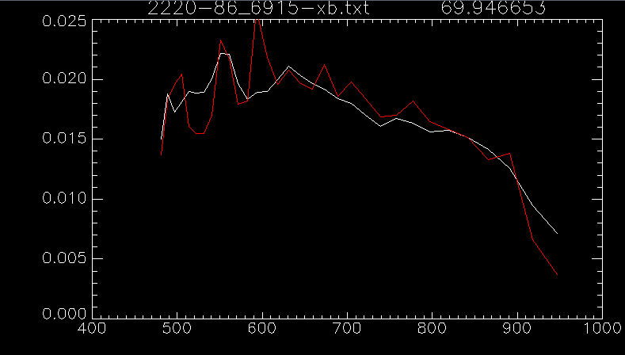
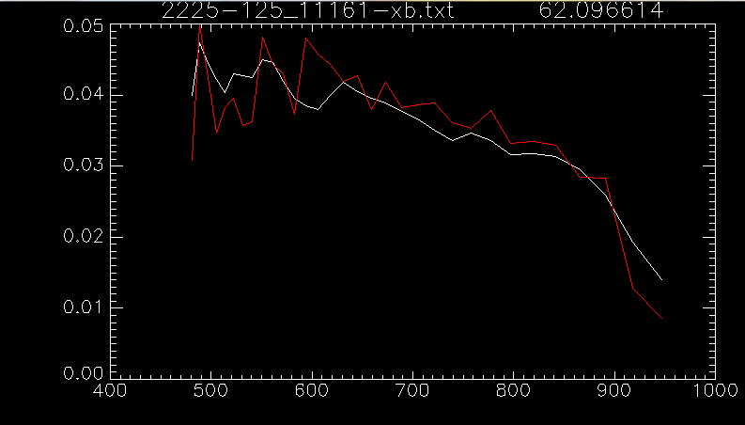
Before Phase correction
Image processing
1. 相位校正、切趾(Phase correction and apodization)
After Phase correction
apodization
apodization

Slide 14
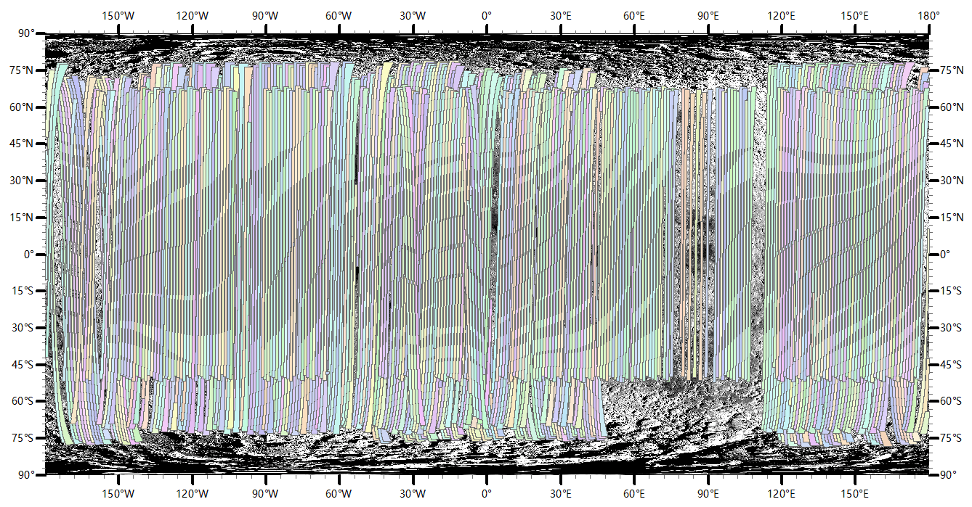

Slide 15
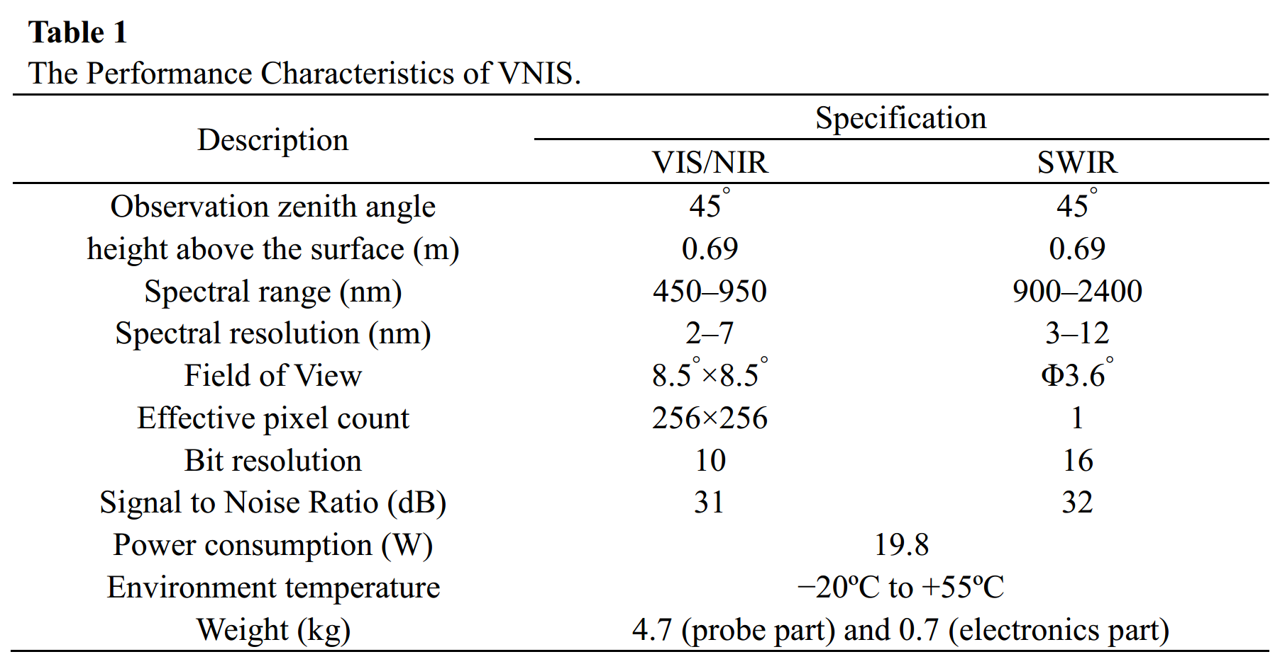
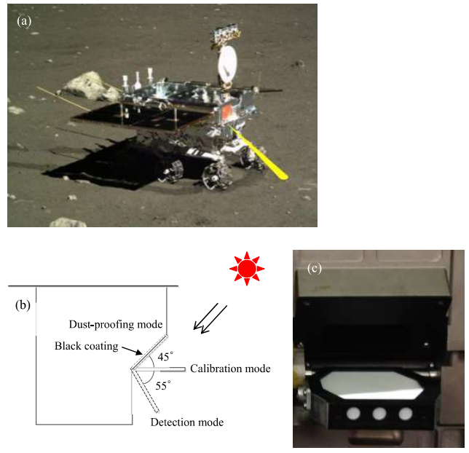
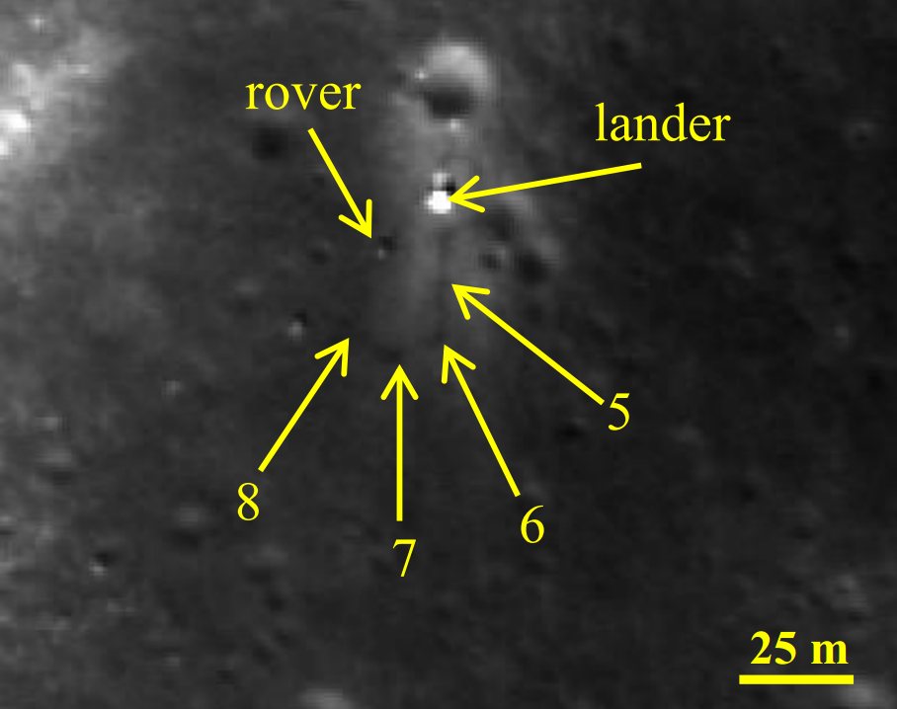
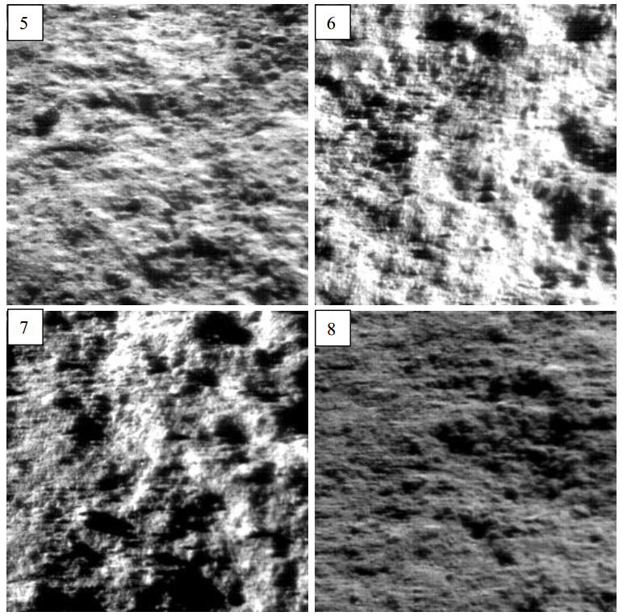
Data
Chang’E-3 Visible-Near Infrared Spectrometer (VNIS)

Slide 16
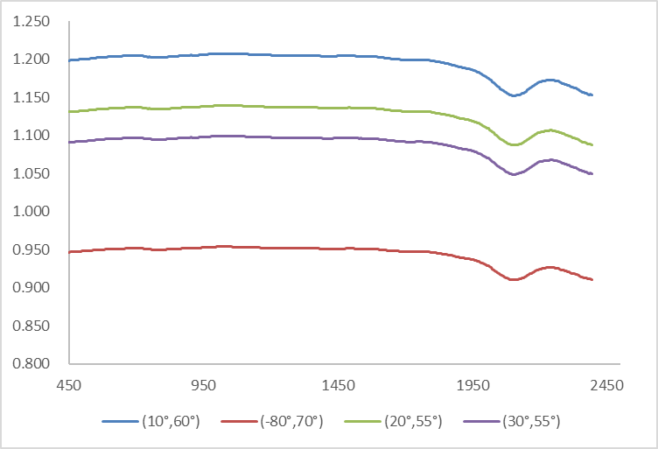
Table 2 Data acquisition conditions of the four sites analyzed by VNIS. Angles are in degrees.
Site | Time | Local Time | Sun zenith angle | Sun azimuth angle | view zenith angle | view azimuth angle | Sun- Moon distance (AU)
5 | 20131223T02:10 | 15:09 | 60.02 | 238.48 | 48.27 | 55.01 | 0.985
6 | 20131224T01:35 | 15:57 | 67.48 | 248.44 | 47.42 | 355.47 | 0.984
7 | 20140112T15:30 | 7:48 | 69.57 | 108.72 | 47.03 | 6.00 | 0.985
8 | 20140114T16:31 | 9:29 | 53.95 | 131.20 | 44.39 | 287.12 | 0.986
BRF of white panel

Slide 17
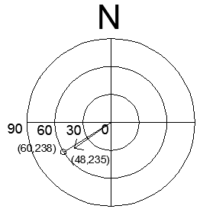
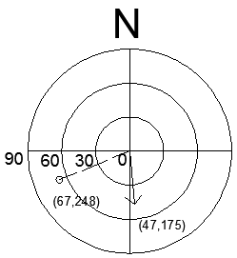
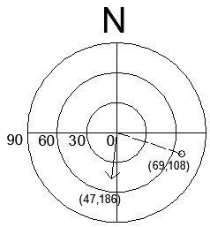
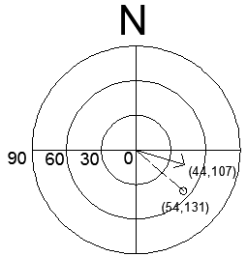
Site 5
Site 6
Azimuth angle of 4 measurements by CE-3
Site 7
Site 8

Slide 18
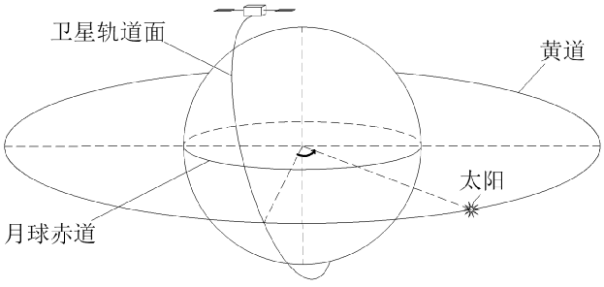
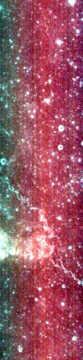
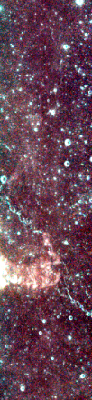
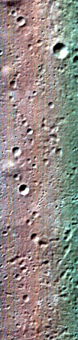
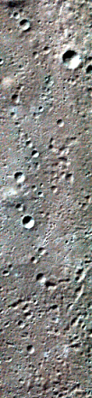
Results
Chang’E-1 IIM model (Wu et al., 2013)
Flat field correction
A new method for the correction of flat field (inhomogeneity of spatial response) was developed.
the orbits which are systematically distributed with respect to zero beta angle are used for deriving the correction factor , the photometric effects can be counteracted.
before
inhomogeneity
after
homogeneity
18
Notes:
18

Slide 19
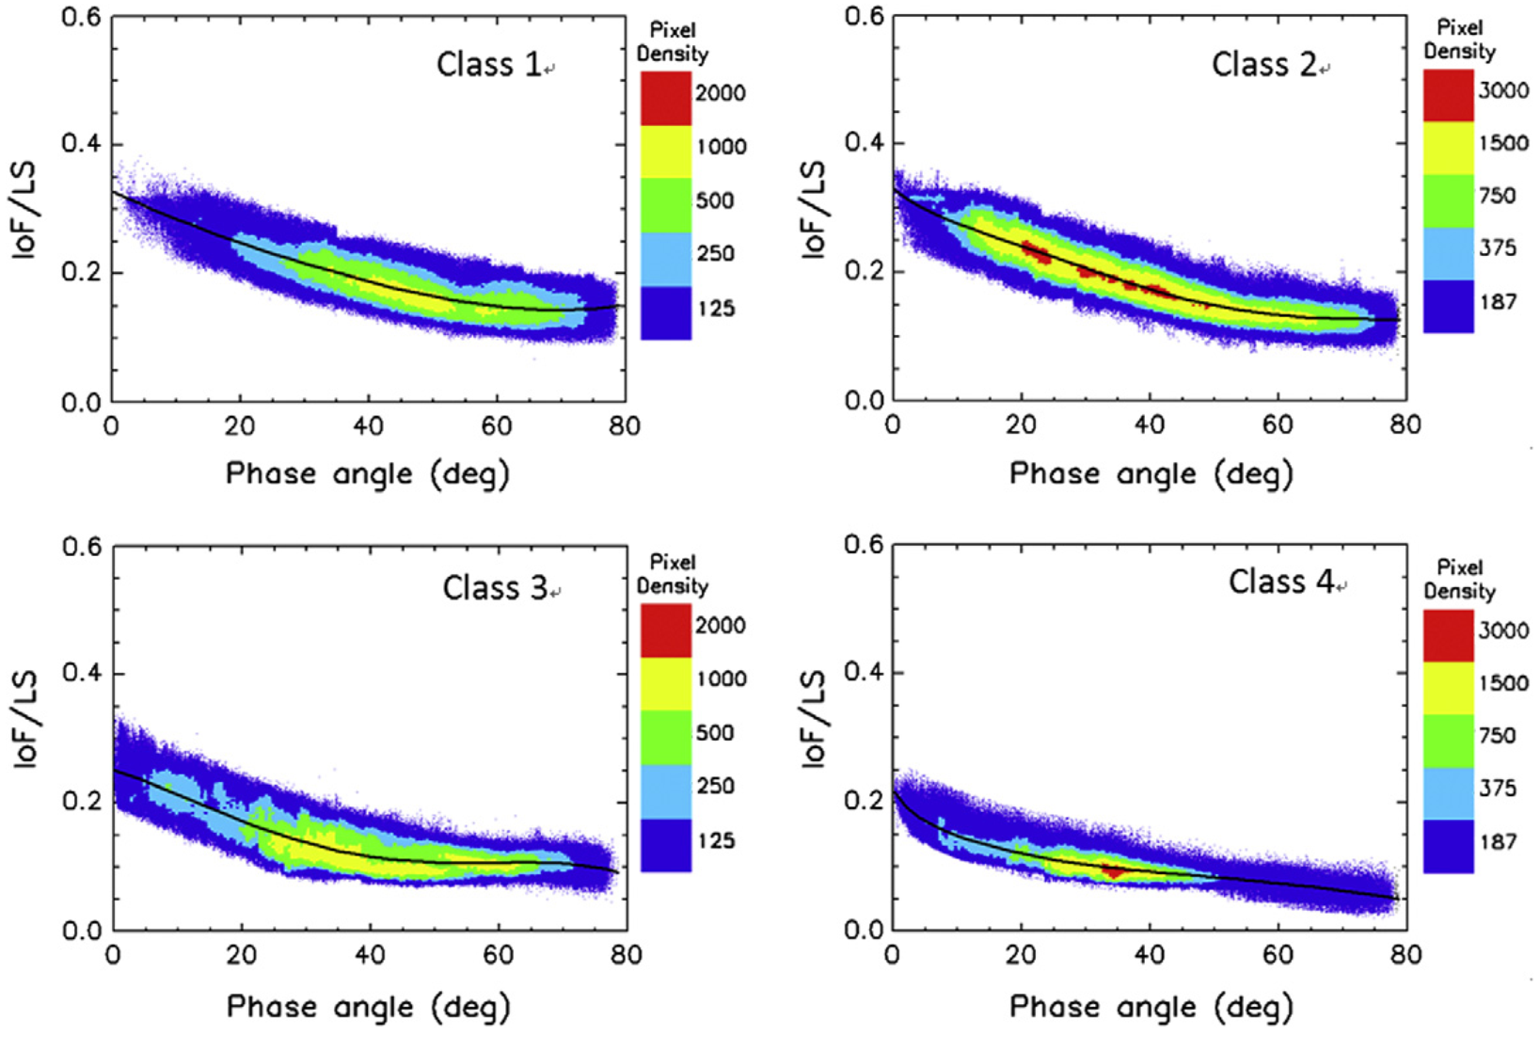
Results
Chang’E-1 IIM model (Wu et al., 2013)
Photometric model
The Moon was classified into 4 classes (Note lunar scattering varies with its albedo so it needs multiple models), which are the most classes among the current models
The phase functions of the four classes @757 nm.
19
Notes:
19

Slide 20
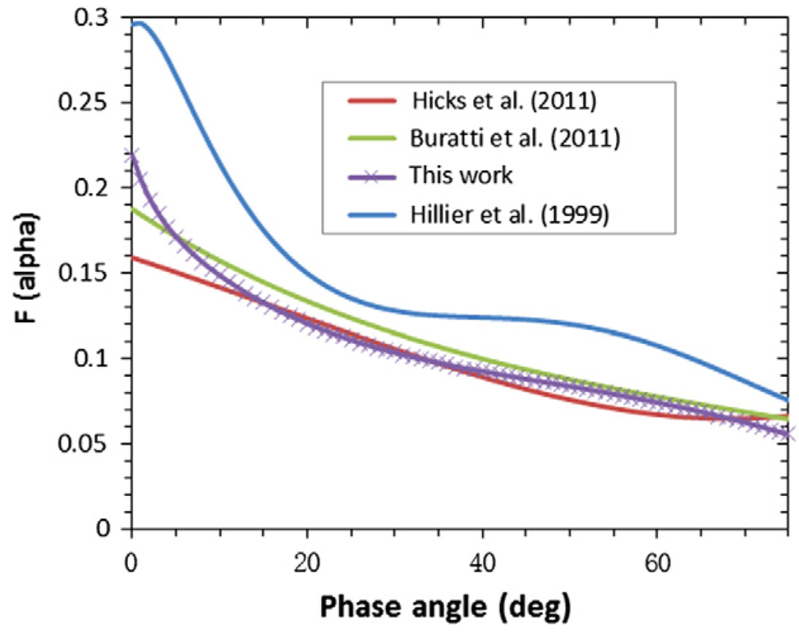
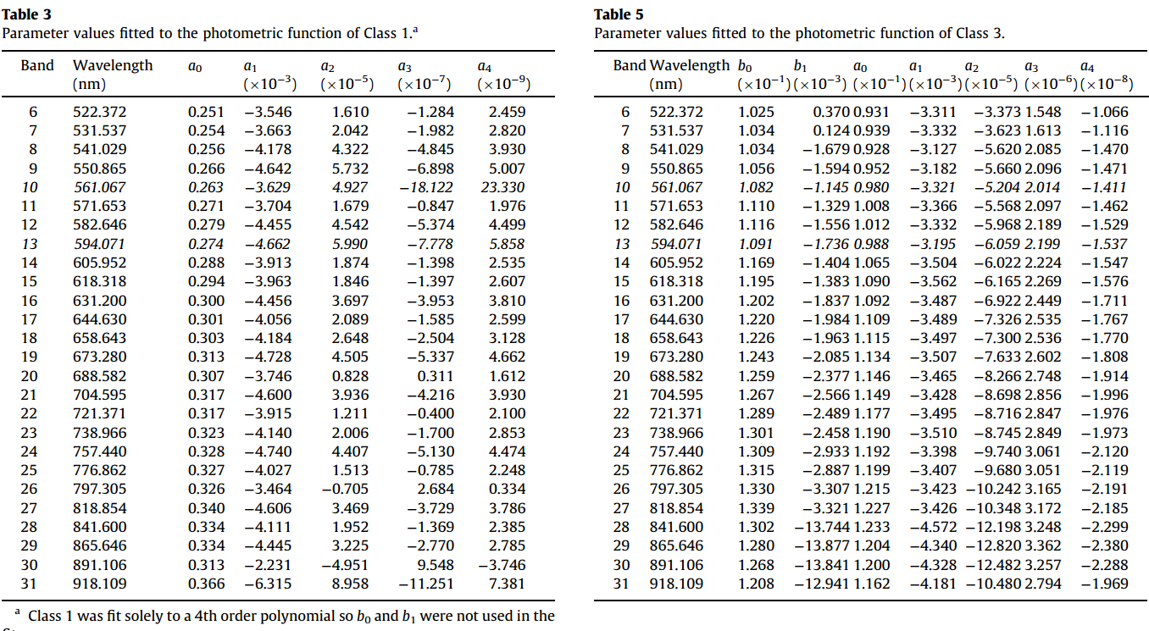
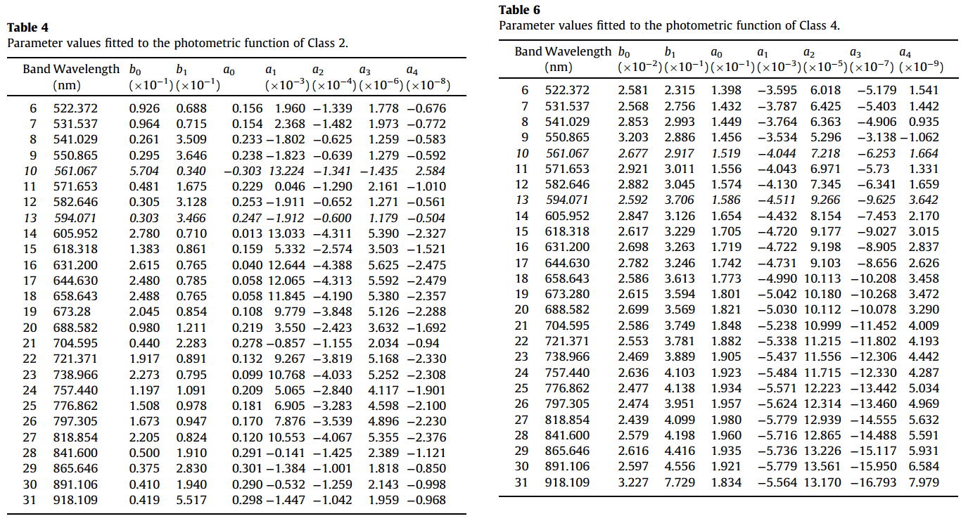
Parameter values of IIM model
Comparison of the phase function for the lunar maria at 750 nm
our phase function exhibits the darkest brightness and a clear opposition surge, which indicates the improvements of our work in terms of data selection and classification methods
Wu et al. 2013 Icarus

Slide 21
Very small relative error
Highlands
Relative error(%)
 | original | final
Mare | 6.15 | 0.73
Highlands | 4.91 | 0.21
Mare
高地
Mare
月海
Highlands
21

Slide 22
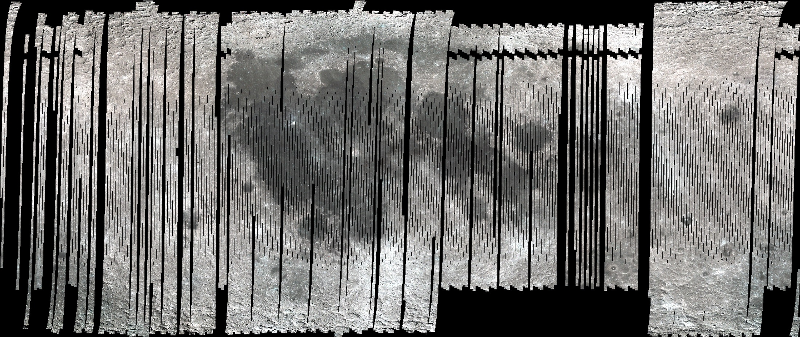
IIM color Moon
R: 900 nm; G: 757; B: 500 nm
（Wu et al., 2013, Icarus）
The absolute reflectance of the Moon
 | Absolute Reflectance（@776 nm） | Lat | Lon
Brightest | 0.180 | 24.02N | 47.90W
Darkest | 0.036 | 9.02N | 35.74E
Average | 0.103

Slide 23
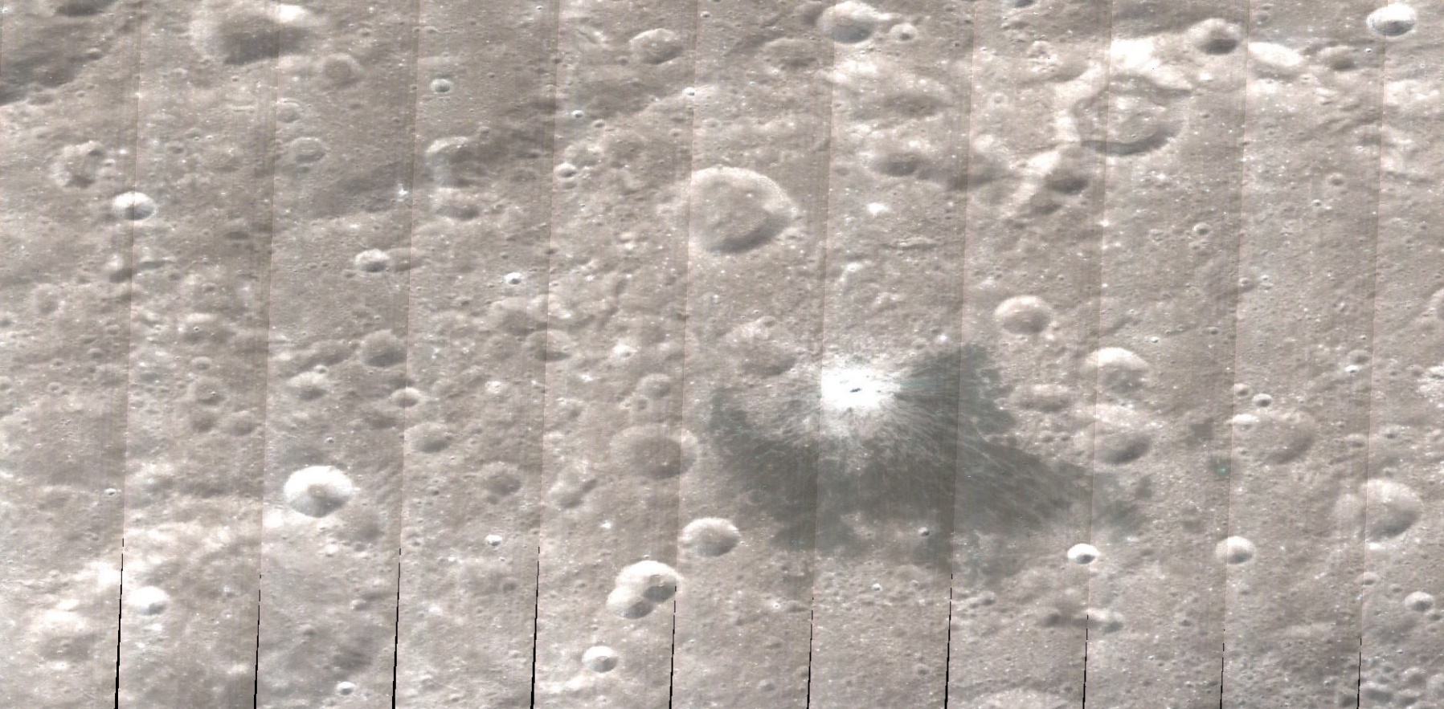
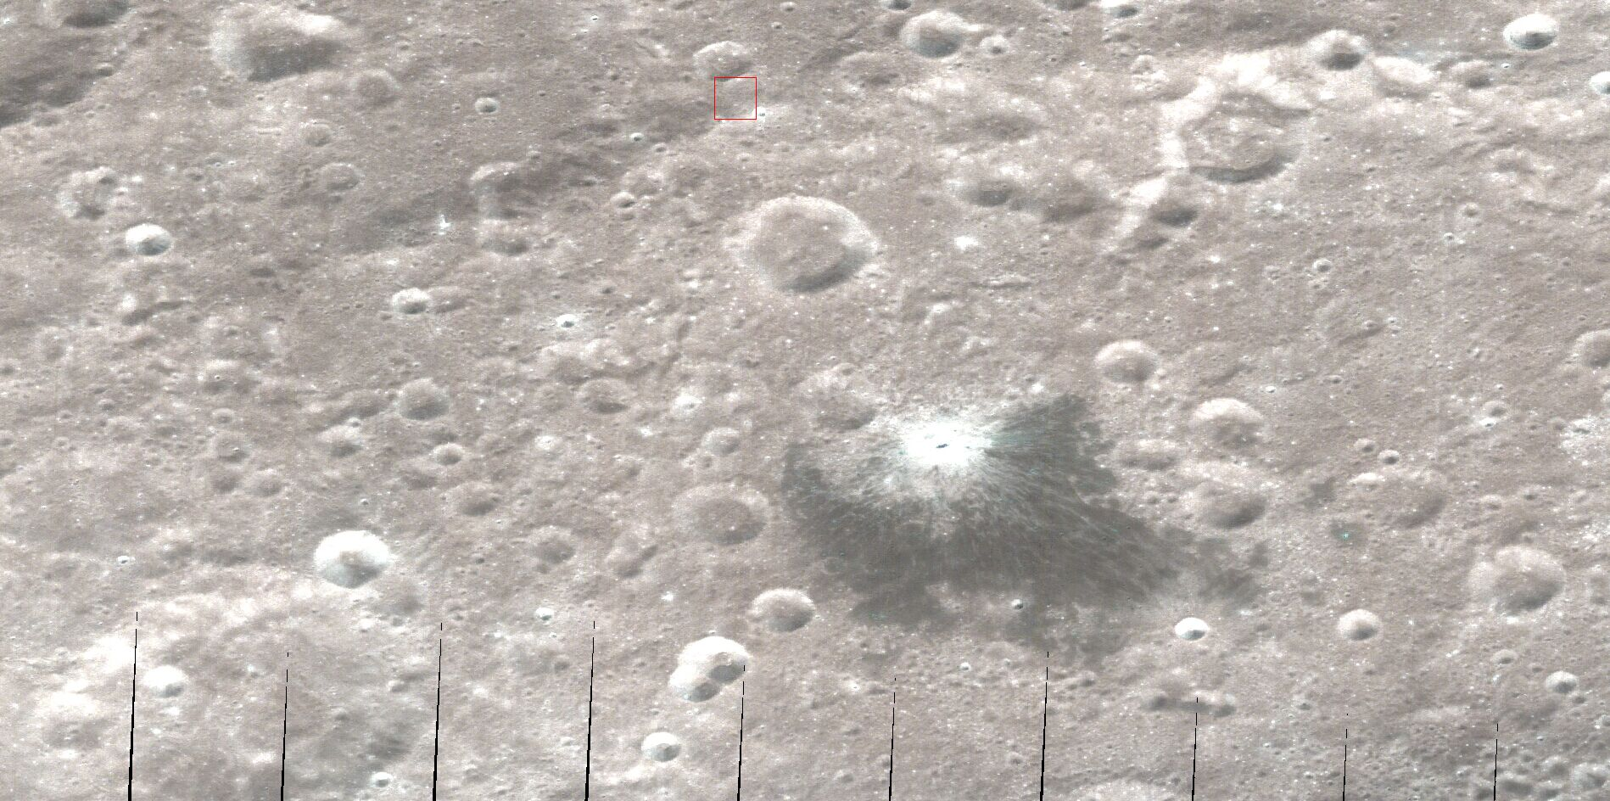
Reflectance（30º,0º,30º）
Seamless mosaic means low relative error

Slide 24
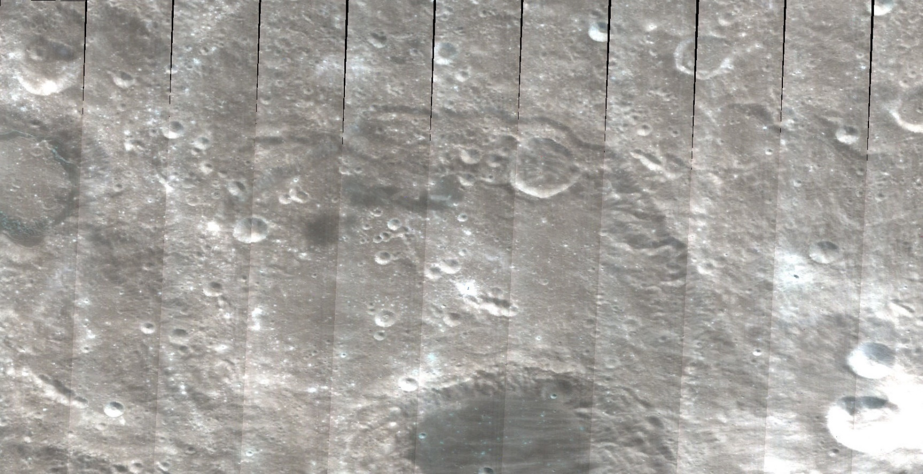
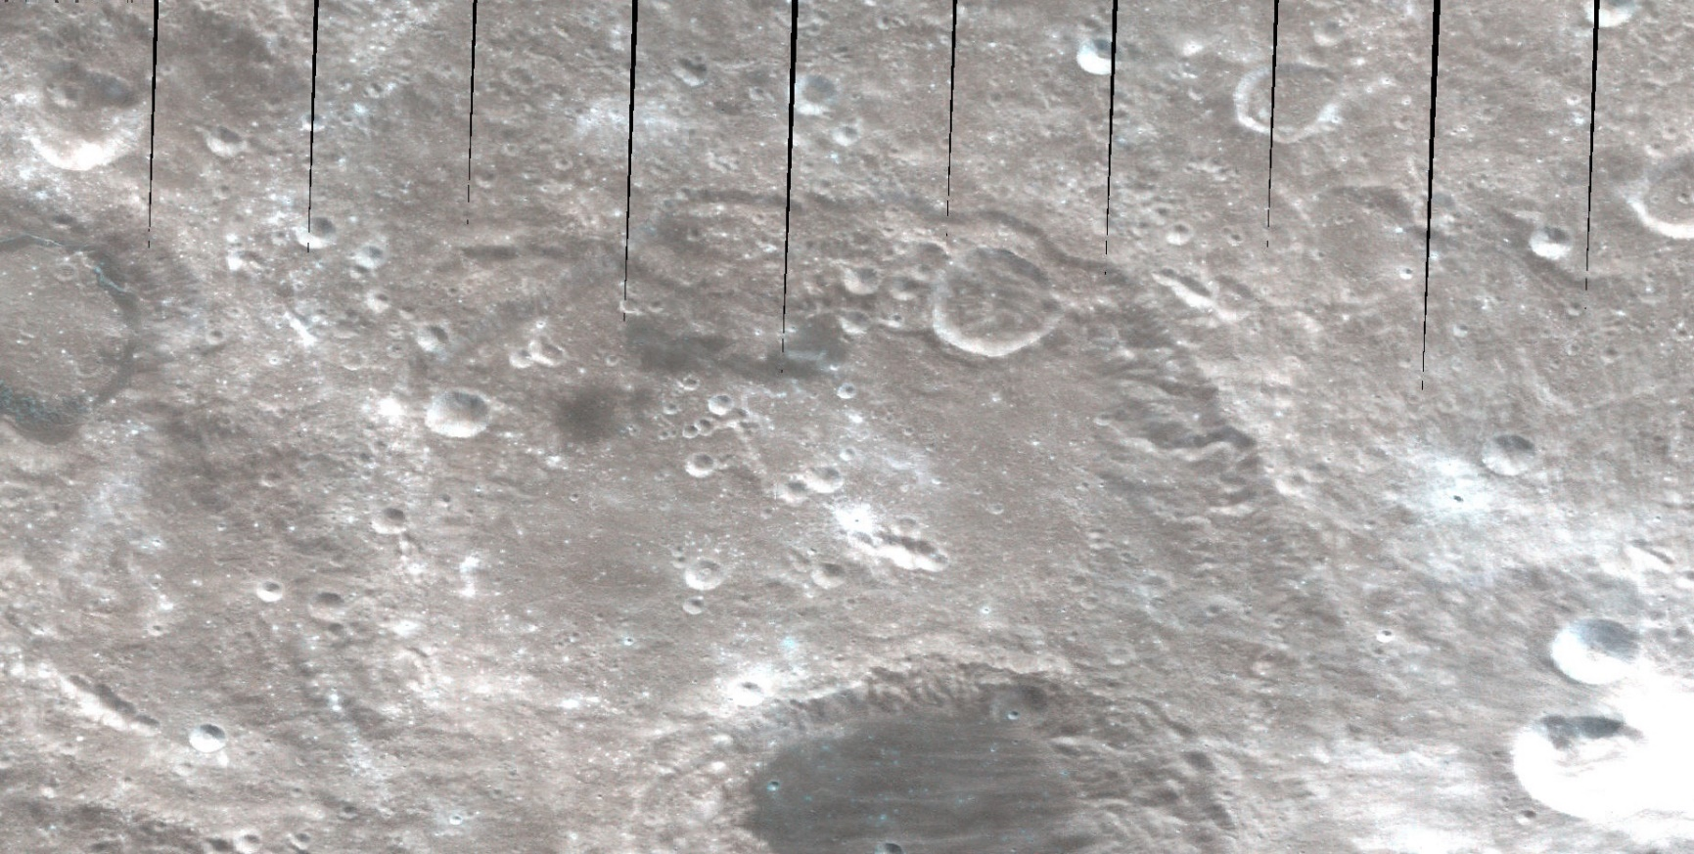
Reflectance（30º,0º,30º）
Seamless mosaic means low relative error

Slide 25
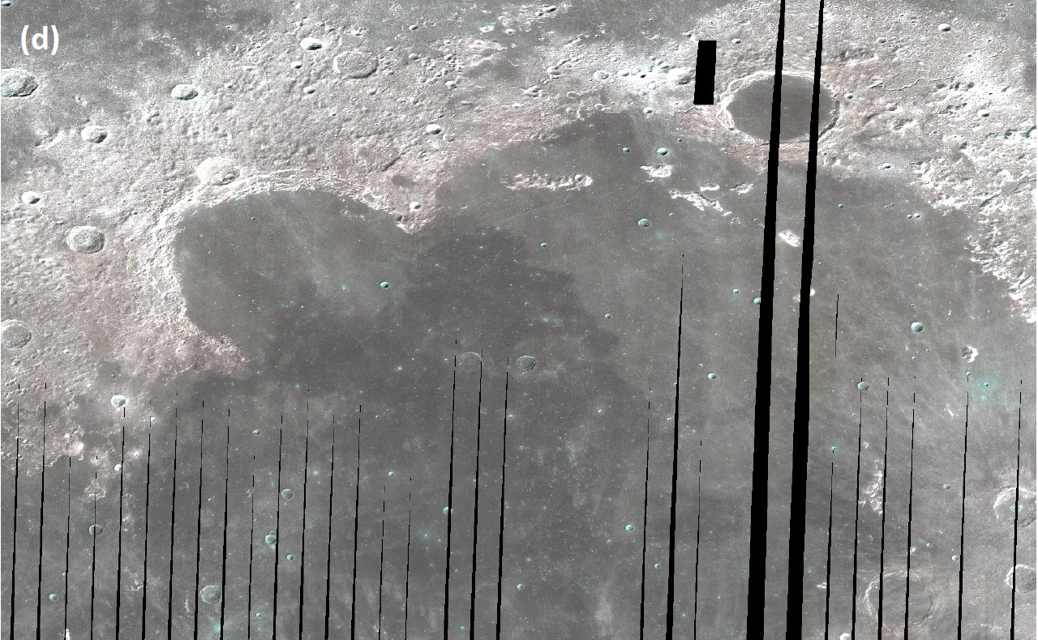
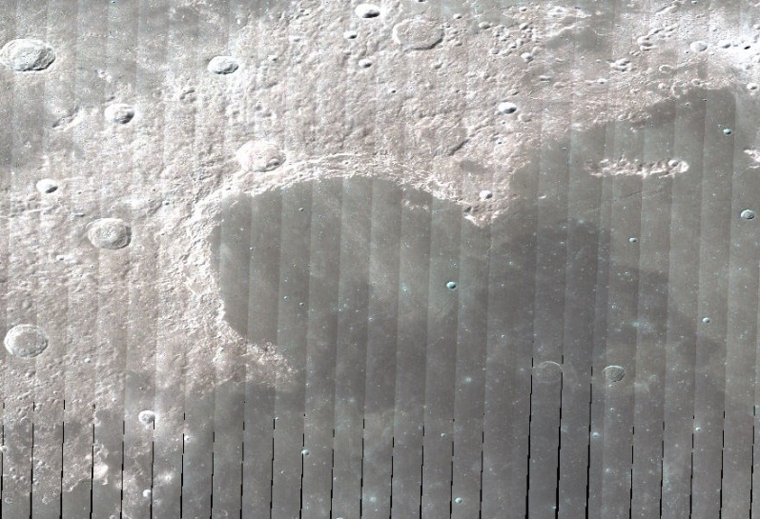

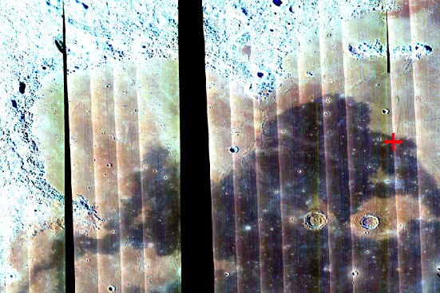
柏拉图
虹湾
嫦娥三号
苏联Luna 17
美国M3图像
Reflectance（30º,0º,30º）

Slide 26
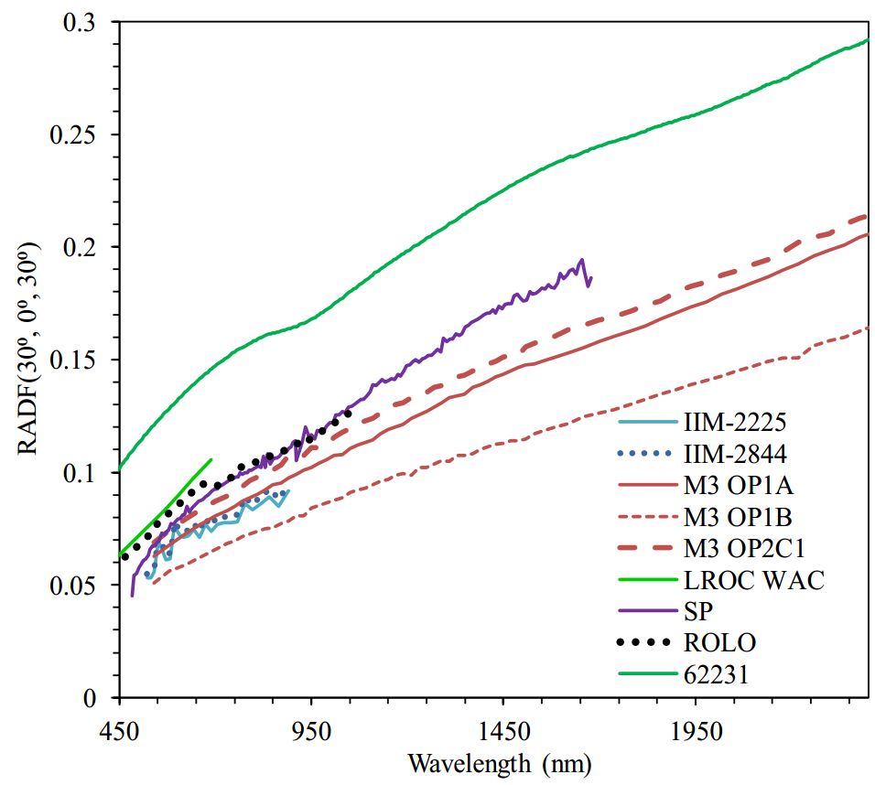
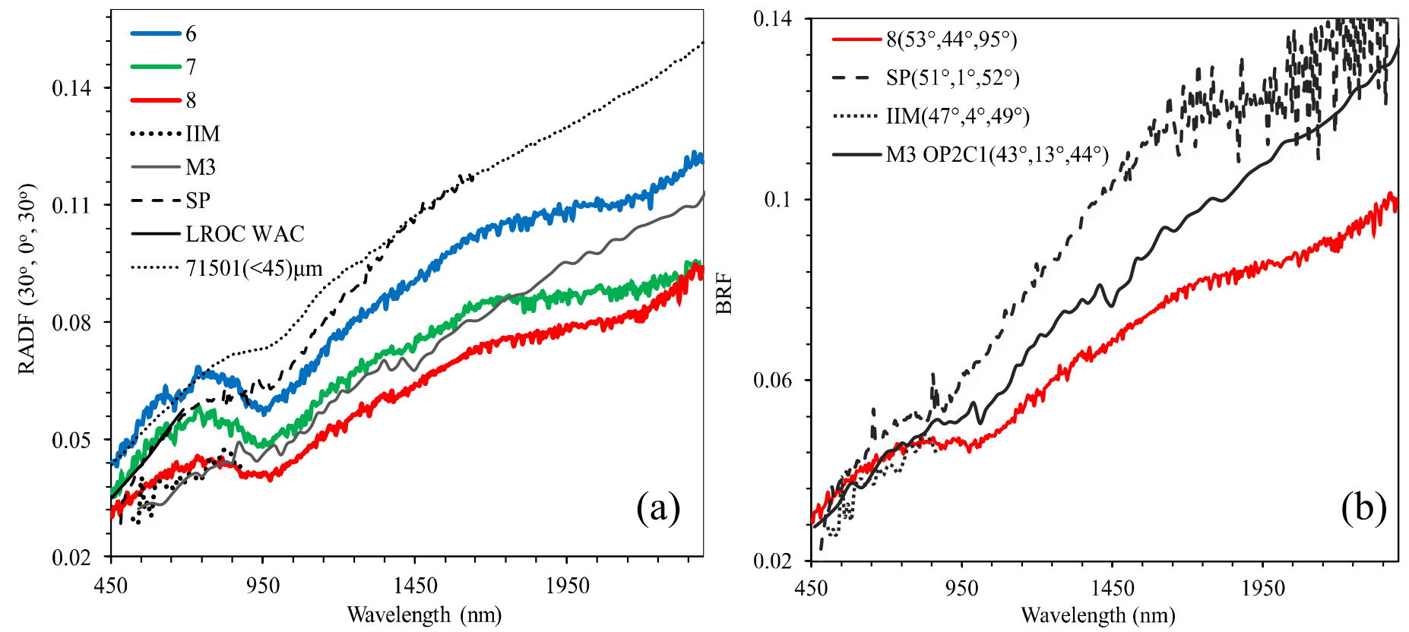
Comparison-1: Reflectance
CE-3
Apollo 16
CE-3
CE-3

Slide 27
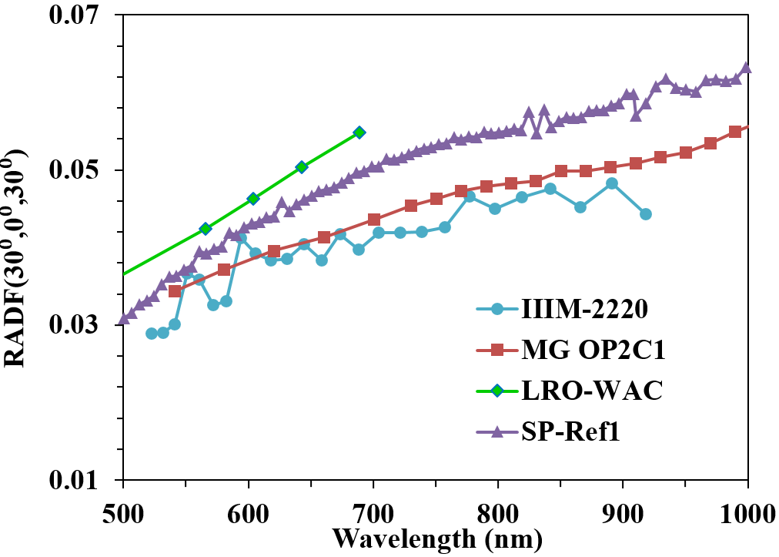
Comparison-1: Reflectance
Brightest
Darkest
MS-2
Note that the LROC-WAC is old data
Current LRO-WAC has reduced reflectance and slope by times 0.91 factor.

Slide 28

Comparison-2: Radiance
CE-3
CE-3
Radiance values (a) and the values normalized to unity at 750 nm (b) comparison among different instruments.

Slide 29




CE-3 landing site was suggested as new calibration site
(a)
(b)
Previous sites (MS-2; Apollo 16; see Pieters 2008) are all old (>3.2 Ga) so very rough.
CE-3 is much younger hence roughness is smaller.
CE-3 site is very large because it represents late stage of lunar volcanism.
There are in situ reflectance and composition (APXS).
(c)

Slide 30



亮度@757 nm
W
N
Waxing Moon
2018-12-20T12:20
Phase angle=-30º
Waning moon
2018-12-24T23:05
Phase angle=30º
20
W/m²/μm/Sr
110
Total irradiance: 0.0036@750 nm
Simulated Moon and its absolute irradiance and radiance using the IIM reflectance model
2018-12-22T18:45(2018年超级月亮Super Moon)
 | 时间（UTC） | E-M D(10⁵ km) | S-M D(10⁸ km) | Sub-Earth |  | Sub-Solar |  | phase | 月球方位角 | 月球天顶角
近地点 | 2018-12-20T12:20 | 3.68 | 1.47 | -5.57 | 6.29 | 23.92 | 0.79 | -29.94 | 129.79 | 34.52
 | 2018-12-22T18:45 | 3.58 | 1.48 | -3.45 | 3.37 | -3.57 | 0.72 | 2.65 | 250.49 | 38.14
 | 2018-12-24T23:05 | 3.58 | 1.47 | 0.018 | -0.084 | -30.01 | 0.64 | 30.04 | 273.47 | 63.43
远地点 | 2018-06-25T11:20 | 3.97 | 1.52 | 5.52 | -5.39 | 35.17 | -0.87 | -29.93 | 136.62 | 69.74
 | 2018-06-28T12:50 | 4.04 | 1.52 | 1.97 | -2.23 | -2.18 | -0.80 | 4.39 | 128.84 | 80.75
 | 2018-06-30T22:50 | 4.05 | 1.52 | -2.68 | 0.74 | -31.66 | -0.74 | 29.01 | 241.23 | 86.41

Slide 31
Summary
The reflectance of lunar samples has a factor of 2.5 to 1.41 higher than the actual reflectance.
The differences in the measurements of orbital instruments are very large and indicate inherent differences in their absolute calibration.
IIM has the lowest relative uncertainty (<1%).
The M3 and IIM measurements are much smaller than LROC WAC and SP, and the VNIS measurement falls between these two pairs. The comparison demonstrates that the measurements of the LROC WAC and SP are too high and too red.
When using the Moon as a radiance source for the on-orbit calibration of spacecraft instruments or building a model, one should be cautious about the data.
CE-3 landing site, a young and homogeneous surface, can be as the new optical standard site.

Slide 32
Issues on comparison
The spatial resolution varies much from 0.5mm (in situ) to 140 m (M³) to 7.4 km (ROLO).
The observation angle of CE-3 in situ data is 45º and phase angle is large (85º -104º). For orbital data such as IIM, M3 and SP they were nadir observing.
For ROLO currently only Apollo 16 was available for comparison (figures from Besse et al., 2013; Staid et al., 2007). There is no data for MS-2, CE-3.

Slide 33

Thank you！
This work is supported by the National High Technology Research and Development Program of China (2015AA123704) led by China Meteorological Administration

Slide 34
Summary

