Slide 1

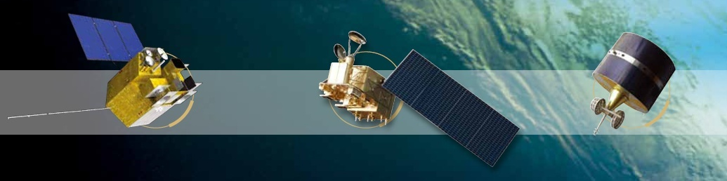


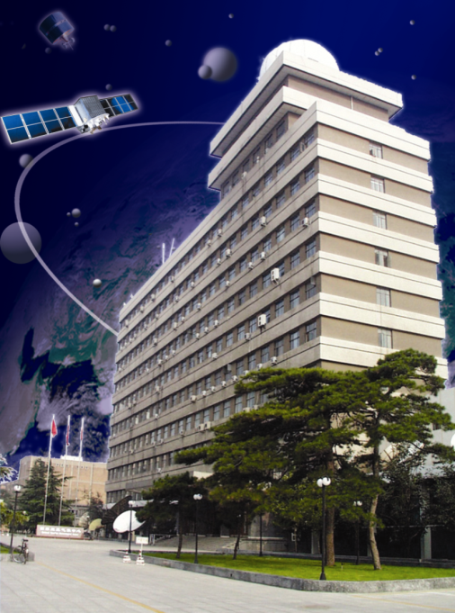

MTF Evaluation for FY-2G Based on Lunar
Lin Chen
National Meteorological Satellite Center
chenlin@cma.gov.cn
Acknowledgement:
Hailong Chen, Yifan Huang(BIT);
Min Min, Lei Yang, Xiuqing Hu(CMA)
Nov. 13~16, 2017, Xi'an, China

Slide 2
Outline
1. Background Introduction
2. Data Acquisition
3. Standard Processing Step for Edge target
4. Results and Analysis
5. Conclusions
Notes:
Here is the outline of my presentation today, firstly I would like to give a introduction of knife edge method.

Slide 3
Previous works
Many researchers have made contributions to the development of on-orbit MTF calculation by lunar.
  1999: Lunar limb (GOES-9) - James
  2005: Relationship between MTF and the SNR -- Taeyoung Choi
  2014: MODIS --Wang
  2017: Himawari-8/AHI -- Graziela
We calculated the on-orbit MTF for FY-2G based on knife-edge method and lunar image. The principal method are referenced above.
Notes:
Many researchers have made contributions to the development of on-orbit MTF measurements. In 1999, James proposed a method based on lunar limb knife-edge to measure the optical transfer function for GOES-9. in 2005, Taeyoung Choi built the relationship between MTF and the SNR of image. In 2014, Wang tested the on-orbit characterization of MODIS modulation transfer function using the moon. In 2017, Graziela R analyze the MTF using lunar observations for Himawari-8/AHI. We researched the MTF for FY-2G using lunar image and knife-edge method.

Slide 4
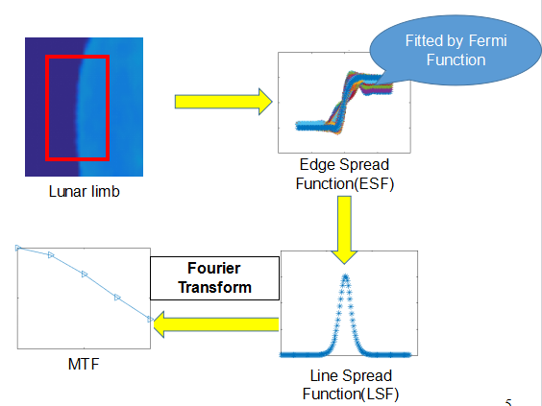
Knife-edge Method
In lunar image, multiple scan-direction Moon-to-background transition profiles are aligned by the subpixel edge locations from a parametric Fermi function fit. Corresponding accumulated edge profiles are filtered and interpolated to obtain the edge spread function (ESF). The MTF is calculated by applying a Fourier transformation on the line spread function through a simple differentiation of the ESF.
Notes:
The Knife-edge method based on lunar limb can be described as follow : In lunar image, multiple scan-direction Moon-to-background transition profiles are aligned by the subpixel edge locations from a parametric Fermi function fit. Corresponding accumulated edge profiles are filtered and interpolated to obtain the edge spread function (ESF). The MTF is calculated by applying a Fourier transformation on the line spread function through a simple differentiation of the ESF.

Slide 5
Outline
1. Introduction
2. Data Acquisition
3. Standard Processing Step for Edge target
4. Results and Analysis
5. Conclusion

Slide 6
Data Acquisition
VISSR, on-board the FY-2G
Five channels
Visible channel have 4 detectors
Band | Wavelength/μm | Bit | Line scan/s | Dynamic
VIS IR1 IR2 IR3 IR4 | 0.5~0.9 10.3~11.3 11.5~12.5 6.3~7.6 3.5~4.0 | 6 10 10 10 10 | 0.6 0.6 0.6 0.6 0.6 | 0-98% 180k~330k 180k~330k 190k~300k 180k~340k
Notes:
The device used for this study is the VISSR, housed on the FY-2G. The imager has five channels including one vis channel and four IR channels. The visible channel is comprised of 4 detectors, arranged in a north/south column. The moon will appear in the view of VISSR, and be recorded in the remote image.

Slide 7
Outline
1. Introduction
2. Data Acquisition
3. Standard Processing Step for Edge target
4. Results and Analysis
5. Conclusion

Slide 8
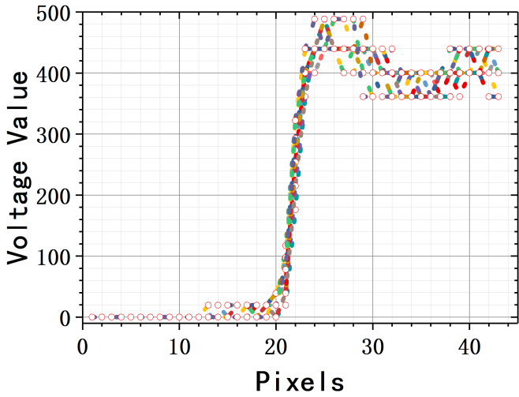
Edge Spread Function
Why use lunar limb?
  High contrast edge
  No atmospheric effect
Initial ESF:
  Have noise
  Misalignment(due to inclined angle on edge)
The Moon offers a high contrast edge and because there is no atmosphere around the Moon, so the edge sharpness is not degraded by atmospheric effect as occurs with targets on Earth. That makes the Moon a good target for MTF analyses. And then we get multiple sampled line from east to west as the initial ESF. However, the initial ESF has higher noise and misalignment.
Notes:
The Moon offers a high contrast edge and because there is no atmosphere in between the Moon and the sensor, the edge sharpness is not degraded by atmospheric processes as occurs with targets on Earth. That makes the Moon a good target for MTF analyses. And then we get multiple sampled line from east to west as the initial ESF. The initial ESF has higher noise and misalignment.

Slide 9
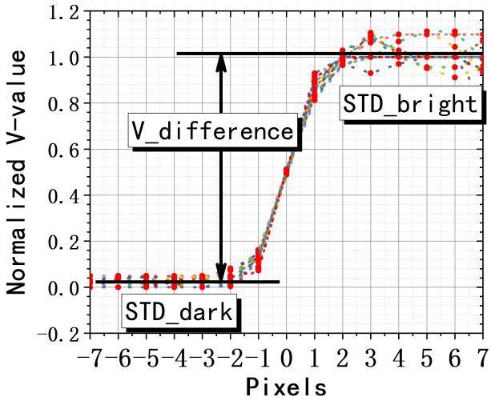
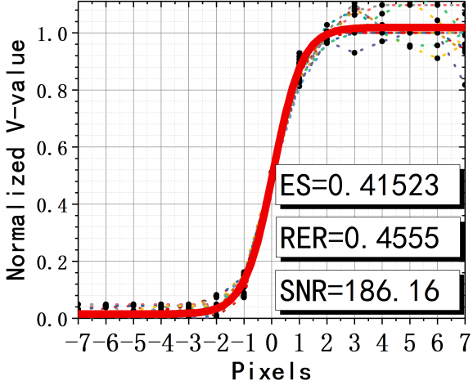
Edge Spread Function
Normalized the data
Scan line averaging
Sub-pixel re-sampling (due to slightly inclined angle)
The definition of SNR and Fermi function fit
To produce an edge spread function having low noise and low aliasing potential, a technique of scan line averaging is used. SNR needs to be defined for pulse and edge targets to perform the quality of the image. Often, SNR is defined as the ratio of the mean value of an input signal to its standard deviation. Finally the ESF is fitted using a Fermi function.
Notes:
To produce an edge spread function having low noise and low aliasing potential, a technique of scan line averaging is used. SNR needs to be defined for pulse and edge targets to perform the quality of the image. Often, SNR is defined as the ratio of the mean value of an input signal to its standard deviation. Finally the ESF is fitted using a Fermi function.

Slide 10
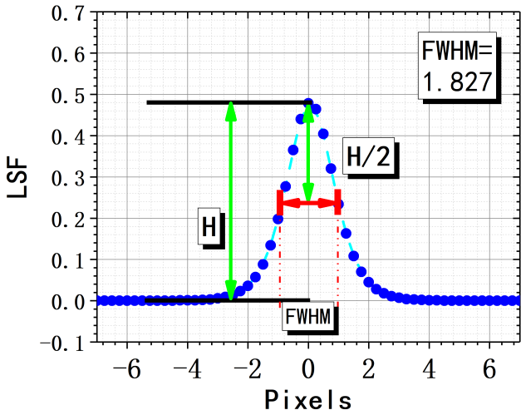
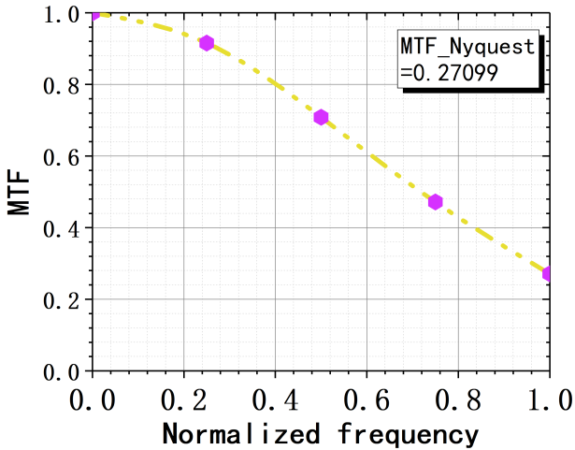
LSF and MTF
LSF(the differentiation of ESF)
MTF(the Fourier Transform of LSF)
The line spread function(LSF) is a simple differentiation of the ESF.
The MTF is calculated by applying a Fourier transformation on the LSF.
Notes:
the line spread function is a simple differentiation of the ESF.
The MTF is calculated by applying a Fourier transformation on the LSF.
These are the main step of the image processing.

Slide 11
Outline
1. Introduction
2. Data Acquisition
3. Standard Processing Step for Edge target
4. Results and Analysis
5. Conclusion

Slide 12
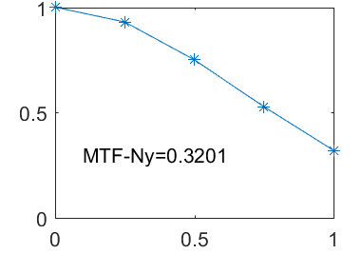
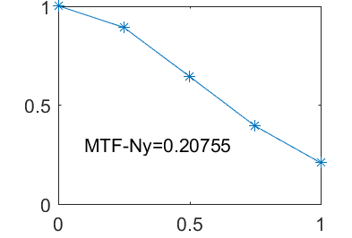
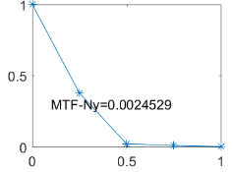
Different Targets
The results calculated based on lunar and telluric limb show that the suitable moon target do have the advantages on MTF analysis.

Slide 13
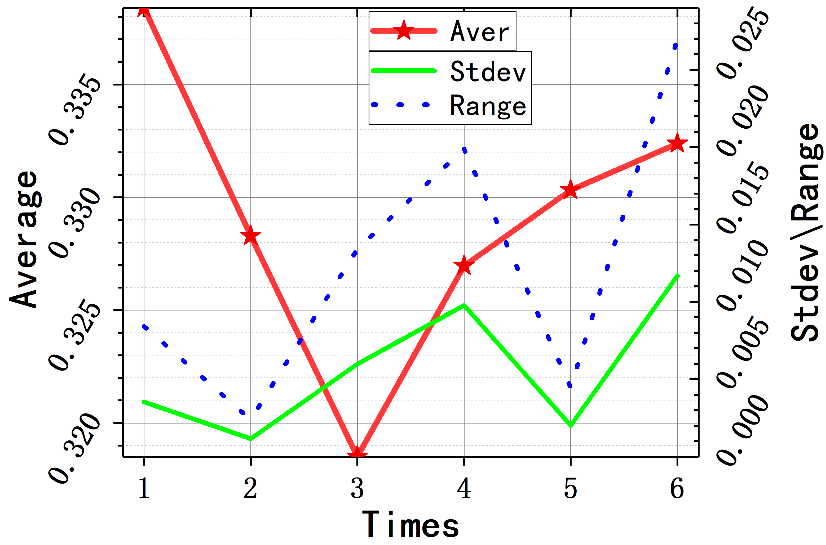
MTF of Each Detectors
Frequency Detectors | 0.00 | 0.25 | 0.50 | 0.75 | 1.00
detector1 | 1 | 0.93405 | 0.76284 | 0.54562 | 0.33737
detector2 | 1 | 0.93561 | 0.76750 | 0.55212 | 0.34330
detector3 | 1 | 0.93357 | 0.76132 | 0.54327 | 0.33489
detector4 | 1 | 0.93436 | 0.76370 | 0.54663 | 0.33802
Average | 1.0000 | 0.93440 | 0.76380 | 0.54692 | 0.33840
Standard Derv | 0.0000 | 0.00087 | 0.00263 | 0.00375 | 0.00354
The results from different detectors are very close.
The results is stable on time.

Slide 14
Each Detector's Result of time series
Detector Time | detector1 | detector2 | detector3 | detector4
201502070627 | 0.337375 | 0.343309 | 0.334894 | 0.338027
201502070633 | 0.328968 | 0.328720 | 0.326575 | 0.328915
201502070639 | 0.321531 | 0.319354 | 0.323287 | 0.309869
201502070645 | 0.331280 | 0.332204 | 0.332061 | 0.312314
201502070651 | 0.333263 | 0.329304 | 0.328793 | 0.329933
201502070657 | 0.334583 | 0.315598 | 0.336779 | 0.342585
201502080705 | 0.333898 | 0.324360 | 0.319818 | 0.319449
Average | 0.331557 | 0.32755 | 0.328887 | 0.32587
Standard Derv | 0.005143 | 0.00908 | 0.006156 | 0.012477
The results of each detector have tiny difference.

Slide 15
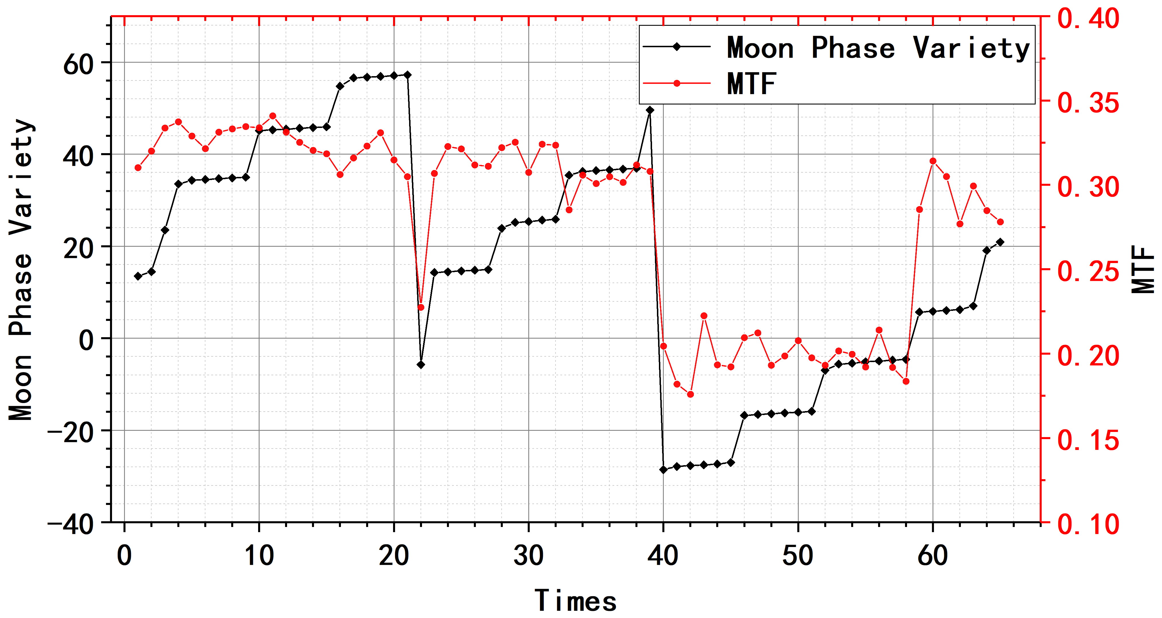
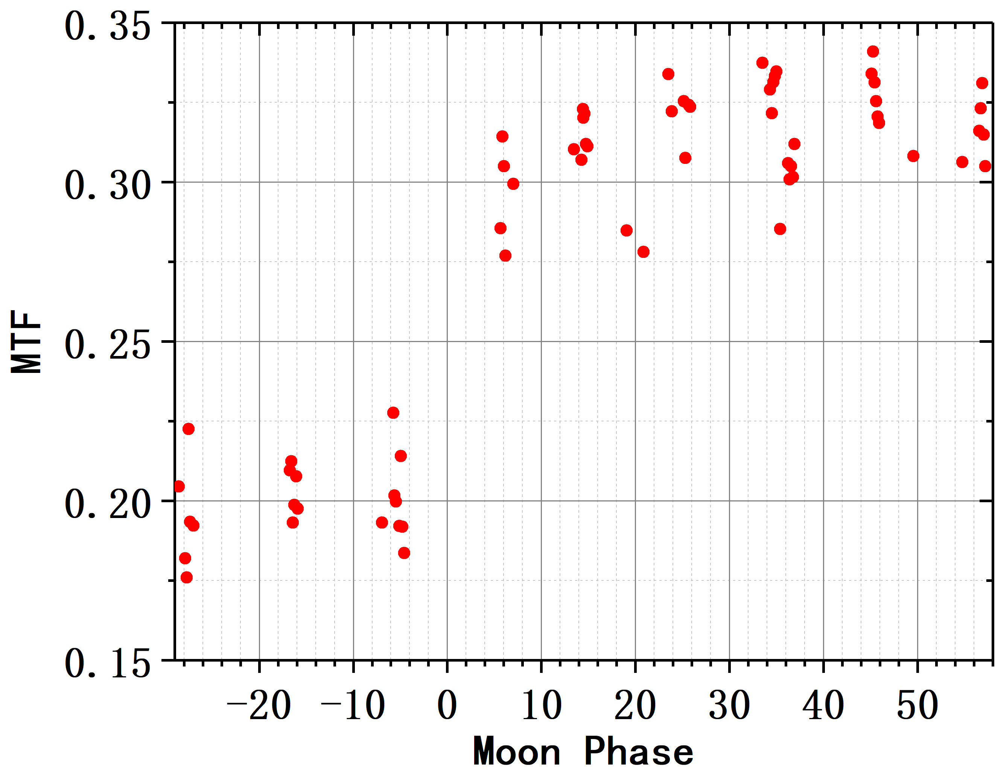
MTF with Variation of Moon Phase Angle
MTF changed with the variable moon phase angle or waxing and wane
Notes:
MTF changed when the moon phase is variable. Different moon phase means diverse image quality. The lager the moon variety is, the better the image quality is. Then the results are better.

Slide 16
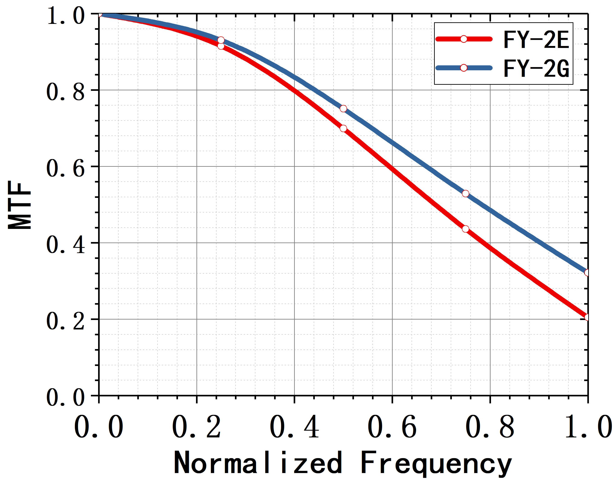
Comparisons between FY-2E and FY-2G
The performance of optical system for FY-2G is better than that for FY-2E.

Slide 17
Conclusions
The Moon offers a high contrast edge, not degraded by the atmospheric processes, make it a good target for MTF analysis
The MTF results could vary with the different SNR
The results show that MTF from different detectors are quite close
The relationship between moon phase and MTF are shown.
The MTF comparison results of FY-2E and FY-2G show the improvment of FY-2G on image quality.

Slide 18
Thanks

Slide 19
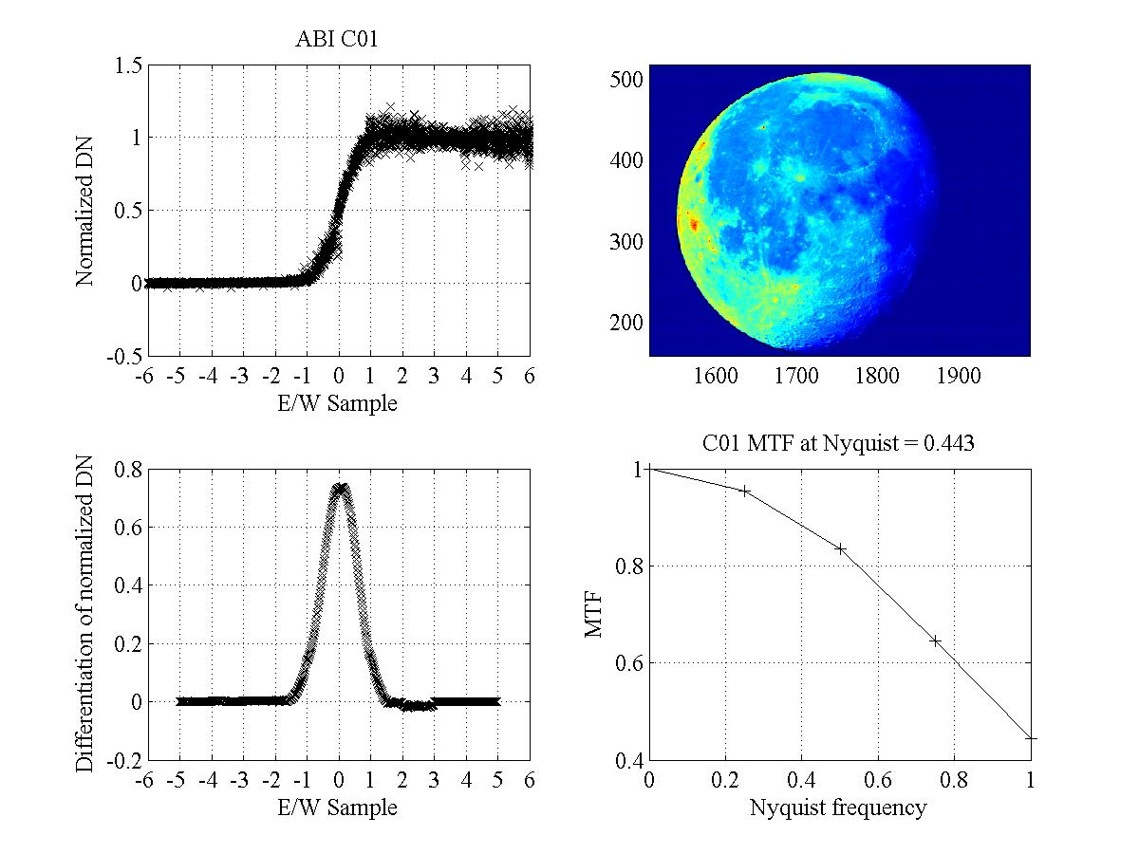
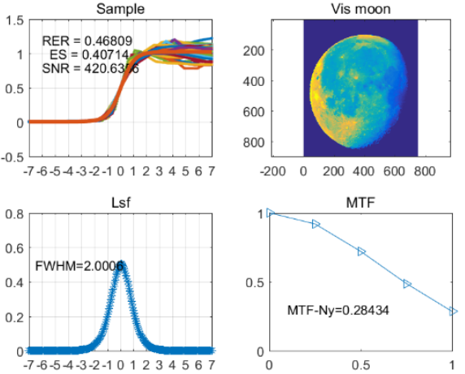
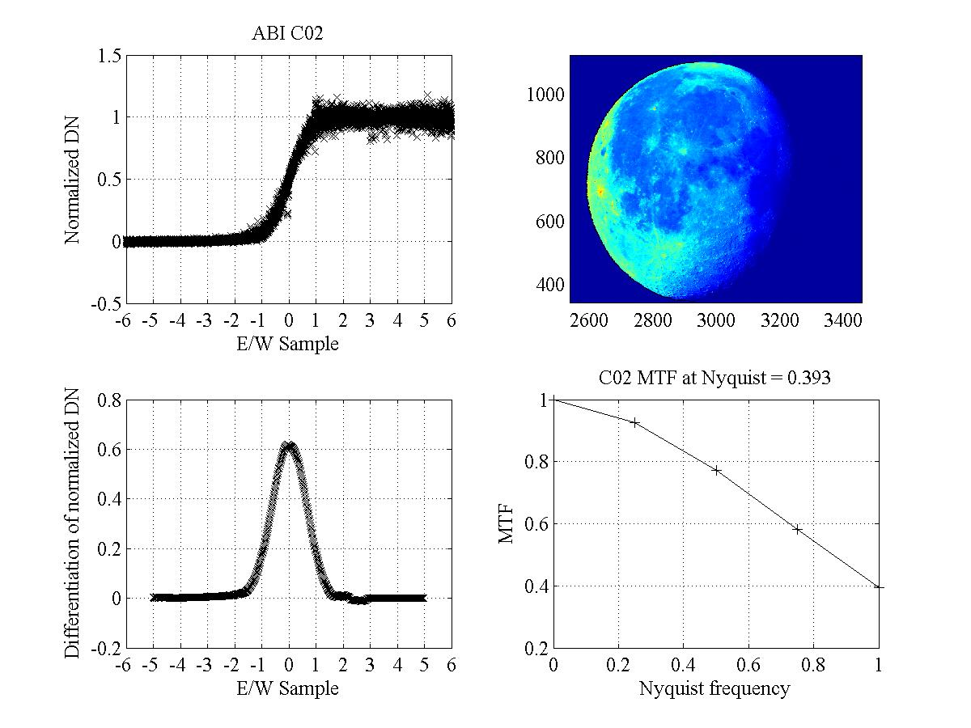
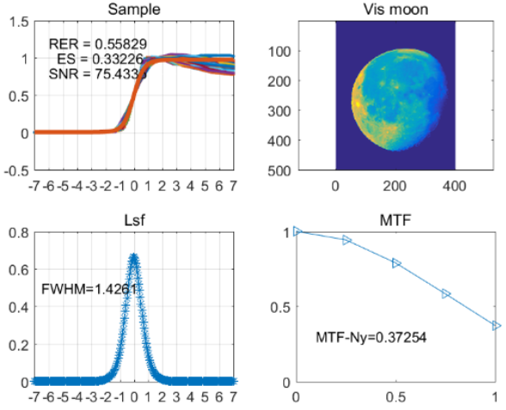
NOAA
CMA

