Slide 1


Characterization and Correction of Electronic Crosstalk Using Lunar Observations in MODIS
MODIS Characterization and Support Team
Presented By Truman Wilson
NASA/GSFC
2017 Joint GSICS/IVOS Lunar Calibration Workshop
Nov 13 – 17, Xian, China

Slide 2
Introduction
Electronic crosstalk is an issue that affects many space-based remote sensing instruments, including MODIS and VIIRS.
For scanning radiometers like MODIS and VIIRS, spatial dislocation between the spectral bands allow for us to observe crosstalk in lunar observations, as the Moon is a small, bright target against the dark background of space.
This detector is observing space, but may measure some contaminated signal from the bands that are observing the Moon
For this presentation, I’ll concentrate mainly on our work with Terra MODIS. The same principles for application apply to both Aqua MODIS and SNPP VIIRS.

Slide 3
Introduction
Signs of electronic crosstalk
  Introduces detector-to-detector differences in EV images
    Striping and Radiometric bias
    Loss of calibration fidelity
  Out-of-band properties
    Land/water boundaries in a spectral channel that should not observe this
  Anomalous peaks in lunar observations

Slide 4
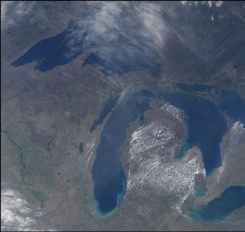
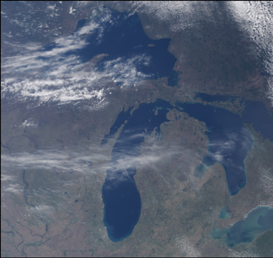
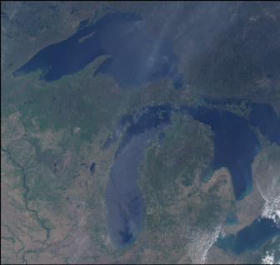
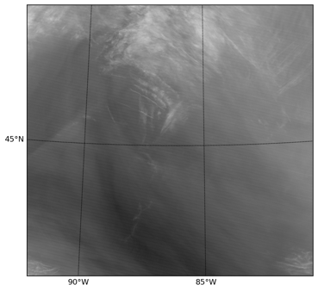
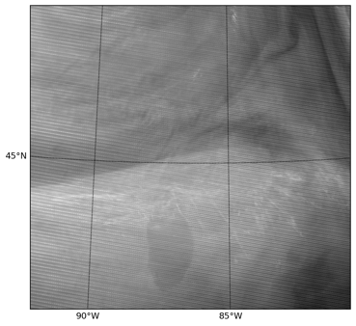
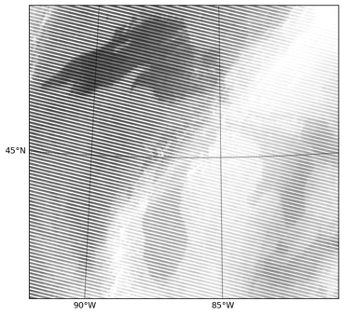
Striping and Land Features in
Terra MODIS Band 27 (6.72 μm)
2000
2008
2016
True Color
Band 27
BT
Hist.
T. Wilson et. al., Remote Sens. 9 (6), 569 (2017).

Slide 5
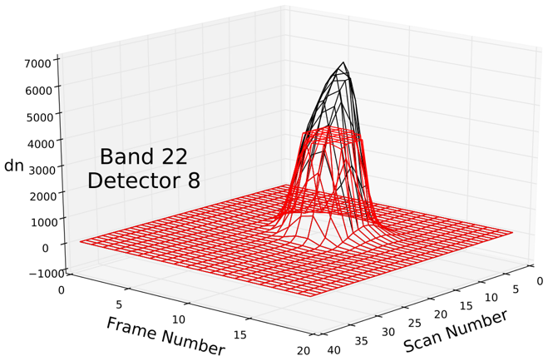
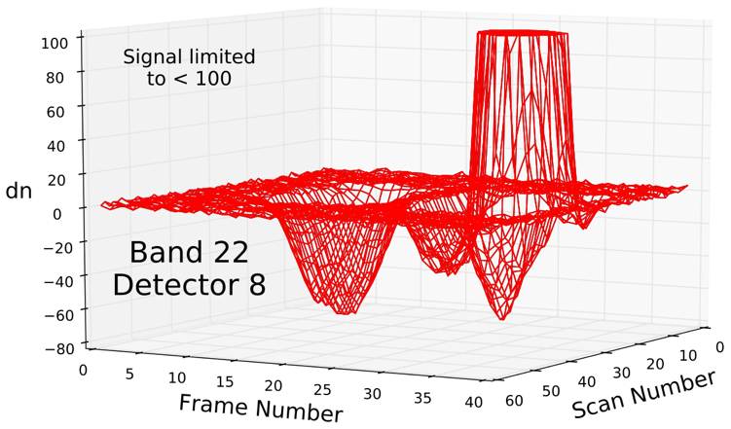
Single Detector Lunar Data
The signal during lunar observations saturates at 4095 before background subtraction due to the high scene temperature of the Moon (red data).
The saturation can be corrected using the ratio of the unsaturated pixel values with band 31 (black data).
Outside of the main lunar signal, contamination can be seen in the form of a signal deviation from the background level.
T. Wilson et. al., Proc. SPIE 104231Z (2017).

Slide 6
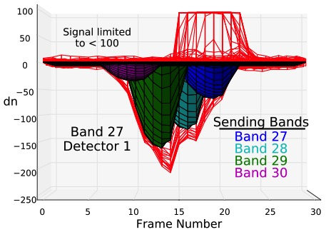
Identifying the Sending Bands
The sending bands can be identified by shifting the sending data by the appropriate frame offset and scaling it to match the contamination level.
In MODIS, there can be a significant contribution to the contamination from detectors within the same band.
The main type of contamination involves all the detectors within a given band at nearly the same contamination level. This is not strictly the case though.
T. Wilson et. al., Remote Sens. 9 (6), 569 (2017).

Slide 7
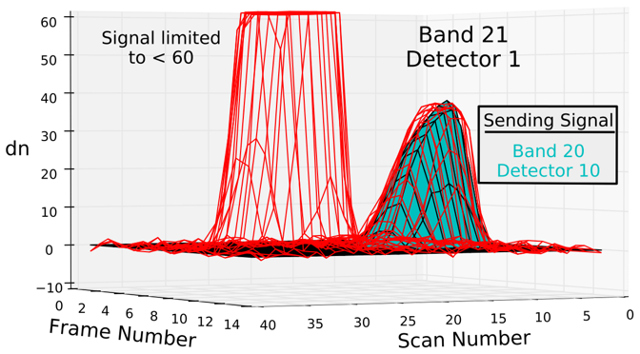
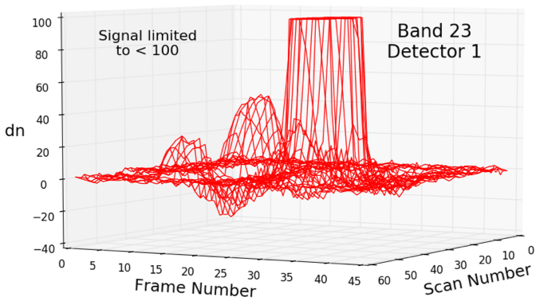
Identifying the Sending Anomalies
For some detectors, we can further identify crosstalk contamination from individual sending detectors
B25 D10
B25 D1
B24 (all)
We can treat these sending detectors separately from the band average in order to provide the best possible characterization of the contamination.
T. Wilson et. al., Proc. SPIE 104231Z (2017).

Slide 8
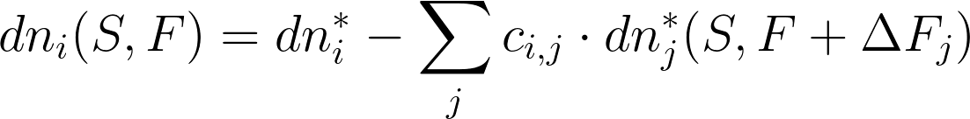
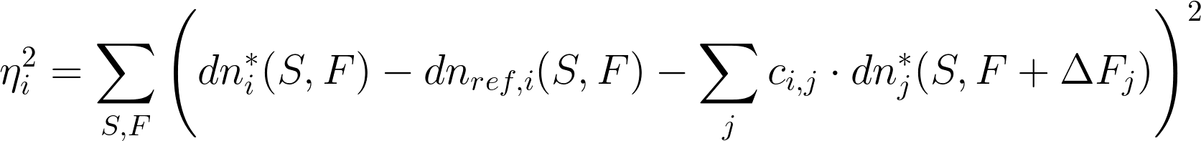
Algorithm
We use linear correction coefficients which are multiplied by the measured signal to represent the contamination. Some non-linear behavior has been identified but the linear correction works well for nearly all detectors.
The corrected signal for the ith detector is defined by:
The crosstalk coefficients, c_{i,j}, are found for detector, i, through a minimization of:
A reference signal from band 31 is used for some detectors to model low signal behavior.
We use band-averaged coefficients except for identified sending anomalies.

Slide 9
Trending Coefficients
The LWIR bands in Terra MODIS are the only bands that show significant changes over the course of the mission.
The MWIR bands for both Terra and Aqua MODIS show similar behavior to the SWIR bands.
Selected Coefficients for the MODIS SWIR bands
T. Wilson et. al., Proc. SPIE 1042313 (2017).

Slide 10
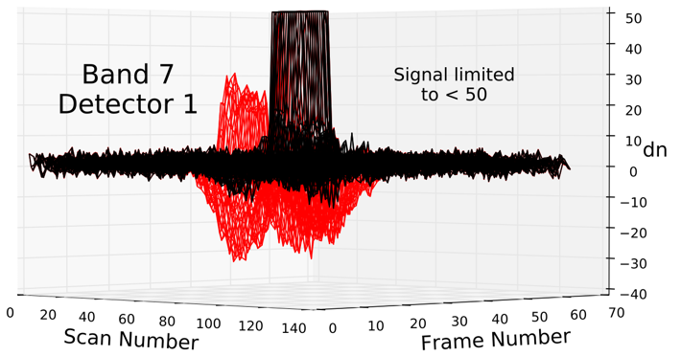
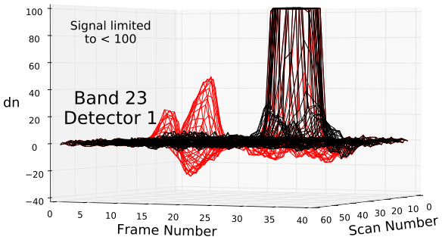
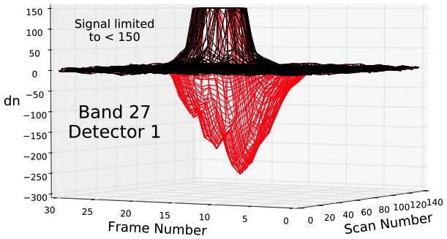
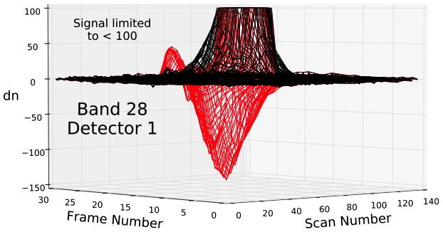
Correction of the Lunar Data
The uncorrected data is in red and the corrected data is in black.
T. Wilson et. al., Remote Sens. 9 (6), 569 (2017). T. Wilson et. al., Proc. SPIE 1042313 (2017). T. Wilson et. al., Proc. SPIE 104231Z (2017).

Slide 11
Correction of the Lunar Data
For the SWIR bands in Terra MODIS (5-7, 26), electronic crosstalk introduces significant oscillations to our lunar calibration results.
The remaining oscillations can be attributed to lunar libration.
T. Wilson et. al., Proc. SPIE 1042313 (2017).

Slide 12

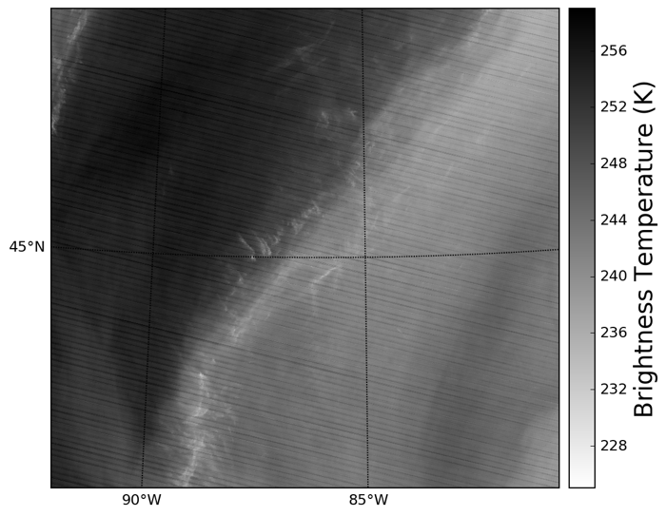
Effectiveness of the Correction on EV Data
Correcting the gain parameters (a₀, b₁, a₂) are only one part of the crosstalk correction. To properly correct the data, we need to apply the correction to every place where raw data is used.
Band 27
2016
T. Wilson et. al., Remote Sens. 9 (6), 569 (2017).

Slide 13
Effectiveness of the Correction on EV Data
Plotting histograms of the BT retrieval is a good way to show the effect of the correction over large scenes.
T. Wilson et. al., Remote Sens. 9 (6), 569 (2017).

Slide 14
Effectiveness of the Correction on EV Data
The long-term effectiveness of our correction can be analyzed using the drift in ocean brightness temperature data relative to a stable reference band (band 31 in this case).
T. Wilson et. al., Remote Sens. 9 (6), 569 (2017).

Slide 15
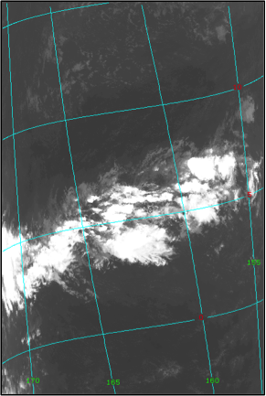
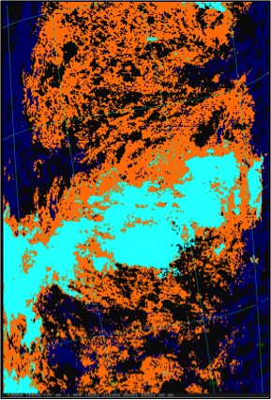
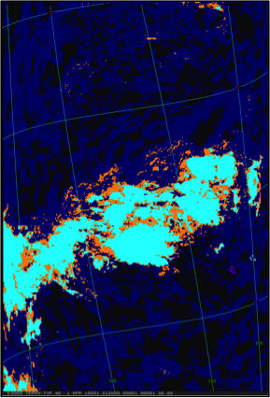
Impact on MODIS Science Products
Cloud Particle Phase Retrieval (CPP): The correction reduces the “uncertain” phase retrieval.
Band 31 Image
CPP Before Correction
CPP After Correction
T. Wilson et. al., Remote Sens. 9 (6), 569 (2017).

Slide 16
Conclusions
Observations of the Moon can be used effectively to characterize and correct electronic crosstalk in multi-channel scanning radiometers, such as MODIS and VIIRS.
The Terra MODIS LWIR bands 27 – 30 [6.7 – 9.7 μm] have had the most significant impact from crosstalk contamination. A correction has been implemented in Collection 6.1, and is currently being reprocessed for the entire mission history. The impact on Aqua MODIS data is currently being assessed.
The same methodology is being developed for the MWIR bands in both Aqua and Terra MODIS (20 - 25) [3.7 – 4.5 μm] and the SWIR bands (5 - 7, 26) [1.2 – 2.1 μm].

