Slide 1
Double Difference of IASI-A/B Against COMS IR channels
Minju Gu
NMSC/KMA

Slide 2
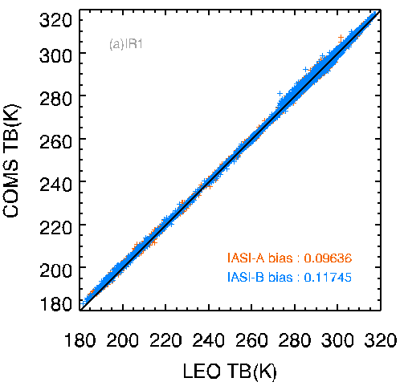
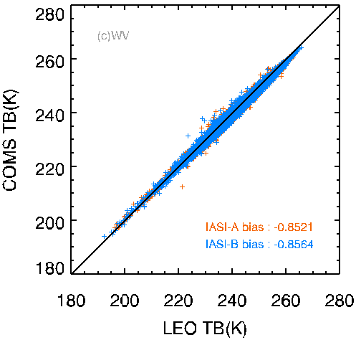
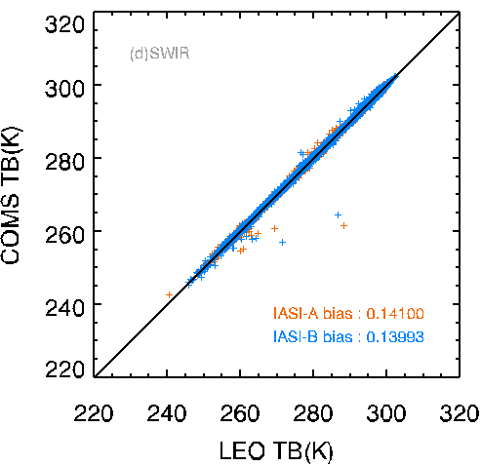
Double Difference between IASI A and IASI B
MetOp-A/IASI Period : April/2011-Aug./2017, MetOp-B/IASI Period : Aug./2013-Aug./2017
Double Difference Period: Aug./2013-Aug./2017
 |  | IASI-A | IASI-B
IR1 | Number | 162742 | 184837
 | Bias | 0.0964 | 0.1175
 | RMSE | 0.3366 | 0.3502
 | Slope | 0.9955 | 0.9953
 | Intercept | 1.4261 | 1.4985
IR2 | Number | 178594 | 204695
 | Bias | -0.0185 | 0.0096
 | RMSE | 0.3216 | 0.3380
 | Slope | 0.9914 | 0.9918
 | Intercept | 2.4677 | 2.4014
WV | Number | 209084 | 241160
 | Bias | -0.8521 | -0.8564
 | RMSE | 0.4171 | 0.4219
 | Slope | 0.9850 | 0.9830
 | Intercept | 2.8133 | 3.2918
SWIR | Number | 52381 | 59124
 | Bias | 0.1445 | 0.1399
 | RMSE | 0.1410 | 0.2180
 | Slope | 0.9943 | 0.9897
 | Intercept | 1.8213 | 3.1762
10.8 m
12.0 m
6.8 m
3.8 m

Slide 3
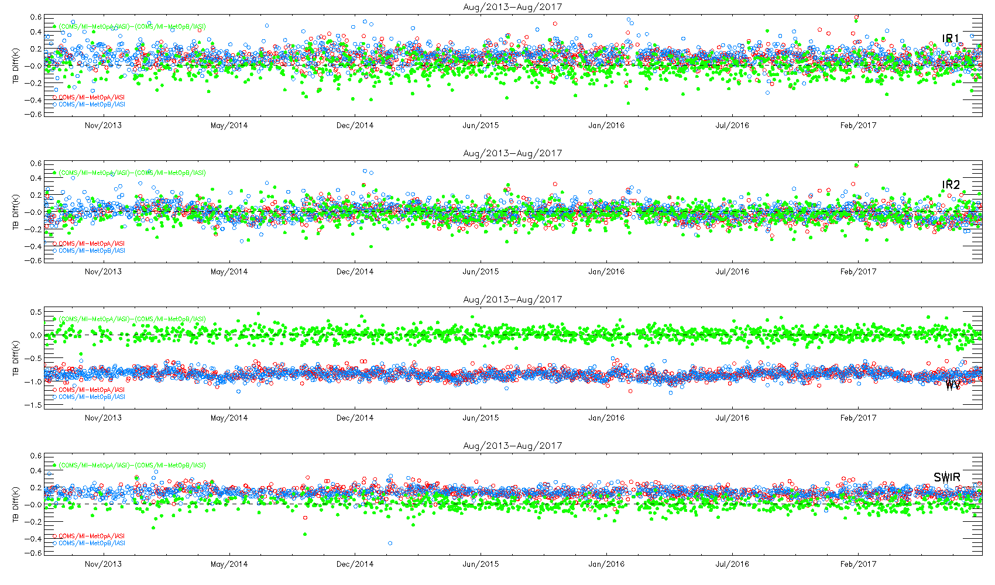
Daily Double Difference
Period: Aug/2013-Aug/2017
Daily TB for COMS/MI-MetOpA/IASI and COMS/MI-MetOpB/IASI Daily TB for (COMS/MI-MetOpA/IASI)-(COMS/MI-MetOpB/IASI)

Slide 4
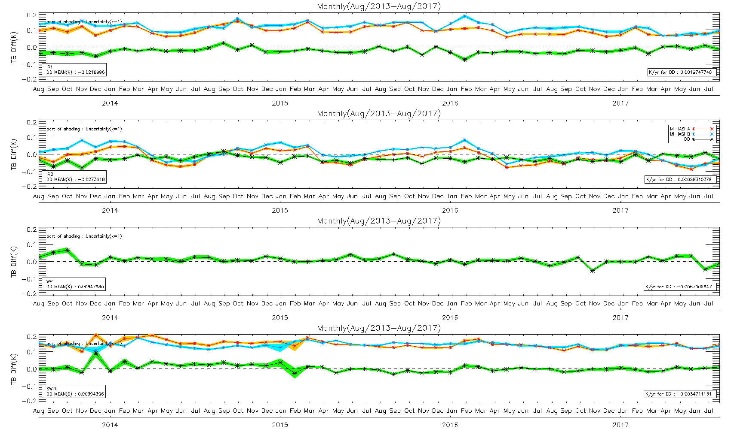
Monthly Double difference
Period: Aug/2013-Aug/2017
Monthly TB and uncertainty(k=1) for COMS/MI-MetOpA/IASI, COMS/MI-MetOpB/IASI and (COMS/MI-MetOpA/IASI)-(COMS/MI-MetOpB/IASI)

Slide 5
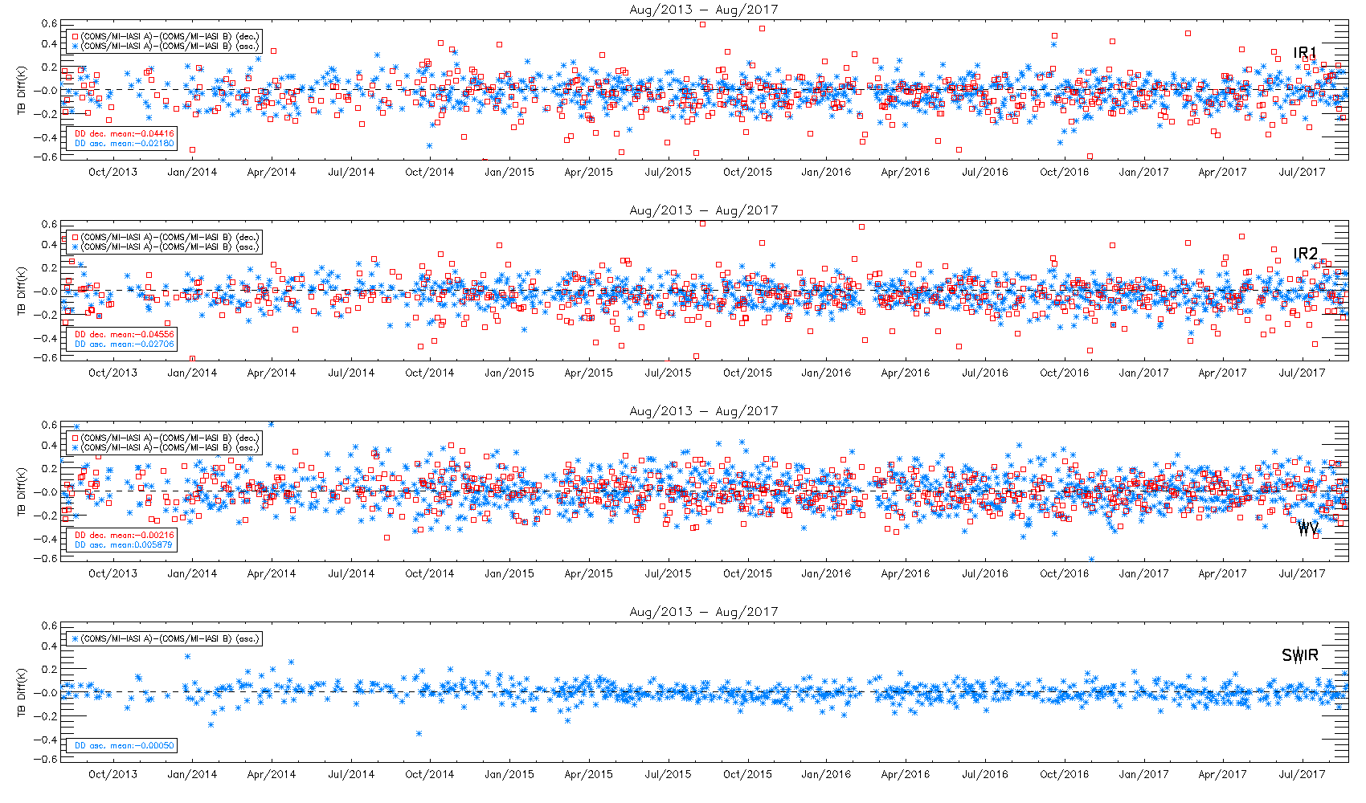
Double Difference for Ascend & Descend of IASI
Daily descending mean for DD (COMS/MI-MetOpA/IASI)-(COMS/MI-MetOpB/IASI),
Daily ascending mean for DD (COMS/MI-MetOpA/IASI)-(COMS/MI-MetOpB/IASI)

Slide 6
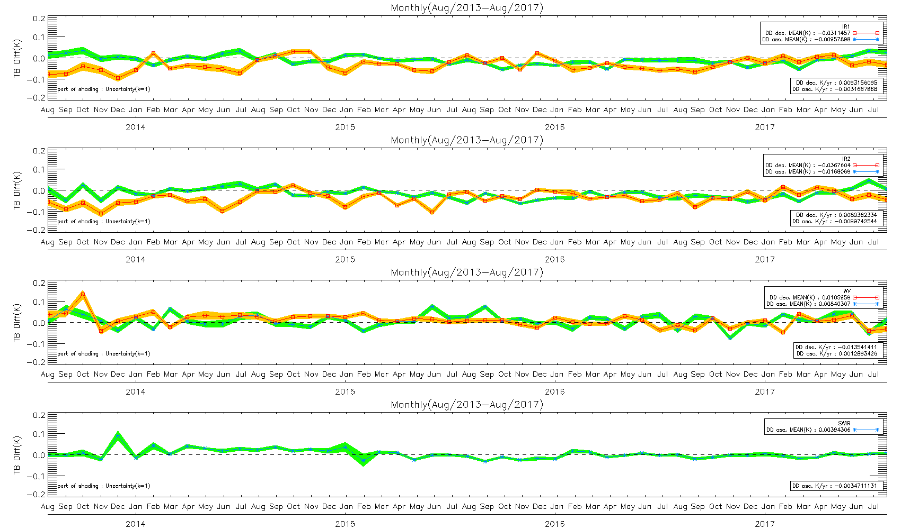
Double Difference for Ascend & Descend of IASI
Monthly descending mean for DD (COMS/MI-MetOpA/IASI)-(COMS/MI-MetOpB/IASI),
Monthly ascending mean for DD (COMS/MI-MetOpA/IASI)-(COMS/MI-MetOpB/IASI)

Slide 7
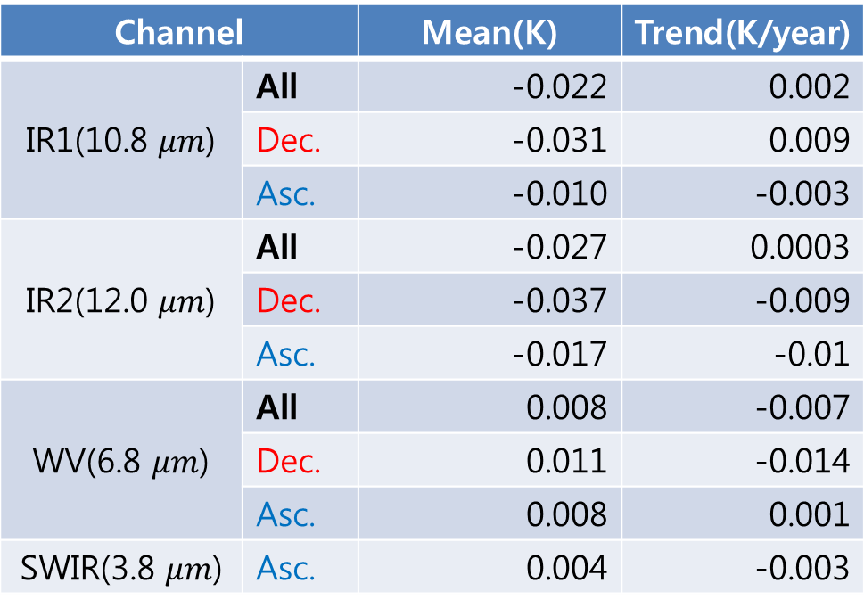
Mean & Trend of Double Difference
Mean and Trend of Double Difference(MI-IASI A)-(MI-IASI B)
MetOp-A/IASI Period : April/2011-Aug./2017, MetOp-B/IASI Period : Aug./2013-Aug./2017
Double Difference Period: Aug./2013-Aug./2017
Channel |  | Mean(K) | Trend(K/year)
IR1(10.8 $μm$) | All | -0.022 | 0.002
 | Dec. | -0.031 | 0.009
 | Asc. | -0.010 | -0.003
IR2(12.0 $μm$) | All | -0.027 | 0.0003
 | Dec. | -0.037 | -0.009
 | Asc. | -0.017 | -0.01
WV(6.8 $μm$) | All | 0.008 | -0.007
 | Dec. | 0.011 | -0.014
 | Asc. | 0.008 | 0.001
SWIR(3.8 $μm$) | Asc. | 0.004 | -0.003

Slide 8
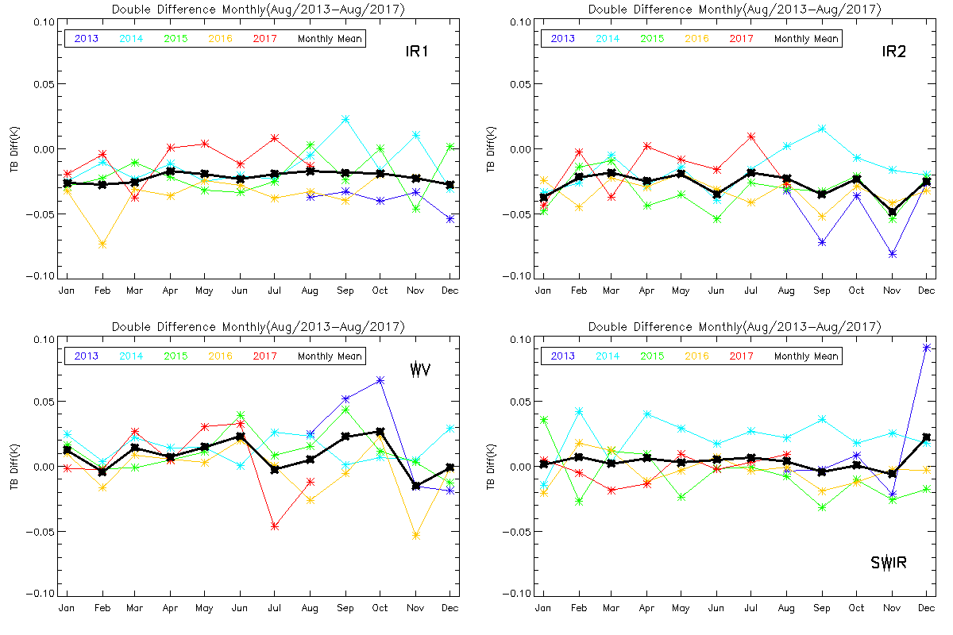
Seasonal variation for Double Difference

Slide 9
Thank You

