Slide 1
ESA Agency Report
GSICS 2018 Annual Meeting
19 March 2018
Shanghai, China
Philippe Goryl

Slide 2
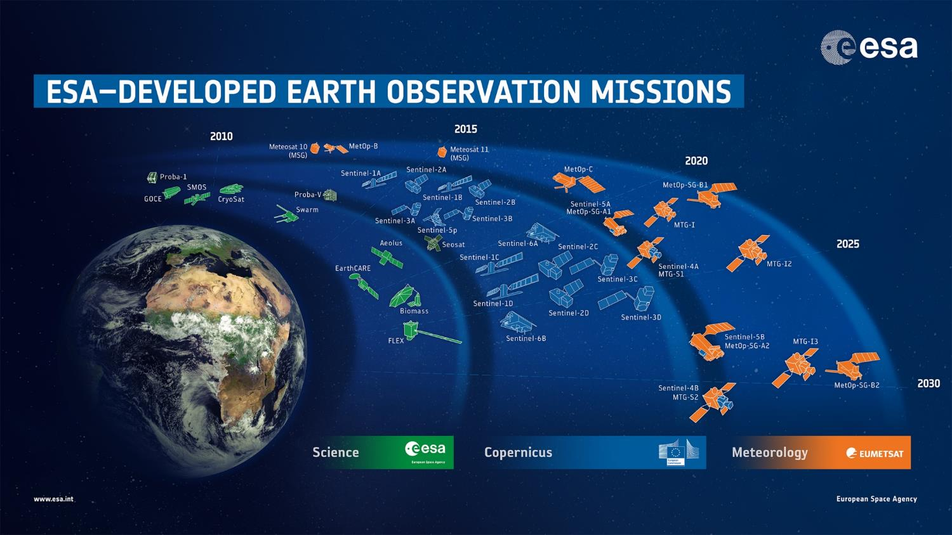
28 satellites in development, 13 in operations

Slide 3


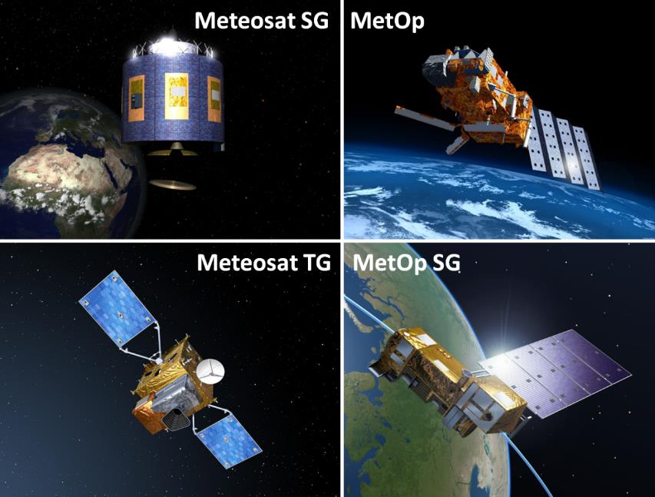
New Meteorological Systems
< Current Systems
< Post-2020 Systems
Notes:
ESA develops the innovative satellites for the European Organisation for the Exploitation of Meteorological Satellites (EUMETSAT) and procures the recurrent versions on its behalf.
EUMETSAT is responsible for the overall user and mission requirements, the development of the ground segment (incl. data dissemination) and the satellite operations.

Slide 4
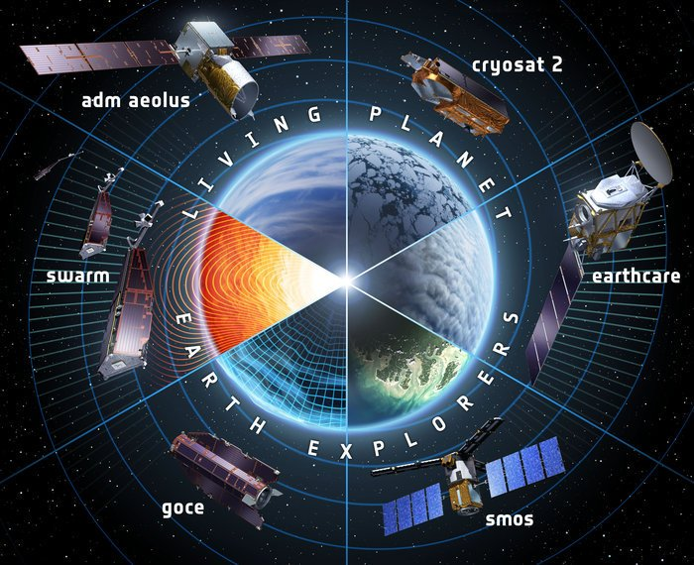
Earth Explorers
GOCE | 2009 – 2013
SMOS | 2009 – Present
Cryosat | 2010 – Present
SWARM | 2013 – Present
Aeolus |  | 2018
EarthCARE |  | 2020
Biomass |  | 2021
FLEX |  | 2022
Notes:
The Earth Explorers allow us to understand the Earth System and its diverse aspects in more and more detail.

Slide 5
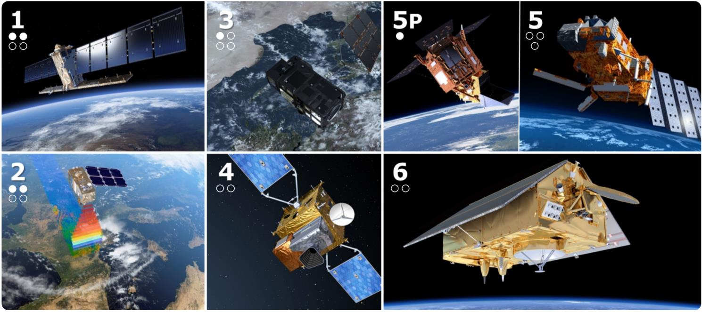
Copernicus – European Leadership in EO
Notes:
Image: the dots indicate the launch status of the six Sentinel satellites (a filled dot means launched, a blank signifies a satellite in development)
Main Points:
Copernicus is a System for Global Monitoring of the Environment & Security (formerly known as GMES)
Integrated “system of systems”, space & in-situ
Led & mainly financed by the European Union
Dawn of an operational phase in EO
Six Services + Full and Open Data Policy
ESA is the coordinator of the Copernicus Space Component (6 Sentinels and the related Ground Segment)
ESA is the development and procurement agency for the dedicated space infrastructure.
ESA is responsible for the definition of the overall Copernicus Space Component architecture and its future evolution

Slide 6
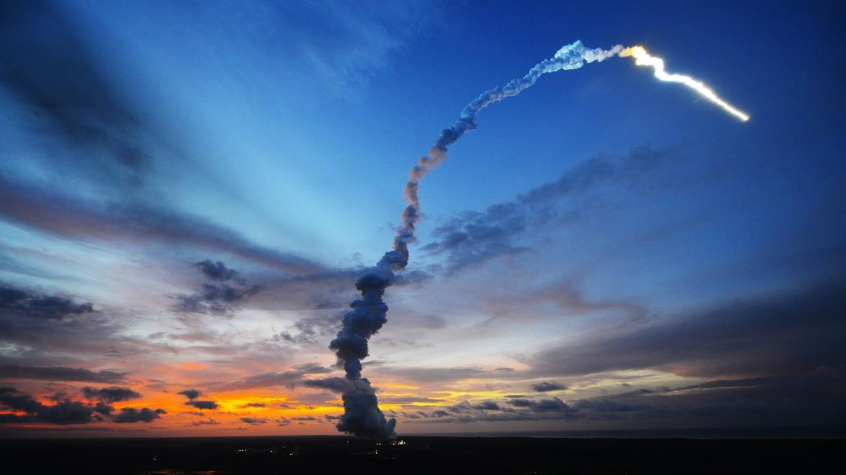
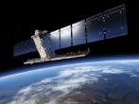
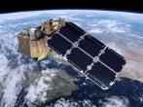
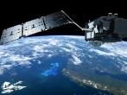
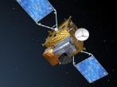
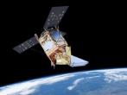

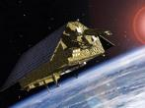

Copernicus – European Leadership in EO
S-1
S-2
S-3
S-4
S-5P
S-5
S-6
Radar
High Resolution Optical
Medium Resolution Optical & Altimetry
Atmospheric Chemistry (GEO)
Atmospheric Chemistry (LEO)
Atmospheric Chemistry (LEO)
Altimetry
A
3 Apr. 2014
A
23 Jun. 2015
A
16 Feb. 2016
A
2021
A
13 Oct. 2017
A
2021
A
2020
B
25 Apr. 2016
B
6 Mar. 2017
B
2018
B
2027
B
2027
B
2025
C
2022/23
C
2022/23
C
2023
C
> 2027
D
> 2022/23
D
> 2022/23
D
> 2023

Slide 7

CSC Expansion (Sentinel 7, 8, 9, …)
High Priority Candidates | Applications
Anthropogenic CO₂ | Greenhouse Gases - Climate Change
High Res. Land Surface Temperature | Agriculture & Urban Management Services
Polar Ice & Snow Topography | Land & Sea Ice Thickness
Passive Microwave Imaging | Sea Ice Concentration
HyperSpectral Imaging | Mining & Waste Management
L-band SAR | Soil, Vegetation, Food Security & Precision Farming
Notes:
In December 2017, all six Copernicus Space Component Phase A/B1 system studies Invitation to Tenders (ITTs) of Copernicus High Priority Candidate Missions (HPCMs) were published. Mission Advisory Groups (MAGs) for each of the HPCMs are being established in line with ESA’s standard advisory group mechanism.
Anthropogenic CO2 Monitoring Mission
This mission aims to analyse through the use of CO₂ satellite imagers the man-made CO₂ emissions and overall CO₂ budget at country and regional (e.g. city) scales and assess the effectiveness of the relevant COP21 decisions. This requires the capability to provide satellite accurate and consistent quantification of anthropogenic CO₂ emission and their trends.
High Spatio-Temporal Resolution Land Surface Temperature (LST) Monitoring Mission
Surface temperature is already being observed from space with thermal-infrared (TIR) sensors, however at spatio-temporal resolutions insufficient for many applications and services including agriculture. This mission shall be able to complement the current visible (VIS) and near-infrared (NIR) Copernicus observations with high spatio-temporal resolution Thermal Infrared observations over land and coastal regions in support of agriculture management services and possibly a range of additional services.
Polar Ice and Snow Topographic Mission
Measurements of land ice elevation and sea ice thickness are essential to monitor critical and direct climate change signals: ice cap melting and sea level. Building on Cryosat experience, this mission shall provide enhanced of land ice elevation and sea ice thickness measurements implementing higher spatial resolution for improved lead detection and additional capability to determine snow loading on sea ice. Improved on-board tracking systems for operation in rough terrain and addition of radiometer for all-round oceanographic use and coastal altimetry may also be considered.
Passive Microwave Imaging Mission
Passive Microwave Imaging Multi-Spectral Radiometers uniquely observe a wide range of parameters, in particular sea ice concentration, and serve operational systems at almost all weather conditions, day and night. This mission shall provide improved continuity of sea ice concentration monitoring missions, in particular in terms of spatial resolution (15 km), temporal resolution (sub-daily) and accuracy (in particular near the ice edges). Additional measurement of Sea Surface Temperature in the polar regions may also be included.
HyperSpectral Imaging Mission
For raw material resources applications, only a hyperspectral imager with contiguous bands can provide the spectral signatures in the Visible, Near Infrared and Short Wave Infrared (VNIR and SWIR), needed to identify and separate observed minerals, rocks and soils and their chemical composition. This is also the case for identifying and monitoring of mining operations and mine-waste management activities.
L band SAR Mission
This mission is responding to the requirements expressed by both the Land Monitoring and the Emergency Management services. Its target applications are: soil moisture, crop type discrimination, forest type/forest cover (in support to biomass estimation), food security and precision farming. In addition the mission will contribute to the monitoring of ice extent in the polar region. Other emerging applications will be possible by the synergetic and complementary observations with C band and X band SAR systems.

Slide 8
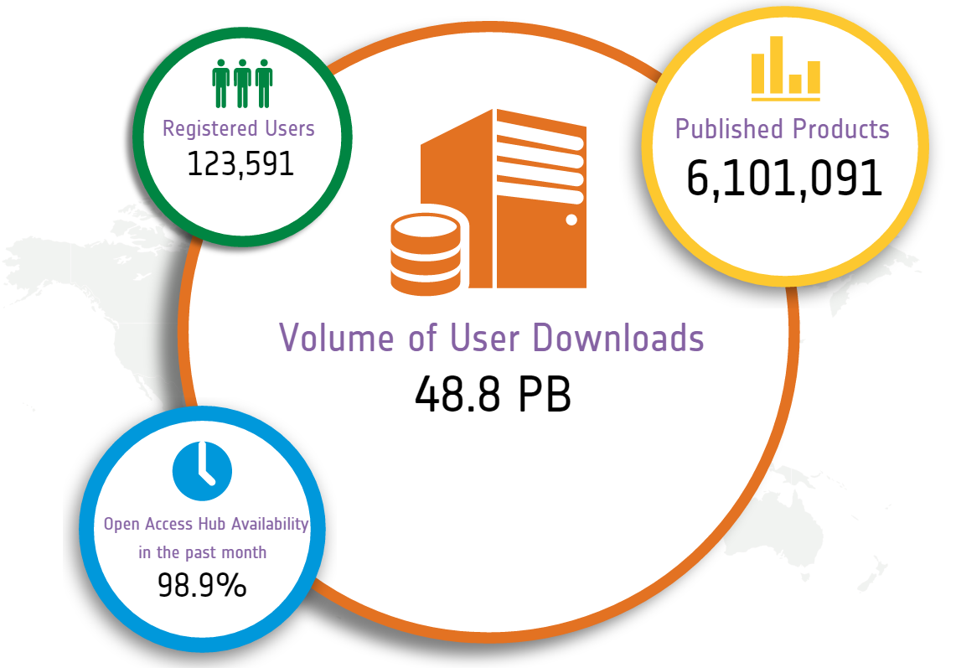
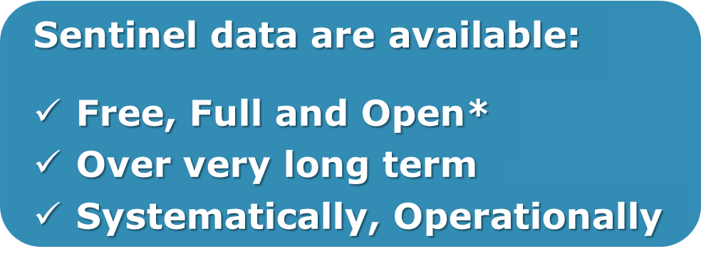
Sentinel Open Access Data Hub
Statistics on
15 Feb. 2018
scihub.copernicus.eu

Slide 9
Sentinel-1
Paramter | Value
Career Frequency | 5.405Ghz
Antenna size | 12.3 x 0.82m
Chirp bandwith | 48-88 MHz
Polarisation | Single and Dual Polarisation
PRF | 1000-3000Hz
Instrument Mass | 945Kg
CSAR DC power | 3.87KW
Data Compression | Echo: FDBAQ Noise: BAQ-5 Cal: Bypass
Bit quantisation | FDBAQ: variable up to 16bits Noise: 5 bits Cal: 10 bits
Instrument operation | 25min / orbit in SM, IW or EW 75min/ orbit WV
Downlink rate | 2x260Mbps
Look Direction | right
Constellation of two satellites C-band SAR (A & B units)
Designed for 7 years life time with consumables for 12 years
  S-1A launch: April 2014
  S-1B launch: April 2016
Near-Polar sun-synchronous (dawn-dusk) orbit at 698 km
12 days repeat cycle (1 satellite), 6 days for the constellation
Both Sentinel-1 satellites in the same orbital plane (180˚ phased in orbit)
Mission status is nominal for both satellites

Slide 10
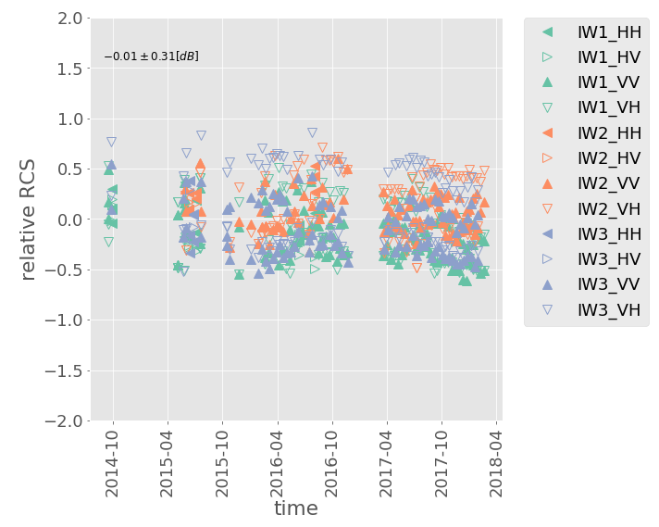
Sentinel-1 Calibration
S-1A/B radiometric calibration is measured over the dedicated calibration composed by 3CR and 3 transponders in Germany.
  Radiometric accuracy is ~ 0.3dB (1sigma) for both satellites - requirement is 0.33dB (1 sigma)
S-1A/B geolocation accuracy is very good and very well within the specification (10-15 times smaller than the pixel spacing)
  Further improvements will come to improve the location accuracy in azimuth to get sub-metric accuracy
S-1A IW radiometric accuracy
since launch
Geolocation accuracy
Rg: 0.145±0.189m
Az: 1.43±1.183m

Slide 11

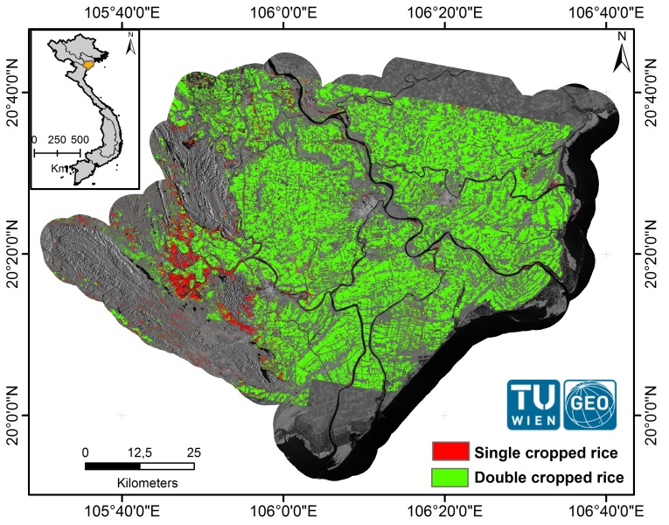
Monitoring Rice Yields
Duong Delta
Northern Vietnam
Based on Sentinel-1 Data
© TU Wien, GEO
Notes:
Intra-annual Sentinel-1 data from January 2015 to December 2015 were used to produce rice-cropping systems map in the Red River Delta, Vietnam. In this case study, a significant area of rice paddies grows two crops per year (green). The remaining areas, in mountainous and riverine regions (red), are where the long-term flooded or saturated soil conditions permitted only one crop of rice per year.

Slide 12
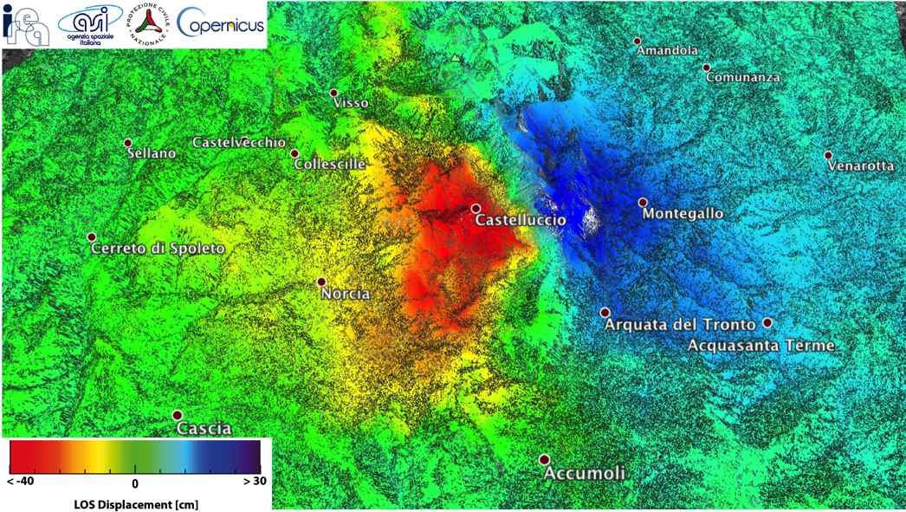
Earthquakes
Italy
30 Oct. 2016
Based on Sentinel-1A & B data
Notes:
Ground deformations extending to about 130 sq. km and with a maximum LOS displacement of at least 70 cm, in the area of Castelluccio
On the ground deformation map, the acquisition of this morning has been used, it covers much more on the eastern side of Castelluccio, where an uplift can be observed (in blue).
Please remember that these are ground deformation LOS (light of site, ie in the direction of the satellite). The effective max subsidence close to Castellucia may rather be in the order of 50-60 cm (not 70 cm).
Based on interferogram generated with:
S1B acquisition of 26 Oct 2016
S1A acquisition of 1 Nov 2016

Slide 13
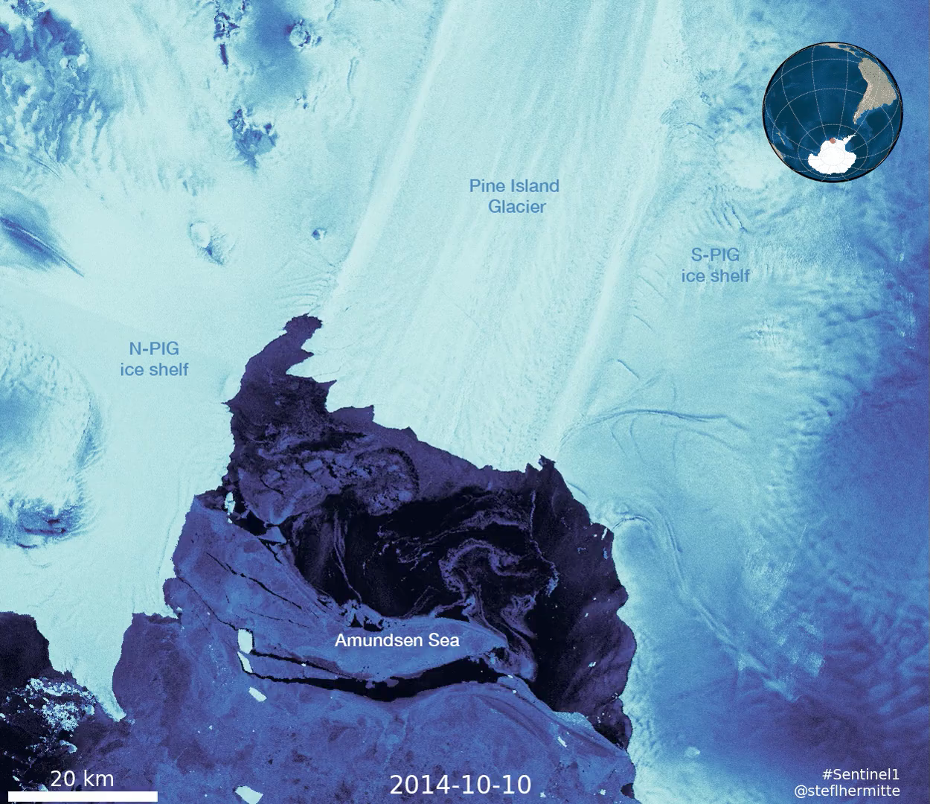
Glacier Flow
Pine Island Glacier Antarctica
Sentinel-1B
2014-2016
Notes:
Video: Ice speed of the Pine Island Glacier at the Western Palmer Land (Southwest Antarctica Peninsula), measured by the Copernicus Sentinel-1 mission between 2014 and 2016.

Slide 14
Sentinel-2
Launch: Sentinel-2A on 23 June 2015; Sentinel-2B on 7 March 2017
Launcher: Vega rocket from Kourou, French Guiana
Orbit: Polar, Sun-synchronous at altitude of 786 km
Revisit time: Five days from two-satellite constellation (at equator)
Coverage: Systematic coverage of land and coastal areas between 84°N and 84°S
Life: Minimum of seven years
Satellite: 3.4 m long, 1.8 m wide, 2.35 m high
Mass: 1140 kg (including 123 kg fuel)
Instrument: Multispectral imager (MSI) covering 13 spectral bands (443 nm–2190 nm) with a swath width of 290 km and spatial resolutions of 10 m (4 visible and near-infrared bands), 20 m (6 red-edge/shortwave-infrared bands) and 60 m (3 atmospheric correction bands)
Main applications: Monitoring agriculture, forests, land-use change, land-cover change; mapping biophysical variables such as leaf chlorophyll content, leaf water content, leaf area index; monitoring coastal and inland waters; risk mapping and disaster mapping
Mission status is nominal for both satellites

Slide 15
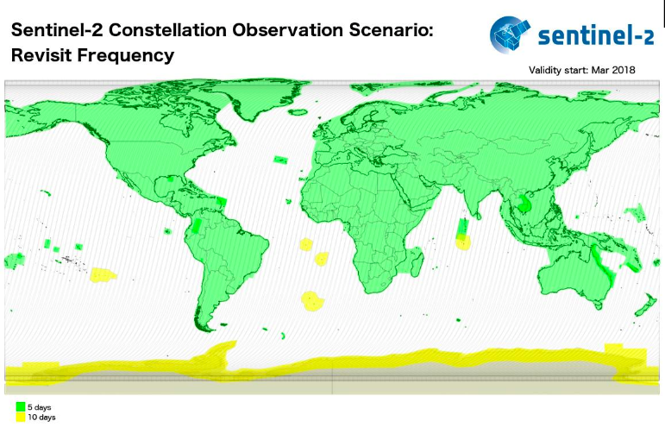
Sentinel-2 Mission Status Highlights
Since 17 February, Sentinel-2 reached full operational capacity performing global and systematic acquisitions with 5-day revisit.
In addition to the baseline acquisition areas, other regions are being acquired (e.g. Antarctica every 10 days).
Production of Level-2A (surface reflectance) products (over Europe and for both Sentinel-2A and Sentinel-2B) is available on the Copernicus Hubs.
Expansion to global production by mid-2018.
B11
Band 11

Slide 16
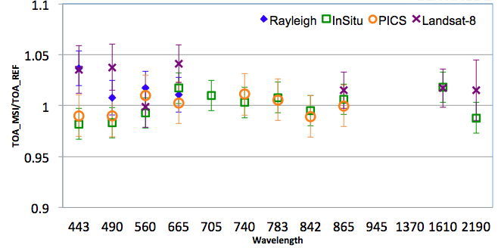
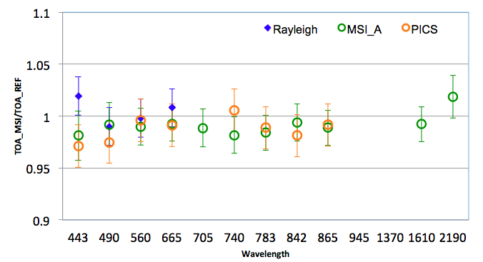
Data Quality Status / Radiometry
MSI-A
>450 acquisitions from MSI-A & >240 acquisitions from MSI-B are used.
Good consistency over all methods.
Results are within 5% (mission requirements).
MSI-B
Absolute geolocation: CE 9.2 m at 95%, well below the mission specification without the GRI (20 m)
B11
Band 11

Slide 17
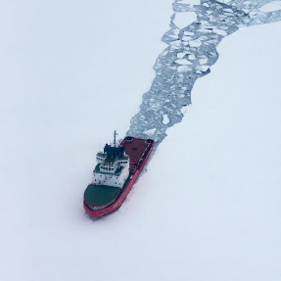
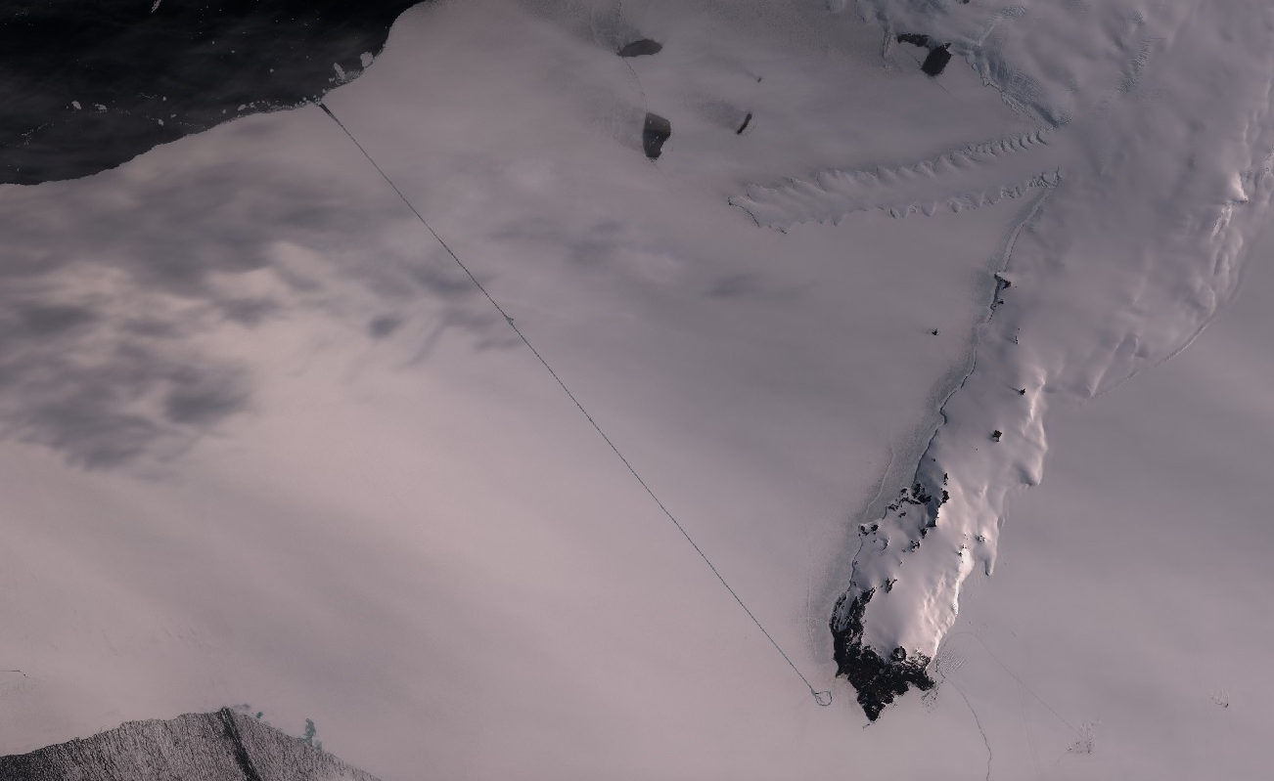
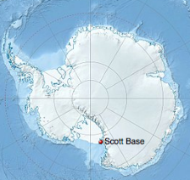
Example of Antarctica Acquisitions
Icebreakers opened a way through the ice for providing supplies to the research bases.

Slide 18
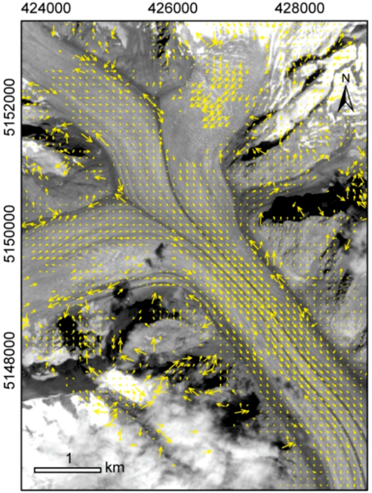
Glacier Remote Sensing Using Sentinel-2
[Kääb et al., 2016]
For Aletsch Glacier, Swiss Alps, tracked displacements using Sentinel-2A band 8 data from 30 July and 8 September 2015, i.e. over 40 days.
Band 11

Slide 19
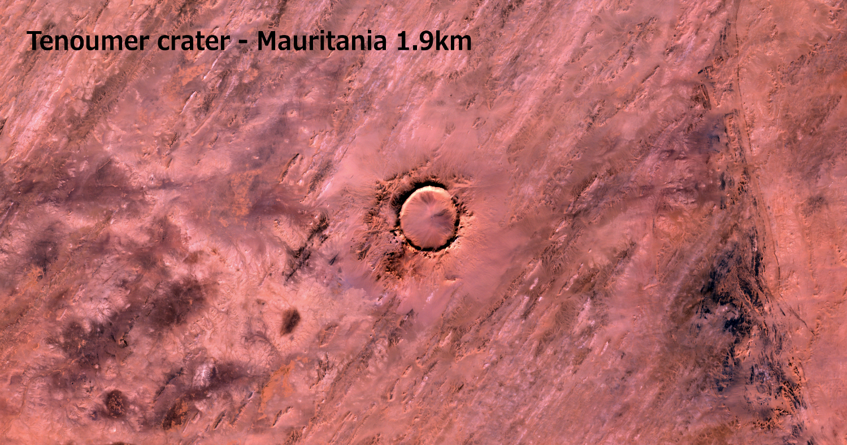

Slide 20
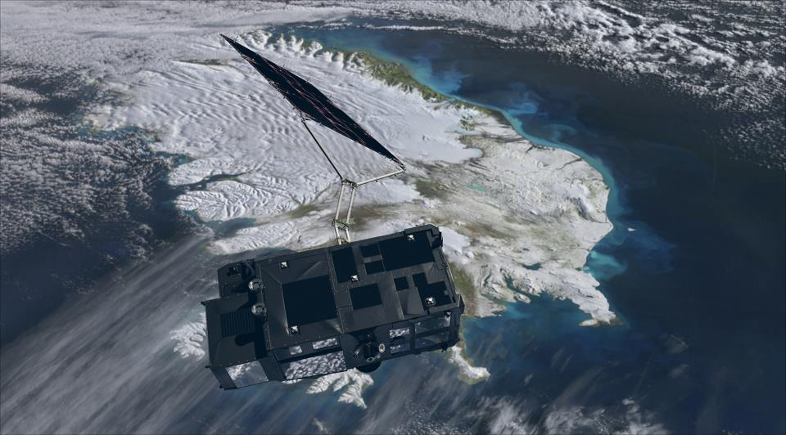
Sentinel-3
Operational mission in high-inclination, low Earth orbit
Full performance achieved with 2 satellites in orbit (S-3A,-3B)
Optical Mission Payload providing
  Sea and land color data, through OLCI (Ocean and Land Color Instrument)
  Sea and land surface temperature, through the SLSTR (Sea and Land Surface Temperature Radiometer)
Topography Mission Payload providing
  Sea surface topography data, through a Topo P/L including a Ku-/C-band Synthetic Aperture Radar Altimeter (SRAL), a bi-frequency MicroWave Radiometer (MWR), and a Precise Orbit Determination (POD) including
    GNSS Receiver
    DORIS
    Laser Retro-Reflector
➔ S-3A successfully Launched on 16 Feb 2016
➔ S-3B Launch currently planned on 25 April 2018
All S-3A L1 & L2 science products have been qualified, validated and released to the Copernicus Services and User Community
Information on S-3 science core performance @ product https://sentinels.copernicus.eu/web/sentinel/missions/sentinel-3
Meteorological
Programme
Copernicus
Programme
Earth Observation
Envelope Programme

Slide 21
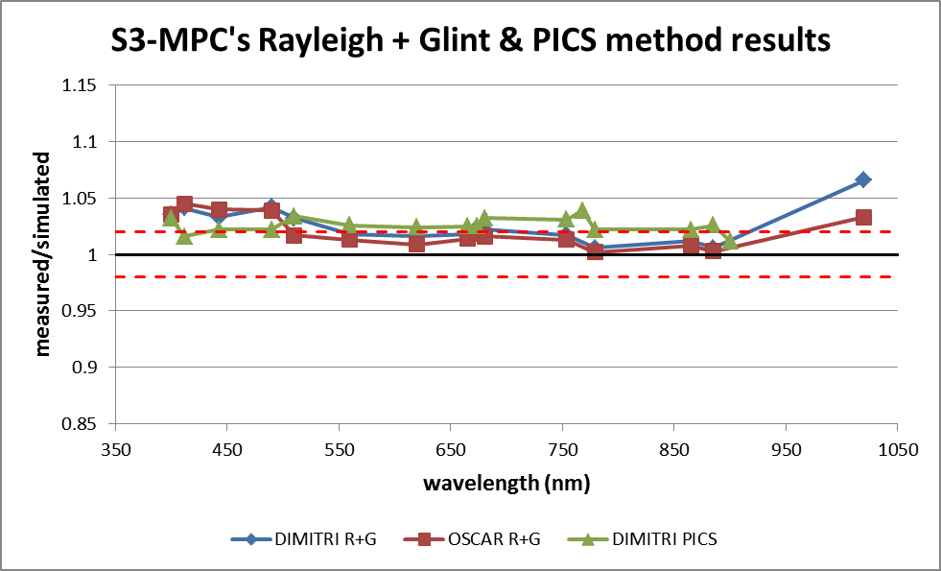
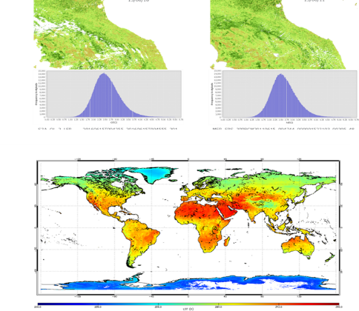
S-3 Optical mission status
Radiometric Validation:
desert (PICS), PICS, Rayleigh
Excess of brightness 2-3%,
Absolute radiometric bias of 2-3% impacting OC retrieval but mitigated by SVC
OLCI L2 OTCI and OGVI showing good consistency with MERIS climatology and MODIS FAPAR products.
SLSTR L2 LST Products validated to be within 1 K using different LST validation sites. LST however continuously fine-tuned per biome.
L2 SST validated to be at around 0.1K accuracy.

Slide 22
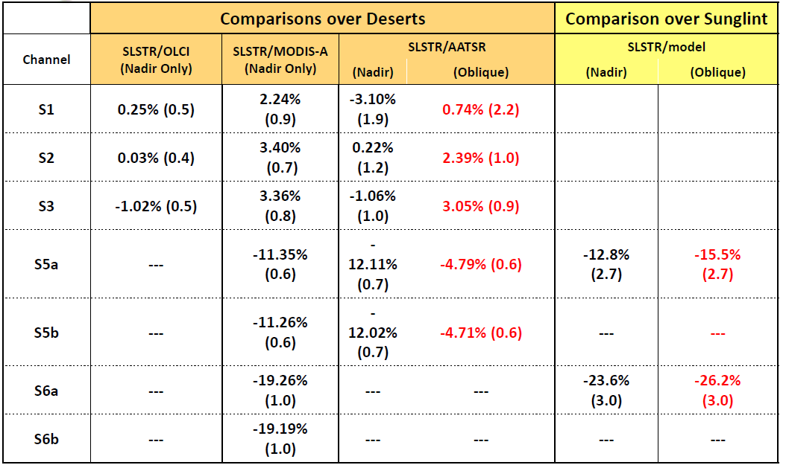
SLSTR calibration status VIS - SWIR
It is recognised that the current SWIR channel (S5 & S6) calibration is limiting usefulness of data
• Recommendation by QWG is to adjusting S5 and S6 radiometric calibration to align to AATSR/MODIS channels
S5 correction by
12% N 15% O
S6 correction by
20% N 26% O

Slide 23
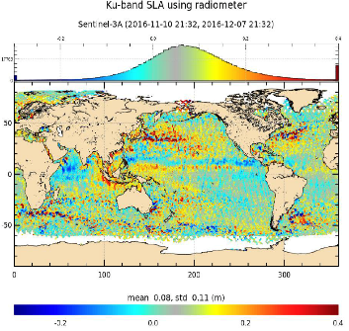
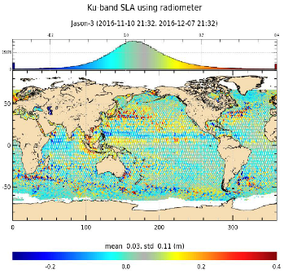
S-3 Altimetry mission status
S-3A
J-3
S-3 STM mission: First Altimetry mission in 100% SAR mode
Very good data availability (~100%)
Very good performance over Ocean close to J-3 mission
Good potential over land and sea ice close to CryoSat but still ground processing to be improved
Sea Level but also Sigma0, SWH, Wind Speed show good metrics, close to J3 performance
Ocean validation - cycle 11
Very good performance over Inland Waters – on-board DEM being improved
(See and contribute to https://www.altimetry-hydro.eu/)
Very good orbit data quality (<1 cm rms in NTC)
Notes:
- SAR processing is very promising to improve the along track resolution of altimetry products and pave the way for high resolution altimetry
- SAR ocean data also allows to better understand errors in the existing altimetry and possibly propose new processing to reach smaller spatial scales with LRM altimetry !!!!

Slide 24
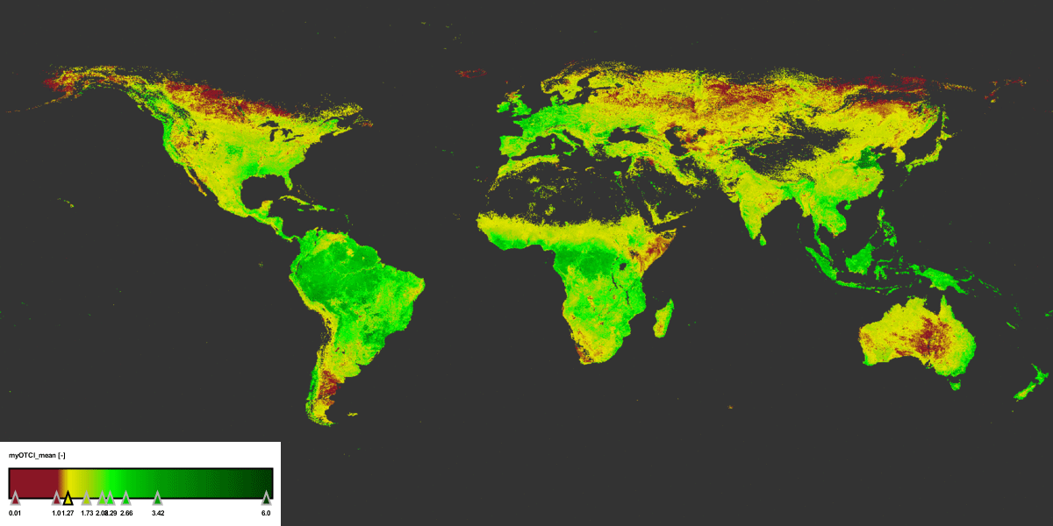
Plant Growth in Spring
Vegetation Index
Based upon Copernicus Sentinel-3A data (2017)
© University of Southampton–J. Dash/Brockman Consult (S3-MPC)
Notes:
The Copernicus Sentinel-3A’s ocean and land colour instrument can ‘see’ chlorophyll in vegetation. The animation shows how chlorophyll, which is essential in photosynthesis, around the world changed between 1 April and 27 May 2017. While tropical rainforests can be seen to maintain a high degree of chlorophyll, the animation clearly shows the progress of spring greening in the northern hemisphere. This is particularly evident in the eastern part of the USA. It also captures the progress of agricultural planting for summer crops across China where planting normally takes place between March and May. Here various stages of growth are captured. The chlorophyll index ranges from 1 to 6.5.

Slide 25
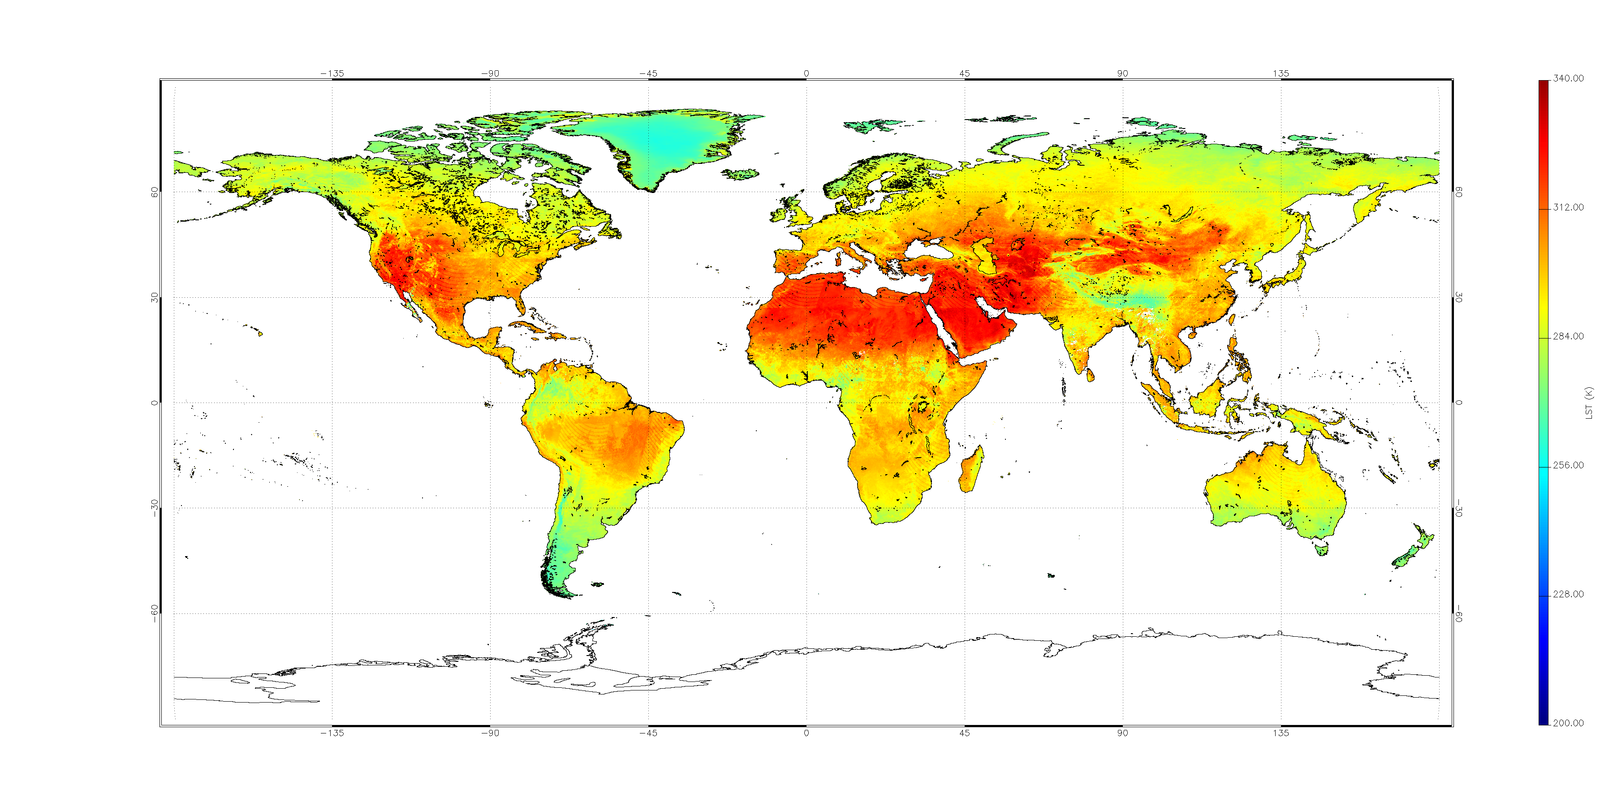
Earth Surface Heat
Contains modified Sentinel-3A data (2016)
© UK National Centre for Earth Observation/University of Leicester
Notes:
Information from Sentinel-3A’s radiometer, which measures radiation emitted from Earth’s surface, reveal how the temperature of Earth’s land changes between July and November 2016. Measurements are in kelvin.

Slide 26
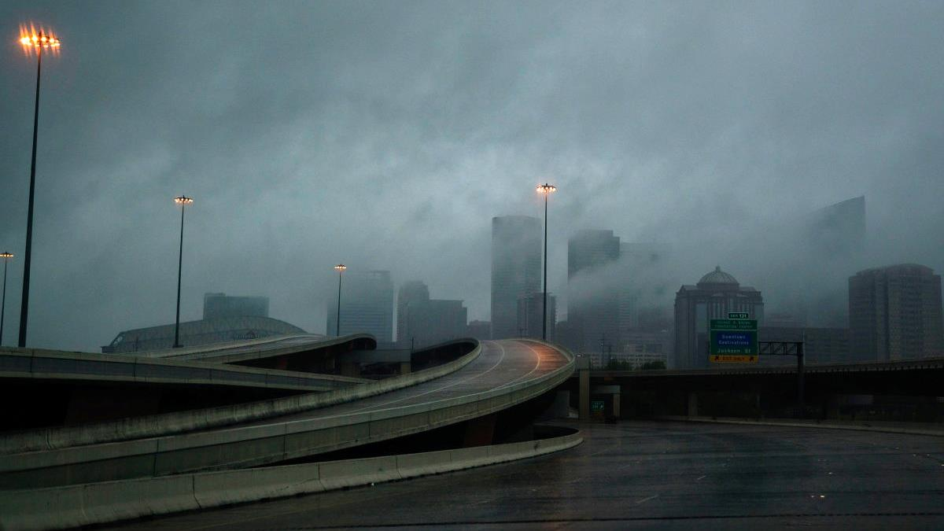
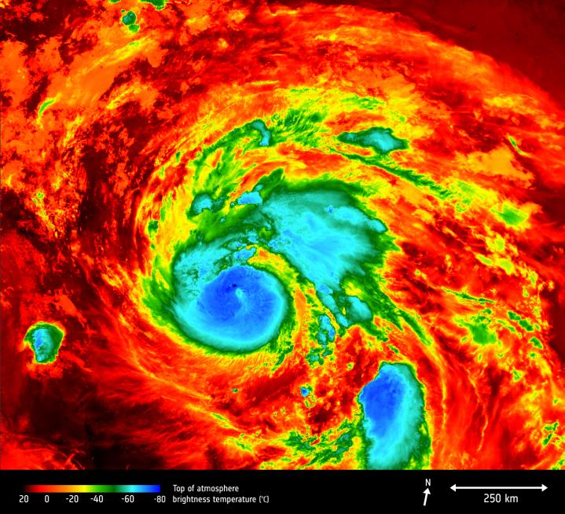
Hurricane Monitoring
< Temperature at the top of Harvey as the storm approaches Texas
Based on Sentinel-3A data
25 August 2017
© BY-SA 3.0 IGO
Notes:
The Copernicus Sentinel-3A satellite saw the temperature at the top of Hurricane Harvey on 25 August 2017 at 04:06 GMT as the storm approached the US state of Texas. The brightness temperature of the clouds at the top of the storm, some 12–15 km above the ocean, range from about –80°C near the eye of the storm to about 20°C at the edges.
Hurricanes are one of the forces of nature that can be tracked only by satellites, providing up-to-date imagery so that authorities know when to take precautionary measures. Satellites deliver information on a storm’s extent, wind speed and path, and on key features such as cloud thickness, temperature, and water and ice content.
Sentinel-3’s Sea and Land Surface Temperature Radiometer measures energy radiating from Earth’s surface in nine spectral bands and two viewing angles.

Slide 27
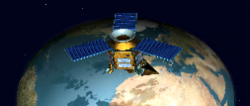
Sentinel-5 Precursor mission status
  S5P Mission
  Funded by EC/ESA + national NL/NSO, D/DLR, BE/BELSPO
  First operational mission on air quality & climate change
  Earth global daily coverage, at 13.30 Solar Local Time at Ascending Node
TROPOMI (TROPOspheric Monitoring Instrument)
Nadir viewing instrument, UV-VIS-NIR–SWIR spectral ranges (270-500, 675-775, 2305-2385 nm)
Spatial resolution (Km² ): 3.5 x 7 (across x along track); 7x7 SWIR
  Data products: Total column (O₃, NO₂, CO, SO₂, CH₄, HCHO); Tropospheric column (O₃, NO₂); O₃ Profile; UV Aerosol Index and Layer Height; Clouds
  Main Users: CAMS (Copernicus Atmospheric Monitoring Service); C3S (Copernicus Climate Change Service)
S5P Mission status
  Launched on 13th Oct 2017 from Plesetsk (at 11:27 local time) - Rockot launcher
  LEOP (Launch and Early Operations Phase) in record time (33 hours) with no single anomaly
  In Commissioning Phase (E1) (since 16th Oct 2017) 6 months duration - progressing nominally
    After decontamination period (16th Oct - 7th Nov 2017), earth radiance (science) measurements started
    Successful start of solar irradiance measurements (15th Nov 2017)
    Solar diffuser-1 (QVD-1) bidirectional reflectance characterization campaign (9th Jan – 6th Feb 2018) – preliminary results show nominal degradation. Solar diffiuser-2 (QVD-2) on-going (started 26th Feb 2018)
  Implementation of enhancements for the processors deliveries at end of Phase E1 - Ongoing
  Data access: Only phase E1 support teams & algorithm developers. Cal/Val teams (mid-March)

Slide 28
Sentinel-5 Precursor Cal/Val status
S5P CAL/VAL activities: MPC (Mission Performance Centre) x Cal/Val (operational by end of Phase E1); S5PVT (S5P Validation Team) x independent contribution to Validation.
OMPS – (Ozone Mapping and Profiler Suite)
TROPOMI
CAMS model
Calibration status: overall in good shape. Current focus on:
Reflectance: band 1 seems too high (see plot)
Radiance: occasional saturation over cloudy scenes on tropical areas. Possible change in along-track resolution: 7 → 5.5 Km
NIR Out Of Band (OOB) stray light: correction in place, but accuracy to be validated during Phase E1
Validation status: Preliminary results within Phase E1 team tasks. Activities by MPC & S5PVT starting Mid March 2018.
UV Aerosol Index: no outstanding issues
  Tropospheric column O₃: no outstanding issues
  SO₂: no outstanding issues
  HCHO: no outstanding issues
  Suomi NPP Clouds: no outstanding issues
Aerosol Layer Height: known issues (pixel selection to be improved)
O₃ Profile: known issues (bias identified)
NO₂: Known issues (FRESCO cloud pressures, DOAS fit iterations)
CO: Known issues (minor stripes, differences with prototype algorithm)
CH₄: known issues (data filtering problem)
Clouds: impact of stray light and inter-band co-registration ongoing
O₃: (OFFL) performance improvement ongoing; (NRT) production starting mid-March

Slide 29
Sentinel-5 Precursor Products Release Plan
S5P Data Provision plan to the public
Launch +8 months - Level-1B; Total Columns of Ozone (O₃), Sulphur Dioxide (SO₂), Nitrogen Dioxide (NO₂), Carbon Monoxide (CO); Cloud & Aerosol information
Launch +10 months - Total Columns of Tropospheric Ozone (O₃), Formaldehyde (HCHO)
Launch +12 months - Total Columns of Methane (CH₄)
Launch +14 months - Aerosol Layer Height, Ozone (O₃) Profiles
Quality Working Group (QWG)
Kicked-Off (KO): 7th February 2018
First meeting: 25th-26th June 2018, focused on products of first release (Launch + 8 months)

Slide 30
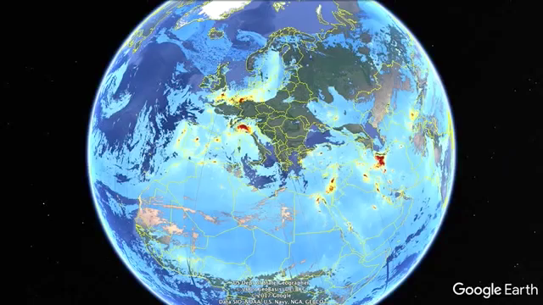
Atmospheric Pollution
Nitrogen dioxide
Sentinel-5P
KNMI
November 2017
Notes:
This animation by the Dutch Meteorological Institute (KNMI) shows different S5p images laid over the globe, all taken on the same day. The animation zooms in on:
To the middle East – Arabian Peninsula – Iran (where we see a lot of pollution also from oil wells)
Iberian Peninsula (Spain & Portugal)
West-Africa (Benin, Togo & neighboring states)
New York City
Mexico City
The Bay Area in California (San Francisco – San Jose region)
For cities we see points indicating pollution, for megacities and large industrial regions the pollution spreads over a much more vast area.

Slide 31
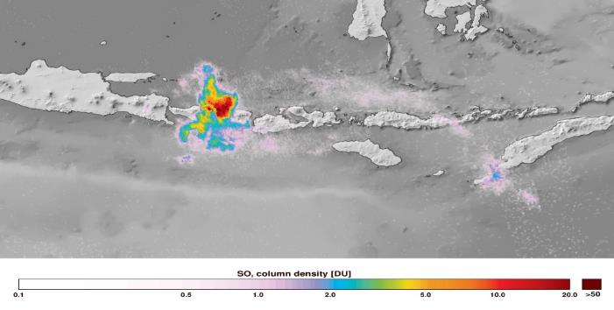
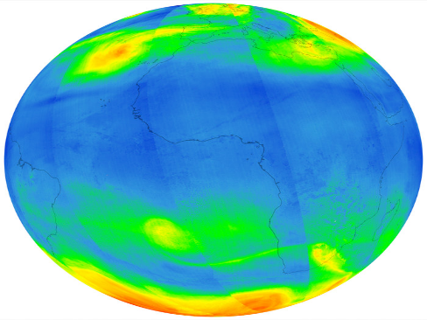
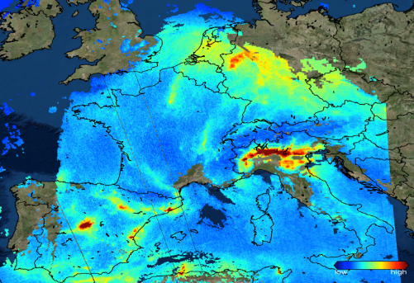
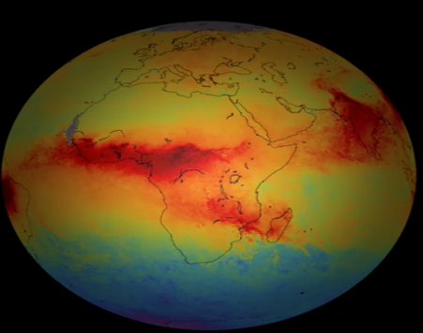
Sentinel-5 Precursor mission preliminary results
SO₂: Mount Agung eruption Bali, Indonesia (27 Nov. 2017)
O₃ (November 2017)
Credits: DLR/ESA
Credits: DLR/ESA
NO₂ over Europe (22 November 2017)
CO (November 2017)
Credits: KNMI/ESA
Credits: SRON/ESA
Notes:
This S59 image of 7 November 2017 reveals strong pollution over the industrial areas of Germany (Ruhr area), the Netherlands, and in particular Northern Italy (Po Valley, Italy’s industrial manufacturing belt).
According to the EEA's Air quality in Europe - 2016 report, the toxic gas nitrogen dioxide (NO2) - released by vehicles and central heating boilers - has an impact equivalent to 71,000 premature deaths a year.

Slide 32
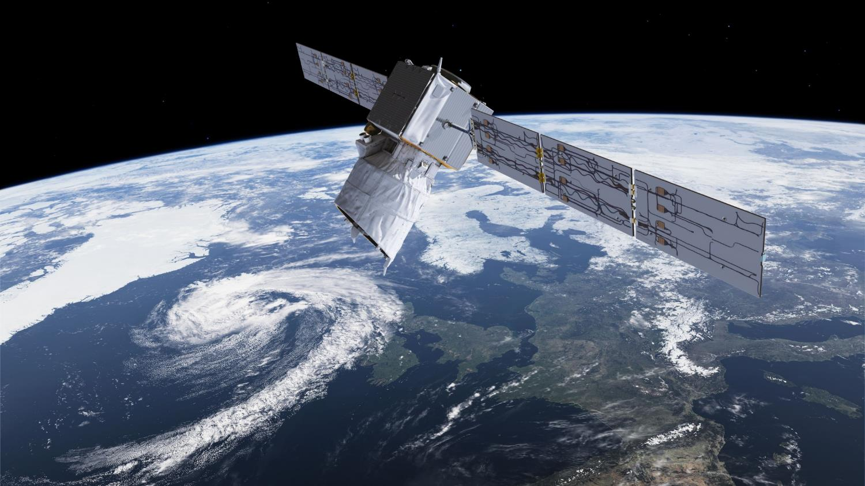
Aeolus
Launch Q3 2018
Wind Mission
First ever UV LIDAR in Space
Notes:
Aeolus
Global observations of wind profiles for analysis of global 3D wind field
The impact of Aeolus data in the ECMWF weather forecast will be significant, in particular for mid-term forecasts, as demonstrated by two independent studies
Launch planned for 2018

Slide 33
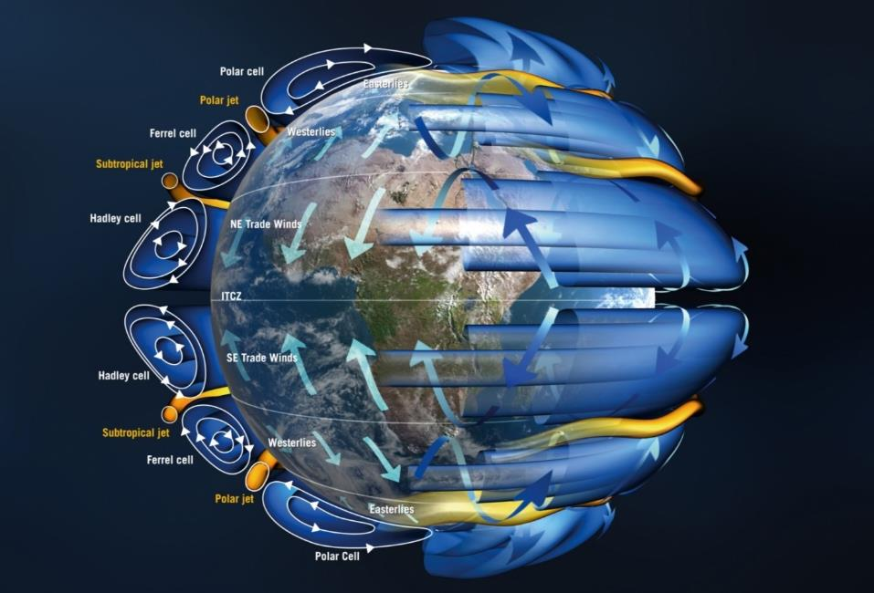
Aeolus Mission Objectives
Scientific objectives
To improve the quality of weather forecasts;
To advance our understanding of atmospheric dynamics and climate processes;
Explorer objectives
Demonstrate space-based Doppler Wind LIDARs potential for operational use.
Observation means:
Provide global measurements of horizontal wind profiles in the troposphere and lower stratosphere
Payload
ALADIN: Atmospheric LAser Doppler INstrument

Slide 34
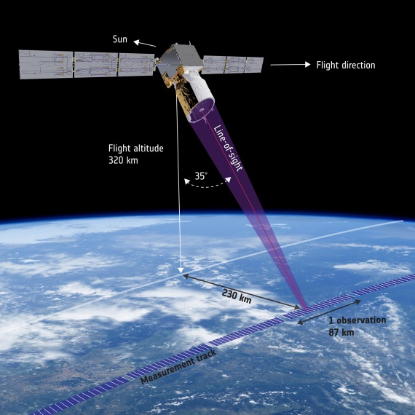
Aeolus: Measurement Principle
Direct detection UV Doppler wind Lidar operating at 355 nm and 50 Hz PRF in continuous mode, with 2 receiver channels.
Mie receiver to determine winds from aerosol & cloud backscatter.
Rayleigh receiver to determine winds from molecular backscatter.
The line-of-sight is pointing 35º from Nadir to obtain horizontal backscatter component
The line-of-sight is pointing orthogonal to the ground track velocity vector to remove contribution from the satellite velocity.

Slide 35
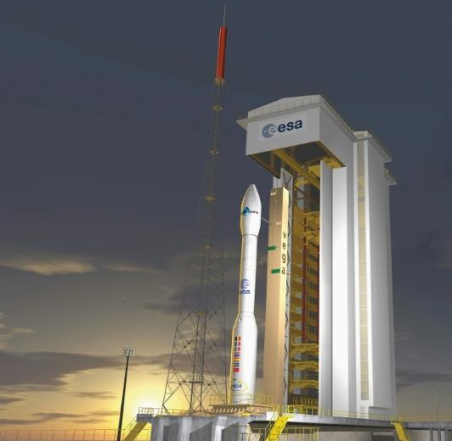
Status of Mission and Cal/Val Preparations
More than 12 years of development challenges, -Invaluable experience has been gained
The mission remains worldwide unique
Enthusiastic user communities anticipating break-through in weather forecast and climate research
The Project and the Industrial team committed to complete Aeolus and be ready for launch in August 2018!
Cal/Val preparation picking up speed
Last pre-launch Cal/Val workshop in 2017 in Toulouse.
First post-launch workshop planned for Q1 2019.
Aeolus DISC (Data Innovation and Science Cluster) to start work at IOCR.
ESA Cal/Val AO call permanently re-opened on March 9th, 2018

Slide 36
Thank you for your attention!
www.esa.int

Slide 37



Lunar irradiance measurement and modelling for absolute radiometric calibration of EO sensors
M. Bouvet (ESA), Emma Woolliams (NPL), Claire Greenwell (NPL), Maria Garcia Miranda(NPL), Carlos Toledano (Univ. Valladolid), Alberto Berjón (Univ. Valladolid), África Baretto (Univ. Valladolid), Stefan Adriaensen (VITO)

Slide 38
Objective of the study
Define a strategy for the measurement of the lunar spectral irradiance variation from the ground
Demonstrate the feasibility of such measurements
Compile a database of such measurements and on that basis improve the modelling of the lunar disk irradiance variations through its cycles (targeting sub-2 % absolute radiometric accuracy)
Compare the improved lunar disk irradiance model to various independent sources of lunar observations from space

Slide 39
Planning
KO of activity in Sept. 2017
KO+2 months: definition and procurement of lunar photometer
KO+6 months (19th of March 2018): Review of instrument characterisation (spectral, geometric and radiometric), calibration and derivation of measurement uncertainties.
KO+6 months (19th of March 2018) to end:
  Lunar data collection at Pico Teide / Izana (Spain)
  Development of a model of lunar irradiance
KO+12 month to end: comparison of the model of lunar irradiance to:
  lunar observations: from Proba-V, PLEIADES and a subset of the GLOD
  Other lunar model(s): GIRO
Duration: 21 months
Notes:
Depuis l’instrument a ete calibre au NPl et a l’university de valladoide.
Result of instrument cal. Now.
Entre now et la fin on fait des mesures et on fait un modele base sur rolo (usgs).
Glod: ensemble des donnees mise en commun du gsics (modis, pleiades, proba).
Peut etre pas utiles de demander des donnees glod. Mais on s engage a contribuer a glod (a la fin).

Slide 40
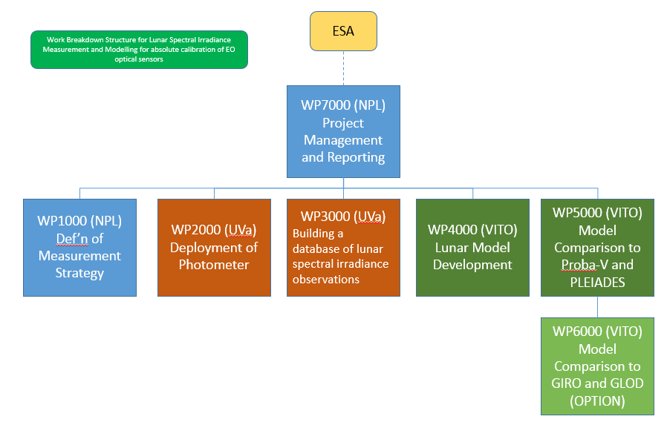
Project team

Slide 41
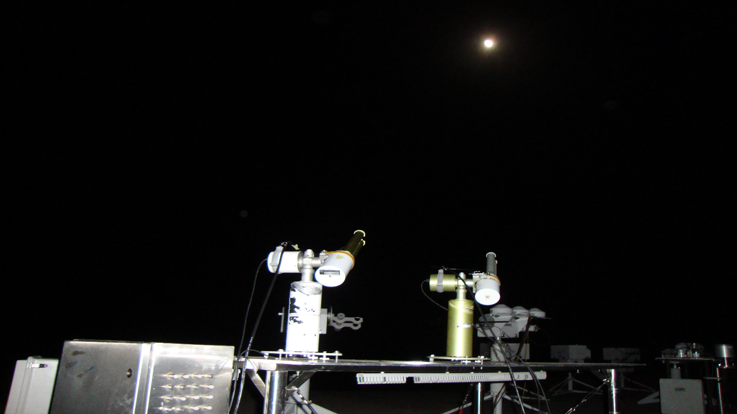
WP 1000: Instrument specification, characterisation, calibration and uncertainty budget
Instrument selected is the Sun-Sky-Lunar photometer CE318 from CIMEL:
Spectral channels: 340, 380, 44, 500, 670 870, 936, 1020, 1640 nm
Double filter wheel for polarimetric measurements
Modification of firmware for polarimetric capabilities in direct lunar observation configuration
Notes:
Wp finalised waiting for report.
Rapport available at the end.

Slide 42
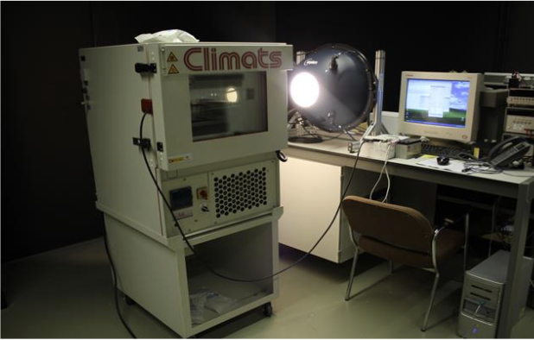
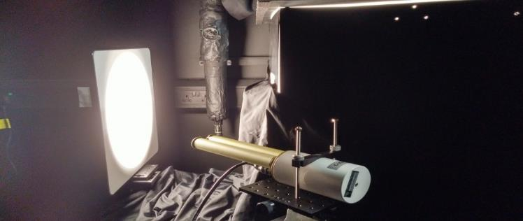
WP 1000: Instrument specification, characterisation, calibration and uncertainty budget
Temperature characterization (UVa)
Irradiance responsivity (NPL)
Linearity of the instrument (NPL)
Effective Wavelength of the instrument (NPL)
Polarisation (NPL)
Final tests at Izana Observatory
Notes:
Test at izana just done.

Slide 43
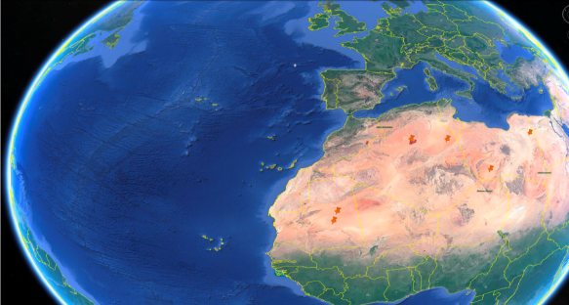




WP 2000: Deployment
Notes:
Wp 2000 start now. Monday 19 march.

Slide 44
WP 2000: Deployment
Measurement principle
Langley plots for AOD and TOA lunar irradiance measurements
Might require iterative use of lunar irradiance model
Notes:
Might require iterative use of lunar irradiance model
→ Tu suis la lune pendant la nuit

Slide 45

WP 2000: Deployment

Slide 46

WP 2000: Deployment
Additional instrument (already previously) deployed will include:
Standard lunar photometer CIMEL (no polarimeteric capabilities)
ASD spectrometer
Pandora-2S
Notes:
ASD / Pandora-2S : Utilise pour l hyperspectral.
New vs previous = capacity polarimetric

Slide 47
WP 3000: Building a database of quality controled measurements
Develop an automated processing scheme for the derivation of lunar spectral irradiance measurements
Archive the raw data
Process the raw data into lunar spectral irradiance measurements
Build a database of lunar spectral irradiance measurements

Slide 48

WP 3000: Building a database of quality controlled measurements
Notes:
Part of aeronet
Ils ont l habitude de faire du qc et controle de donnees

Slide 49
WP 4000: Lunar spectral irradiance model development
Define a strategy to derive the model regression coefficients (ROLO based) from the lunar measurements
Derive regression coefficients from database of measurements
Measurements uncertainty propagation in to the model parameters / regression coefficients

Slide 50
WP 5000/6000: Comparison of the lunar spectral irradiance model to space borne observation and other models
Lunar observations:
  Proba-V (ESA mission operated by VITO)
  PLEIADES (through an agreement with CNES)
  GLOD: access requested via EUMETSAT
Other lunar model(s):
  GIRO: access requested via EUMETSAT
Notes:
On contribue a glod.
Name of the model to come.
Giro used for intercomparison.

Slide 51
Thank you for you attention

Slide 52
Principles for a 3D Radiative Transfer Model to support Cal/Val activities

Slide 53
Background
Current situation: many RTM for EO applications, but
  Fragmented user & developer communities (Atmosphere, Water, Lands, Snow+Ice)
    ➙ Difficult to simulate realistic scenes as observed from space accounting for ground observations
  Lack of community-based development efforts due to
    Insufficient user base (narrow target, community fragmentation)
    Insufficient contribution potential (closed/complex code base, no contribution mechanism)
Discussions @ JRC (Jan 2017): need for a single RTM for all communities
  Most appropriate identified method: 3D Monte Carlo ray tracing (MCRT)
  Should feature:
    Account for multiple radiative processes (reflection, emission, polarization, …)
    Multi-scale to model both satellite & ground radiometric measurements
    Availability of spectral databases and standard scenes to support Cal/Val activities
Notes:
Difficult to simulate realistic scenes: impossible to have atmosphere + land + water surfaces + etc. with complex geometry + detailed spectral model + polarization + etc.
Lack of community-based effort: the EO community has not yet started to build a unified tool for radiation transfer simulation. Each team or small consortium has their own thing, there is no reference community code (as opposed to the CFD community, which has OpenFOAM and many other well-engineered pieces of software)
Narrow target + community fragmentation: communities are small so they have trouble allocating sufficient resources for that
Insufficient contribution potential: even when code is open source (and it often isn’t), contributing is difficult because the code is not designed for it: potential contributors are discouraged

Slide 54







Current and future actions
Development phases
  User requirement definition & analysis ☚ we are here
  Kickstart development
    Implement fundamental feature set
    Set ground for collaborative development
  Community-based development
Current actions [MetEOC-3 project]
  User requirement assessment [Spring 2018]
  ➙ User Requirement Workshop @ JRC [Ispra, 23-24th April 2018]
  Guidelines for implementation [Fall 2018]
Beta release with partial functionality planned for early 2020
Setup standard protocols for validation (e.g., RAMI, I3RC, …)
Notes:
Kickstart development: no community contribution expected
Community-based development: community contributions are expected for the project to grow and mature

Slide 55
Applications & Benefits
Generation of reference data for
  Calibration (e.g., RadCalNet)
  Geophysical product validation vs synthetic data sets (e.g., QA4ECV, MetEOC-2)
Sensitivity analysis, e.g.
  Cloud-aerosol interactions over different type of terrains
  Effects of canopy 3D structure on reflectance seasonality
Preparation of space missions requiring realistic simulation of observations
Optimization of in situ observation sampling strategy and upscaling
Radiative transfer research and teaching (virtual laboratory)

Slide 56

Notes:
Voici une illustration. Il s’agit d’une comparaison entre données simulées (SIM) et observations MERIS (OBS) sur Libya-4. Les simulations (voir article ci-joint pour le détail des simulations) sont effectuées avec 3 modèles 1D différents, dont l’input est rigoureusement le même à l’exception des absorptions gazeuses qui diffèrent d’un modèle à l’autre.
- SIXS-V inclut en plus la polarisation, liquation du transfer est résolue avec la méthode des Successive Order. Le couplage surface-atmosphere et diffusion-absorption gazeuse sont paramètres;
- LibRadtran résout l’equation du transfer avec DISORD sans polarisation;
- RTMOM résout l’equation du transfer avec les Matrix Operator (bon couplage surface-atmosphere) sans polarisation;
Comme tu peux le voir, le désaccord entre les modèles est assez important. Pour pouvoir vérifier l’étalonnage de S2/MSI avec une précision inférieure à 3%, il faut donc un modèle qui soit capable d’atteindre cette précision.

Slide 57


simulations on Libya4 with 3 RTM vs S2A.
Notes:
Voici les résultats de comparaison entre nos simulations sur Libya4 avec 3 modèles différents de transfer comparés aux acqusition S2A_MSI.
J’ai produit une figure pour SZA [0,30] et une pour SZA [30,70].
Pour descendre avec une précision inférieure à 3%, il est nécessaire de faire un travail d’améliorations sur les modèles de transfert.
De même, pour comparer des instruments avec des temps d’acquisition différent, ie, différents angles SZA, ou différents angles de vue, il est également nécessaire de mettre les modèles d’accord.
Finalement, on observe un grande variabilité spectrale des différence, résultant principalement du traitement du couplage entre absorption gazeuse et diffusion.

Slide 58

Fundamentals [extra slide]
Notes:
Extra slide (but contains interesting details in case people would like to learn a bit more)
MCRT: Monte Carlo ray tracing. Allows realistic simulation of physical processes and radiometric measurements, with good efficiency. Arbitrary complex 3D geometry and media (e.g. complete forest patch, realistic dunes, heterogeneous clouds, water surfaces, urban canopies) can be supported with a sufficient amount of modeling and work. Additional radiative processes (e.g., spectral correlation, polarization, etc.) can be taken into account.
Wide application range: See previous point. Realistic detectors can be simulated (advanced topic), but also unmeasurable quantities such as BRDF. Any scene can be modeled with the appropriate geometrical description and interaction model (e.g., reflectance or phase function).
Contribution mechanism: A key point of the development is that it should be easy to add contributed data (e.g. scenes, spectra, reflectances, phase functions) and rather easy to extend the code (e.g. add new interaction model or integration method). Detailed contribution guidelines will also be edited to encourage contribution.
Rigorous development practices: If we want the code to be testable, maintainable and improvable, we need rigorous development practices. Hence the 3-phase development model, with the highly critical phase 1 (requirement assessment and analysis).

