Slide 1
JMA Agency Report 2018
Masaya Takahashi, Yusuke Yogo and Hidehiko Murata
Meteorological Satellite Center, Japan Meteorological Agency

Slide 2
Presentation Overview
GSICS Activities, Action & Achievements Summary
Support to GRWG/GDWG Activities incl. Action Statuses
Instruments Updates – Himawari-8/9 AHI
GSICS activities to be discussed in this joint meeting

Slide 3
JMA GSICS Activities & Achievements Summary
Current GSICS activities
Implementation of GSICS inter-calibration methods to Himawari-8/9 AHI VNIR and IR bands
Notable achievements after 2017 Annual Meeting
Himawari-8/AHI IR GSICS Corrections w.r.t. IASI/AIRS entered Demonstration Phase in December 2017
Submission to Pre-Operational phase incl. AHI-CrIS GSICS Correction is ongoing
Inter-comparison of AHIs on Himawari-8/9 calibration during Himawari-9 “Health Check” periods (shown in later slides)
Collaboration on AHI/ABI calibration with NOAA ABI calibration team
Collaboration with EUMETSAT and USGS for GIRO benchmarking

Slide 4
Support to GRWG Activities
Summary of the tasks of JMA’s supports in the GRWG
To implement VNIR/IR inter-cal. methods to Himawari-8/9 AHI
To develop new Cal/Val approaches for GSICS methods
Vicarious cal. using LEO (incl. Rayleigh Scattering), GEO-GEO, Lunar radiance cal.
To develop inter-cal. algorithms for heritage GEO imagers
GMS/MTSAT imagers within SCOPE-CM/IOGEO
Member
Masaya Takahashi : GEO-LEO-IR, Lunar cal., GEO-LEO-VNIR DCC/Ray-matching
Yusuke Yogo (new) : GEO-LEO-VNIR Vicarious cal., (Lunar radiance cal.)
Hidehiko Murata (outgoing) : GEO-GEO
(Tasuku Tabata : SCOPE-CM/IOGEO, 1-year visiting scientist at EUM)
Issues
Limited resources

Slide 5
Statuses of Major Actions
GRWG (Action / Recommendation)
GIR.2016.3o.2 | Arata to use the various regression methods for both radiance and brightness temperatures and process the corrections as derived from AIRS and report back (Arata's successor will take over.). | To be closed at future web meeting (or Day-3)
A.GRWG.2017.7c.1 | JMA to report at the next annual meeting on their investigations regarding the diurnal variation in AHI by using GEO-GEO approach. | To be closed on Day-3
A.GRWG.2017.7c.3 | JMA to report at the next annual meeting on their uncertainty analysis in the gap filling method with AHI/AIRS. | To be closed on Day-3 and future web meeting
R.GRWG.2017.c.4 | JMA to report at the next annual meeting on the double differences on the bias time series. | To be closed on Day-3

Slide 6
Support to GDWG Activities
Summary of the tasks of JMA’s supports in the GDWG
To coordinate/develop the specification of GSICS deliverable formats/ tools as a “bridge” b/w GRWG/GDWG
To review GSICS deliverables (e.g. GSICS Correction)
To suppor Lunar Calibration activities (e.g. generating SRF netCDF)
Member: Masaya Takahashi (Co-chair -> Chair)
Issues
Required contribution for GDWG activities (1 person-month / year at least) has been spent for the Web/Annual/EP Meeting
Difficult to spend more time for GDWG because the member is also involved with GRWG with higher priorities

Slide 7
Statuses of Major Actions
GDWG (Action)
GDWG.2016.5b.1 | JMA to include invalid_hours in the agreed conventions once the time format has been checked that it follows ISO 8601 format. | Delayed
GDWG.2016.6g.2 | JMA to investigate the impact enhancement data model, use of grouping (create an example - available in java or other in C/Fortran). What tools are available to read this? | Delayed
A.GDWG.2017.5a.6 | JMA to upload their inter-calibration ATBD as document files. | Closed
A.GDWG.2017.5d.4 | JMA to provide user requirement to CMA for the NetCDF Format Checking Tool. | Delayed
A.GDWG.2017.5e.1 | JMA to update Wiki with a proposal of NetCDF SRF, including a new international data category in Data Designators category. | Delayed
A.GDWG.2017.5e.3 | JMA to produce a prototype of the new NetCDF SRF for review by the GDWG; a template and an instance of the template with data. | Delayed
A.GDWG.2017.6a.1 | GDWG members to consider to add “Calibration related documents” on their landing pages. | JMA closed

Slide 8
Instruments Updates
Himawari-8 (operational since Jul. 2015)
Advanced Himawari Imager (AHI) with 16 spectral bands
Full-disk observation every 10 min + regional observations every 2.5/0.5 min
Jul. 2017: reduction of VNIR banding/striping by updating calibration slopes
Feb. 2018: maintenance of Himawari-8 (~2 days)
Reduction of striping by Best Detector Selection (BDS) map updates
Special observations with switching of AHI detector columns
Himawari-9 (in-orbit standby since Mar. 2017)
“Health Check” observation (~2 weeks) a few times every year
Feb. 2018: back-up operation of Himawari-8
JFY 2010 2015 2018 2022 2029
Himawari-8 Himawari-9
Launch
Operational
In-orbit standby
Manufacturing
In-orbit standby
Operational
Launch

Slide 9
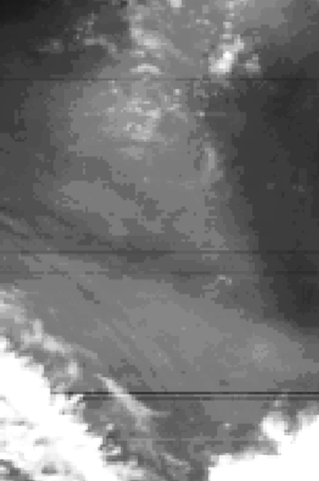
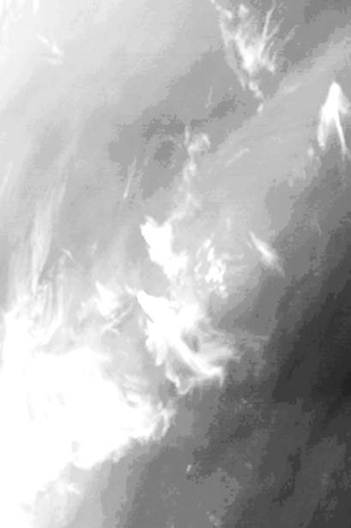
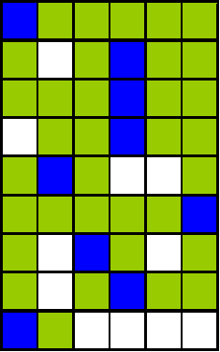
Updates of BDS Map and Special Obs. with Switching of AHI Detector Column
AHI has 3 or 6 redundant detector columns for each band
Performance of all detectors: evaluated in Himawari-8 commissioning phase
The same best detector select (BDS) map has been used
Himawari-8 maintenance in Feb. 2018
Updates of IR BDS maps to remove E-W stripes
Earth observation by all the detectors to re-evaluate their performance
Before BDS map updates
(2017-7-19 03:00 UTC)
After BDS map updates
(2018-2-13 09:40 UTC)
Selection of the best element in each row
BDS map for one of Bands 4 to 16 (Griffith 2015)

Slide 10
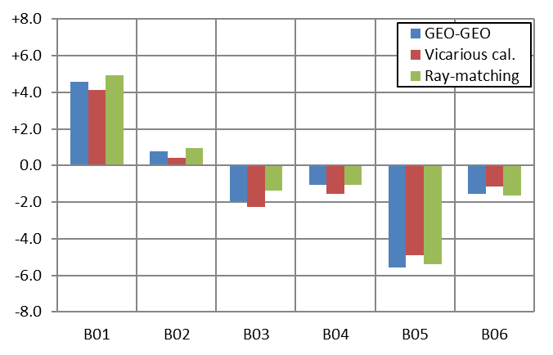
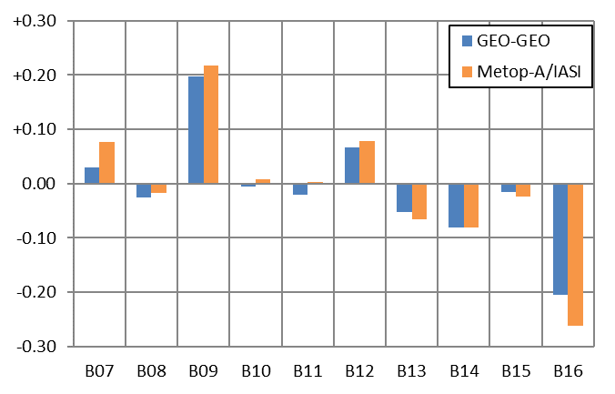
Inter-comparison of Himawari-8/9 AHI Calibration Biases
VNIR: vicarious calibration using Aqua/MODIS + RTM, ray-matching w/ S-NPP/VIIRS, and GEO-GEO (i.e. AHI9 – AHI8)
IR: Quasi-SNO w/ Metop-A/IASI and GEO-GEO
Good agreements among all the validation approaches
Root causes of the bias differences (e.g. B01, 05, 09, 16): to be investigated
(AHI9/AHI-8 -1) x 100 [%]
AHI9 – AHI8 [K]
0.47 0.51 0.64 0.86 1.6 2.3 [μm] 3.9 6.2 6.9 7.3 8.6 9.6 10.4 11.2 12.4 13.3 [μm]
Period of time for stats: 3-12 Feb. 2018

Slide 11
Agenda items reported by JMA
GRWG
IR Sub-Group (Day-3)
Agency updates [4b], GEO-GEO approach for accounting diurnal calibration variation [4c], IRRefUTable Report [4p]
VNIR Sub-Group (Day-4)
AHI Rayleigh Scattering approach using MODIS [7s]
GDWG
Updating GSICS Plotting Tool to support VIS/NIR products [5g, Day-3]
GRWG/GDWG actions at GSICS-EP-18 (also to be discussed on Day-5)
Requirements for Instrument Performance Monitoring System [8e, Day-4]
Annual GSICS Calibration Report [8j, Day-4]
GDWG fact sheet - information presentation [8k, Day-4]

Slide 12
Thank you for your attention

Slide 13
JMA’s Personnel supporting GSICS
GRWG
Masaya Takahashi
IR inter-calibration
Lunar calibration using GIRO, VNIR inter-calibration based on DCC and Ray-matching
Yusuke Yogo (successor of Arata Okuyama)
VNIR vicarious calibration (Ocean, Desert, Water Cloud and DCC) using RTM and LEO obs.
Lunar calibration based on radiance approach
Hidehiko Murata
GEO-GEO inter-comparison incl. blending GEO-GEO and GEO-LEO
GDWG
Masaya Takahashi
Keep current contribution to GDWG activities as GDWG Chair
Others
Tasuku Tabata
1-year visiting scientist at EUMETSAT Climate team (will come back to JMA this week!)
Inter-calibration of heritage GEO imagers within a framework of SCOPE-CM/IOGEO

