Slide 1
GEO-ring applications: Benefits of GEO-GEO Comparisons & RGB Composites Tim Hewison Masaya Takahashi
Special Issue of the IEEE TGRS on “Inter-Calibration of Satellite Instruments”:
Special Issue of the IEEE TGRS on “Inter-Calibration of Satellite Instruments”:

Slide 2
Benefits of GEO-GEO Comparisons
Addressing EP-18.04: “Assess the value of GEO-to-GEO intercalibration for GSICS”
Validation of Multispectral GEO-LEO products
by double-differencing
(GEO2-LEO1)-(GEO1-LEO1)=(GEO2-GEO1)?
Including uncertainties
Quantifying diurnal rel. calibration variations
Hyperspectral-Multispectral comparisons
SRF validation/retrieval
Supporting Composite image generation…
Anything else?

Slide 3
GEO-ring applications: Benefits of GEO-GEO Comparisons & RGB Composites Tim Hewison Masaya Takahashi
Special Issue of the IEEE TGRS on “Inter-Calibration of Satellite Instruments”:
Special Issue of the IEEE TGRS on “Inter-Calibration of Satellite Instruments”:

Slide 4
WMO RGB Expert/Developer Workshop
Masaya attended WS at JMA on composite imagery
RGB imagery could be potential user of GSICS products
Relies on the L1 data quality
Not so much attention to calibration accuracy/stability
although RGB composites recipes affected by calibration
E.g. narrow TB differences assigned to Red/Green/Blue for Night Microphysics
-4 to +2 K (IR12.0 - IR10.8) for Red beam
0 to +10 K (IR10.8 - IR3.9) for Green beam
RGB image colors for convective clouds could differ for different instruments if one has large bias.
E.g. for cold scenes SEVIRI IR3.9 is very stable (~0 K) whereas AHI 3.9µm has large negative bias (~4 K) validated by AHI-IASI GSICS Correction

Slide 5
Common Reference Channels (again!)
Current GSICS algorithms assume imagers’ SRFs well-known
So composite images from multiple GEOs see discontinuities in overlap regions
Possible to apply SBAFs to account for this and make common channels look like they had similar characteristics (with an associated increase in uncertainty)
Several participants are interested in Global composite RGB imagery or "seamless" colour among different instruments.
By applying “Limb Correction” (atmospheric correction depending on optical path)
Main interests: Adjusting RGB colours to reference instrument (e.g. SEVIRI)
Hidehiko Murata (JMA GRWG member) proposed colour adjustment using pseudo SEVIRI/AHI radiances from IASI observation based on GEO-LEO-IR technique.
Adjusting to a common reference channel (CRC) using GSICS approaches may also be another choice.
2014 Discussion on the composite satellite imagery by defining CRCs (SRFs)
Tim’s preference: for GSICS not to generate correction to CRCs
But could discuss idea of recommending an algorithm to generate them…

Slide 6
Feedback from Jochen Kerkmann (EUM)
Would you be interested in algorithm to generate Common Reference Channels?
If so, what requirements would you place on such an algorithm?
e.g. Which channels? What level of systematic and random uncertainties would be acceptable?
Composite images (single channel, or RGBs) discontinuities in overlap regions
because of different SRFs
but even more because of different viewing angles.
So, if you wanted to improve you need to do 2 corrections
a) SRF correction and
b) viewing angle (limb) correction (which has a stronger impact) in the overlap areas that are typically areas with high viewing angles.
Discontinuity effect is stronger in RGB composites that use channel differences
like airmass RGB or the Dust RGB. Attached, 3 examples. ->>

Slide 7
Example RGB Composite #1: Airmass
R : WV6.2-WV7.3
G : IR9.7-IR10.8
B : WV6.2

Slide 8
Example RGB Composite #2: Dust
R: IR12.0-IR10.8
G : IR10.8-IR8.7
B : IR10.8

Slide 9
Example RGB Composite #3

Slide 10
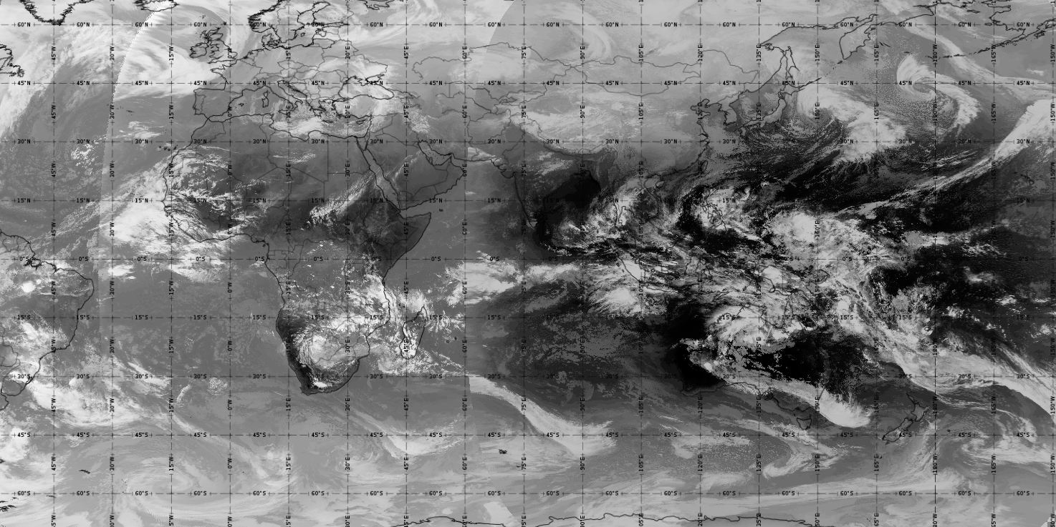
Feedback from Jochen Kerkmann (EUM)
RGBs that use solar channels have even stronger discontinuities
as the solar reflectance depends strongly on viewing angle,
so we usually do not create composites from solar channels.
In single channel (e.g. IR) composite the colour jumps in the overlap are not so large, but still visible (see attached one example).

Slide 11
Feedback from Jochen Kerkmann (EUM)
As regards the spectral band adjustments, this is hard to do as you need to know the amount of absorbing gases, in particular H2O (for IR channels)…
If you do such adjustments, the uncertainty (error) should be small if you want to look at RGB images like the Dust RGB, smaller than 0.5 K I guess.
For which channels?
Usually global composites are done for the IR channel, for the 11 micron band.
So for the SEVIRI 10.8 and AHI/ABI 11.2.
If you want to do global RGB composites, than you need to do it for all IR channels needed to create the RGBs:
This would be (for AHI): WV6.2, WV7.3, IR8.5, IR9.6, IR10.4, IR11.2, IR12.3 (IR11.2 is missing on MTG FCI).

Slide 12
Interpretation of RGB Composite requirements
Actual calibration differences between the sensors are a relatively small contribution to their overall differences when generating RGBs.
dL_cal < dL_srf < dL_limb
Logically, we should apply any GSICS Corrections
To align the instruments' calibration to that of the reference instrument
Before applying the spectral band adjustment factor,
Then finally apply limb correction.
However, in practice we can understand that RGB expert/developer might want to do the limb correction first, then see what discontinuities are left before going into more detail.

Slide 13
Other Potential Users
Jean-Baptiste Hernandez (MetéoFrance)
5 GEO Airmass RGB on their visualization software
Gary Jedlovec of NASA Marshall Space Flight Center
application of "limb correction" to GEO and LEO imageries [CGMS-44 NASA-WP-03]

Slide 14
RGB Composite Support – Way Forward
So, what next?
Do we offer SBAF algorithms?
How?
Work together with composite users?
E.g. Invite potential users to GSICS User‘s Workshop or Web Meeting?
Who to lead?

Slide 15
Thank You for your contributions!

