Slide 1
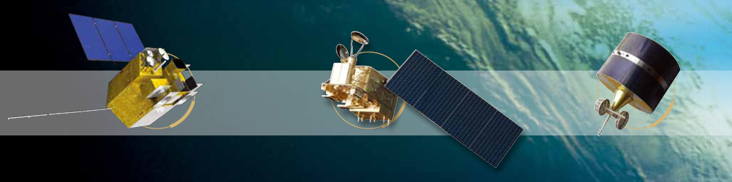

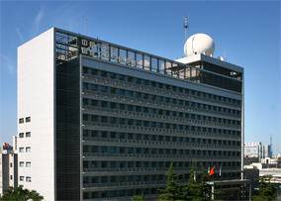


Early calibration results of FY-4A/GIIRS during in-orbit testing
Xuan Feng, Qiang Guo
National Satellite Meteorological Center,
China Meteorological Administration
(NSMC/CMA)

Slide 2
Contents
GIIRS background
Accuracy assessment
Summary

Slide 3
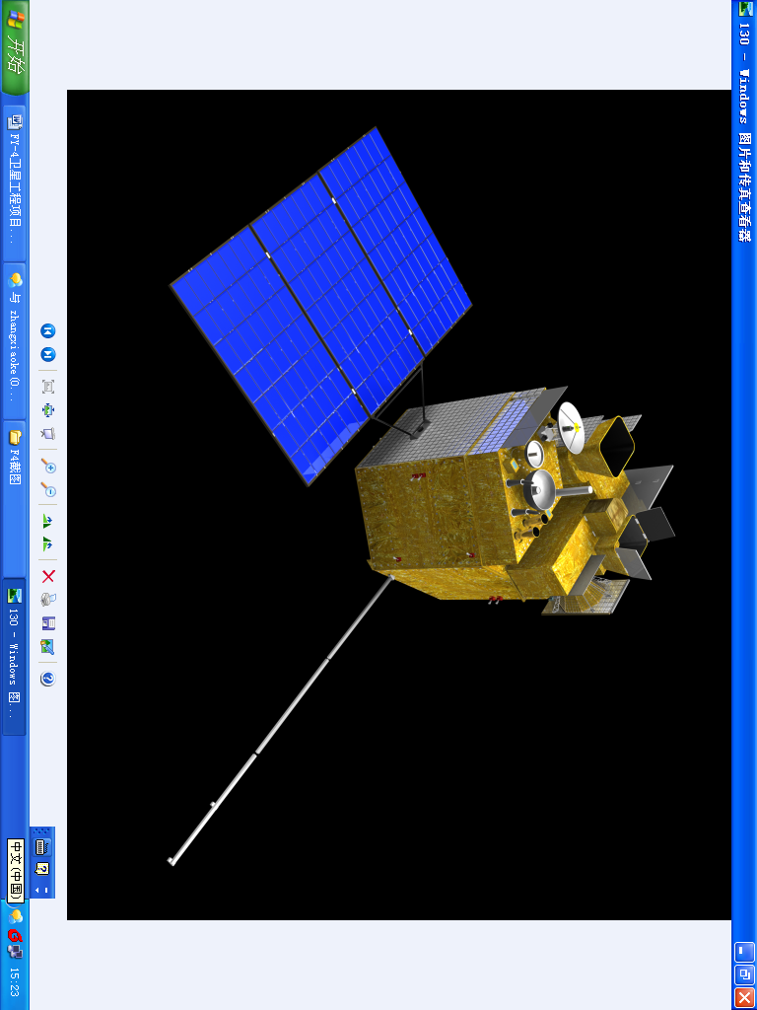
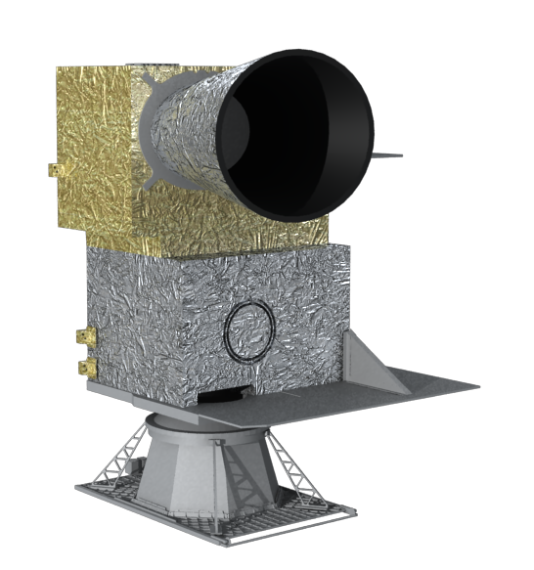
GIIRS Background
Geostationary Interferometric Infrared Sounder(GIIRS) is located on the new generation geostationary platform FY-4A.
GIIRS is a Michelson interferometer based on the principle of Fourier Transform and designed to measure the emission of infrared radiation from the atmosphere in the two infrared spectral bands.
GIIRS
FY-4A

Slide 4
GIIRS Background
The GIIRS scanning is performed in step-and-stare mode, and the instrument stares for a dwell-time of at least 1.3 seconds over the same Earth location and gets an inter ferogram.
A number of interferograms are acquired by two sets of array-detectors (32×4 samples, IFOV@Nadir: 16km) within both LWIR and MWIR bands, respectively during the dwell time.
32×4 Array of
GIIRS FOVs
( 16km in length each )

Slide 5
GIIRS specifications
Band | Spectral Range (cm⁻¹) | Resolution (1/2L) (cm⁻¹) | MPD (cm) | Sensitivity (mW/m² sr cm⁻¹) | Spatial resolution (Km)
LW | 700 – 1130 | 0.625 | 0.8 | 0.5-1.1 | 16
MW | 1650-2250 | 0.625 | 0.8 | 0.1-0.14 | 16
Notes:
There are two infrared spectral bands defined for the GIIRS sensor: the Long Wave (LW), the Mid
Wave (MW).
The spectral limits corresponding to these bands and the required on-axis unapodized spectral resolution
in each band is 0.625 cm–1.

Slide 6
GIIRS Operational Concept
Space segment：
  At each dwell, GIIRS observes 8 Earth scenes with interferometer sweeps in forward and reverse direction
  Every 15 mins, GIIRS observes 16 calibration targets (8 Deep Space + 8 hot body Target)
Ground segment：
  Transform GIIRS interferograms into fully calibrated and geolocated spectra
  Transform spectra into temperature, pressure and moisture profiles

Slide 7
Contents
GIIRS background
Calibration and validation
Summary

Slide 8
Calibration and validation
The radiometric calibration
  The cold space spectrum and the hot body spectrum are used to compute the instantaneous radiometric calibration coefficients
The Spectral calibration
  Initially was based upon pre-launch measurements
  Through post-launch testing , the spectral calibration coefficients have been updated using clear sky earth spectrum
Noise Equivalent Differential Radiance(NEdN)
  estimated as the standard deviation of the measured spectral radiance over a set of acquired blackbody samples
Radiometric accuracy assessment
  Through comparison with IASI

Slide 9
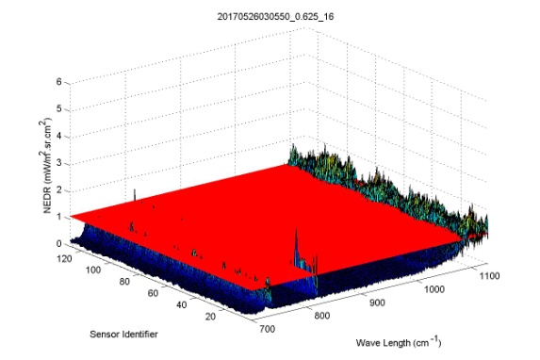
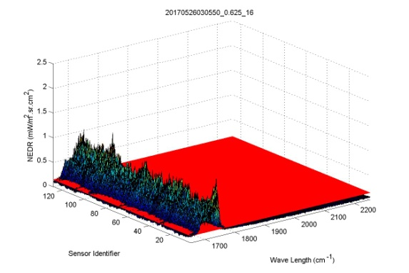
Noise Performance
NEdN in the longwave spectral range
NEdN in the midwave spectral range
GIIRS Radiance measurement requirements are 0.5-1.1 mw/m² sr cm⁻¹ in LMIR and 0.1-0.14 mw/m² sr cm⁻¹ in MWIR
The noise performance is good in most of the spectral range
In some spectral range, NEdN is larger
Up to now, the reason is still unknown

Slide 10
Radiometric accuracy assessment
SNO Criteria
Time difference:
less than 15min
Zenith angle difference:
ABS(cos(a1)/cos(a2)-1) <= 0.01
Pixel distance:
the FOV of GIIRS almost covers
the FOV of IASI completely
Assessment of GIIRS radiometric accuracy is through comparison with IASI.
Agreement is good for most of the spectral range
Larger BT difference in some spectral range

Slide 11
SNOs between GIIRS and IASI
MWIR
LWIR
760
1050
1800
2188
LWIR
MWIR
Period: 20170801~20171031; Ref: METOP-A/IASI; Samples: 110(LW)/108(MW)
Notes:
Because the noise performance is poor in some spectral range, the results are compared from 760 to 1050 cm-1 and from 1800 to 2188 cm-1.
Comparison with IASI ,the bias is less than 1 Kelvin, but Larger standard deviation in the midwave spectral range

Slide 12
On-orbit spectral calibration
Spectral calibration will be performed using Earth scene atmospheric reference lines.
The optimal effective laser wave-number minimum (resulting GIIRS wavenumber scale) is found when the RMS residual (observed minus calculated radiance) is minimum
There is a well defined minimum in this curve, establishing the spectral calibration to better than 10ppm
Notes:
Here shows integrated residuals (observed and calculated) for the 700 to 718 cm-1 region with the effective
laser wavenumber perturbed by various
The GIIRS spectral calibration requirement is less than 10ppm
700-718 cm⁻¹ and 2050-2100 cm⁻¹, respectively.

Slide 13
spectral calibration coefficients
LWIR
MWIR
Forward sweep
Forward sweep
Reverse sweep
Reverse sweep
Notes:
Here, showing the spectral calibration coefficient of every field of view(FOV) in the forward and reverse direction over each band.
The black line means getting from pre-launch measurements
The red line means the new one using Earth scene atmospheric reference lines.

Slide 14
光谱定标修正前
光谱定标修正后
Notes:
The top panel have been shown before, the spectral calibration coefficient was based upon pre-launch measurements
The down panel use the new spectral calibration coefficient
As we can see, the bias and standard deviation in the mid-wave spectral range has declined.

Slide 15
MW: No.47
Notes:
Let us see the details of the spectrum, the left use the old spectral calibration coefficient, right use the new spectral calibration coefficient
line structures show very good agreement between GIIRS and IASI when using the new coefficient.
FOV47 is the field of view near the axis

Slide 16
MW: No.66
Notes:
FOV66 is the field of view off the axis.
the left use the old spectral calibration coefficient, right use the new spectral calibration coefficient
when using the new coefficient, line structures show better agreement than before.

Slide 17
Contents
GIIRS background
Accuracy assessment
Summary

Slide 18
Summary
Spectral calibration working very well
Radiometric calibration accuracy :
  Comparisons to IASI within 1K for most of the spectral range
  Larger standard deviation in MWIR
On-going/Future Work
  Because of the extremely small range of angles contributing to each individual detector pixel , the variation of ILS (Instrument Line Shape) across the array is extremely small and be ignored
  non-linearity correction

Slide 19
Thank you!

