Slide 1
GIIRS and HIRAS Hyperspectral instrument evaluation for FY-4A and FY-3D
Hanlie XU, Xiuqing HU, Chunqiang Wu, Tianhang Yang, Na Xu
NSMC CMA
2018-3-21

Slide 2
Outline
Introduction
FY4A-GIIRS evaluation using CrIS and FY4A-AGRI
FY3D-HIRAS evaluation
Summary and discussion

Slide 3
Introduction
FY4A ----GIIRS, AGRI
11 Dec., 2016: launched
26 Dec., 2017: Started in-orbit test
FY3D ----HIRAS, MERSI
15 Nov., 2017: launched
08 Dec., 2017: MERSI-II started working
11 Dec., 2017: Started in-orbit test
25 Feb., 2018: HIRAS started working
04 Mar., 2018: Received earth view data
FY4A/GIIRS
Hyperspectral Sounder
FY4A
FY4A/AGRI
Imager
NPP/CrIS
Hyperspectral Sounder
FY3D/MERSI
Imager
FY3D
FY3D/HIRAS
Hyperspectral Sounder

Slide 4
Outline
Introduction
FY4A-GIIRS evaluation using CrIS and FY4A-AGRI
FY3D-HIRAS evaluation
Summary and discussion

Slide 5
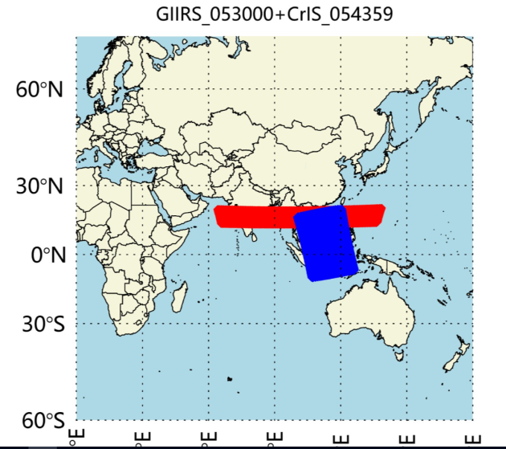
Pixel collocation method
FY4/GIIRS and NPP/CrIS
Region restricting: GEO nadir ±35º area
First geolocation collocating: if there is overlapping region
Overlapping：find the total overlapping region
Collocation criteria:
Pixels distance difference： <=(16+14)/4=7.5 km；
Viewing geometric difference：ABS(cos(s1)/cos(s2)-1) <0.01
Time difference：180 s

Slide 6
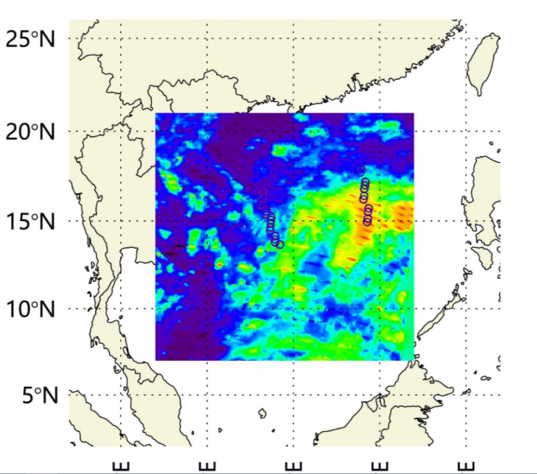
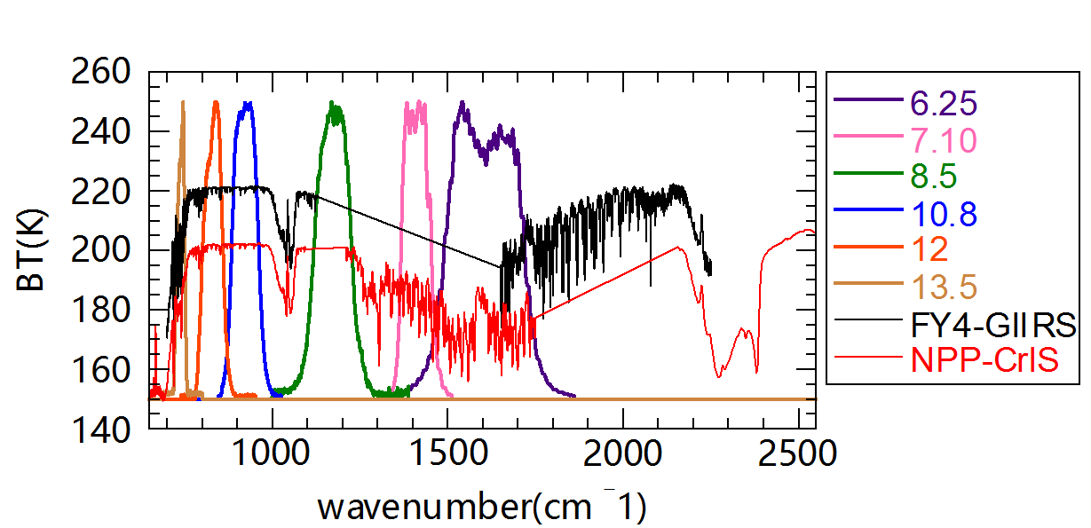
Target uniform check
Using the FY4A/AGRI infrared channel to check the uniform
7 pixels
Uniform area check：STD/MEAN<0.01
GIIRS
28 km
CrIS
Using 13.5 band
AGIR
Uniform check schematic diagram
FY4A/AGRI
IR band SRF

Slide 7
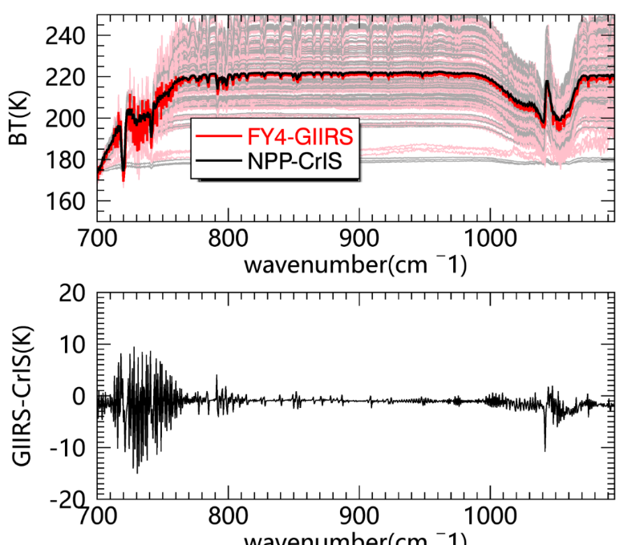
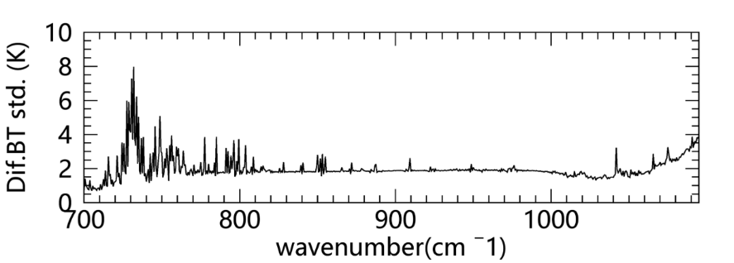
Comparison Results between GIIRS and CrIS
Only the longwave results are shown here
Period: 20180201-20180205
Matched Number: 240
Good consistency between GIIRS and CrIS in window bands, GIIRS is a little lower than CrIS;
The differences in absorption regions are larger;
The standard deviation of BT difference in absorption regions are larger than window regions;

Slide 8
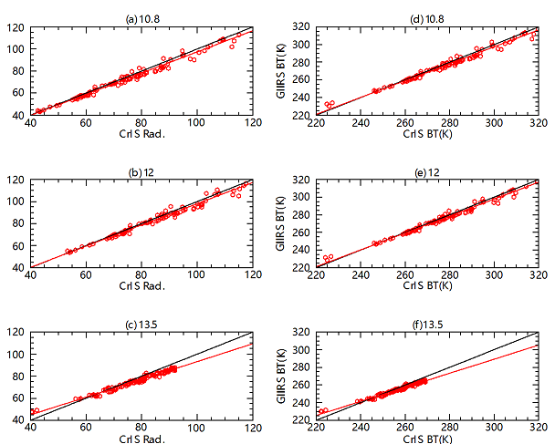
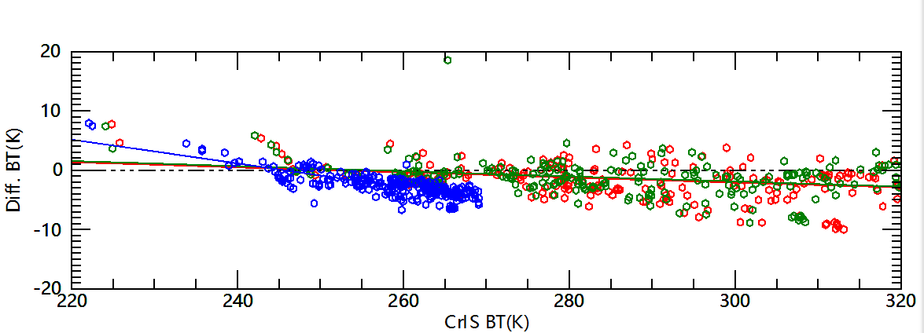
Results of radiance convoluted at AGRI bands
Red:10.8; Green:12; Blue:13.5
GIIRS is colder than CrIS
BT differences in window channel is less than 0.5 K, in absorption region are larger;
Bias Target dependent
The difference relies on temperature, all the three bands show that, on low temperature, the GIIRS is a little higher than CrIS, and on the high temperature, GIIRS is lower.
Notes:
The difference relies on temperature, all the three bands show that, on low temperature, the GIIRS is a little higher than CrIS, and on the high temperature, GIIRS is lower.

Slide 9
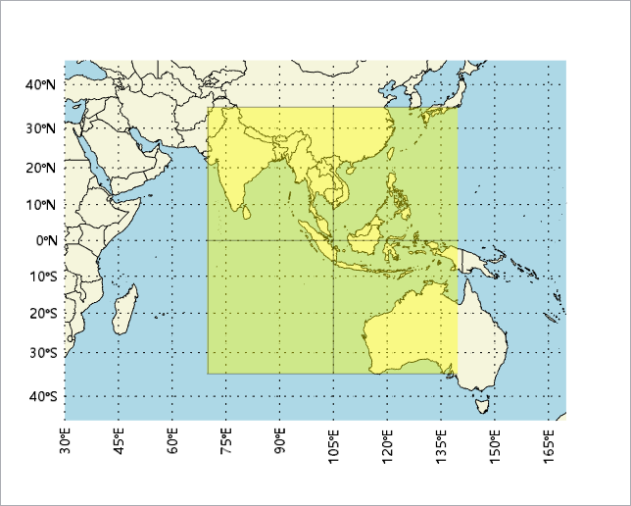
AGRI and GIIRS consistency check
Collocation area: GEO nadir ±35º area;
Time difference: 180s
Target area: 5*5 AGRI pixels
Environment area: 15*15 AGRI pixels
Only uniform areas are chosen.
GIIRS Simulated 13.5
AGRI 13.5
GIIRS-AGRI
Notes:
Hyperspectral sonder GIIRS and imager AGRI are both carried on FY4A;
Need to check the consistency between the two instruments on the same platform;
The shape and size of GIIRS’s pixels could change with geolocation, for example, the most northwest pixel is an ellipse, and the major axis is about 29.87 km, the minor axis is about 23.40 km;

Slide 10
AGRI and GIIRS consistency check
A case: 20180105
Band | 10.8 | 12 | 13.5
Scene (K) | 286 | 285 | 258
AGRI-GIIRS | 0.33 | 0.19 | 0.83
GIIRS and AGRI have a good consistency, at the standard sense temperature, GIIRS is a little lower than AGRI;
In this case, for window bands, the bias is less than 0.5 K, for absorption band, bias is less than 1 K;
Bias has BT dependence, in low temperature area, the bias is larger;

Slide 11
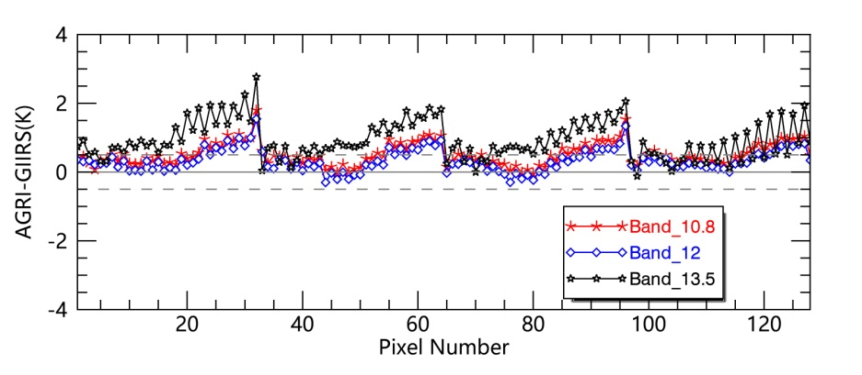
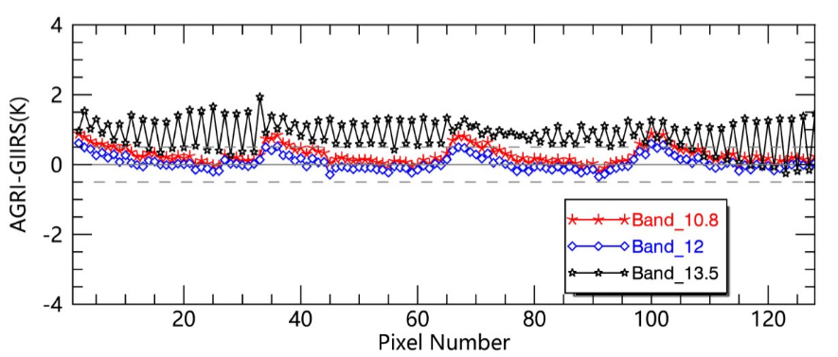
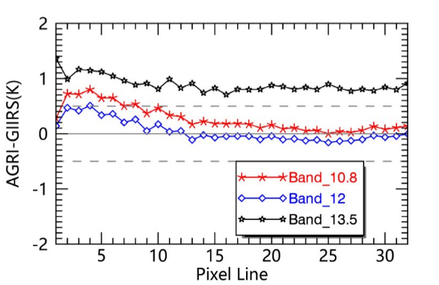
Bias of FOV dependent
201708
201801

Slide 12
Outline
Introduction
FY4A-GIIRS evaluation using CrIS and FY4A-AGRI
FY3D-HIRAS evaluation
Summary and discussion

Slide 13
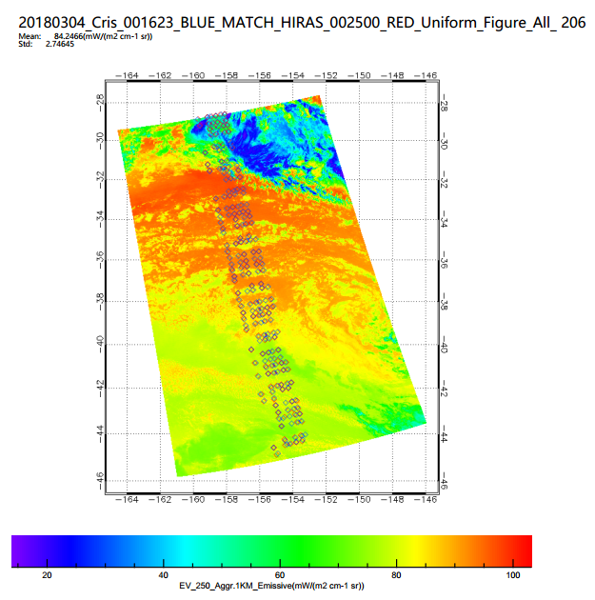
Collocation between HIRAS and CrIS
SNO
SNOx
A case of 20180304
Collocation criteria:
Pixels distance difference： <=(16+14)/4=7.5 km；
Viewing geometric difference：ABS(cos(s1)/cos(s2)-1) <0.01
Time difference：600 s
Matched Number: 206

Slide 14
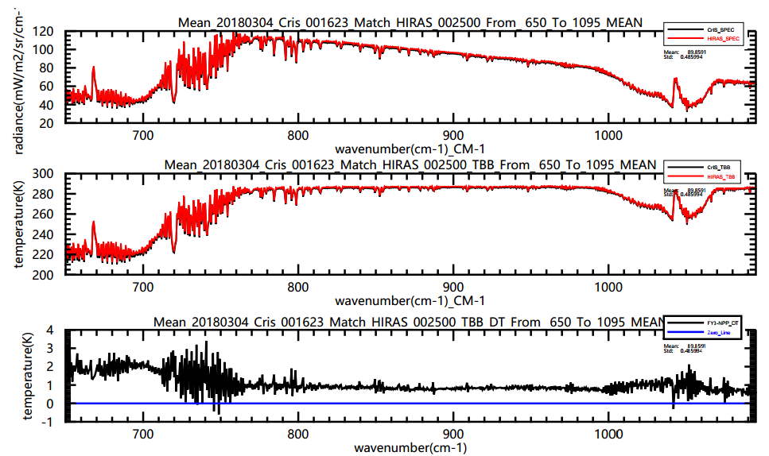
Spectrum of HIRAS and CrIS
Radiance
CrIS
HIRAS
BT
No nonlinear correction results

Slide 15
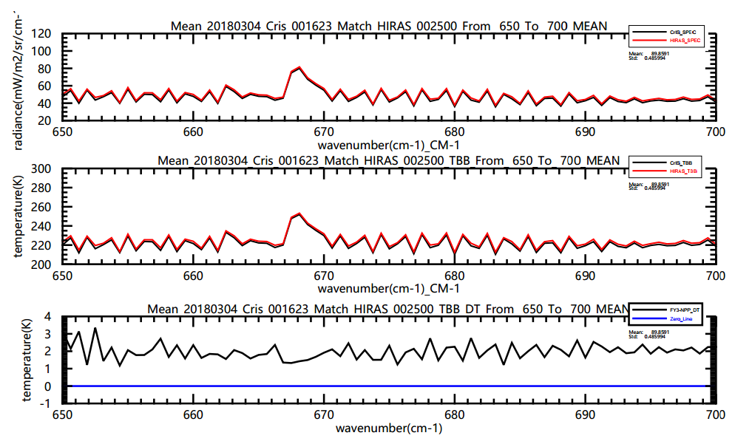
BT of HIRAS and CrIS (Zoom in)
650-700cm-1

Slide 16
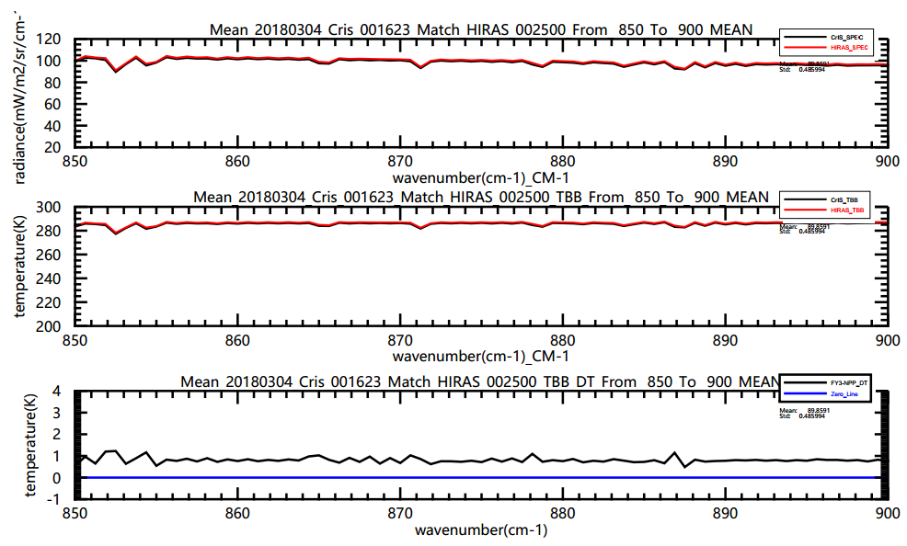
BT of HIRAS and CrIS (Zoom in)
850-900cm-1

Slide 17
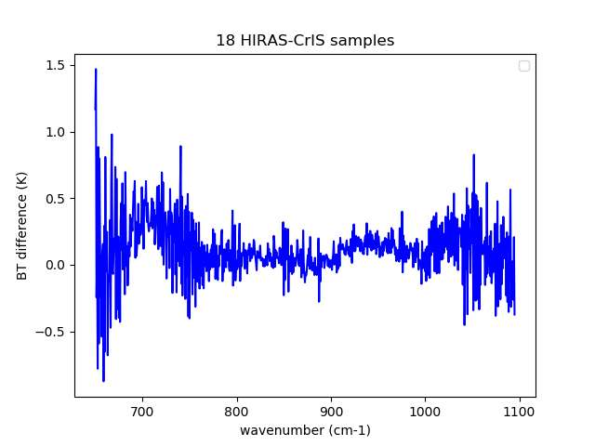
Bias between HIRAS and CrIS
Difference between HIRAS and CrIS
After NL correction
18 samples average

Slide 18
Accurate collocation Method
According to Dr. Wang’s accurate collocation between hyperspectral sounder and image on the same platform (Wang et al., 2013,2016).
Satellite
P
Wang et al., 2015
Thanks for Likun Wang’s sincerely help!

Slide 19
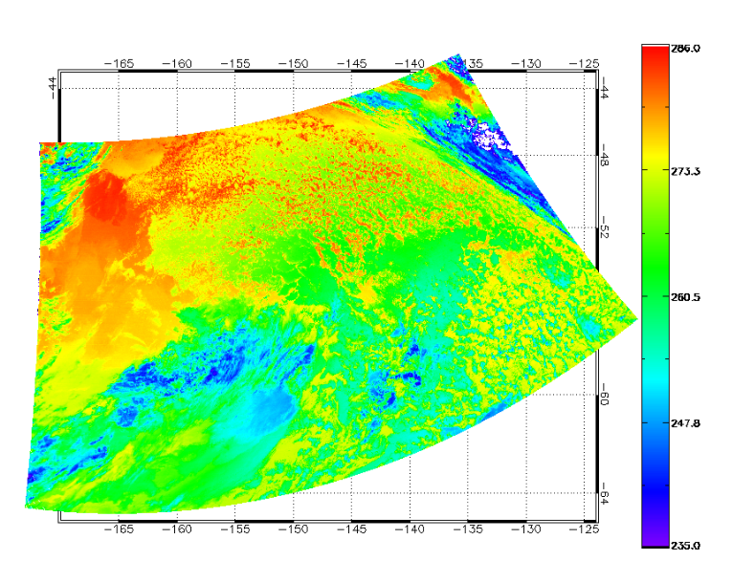
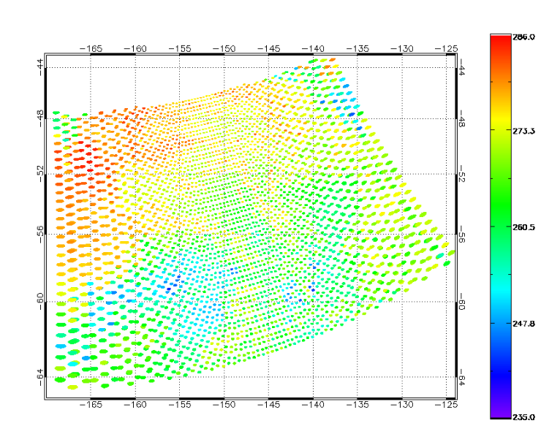
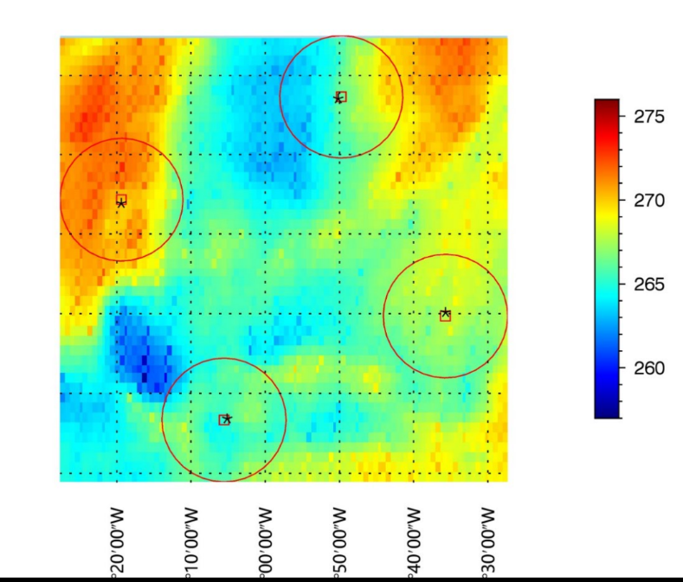
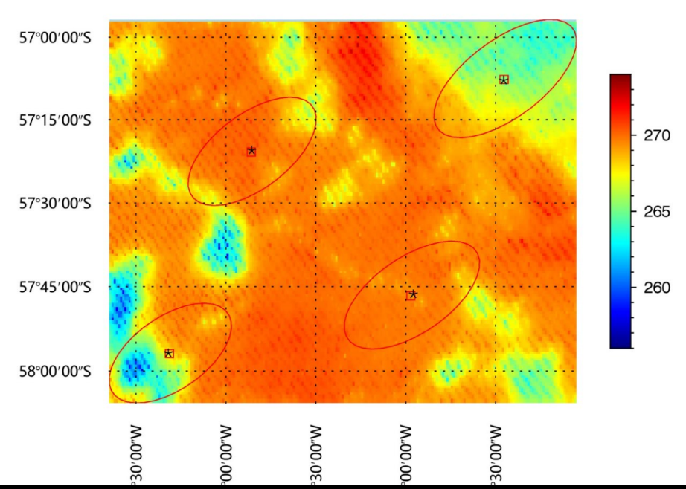
Pixel collocation
BT of MERSI and HIRAS at the same time (12 um)
MERSI
HIRAS
Nadir FOR
Edge FOR

Slide 20
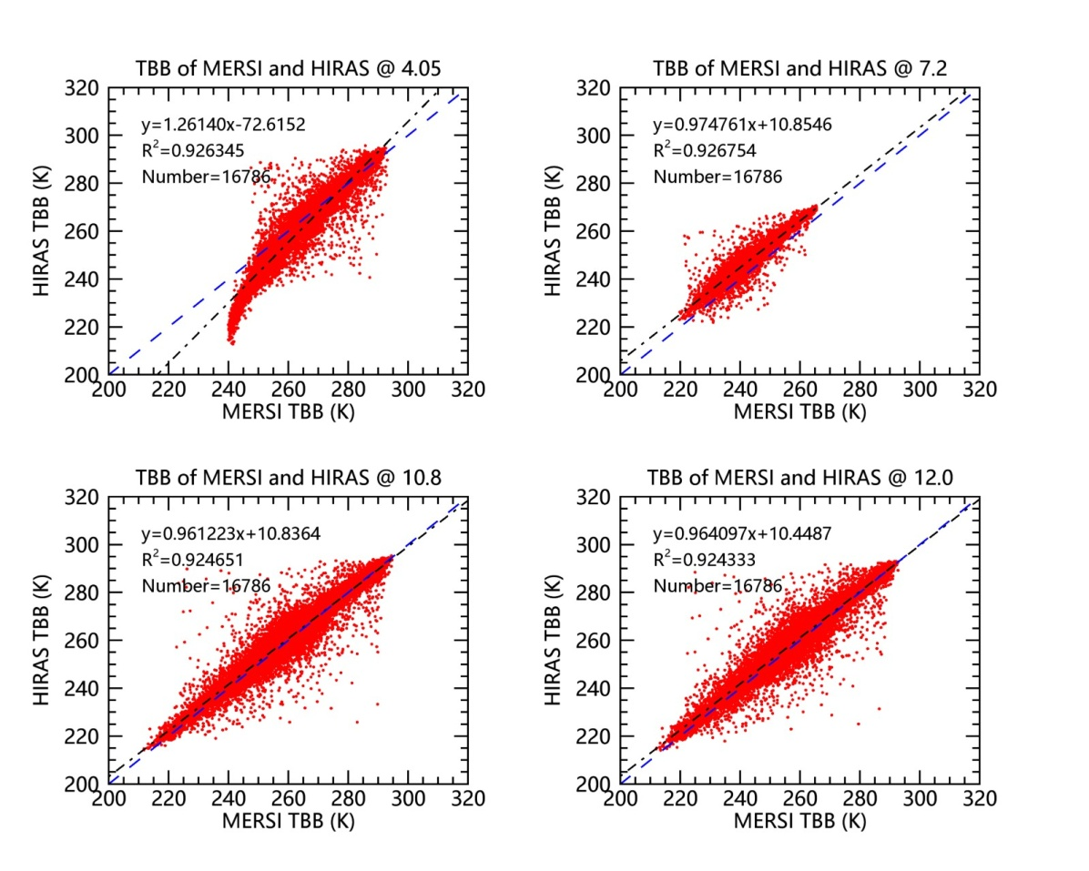
Day 1:without uniform check and NL correction
5 granule data before uniform check
Uniform check:
Because of geolocation is still tuning, so choose uniform area is very important.
For each channel:
Calculating the standard deviation MERSI pixels which collocated in HIRAS pixel ;
STD/AVE<0.1

Slide 21
Day 1:uniformity pixels and no NL correction
HIRAS-MERSI (12 um)
Circles: Uniformity HIRAS pixes
Left: MERSI TBB;
Right: MERSI TBB collocated in HIRAS

Slide 22
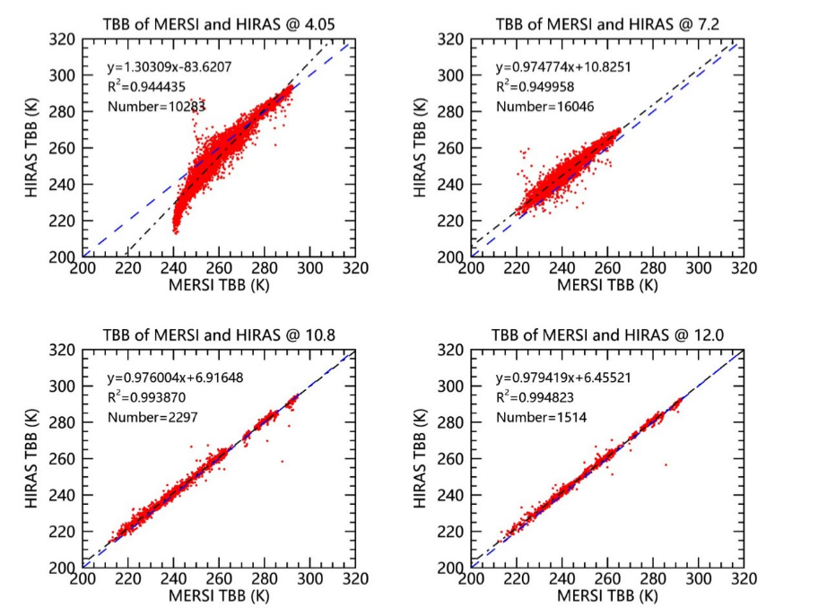
Day 1:Data consistency evaluation
Channel （um） | Scene_ bt (K) | HIRAS-MERSI (K)
4.05 | 284 | 2.476
7.2 | 251 | 4.513
10.8 | 286 | 0.151
12 | 285 | 0.699
5 granules uniformity data combine;
HIRAS no NL correction

Slide 23
Summary and Discussion
Using NPP/CrIS to evaluate the radiometric calibration, checking the consistency between the hyperspectral sounder and imager on the same platform;
FY-4A/GIIRS’s radiance has a good consistency to NPP/CrIS, the bias between them is less than 1 K, GIIRS is a little lower than CrIS;
GIIRS and AGRI have a good consistency, the bias depend on FOV has much improved;
Comparing to CrIS, FY-3D/HIRAS’s radiance is a littler higher than CrIS, and after nonlinear correction, the bias in window channels is less than 0.5 K;

Slide 24
Thanks for your attention!

