Slide 1
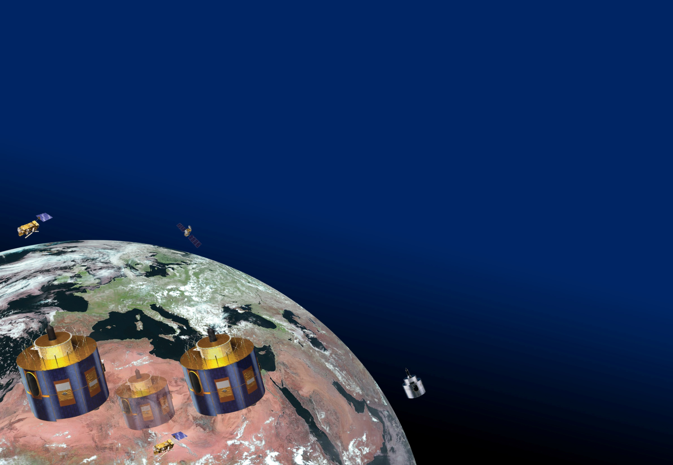
GSICS LEO-LEO IR
Sentinel-3/SLSTR-IASI Products
Tim Hewison

Slide 2
GSICS LEO-LEO IR Products
In 2017, we asked :
Share your thoughts on developing GSICS products for LEO imagers
  (at least for the IR channels)
  a) Would it be useful to have GSICS corrections to inter-calibrate LEO imagers to a common reference?
  b) If so, do they need regularly updating or could they be static?
  c) What form would such corrections need to take to meet user expectations?
  d) Anything else on this theme?

Slide 3
LEO-LEO IR Products for SLSTR
EUMETSAT have started thinking about generating LEO-LEO IR GSICS products for SLSTR
a) Would it be useful to have GSICS corrections to inter-calibrate LEO imagers to a common reference?
  Yes – some internal interest from EUMETSAT
  Seeking further feedback from SST community, and other users through GSICS
b) If so, do they need regularly updating or could they be static?
  Static, but calibration routinely monitored to check validity
c) What form would such corrections need to take to meet user expectations?
  TBD, but maybe quadratic in radiance (no space view, but 2 BBs)
d) Anything else on this theme?
  Need to deal with IASI spectrum missing from the 3.7µm channel
  (Research Topic for Copernicus Calibration Expert at EUMETSAT)
  Already need to think about how to integrate with VIS/NIR channels
  – large bias at 1.6µm and 2.2µm

Slide 4
SLSTR-IASI
No further development since 2017 meeting
Outstanding issues:
  Only 11µm and 12µm channels covered
  Investigation of cold end bias (no space view)
    Form of correction – quadratic?
  Extrapolation of IASI data to cover 3.6µm band
  Optimising match-up process for polar SNOs
    Handling oblique view
  Quasi-SNO method
    To cover bigger range of latitudes/radiances
  Need for VIS/NIR/SWIR channel product
    Large biases in 1.6µm (16/20% nad/obl) and 2.2µm (~25%) channels
    Will investigate potential of SSCC (Desert sites)
  Sentinel-3B
    Launch due 25 April 2018
  Decision to develop demonstration GSICS Corrections

Slide 5
Thank You!

