Slide 1
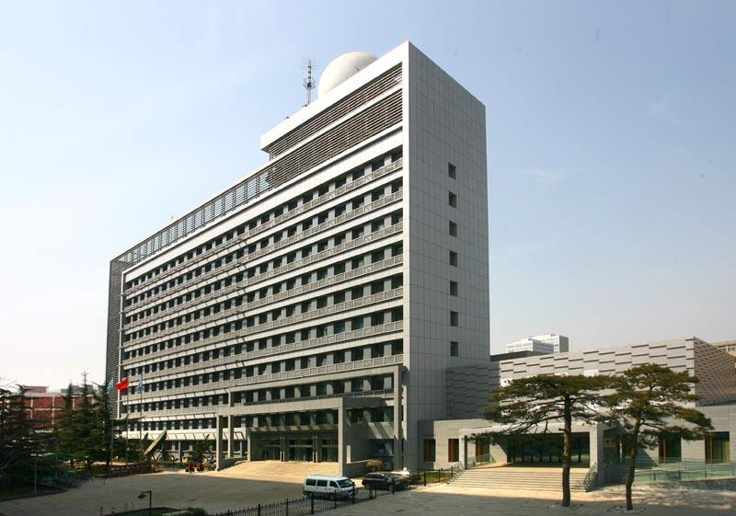
FY-3D/HIRAS
On-orbit Performance : DAY-1 Results
Chengli Qi, Chunqiang Wu, Xiuqing Hu, Hanlie Xu, Lu Li, Fang Zhou
National Satellite Meteorological Center(NSMC), CMA
Mingjian Gu, Chunyuan Shao, Xiaojie Sun,
Jianwen Hua
Shanghai Institude of Technical Physics(SITP), CAS
GSICS Annual Meeting, Shanghai, China 19-23 Mar 2018

Slide 2
Outline
HIRAS Introduction
Instrument & Ground Processing Status
HIRAS Performance
HIRAS Radiometric Error Budget Analysis
Non-linearity Evaluation and Correction
Summary

Slide 3
1. Introduction
HIRAS is a Fourier transform interferometer which posses of high spectral resolution, low radiometric noise and high spectral and radiometric accuracy.
HIRAS instrument requirements
Parameters | Specification
Scan Period | 10s
FOV size | 1.1°
Pixels per scan line | 116 (4 FOVs x 29 FORs)
Maximum scan angle | ± 50.4°
Radiometric calibration accuracy | < 0.7K
Spectral calibration accuracy | < 7ppm
Direction pointing bias | ＜±0.25°

Slide 4
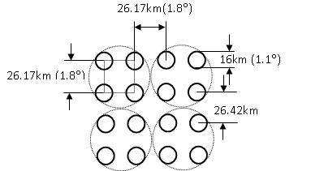
FY-3D/ HIRAS Specifications
HIRAS scan, field-of-regard (FOR), field-of-view (FOV)
2×2 Four detectors define 1 FOR
33 sweeps, including 29 Earth Scene (ES), 2 Deep Space (DS) & 2 Internal Calibration Target (ICT) measurements
Nadir spatial resolution is 16km
Band | Spectral Range (cm⁻¹) | Spectral Resolution (cm⁻¹) | Sensitivity (NEΔT@280K) | No of Channels
LW | 650*～1136 （15.38μm～8.8 μm） | 0.625 | 0.15～0.4K | 778
MW | 1210～1750 （8.26μm～5.71 μm） | 1.25 | 0.1～0.7K | 433
SW | 2155～2550 （4.64μm～3.92 μm） | 2.5 | 0.3～1.2K | 159

Slide 5
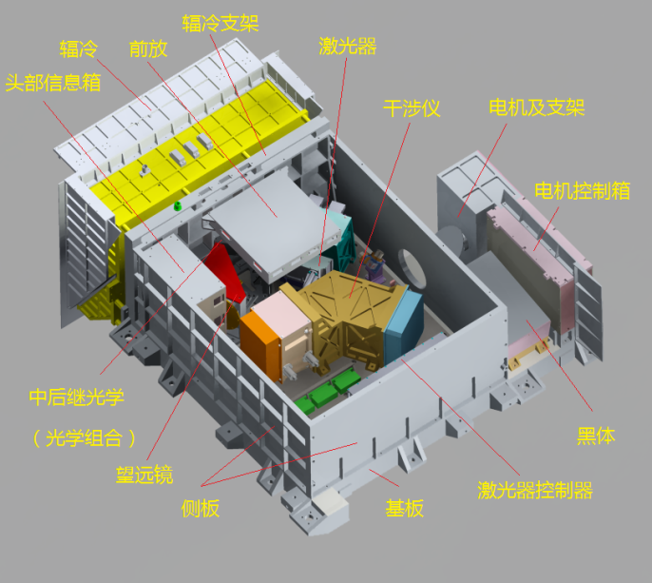
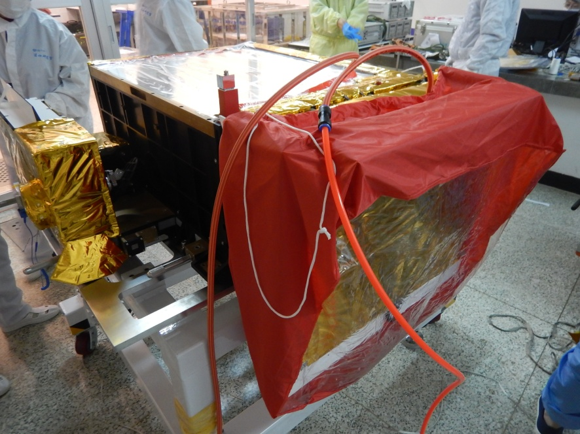
FY-3D launched on 15 Nov, 2017.
3 month outgassing; initially turned on 1st Mar.
Designed and manufactured completely by Shanghai Institute of Technical Physics (SITP), Chinese Academy of Sciences (CAS) .
Instrument structure
HIRAS

Slide 6
2. Instrument & Ground Processing status
Initial data analysis and instrument tuning
1,Mar
- HIRAS infrared detectors powered on
- Telemetry parameters check
- 1st IGM check
- Raw Spectra check
- Calibrated spectra check
- Pre-processing system in operation
2-3, Mar
- Interferometer fixed-mirror alignment
5, Mar
- ZPD position tuning
6, Mar ~ present
- NEdT evaluation
- Spectral channel frequencies compared with LBL simulation
- Radiance spectra compared with NPP/CrIS

Slide 7
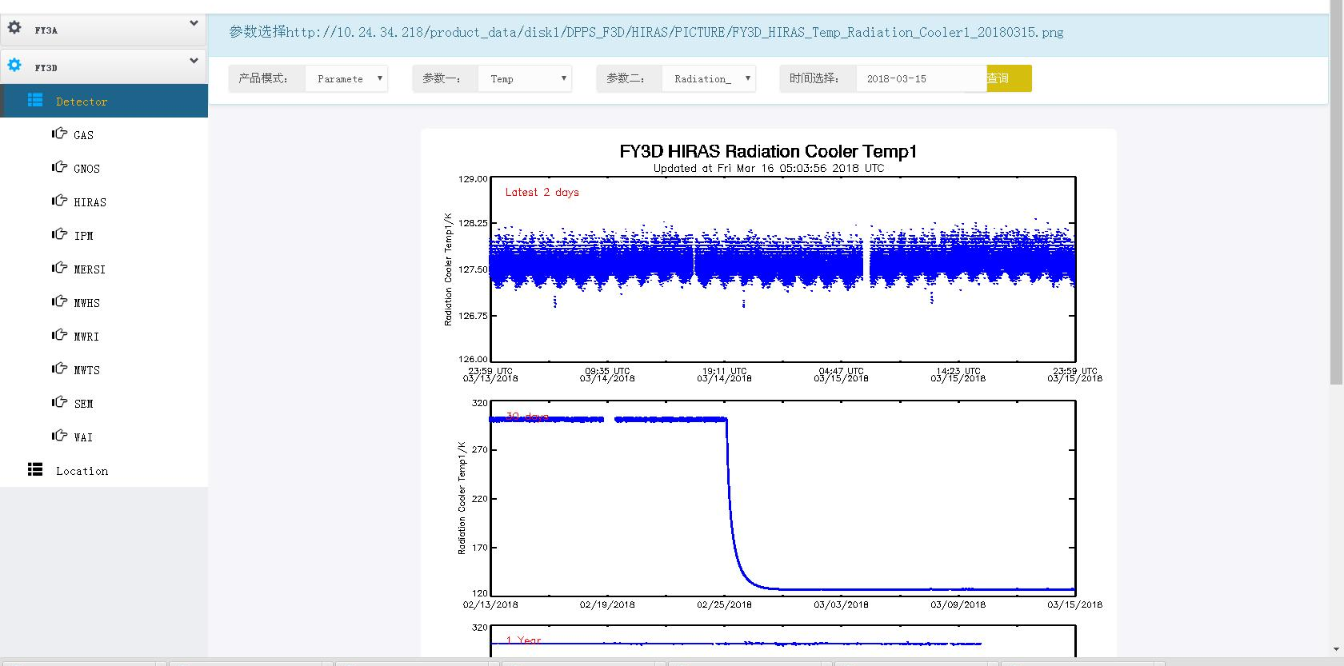
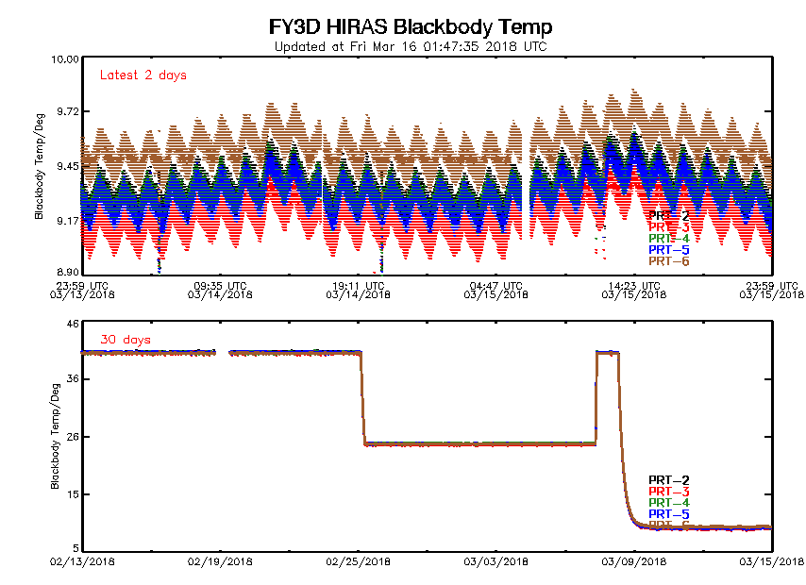
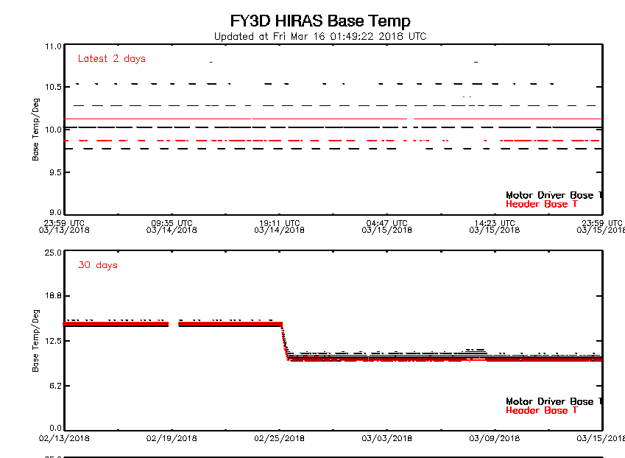
Instrument Monitoring System
补充系统链接图
Telemetry parameters:
Components temperature
Instrument status
Moving mirror velocity
Laser signal
Motor mode

Slide 8
Raw BB Spectra: before & after optical Alignment
Raw BB & Calibrated ES Spectra
LW
MW
SW
Calibrated Unapodized Spectra (0.625 cm⁻¹ resolution for all 3 bands)
LW
MW
SW

Slide 9
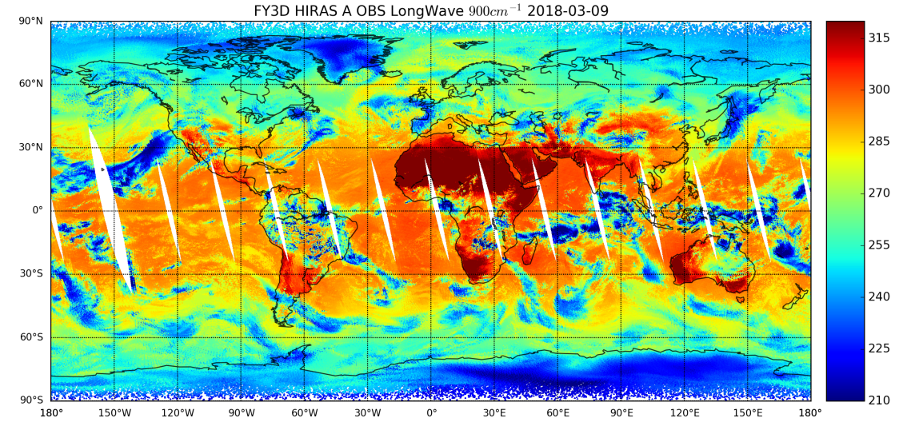
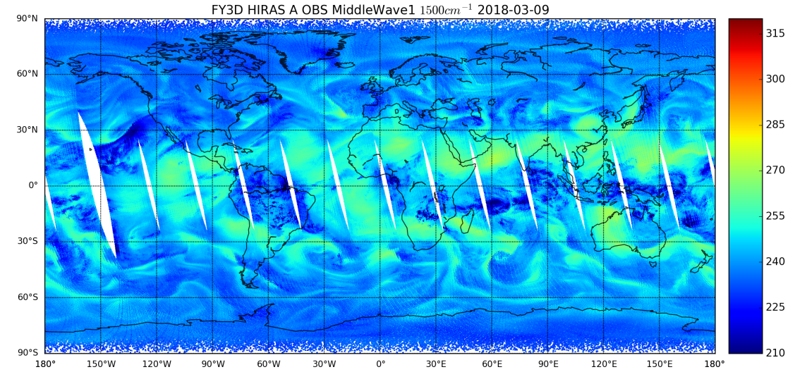
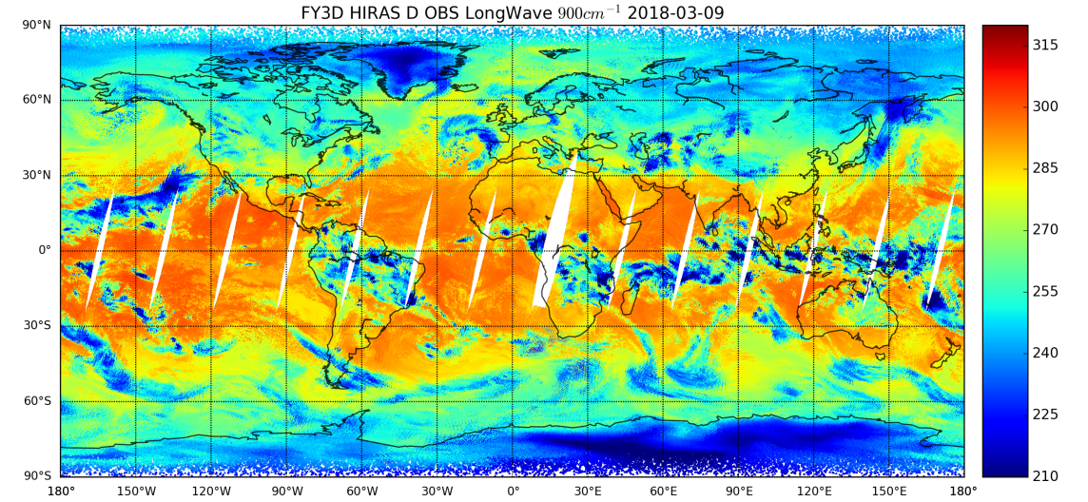
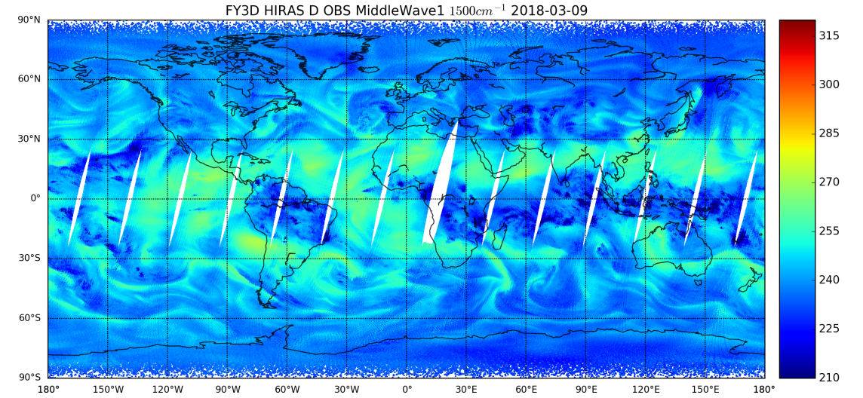
Day-1 Global BT(Real Part)
LW 900cm-1
MW 1500cm-1
After data downlink, ground system generates L0 data, decodes them into L1A data and then processes the data into L1 & OBC dataset.

Slide 10
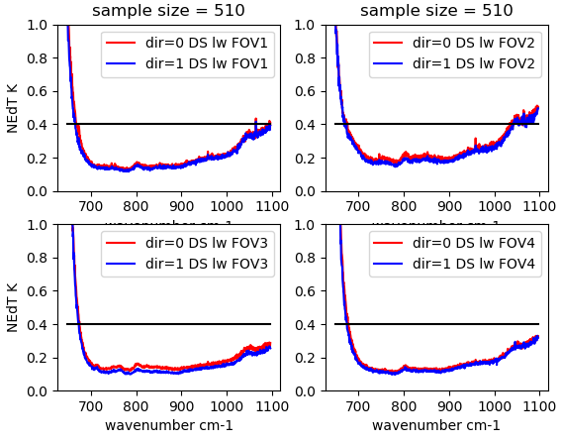
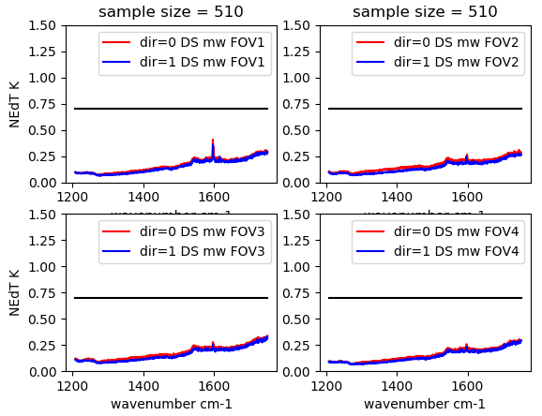
3. HIRAS performance: NEdT
LW @ 0.625cm-1 Res
MW @ 1.25cm-1 Res
Noise performance: derived from DS measurements
Expect better results after fine tuning in May.

Slide 11
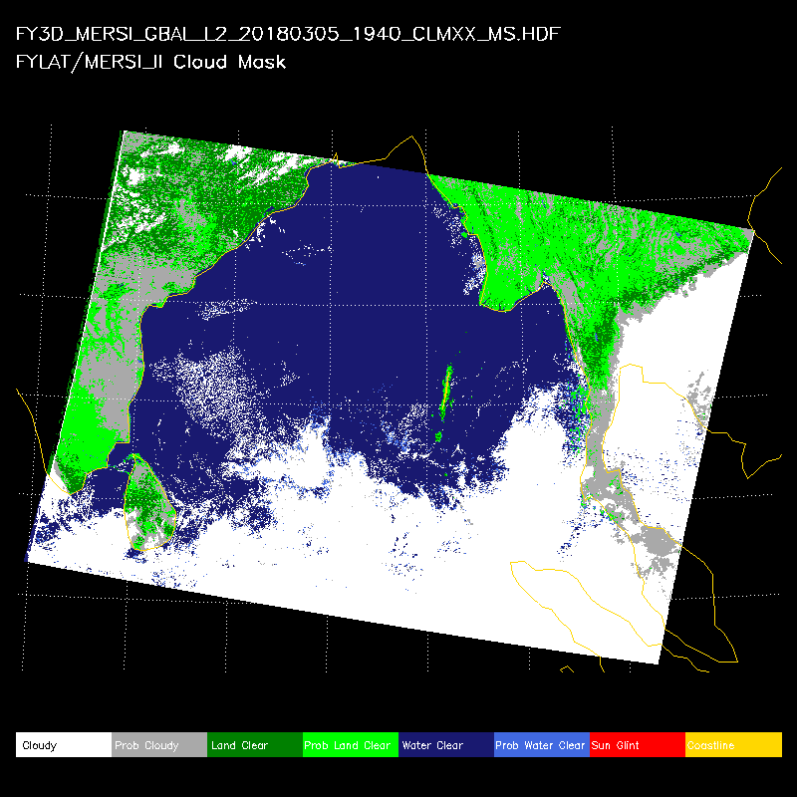
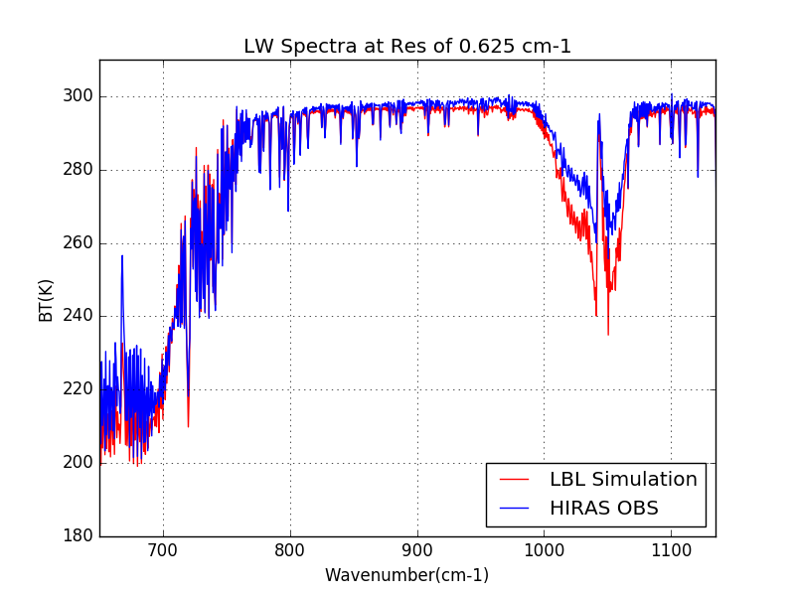
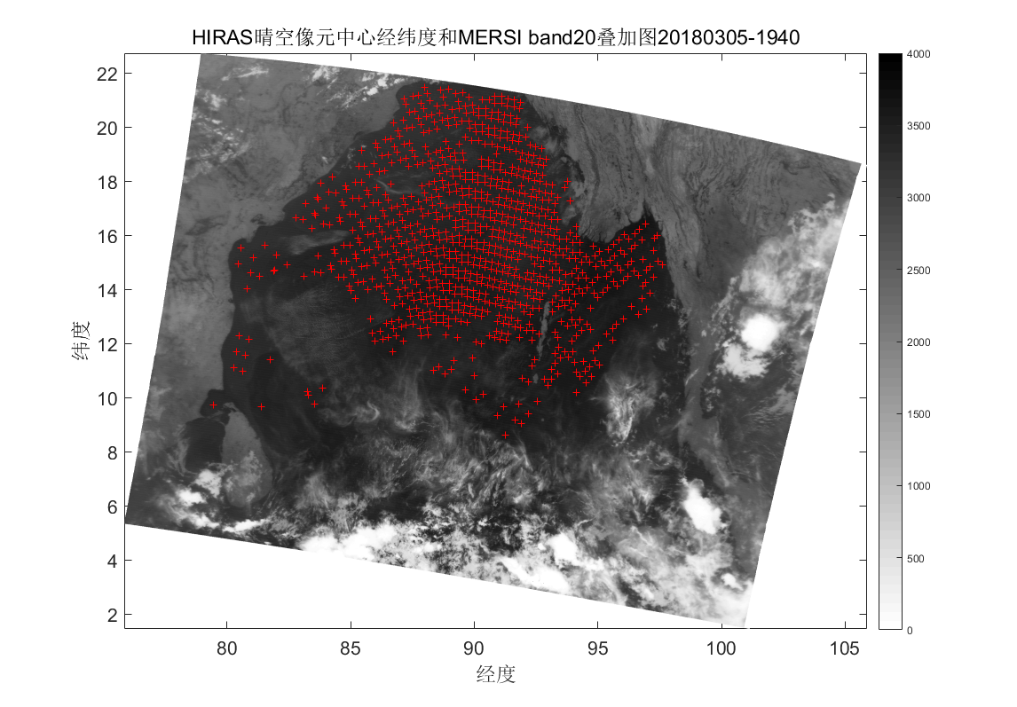
Data Collection for Spectral Calibration
MERSI-II Cloudmask
HIRAS OBS compared with LBLRTM simulation （LW）
Clear pixels determined from MERSI cloudmask
Frequency biases relative to LBLRTM will be derived; ILS & laser parameters may be adjusted

Slide 12
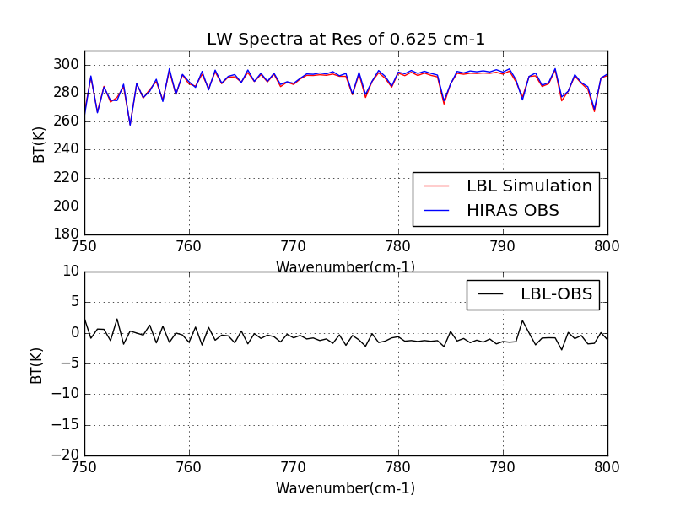
LW band HIRAS OBS compared with LBLRTM simulation: Zoom in
BT Diff

Slide 13
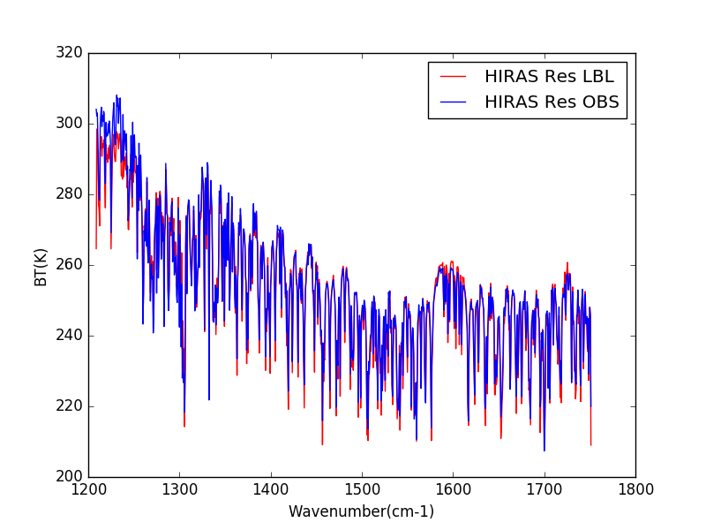
MW band HIRAS OBS compared with LBLRTM simulation

Slide 14
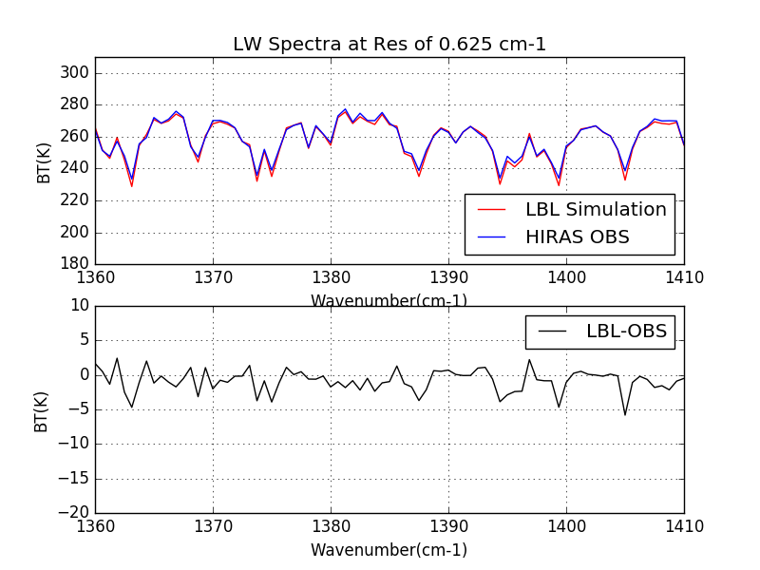
MW band HIRAS OBS compared with LBLRTM simulation: Zoom in
BT Diff

Slide 15
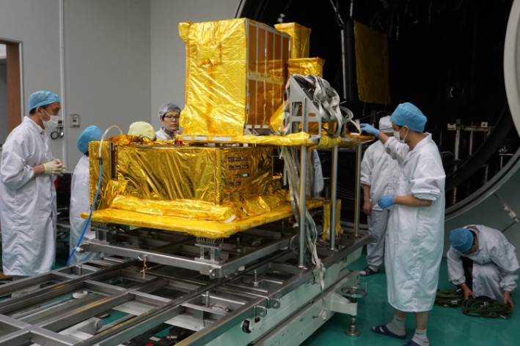
4. Radiometric uncertainty contribution
calibration blackbody
  temperature accuracy
  blackbody emissivity
detector temperature
detector nonlinearity
reference cold target temperature and emissivity
background radiometric variation

Slide 16
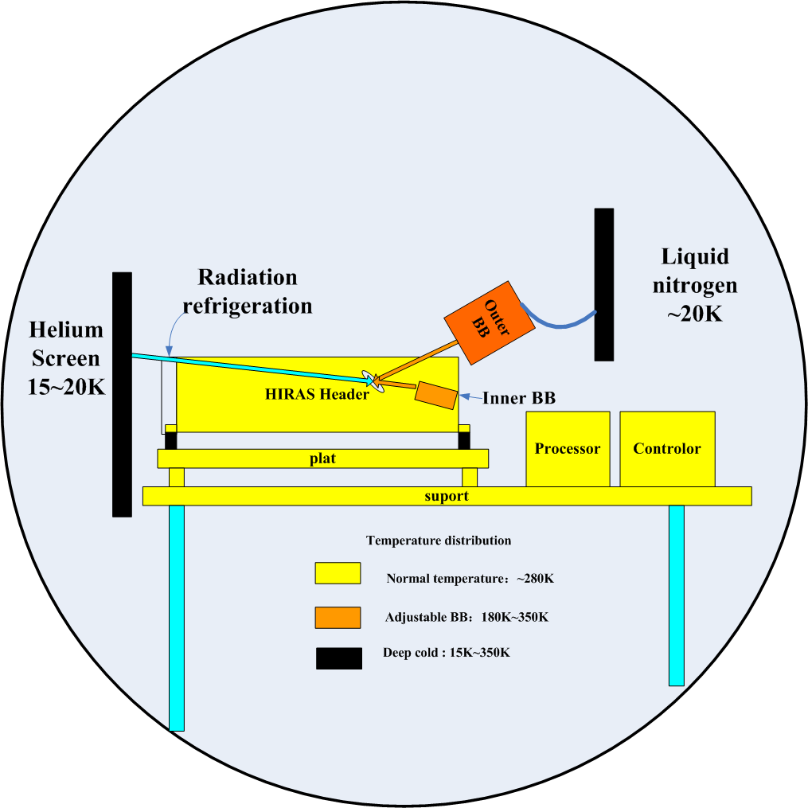
prelaunch radiometric calibration
Helium Screen (≤20K, ε>0.9) used for Radiation refrigeration to cool detector and cold optics
Helium Screen is also used for simulating the deep space
External calibration blackbody temperature can be adjusted from 180K to 350K
Internal calibration blackbody can be set at 297K or 313K for calibrating on orbit
HIRAS optical components will be set at three temperature conditions the same as on-orbit status

Slide 17
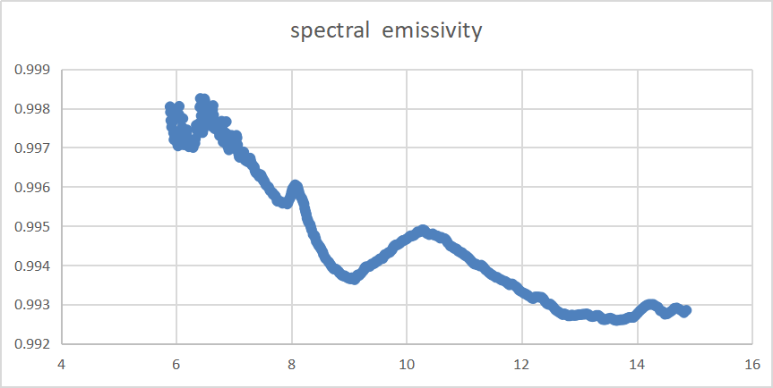
uncertainty contribution budget
calibtration blackbody uncertainty (main)
  temperature PT：±0.1K (acuracy ) and ±0.06K (stability orbit)
  blackbody emissivity：0.9946(uncertainty = 0.25% k=1)
On orbit uncertainty budget
  temperature uncertainty (include PT100, circuit, nonuniform and long term stability ) is about 0.16K.
  temperature stability in 5min is about 0.06K
  Emissivity uncertainty is about 0.2K
  coupling effect between calibration BB and HIRAS is less than 0.3%
Orbit blackbody performance

Slide 18
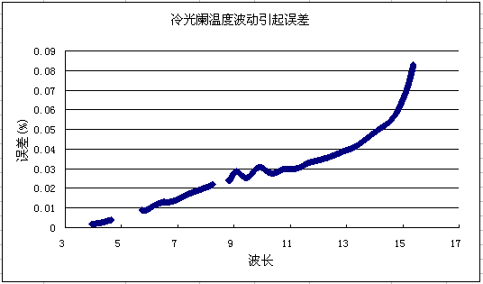
uncertainty contribution budget
detctor temperature variation
  detector temperature variation：±0.2K(5min)
  Radiometric response of IR detector varies with temperature variation. Response variation can be reduced by building relationships with temperature and response.
Background temperature variation
  temperature ：205K and 125K±0.1K（during 250ms）
  surface emissivity：0.03
curve of detector temperature in 5min
The above uncertaities are not significant in the budget.

Slide 19
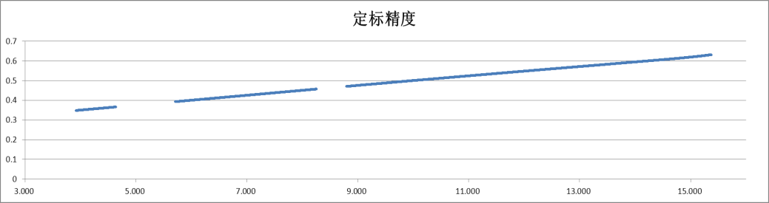
Total radiometric uncertainty
  Main contributor : calibtration blackbody temperature, stability and emissivity.
  all traceable to National Institute of Metrology, China( NIM)
Contribution does not include detector nonlinearity

Slide 20
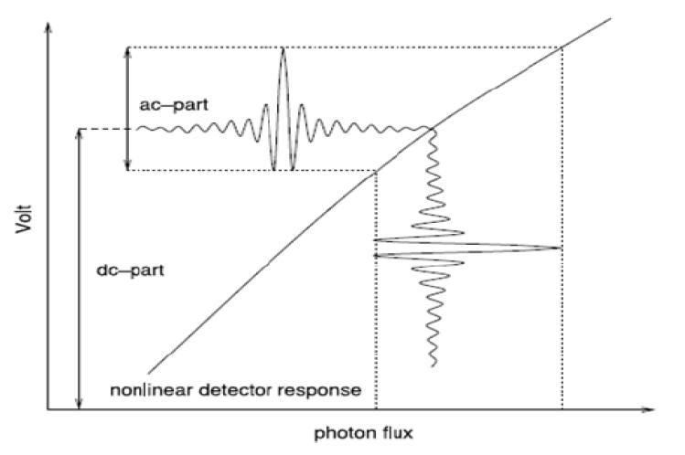
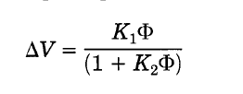
5. Non-linearity evaluation and correction
HIRAS Nonlinear Characteristics
Measured and Predicted BT Diff
LW
Abrams et al. 1994
HIRAS LW and MW bands show nonlinear phenomenon, more significant for the MW band.
Two NL correction methods are used:
1, NL Correction performed on Spectrum, following the method used by CrIS.
2, NL Correction performed on Interferagram, high order correction term can be considered.
MW
ECT Temperature [K]

Slide 21
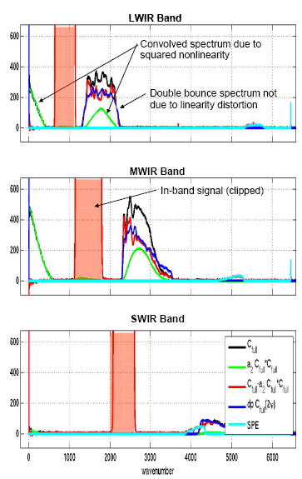

Method
From CrIS ATBD 2013

Slide 22
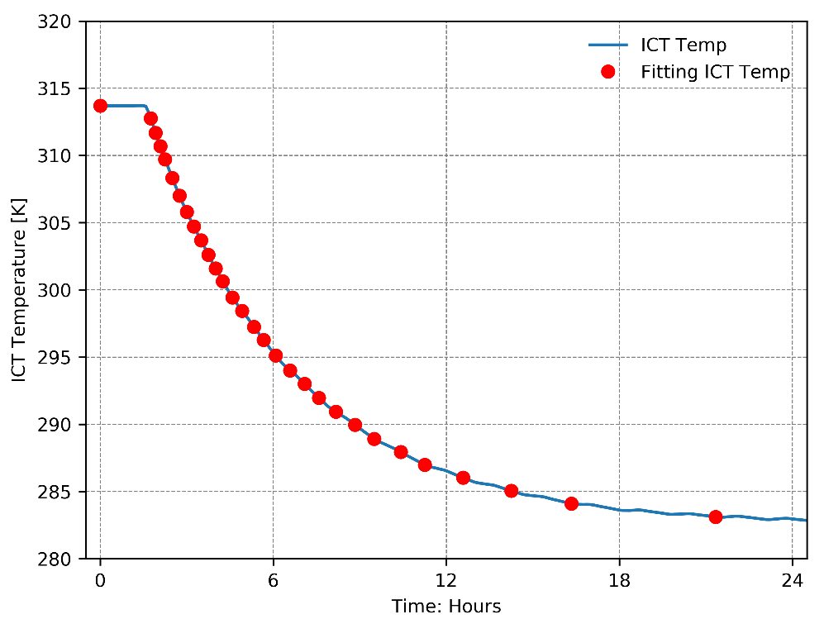
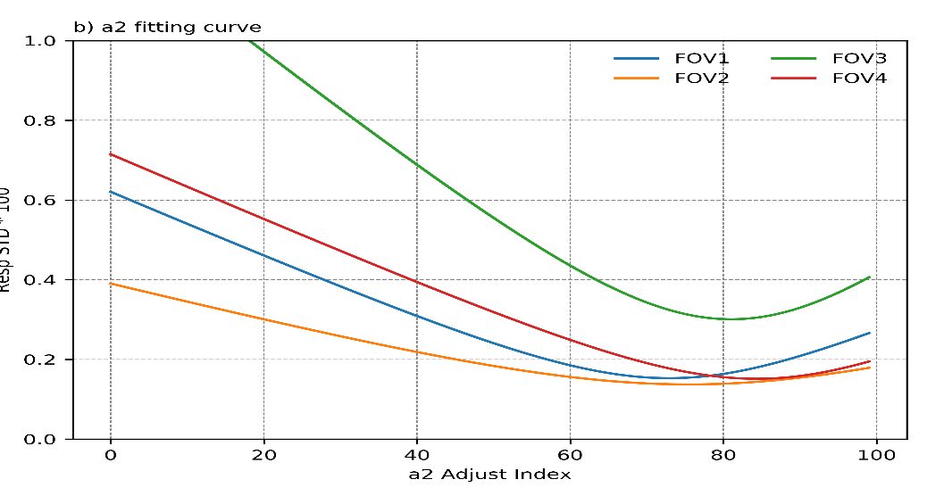
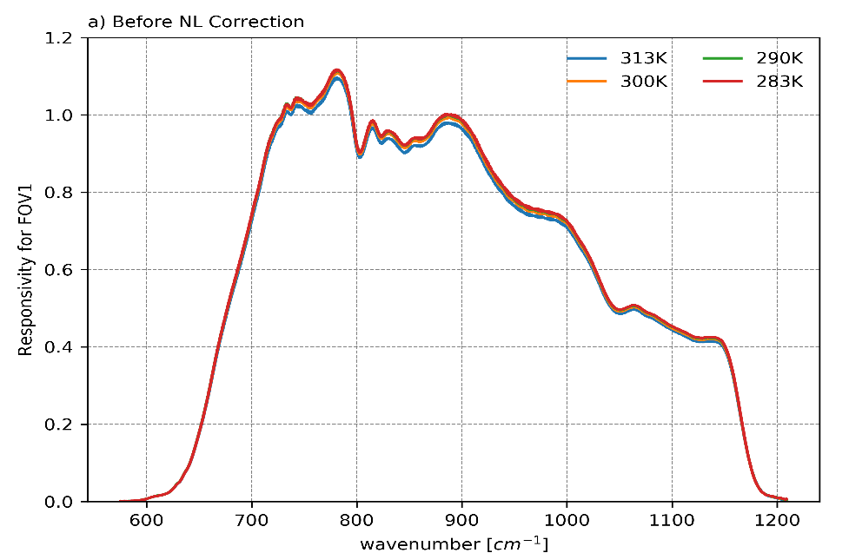
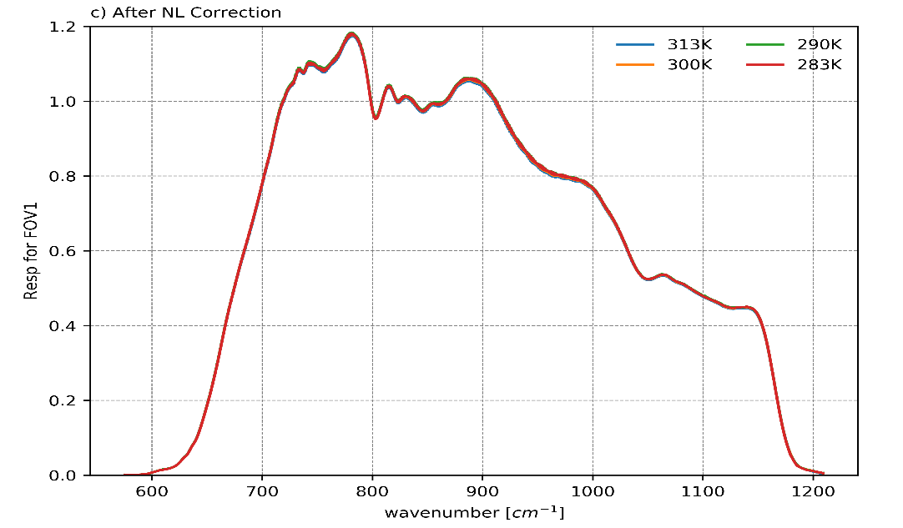
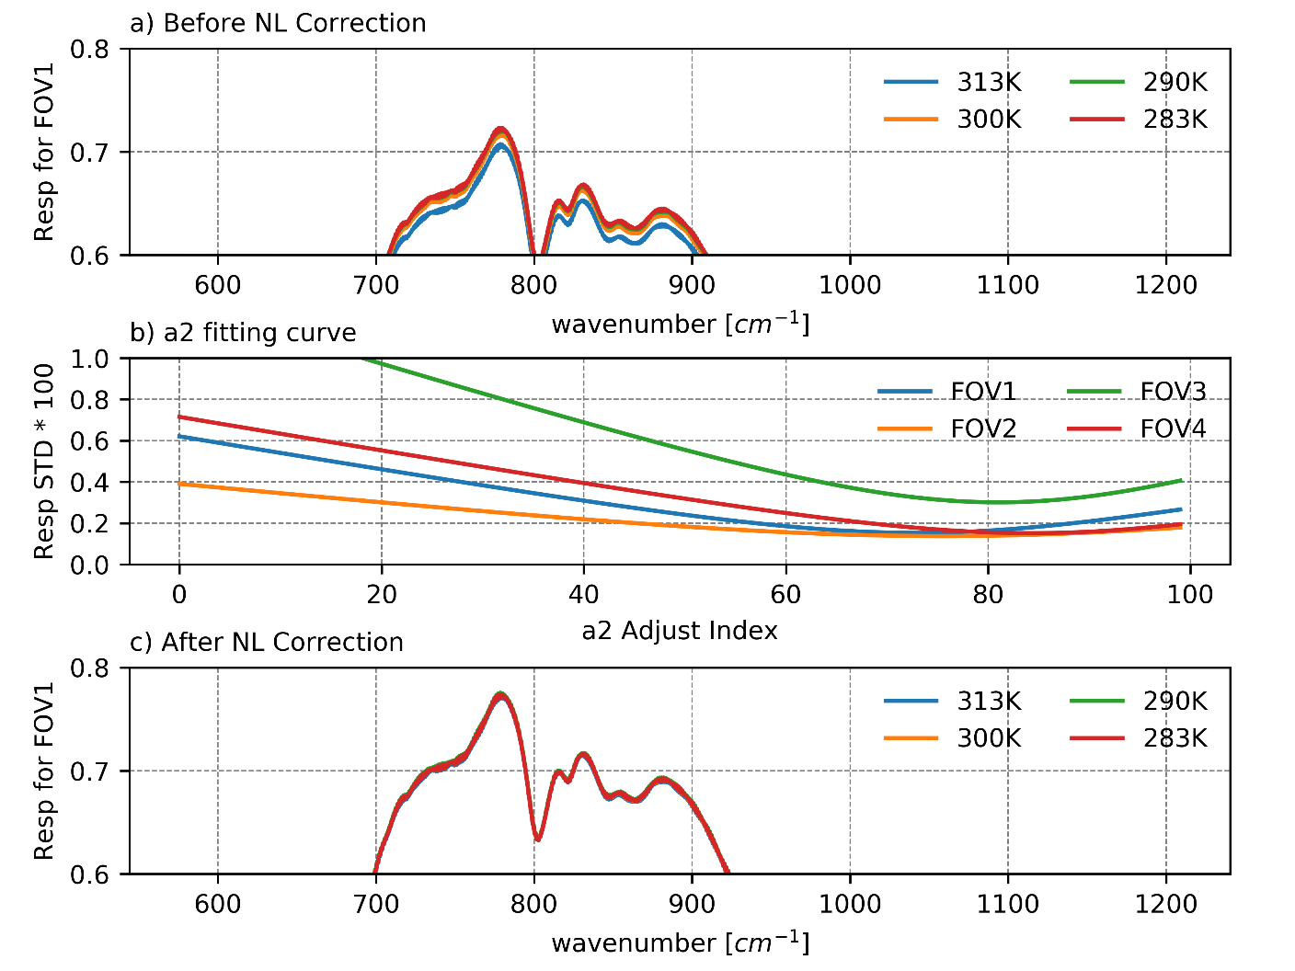
Method deriving a2 from On-Orbit ICT with Variable Temperature
Failed to derive a2 from TVAC data for some FOVs (1 & 3).
a2 from TVAC may be not suitable for the on orbit condition
Basic Assumption:
The Responsively of ICT of with different temperature should be the SAME.
a2 fitting to minimize the responsivity Diff
ICT temperature changes from 313 K to 282K
Responsivities variation due to nonlinearity
Responsivities after NL Correction
FOV1
FOV1

Slide 23
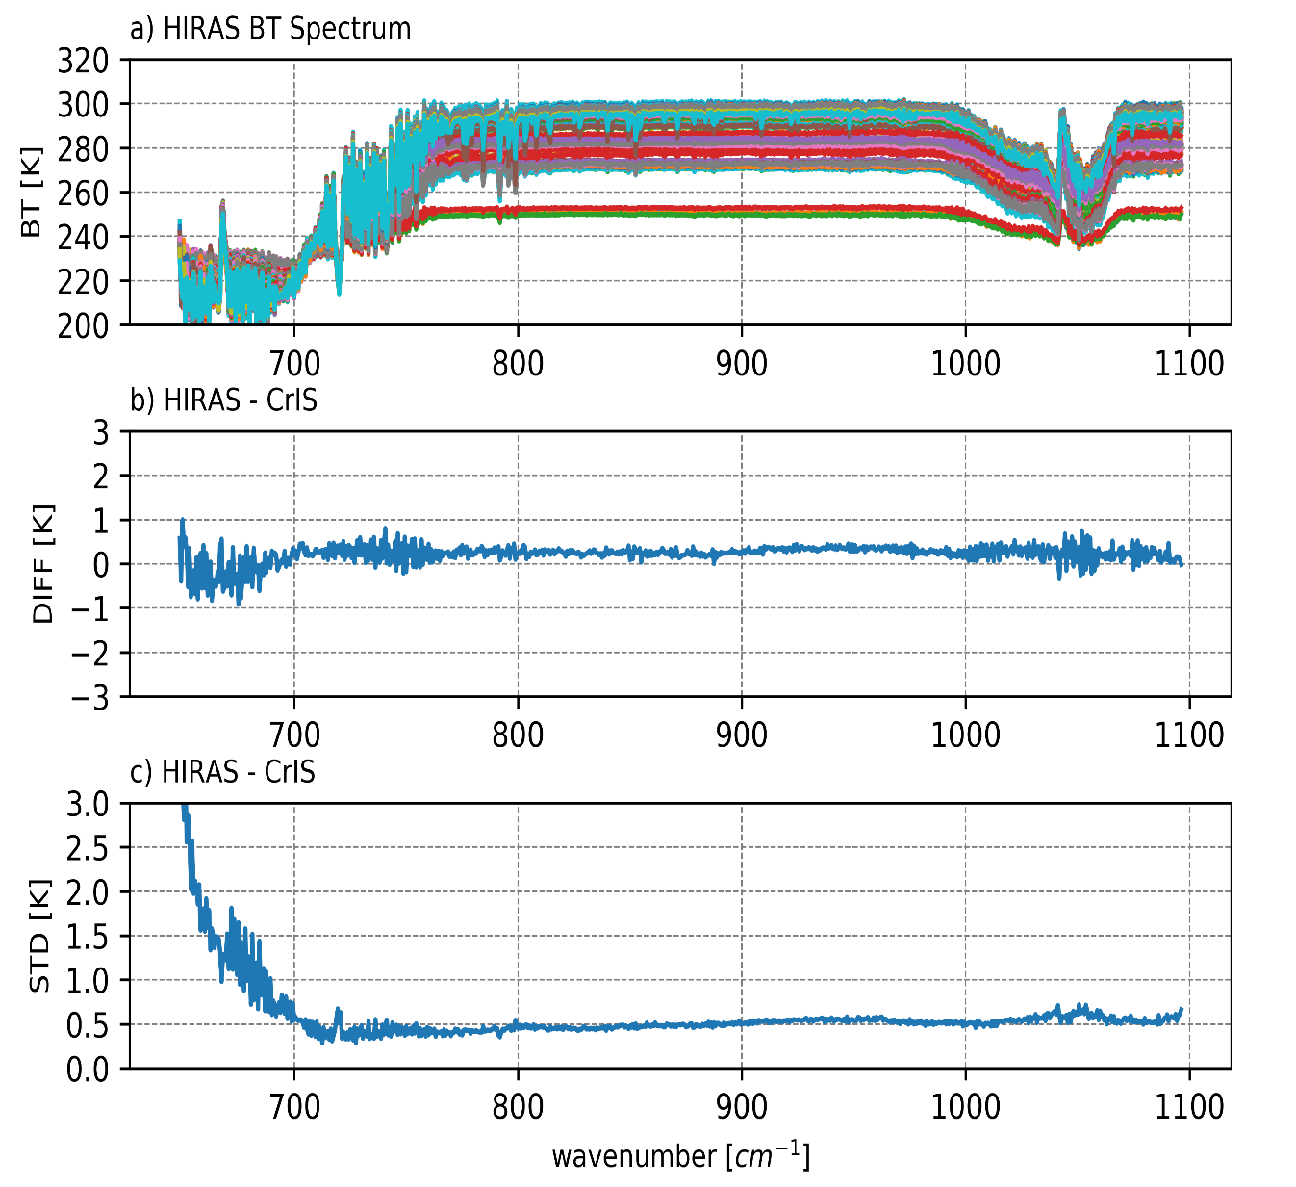
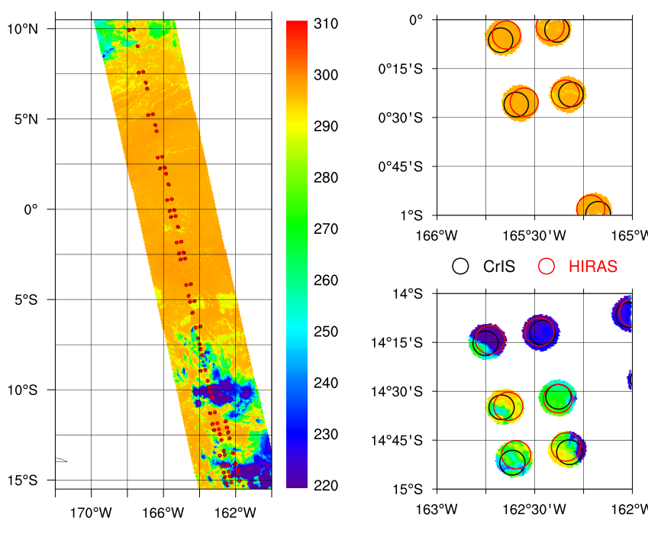
Nonlinearity Correction using updated a2
SNO Pairing Method
Time Constrains:
10 minutes
Air Path Constrains
FOR 14-17 for CrIS
FOR 14-16 for HIRAS.
Distance constrains
5 km (Great circle )
Scene uniformity
VIIRS and MERSI: std < 0.2K
LW
Window Chs: ~0.3K vs ~1.0K bef. NL Correction
219 SNO samples
Expect better results after ILS Parameters and ICT model tuning
Method: Wang et al 2016

Slide 24
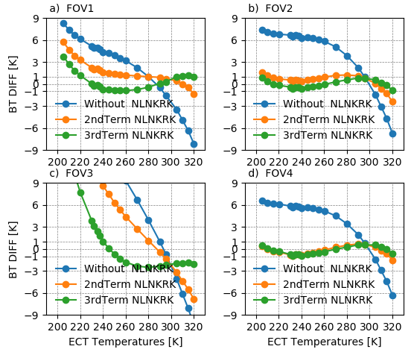
MW Band May Have Higher Order Nonlinearity
Nonlinear Characteristics
BIAS before and after NL Correction
a2 prime ECT Temp dependence
We are considering the higher order nonlinear correction.

Slide 25
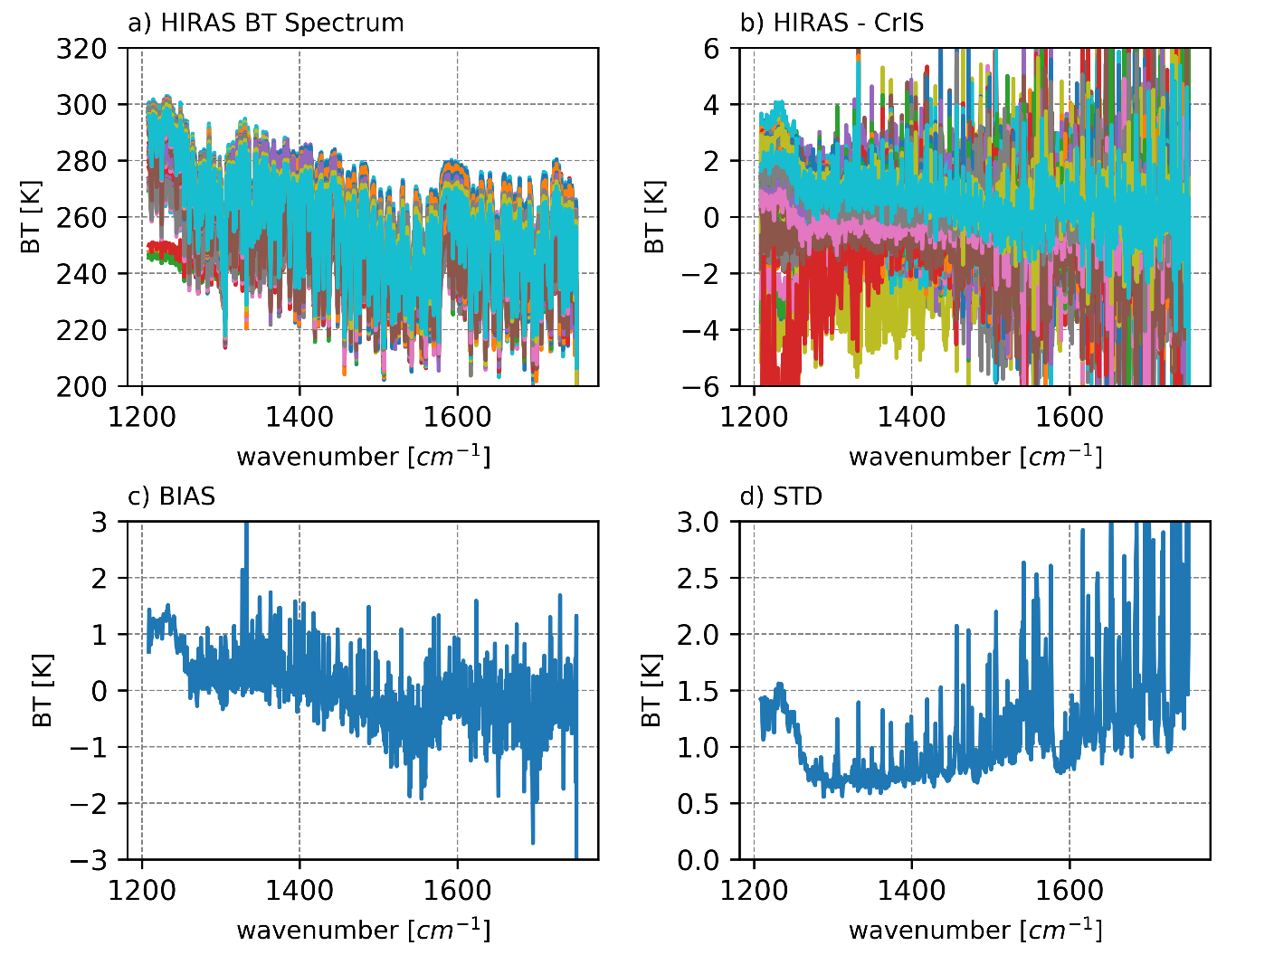

Slide 26
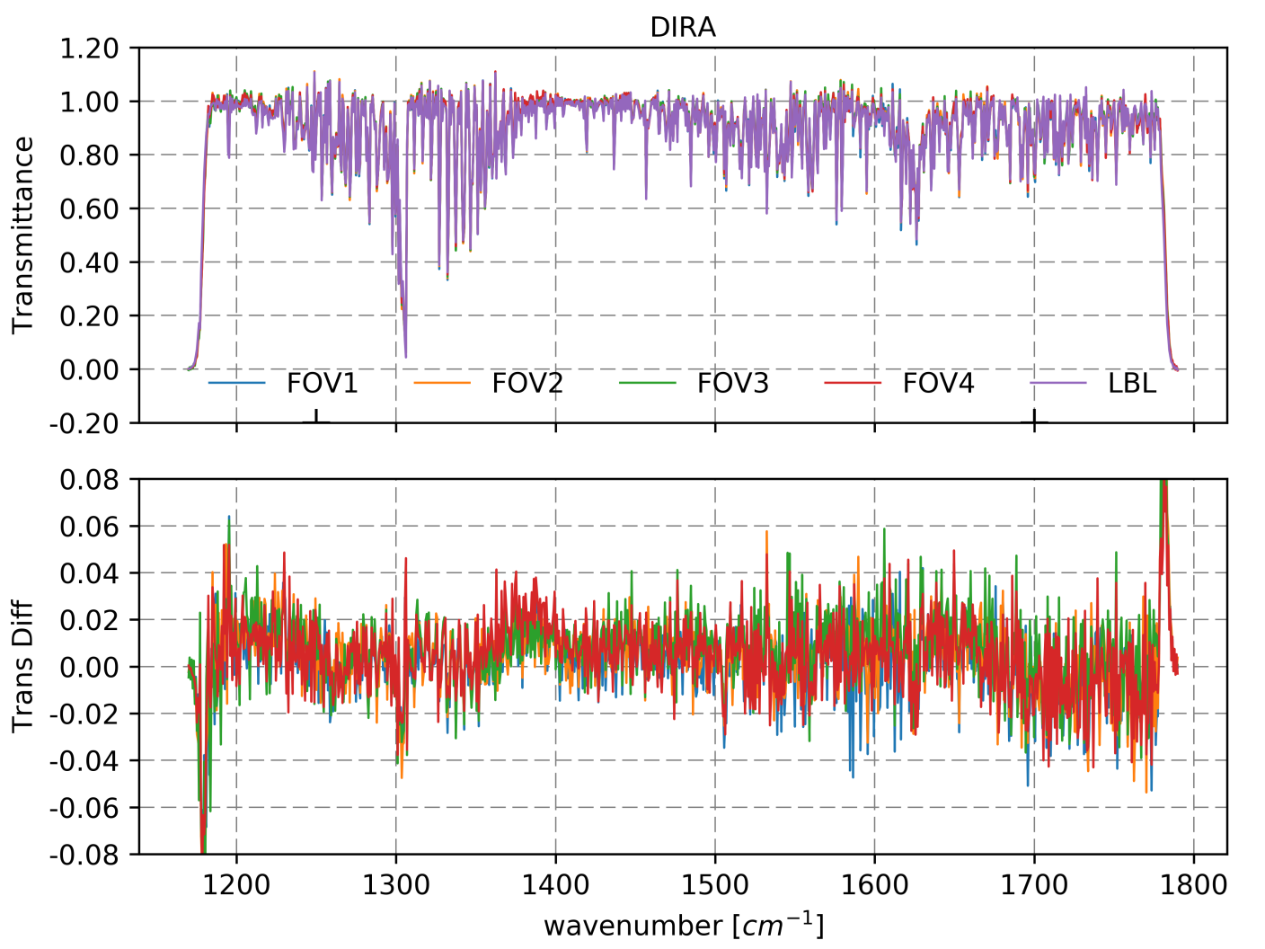
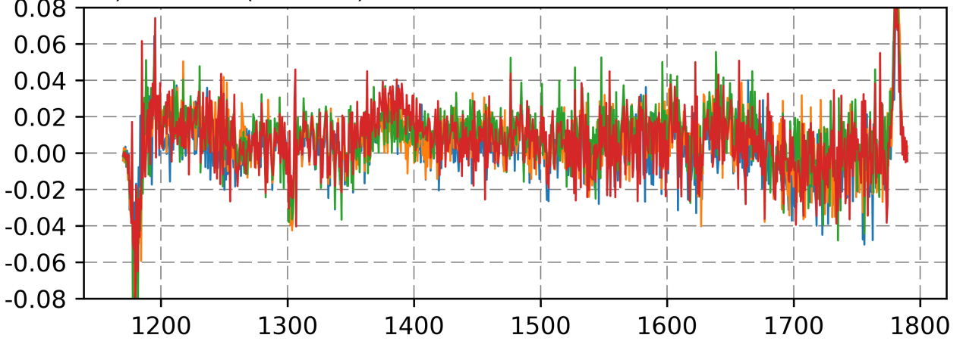
Transmittance residual
MW

Slide 27
Next Steps:
1. Alignment : Fine tuning of fixed mirror.
2. Spectral parameter tuning.
3. Non-linearity correction coefficient tuning.
4. Polarization check.
5. Completion of Quality Control system.

Slide 28
SUMMARY
Ground processing system is running smoothly and is generating L1 data in real time
Initial optical alignment was performed; main instrument components were checked
The Day-1 results are exciting and promising
HIRAS is a great improvement to Chinese satellite infrared atmospheric sounding system
HIRAS will be operational and provide L1 data for
NWP and retrieval systems in June 2018

