Slide 1
Current Status of CMA GSICS Collaboration Server
XU Zhe
CMA GDWG
2018-3-21 ShangHai

Slide 2
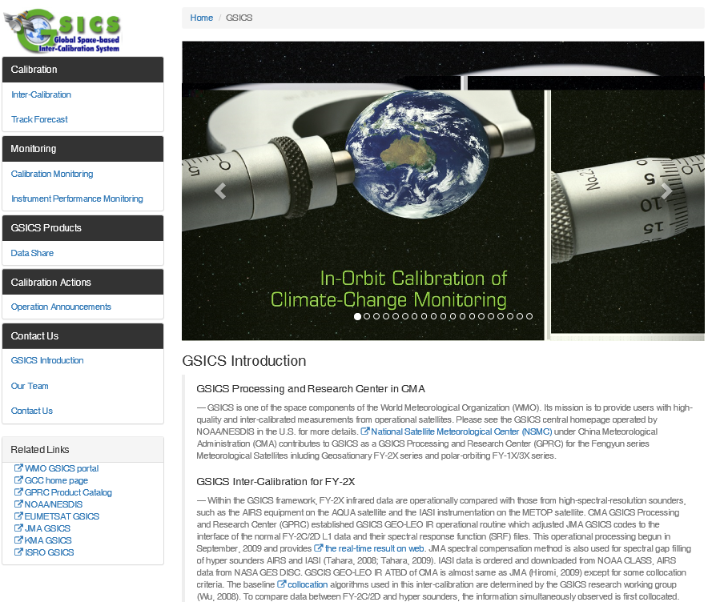
CMA GPRC Website Update
Reviewed by GDWG co-chairs, last annual meeting
Fix error links, new webpage online http://gsics.nsmc.org.cn
CMA GRWG: Content provider
CMA GDWG: Website construction and operation
Integrated into NSMC Web Portal, Servers operated by NSMC IT Dep.
Notes:
GSICS Processing and Research Centres (GPRC)

Slide 3
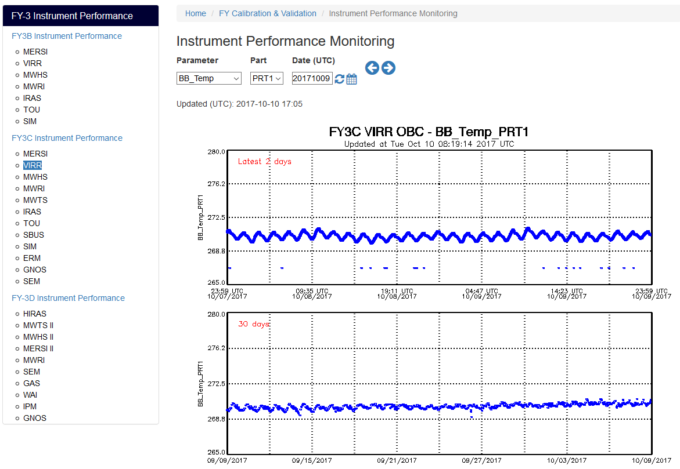
CMA GPRC Website Update
Instrument Performance Monitoring

Slide 4
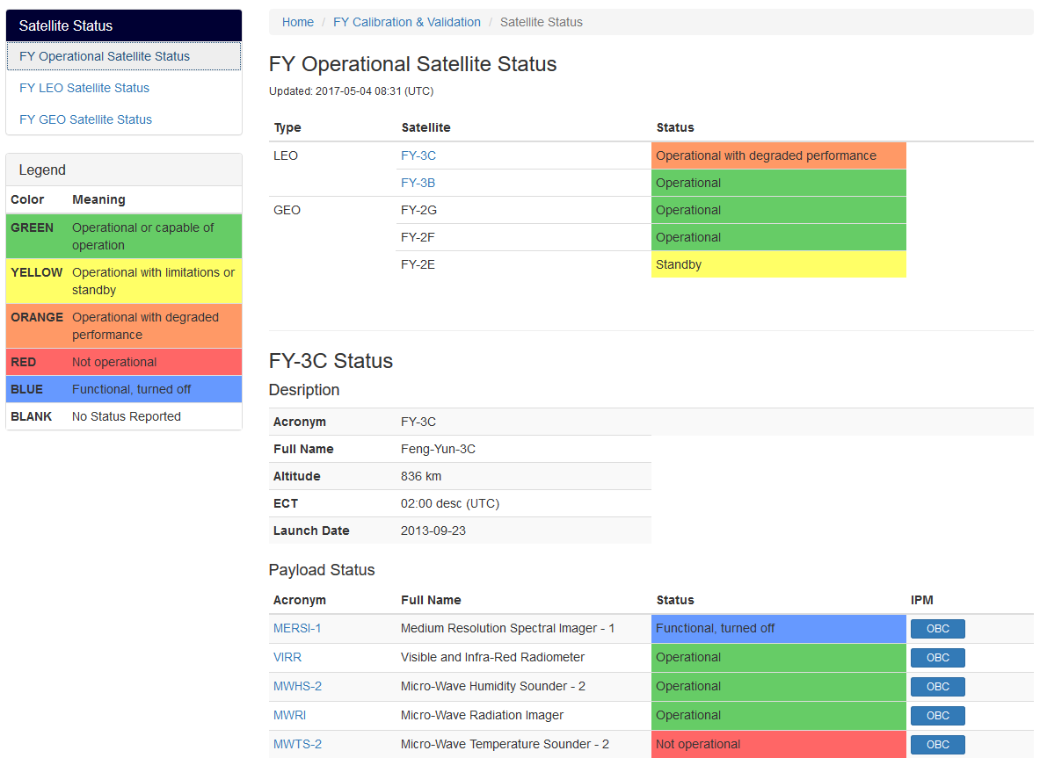
CMA GPRC Website Update
Instrument Status

Slide 5
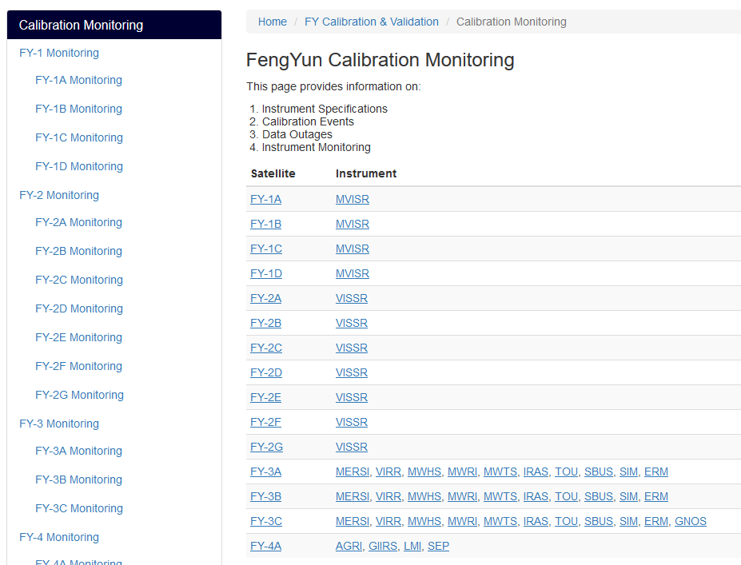
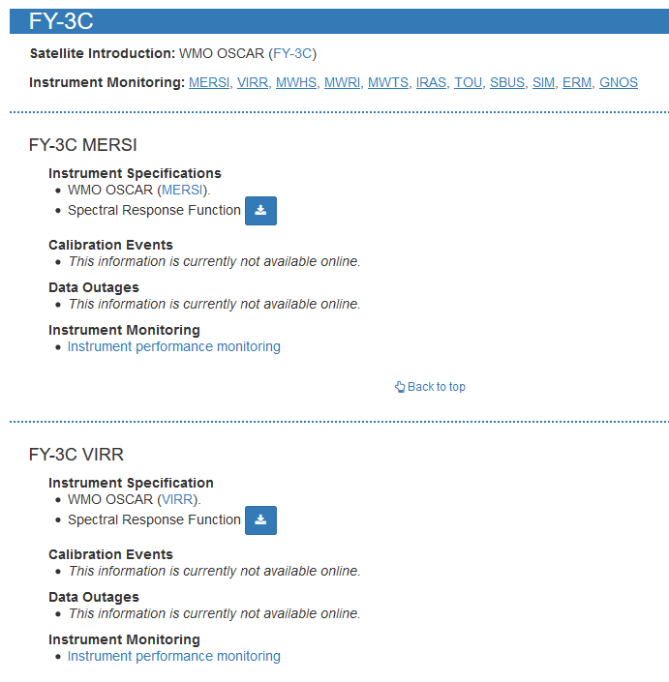
CMA GPRC Website Update
Landing Page (Li Yuan)

Slide 6
Preservation of GSICS Products: CMA Solution
Data flow: GET and PUT
GET：Data collecting server, download file from EUMETSAT Thredds
PUT：Tamper-resistant server, a back up for all static content on Web sever.
Scheduled routine job, 1/day
For backup, no timeliness requirement
Con.: No supervise and monitoring
Collecting server: Shell script and a configuration file
DMZ(NSMC)
Data Collecting
Remote Servers(EUM)
Tamper-resistant
Web Server

Slide 7
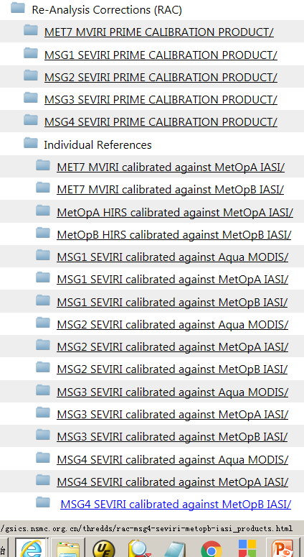
Preservation of GSICS Products
Notes:
GSICS Processing and Research Centres (GPRC)

Slide 8
Preservation: CMA To EUMETSAT
EUMETSAT provide FTP account for CMA to upload (Thanks to Peter Miu)
CMA RAC product generation updating now (Vendor change)
Begin to upload to EUM when CMA RAC product generate stable

Slide 9
NetCDF Check Tool
Basis: FY-4A L2 product : All NetCDF
QC Check: Meta-data and data field
Convention/Standard requirement
Variable type check
Format Check
Value:
Static: Value Check
Dynamic: Range check

Slide 10
Thank you for your attention
WMO GSICS Portal
http://gsics.wmo.int
GSICS Coordination Centre http://www.star.nesdis.noaa.gov/smcd/GCC/index.php
GSICS Product Catalog https://www.star.nesdis.noaa.gov/smcd/GCC/ProductCatalog.php
GSICS Wiki
http://gsics.atmos.umd.edu/wiki/Home

