Slide 1
The Successor of the TOU
Yongmei Wang & Whole team
National Space Science Center,CAS
GSICS 19-23 March 2018

Slide 2
Outline
Total Ozone Unit (TOU)
High Resolution Total Ozone Detector (HRTOU)

Slide 3
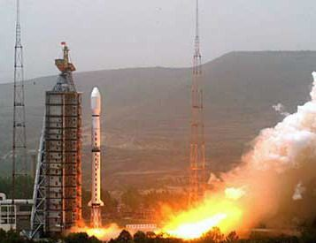
1、TOU---introduction
FY-3series satellites are Chinese
second-generation polar-orbiting
meteorological satellites
Total Ozone Unit (TOU): Total ozone mapper
on FY-3A (May 27, 2008 --- 2015),
FY-3B (Nov. 5, 2010 --- )
and FY-3C (Sept. 2013----)
It is the first instrument for daily global coverage of total ozone monitoring in China

Slide 4
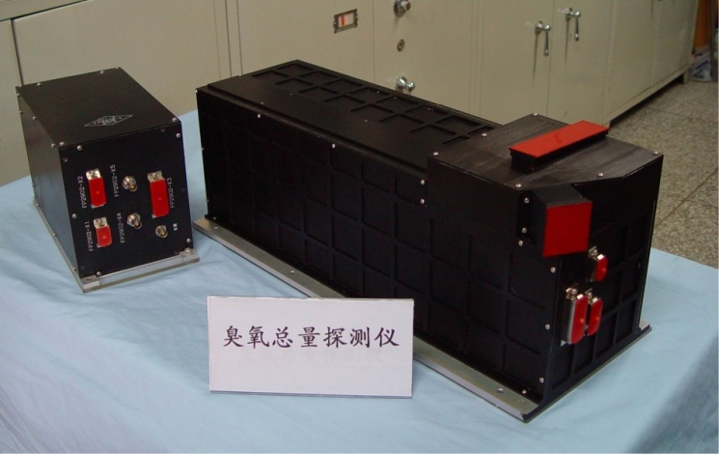
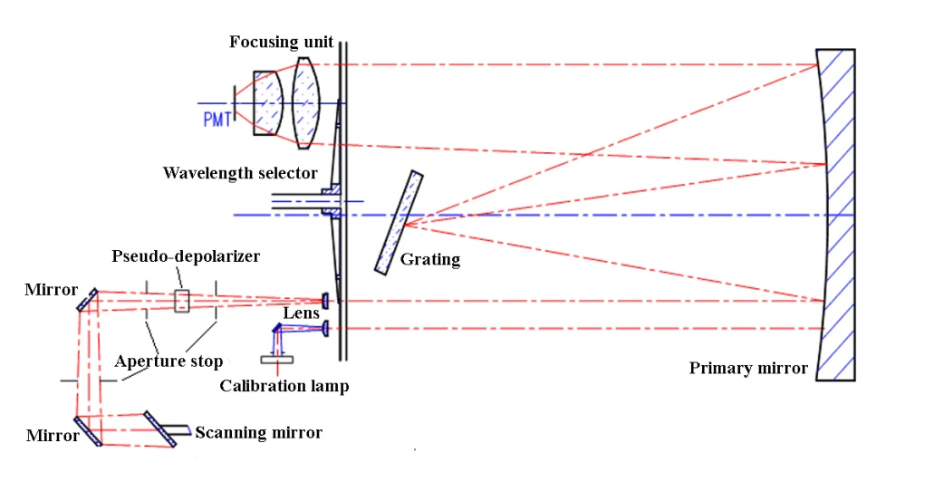
1、TOU---introduction
Instrument Characteristics
Parameter | Value
Detector | Multiplier Tube detector (PMT)
FOV | 3.6°×3.6°
Spatial Resolution | 50km at Nadir
Swath width | 2908km
Number of samples/scan | 31 points in 8.16s
Operation modes | 1. Normal scan 2. Wavelength monitoring 3. Radiometric Calibration
Scientific objectives | Total column ozone, Aerosol, volcanic SO₂
Picture of FY-3A/TOU:optical assembly and eletronical unit
Spectral propterties
Channel | Central wavelentgh (nm) | Band width (nm)
1 | 308.68±0.15 | 1.0+0.3, -0.0
2 | 312.59±0.15 | 1.0+0.3, -0.0
3 | 317.61±0.15 | 1.0+0.3, -0.0
4 | 322.40±0.15 | 1.0+0.3, -0.0
5 | 331.31±0.15 | 1.0+0.3, -0.0
6 | 360.11±0.25 | 1.0+0.3, -0.0
It has a single, fixed Ebert-Fastie monochromator with a fixed grating and an array of exit slits

Slide 5
1、TOU---status on orbit
FY-3A/TOU: 5th and 6th channel ‘s higher about 17-20%,caused by reflectivity of satellite coat
FY-3B/TOU: all channels have good agreement, about 2%
FY-3C/TOU: atmospheric radiance mode work well, but solar irradiance mode has problem,
Comparisons for clear sky earth’s radiance and solar irradiance for FY-3B/C

Slide 6
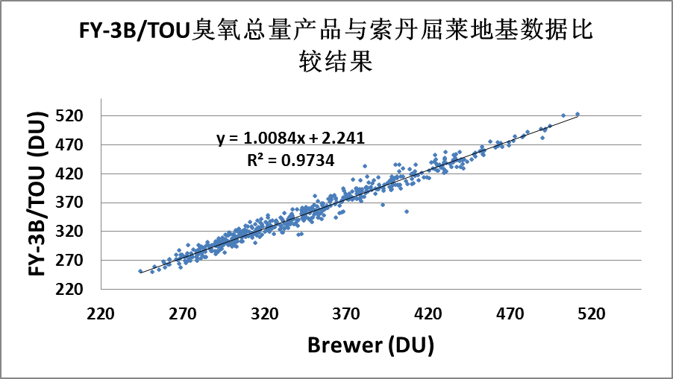
1、TOU---Validation
Comparison of total ozone between FY-3B/TOU and Brewer (Finland).
Mean deviation: 1.45%，RMS Deviation: 2.65%，
R²: 0.9866
Comparison of total ozone between FY-3B/TOU and Metop-B/GOME-2.
R²:0.9937
(Results by Wang Weihe,CMA)

Slide 7
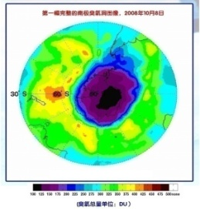
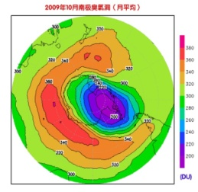
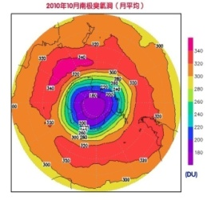
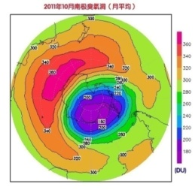
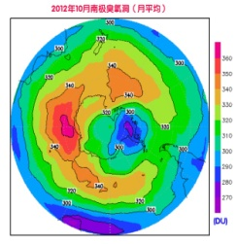
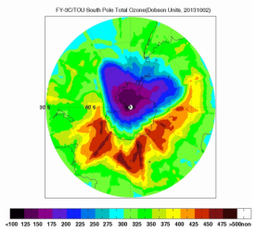
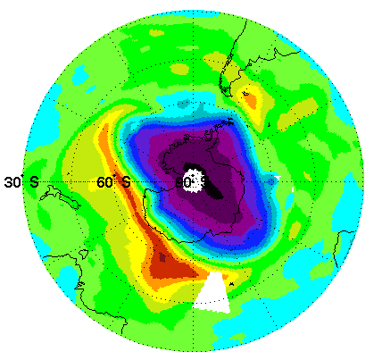
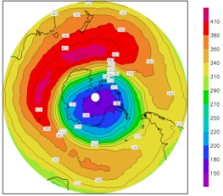
1、TOU---Products
2008
2009
2010
2011
2012
2013
2014
2015
2016+2017….
the Antarctic ozone hole from 2008 to 2015 (By: Wang Weihe,CMA)

Slide 8
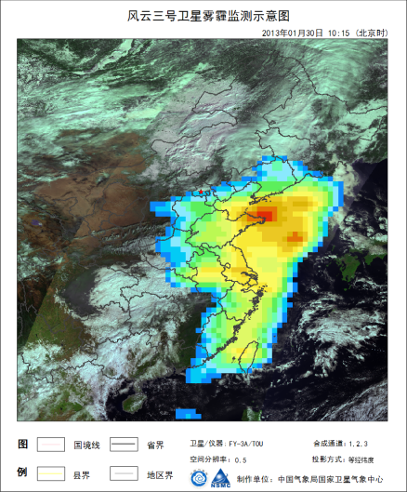
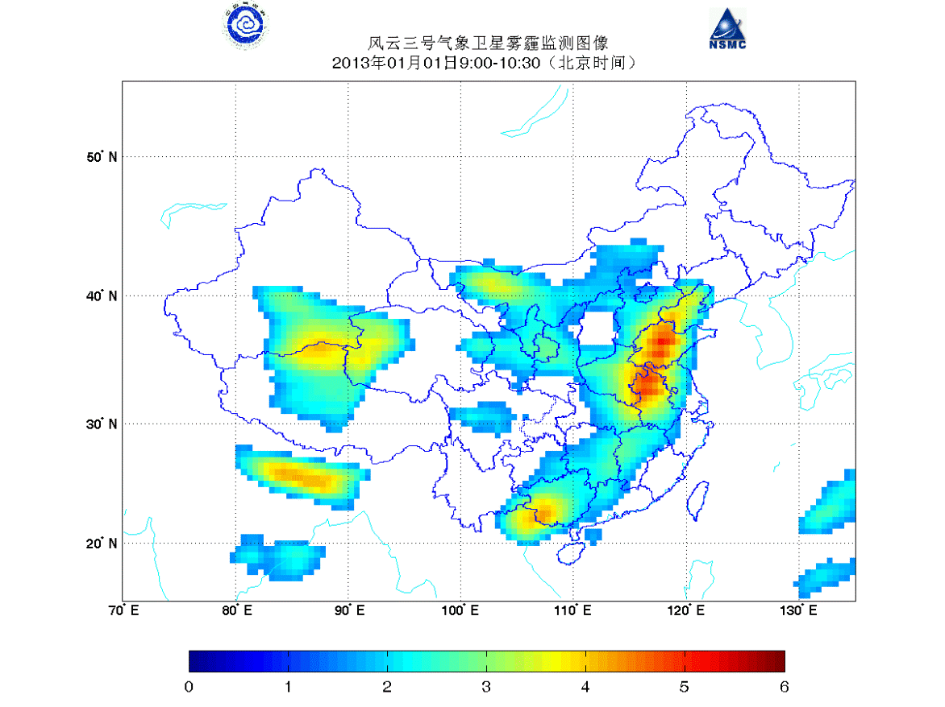
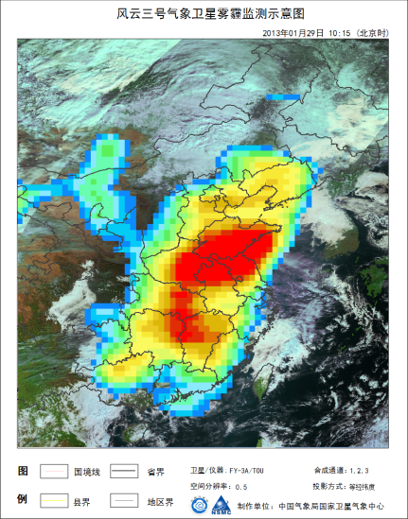
1、TOU---Products
Smog/dust observation
dust
smog in 2013

Slide 9
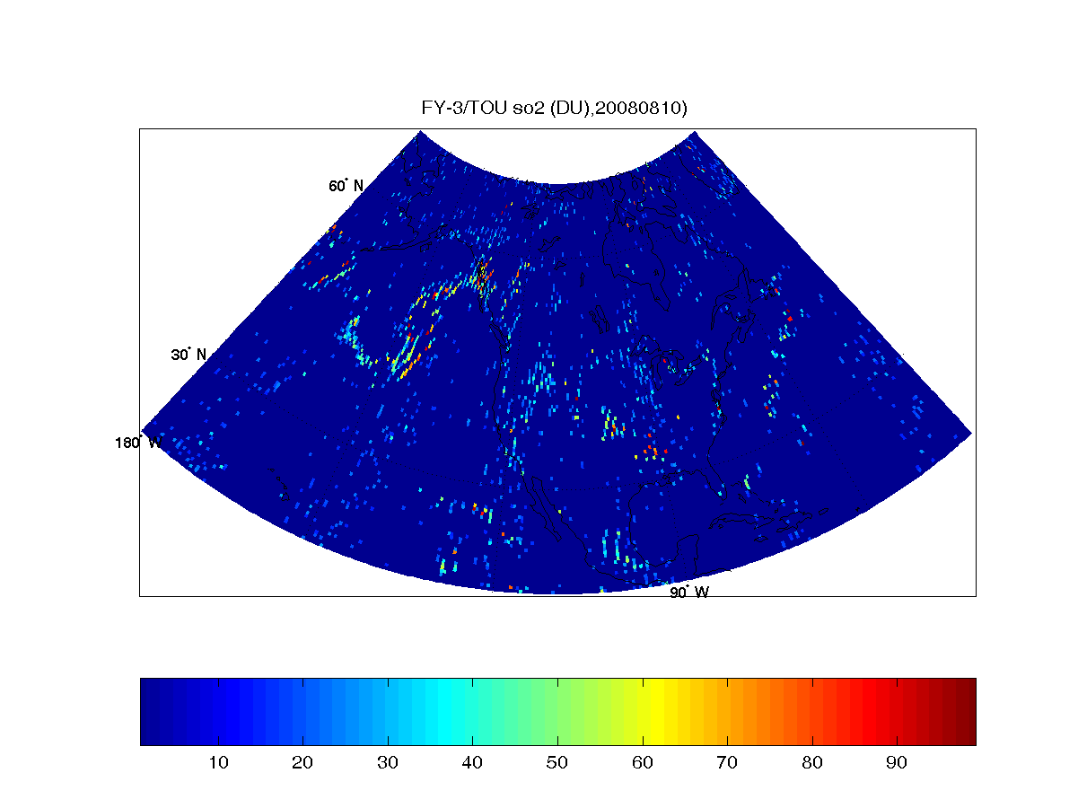
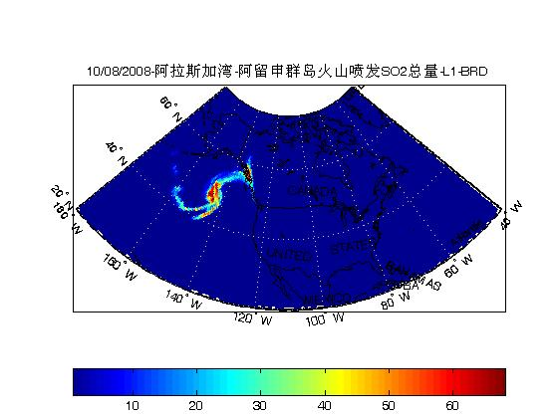
Shortage of TOU
By TOU
Only total ozone column can be obtained very accurately.
50*50km spatial resolution just suitable for O₃
for SO2 measurement , sensitivity and spatial resolution should be higher
To predict the change of O3, related trace gases should be detected
By OMI
Total SO₂ monitoring when Aleutian Islands volcano erupted on Aug. 10,2008

Slide 10
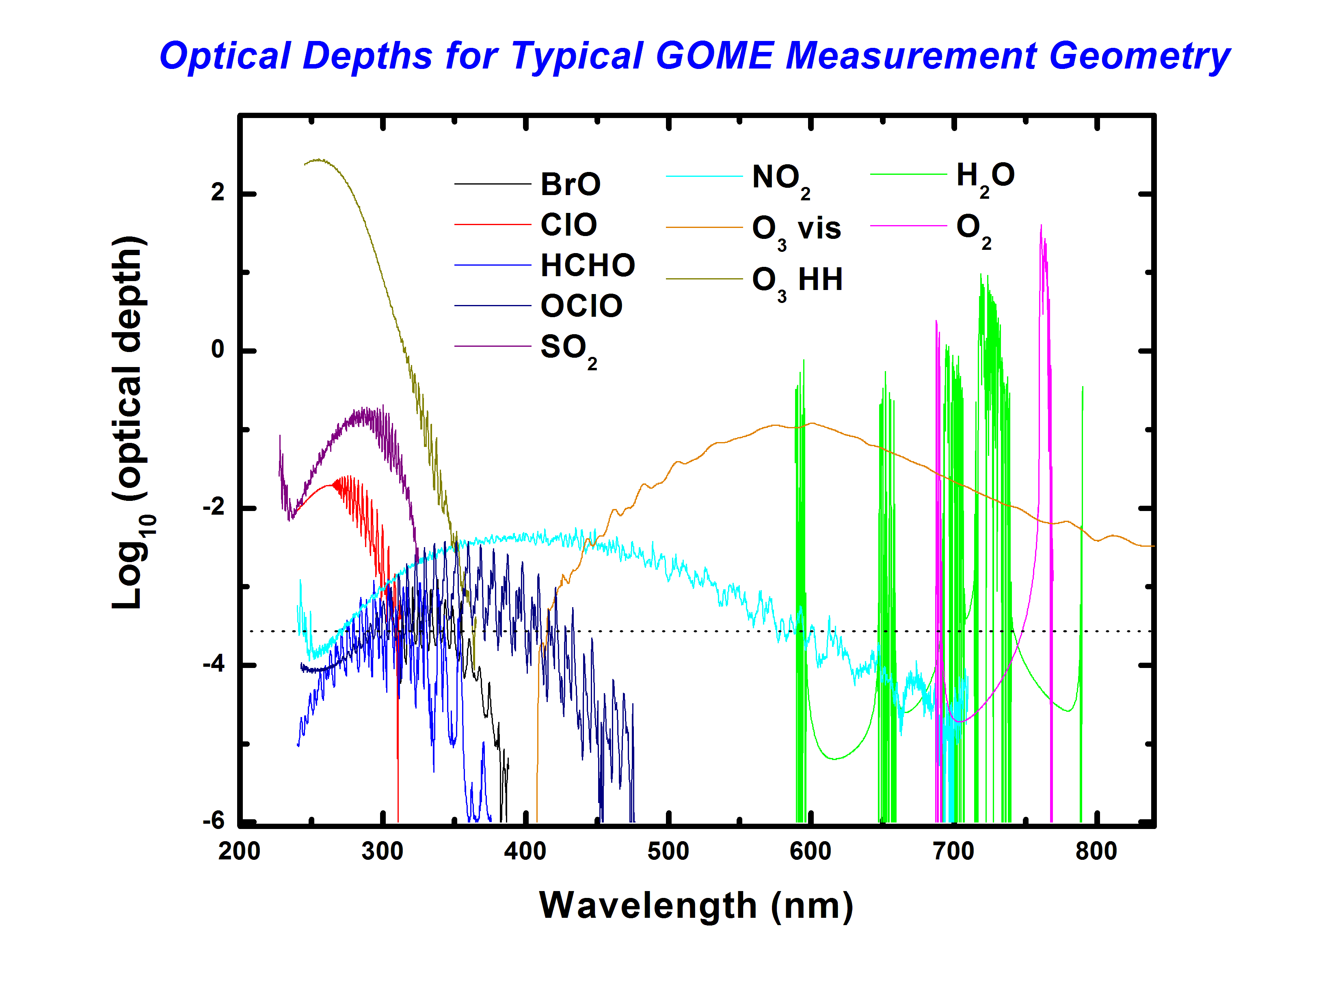
2 High-Resolution Total of Ozone Unit
Next generation instrument on FY-3F----HRTOU
  Objects:
  Continue FY-3/TOU ozone mapping record
  Related trace gases for ozone layer prediction
  Hyper-spectral imaging
  Wide swath telescope yields daily global maps
  High spatial resolution
Optical depths for UV-VIS measurement
(From GOME website)

Slide 11
2 、HRTOU---Specfications
Charactristics | HRTOU | TOU
Spectral range | 300~500nm | 300-360nm (6 channels)
Scientific purposes | O₃, SO₂, NO₂, BrO, Aerosol, Cloud, etc. | O₃, SO_{2,} Aerosol
Spectral resolution | 0.4nm∼0.6nm | 1.15 nm
Spatial resolution(km) | ～15(along)×10(cross) | 50km×50km
Field of view | 112º | 108º
Dynamic range | 10⁴ | 10⁴
Wavelength cal. accuracy | 0.01nm | 0.03nm
Retrieval Algorithms | Wavelength pair and DOAS | Wavelength pair
HRTOU is a pushbroom imaging spectrometer

Slide 12
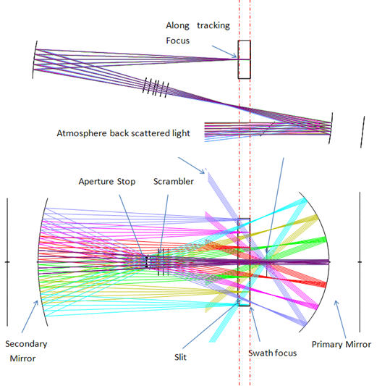
Telescope
The telescope is off-axis, all-reflective, image telecentric system. the telescope has two different back focal length in the flight and swath directions
Items | Value
Swath Fov(ACT @entrance pupil) | 112°
Along track FoV (at earth) | 15km
f/# (swath) | F/10
f/# (along-track) | F/12
Focal length(swath) | 34mm
Focal length(along track) | 68mm
Entrance Area | 9.3mm²
Slit Length | 68mm
Slit width | 0.8mm
12

Slide 13
Future
Continuity of GOME(2)/SCIAMACHY/OMI/TROPOMI
TOMS
GOME
GOME-2
SCIAMACHY
OMI
OMPS
TROPOMI
S4/UVN
S5/UVNS
FY-3/TOU
FY-3/HRTOU
1980
1990
2000
2010
2020
2030
2040
(By:Joost Carpay, Netherlands Space Office)

Slide 14
Thank you for your attention!
谢 谢！

