Slide 1
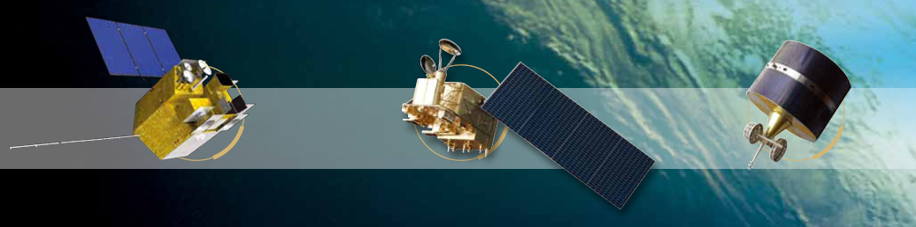

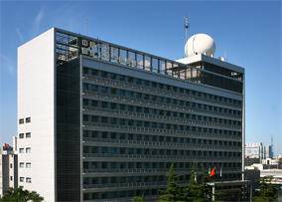


Calibration monitoring based on snow PICS over Tibetan Plateau
Ling Wang
NSMC, CMA
2018.03.22

Slide 2
Outline
1. Background
2. Study area information
3. Identifying snow PICS over Tibetan Plateau (TP)
4. TOA BRDF modeling for TP snow PICS
5. Tacking FY-3A MERSI on-orbit radiometric stability using TP snow PICS
6. Preliminary test on absolute radiometric calibration using TP snow PICS
7. Summary and future work

Slide 3
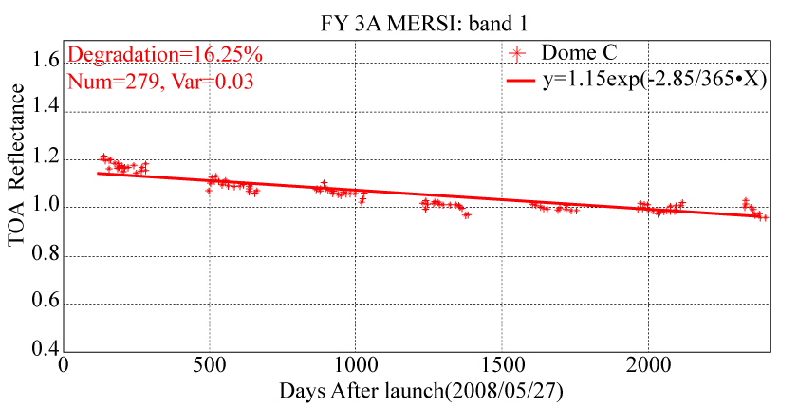
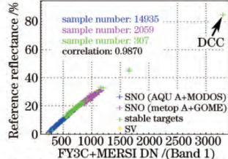
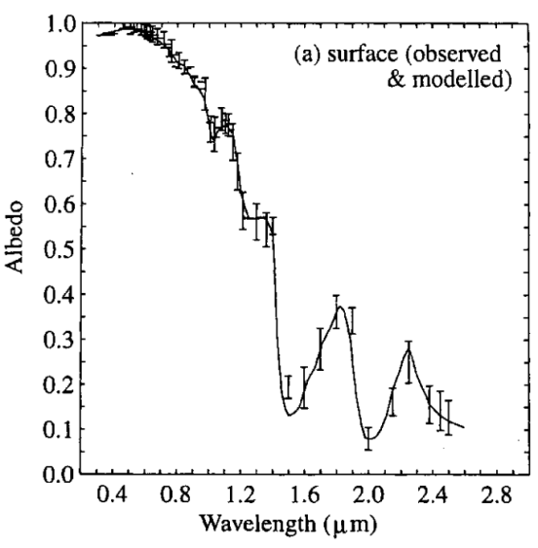
1. Background
The on-orbit vicarious calibration samples can not cover the whole dynamic range of satellite sensors, impacting the calibration accuracy for sensors with non-linear response.
More high reflective targets as DCC are needed to fill the gap to reduce the calibration uncertainty for sensors without onboard calibrator.
The polar glaciers have the limitation of polar night and large solar zenith angle.
Large Gap
Time series of FY-3A/MERSI TOA reflectance over Dome C
FY-3C MERSI calibration using multiple methods(Xu et al., 2015)
Snow reflectance spectral (Masonis, 2001)

Slide 4
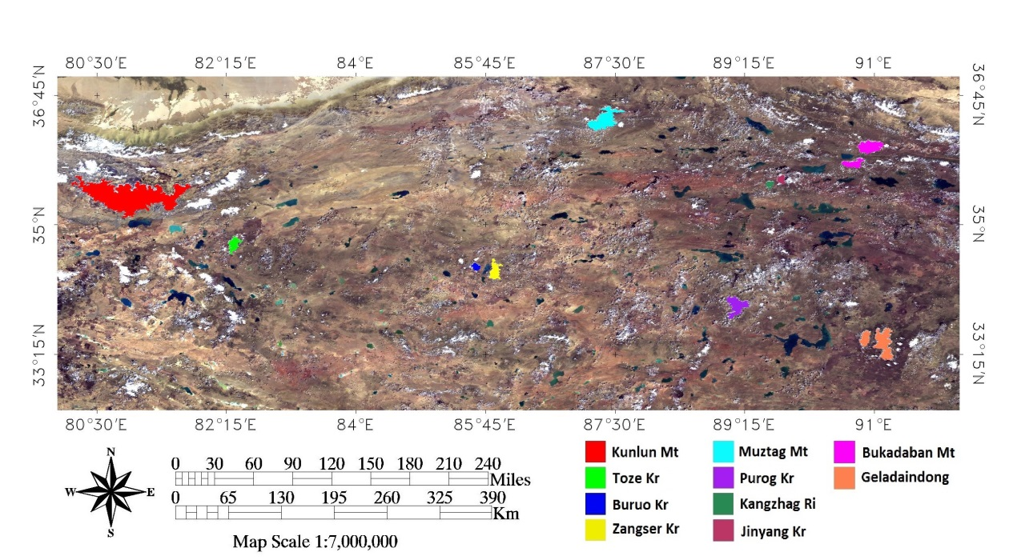
2. Study area information
TP Location: 26.00–39.78°N, 73.31–104.78°E of Western China
Average elevation > 4600 km
Climate is arid and atmosphere is clean.
10 relative large, flat glaciers were selected to identify the potential snow PICS.

Slide 5
Location, elevation, and area of 10 selected glaciers in TP
No. | Name | Latitude (°) | Longitude (°) | Elevation (m) | Area (km²)
1 | Kunlun Mountain | 35.34 | 80.99 | 6228 | --
2 | Toze Kangri | 37.74 | 82.34 | 6356 | 147.00
3 | Buruo Kangri | 34.45 | 85.50 | 6436 | --
4 | Zangse Kangri | 34.34 | 85.63 | 6460 | 348.55
5 | Muztag Mountain | 36.37 | 88.37 | 6973 | 681.17
6 | Purog Mountain | 33.89 | 89.16 | 5350–6400 | 422.00
7 | Kangzhag Ri | 35.50 | 89.50 | 6305 | --
8 | Jinyang Kangri | 35.56 | 89.75 | 6305 | 167.20
9 | Bukadaban Mountain | 36.00 | 90.90 | 6860 | --
10 | Geladaindong | 33.50 | 91.00 | 6621 | --
The smallest glacier, Jinyang Kangri has a area of lager than 150 km², i.e., more than 10*10 pixels in the image with a spatial resolution of 1 km.
Notes:
i.e. that is

Slide 6
3. Identifying snow PICS over TP
Data and pre-processing
  8-Day Global 500 m MOD09A1 product
  Period: each June from 2010 to 2014
  Seven bands : VIS-SWIR (460, 555, 659, 865, 1240, 1640, and 2130 nm)
  Two tiles, from h24v05 to h25v05 were needed to cover study area.
  Two tiles on the same day were mosaicked, then reprojected and resampled into a 1 × 1 km grid in the WGS84 coordinate system using MRT software.

Slide 7
3. Identifying snow PICS over TP
Coefficient of variation (CV) is used to characterize the spatial uniformity and temporal stability of the TP glaciers.
MOD09A1 images in June 2011 were used to calculate the spatial CV (CV_{s}) (Julian day number: 153, 161, 169, and 177).
MOD09A1 images obtained each June from 2010 to 2014 were used to calculate the temporal CV (CV_{t}).
 | i, j
t₀
t₁
t_{n}
i, j
i, j
… …
i, j
Notes:
3 × 3 window

Slide 8
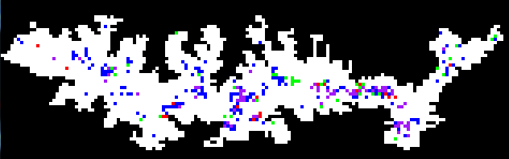



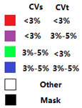
3. Identified snow PICS over TP
Kunlun
PICS criteria:
CV_{s} < 5% & CV_{t} <5%
Muztag
Jingyang
Toze
Mean value of some parameters of the snow PICS
 | CV_{s} % | CV_{t} % | slope | Latitude | Longitude | Area (km²)
Kunlun | 3.32 | 3.77 | 3.96 | 81.00 | 35.34 | 34
Muztang | 3.65 | 3.35 | 3.13 | 87.43 | 36.38 | 20
Toze | 3.99 | 2.45 | 5.97 | 82.35 | 34.77 | 8
Jinyang | 3.68 | 2.42 | 8.00 | 89.73 | 35.61 | 16
Notes:
contiguous areas

Slide 9
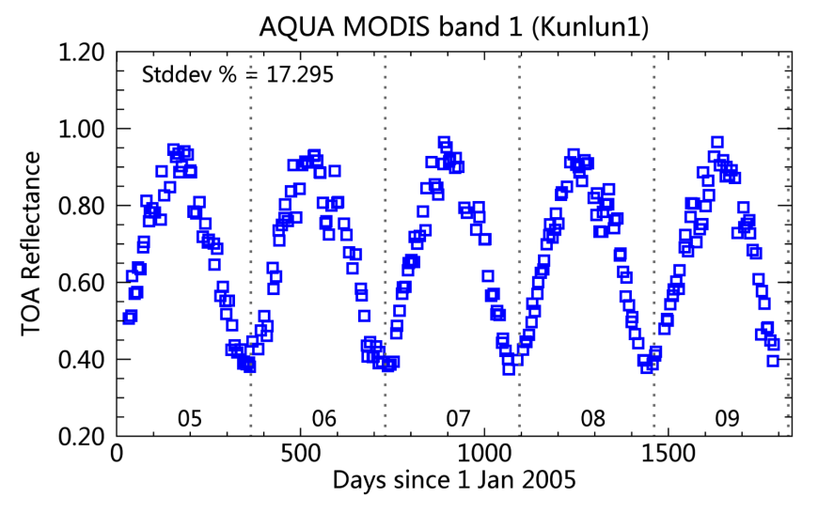
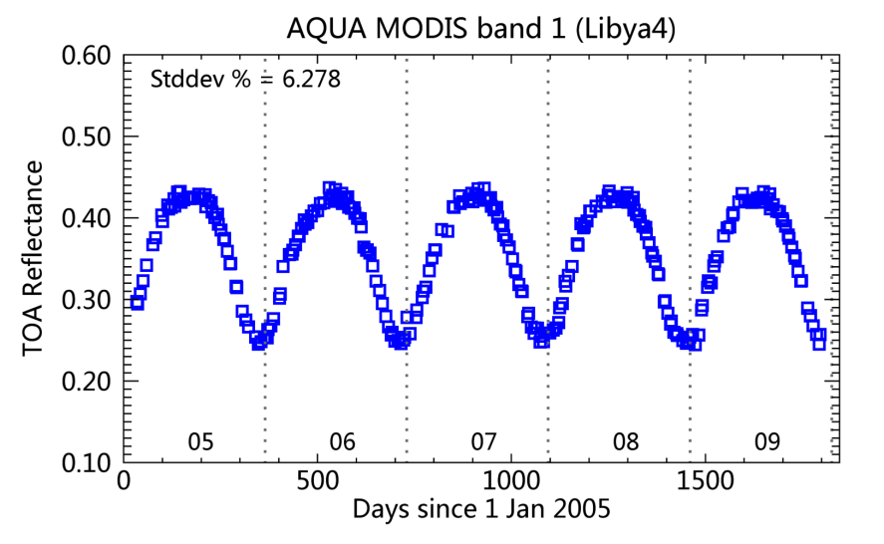
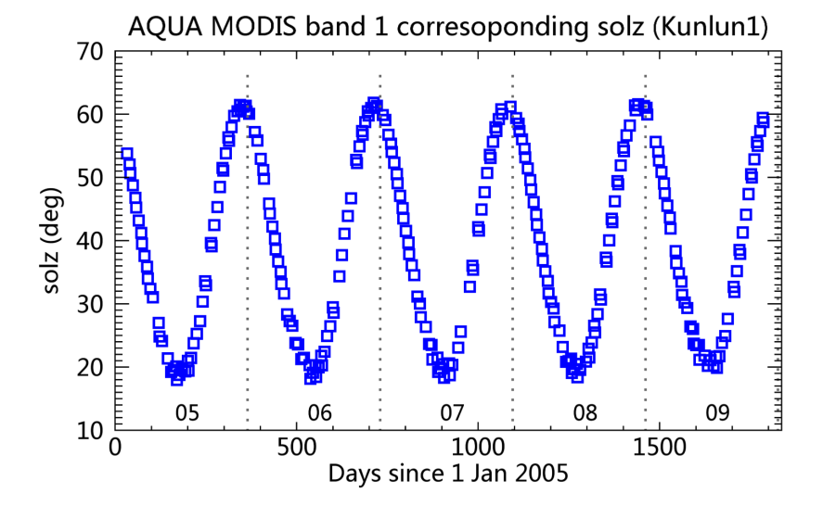
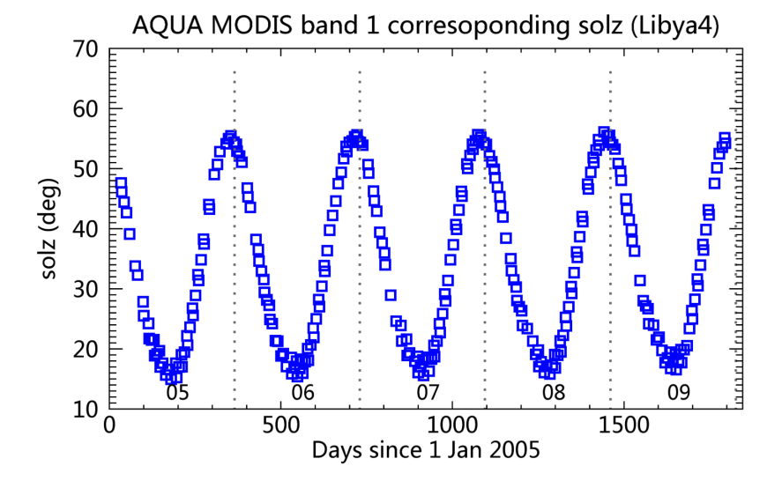
Monitoring Calibration stability of Aqua MODIS using snow PICS over TP and Libya 4 desert
Period: 2005.01-2009.12
Data with sensor zenith angle of less than 20° were used.
The TOA reflectance is averaged over a 3 × 3 pixel window.
Kunlun
Libya 4
Notes:
To reduce the impact of variations in observed TOA reflectance caused by the differences in viewing geometry
seasonal oscillations in TOA reflectance, which was highly correlated with their solar zenith angle

Slide 10
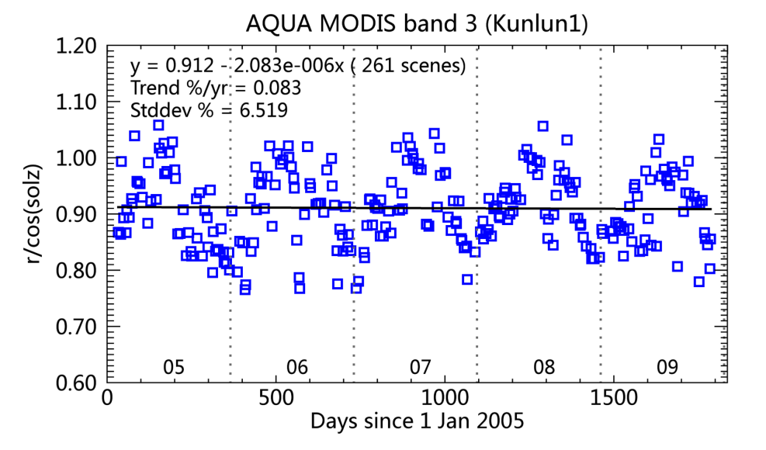
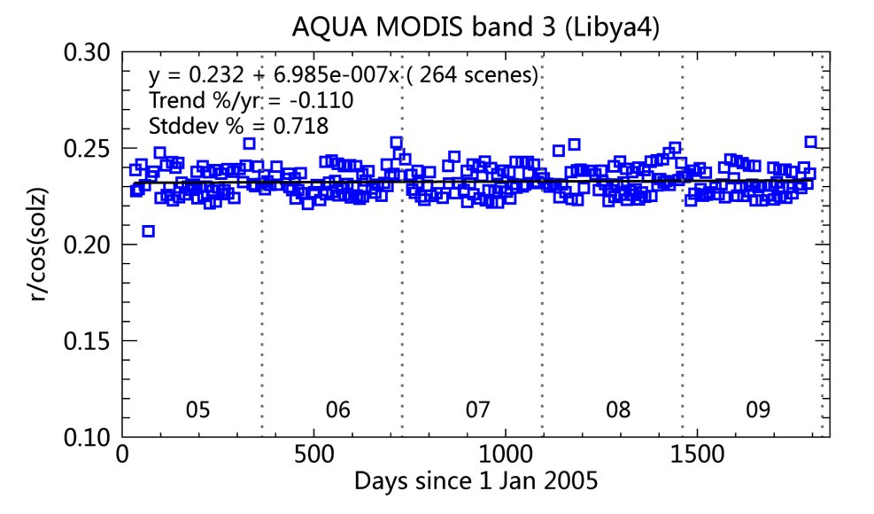
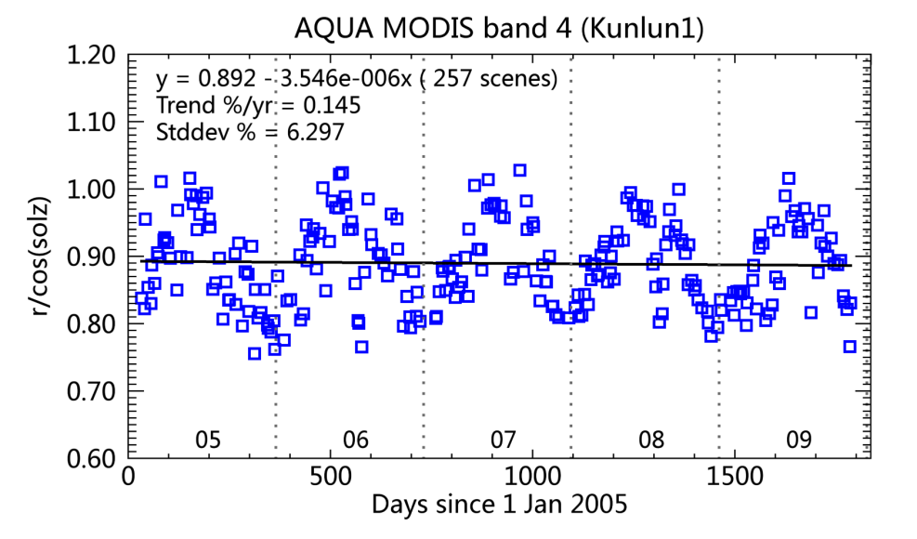
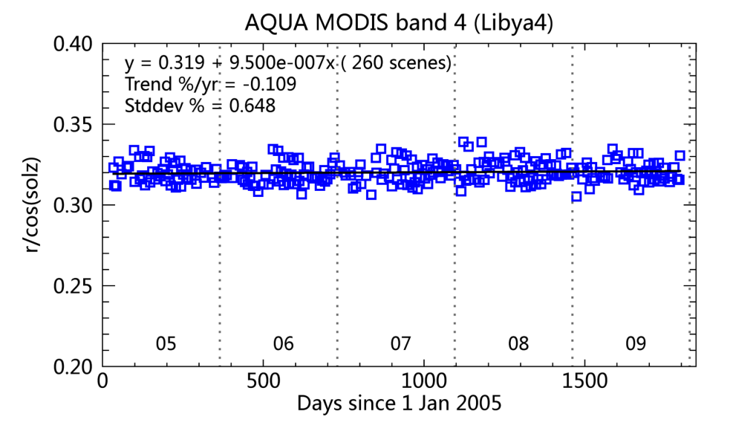
Time series of Lambertian corrected TOA reflectance from Aqua MODIS (2005.01 - 2009.12, sensor zenith angle < 20° )
Kunlun
Libya 4
B3(460 nm)
KLN: 0.083%
LBY: -0.011%
Kunlun
Libya 4
B4(555 nm)
KLN: 0.145%
LBY: -0.109%
The Lambertian corrected reflectance over Kunlun had a stronger seasonal pattern than Libya 4. This may indicated that Kunlun had a much stronger non-Lambertian characteristic than Libya 4.
Notes:
The r/cos(solz) series were almost flat over Libya 4, but the r/cos(solz) series over Kunlun1 still had a seasonal pattern. This indicated that Kunlun1 had a much stronger non-Lambertian characteristic than Libya 4 did.

Slide 11
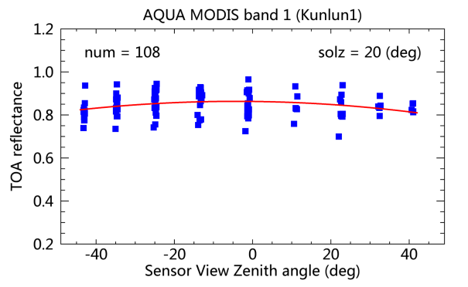
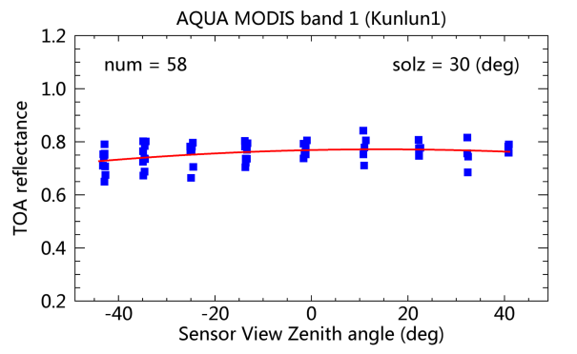
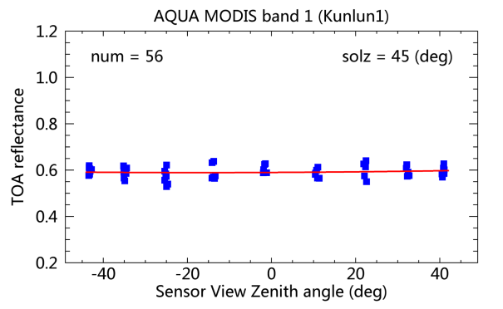
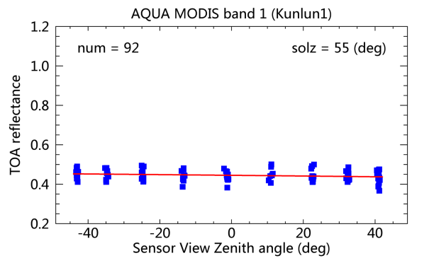
4. TOA BRDF modeling for TP snow PICS
  Variation of TOA Reflectance as a function of sensor zenith angle
Data: Aqua MODIS, 2005.01-2009.12
(a)
(b)
Solz (°) | mean | Stddev (%)
20 | 0.88 | 5.6
30 | 0.75 | 4.1
40 | 0.66 | 3.4
45 | 0.59 | 2.5
55 | 0.44 | 2.9
(c)
(d)
To limit the change in solar zenith angle, its variation is within 5° for each figure.
  The variations in reflectance caused by sensor scan angle is small with a range of 2.5~5.6%, and for solz > 45º, the TOA reflectance tends to be independent to the sensor scan angle changes.

Slide 12
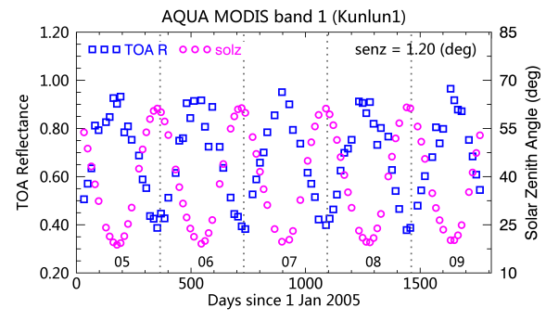
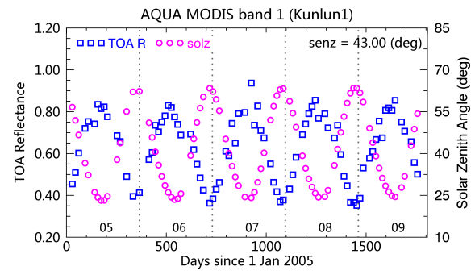
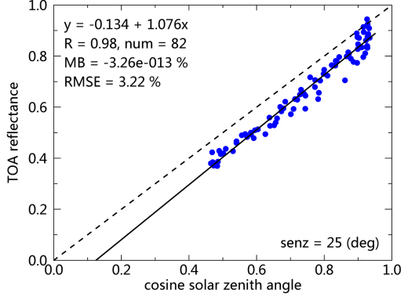
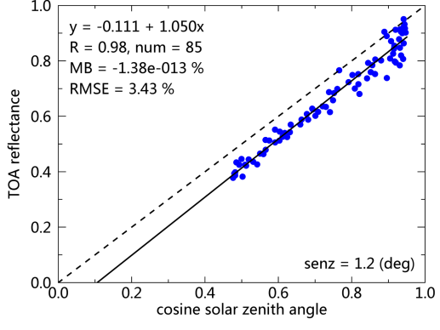
Variation of TOA reflectance as a function of solar zenith angle
Nadir
Off-Nadir
Data acquired from repeatable orbits (with a fixed sensor scan angle) are used.
TOA reflectance is linear correlated with the changes in solar zenith angle, which varies from ~0.9 to ~0.4 as the solar zenith angle increased from 20 to 60 degree.
Notes:
at a fixed sensor zenith angle

Slide 13
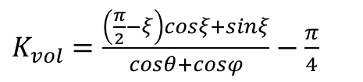
  TOA Bi-Directional Reflectance modeling for snow PICS over TP
Ross-Li BRDF model
（1）
$K_{vol}=\frac{\left(\frac{π}{2}−ξ\right)cosξ+sinξ}{cosθ+cosφ}−\frac{π}{4}$
$K_{geo}=Ο\left(θ,φ,ϕ\right)−secθ^{′}−secφ^{′}+\frac{1}{2}(1+cosξ^{′})secθ^{′}secφ^{′}$
Snow surface BRDF model
（2）
,
,
Notes:
Used to produce MODIS BRDF products
Dome C

Slide 14
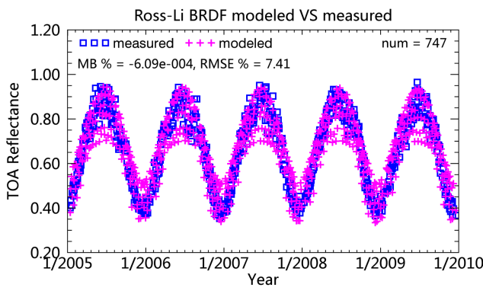
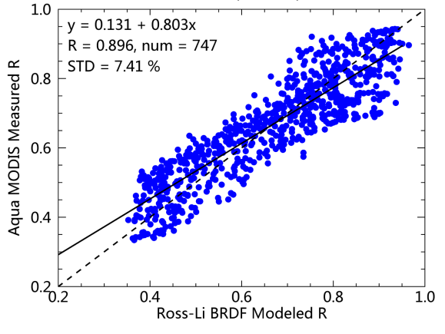
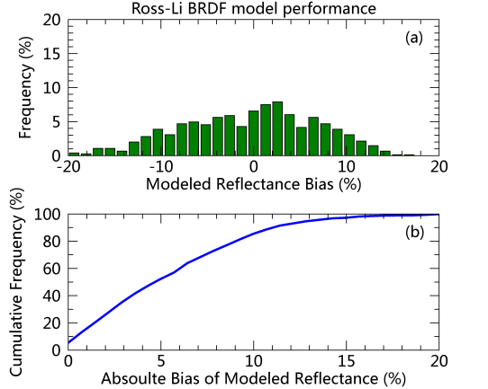
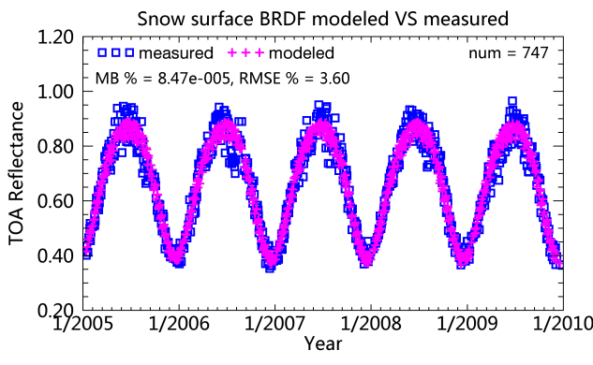
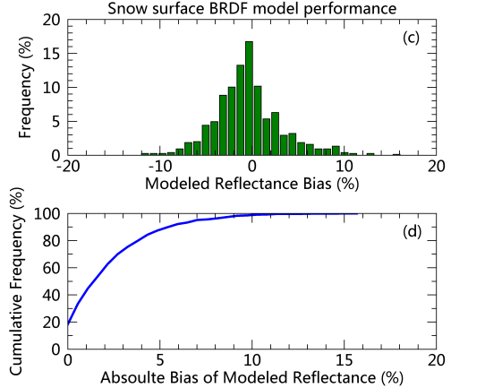
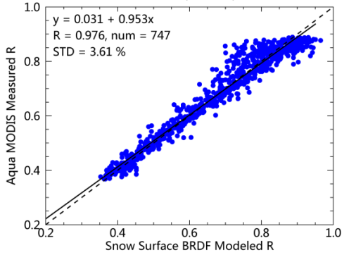
Ross-Li BRDF vs Snow Surface BRDF
Scatter plot of obv vs simu.
Modeling error distribution
Ross-Li
Snow surface
Snow surface BRDF model has better correlations with the measurements and lower RMSE than Ross-Li BRDF model.
The RMSE of snow surface BRDF model is 3.60%, about half of the Ross-Li BRDF model (7.41%).

Slide 15
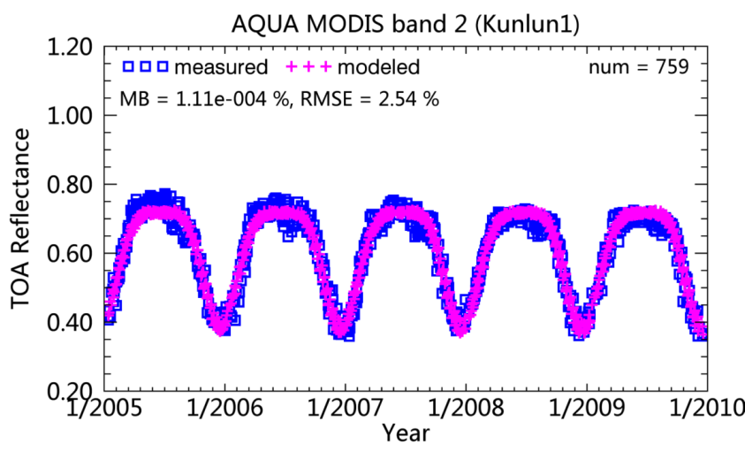
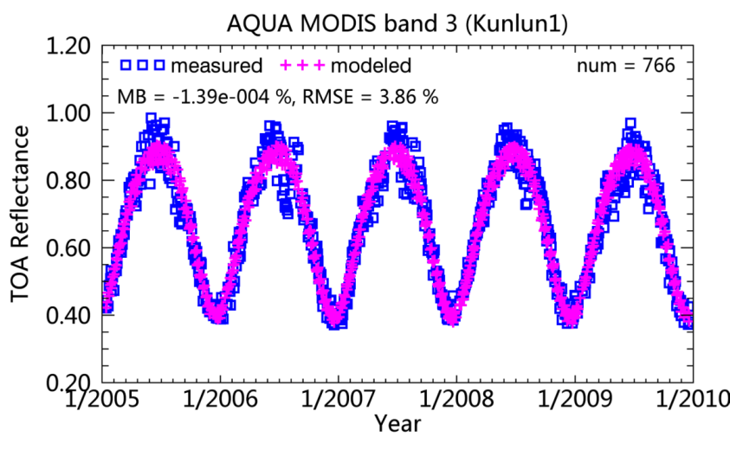
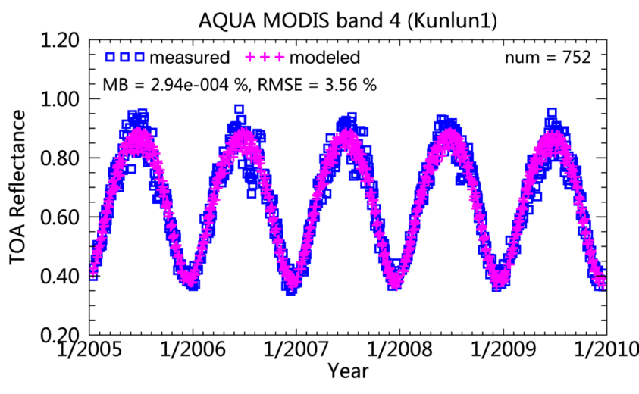
TOA Bi-Directional Reflectance modeling results in other bands for Kunlun site
Model performance of MODIS B1-B4
Band | R | MB (%) | STD (%) | MAX (%) | MIN (%) | RMSE (%)
1 | 0.976 | 8.47e-5 | 3.61 | 15.67 | -11.63 | 3.60
2 | 0.976 | 1.11 e-4 | 2.00 | 9.18 | -6.62 | 2.54
3 | 0.974 | -1.39 e-4 | 3.86 | 16.80 | -11.65 | 3.86
4 | 0.977 | 2.94 e-4 | 3.56 | 15.25 | -11.29 | 3.56
The snow surface model performs well in MODIS bands 1-4 with model RMSE being less than 4%.

Slide 16
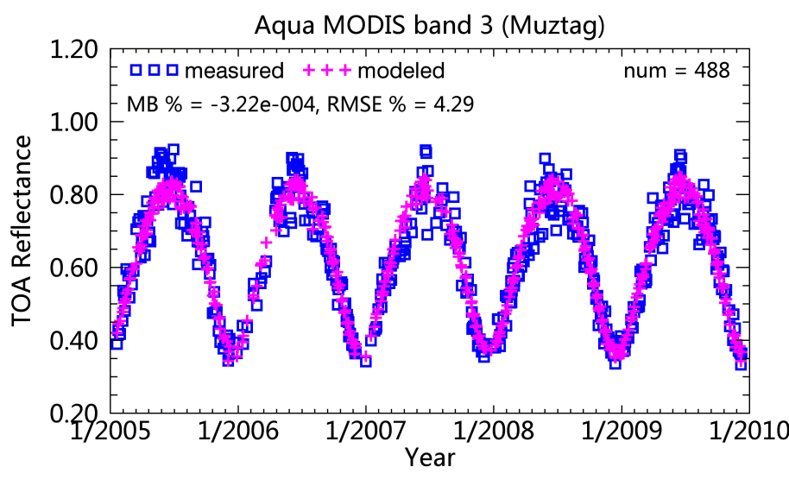
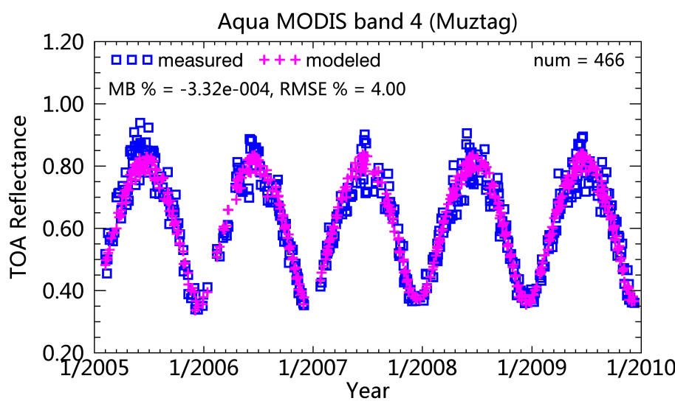
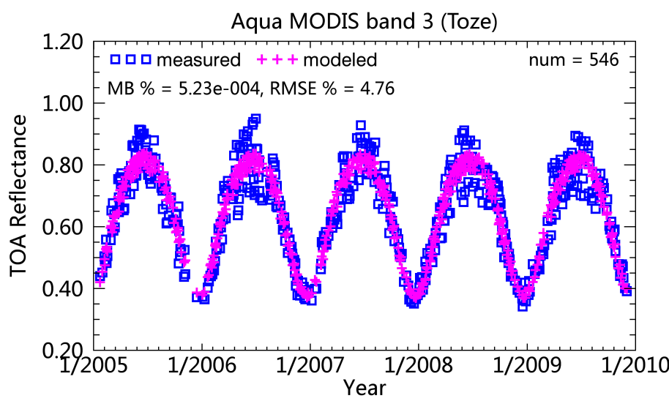
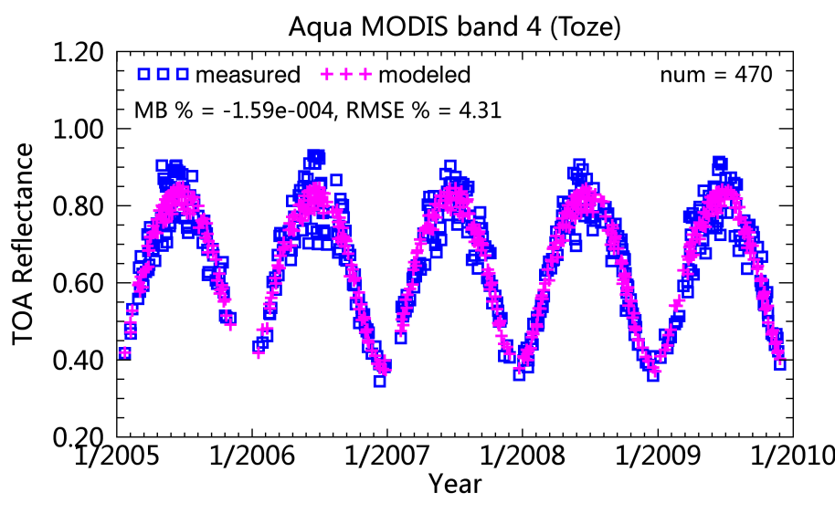
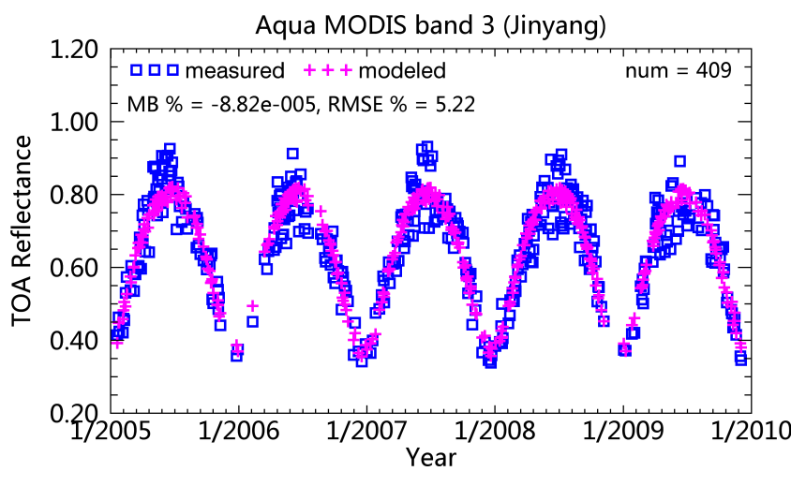
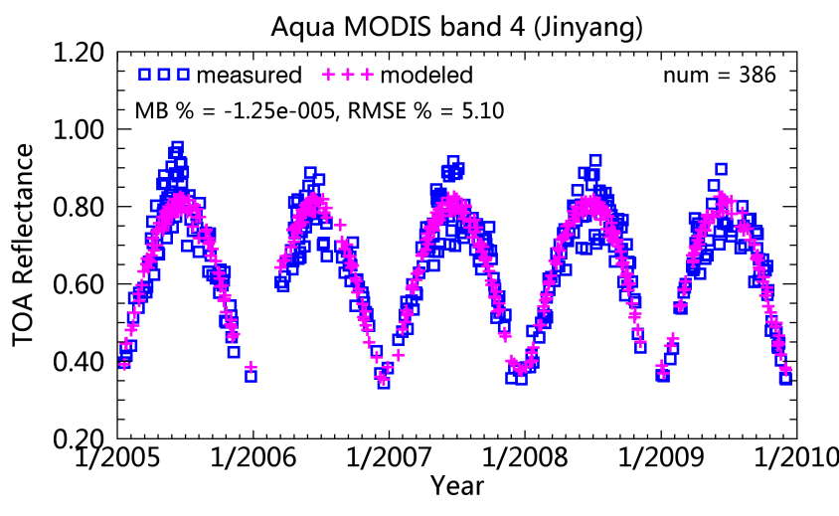
TOA Bi-Directional Reflectance modeling results for Muztag, Toze and Jinyang site

Slide 17
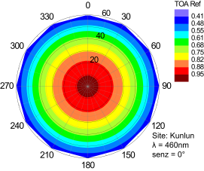
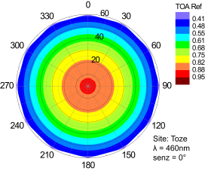

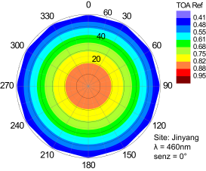
TOA Bi-Directional Reflectance modeling results for four snow PICSs over TP
Nadir-looking
Band：460 nm
RAA：0~360° ；
solz: 0~60°, with a interval of 10°
Reflectance at a given solz
Masonis, 2001
The spectral dependence of the model derived TOA reflectance agrees well with the findings reported in the published literatures.
Notes:
the TOA reflectance of the snow PICS can be calculated according to the BRDF model when the viewing geometry is known. The

Slide 18
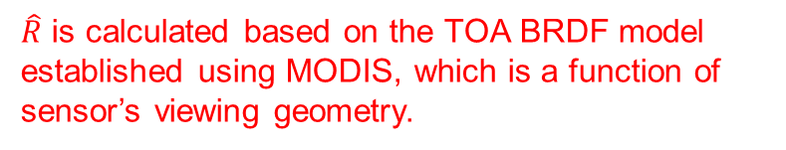

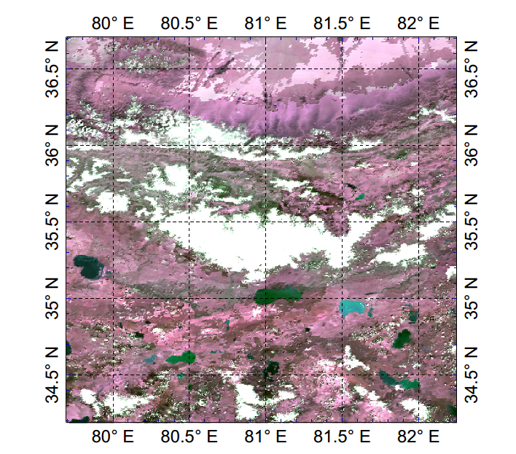
5. Tacking of MERSI on-orbit radiometric stability using TP snow PICS
Data: FY-3A MERSI L1B data, bands 1-4 (correspond to MODIS bands 1-4), from launch (2008.06) to 2014.12
Method
  Calculate TOA reflectance ρ_{TOA} within a 3 × 3 pixel window
  Exclude cloud contaminated scenes
  Correct BRDF effect of TOA reflectance based on the TOA BRDF model of Kunlun
R_{TOA}=ρ_{TOA}/$\hat{R}$
$\hat{R}$ is calculated based on the TOA BRDF model established using MODIS, which is a function of sensor’s viewing geometry.
Kunlun
  Linear regression fit is applied to the R_{TOA} series to obtain the long-term radiometric stability.
MODIS R1G3B4 image over Kunlun Mountain glacier on Aug 29, 2011.

Slide 19
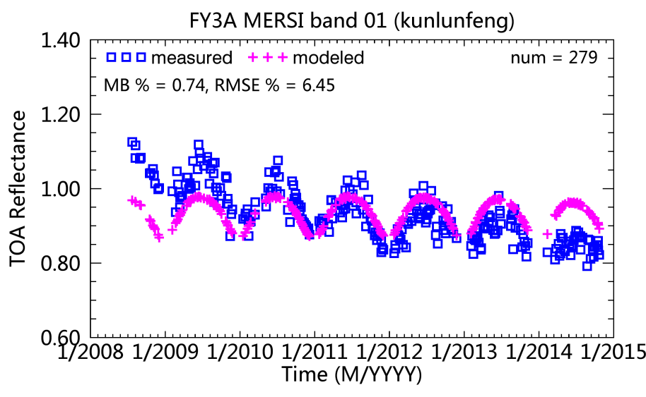
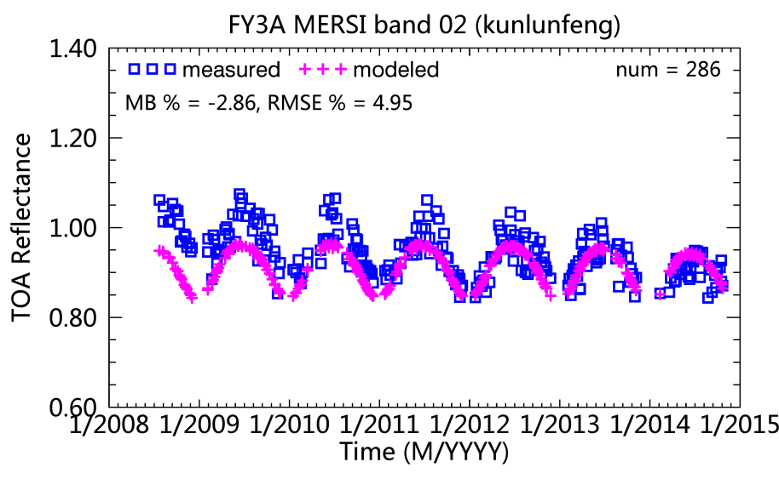
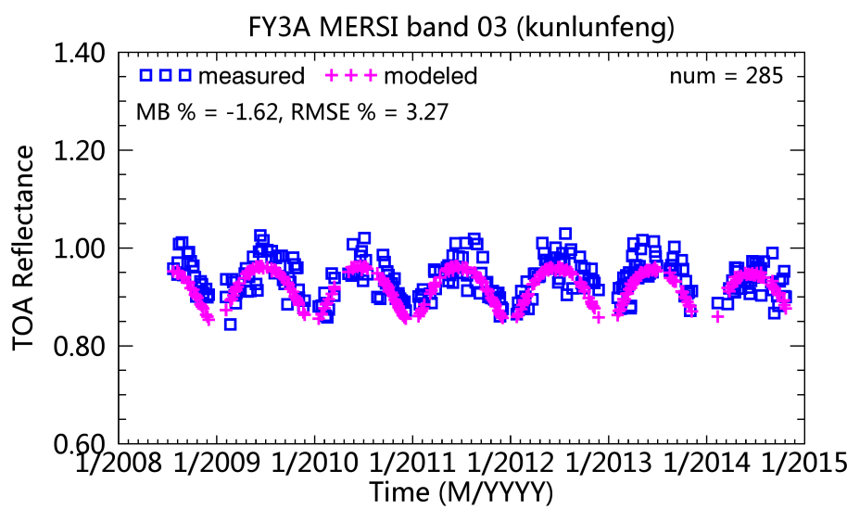
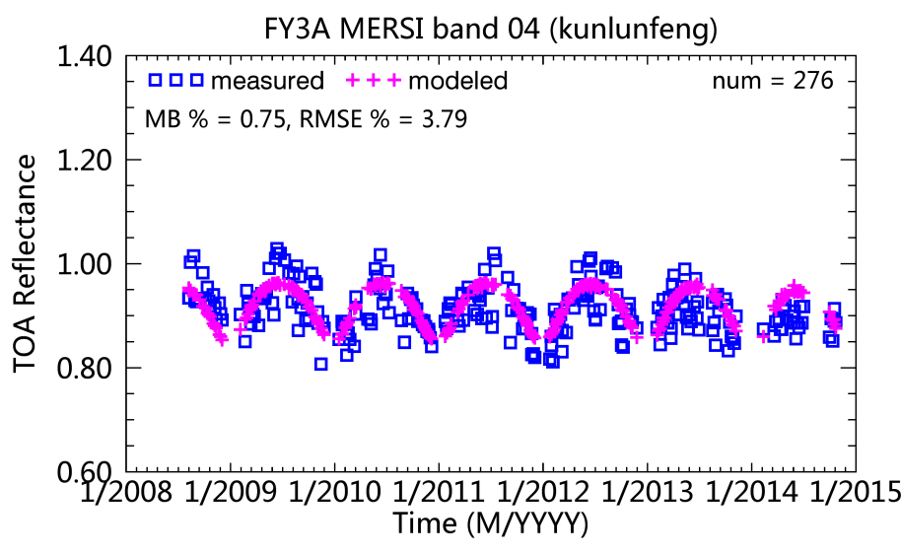
FY-3A MESRI measured TOA reflectance and model simulated results
Notes:
The MODIS based snow BRDF model simulations correspond well to the seasonal variation in the MERSI measured TOA reflectance

Slide 20
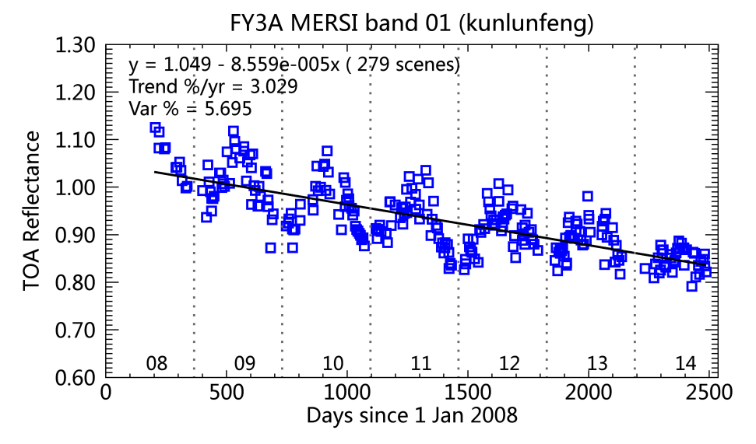



Trending results based on the BRDF corrected TOA reflectance for FY-3A MERSI
no BRDF corrected
BRDF corrected
470 nm
550 nm
After BRDF correction, the seasonal oscillation in the TOA reflectance decreased.
Notes:
standard deviation of residuals (the residuals
refer to the differences between data values and the regression
line) and μ is the mean value of the regression line

Slide 21




Stability trending for FY-3A MERSI Bands 3 and 4
no BRDF corrected
BRDF corrected
670 nm
865 nm
The radiometric response of longer wavelength bands, i.e, bands 3 and 4 is more stable than short wavelength bands, i.e., bands 1 and 2 for FY-3A MERSI,

Slide 22





Comparison of trending result with that derived from Libya 4 and polar glacier (PG)
Tracking FY-3A MERSI using Libya 4 (no BRDF correction)
470 nm
550 nm
670 nm
865 nm
FY-3A MERSI band 4 of 865 nm influenced by water vapour absorption resulted in seasonal oscillation in the TOA reflectance.
Notes:
the seasonal variation in water vapor amount
in the atmosphere resulted in large oscillation in the TOA
reflectance time series

Slide 23

Radiometric stability tracking for FY-3A MERSI by joint use of Dome C and Greenland
Establish TOA BRDF model for polar glacier
Model data: FY-3A MESRI L1B in 2013 with sensor zenith angle less than 20°
TOA BRDF Model performance
 | Greenland |  | Dome C
Band | RMSE % | R² | RMSE % | R²
1 | 0.63 | 0.953 | 0.58 | 0.975
2 | 0.99 | 0.936 | 0.24 | 0.963
3 | 0.84 | 0.913 | 1.42 | 0.930
4 | 1.22 | 0.538 | 1.73 | 0.893
Greenland
Dome C
Notes:
RMSE is less than 2% for all the bands.

Slide 24
FY-3A MESRI measurements VS model simulations in bands 1, 2
Dome C
Greenland

Slide 25
FY-3A MESRI measurements VS model simulations in bands 3, 4
Dome C
Greenland
Notes:
TOA reflectance from single polar glacier site is not continues through time.

Slide 26
Tracking FY-3A MERSI based on BRDF corrected TOA reflectance over two polar glaciers
Notes:
The BRDF corrected TOA reflectance over Dome C and Greenland formed a continous time series, from which we can monitor monthly variations in the sensor performance throughout the year.

Slide 27
Comparison of FY-3A MERSI trending results by using Libya 4, Polar glacier and Kunlun snow PICS
 |  | Varibility(ρ) % |  |  | Annual drift % |  |  | Total drift % |  |  | Bias in total drift %
Band | CW (nm) | Libya 4 | Polar glacier | Kunlun | Libya 4 | Polar glacier | Kunlun | Libya 4 | Polar glacier | Kunlun | KL-L4 | KL-PG
1 | 470 | 4.94 | 1.67 | 3.90 | 2.48 | 2.69 | 3.06 | 15.72 | 17.39 | 19.15 | 3.43 | 1.76
2 | 550 | 2.77 | 2.73 | 3.80 | 2.09 | 1.32 | 1.46 | 13.23 | 8.54 | 9.11 | -4.12 | 0.57
3 | 650 | 1.82 | 2.04 | 3.56 | -0.30 | -0.47 | 0.07 | -1.91 | -3.06 | 0.47 | 2.38 | 3.53
4 | 865 | 3.25 | 2.55 | 4.38 | 0.49 | 0.37 | 0.66 | 2.92 | 2.24 | 4.13 | 1.21 | 1.89
After BRDF correction, the oscillation in the reflectance time series over Kunlun snow PICS is comparable to Libya 4.
For short wavelength channels, the trending results based on Kunlun snow PICS are more consistent with that based on polar glacier than Libya 4 desert site.
Notes:
This table summarized the comparison of FY-3A MERSI trending results by using ****.
White Sands had the largest values for the corrected data
The parameter of varibility indicate that after BRDF correction, the ****
The bias in total drift reveals that

Slide 28


6. Absolute radiometric calibration for FY-3D MERSI -II using deep ocean, desert, salt lake and snow PICS
Calibration reference calculation
  Deep ocean, salt lake, deserts-> 6S RTM simulation
  Snow sites over TP -> TOA BRDF model (established based on MODIS bands 1-4 L1B data) simulation
FY-3D MERSI-II Bands 1-4 and Bands 10-12, 15 which correspond to MODIS bands 1-4 are tested.
Comparison of Spectral Response between MODIS and FY-3D MERSI
Notes:
A preliminary calibration test is performed by adding the snow PICS into the current established MST calibration method in our group.
As introduced in my previos presentation, the *** is obtained from , for the sonw
In order to reduce the model transform error, the FY-3D M

Slide 29






Deep sea (low brightness) + deserts (medium brightness) + snow (high brightness)
470 nm
550 nm
650 nm
490 nm
555 nm
670 nm
Due to the use of snow PICS, the dynamic range of the calibration samples in the short wavelength bands (<600 nm) are increased from ~20% to ~40% (doubled).
Notes:
Scatter plots of DN and TOA reflectance from different stable targets show that the snow site samples and other site samples are in family.
And Due to use of

Slide 30
7. Summary and future work
Five potential snow PICS with contiguous areas of 8–38 km² were identified over the TP region in China.
The snow PICS had stronger non-Lambertian characteristics than Libya 4 did. The TOA BRDF models based on MODIS are establishes to account this effect.
Overall, the trending results for FY-3A MERSI using snow PICS over TP agree well with that using Libya 4 and polar glacier.
The MODIS based TOA BRDF model of TP snow PICS performs well in the absolute calibration for other satellite sensors such as FY-3D MERSI-II.
Notes:
To summarize,

Slide 31
Future work
To further characterize radiometric properties of the TP snow PICS by using High spatial resolution and hperspectral images.
Account for difference in the spectral response function, when transferring the MODIS based TOA BRDF to other sensors, to improve accuracy of the TP snow PICS based calibration approach.
To further investigate the application conditions (e.g. the spectral range, viewing geometry) of the TP snow PICS BRDF model.
Notes:
IN the future, we plan to

Slide 32
Thanks for your attention!

