Slide 1



Status of MODIS and VIIRS Reflective Solar Calibration
X. Xiong¹, C. Cao², A. Angal³, N. Lei³, and A. Wu³
¹NASA Goddard Space Flight Center, Greenbelt, MD 20771, USA
²NOAA STAR, College Park, MD 20740, USA
³SSAI, Lanham, MD 20706, USA
Contributions:
NASA MODIS/VIIRS Characterization Support Team (MCST/VCST)
NOAA S-NPP and JPSS VIIRS SDR Calibration Team
GSICS 2018 Annual Meeting, March 19-23, 2018, Shanghai, China
1

Slide 2

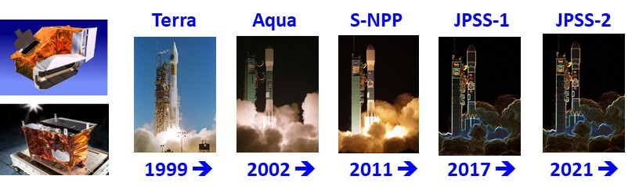
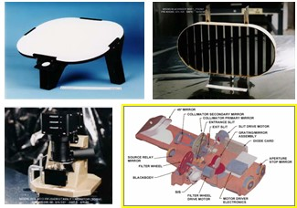
Outline
Calibration Approaches and Activities
On-orbit Performance
Challenging Issues and Future Efforts
On-board Calibrators
2

Slide 3
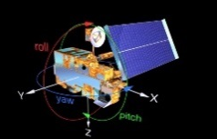
Calibration Approaches and Activities
Calibration Approaches
Calibration Activities (RSB)
MODIS
SD/SDSM calibration: regularly scheduled (except for Terra since 2003)
SRCA radiometric: monthly
Lunar observations: near-monthly (Terra/Aqau)
Regular (less frquent) SRCA operations
Ground reference targets, such as PICS
VIIRS
SD calibration: each orbit
SDSM: secheduled (more frequently than MODIS)
Lunar observations: near-monthly (S-NPP/N-20)
DNB: monthly VROP operation
3

Slide 4
On-orbit Performance (RSB)
Aqua MODIS
  SD degradation: large at short wavelengths; slower than T-MODIS and VIIRS
  Spectral band responses: large at VIS and NIR (rate varies), stable for SWIR
  BBR (tracked using SRCA): stable over the mission
  Spectral performance: changes are small (0.5-1.0 nm) for most VIS/NIR bands with narrow BW and relatively large for bands with broad BW
S-NPP VIIRS
  SD degradation: similar to Terra MODIS
  Spectral band responses: large at NIR and SWIR
  BBR: stable (tracked using lunar observations)
  Spectral performance: on-orbit modulated RSR (due to wavelength dependent optical throughput degradation)
JPSS-1 (N-20) VIIRS
  SD degradation: similar to S-NPP and Terra MODIS
  Spectral band responses: stable for all RSB (better than S-NPP)
  BBR: consistent with pre-launch; to be continuously monitored
4

Slide 5
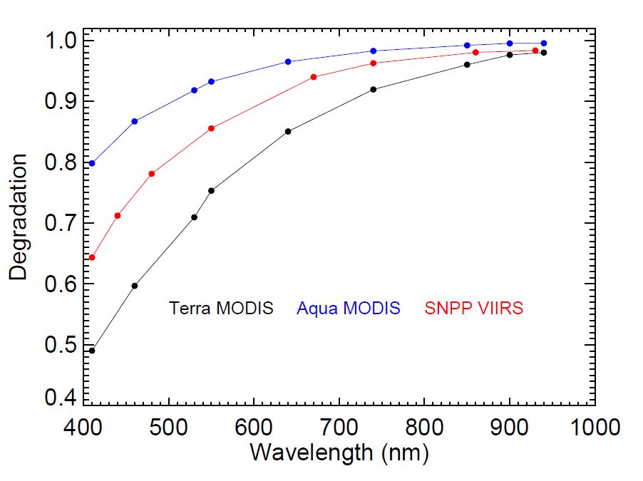
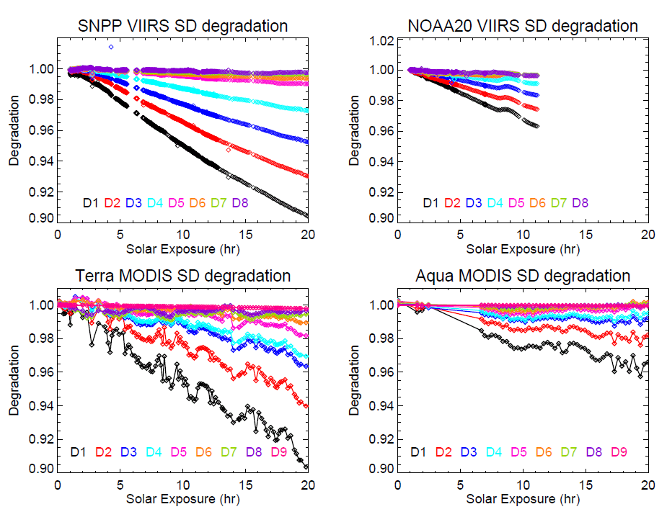
MODIS and VIIRS SD Degradation
Large SD degradation at short wavelengths – same for both MODIS and VIIRS
Increased SD degradation in Terra MODIS after its SD door fixed at “open”
VIIRS has no SD door
Mission beginning degradation (as a function of solar exposure time): S-NPP is more close to T-MODIS and N-20 is more close to A-MODIS
18 years 15 years 6 years
5

Slide 6
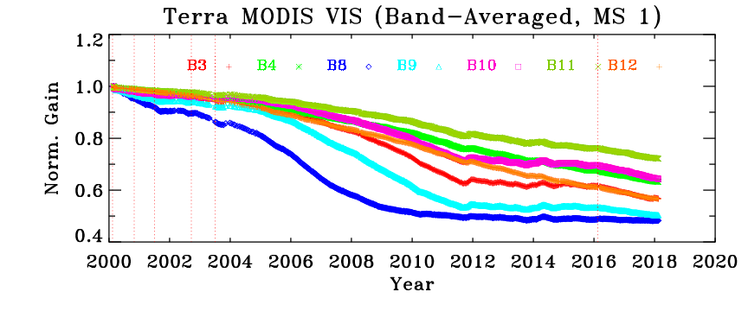
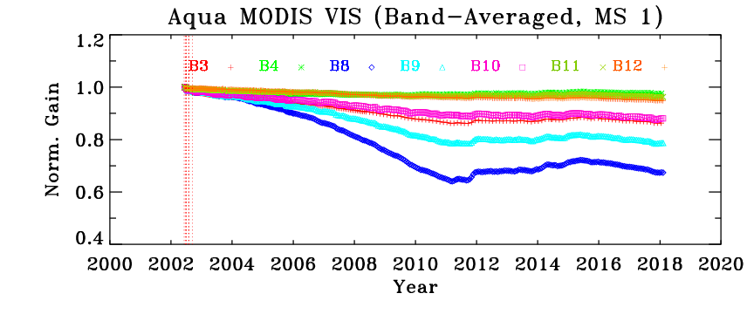
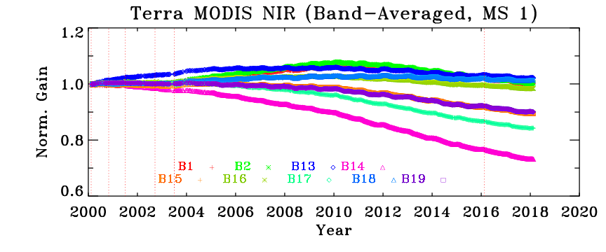
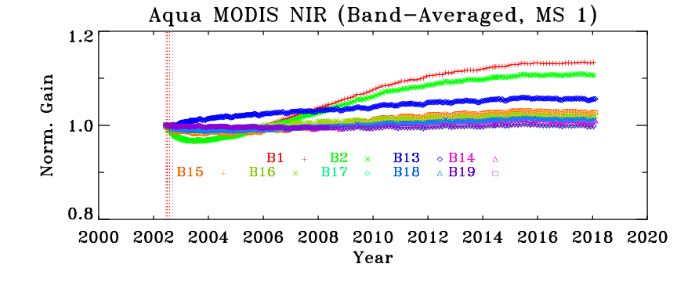
MODIS VIS/NIR Spectral Band Responses (Gains)
Much stable for SWIR bands (Terra and Aqua MODIS)
6

Slide 7
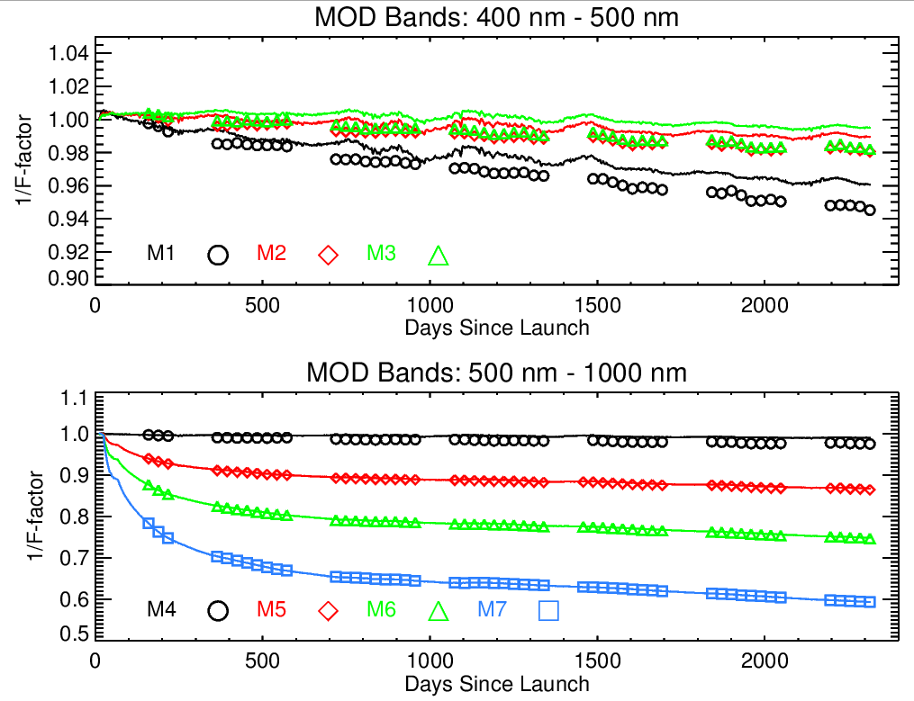
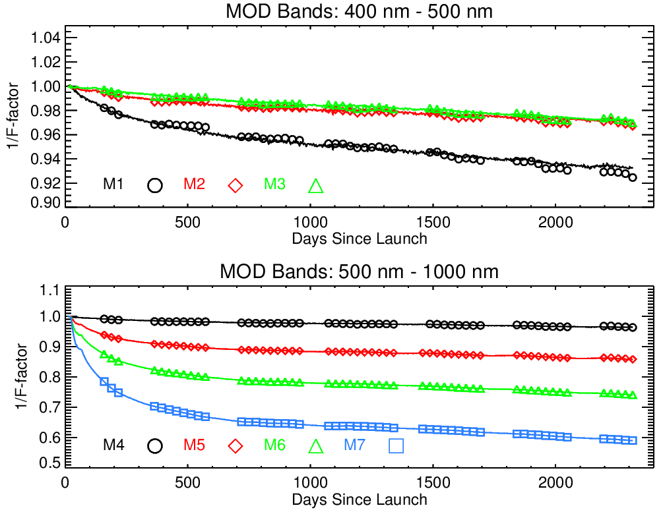
S-NPP VIIRS VIS/NIR Spectral Band Responses (Gains)
V1
V2
Large degradation at NIR and SWIR region => modulated RSR
7

Slide 8
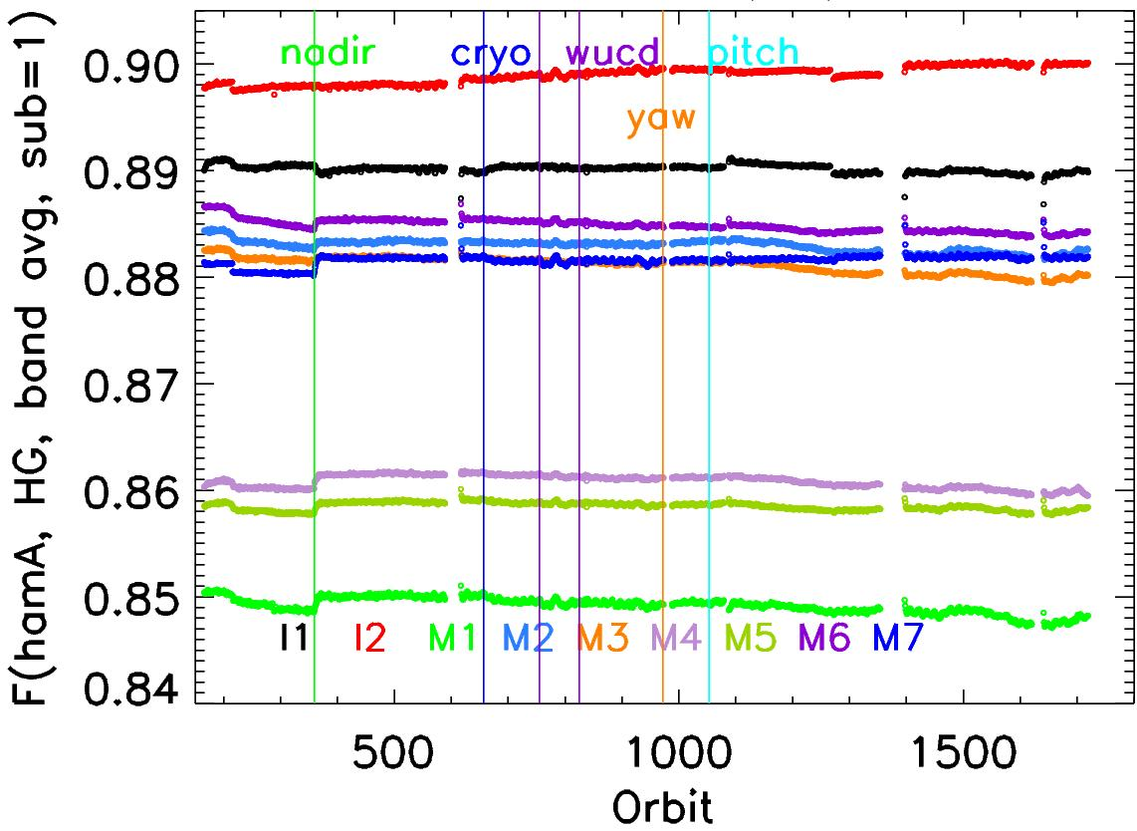
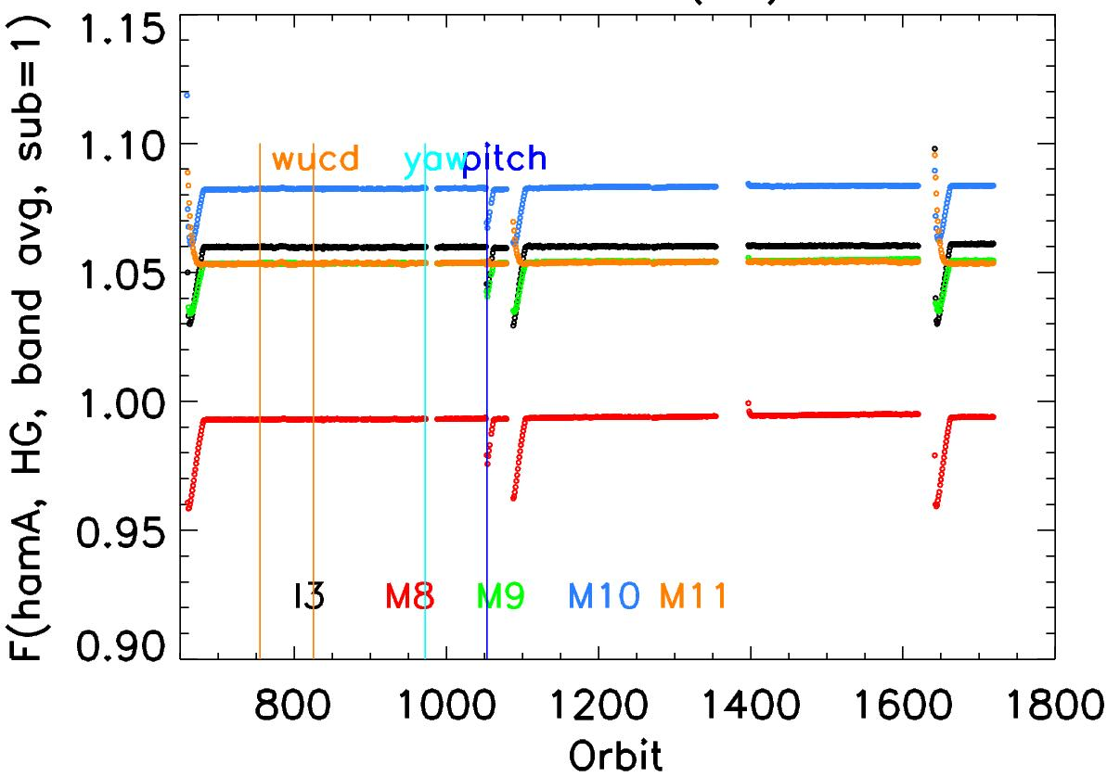
N-20 VIIRS RSB Spectral Band Responses (Gains)
Much stable than S-NPP for all VIS, NIR, and SWIR spectral bands
VIS/NIR
SWIR
SWIR located on CFPA
Reference Sensor?
8

Slide 9
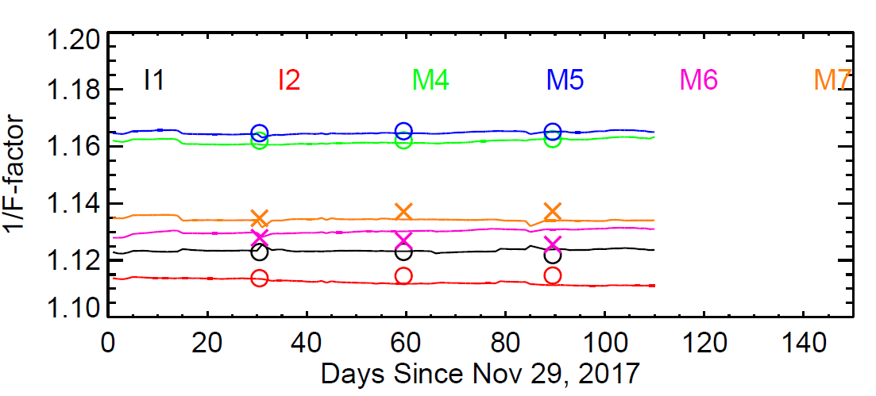
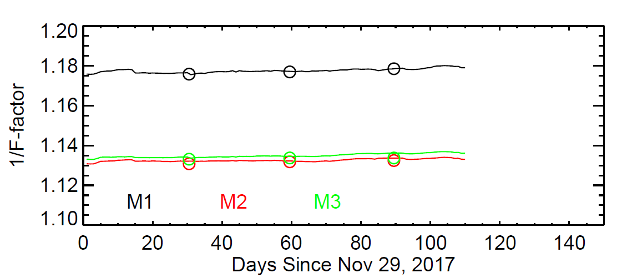
N-20 VIIRS RSB Spectral Band Responses (Gains)
N-20 RSB gains (1/F) from SD (line) and Moon (symbol)
Results are preliminary
Lunar responses (gains) normalized to SD gains
SD degradation correction applied to M1-M5 and I1
9

Slide 10
Challenging Issues and Future Efforts
Changes in MODIS VIS/NIR response versus scan-angle (RVS)
Potential changes in Aqua MODIS polarization sensitivity (issues identified in Terra MODIS)
Large SD degradation in VIS bands and no SD degradation monitoring for SWIR bands
Special calibration and validation effort in support of VIIRS data reprocessing – joint effort by NASA and NOAA teams (groups)
Improved use of VIIRS SD and lunar calibration parameters
Potential changes in VIIRS RVS – lessons from MODIS
MODIS and VIIRS calibration consistency and impact on science products
Extensive efforts made by NASA MCST/VCST and NOAA SDR team on calibration inter-comparison of Aqua MODIS and S-NPP VIIRS, S-NPP and N-20 VIIRS
10

Slide 11
Backup Slides
11

Slide 12
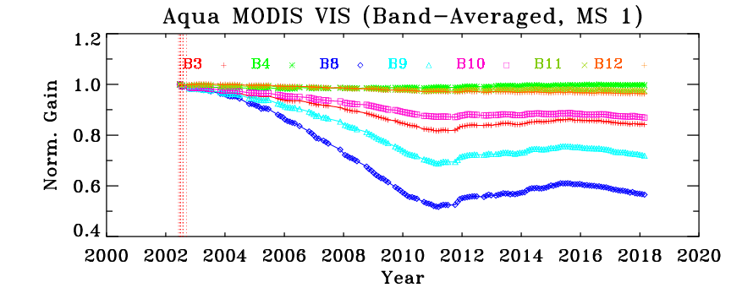
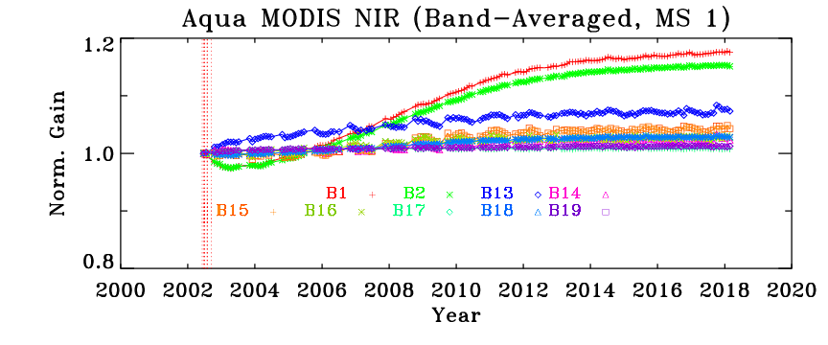
Changes in MODIS VIS/NIR Response Versus Scan-angle (RVS)
RVS is wavelength, mirror-side, and AOI dependent
Challenges for both Terra and Aqua MODIS
SD Calibration
Lunar Calibration
12

Slide 13
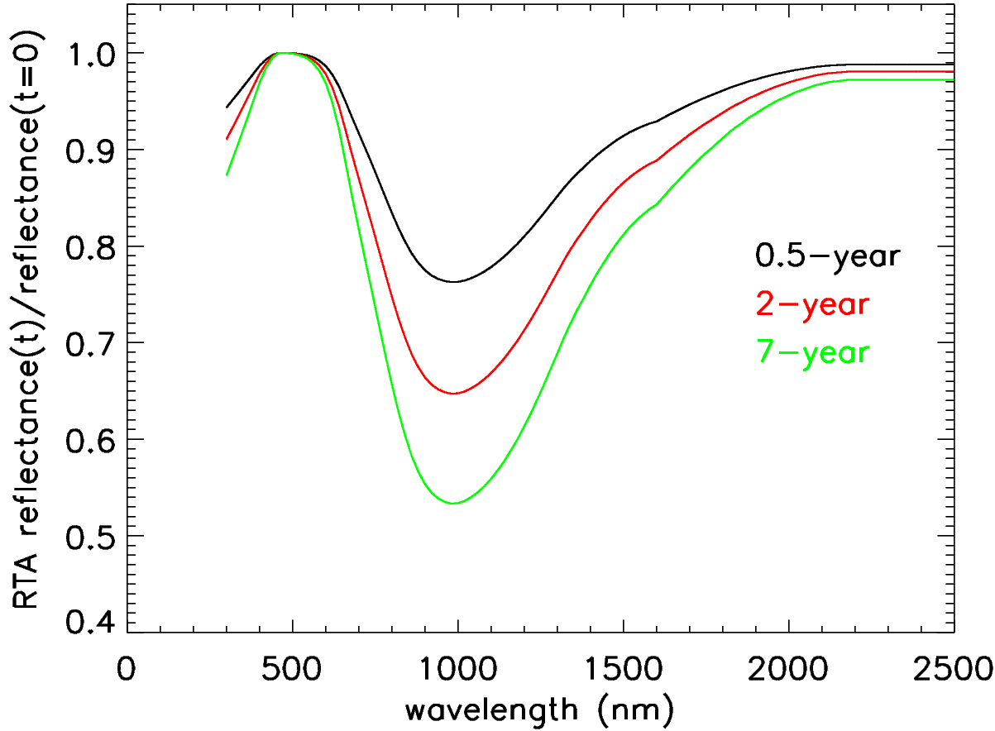
S-NPP On-orbit Modulated RSR
Large impact for DNB (broad bandwidth)
Impact for bands with OOB responses
λ dependent optics degradation
DNB
13

Slide 14
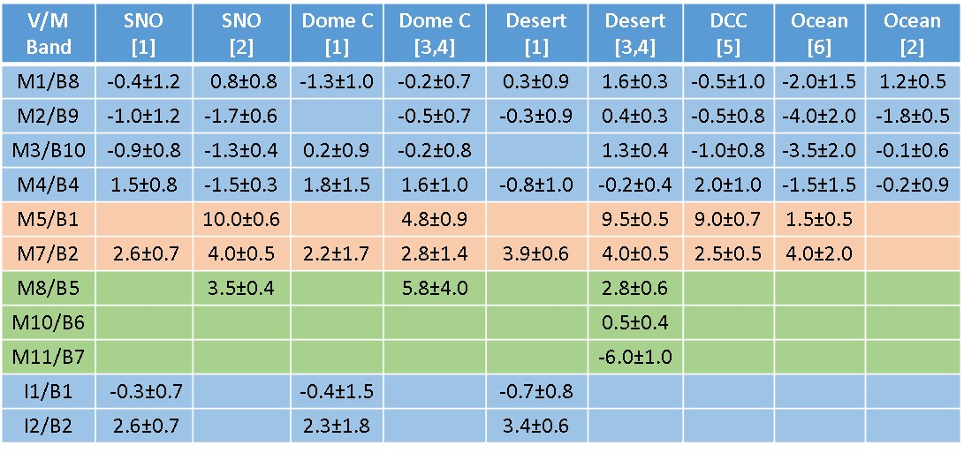
Aqua MODIS and S-NPP VIIRS Calibration Differences
Large RSR difference
1) Difference computed as 100*(VIIRS-MODIS)/MODIS
2) Non RSR correction applied
3) Numbers shown in the brackets are reference numbers
4) Results are based on MODIS C6 L1B and VIIRS IDPS/Land PEATE SDR
Atmospheric impact and MODIS SWIR xtalk
Challenges: help establish and generate long-term consistent science products from MODIS and VIIRS observations
14

