Slide 1
Annual GSICS Calibration Report for {Agency} - Discussion from Data Management point of view
Masaya Takahashi (JMA), Dohyeong Kim (KMA),
Tim Hewison (EUMETSAT), Xiuqing ”Scott” Hu (CMA), Peter Miu (EUMETSAT) and Ashim Mitra (IMD)

Slide 2
GDWG/GRWG Joint Action at GSICS-EP-18 (Jun 2017)
GDWG/GRWG were asked by GSICS-EP to provide instrument performance report using GSICS inter-calibration methods
Benefits for both GSICS and satellite data user’s communities
Drafting a template of the report will be discussed tomorrow
Need GDWG thoughts/ideas/recommendations before the discussion
Reference | Action Description | Actionee | Due date
EP-18.A03 | GDWG and GRWG to develop an approach for an Annual GSICS report on the State of the Observing System with respect to Instrument Performance and Inter-comparisons with GSICS Reference Instruments (from presentations given at the GRWG meeting) | GDWG and GRWG | EP-19

Slide 3
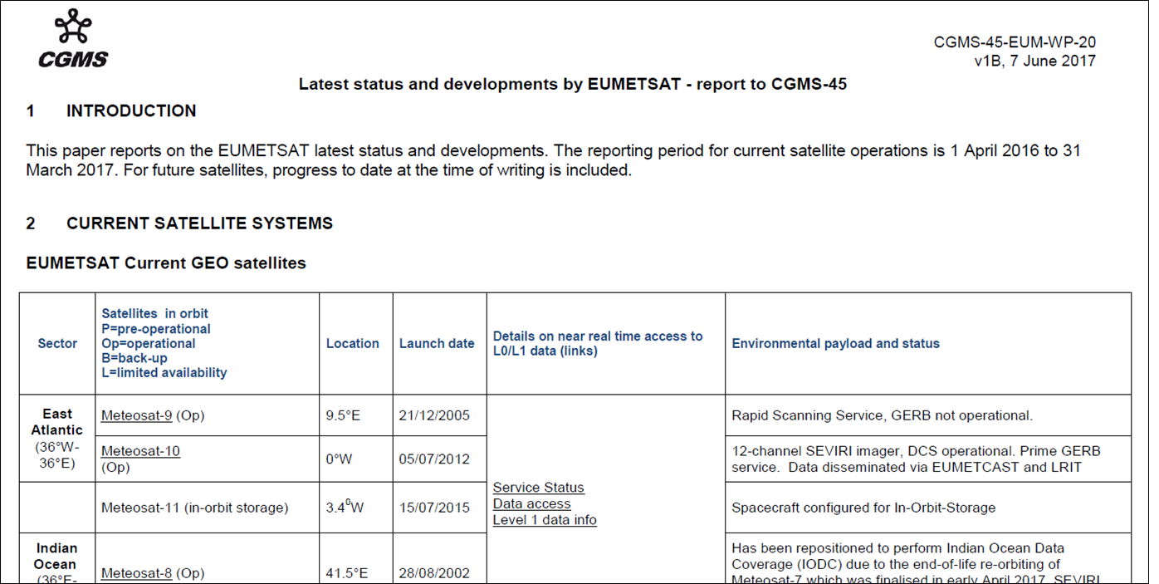
CGMS (Coordination Group for Meteorological Satellites) WPs
CGMS member agencies have been reporting their spacecraft status using the same format (text-format document)

Slide 4
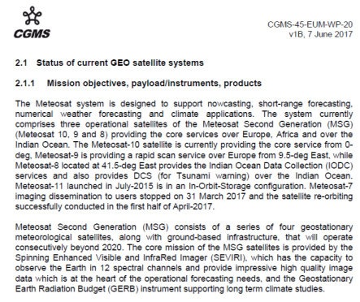
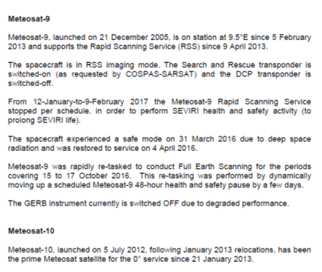
Proposal for the Report
We could also formulate the template for GSICS agency’s reports on instrument performance
To be reported to CGMS meeting (+ uploaded on the GSICS Wiki?)

Slide 5
Concepts of the Report
Target readers
Satellite data users (+ satellite operators?)
Adopting existing formats/conventions as possible
Be simple / fewer slides for non calibration experts
Reducing GSICS members’ work is also important
Detailed information can be uploaded on Calibration Landing Page
Existing satellite/instrument reports helped us a lot for drafting the report
Weekly NOAA POLAR-Orbiting Spacecraft Status Reports
IASI L0 and L1 Daily Monitoring Report
Aqua Status File
MODIS Weekly Reports
and so on …

Slide 6
GSICS Report - State of the Observing System - (Instrument Performance and Inter-comparisons with GISCS Reference Instrument)
Strawman
Name
(Agency)

Slide 7
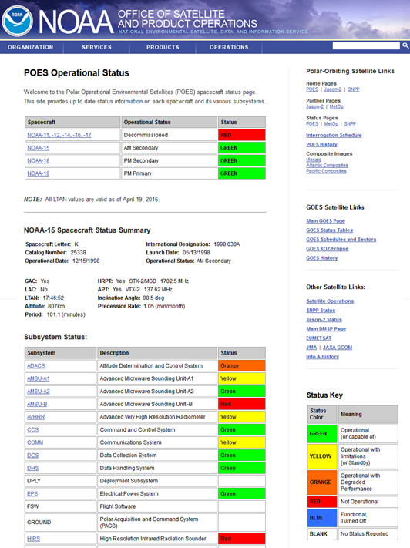
Satellite/Instruments Summary - NOAA
Satellite (status) |  | ECT (Asc.) | Launch date | EO instruments
NOAA-15 | (Op) | 18:11 | 1998-05-13 | AMSU-A1 | AMSU-A2 | AMSU-B | AVHRR | HIRS
NOAA-18 | (Op) | 18:52 | 2005-05-20 | AMSU-A1 | AMSU-A2 | MHS | AVHRR | HIRS | SBUV
NOAA-19 | (Op) | 15:12 | 2009-02-06 | AMSU-A1 | AMSU-A2 | MHS | AVHRR | HIRS | SBUV
NOAA-20 | (P) | XX:XX | 2017-11-18 | ATMS | CrIS | VIIRS | OMPS | CERES
Major calibration relevant events in 2017
2017-XX-XX:
Satellite Status
 | Op = Operational
 | P = Pre-operational
 | B = Back-up, secondary
 | L = Limited availability
Instrument Status
 |  | Operational (or capable of)
 |  | Operational with limitations (or Standby)
 |  | Operational with Degraded Performance
 |  | Not Operational
 |  | Functional, Turned Off
Used in CGMS Working Paper
Used on NOAA/OSPO GOES/POES status webpages

Slide 8
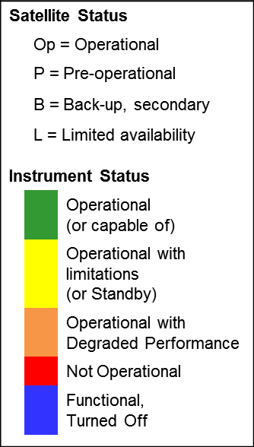
2017 Satellite/Instruments Summary – LEO
Satellite (status) |  | ECT (Asc.) | Launch date
Sat-A | (Op) | XX:XX | 20XXX-XX-XX
EO Instruments | Jan | Feb | Mar | Apr | May | Jun | Jul | Aug | Sep | Oct | Nov | Dec
Instrument-A
Instrument-B
Instrument-C
Instrument-D
Instrument-E
Instrument-F
Major calibration relevant events in 2017
2017-XX-XX:
…
…
Overall instrument status could also be shown as the same color-style

Slide 9
Calibration Performance: Himawari-8/AHI Visible/Near-Infrared Bands
Summarize the instrument’s
calibration performance
in 1 or a few slides
Summary Statistics of Himawari-8/AHI VNIR Calibration Performance (All Uncertainties are k=1)
Channel Name (Central Wavelength in μm) |  | BAND01 (0.47) | BAND02 (0.51) | BAND03 (0.64) | BAND04 (0.86) | BAND05 (1.6) | BAND06 (2.3) | Units
Ray-matching w/ S-NPP/VIIRS | Mean Bias | 2.2 ± 0.8 | +3.1 ± 0.8 | -2.9 ± 0.8 | -0.8 ± 0.7 | -6.3 ± 0.8 | +4.9 ± 0.9 | %
 | Annual Drift | -0.53 ± 0.15 | -0.52 ± 0.12 | -0.79 ± 0.09 | -0.58 ± 0.06 | -0.06 ± 0.13 | -0.18 ± 0.11 | %
Vicarious Cal. using Aqua/MODIS + RTM | Mean Bias | 1.0 ± 1.6 | +1.7 ± 1.8 | -1.9 ± 1.8 | -2.8 ± 1.6 | -4.3 ± 1.0 | +3.5 ± 0.9 | %
 | Annual Drift | -0.72 ± 0.17 | -0.92 ± 0.18 | -1.26 ± 0.17 | -1.20 ± 0.17 | -0.39 ± 0.12 | -0.24 ± 0.19 | %
Mean Bias: monthly average and standard deviation of the daily results in January 2017
Annual Drift: calculated using Mean Bias from July 2015 to December 2017
Ray-matching: Spectral Band Adjustment Factors on NASA Langley website compensates Spectral diff. (ATBD)
Vicarious calibration uses optical parameters retrieved from Aqua/MODIS C6 L1B (Reference)
Trend of the ratio of observation to reference computed using Ray-matching / Vicarious calibration approaches
BAND01 (0.47 μm)
BAND03 (0.64 μm)
BAND05 (1.6 μm)

Slide 10
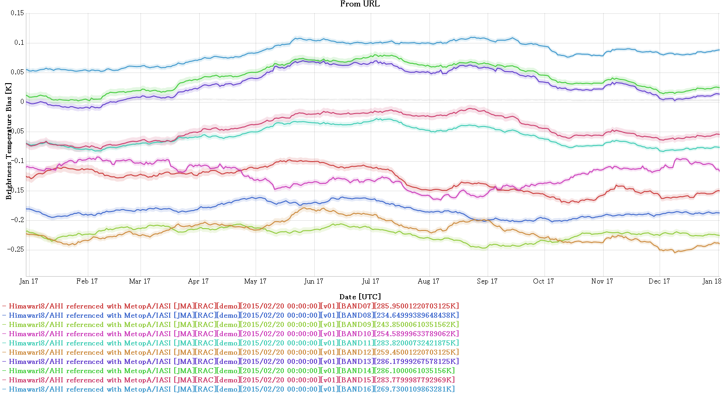
Calibration Performance: Himawari-8/AHI Infrared Bands
Summarize the instrument’s
calibration performance
in 1 or a few slides
Summary Statistics of Himawari-8/AHI IR Calibration Performance in 2017 (All uncertainties are k=1)
Channel Name (Central Wavelength in μm) | BAND07 (3.9) | BAND08 (6.2) | BAND09 (6.9) | BAND10 (7.3) | BAND11 (8.6) | BAND12 (9.6) | BAND13 (10.4) | BAND14 (11.2) | BAND15 (12.4) | BAND16 (13.3)
Standard Radiance as Tb (K) | 286.0 | 234.6 | 243.9 | 254.6 | 283.8 | 259.5 | 286.2 | 286.1 | 283.8 | 269.7
Mean Bias (K) | -0.11 | -0.173 | -0.212 | -0.129 | -0.05 | -0.216 | 0.036 | 0.045 | -0.04 | 0.078
Standard Deviation of Bias (K) | 0.008 | 0.012 | 0.009 | 0.014 | 0.012 | 0.017 | 0.018 | 0.019 | 0.017 | 0.015
The statistics are derived from Himawari-8/AHI GSICS Re-Analysis Correction vs. Metop-A/IASI (ATBD)
Standard Radiance: typical scene defined by GSICS for easy inter-comparison of sensors’ inter-calibration biases
Random Uncertainty of Bias is calculated as estimated as rolling standard deviation of Tb Bias over 29-days
Time series of Himawari-8/AHI Tb biases w.r.t. Metop-A/IASI at standard radiance
Use of GSICS Plotting Tool is recommended if available

Slide 11
Discussion
Report format (incl. use of colors)
Text? Slide? Spreadsheet? Html?
Links to GSICS relevant information
WMO/OSCAR, Instrument Calibration Landing Page, Instrument Performance Monitoring System, GPRC Website, …
…

Slide 12
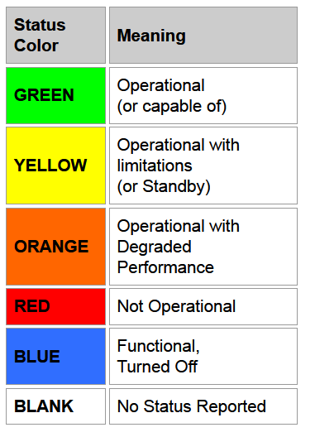
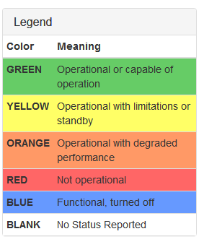
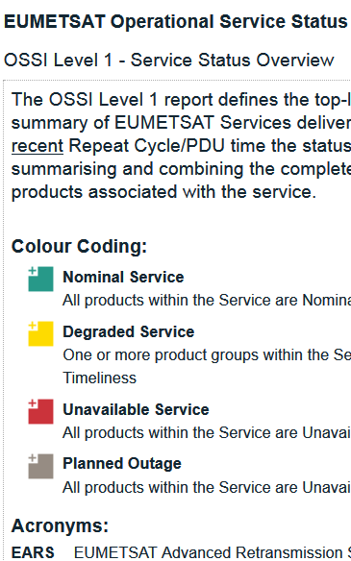
Colors for Instrument Status
Do we agree to use existing color convention?
NOAA
CMA
EUMETSAT

Slide 13
Adding hyperlinks to GSICS relevant webpages
Too many hyperlinks – useful for users? could cause user’s confusion?
Satellite (status) |  | ECT (Asc.) | Launch date | EO instruments
NOAA-15 | (Op) | 18:11 | 1998-05-13 | AMSU-A1 | AMSU-A2 | AMSU-B | AVHRR | HIRS
NOAA-18 | (Op) | 18:52 | 2005-05-20 | AMSU-A1 | AMSU-A2 | MHS | AVHRR | HIRS | SBUV
NOAA-19 | (Op) | 15:12 | 2009-02-06 | AMSU-A1 | AMSU-A2 | MHS | AVHRR | HIRS | SBUV
NOAA-20 | (P) | XX:XX | 2017-11-18 | ATMS | CrIS | VIIRS | OMPS | CERES
Hyperlinks to WMO/OSCAR?
Hyperlinks to
Each agency’s Instruments Landing Page?
WMO/OSCAR if Landing Page does not exist?

