Slide 1
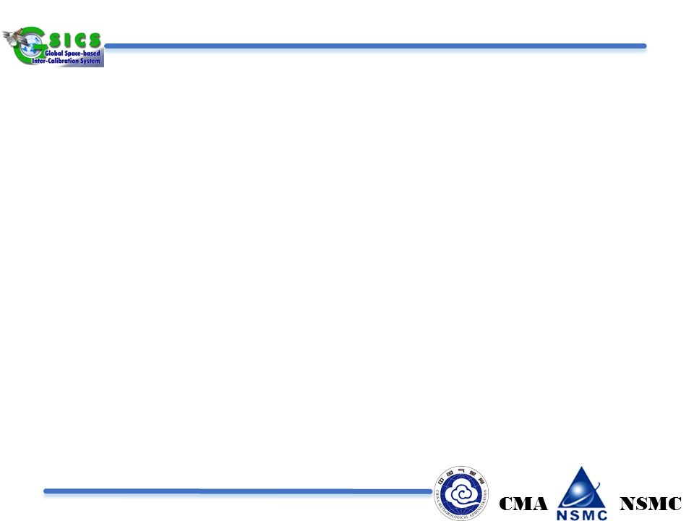
Development of FY-3/MWRI Calibration on Warm Target and Reflector Emissivity
Shengli Wu@NSMC
XinXin Xie@SSITT
Miao Zhang@NSMC
Hongxin Xie@SSITT
GSICS 2018@Shanghai 2018.03.22

Slide 2
Outline
Motivation
Warm Calibration system of FY-3/MWRI
Warm Target correction
Reflector correction
Conclusion

Slide 3
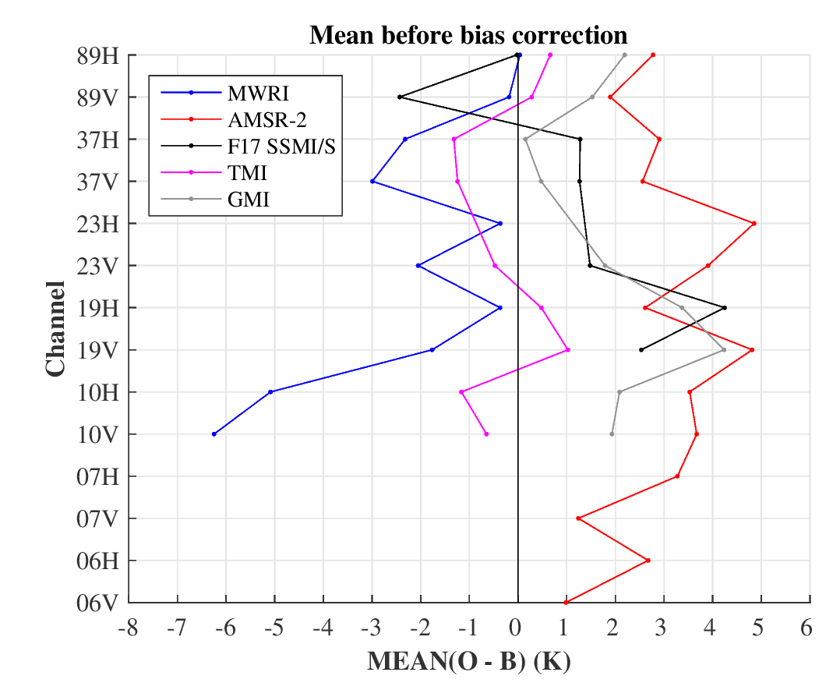
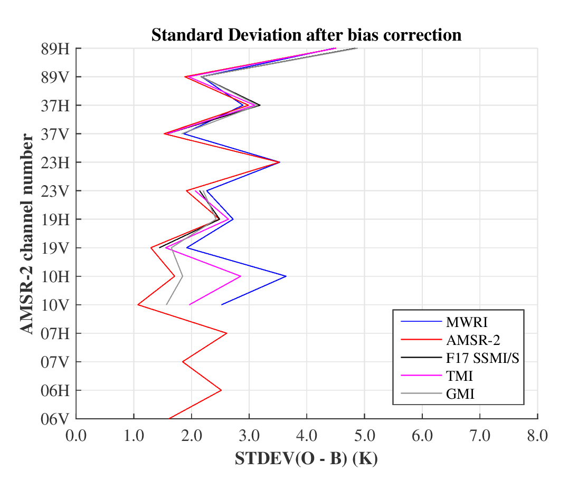
Motivation
Observation minus ECMWF Background Statistics for June 2014
Data: 1 month, after cloud screening, ocean +/- 60 latitude

Slide 4
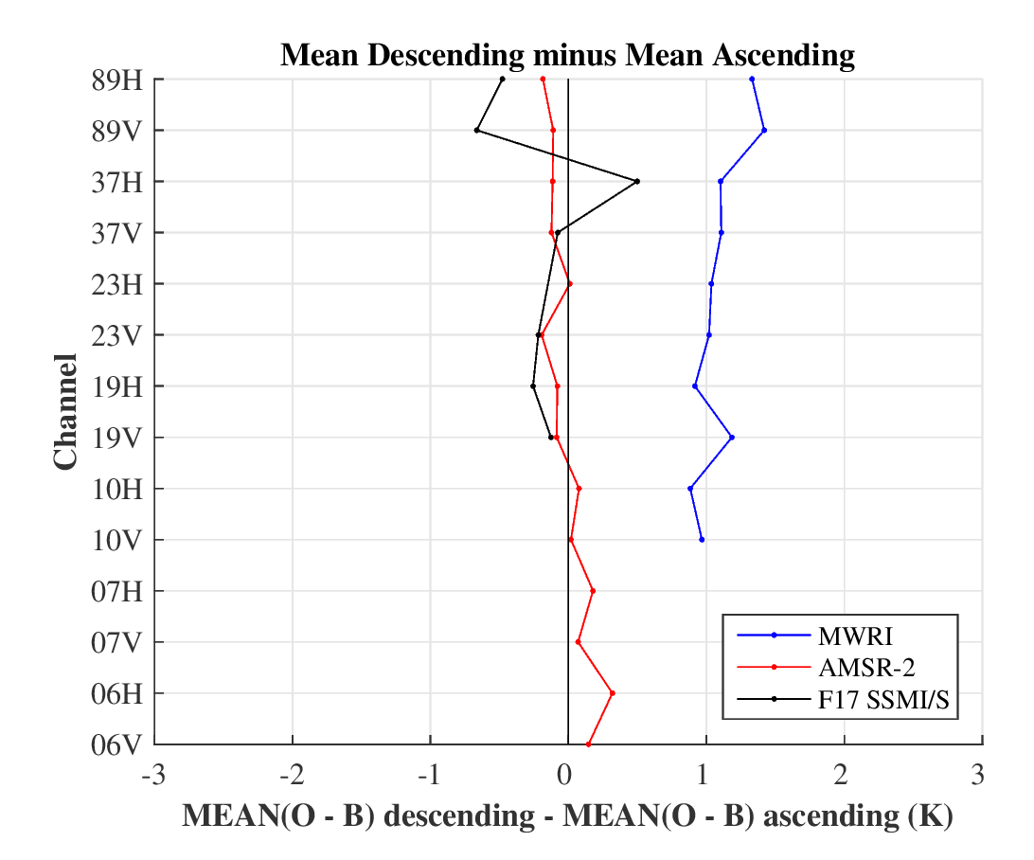
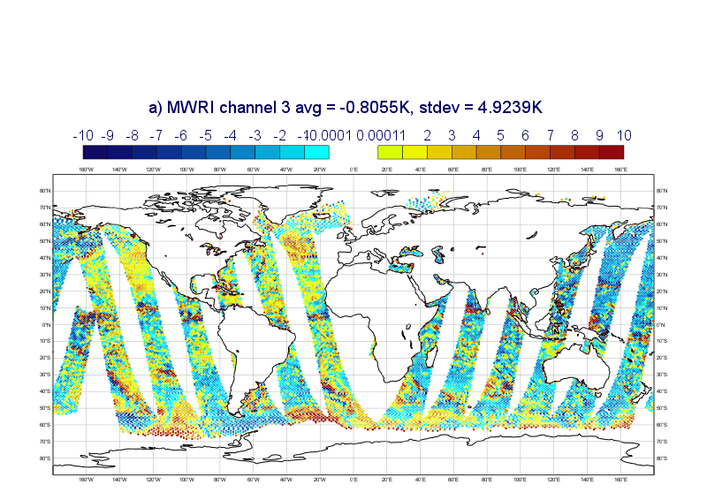
Motivation
Ascending/Descending Biases:
e.g. channel 3 (19V) O - B
19V Channel

Slide 5
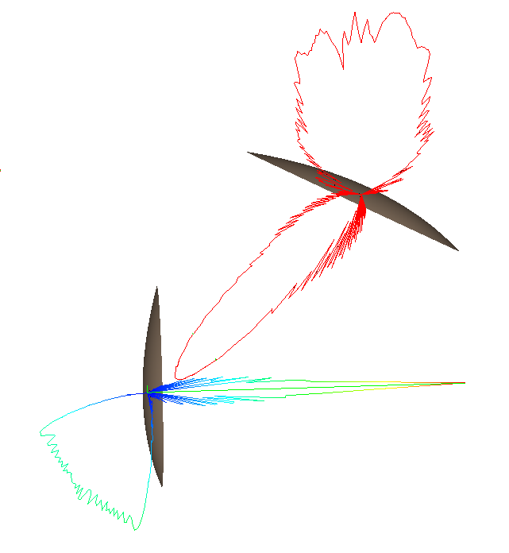

Warm Calibration system of FY-3/MWRI
is the efficiency of main reflector;
is the efficiency of hot-reflector
is the efficiency of warm-load
Reflector Emission

Slide 6
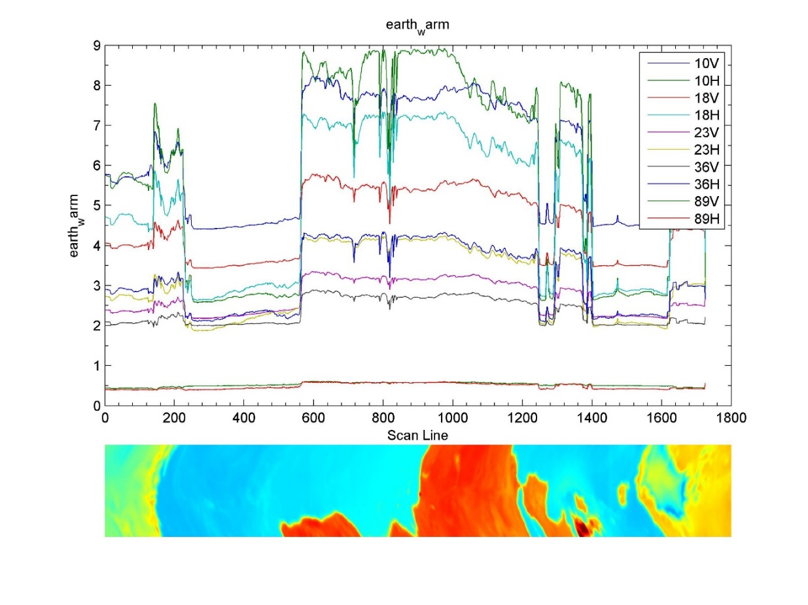
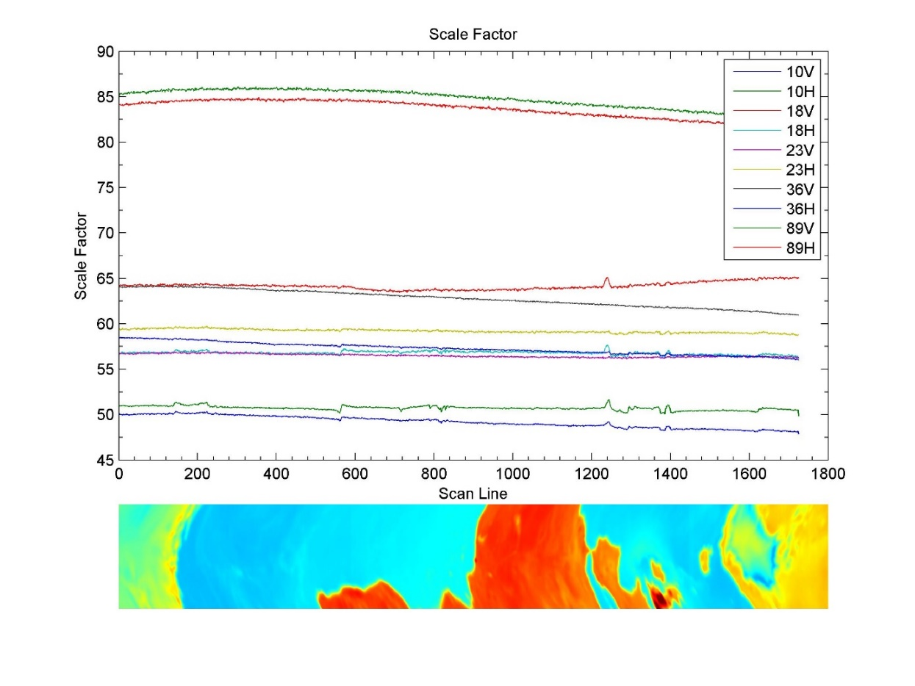
Warm Target correction

Slide 7
Warm Target correction : Error Source 1/2
Brightness temperature of earth-surface in the direction of the warm reflector back lobe;
Error Source 1
Error Source 2

Slide 8
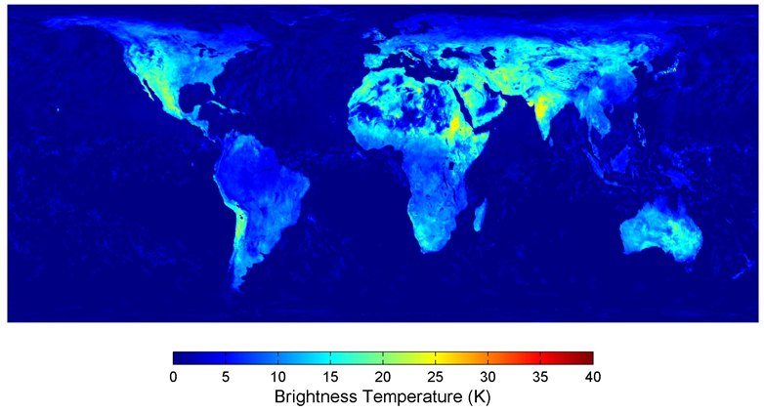
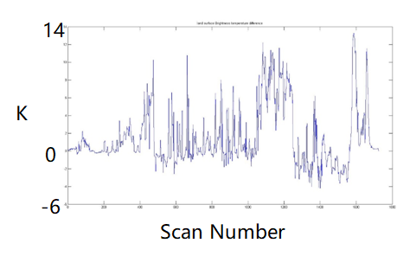
Warm Target correction : Error Source 1
Difference of Min/Max BT
  operational: using a climate brightness Temperature dateset (from AMSR-E Jan-Dec/2006, monthly average);
  Improve: Consider the local time of the warm reflector back lobe direction
Difference of BT result before and after correction

Slide 9
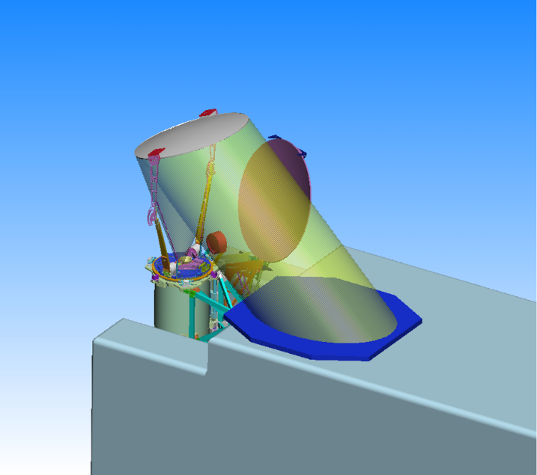
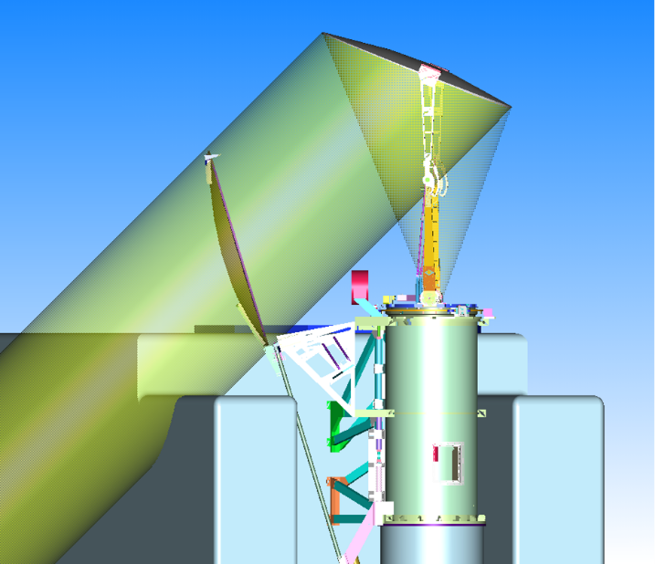
Warm Target correction : Error Source 2
is not the real factor of warm reflector back lobe, the true value should be smaller.
cold
We can’t use the ground measured to get the back lobe factor directly.
Warm

Slide 10
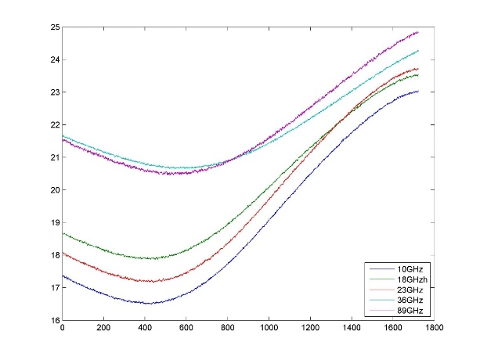
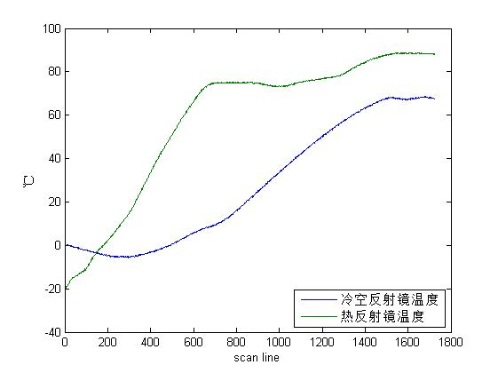
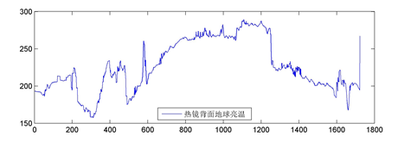
Warm Target correction : Error Source 2
The parameters that affect scale factors(Gain)
  Temperature of Receiver (Parameter 1);
  Warm/cold reflectors emission(Parameter 2);
  Back lobe of warm reflector(Parameter 3).
Sudden change Only appear on back lobe of warm reflector.
P1
P2
P3

Slide 11
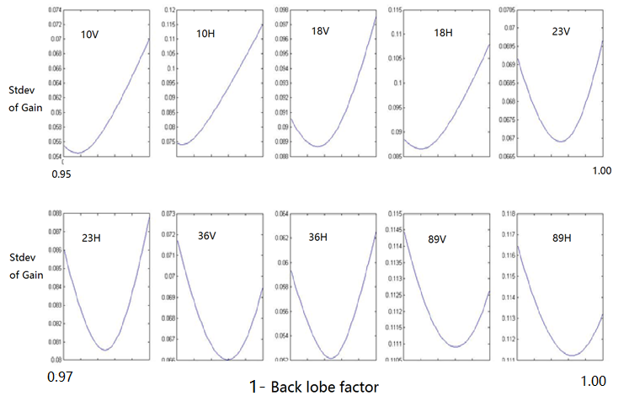
Warm Target correction : Error Source 2

Slide 12
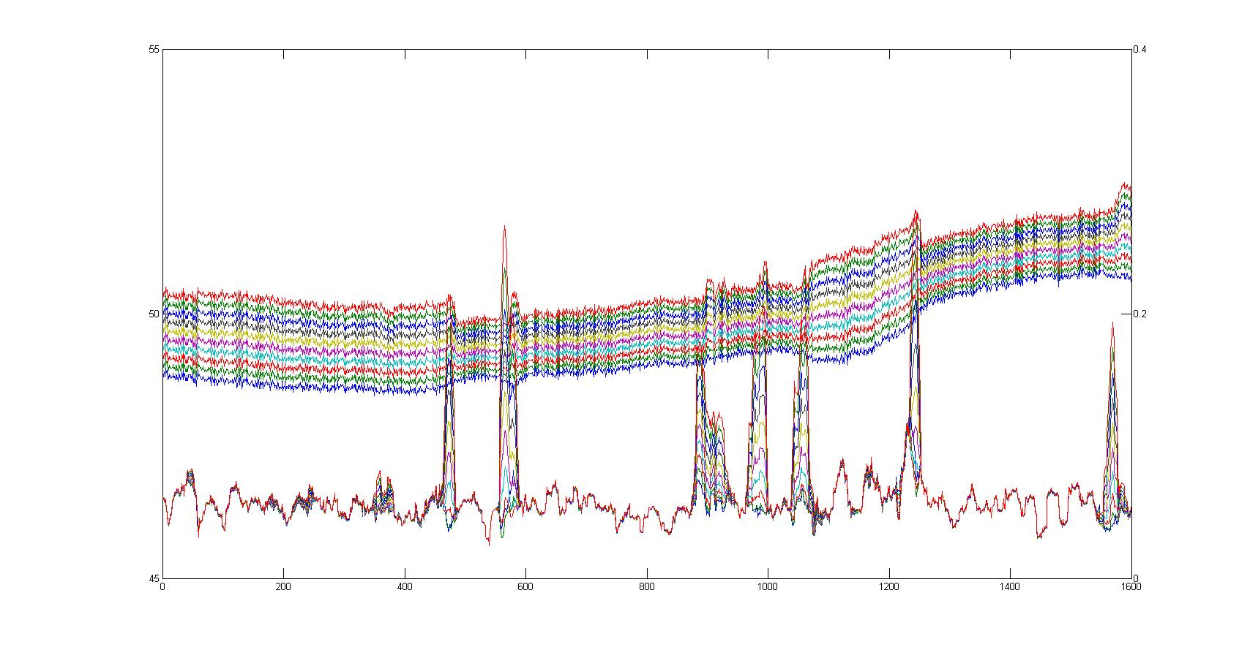
Warm Target correction : Error Source 2
Different Color: Back lobe factors
Up: Gain
Down: Stdev of Gain

Slide 13
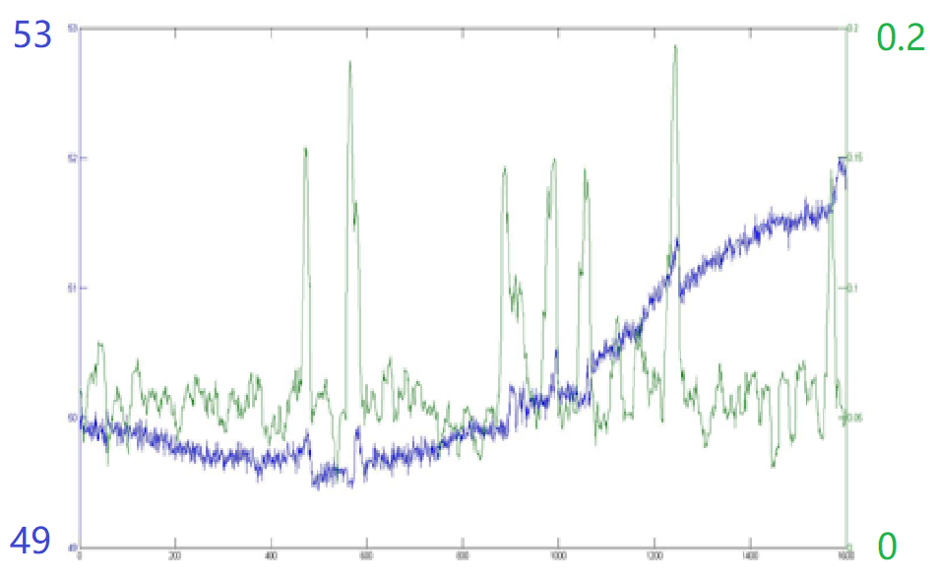
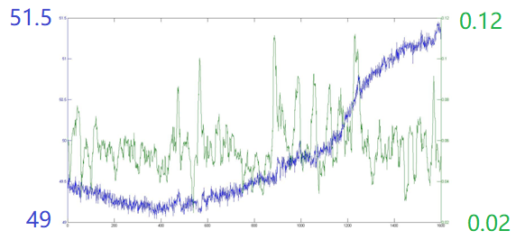
Warm Target correction : Error Source 2
Gain
Stdev of Gain
Before
Gain
Stdev of Gain
After

Slide 14
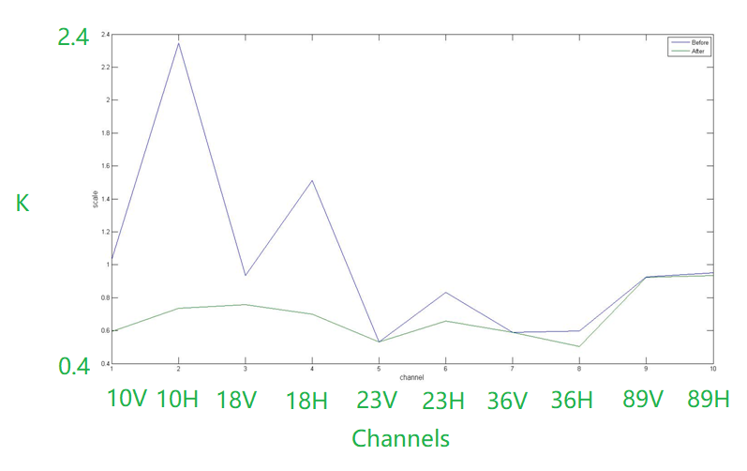
Warm Target correction : Error Source 2
NeDT(total orbit data)

Slide 15
Reflector Correction
SSMIS
MWRI
19V Channel

Slide 16
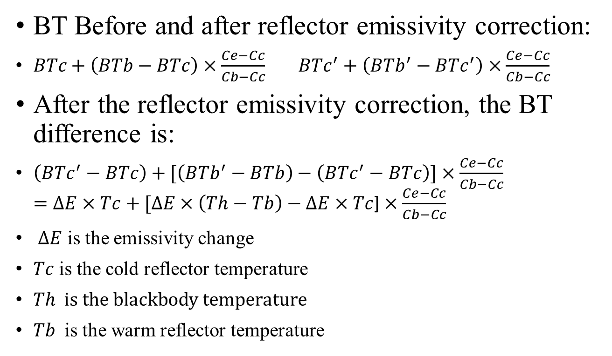
Warm/cold reflector emission
BT Before and after reflector emissivity correction:
$BTc+\left(BTb−BTc\right)×\frac{Ce−Cc}{Cb−Cc} BTc^{′}+\left(BTb^{′}−BTc^{′}\right)×\frac{Ce−Cc}{Cb−Cc}$
After the reflector emissivity correction, the BT difference is:
$\left(BTc^{′}−BTc\right)+[\left(BTb^{′}−BTb\right)−\left(BTc^{′}−BTc\right)]$ $×\frac{Ce−Cc}{Cb−Cc}$
$=∆E×Tc+[∆E×\left(Th−Tb\right)−∆E×Tc$] $×\frac{Ce−Cc}{Cb−Cc}$
$∆E$ is the emissivity change
$Tc$ is the cold reflector temperature
$Th is the blackbody temperature$
$Tb$ is the warm reflector temperature

Slide 17
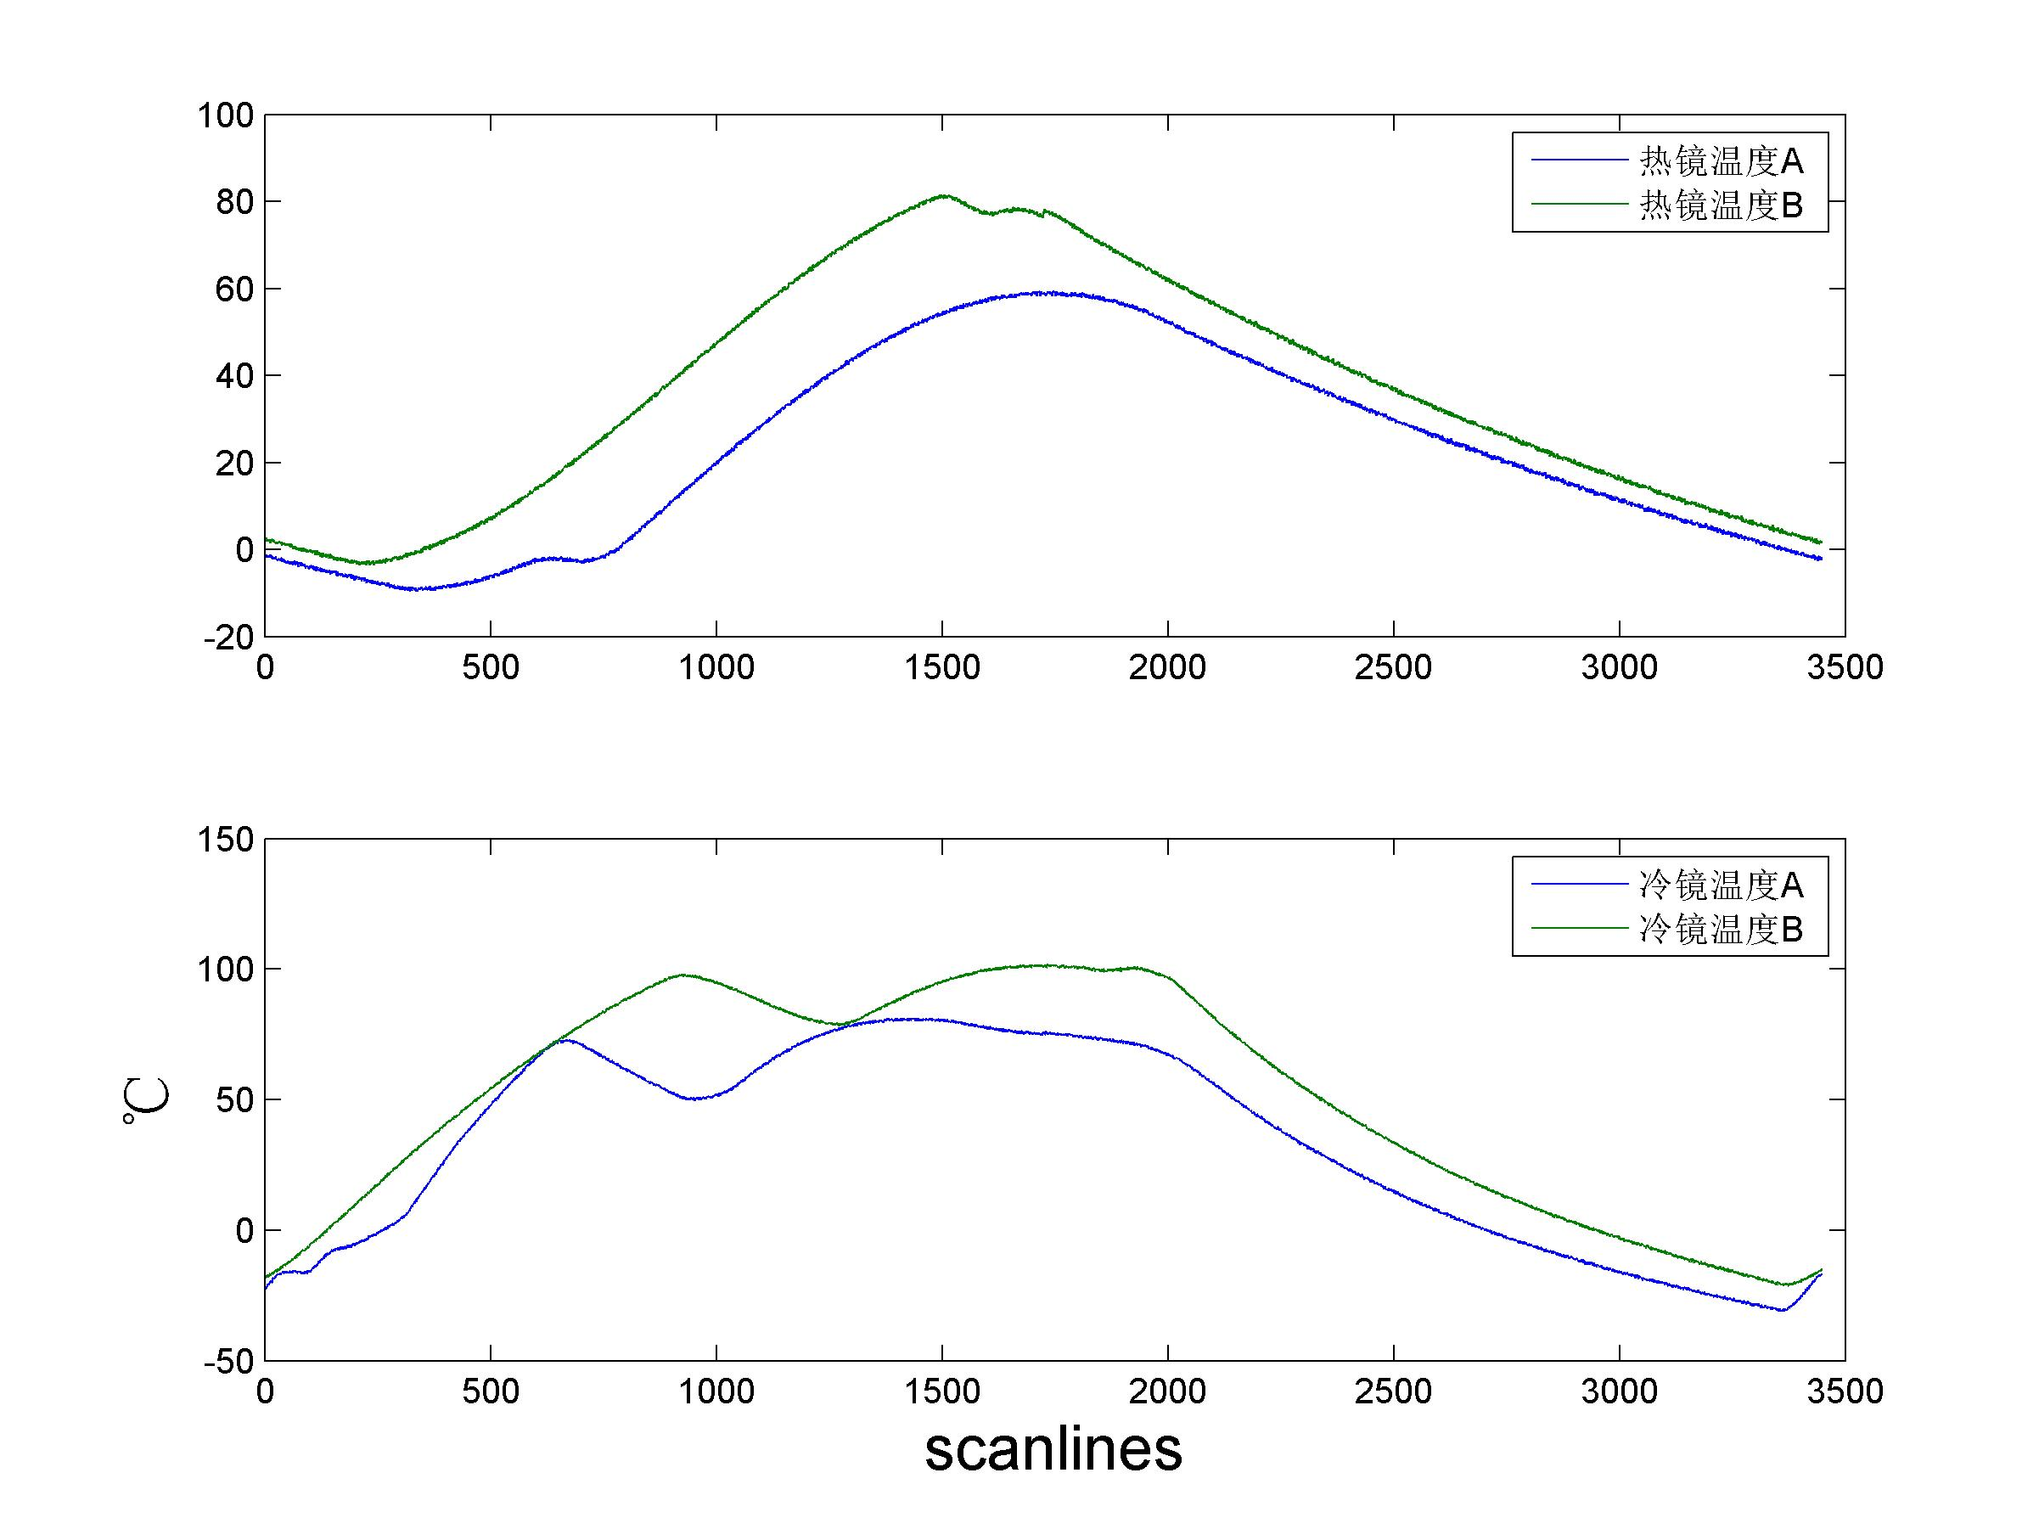


降轨
升轨
降轨
升轨

Slide 18
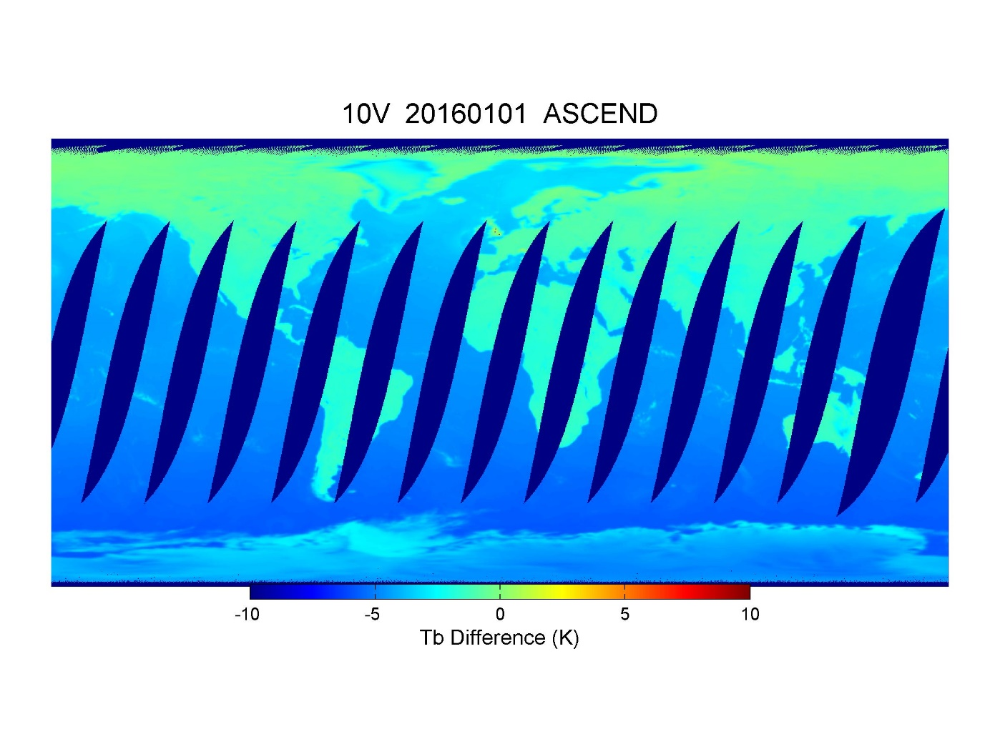
Change emissivity from 0.9996 to 0.97

Slide 19
Warm/cold reflector emission
“Real” BT
MWRI BT
nonlinear
Back lobe
Ascending/Descending Bias =warm reflector emission+cold reflector emission

Slide 20
Warm/cold reflector emission(Emi V1.0)
b
Y
X1
X2

Slide 21
Warm/cold reflector emission(Emi V 2.0)
Consider the material and technology of warm and cold reflectors, only emissivity of warm reflector could be changed on orbit (or larger than the aluminum emissivity in the very beginning).
 | Ɛ of pure aluminum | Tested Ɛ (cold sky mirror)
10.65 GHz | 0.00036 | 0.00036
18.7 GHz | 0.00047 | 0.00048
23.8 GHz | 0.00053 | 0.00054
36.5 GHz | 0.00066 | 0.00067
89 GHz | 0.00103 | 0.00104
For “real” BT, b should be 0

Slide 22
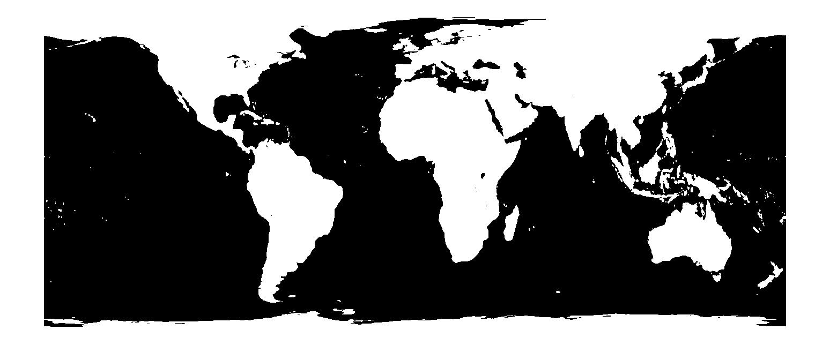
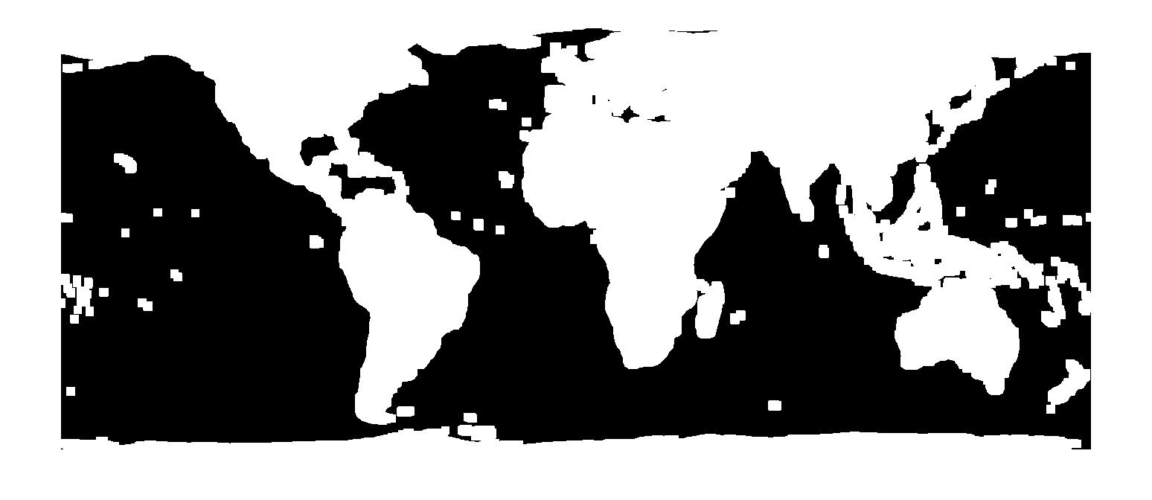
Coast Buffer and Scatter filter (Emi V 2.0)
Scatter Filter
37V-37H>50 K
37V>19V
19H<185 K
37H<210 K
89V-19V>10 K
89H-19H>30 K
89V>23V
89V>37V
89H-37H>10 K
Coast Buffer

Slide 23
10 Channels’ Regression
Warm reflector emissivity
Channel | 10.65 | 18.7 | 23.8 | 36.5 | 89
V H | 0.0434 0.0875 | 0.0503 0.0707 | 0.0389 0.0541 | 0.0437 0.0615 | 0.0342 0.0406
Ascending/Descending Bias
 | Channel | 10.65 V | 10.65 H | 18.7 V | 18.7 H | 23.8 V | 23.8 H | 36.5 V | 36.5 H | 89 V | 89 H
A/D bias (K) | before Correction | 1.75 | 1.78 | 2.31 | 2.10 | 2.10 | 2.24 | 2.26 | 2.29 | 2.17 | 2.27
 | after correction | -0.004 | -0.008 | -0.008 | -0.007 | -0.008 | -0.006 | -0.004 | -0.001 | -0.008 | -0.014

Slide 24
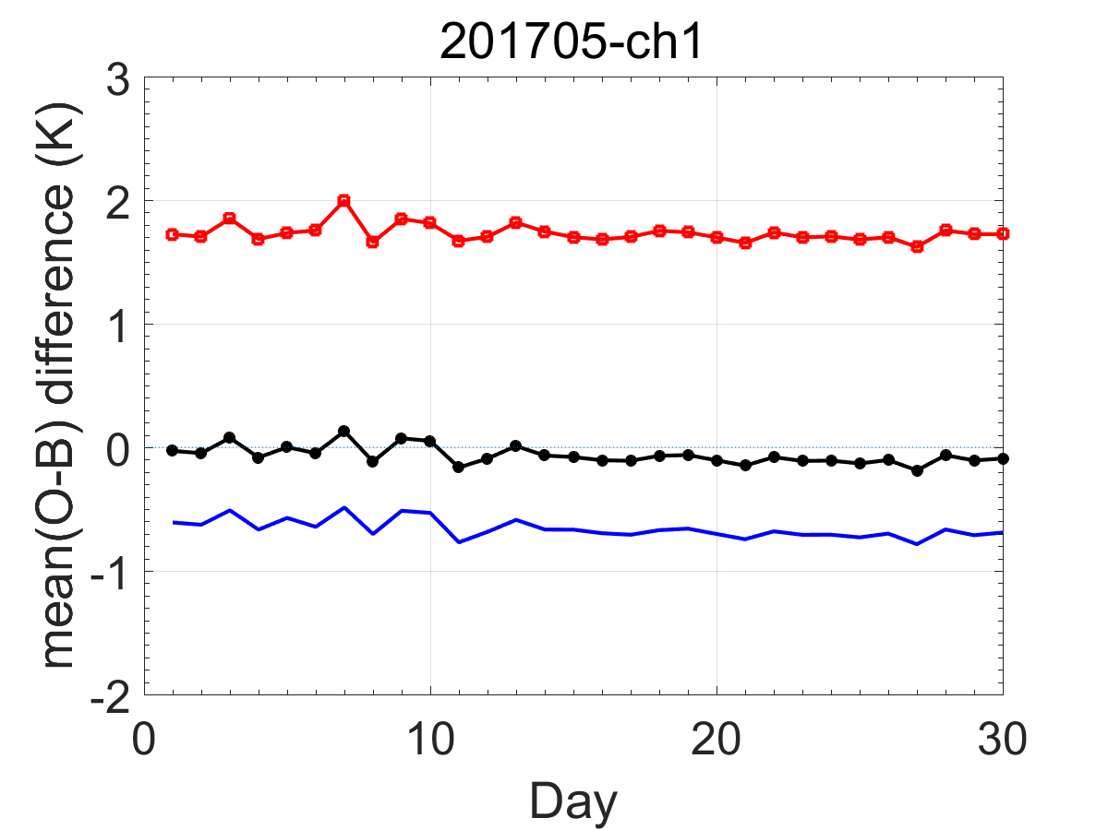
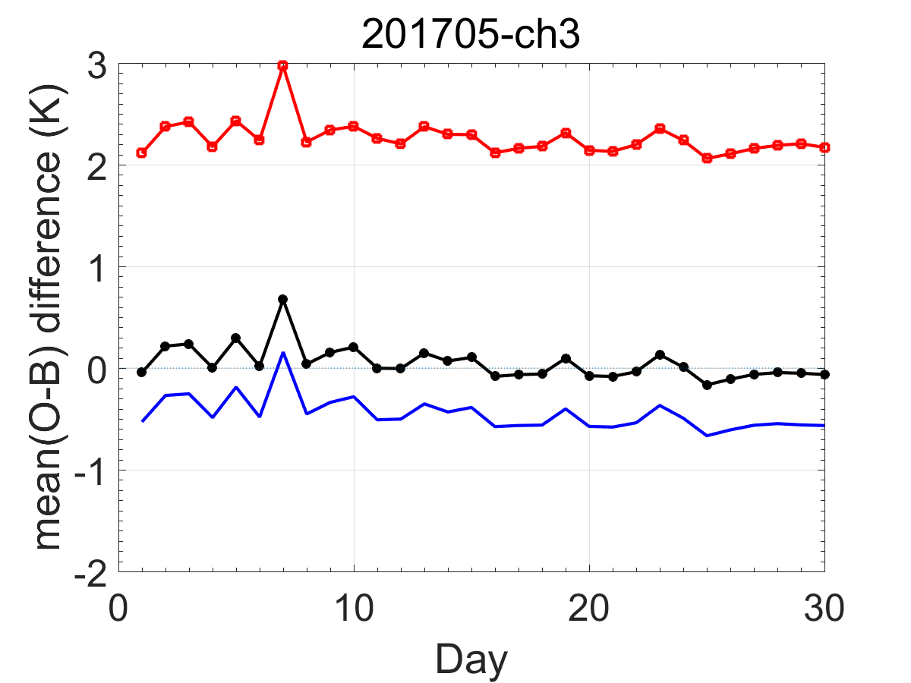
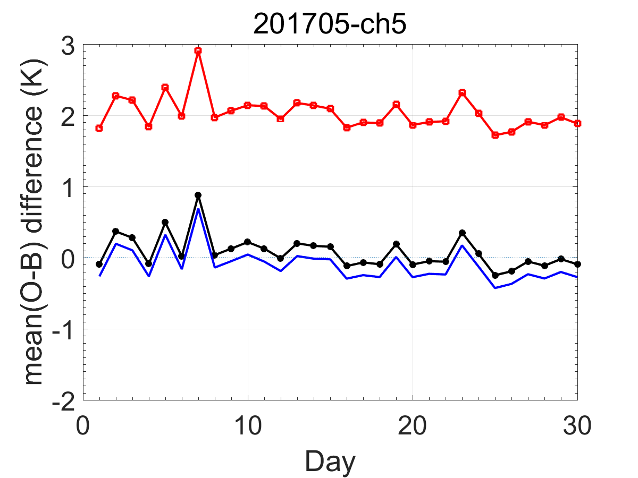
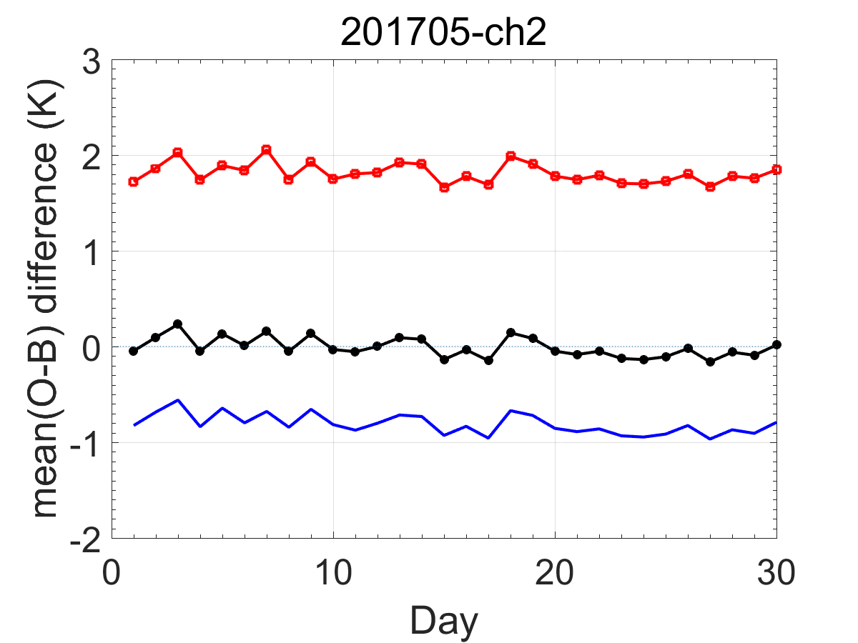
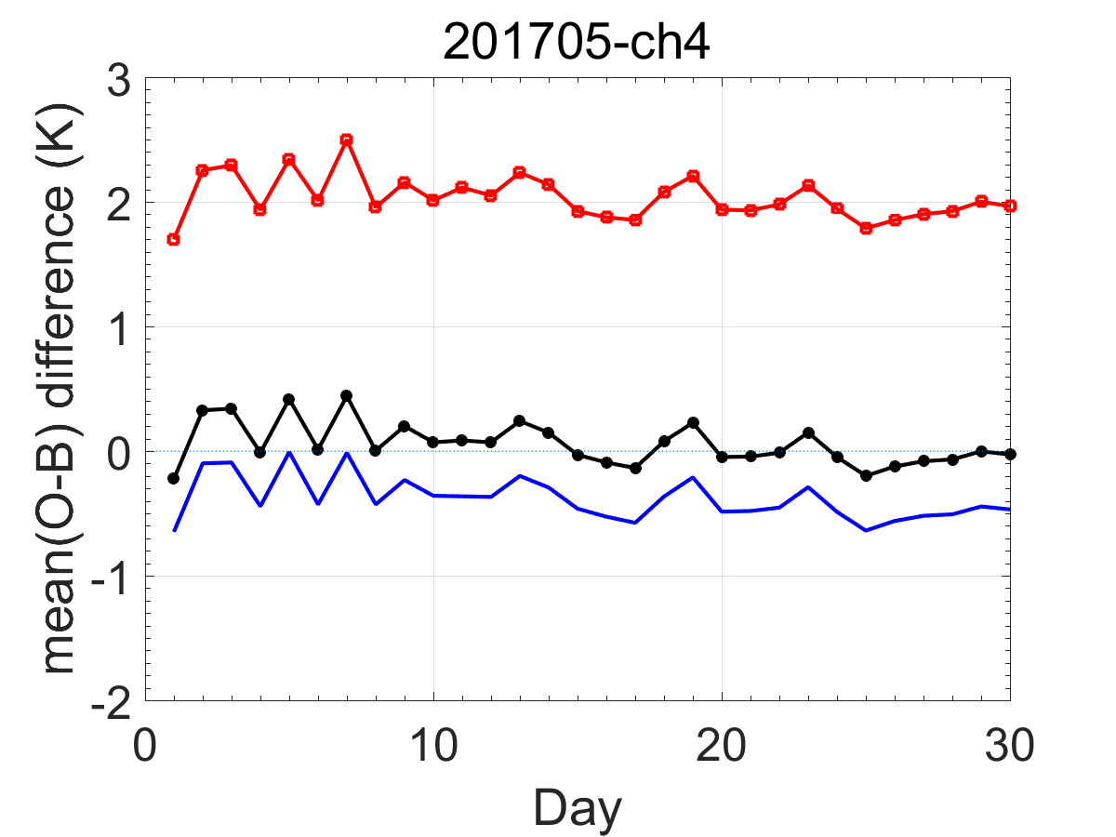
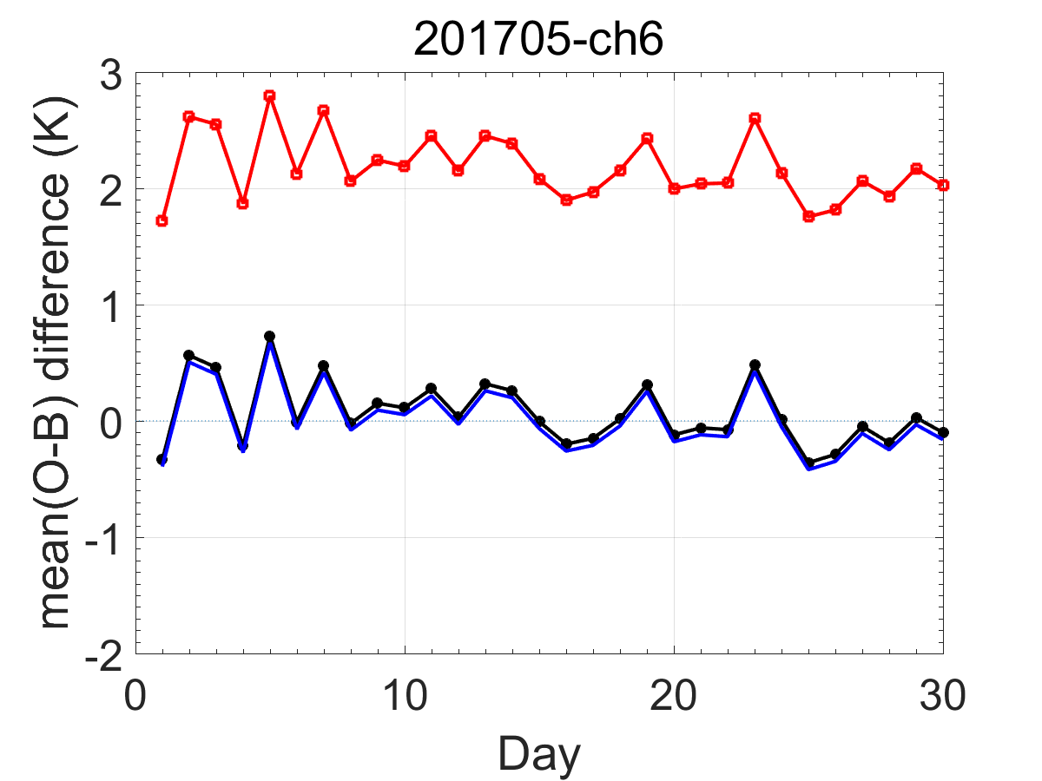
Distribution of A/D Bias
FY-3C Bias
FY-3C Emi V 2.0
FY-3C Emi V 1.0

Slide 25
Conclusion
After the Warm Target correction, stability of the Gains of MWRI’s 10 channels are significant improved.
Reflector correction reduced the ascending/descending Bias from 1~2K to less than 0.1K.

Slide 26
Thank You for your attention!

