Slide 1
Development and Standardization of the Guidelines for Prelaunch Calibration of Microwave Sensors –Perspective of the CEOS WGCV
Xiaolong Dong, Chair of MSSG, CEOS WGCV
Zhenzhang Wang, Xiyu Xu
CAS Key Laboratory of Microwave Remote Sensing
National Space Science Center
Chinese Academy of Sciences
(MiRS, NSSC, CAS)
Emails: dongxiaolong@mirslab.cn, wangzhenzhan@mirslab.cn, xuxiyu@mirslab.cn

Slide 2
OUTLINE
1. A brief introduction of Microwave Sensors Subgroup (MSSG) of CEOS Working Group on Calibration and Validation (WGCV)
2. Standardization of the Guidelines for Prelaunch Calibration of Passive Microwave Sensors
3. Status for ECV of Ocean Surface Wind Vector & Ocean Surface Topography
4. Summary & Prospectives

Slide 3
1. Microwave Sensors Subgroup (MSSG) of CEOS Working Group on Calibration and Validation (WGCV) ① Missions & Objectives of MSSG
Missions:
The mission of the Microwave Sensors subgroup of CEOS Working Group on Calibration and Validation is to foster high quality calibration and validation of microwave sensors for remote sensing purposes. These include both active and passive types, airborne and spaceborne sensors.
Objectives
Facilitate international cooperation and co-ordination in microwave sensor calibration / validation activities by sharing information on sensor development and field campaigns.
Promote accurate calibration and validation of microwave sensors, through standardization of terminology and measurement practices.
Provide a forum for discussion of current issues and for exchange of technical information on evolving technologies related to microwave sensor calibration / validation.
Provide calibration/validation support to CEOS virtual constellations and data application groups/communities by coordination of reference sites for both passive and active microwave sensors, and standardization of quality assurance of microwave remote sensing data.

Slide 4
② Coverage
All EO sensors operated in microwave spectrum, except SAR
Works currently focuses on:
Microwave Radiometers (sounders, imagers)
Radar Scatterometers (surface and volume)
Radar Altimeters (nadir and wide swath)
With current emphasis on
Microwave Radiometers (Passive Microwave)
Radar Scatterometers (Ocean and land surface)
Radar altimeters (Ocean, coastal, in-land water, ...)

Slide 5
Characteristics of Microwave Sensors
Relatively low spatial resolution (km, tens of km, hundreds of km) for atmospheric, oceanic, large-scale terrestrial environmental applications
Data dependent on sensor and processing (model, retrieval, algorithm, cal/val)
Importance of processing and quality control

Slide 6
③ Requirements and Challenges
Climate and global change applications
Higher requirements, especially for climate and global change applications: sensitivity, accuracy, stability, traceability;
Cross-calibration requirements of sensors flown for different missions;
No traceable standards available for microwave sensors;
New developed sensors
Polarized radiometers and scatterometers
Interferometric synthetic aperture radiometers
Scatterometers for terrestrial applications
Wide swath and SAR altimeters…

Slide 7
④ Priorities and focuses
Objectives
Support Climate Data Record (CDR) from microwave;
Support CEOS Virtual Constellations (VCs);
Benefit member agencies and communities
(where support to GSICS is an important task from the strategy of CEOS)
Priorities and focuses
MWR & SCAT Level 1 data
Brightness temperature for MW radiometer
Backscattering coefficient for radar scatterometer
MWR & ALT standards
MWR Onboard calibrator (noise source, RAM blackbody)
Prelaunch measurement and characterization
GNSS-buoy references
Models and algorithms

Slide 8
⑤ Identification of calibration uncertainty and bias of MWR for CDR
Requirements from CDR
Long-term stability
Consistency between different instruments
Precision requirements
Focuses
Procedure and processing of calibration
Stability and characterization of On-board calibrators
Prelaunch calibration requirements
Progresses
Standardization of the Guidelines for Prelaunch Calibration of Passive Microwave Sensors
Key topics identified
Antenna characterization
On-board calibrator characterization
Near-field characterization for emission and effect from satellite body structure
Status of ECV of Ocean Surface Wind Vector
Status of ECV of Sea Level

Slide 9
2. Standardization of the Guidelines for Prelaunch Calibration of Passive Microwave Sensors
Requirements and Necessity
Data product, especially Brightness Temperature, directly dependent on calibration processing, which uses the prelaunch calibration
Both NWP and climate use of passive microwave data requires Inter-satellite/instrument consistency
Standardization of the guidelines (procedure and processing) for prelaunch calibration becomes an important task
Progresses
A project accepted by ISO-TC 211 WG-6 for future standard/specification
A draft had been proposed
More participants and supports from international community are expected

Slide 10
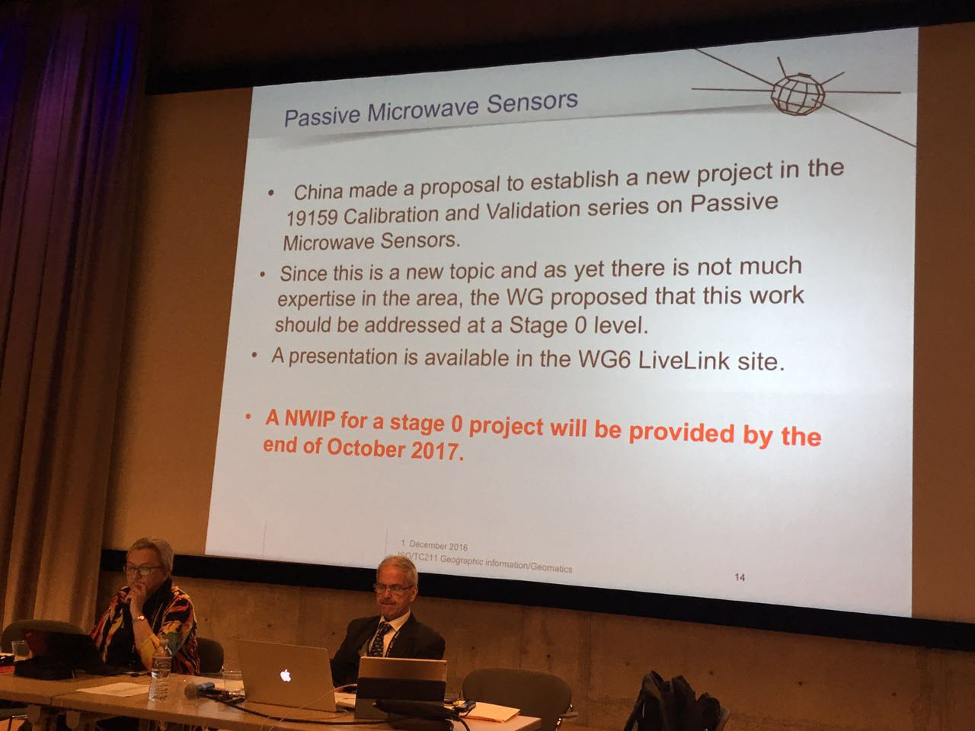
ISO/TC-211 for ISO/TS-19159
ISO/TS-19159: Geographic information -- Calibration and validation of remote sensing imagery sensors and data
19159-1:2014, Part 1: Optical Sensors
19159-2:2016, Part 2: Lidar
19159-3 (under development), Part 3: SAR/InSAR
19159-4 (proposed), Part 4: passive microwave
Proposed in Nov 2016 to ISO-TC211
Accepted by ISO-TC 211 as an future project in December 2017

Slide 11
Proposed Scope
This Technical Specification defines the calibration of space-borne passive microwave radiometers and validation of space-borne passive microwave radiometers calibration information. This Technical Specification addresses earth based remote sensing. The specified sensors include space-borne passive microwave remote sensing sensors. This Technical Specification also addresses the metadata related to calibration and validation.
This Technical Specification is Part 5 of a series of specifications. Part 1 addresses the optical sensors. Part 2 addresses the airborne lidar (light detection and ranging) sensors. Part 3 addresses the SAR/InSAR sensors.

Slide 12
General Space-borne passive microwave radiometer calibration model and process
6.1 on-orbit calibration method and model
6.1.1 Flow chart
6.1.2 deviation of brightness temperature for cosmic
6.1.3 deviation of brightness temperature for high-temperature target
6.1.4 effectiveness of voltage for cosmic
6.1.5 effectiveness of voltage for high- temperature target
6.1.6 nonlinear parameter
6.1.7 linearity
6.1.8 sensitivity
6.1.9 calibration accuracy
6.1.10 calibration of platinum resistance temperature
6.2 Antenna calibration methods and models
6.2.1 principle
6.2.2 antenna pattern
6.2.3 Standing wave
6.2.4 Main beam efficiency
6.2.5 Antenna side lobes
6.2.6 Cross polarization
6.2.7 Incident angle
6.2.8 Radiation efficiency
6.2.9 bandwidth
6.2.10 Beamwidth

Slide 13
6.3 microwave radaitive transfer model and simulation
6.3.1 integral calculating principle and method
6.3.2absorption coefficient and model: Oxygen, water vapor, nitrogen, other gas, liquid water, cloud ice, cloud cover
6.3.3 channel response function
6.3.4 polarization
6.3.5 antenna temperature
6.3.6 brightness temperature
6.4 contents and methods of calibration/validation
6.4.1 concepts and principles
6.4.2 process
6.4.3 data matching: dataset
6.4.4 cross-calibration: frequency conversion
6.4.5incident angle correction
6.4.6 de-modeling
6.4.7alternative calibration
6.4.8cosmic interference
6.4.9gradient of high-temperature target
6.4.10matching rule
6.4.11validity judgement

Slide 14
Requirements of GSICS-MW community for CAL/VAL of MW sensors and Future Collaboration
Requirements from GSICS-MW (As in July 2016)
Mapping time series of similar sensors but from vastly different heritage (e.g., SSMT2 to AMSU-B) together is of low priority
More precise, longer latency corrections are preferred
It does appear most users would look at time series for global trends (most likely the O₂ & H₂O bands) and use them to derive geophysical parameters (most likely window & H₂O bands)
The average desired accuracy of the corrections was on the order of 0.4 K (slightly less for the O₂ bands)
Future Collaborations
Identify requirement for prelaunch and post launch calibration for climate applications
How the pre-launch calibration & mission planning can support climate applications.
Some of the inter-satellite re-analysis/re-calibration algorithm can be recommended.
Participation and support for future standardization project

Slide 15
3. Status for ECV of Ocean Surface Wind Vector & Ocean Surface Topography
Ocean surface wind vector and ocean surface topography are Essential Climate Variables (ECVs). However, a manifold of calibration procedures exists for microwave sensors, both on the level of the microwave measurements (L1) and winds / sea level (L2) or higher level products.
Different producers use different procedures and standardization is far from optimal. This results in inhomogeneous Climate Data Records (CDR) to the detriment of climate applications, where the CDRs are used for climate analyses.
While satellite agencies are applauded for planning new scatterometer missions, they may moreover support the establishment of uniform CDRs.
Coastal and in-land water altimetry have moved to the center of the stage, consistent processing, although difficult, should be considered.
It would be a main step forward, when CDR producers could easily interchange their calibration procedures, data and results, as well as the processors for L1 and L2 production to establish a higher level of communication between experts.

Slide 16
To establish such intense collaboration, resources would need to be made available, in particular by the agencies participating in CEOS.
Such action would in particular support the goals of the CEOS Ocean Surface Vector Winds Virtual Constellation (OSVW VC) & Ocean Surface Topography Virtual Constellation (OST-VC).
In line with these CEOS VC objectives, the International Ocean Vector Wind Science Team (IOVWST) set up a working group on CDR generation among different wind data producers and scientists.
However, while these producers are funded by the diverse satellite agencies to establish CDRs, they are usually not funded to standardize and intercalibrate their products, but which would be much for their user’s convenience and the global users of the constellation data.

Slide 17
4. Summary & Prospectives
CEOS WGCV MSSG works on the best-practice for calibration/validation of microwave sensors
Focuses on L1 data of passive and active microwave sensors and techniques for new sensors
Support and collaboration to GSICS is a strategic task from CEOS

Slide 18
Future Workplan
MW radiometer
Support and participation for the ISO TS19159-4 from agencies.
Collaboration on mission data for L-band radiometry.
Potential of microwave sensors to retrieve haze pollution.
MW scatterometer
Focused group for L1 and L2 data guidelines.
Coordinates resources for inter-comparison/calibration guidelines.
Radar altimeter
Standardization of pre-launch instrument test and calibration.
Altimetry calibration field construction guidelines.
Inter-calibration of altimetric missions of different orbit configuration.

Slide 19
Thanks for your attention!!!
Merci pour votre attention!!!

