Slide 1
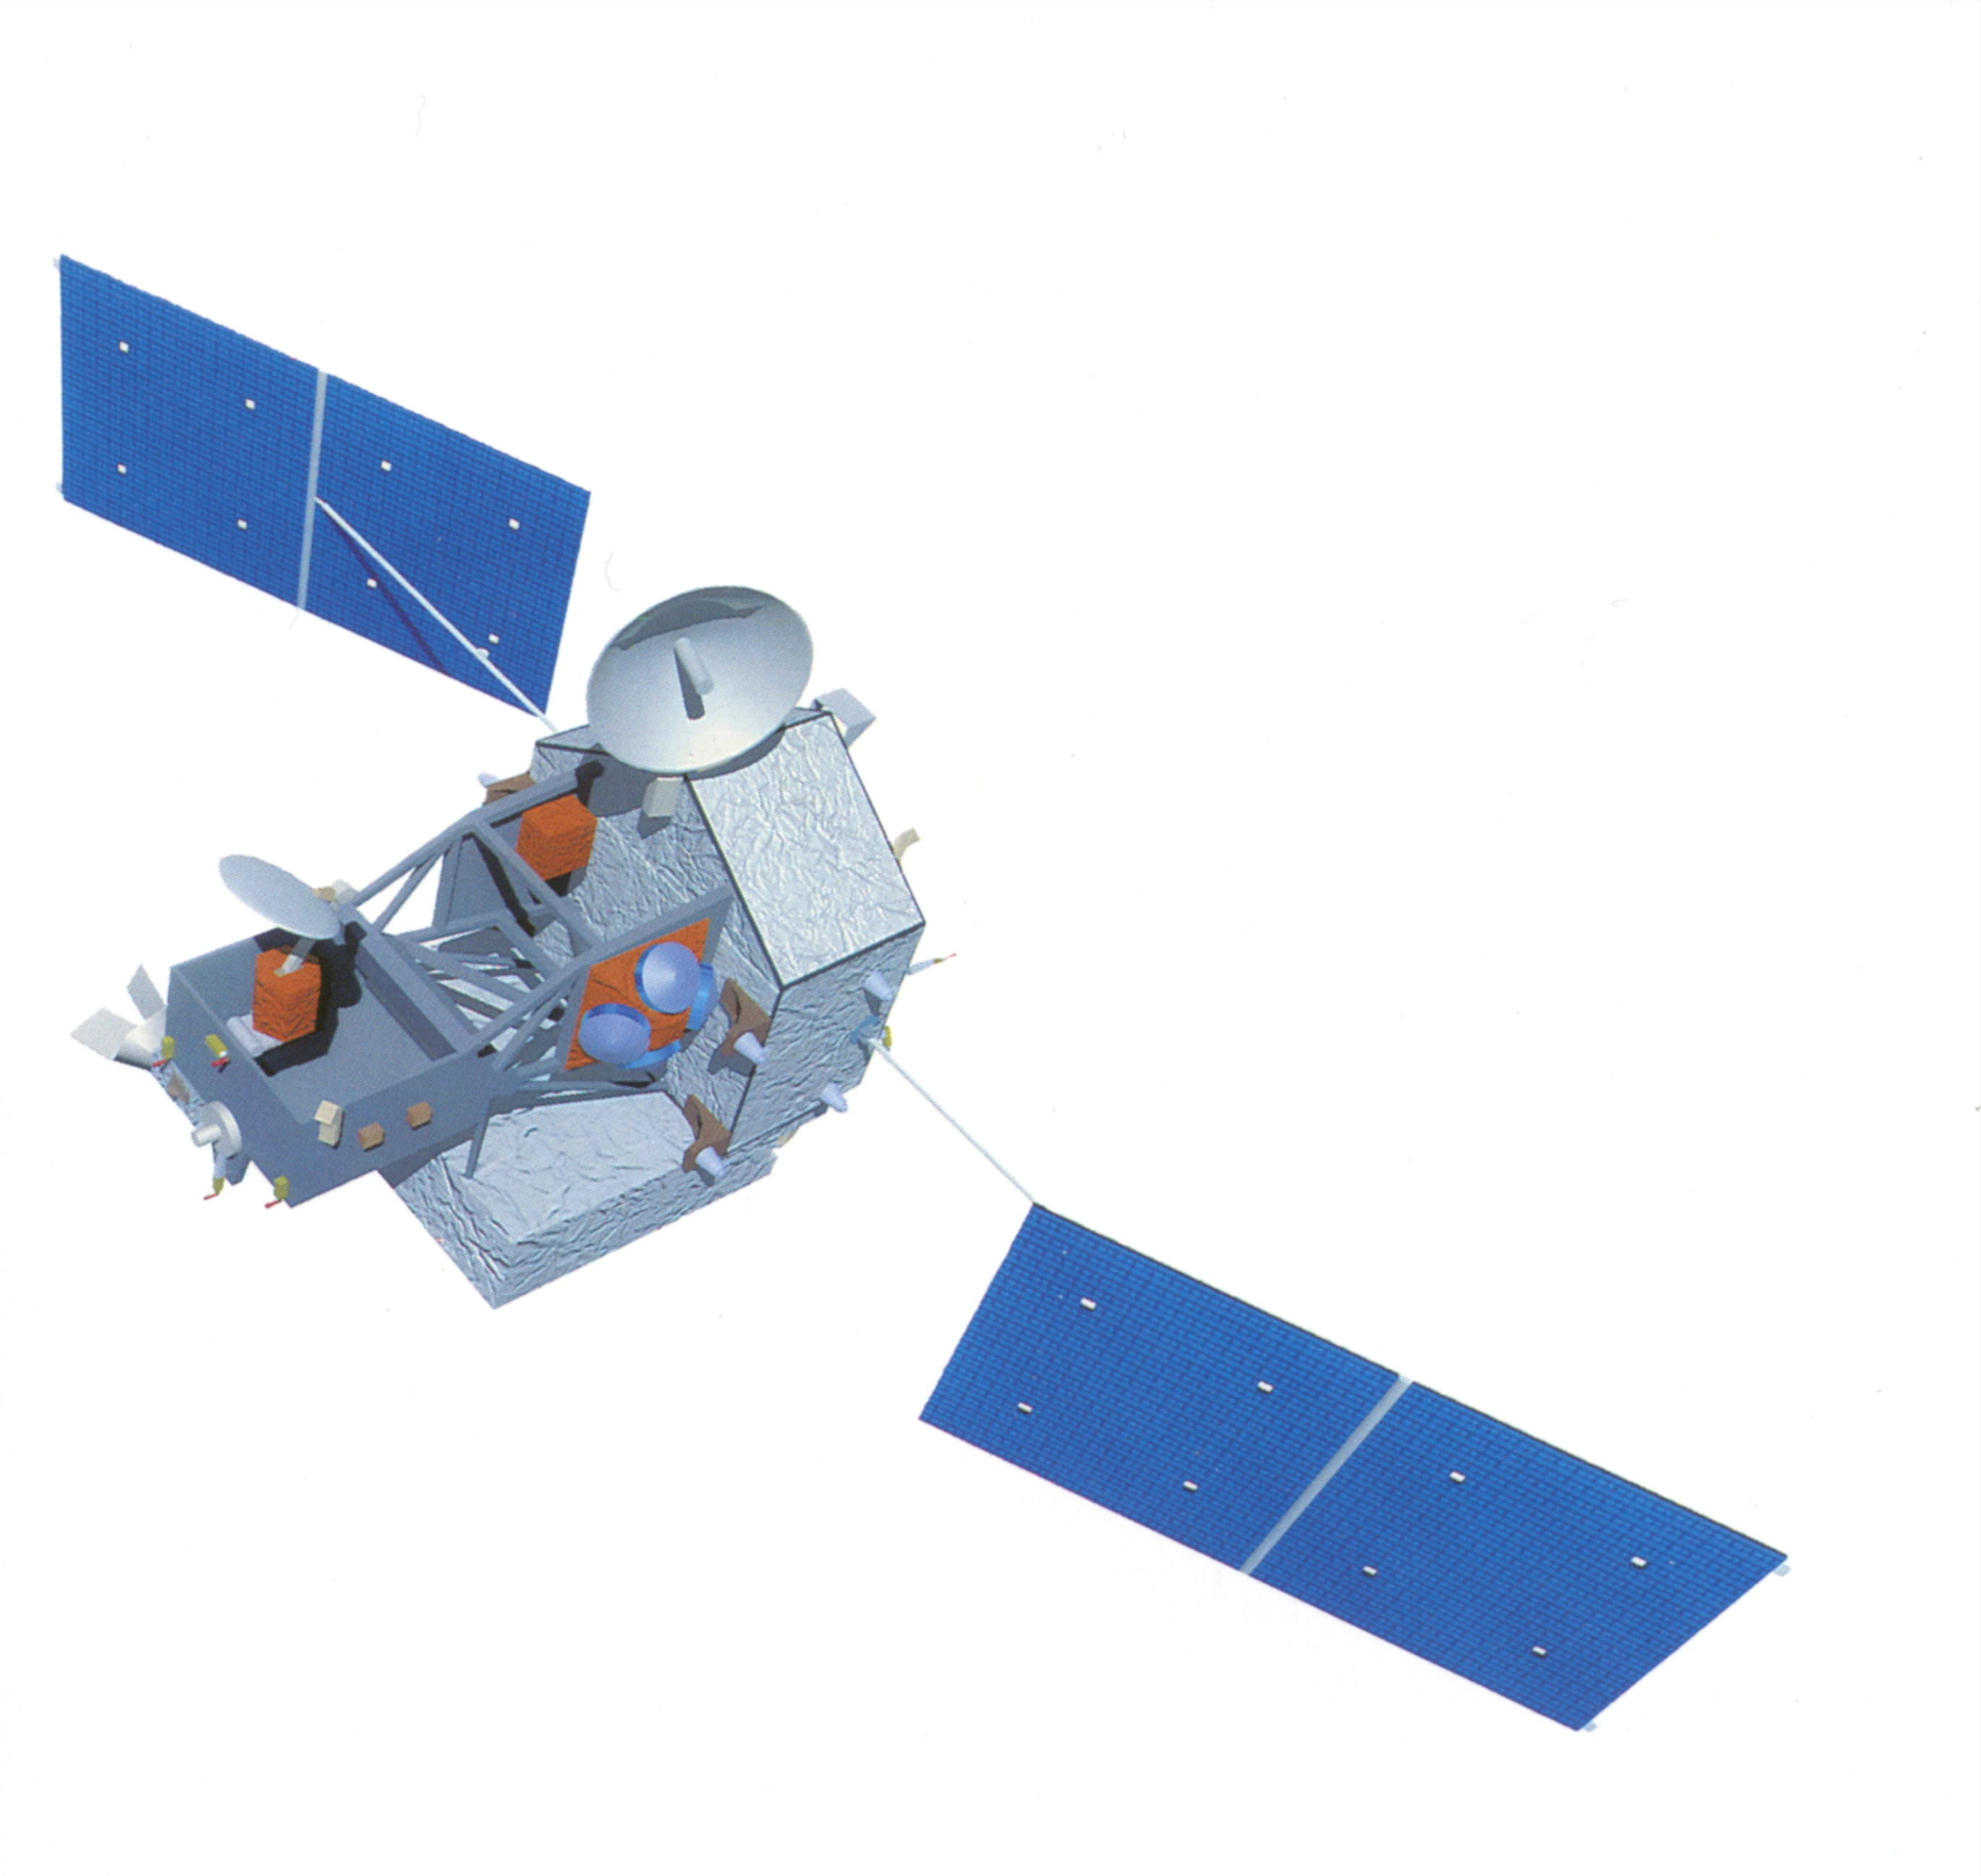
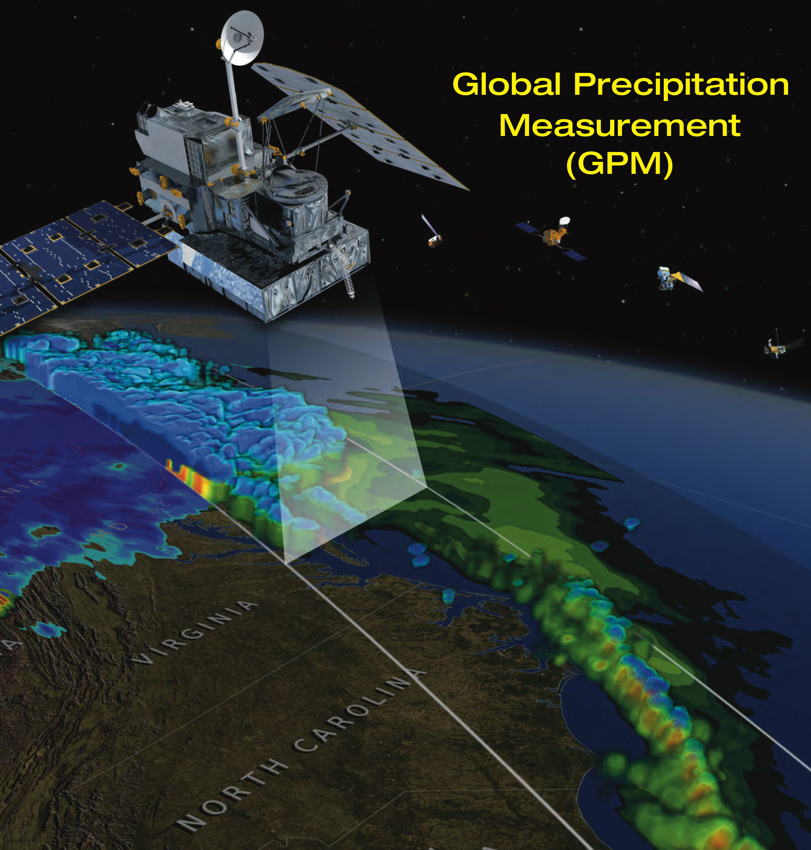
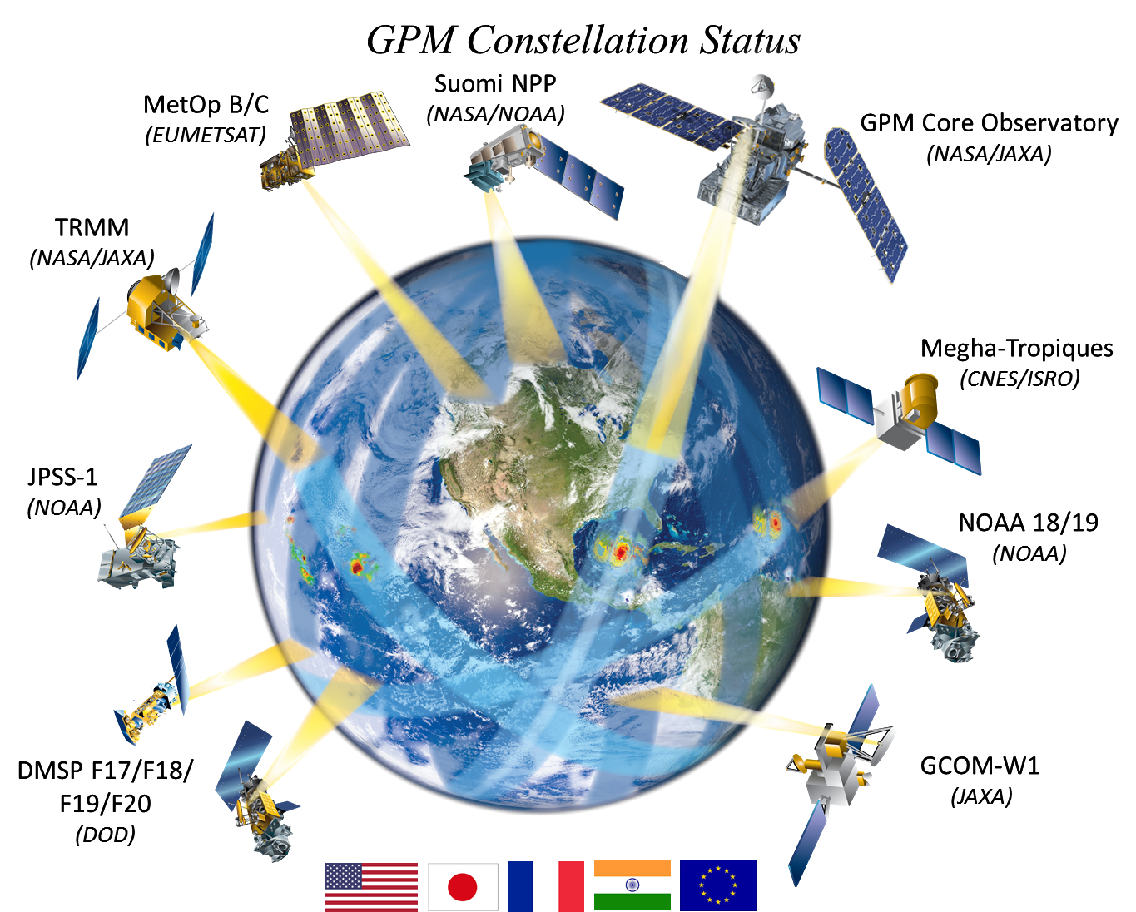
An Update on the Activities of the Precipitation Measurement Missions (i.e. TRMM/GPM) XCAL Team
PMM XCAL Team
Wesley Berg, Rachael Kroodsma, Faisal Alquaeid, Steve Bilanow, Ruiyao Chen, Joyce Chou, Saswati Datta, David Draper, Hamideh Ebrahimi, Spencer Farrar, Yimin Ji, Linwood Jones, Darren McKague, Erich Stocker, Tom Wilheit et al.
TRMM
GPM
Constellation

Slide 2
PMM XCAL Team
The XCAL team is a working group within the Precipitation Measurement Missions (i.e. TRMM/GPM) science team responsible for the Level 1C intercalibrated brightness temperature files used as input to the operational precipitation retrieval algorithm for available constellation microwave radiometers.
Priorities: Focus on microwave sensors/channels used for precipitation retrievals.
Conical window channel imagers
Cross-track water vapor sounders
Temperature sounding instruments/channels not used!
Activities: Following launch of the GPM core satellite in Feb 2014 (Complete, In Progress)
Assess and improve calibration reference sensor: GPM GMI V05
Intercalibrate the GPM constellation radiometers
Update the TRMM TMI Calibration and intercalibrate to GMI V05
Intercalibrate the TRMM constellation radiometers
Extend radiometer constellation back to DMSP F08 SSM/I (July 1987)
Incorporate new (NOAA-20 ATMS, MetOp-C MHS) and additional radiometers (e.g. WindSat)
Other (assess uncertainties, documentation, improve techniques, RFI flagging, …)

Slide 3
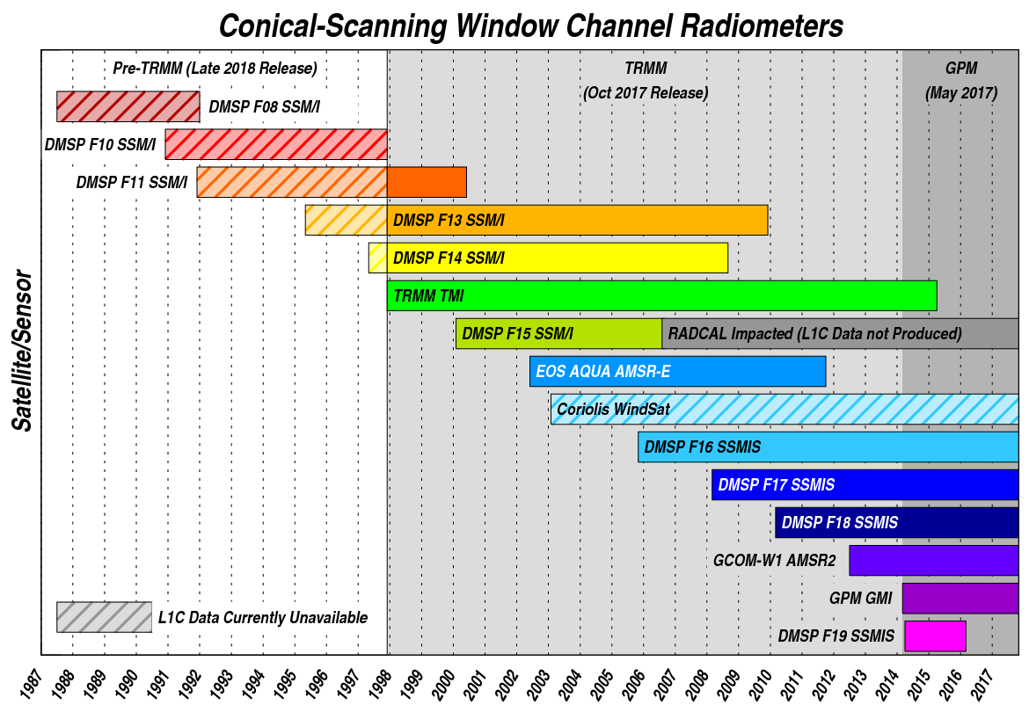
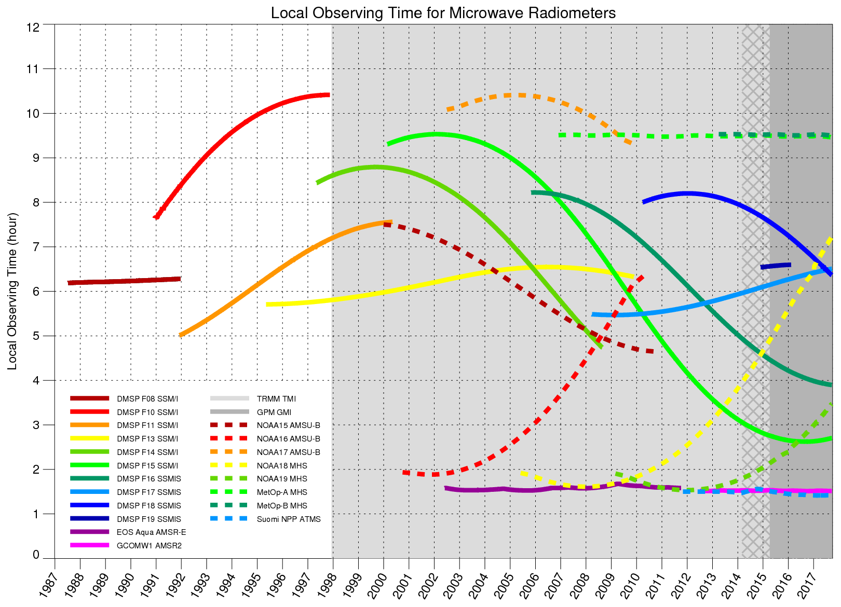
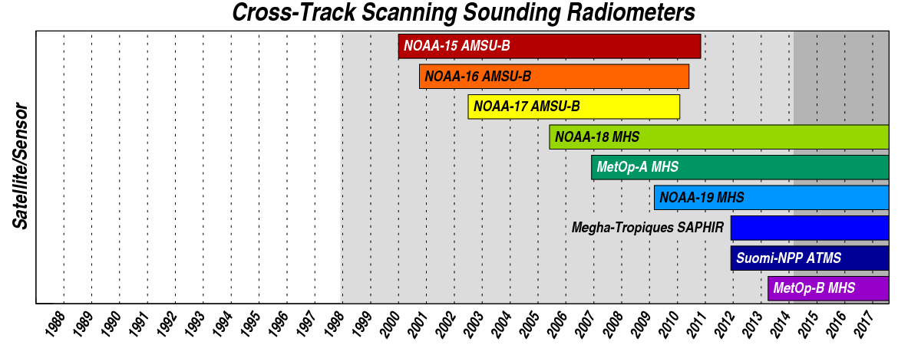
Constellation Radiometers
Intercalibrated L1C Data (available from https://pps.gsfc.nasa.gov)
GPM Era (V05: Released May 2017)
TRMM Era (V05: Released Oct 2017)
Pre-TRMM Era (Late 2018 Release)
Future/other radiometers
WindSat
NOAA-20 ATMS (~Mid 2018)
MetOp-C MHS (Sep 2018 launch)
Notes:
Current and planned availability of intercalibrated Level 1C data

Slide 4
Development of a Long-term Intercalibrated Level 1C Brightness Temperature Dataset
Developed a high-quality TMI/GMI microwave reference dataset
Updated GPM GMI Corrections for use as calibration reference (GMI V05)
Updated calibration corrections for TRMM TMI V8 Tb dataset
Updated spacecraft attitude (using PR roll estimates, sun-sensor, and gyro data)
Updated view-angle offsets (roll, pitch, ½ cone, start angle, timing)
Updated cross-track bias correction (using both cold and warm scene)
RFI in cold reflector correction (new)
TMI antenna-pattern correction (updated)
TMI reflector emisivities (updated)
TMI hot-load correction (new)
TMI reflector temperature (updated)
Adjusted TMI calibration to GPM V05 to be consistent with GMI
Note that TMI Level 1C dataset is now identified as GPM V05 (not TRMM V8)
Intercalibrate the constellation radiometers
Developed calibration corrections when possible
Intercalibrated constellation sensors to TMI/GMI reference data record
Extend back to SSM/I on board DMSP F08 (July 1987)

Slide 5
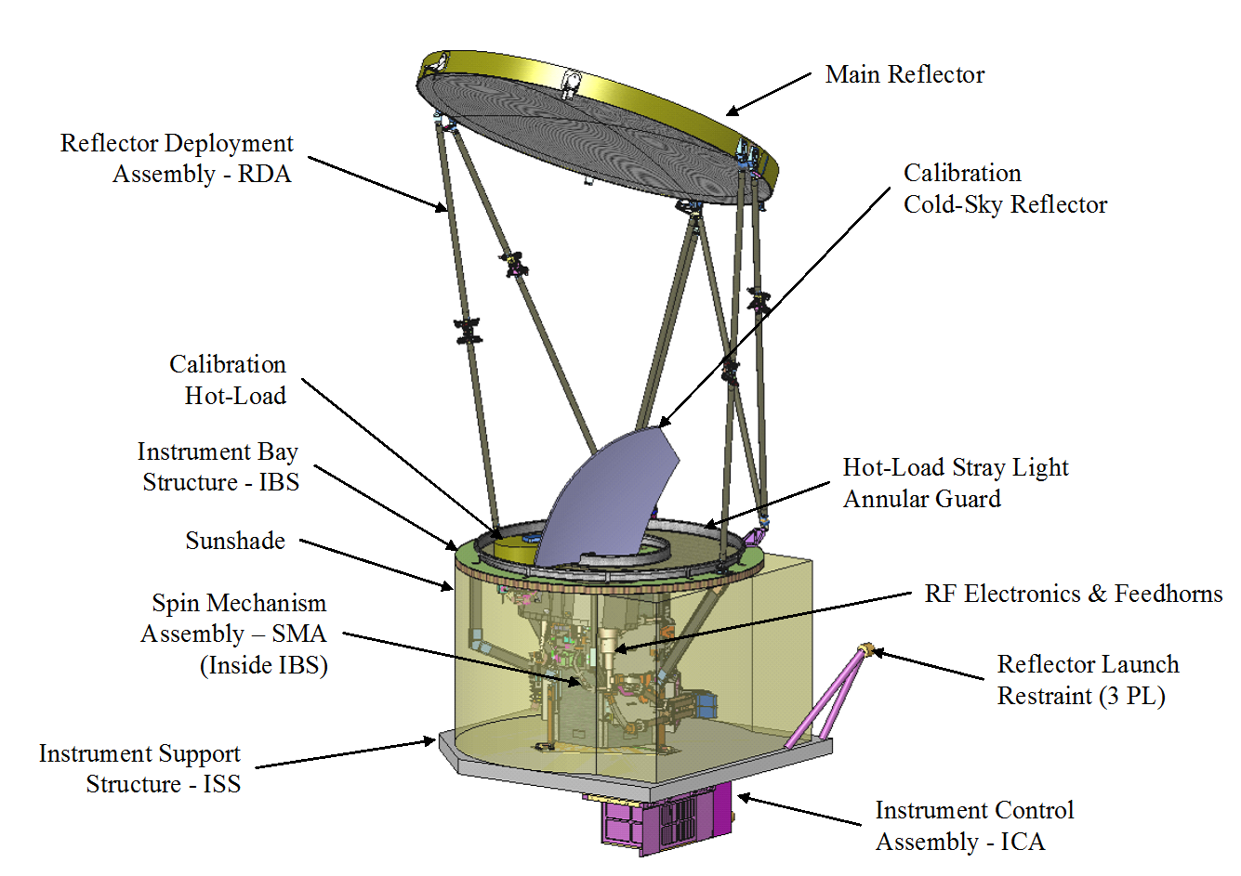
Calibration Reference Sensor: GPM GMI
GMI Specs | 10.65v/h |  | 18.7v/h |  | 23.8v |  | 36.64v/h |  | 89.0v/h |  | 165.5v/h |  | 183+3v | 183+7v
DT x CT Res in km | 32.1x19.4 |  | 18.1x10.9 |  | 16.0x9.7 |  | 15.6x9.4 |  | 7.2x4.4 |  | 6.3x4.4 |  | 5.8x3.8 | 5.8x3.8
Beamwidth (deg) | 1.72 |  | 0.98 |  | 0.85 |  | 0.81 |  | 0.38 |  | 0.37 |  | 0.37 | 0.37
NEDT (K) | 0.96 |  | 0.84 |  | 1.05 |  | 0.65 |  | 0.57 |  | 1.5 |  | 1.5 | 1.5
Beam Efficiency (%) | 91.1 |  | 91.2 |  | 93.0 |  | 97.8 |  | 96.8 |  | 96.5 |  | 95.2 | 95.2
Uncorr Nonlinearity (K) | 0.2 | 0.2 | 0.1 | 0.1 | 0.1 | 0.1 | 0.5 | 0.5 | 0.5 | 0.5 | 0.5 | 0.5 | 0.5 | 0.5
Band Width (MHz) | 100 |  | 200 |  | 400 |  | 1000 |  | 6000 |  | 4000 |  | 3500 | 4500
Feedhorns | 1 |  | 1 |  | 1 |  | 1 |  | 1 |  | 1 |  | 1 | 1
Integration Time (ms) | 3.6 |  | 3.6 |  | 3.6 |  | 3.6 |  | 3.6 |  | 3.6 |  | 3.6 | 3.6
Calibration Summary
Data from a series of on-orbit calibration maneuvers were used to check for calibration anomalies and develop corrections (i.e. magnetic anomalies, spillover corrections etc.)
Changes were made to the spillover corrections for V04 and finalized for V05. Given the limitations of pre-launch measurements this is a likely cause of significant calibration differences between sensors, particularly at lower frequencies.
Calibration corrections are based on data from on-orbit calibration maneuvers and are not dependent on radiative transfer models
Independent comparisons with by both Ball/RSS and XCAL indicate that the GMI calibration is very consistent with clear-sky ocean simulated Tb.
Satellite/Instrument Characteristics
Nominal EIA | 52.8/49.2
Orbit Inclination | 65.0 deg
Local Obs. Time | Variable (Precessing)
Altitude | 407 km
Reflector Size | 1.22 m
Sampling Interval | 13.5 km
Notes:
Specifications for and a short summary of the calibration corrections done for GPM GMI, the constellation calibration reference

Slide 6
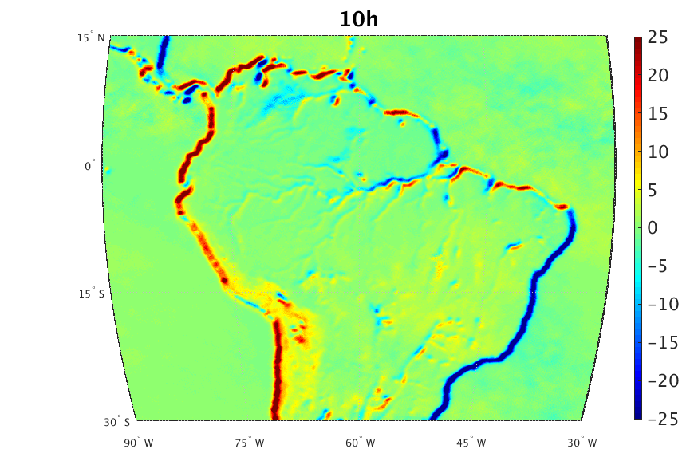
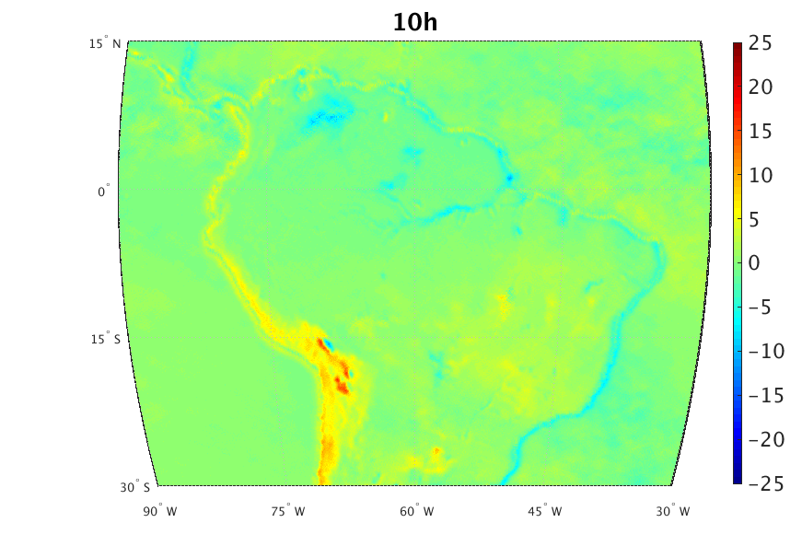
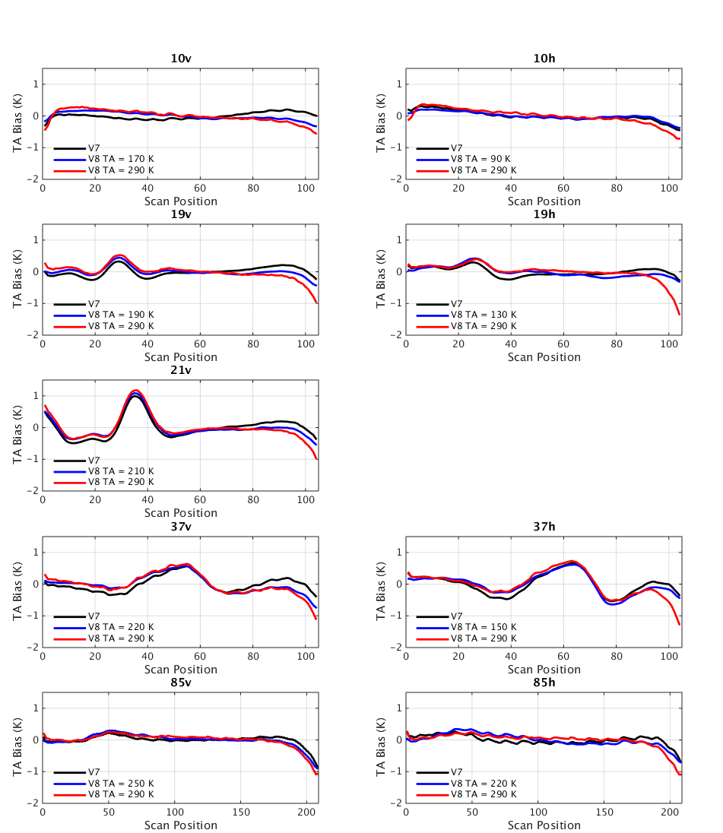
TMI V8 Updates Geolocation and Cross-Track Bias Corrections
Alignment Correction
Cross-Track Bias Correction
V7 uses at-launch values for cone and azimuth start angles
V8 uses values derived from geolocation maps: TB difference between Yaw 0 and Yaw 180 spacecraft orientations. Optimal values make the coastlines disappear
V7 derives offset from over-ocean TBs and applies it at all scene temperatures
V8 derives a correction as a function of temperature, using a linear interpolation between vicarious cold and warm techniques
V7 (1B11)
V8
New for V8: Instrument pitch/roll offset 0.08°/0.08°
V8 accounts for temperature-dependent edge-of-scan obstruction
Channel | Cone Angle |  | Cone Angle Offset for EIA | Azimuth Start Angle
 | V7 | V8 | V8 | V7 | V8
10 GHz | 49.0 | 49.45 | 10v: -0.048 10h: +0.048 | -64.4024 | -63.91
19, 21, 37, 85 GHz | 49.0 | 49.28 | 0 | -64.4024 | -64.36
Updated cone angle and azimuth start angle offsets for TMI V8 by channel. These changes of up to 0.5 degrees in the cone angle have a significant impact on the resulting calibration as well as for highly-sensitive retrieval algorithms such as SST.
Notes:
A few examples of the many updates done for TMI V8

Slide 7
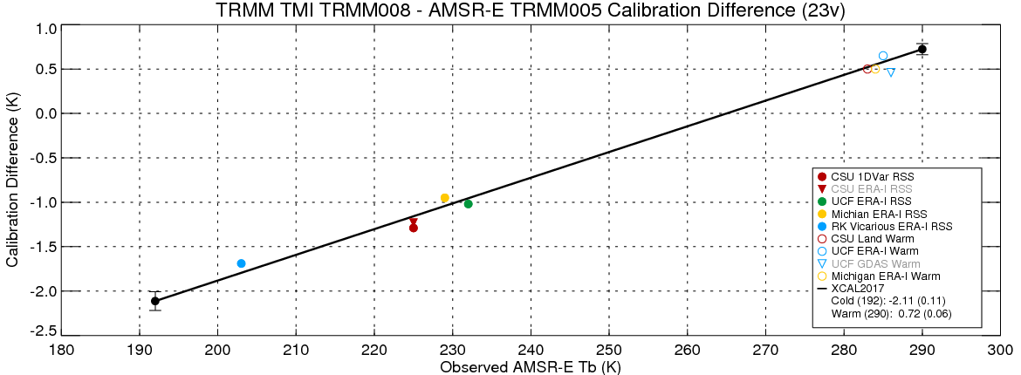
Constellation Radiometer Intercalibration Multiple Independent Techniques
Multiple XCAL members produced calibration offsets for cold ocean scenes and warm land scenes.
Large biases and scene-temperature variations are evident, however, individual results are consistent to ~0.5K.
Intercalibration techniques must take into account expected sensor differences (i.e. frequency, bandwidth, view angle, polarization, etc.)
This means resulting intercalibrated Tb are physically-consistent, but not identical!
Notes:
An example of the final intercalibration derived for the 23v channel on AMSR-E based on results from multiple independent techniques over both cold (ocean) and warm (vegetated land) scenes.

Slide 8
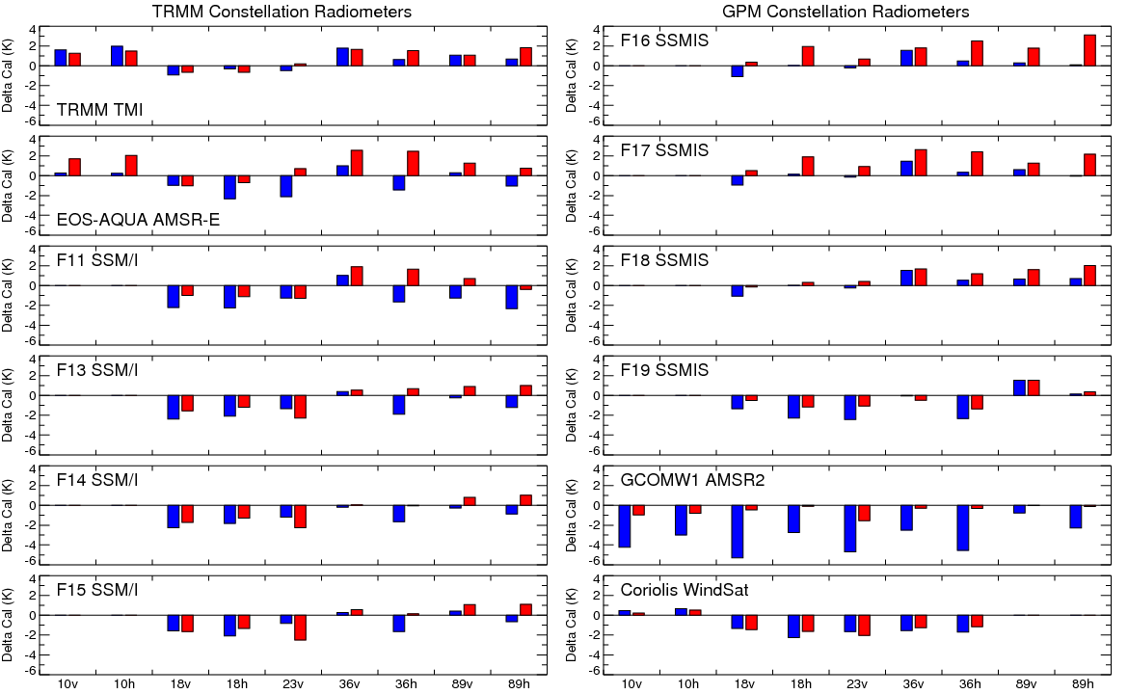
TRMM/GPM Radiometers Calibration Differences
Conical-Scanning Imagers
Blue: Cold ocean scenes, Red: warm vegetated scenes
For conical-scanning imagers, a 2-point intercalibration was applied to the Level 1C brightness temperatures. The blue bars correspond to the calibration offsets over cold ocean scenes and the red bars correspond to the offsets over warm, highly vegetated (i.e. unpolarized) land scenes.
Notes:
The intercalibration offsets applied for the TRMM/GPM conical-scanning imagers for the intercalibrated Level 1C brightness temperature files.

Slide 9
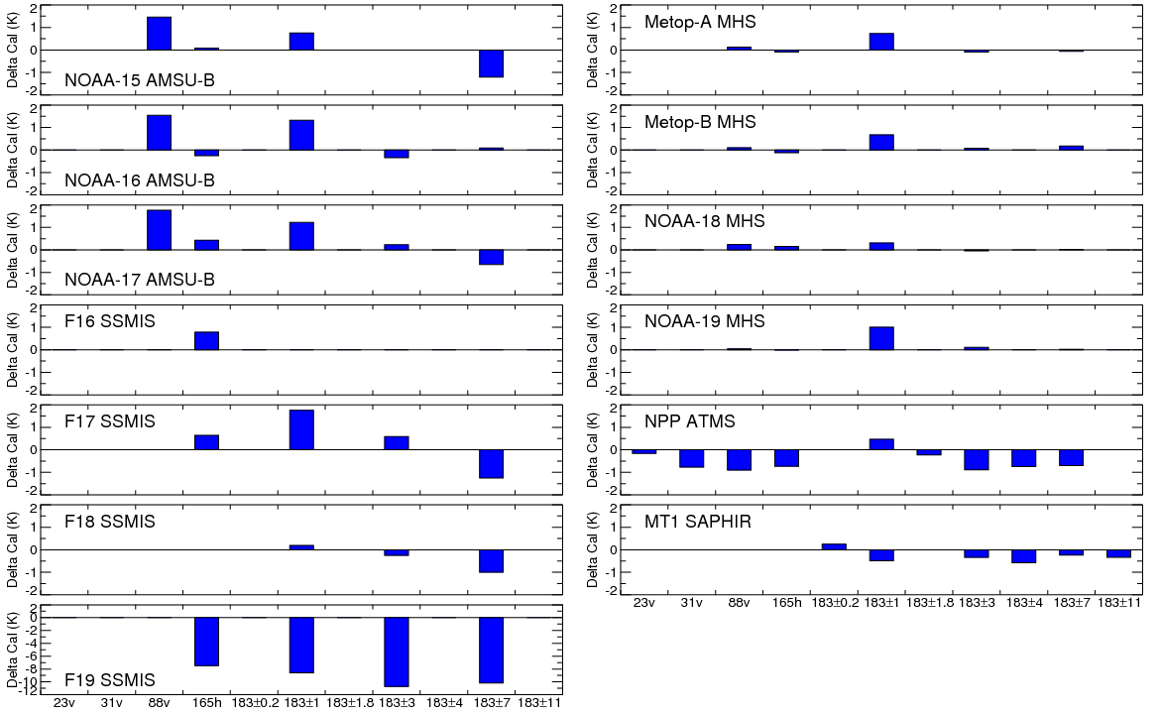
TRMM/GPM Radiometers Calibration Differences
Cross Track Scanning Water Vapor Sounders and SSMIS High Frequencies
For the cross-track water vapor sounders only a single calibration offset was applied to the Level 1C brightness temperatures, independent of scene temperature. The sounders were generally within 1-2 K of GMI with the exception of the F19 SSMIS, which had much larger, but relatively constant biases.
Notes:
The intercalibration offsets applied for the TRMM/GPM cross-track scanning water vapor imagers for the intercalibrated Level 1C brightness temperature files.

Slide 10
Summary
Reprocessing Schedule
Instruments on the GPM core satellite are operating nominally with 3+ year data record
GMI is extremely well calibrated and stable, providing an ideal calibration reference for the constellation radiometers.
The current operational Level 1C Tb dataset has been intercalibrated to GMI V05 and is available from the NASA Precipitation Processing System (PPS).
Details on the GPM intercalibration: Berg et al. 2016: Intercalibration of the GPM Microwave Radiometer Constellation, J. Atmos. Oceanic Technol., Vol 33, pp. 2639-2654.
GPM V05 reprocessing (April 2017)
Changes to GMI calibration, primarily low frequency channels
Level 1C Tb data available for GPM constellation radiometers
TRMM reprocessing (October 2017)
TMI calibration updates
Intercalibrated to GMI V05
Includes constellation sensors back to December 1997
DMSP SSM/I reprocessing (2018/19)
July 1987 forward
Future instruments (TBD)
NOAA-20 ATMS (launched November 2017)
MetOp-C MHS (September 2018 launch)

