Slide 1
Strategies to Mitigate Risk of
Microwave Imager Mission Gap
Tim Hewison
GSICS Microwave Sub-Group
22 May 2018

Slide 2
Background
CGMS actions from discussions in CEOS SIT
  WMO WGIII/ 5.1.1 A45.02 Update the risks assessment and gap analysis of implementation against the CGMS baseline; include the potential risk of gaps in the capability for passive microwave imaging in this update
  H.2 A45.20 CGMS to endorse the gap analysis report and the coordinated action plan in writing prior to CEOS 2017 plenary meeting, to the Joint CEOS-CGMS WG Climate
    CEOS endorsed the ECV gap analysis report and the coordinated action plan
    Will be forwarded now to CGMS 46 for endorsement - expected first week of June
    Important recommendation from GSICS PoV:
    CEOS and CGMS agencies to add the delivery of FCDRs for each individual satellite instrument (linked to relevant precursor instrument series) to their agency remit.
Triggered AGU special session on potential ECV gaps
  (SST, precip, snow, ice, etc.)
My Recommendation:
  GSICS Microwave Sub-group to consider strategy to mitigate risk of gaps in microwave imager constellation

Slide 3
Passive Microwave Imagers: Current and Planned

Slide 4
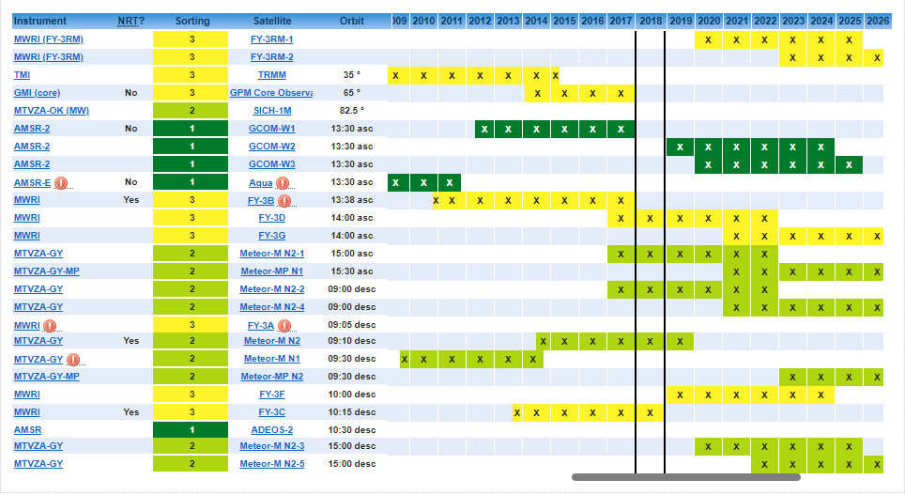
WMO OSCAR Gap Analysis for 8-12 GHz
What are the risks of gaps in microwave imager constellation?
What are the alternatives?
Can identify from WMO OSCAR Gap Analysis tool:
https://www.wmo-sat.info/oscar-testbed/gapanalyses?mission=44
~10GHz Imagers:
GCOM-W2/3 at 13:30
FY-3D/G at 14:00
FY-3F at 10:00

Slide 5
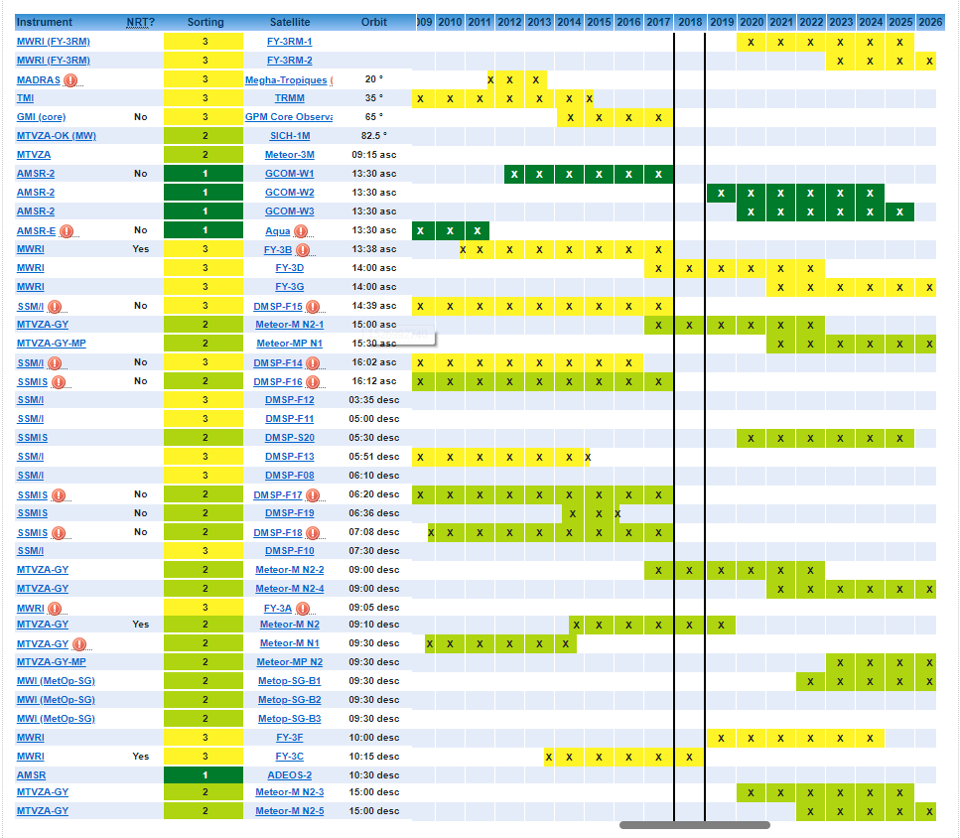
WMO OSCAR Gap Analysis for 12-20 GHz
~18GHz Imagers:
GCOM-W2/3 at 13:30
FY-3D/G at 14:00
FY-3F at 10:00
DMSP-S20 at 05:30?
Metop-SG at 09:30

Slide 6
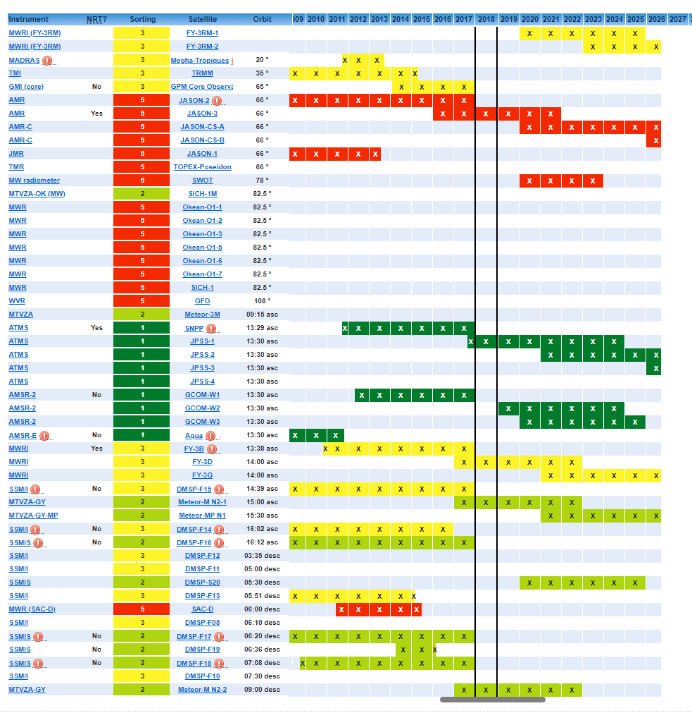
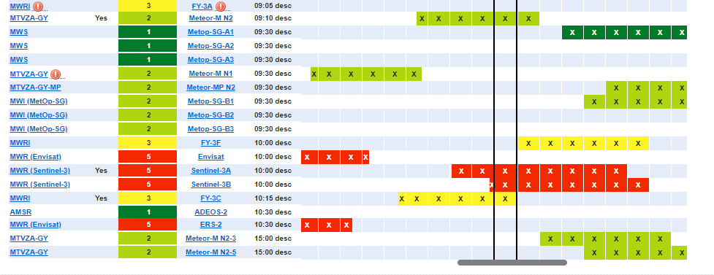
WMO OSCAR Gap Analysis for 20-26 GHz
~22GHz Imagers:
GCOM-W2/3 at 13:30
FY-3D/G at 14:00
FY-3F at 10:00
DMSP-S20 at 05:30?
Metop-SG at 09:30
+ Many Sounders

Slide 7
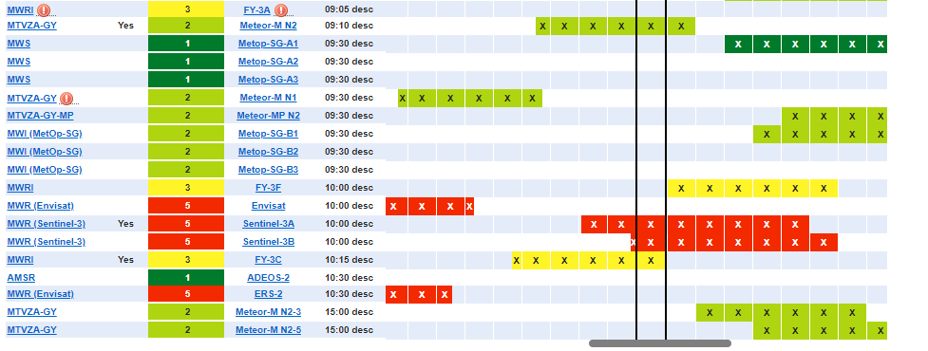
WMO OSCAR Gap Analysis for 26-40 GHz
~37GHz Imagers:
GCOM-W2/3 at 13:30
FY-3D/G at 14:00
FY-3F at 10:00
DMSP-S20 at 05:30?
Metop-SG at 09:30
+ Many Sounders
(typically 31.4GHz)

Slide 8
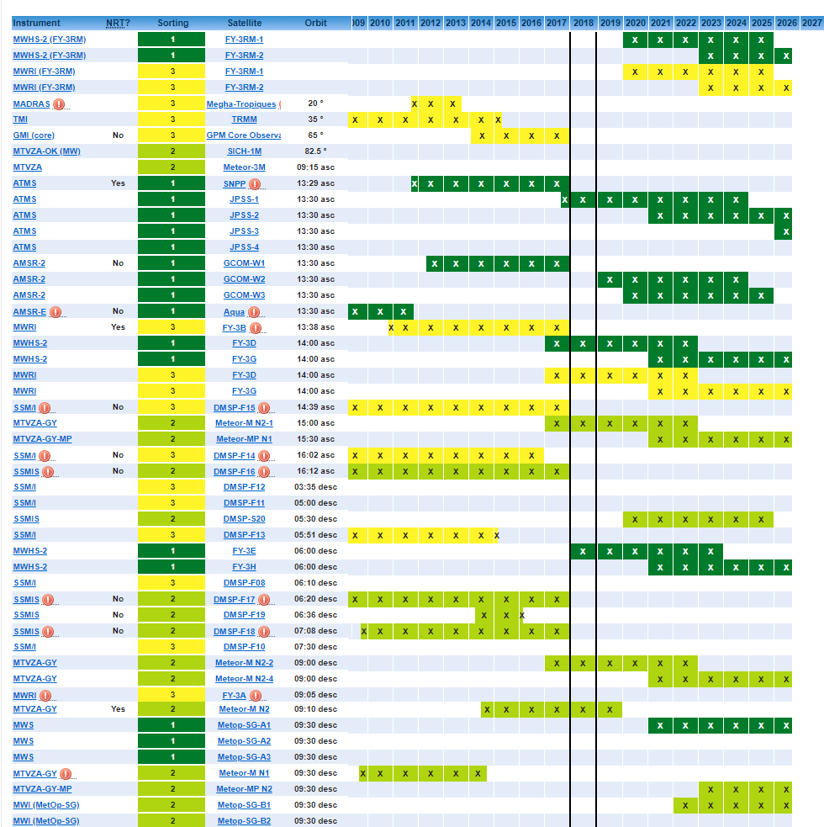
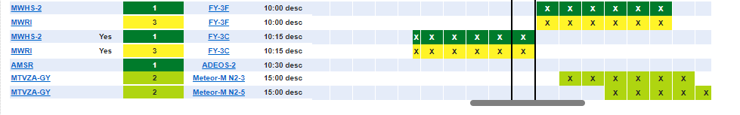
WMO OSCAR Gap Analysis for 70-110 GHz
~89GHz Imagers:
GCOM-W2/3 at 13:30
FY-3D/G at 14:00
FY-3F at 10:00
DMSP-S20 at 05:30?
Metop-SG at 09:30
+ Many Sounders

Slide 9
Discussion
Are current microwave imagers at risk of failure before MWI launch?
  Gap Analysis
FY-3 microwave imagers could provide resilience to mitigate risk
  and Meteor-M
  If they can be inter-calibrated to MWI
What issues need addressing to develop inter-calibration for FY-3?
  Frequencies, calibration stability, ...
Potential to use microwave sounders for these applications?
  Scan angle selection/correction?
Can/should we develop GSICS inter-calibration products?
  Calibration/Corrections?
  Or inter-calibration algorithms?
  Near-Real-Time? Re-analysis? FCDR Support?

