Slide 1

The Langley approach to correct convolution errors of inter-calibration between broad-band and hyper-spectral sensors
Wan Wu, Xu Liu, and Qiguang Yang

Slide 2
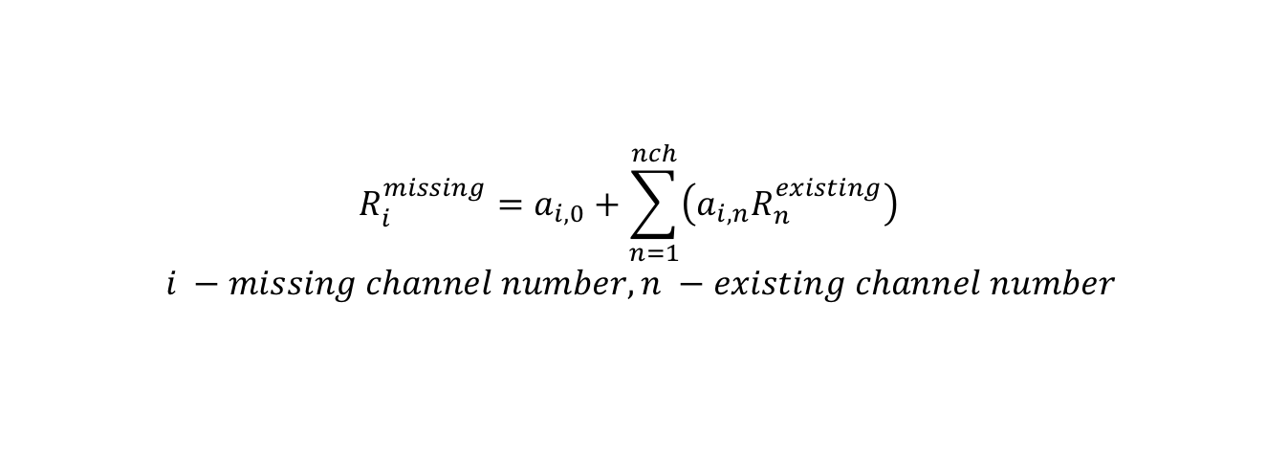
Introduction
Motivation:
  To correct convolution errors of inter-calibration between broadband and hyperspectral sensors (either due to spectral gaps or inadequate spectral sampling)
Methodology:
  Use line-by-line radiative transfer results to accurately characterize the inter-cal errors
  Derive the spectral correlation relationship between the available spectral information and the missing spectral information using simulation results
$$R_{i}^{missing}=a_{i,0}+\sum_{n=1}^{nch}{\left(a_{i,n}R_{n}^{existing}\right)}$$
$$i −missing channel number, n −existing channel number$$

Slide 3
MODIS calibrated by IASI, CrIS, and AIRS
MODIS
IASI
IASI
CrIS
AIRS
CrIS
AIRS

Slide 4
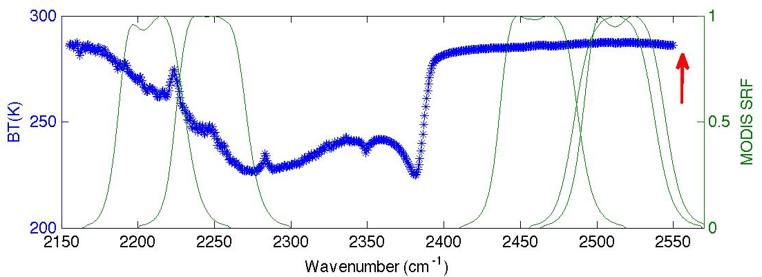
MODIS-CrIS convolution errors

Slide 5
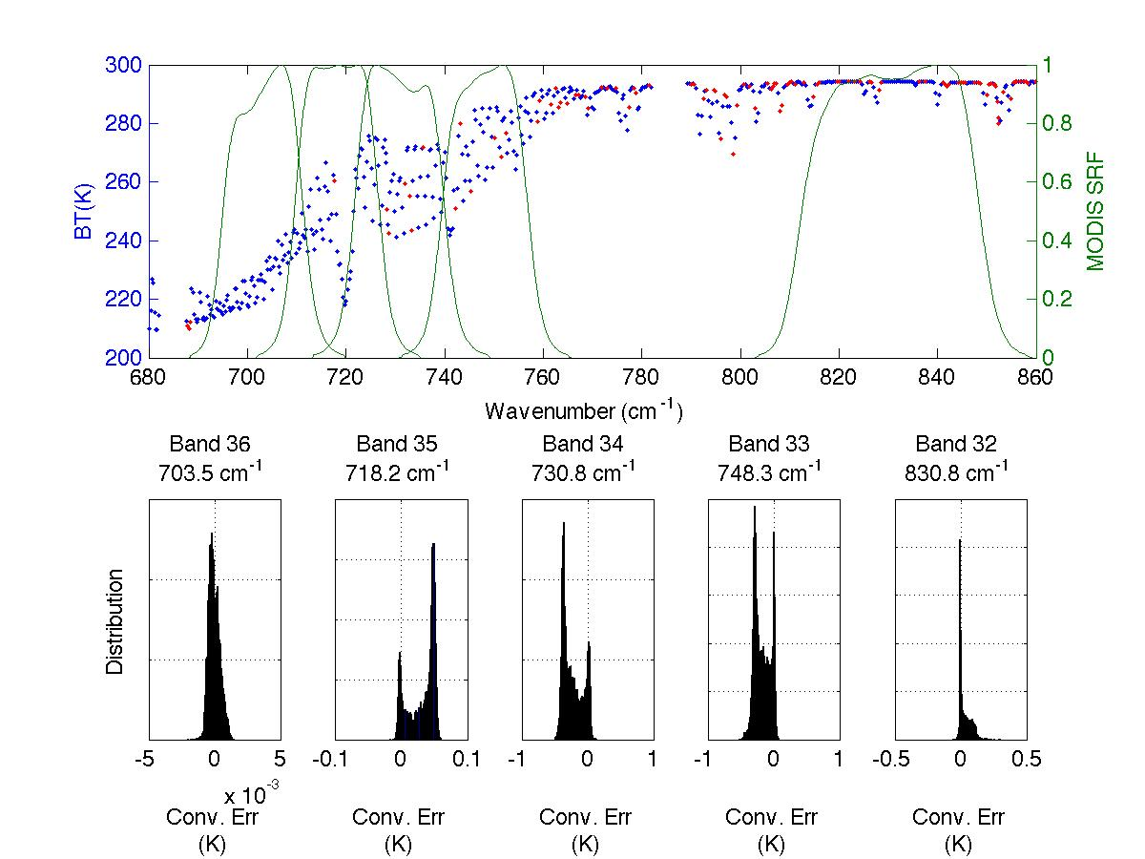
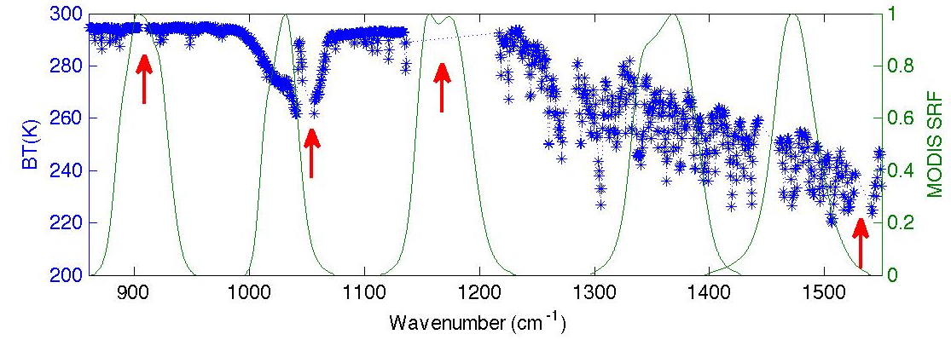
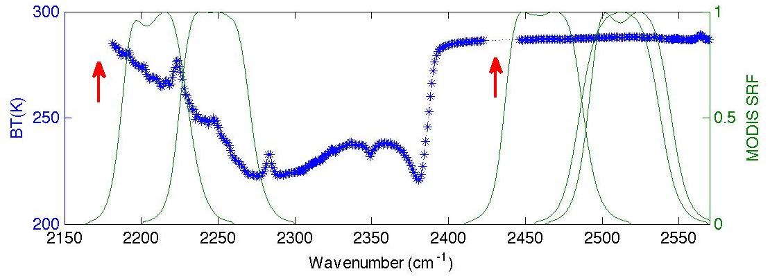
MODIS-AIRS convolution errors

Slide 6
Langley vs JAM gap filling approach
  The regression relationship is derived using thousands of cases that cover various surface, cloud, atmospheric conditions.
  It is both scene dependent and channel dependent
  The regression relationship is directly established between the spectral radiance in the gap region and the spectral radiance outside of the gap. One regression relationship works for all
Langley
  The regression relationship is derived using Eight cases that cover both clear and cloudy sky conditions.
  It is both scene dependent, but not channel dependent
  The regression relationship is established between the available spectral radiance of each observation and the corresponding spectral radiance of Eight simulated cases. The same relationship is then used to predict the missing spectral radiance. The regression relationship has to be derived for each observation.
JAM
JAM gap approach may not be able to address large spectral gaps (e.g. missing CrIS or AIRS spectra in the MODIS band 29 region) due to the lack of available spectral radiance.

Slide 7
Small gap filling using both Langley and JAM approach
MODIS-CrIS Errors before filling gaps
MODIS-CrIS Errors after filling gaps
JAM
Langley

Slide 8
MODIS-CrIS inter-calibration validation using real IASI data as an proxy
IASI, FTIR with evenly distributed spectral bins (645 cm⁻¹ - 2760 cm⁻¹ 0.25 cm⁻¹) -- Convolution errors are negligible due to its high spectral resolution.
Select IASI nadir observations with adequate spatial and temporal coverage as data samples.
Generate CrIS spectra that is perfectly collocated and radiometrically calibrated with reference to the IASI spectra by:
IASI spectra -> interferograms -> OPD truncation -> CrIS spectra
MODIS-CrIS inter-cal Errors =
“CrIS Convolved” MODIS - “IASI Convolved” MODIS

Slide 9
Consistency check between Satellite data based results and the LBLRTM simulation based results

Slide 10
MODIS (Band 22) -CrIS (blackman) inter-calibration error before correction

Slide 11
MODIS (Band 22) -CrIS (blackman) inter-calibration error after correction

Slide 12
MODIS (Band 22) -CrIS (blackman) inter-calibration error after correction

Slide 13
Spectral gap filling for MODIS band 29 region
Langley

Slide 14
Spectral gap filling for MODIS band 29 region
JAM

