Slide 1
Demonstration of Polar Satellite Microwave Data Climate Monitoring Using GRUAN Radiosonde
Tony Reale
Bomin Sun (IMSG)
Cheng-Zhi Zou (NOAA)
Isaac Moradi
Nick Nalli and Ryan Smith
GSICS MW WG July 18, 2018

Slide 2
EDR
EDR
EDR
SDR

Slide 3
Part 1
Sun, Zou, Reale …

Slide 4
Method
Multiply the GRUAN temperature profile by the MSU weighting function to get the microwave equivalent temperature for GRUAN (Sun)
Chan 2
Chan 3
Chan 4
Compare to STAR Microwave CDR (Zou)

Slide 5
MSU Weighting Functions (nadir)

Slide 6
Lindenberg; GRUAN vs. STAR Microwave CDR MSU CH2, Middle Troposphere Monthly Anomaly
Green: 00 utc
Red: 06 utc
Blue: 12 utc
Black: 18 utc
Gray: NOAA STAR MW CDR
Trend:
Green: 00 utc 0.126 (0.043)K/yr
Red: 06 utc 0.134 (0.041)K/yr
Blue: 12 utc 0.117 (0.041)K/yr
Black: 18 utc 0.129 (0.041)K/yr
Gray: STAR 0.093 (0.036)K/yr
Corr. Coeff.
Green: 00 utc 0.883
Red: 06 utc 0.890
Blue: 12 utc 0.884
Black: 18 utc 0.902

Slide 7
Lindenberg; GRUAN vs. STAR Microwave CDR MSU CH3, Upper Troposphere Monthly Anomaly
Green: 00 utc
Red: 06 utc
Blue: 12 utc
Black: 18 utc
Gray: NOAA STAR MW CDR
Corr. Coeff.
Green: 00 utc 0.764
Red: 06 utc 0.746
Blue: 12 utc 0.772
Black: 18 utc 0.749

Slide 8
Lindenberg; GRUAN vs. STAR Microwave CDR MSU CH4, Lower Stratosphere Monthly Anomaly
Green: 00 utc
Red: 06 utc
Blue: 12 utc
Black: 18 utc
Gray: NOAA STAR MW CDR
Corr. Coeff.
Green: 00 utc 0.034
Red: 06 utc 0.006
Blue: 12 utc 0.046
Black: 18 utc 0.057

Slide 9
Lindenberg; GRUAN at weighting peak vs. STAR Microwave CDR MSU CH4, Lower Stratosphere Monthly Anomaly
Green: 00 utc
Red: 06 utc
Blue: 12 utc
Black: 18 utc
Gray: NOAA STAR MW CDR
Corr. Coeff.
Green: 00 utc 0.860
Red: 06 utc 0.853
Blue: 12 utc 0.870
Black: 18 utc 0.847

Slide 10
Part 2
Moradi, Sun, Nalli, Zou, Reale …

Slide 11
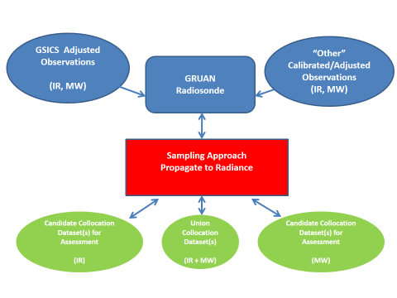
Preliminary Experiment Straw-man
ATMS (NPP, N20)
RIVAL
MW LBL
ATMS, RIVAL
Objective: Can GRUAN help verify the “accuracy/uncertainty” of GSICS adjustments

Slide 12
Radiosonde Inter-comparison and VALidation
(RIVAL)
GRUAN, JPSS/STAR, ARM coordination
Leveraging the existing JPSS dedicated (NOAA-20) Raob Program
Dedicated Radiosondes
Dual RS41 and RS92 (RIVAL)
Single Raobs (RS41) (JPSS)
Two Launches (-40, -10 min wrt N20 overpass)
One Launch (-20 min wrt N20 overpass)
SDR/TDR appended (along with EDR sounding)

Slide 14
Guidelines for Uncertainty Measurements (GUM)
from Immler (2010)
for k.le.2 … in more than 95% of cases, the uncertainties are likely to be smaller than estimated …
for k .gt. 2 … the uncertainties are likely to be larger than estimated …
If k < 1 …

Slide 15
Access RIVAL Radiosondes with SDR/TDR appended
NOAA-20 and SNPP ATMS targeted (30 minutes)
RIVAL Radiosonde RS92 (GDP) and RS41
LBL Microwave RTM
GUM
Compare (k) Calculated vs Observed (SDR/TDR) for selected collocations

Slide 16
Path Forward
Extend Part 1 for more GRUAN sites
Provide collocations for Part 2
Consistency of Calc-minus-Obs … k, TDR vs SDR …
RTM assessments

