Slide 1

Traceability and Uncertainty 4 community (CEOS/GSICS) workshop on benchmark sensors
Nigel Fox
Head of Earth Observation, Climate and Optical
Chair CEOS WGCV IVOS sub-group
Google

Slide 2
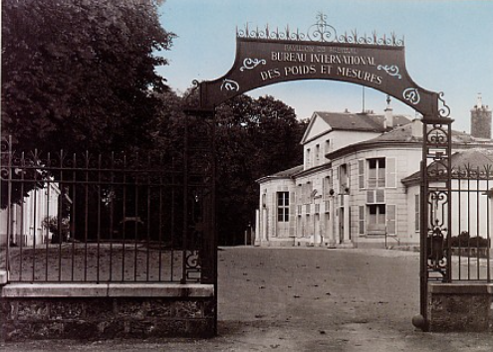
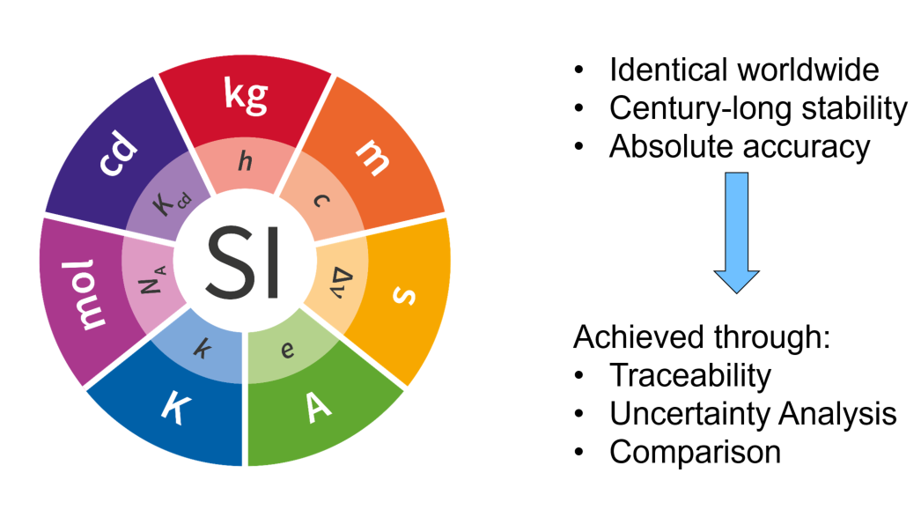
International System of Units (SI)
BIPM (Sevres nr Paris) 1875

Slide 3
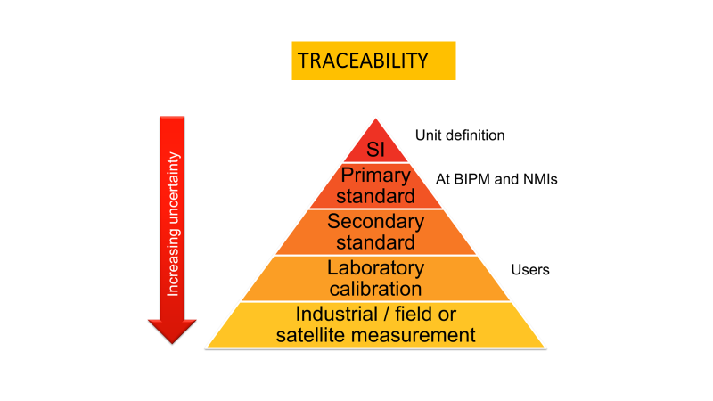
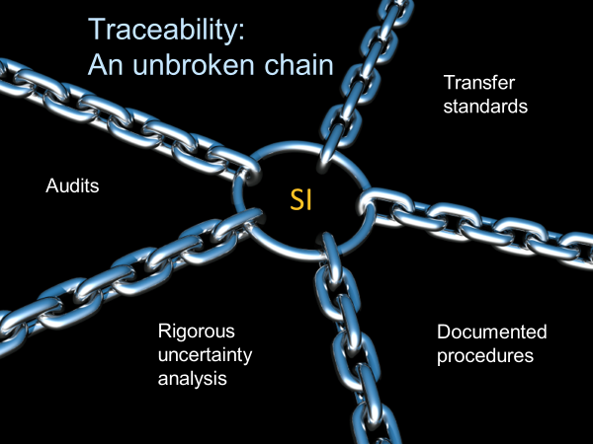
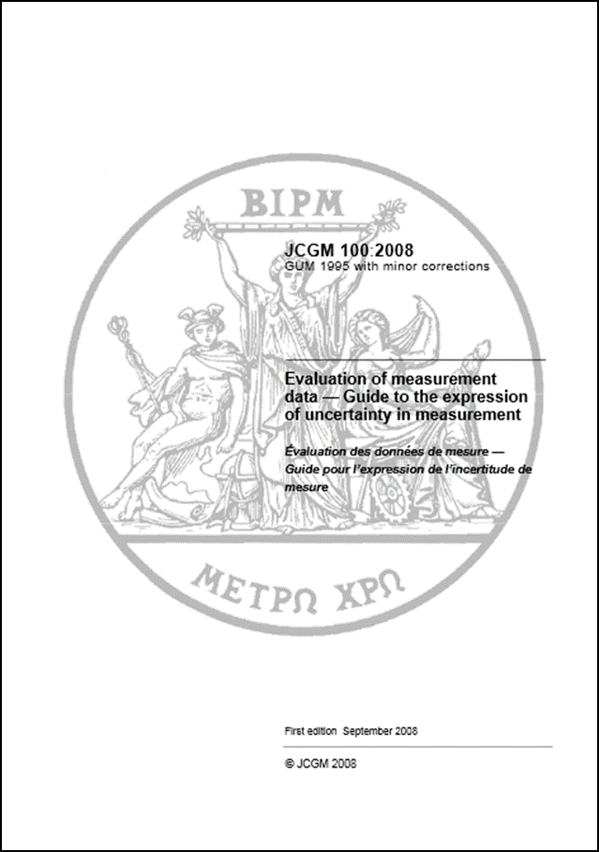
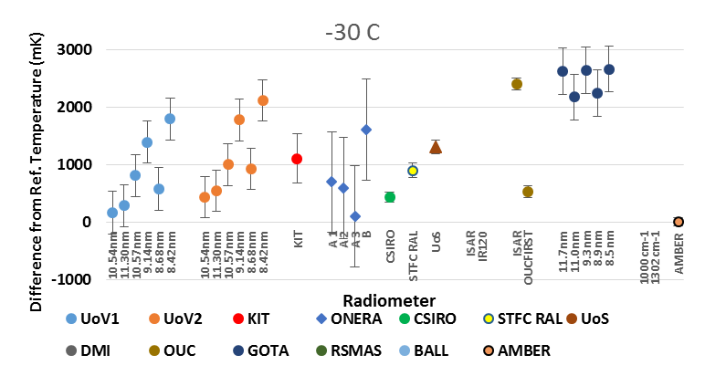
What is Traceability?
GUM
Documented evidence of degree of consistency with international std & Uc budget
i.e.COMPARISONS

Slide 4
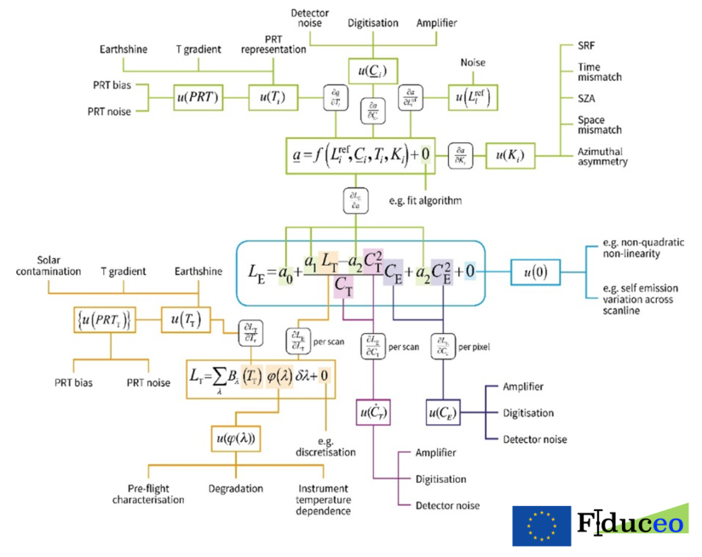
At workshop and messages beyond
Need/benefit of SI traceability for EO and climate in particular
  - contrast with ‘just overlapping’ sensors time-series
  - FCDR’s. other applications (not necessarily needing same Uc)
Evidence traceability of proposed sensors –pre-flight & in-flight and associated breakdown of uncertainties and their nature (sensor, observations, systematic/random, correlations)
  Perhaps structured through measurement eqn diagram
  Including process of sensor calibrations
  Tables of Indicative values
  Comparison evidence!
  Links to SI (primary standard)
How to communicate importance
Value of independent realisations
& comparisons in space

