Slide 1
GSICS Research Working Group Web Meeting 2018-09-13 Planning a GSICS/CEOS-WGCV Workshop on SI-traceable Reference Instruments Tim Hewison
Special Issue of the IEEE TGRS on “Inter-Calibration of Satellite Instruments”:
Special Issue of the IEEE TGRS on “Inter-Calibration of Satellite Instruments”:

Slide 2
Introduction - Background
At 2016 GSICS Research Working Group meeting:
Suggested a workshop could be set-up
to bring together calibration and instrument experts
with those developing inter-calibration algorithms
to explore how the observations could be tied to international (SI) standards
Current GSICS inter-calibration reference instruments are not specific designed instruments for inter-comparison benchmark as international Earth observation
International CLARREO-like workshop may be useful to push this concept into quicker implementation in international community within WMO/GSICS and CEOS/WGCV members

Slide 3
Aims of Web Meeting
Aims of the workshop
Sessions
Workshop location
Workshop dates & duration
Organisation – chairing, etc.
Invitees
Survey Reminder: https://www.surveymonkey.de/r/WNXGGR2
Please provide your input now or during presentations in first part of agenda
Will be used in discussion

Slide 4
Agenda of Web Meeting
Tim Hewison (EUMETSAT) - Introduction to the web meeting
Bruce Wielicki (NASA) – Ideas for Technology Development Needs
Constantine Lukashin (NASA) – Inter-calibration requirements/algorithms for the VIS/NIR
Dave Tobin (SSEC) - IR inter-calibration requirements
Pheng Zhang (CMA) - Development of Chinese SI-traceable reference insruments and retrospective recalibration of historical satellite data
Chuanrong Li/Lingling Ma (AOE) - Cross-calibration through spaceborne SI-traceable reference instruments
Nigel Fox (NPL) - Requirements for uncertainty analysis & Traceability issues
All - Workshop Aims, Chairing and Logistics (as above)
Agenda Items #1-7: max 10 minutes – take notes on above questions
Agenda Item #8: 1 hour Discussion

Slide 5
Aims of Workshop
Aims of the workshop (Examples for discussion)
Focus on SI-traceable hyperspectral reference instruments
Radiometric Calibration
Spectral Calibration
Polarisation aspects?
To bring together calibration and instrument experts with those working to develop inter-calibration algorithms
To explore how the observations could be tied to international (SI) standards
To understand traceability chains
To discuss:
What are the critical issues the calibration community faces related?
How could international cooperation address these?
Follow-up on inter-calibration applications of proposed CLARREO/TRUTHS missions

Slide 6
Topics/Sessions of Workshop
For example, should we address the following:
Development of technology
Development of inter-calibration algorithms & uncertainty analysis
Characterisation of pseudo invariant sites to act as calibration transfers
Are these topics inter-linked? Could they be covered in the same workshop?
In Parallel sessions?
Should we address different spectral bands separately?
In Parallel sessions?
n.b. Traceability and Uncertainty Analysis themes run through all other topics
Are there any other topics you think should be included?
e.g. review technical requirements, possible funding sources, …
Survey Results

Slide 7
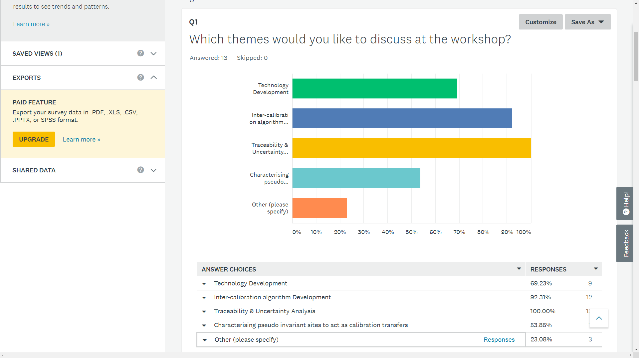
How can the SI traceable calibration be validated, once on orbit?
Current limitations to inter-calibration uncertainties

Slide 8
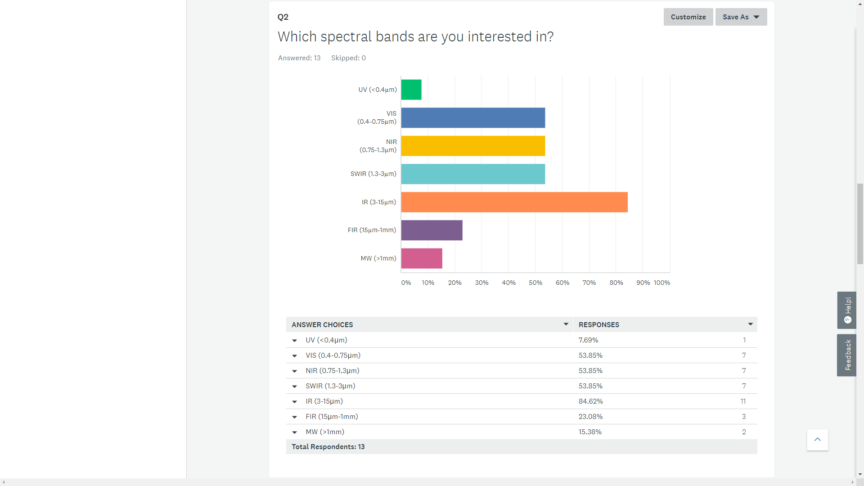

Slide 9
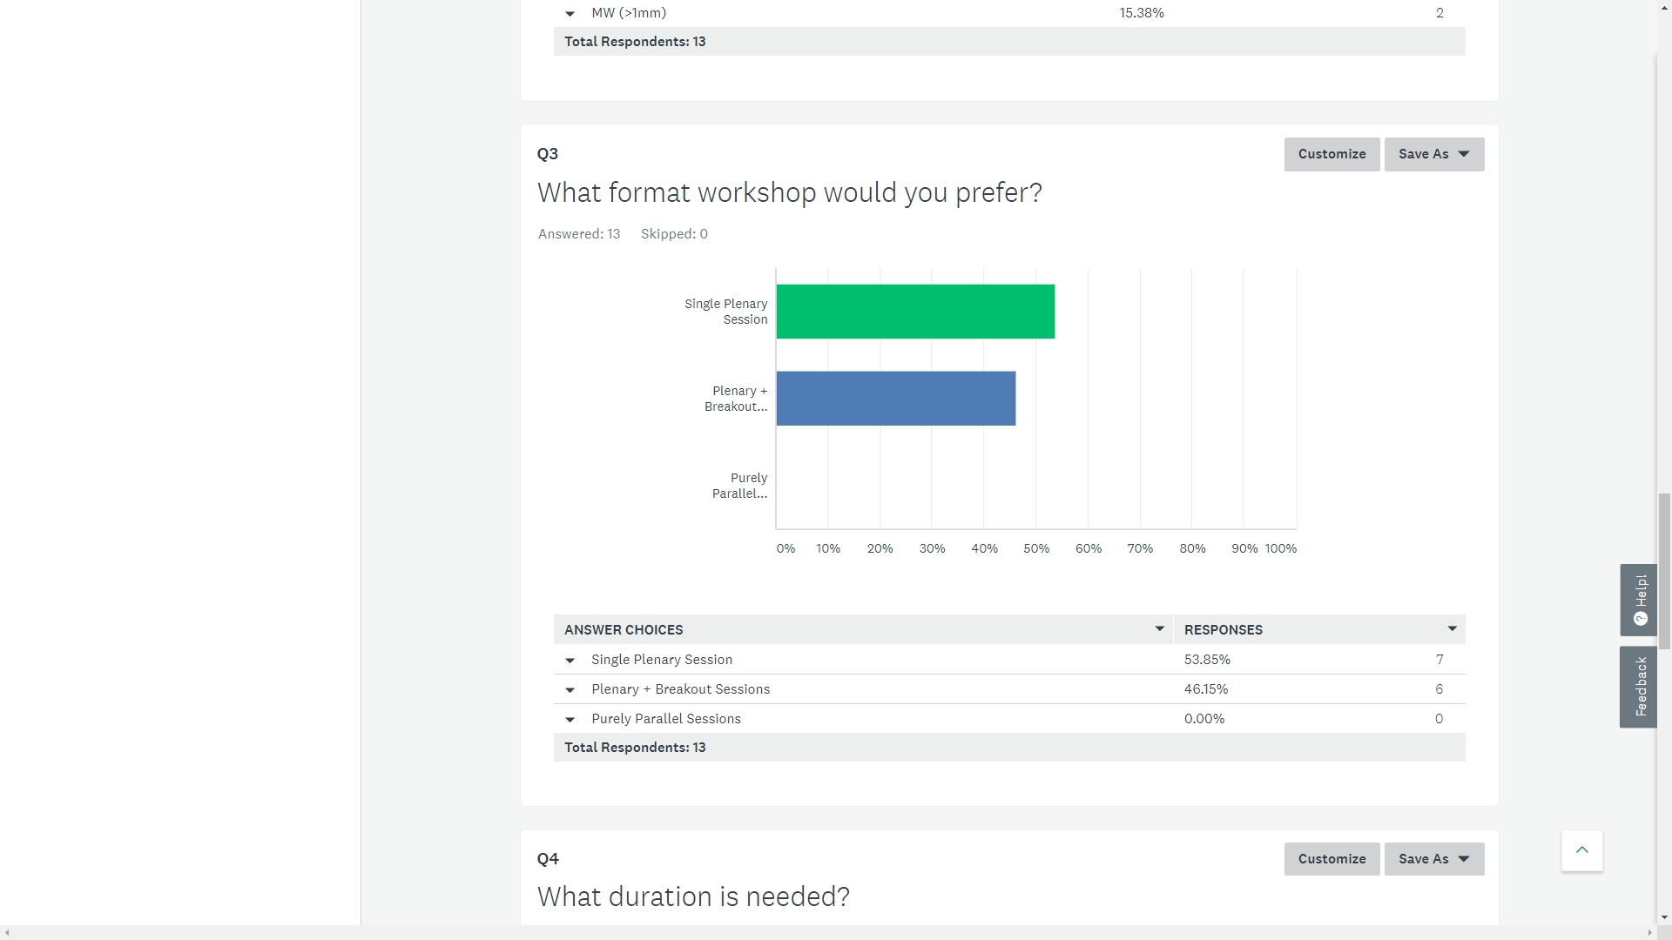

Slide 10
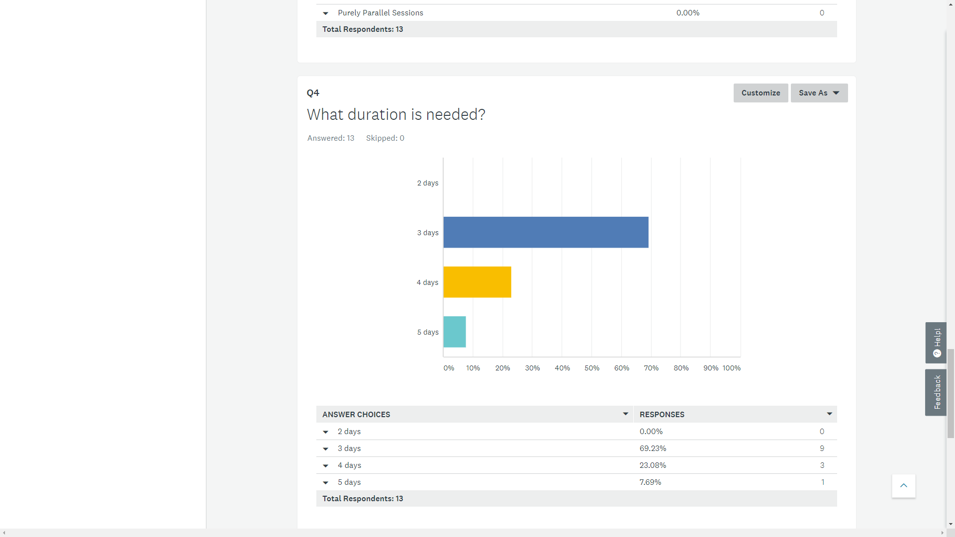

Slide 12
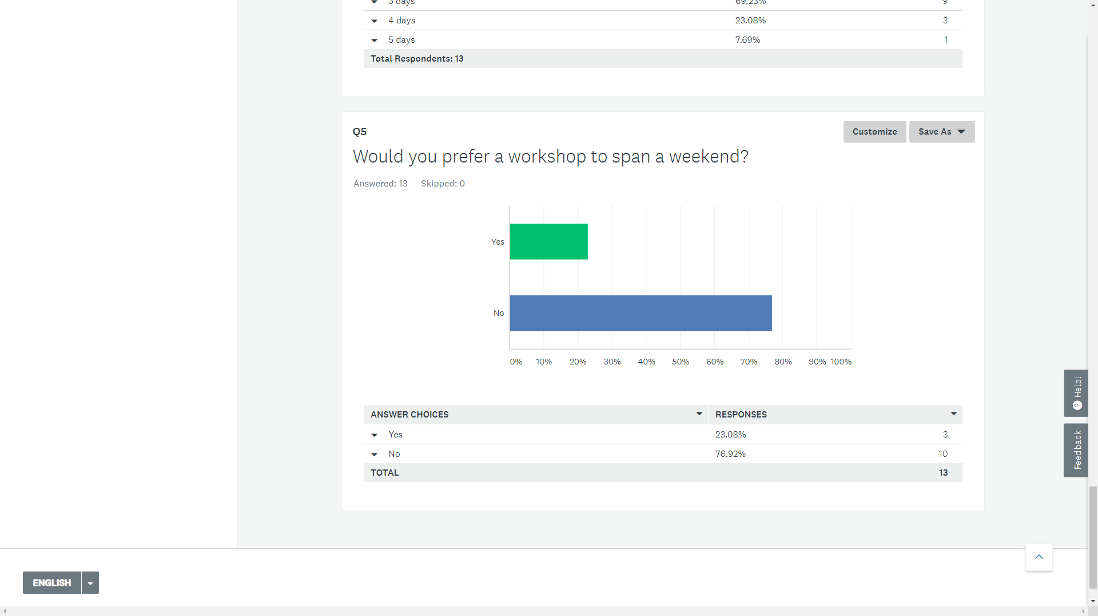

Slide 13
Focus on Workshop Outcomes
What do we want to get out of the workshop?
e.g. Help identify from CEOS WGCV and GSICS key reference recommendations and processes needed
Understanding traceability chain
What are the theoretical uncertainty limits for inter-calibration?
How could we achieve this in a workshop?
Volunteers prepare in advance strawman design – with uncertainty analysis
Break-out groups provide critical review & report
RSB instrument design
TIR instrument design
RSB inter-calibration algorithm
TIR inter-calibration algorithm
PICS characterization algorithm
Moon characterisation algorithm

Slide 14
Name of Workshop
Proposal:
GSICS/CEOS-WCGV SI-Traceable Hyperspectral Inter-Calibration Reference Instrument Workshop
Proposed abbreviation:
SITHICRI Workshop

Slide 15
Practicalities
Workshop location
Preference for Europe?
Workshop dates & duration
e.g. sometime in 2019

Slide 16
Organisation
Chairing
Overall
Session
Invitees
Organising Committee
As above?
Meetings?

Slide 17
Thank You for your contributions!

Slide 18
Discussion with Dave Crisp, Kurt Thome, Albrecht von Bargen
Parellelism:
Uncertainty & traceability throughout
VIS/NIR / TIR - Preference for single session of presentations
Algorithms/Technology - Preference for single session of presentations
Aims/Outcomes:
Recommendations?
Inter-cal to 0.3% or 3% - what are the theoretical limits?
understanding traceability chain
1. identify the nodes in the system
2. What are the levels
Understanding what are the issues to achieve CLARREO/TRUTHS-like accuracies
Review Strawman inter-cal algorithm and uncertainty analysis - e.g. Costy + Tobin??
Ditto for instrument design - e.g. Nigel Fox (NPL)?
Ditto on site characterisation - e.g. Carol Bruegge (JPL), A. Kuze (JAXA)?
Ditto on Moon characterisation – e.g. Tom Stone, Jim Butler, Seb Wagner ??

Slide 19
Email input from Dave Smith (RAL)
1) This is very relevant to our development program for blackbody sources to improve SI traceability. We have a CEOI funded project with NPL and Surrey Nanosystems to develop phase change cell technology and enhanced black coatings for flight calibration sources - a key driver for this is the FORUM mission which is one of the missions to be discussed. We are also performing some pre-development activities for one of the FORUM studies.
2) The Sentinel-3 tandem phase is already providing a lot of useful information and could define limits to what could be achieved in cross-calibration.
3) In my opinion - the way forward is to improve the traceability of existing missions which are already providing high quality data. E.g. IASI, SLSTR rather than developing new missions with unproven heritage.

