Slide 1
ATMS versus AMSU/MHS Simultaneous Nadir Overpass Ta Bias Time Series Results from 12 Data Analysis Methods
Robbie Iacovazzi¹, Ninghai Sun¹, and Mark Liu²
¹GST, Inc., 7855 Walker Drive, Suite 200, Greenbelt, MD 20770
²NOAA/NESDIS/STAR, 5830 University Research Court, College Park, MD 20740
GRWG Microwave Subgroup Meeting
19 November 2019

Slide 2
Outline
ATMS and AMSU-A/MHS operational satellite microwave sounding instrument specifications
Inter-satellite antenna temperature (Ta) bias detection utilizing the Simultaneous Nadir Overpass (SNO) method
Description of data analysis methods
SNO Ta bias results
Summary

Slide 3
ATMS and AMSU-A/MHS Specifications
ATMS Specifications |  |  |  |  | AMSU-A/MHS Specifications
Ch # | Central Frequency (MHz) | Specified NEDT / Accuracy (K) | Pol | 3dB Beamwidth (Cross- and Along-Track) and FOV Size at Nadir (deg & km) | Ch # | Central Frequency (MHz) | Specified NEDT / Accuracy (K) | Pol | 3dB Beamwidth and FOV Size at Nadir (deg & km)
1 | 23800 | 0.70 / 1.0 | V | 6.3 / 5.2 & 75 | A-1 | 23800 | 0.30 / 1.0 | V | 3.3 & 50
2 | 31400 | 0.80 / 1.0 | V | 6.3 / 5.2 & 75 | A-2 | 31400 | 0.30 / 1.0 | V | 3.3 & 50
3 | 50300 | 0.9 / 0.75 | H | 3.3 / 2.2 & 32 | A-3 | 50300 | 0.40 / 1.0 | V | 3.3 & 50
4 | 51760 | 0.7 / 0.75 | H | 3.3 / 2.2 & 32
5 | 52800 | 0.7 / 0.75 | H | 3.3 / 2.2 & 32 | A-4 | 52800 | 0.25 / 1.0 | V | 3.3 & 50
6 | 53596±115 | 0.7 / 0.75 | H | 3.3 / 2.2 & 32 | A-5 | 53596±115 | 0.25 / 1.0 | H | 3.3 & 50
7 | 54400 | 0.7 / 0.75 | H | 3.3 / 2.2 & 32 | A-6 | 54400 | 0.25 / 1.0 | H | 3.3 & 50
8 | 54940 | 0.7 / 0.75 | H | 3.3 / 2.2 & 32 | A-7 | 54940 | 0.25 / 1.0 | H | 3.3 & 50
9 | 55500 | 0.7 / 0.75 | H | 3.3 / 2.2 & 32 | A-8 | 55500 | 0.25 / 1.0 | H | 3.3 & 50
10 | f0=57290.344 | 0.75 / 0.75 | H | 3.3 / 2.2 & 32 | A-9 | f0=57290.344 | 0.25 / 1.0 | H | 3.3 & 50
11 | f0±217 | 1.2 / 0.75 | H | 3.3 / 2.2 & 32 | A-10 | f0±217 | 0.40 / 1.0 | H | 3.3 & 50
12 | f0±322.2±48 | 1.2 / 0.75 | H | 3.3 / 2.2 & 32 | A-11 | f0±322.2±48 | 0.40 / 1.0 | H | 3.3 & 50
13 | f0±322.2±22 | 1.5 / 0.75 | H | 3.3 / 2.2 & 32 | A-12 | f0±322.2±22 | 0.60 / 1.0 | H | 3.3 & 50
14 | f0±322.2±10 | 2.4 / 0.75 | H | 3.3 / 2.2 & 32 | A-13 | f0±322.2±10 | 0.80 / 1.0 | H | 3.3 & 50
15 | f0±322.2±4.5 | 3.6 / 0.75 | H | 3.3 / 2.2 & 32 | A-14 | f0±322.2±4.5 | 1.20 / 1.0 | H | 3.3 & 50
16 | 88200 | 0.5 / 1.0 | V | 3.3 / 2.2 & 32 | A-15 | 89000 | 0.5 / 1.0 | V | 3.3 & 50
16 | 88200 | 0.5 / 1.0 | V | 3.3 / 2.2 & 32 | M-1 | 89000 | 1.0 / 1.0 | V | 1.1 & 16
17 | 165500 | 0.6 / 1.0 | H | 2.2 / 1.1 & 16 | M-2 | 157000 | 1.0 / 1.0 | V | 1.1 & 16
18 | 183310±7000 | 0.8 / 1.0 | H | 2.2 / 1.1 & 16 | M-5 | 190311 | 1.0 / 1.0 | V | 1.1 & 16
19 | 183310±4500 | 0.8 / 1.0 | H | 2.2 / 1.1 & 16
20 | 183310±3000 | 0.8 / 1.0 | H | 2.2 / 1.1 & 16 | M-4 | 183311±3000 | 1.0 / 1.0 | H | 1.1 & 16
21 | 183310±1800 | 0.8 / 1.0 | H | 2.2 / 1.1 & 16
22 | 183310±1000 | 0.9 / 1.0 | H | 2.2 / 1.1 & 16 | M-3 | 183311±1000 | 1.0 / 1.0 | H | 1.1 & 16
16 Identical ATMS and AMSU-A/MHS Channels Used In SNO Analysis
3 Mismatched ATMS and AMSU-A/MHS Channels Used In SNO Analysis
3 ATMS and 1 AMSU-A Channel Not Used in the SNO Analysis.

Slide 4
ATMS, AMSU-A and MHS Scan Profiles
BlackBody
Deep Space
Antenna
During each in-orbit scan line, the ATMS (AMSU-A) [MHS] views three different types of targets:
96 (30) [90] Earth view (EV) positions
4 (2) [4] views of cold space (~2.73K)
4 (2) [4] views of the internal warm target (~273 K – 295 K)
EV-96 +52.275 Deg
(EV-30 +48.3 Deg)
(EV-90 +50.0 Deg)
EV-1 -52.275 Deg
(EV-1 -48.3 Deg)
[EV-1 -50.0 Deg]
Near-Nadir Footprint Size
K/Ka Bands Ch1-2 ~ 75 km, V Band Ch3-15 ~32 km, W/G Bands Ch 16-22 ~16 km
(~ 50 km all channels)
[~ 16 km all channels]

Slide 5
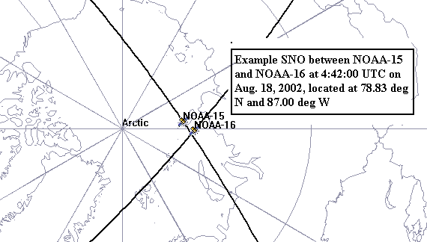
Typical Simultaneous Nadir Overpass
Cao et. al., J. Atmos. Ocn. Tech., 2004

Slide 6
Operational ATMS and AMSU-A/MHS SNO Ensemble Dataset
SNO events are analyzed between NOAA-19, Metop-A and Metop-B AMSU/MHS and
  Suomi-NPP ATMS (January 1, 2012 to August 30, 2019)
  JPSS1 ATMS (January 1, 2018 to August 30, 2019)
Locations are Typically Around 80º North and South
SNO time difference threshold is 90 seconds

Slide 7
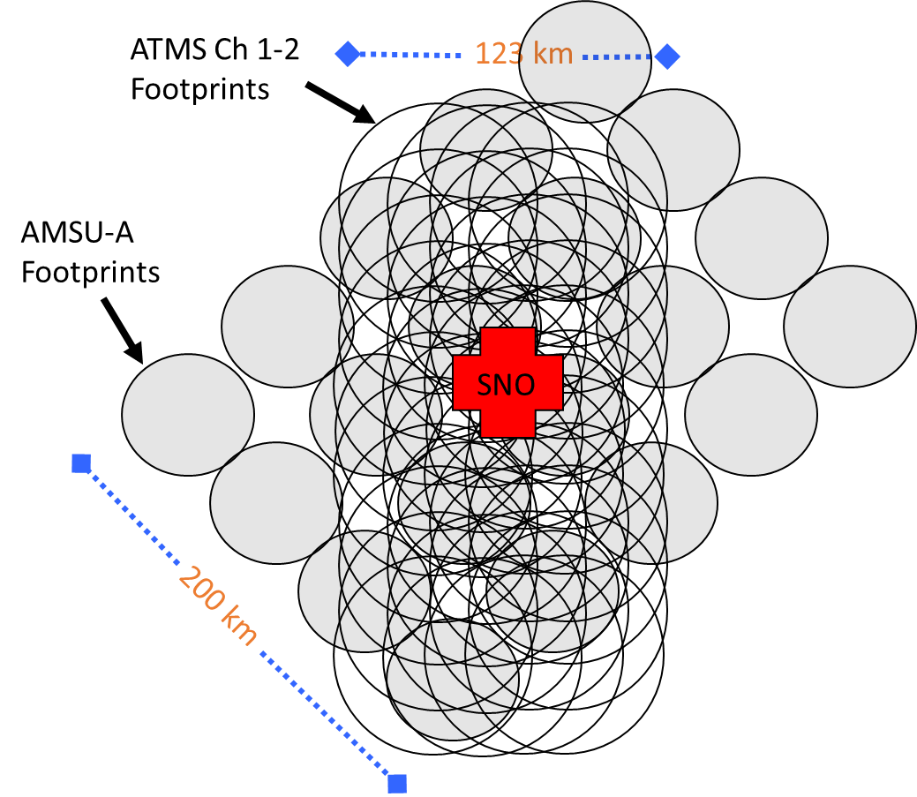
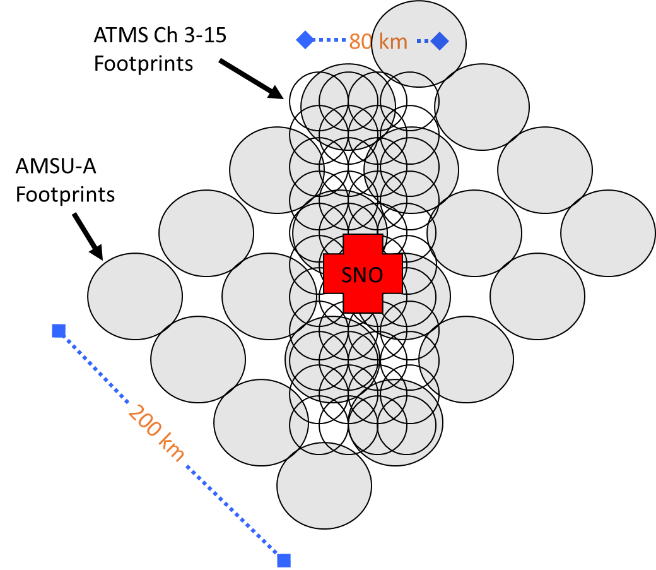
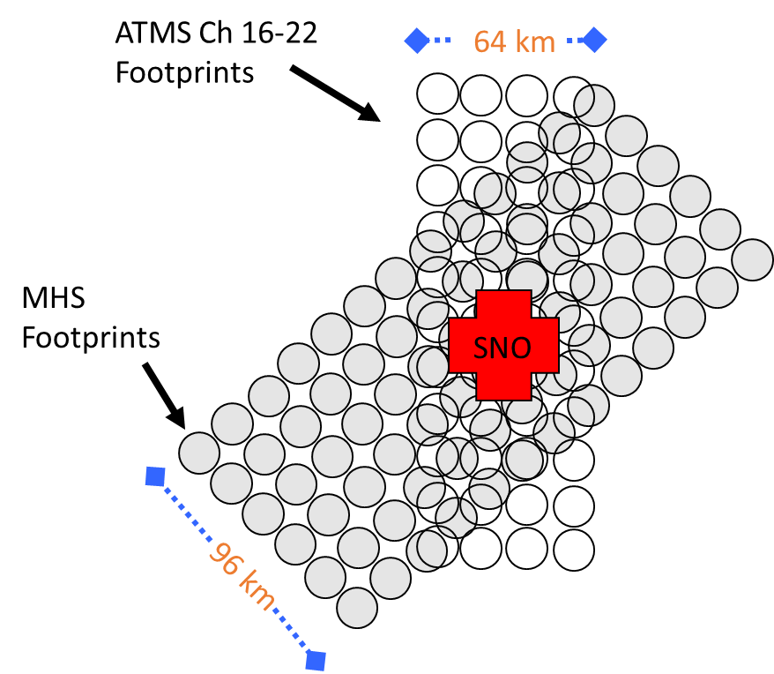
Illustration of SNO Event ATMS and AMSU-A Dataset Collocation
K and Ka Band
V Band
W and G Band

Slide 8
Baseline SNO Event Analysis Method
1) Find collocated matched pairs of ATMS and AMSU-A/MHS data at an SNO event
For ATMS and AMSU-A (MHS) data matchups, assume a distance displacement less than or equal to 15 km (5 km)
2) Perform simple arithmetic and statistics on matched data pairs over the SNO event for associated ATMS and AMSU-A/MHS channels
Determine the Ta bias for each matched ATMS and AMSU-A/MHS sample pair.
Average the Ta bias over all matched data pairs over the whole SNO to obtain an SNO event mean Ta bias.
Baseline SNO analysis can result in large uncertainties, especially for window channels. SNO events can be infrequent (<= 3/month on average), so large uncertainties reduces confidence in microwave sounder Ta biases and trends. The goal of this study is to reduce the uncertainties associated with SNO method data analyses.

Slide 9
Analysis Methods* Tested to Reduce SNO Technique Uncertainties
  Interpolating AMSU/MHS data to ATMS data locations for matched data pairs
  Applying screening techniques to each individual SNO using one or a combination of the following parameters, and their associated threshold values
    For each matchup pair
      Percentage of AMSU/MHS local scene variability due to NEDT (V_NEDT)
      Constant Ta bias offset relative to SNO event mean Ta bias
      Channel dependent Ta bias offset (based on a benchmark estimate of scene Ta variability) relative to SNO event mean Ta bias.
    The required minimum number of resultant matchup pairs
    *See appendix for more details

Slide 10
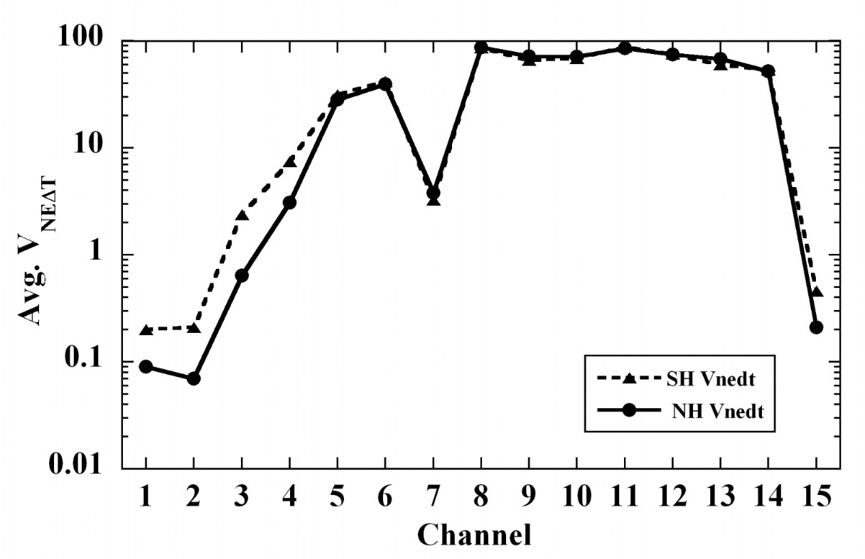
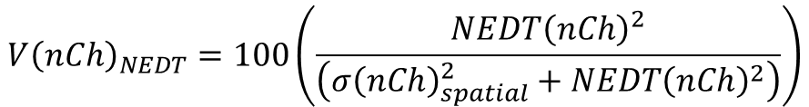
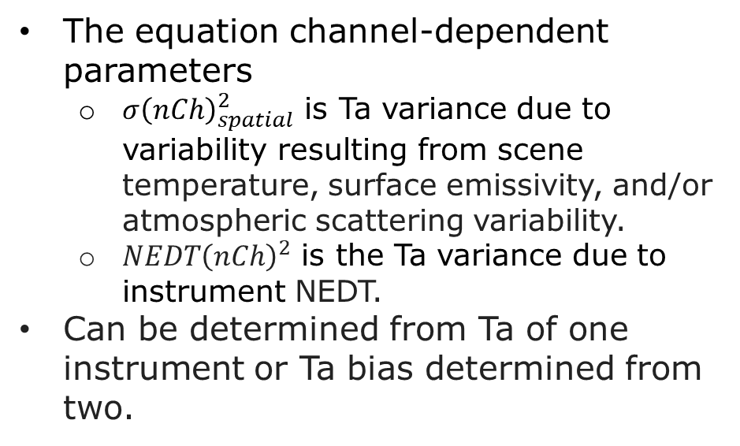
Percentage of AMSU/MHS local scene variability due to NEDT (V_NEDT)
$${V\left(nCh\right)}_{NEDT}=100\left(\frac{{NEDT\left(nCh\right)}^{2}}{\left({σ\left(nCh\right)}_{spatial}^{2}+{NEDT\left(nCh\right)}^{2}\right)}\right)$$
nCh is the channel number 1-15 for ATMS and 1-5 for MHS.
The equation channel-dependent parameters
  ${σ\left(nCh\right)}_{spatial}^{2}$ is Ta variance due to variability resulting from scene temperature, surface emissivity, and/or atmospheric scattering variability.
  ${NEDT\left(nCh\right)}^{2}$ is the Ta variance due to instrument NEDT.
Can be determined from Ta of one instrument or Ta bias determined from two.
The SNO-ensemble average of parameter V_NEDT as a function of AMSU-A channel for the population of 89 Northern Hemisphere and 85 Southern Hemisphere SNO events between N-18 and Aqua AMSU-A instruments. (Iacovazzi and Cao, 2007, JTECH)

Slide 11
Results

Slide 12
Tables of percent change between the output of the SNO technique implemented with interpolation and/or data screening relative to output produced with the Baseline SNO technique.
Time-series Average of Individual SNO Event Ta Bias Standard Deviation

Slide 13
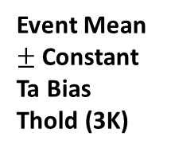
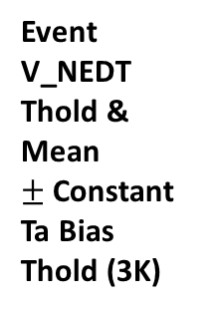
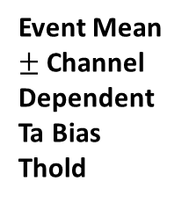
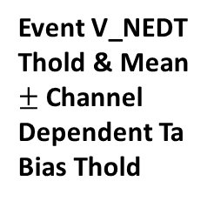
Surface Channels – ATMS Chs 1-3, 5, 15, 16, 21
SAT | S-NPP |  | J01
 | No Int | Int | No Int | Int
N19 | 0 % | -15 % | 0 % | -15 %
MA | 0 % | -17 % | 0 % | -14 %
MB | 0 % | -18 % | 0 % | -17 %
No Screening Method
SAT | S-NPP |  | J01
 | No Int | Int | No Int | Int
N19 | -37 % | -41 % | -34 % | -39 %
MA | -34 % | -41 % | -38 % | -42 %
MB | -35 % | -41 % | -38 % | -44 %
Event Mean $±$Constant Ta Bias Thold (3K)
SAT | S-NPP |  | J01
 | No Int | Int | No Int | Int
N19 | -12 % | -24 % | -10 % | -22 %
MA | -7 % | -20 % | -10 % | -21 %
MB | -11 % | -25 % | -16 % | -27 %
Event Mean $±$Channel Dependent Ta Bias Thold
SAT | S-NPP |  | J01
 | No Int | Int | No Int | Int
N19 | -22 % | -33 % | -21 % | -33 %
MA | -24 % | -35 % | -26 % | -36 %
MB | -24 % | -35 % | -27 % | -38 %
Event V_NEDT Thold
SAT | S-NPP |  | J01
 | No Int | Int | No Int | Int
N19 | -44 % | -47 % | -41 % | -45 %
MA | -42 % | -46 % | -45 % | -47 %
MB | -43 % | -46 % | -47 % | -50 %
Event V_NEDT Thold & Mean $±$Constant Ta Bias Thold (3K)
SAT | S-NPP |  | J01
 | No Int | Int | No Int | Int
N19 | -27 % | -38 % | -25 % | -37 %
MA | -24 % | -35 % | -27 % | -36 %
MB | -28 % | -39 % | -32 % | -42 %
Event V_NEDT Thold & Mean $±$Channel Dependent Ta Bias Thold
Notes:
A constant Ta bias threshold lowers the event standard deviation the most (~35-45%), which is due to having a strict limit on Ta bias relative to the local mean.
Screening for locally large Ta inhomogeneities with the V_NEDT parameter can lower standard deviation by as much as 25-30 %.
Interpolation diminishes the effects of spatial inhomogeneity between data sets, which in turn leads it to lower standard deviation (~15%) by lowering Ta biases.
Interpolation and data screening can act together to reduce standard deviation.
Interesting that the channel dependent Ta bias cause fewest rejected matchup, but does a fairly decent job reducing standard deviation. It gets rid of the worst offenders without artificially reducing variability.

Slide 14
Sounding Channels – ATMS Chs 6-14, 17 and 19
SAT | S-NPP |  | J01
 | No Int | Int | No Int | Int
N19 | 0 % | 0 % | 0 % | -1 %
MA | 0 % | -2 % | 0 % | -2 %
MB | 0 % | -2 % | 0 % | -2 %
No Screening Method
SAT | S-NPP |  | J01
 | No Int | Int | No Int | Int
N19 | -9 % | -10 % | -8 % | -9 %
MA | -11 % | -13 % | -2 % | -3 %
MB | -2 % | -4 % | -3 % | -5 %
Event Mean $±$Constant Ta Bias Thold (3K)
SAT | S-NPP |  | J01
 | No Int | Int | No Int | Int
N19 | -2 % | -3 % | -2 % | -3 %
MA | -7 % | -9 % | -1 % | -3 %
MB | 0 % | -2 % | -1 % | -3 %
Event Mean $±$Channel Dependent Ta Bias Thold
SAT | S-NPP |  | J01
 | No Int | Int | No Int | Int
N19 | -1 % | -1 % | -1 % | -1 %
MA | -9 % | -9 % | -1 % | -2 %
MB | -2 % | -3 % | -3 % | -4 %
Event V_NEDT Thold
SAT | S-NPP |  | J01
 | No Int | Int | No Int | Int
N19 | -10 % | -10 % | -9 % | -9 %
MA | -12 % | -13 % | -3 % | -4 %
MB | -4 % | -5 % | -5 % | -6 %
Event V_NEDT Thold & Mean $±$Constant Ta Bias Thold (3K)
SAT | S-NPP |  | J01
 | No Int | Int | No Int | Int
N19 | -3 % | -3 % | -2 % | -3 %
MA | -10 % | -10 % | -2 % | -3 %
MB | -2 % | -3 % | -3 % | -4 %
Event V_NEDT Thold & Mean $±$Channel Dependent Ta Bias Thold
Notes:
Much less reduction in standard deviation, simply because the scenes themselves are more homogenous.
Metop-A AMSU-A versus S-NPP ATMS causes the largest dips (~10% ) in standard deviation for the sounding channels.
Constant Ta bias threshold relative to the local mean Ta bias reduces S-NPP bias relative to NOAA-19. This could be mainly due to channel 8.
(S-NPP) A08 | 0. 0. -21. -22. -13. -13. 0. 0. -21. -22. -13. -13. |
(J01) A08 | 0. -0. -26. -26. -16. -16. 0. -0. -26. -26. -16. -16. |

Slide 15
Tables of percent change between the output of the SNO technique implemented with interpolation and/or data screening relative to output produced with the Baseline SNO technique.
SNO Ta Bias Time Series Standard Deviation

Slide 16
Surface Channels – ATMS Chs 1-3, 5, 15, 16, 21
SAT | S-NPP |  | J01
 | No Int | Int | No Int | Int
N19 | 0 % | -12 % | 0 % | -13 %
MA | 0 % | -9 % | 0 % | -8 %
MB | 0 % | -7 % | 0 % | -10 %
No Screening Method
SAT | S-NPP |  | J01
 | No Int | Int | No Int | Int
N19 | -5 % | -17 % | -11 % | -23 %
MA | -4 % | -14 % | -5 % | -17 %
MB | -3 % | -10 % | -2 % | -11 %
Event Mean $±$Constant Ta Bias Thold (3K)
SAT | S-NPP |  | J01
 | No Int | Int | No Int | Int
N19 | 1 % | -11 % | 1 % | -13 %
MA | -2 % | -9 % | -3 % | -11 %
MB | 2 % | -5 % | -5 % | -8 %
Event Mean $±$Channel Dependent Ta Bias Thold
SAT | S-NPP |  | J01
 | No Int | Int | No Int | Int
N19 | -5 % | -18 % | -7 % | -19 %
MA | -8 % | -20 % | -5 % | -17 %
MB | -5 % | -16 % | 0 % | -18 %
Event V_NEDT Thold
SAT | S-NPP |  | J01
 | No Int | Int | No Int | Int
N19 | -8 % | -19 % | -14 % | -26 %
MA | -7 % | -17 % | -2 % | -11 %
MB | -8 % | -14 % | -4 % | -13 %
Event V_NEDT Thold & Mean $±$Constant Ta Bias Thold (3K)
SAT | S-NPP |  | J01
 | No Int | Int | No Int | Int
N19 | -3 % | -16 % | -9 % | -21 %
MA | -8 % | -20 % | -6 % | -17 %
MB | -4 % | -14 % | 2 % | -15 %
Event V_NEDT Thold & Mean $±$Channel Dependent Ta Bias Thold
Notes:
Interpolation is an important player in lowering SNO time series standard deviation (~10%)
The local Ta variability expressed by V_NEDT, and a constant Ta bias threshold, similarly lower the SNO standard deviation by less than 10%.
The channel dependent Ta bias has very little impact (<5 %) on reducing SNO time series standard deviation.
Combining interpolation with data screening for either the local Ta variability expressed by V_NEDT, or a constant Ta bias threshold, have similar impacts of reducing SNO time series standard deviation (~15-25%).

Slide 17
Sounding Channels – ATMS Chs 6-14, 17 and 19
SAT | S-NPP |  | J01
 | No Int | Int | No Int | Int
N19 | 0 % | 0 % | 0 % | 0 %
MA | 0 % | 0 % | 0 % | 1 %
MB | 0 % | 0 % | 0 % | 0 %
No Screening Method
SAT | S-NPP |  | J01
 | No Int | Int | No Int | Int
N19 | 2 % | 2 % | 2 % | 2 %
MA | -4 % | -5 % | -2 % | -1 %
MB | 0 % | 0 % | 0 % | 0 %
Event Mean $±$Constant Ta Bias Thold (3K)
SAT | S-NPP |  | J01
 | No Int | Int | No Int | Int
N19 | 1 % | 1 % | 1 % | 2 %
MA | -2 % | -2 % | -2 % | -1 %
MB | 0 % | 0 % | -1 % | 1 %
Event Mean $±$Channel Dependent Ta Bias Thold
SAT | S-NPP |  | J01
 | No Int | Int | No Int | Int
N19 | 0 % | 0 % | 2 % | 2 %
MA | -8 % | -9 % | -2 % | -1 %
MB | -2 % | -2 % | -2 % | -1 %
Event V_NEDT Thold
SAT | S-NPP |  | J01
 | No Int | Int | No Int | Int
N19 | 2 % | 1 % | 2 % | 2 %
MA | -8 % | -8 % | -4 % | -3 %
MB | -2 % | -2 % | -2 % | -2 %
Event V_NEDT Thold & Mean $±$Constant Ta Bias Thold (3K)
SAT | S-NPP |  | J01
 | No Int | Int | No Int | Int
N19 | 2 % | 1 % | 2 % | 3 %
MA | -9 % | -9 % | -4 % | -3 %
MB | -2 % | -2 % | -2 % | -1 %
Event V_NEDT Thold & Mean $±$Channel Dependent Ta Bias Thold
Notes:
All interpolation and screening has much less of an impact on sounding channel scenes, which have a tendency to have Ta that is spatially homogeneous.
There is about a 10 % reduction of for S-NPP versus Metop-A.
(S-NPP) A08 | 0. -0. -43. -59. -18. -18. -100. -100. -100. -100. -100. -100. |
(J01) A08 | -0. -0. -0. -0. -0. -0. -0. -0. -0. -0. -0. -0. |
Could be due to S-NPP algorithm change having effect on Channel 8

Slide 18
Side-by-side plots trending Ta biases produced when implementing the SNO method with
Event Mean ± Constant Ta Bias Threshold (3K)
Combination of interpolation and data screening using 1) Event V_NEDT Threshold and 2) Mean ± Channel Dependent Ta Bias Threshold

Slide 19
S-NPP ATMS versus NOAA-19 and Metop-B AMSU-A

Slide 20
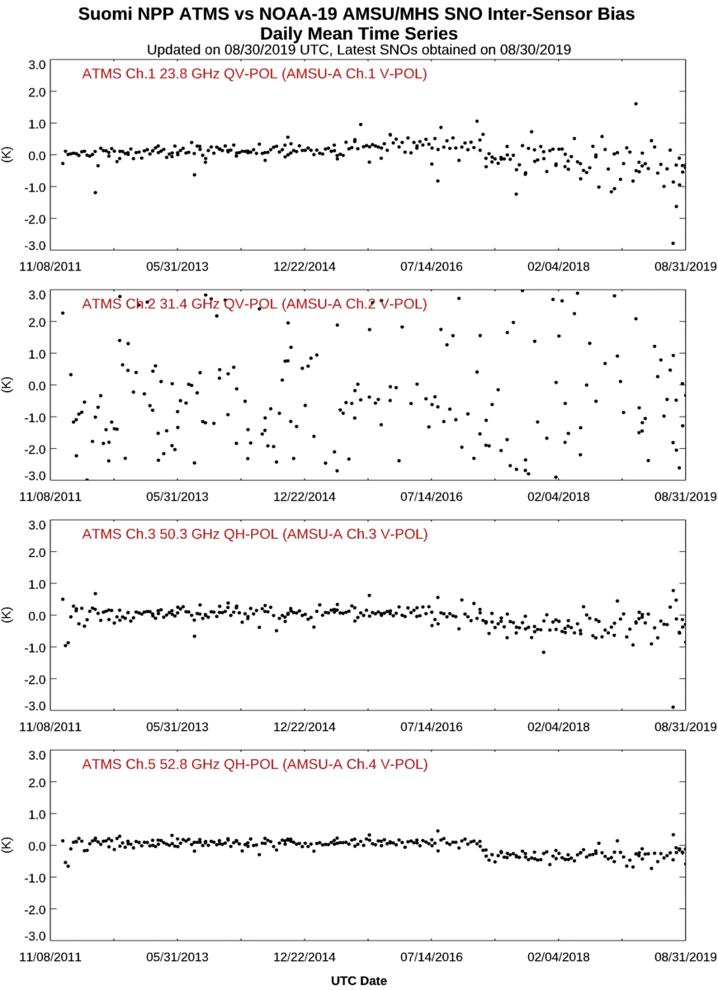
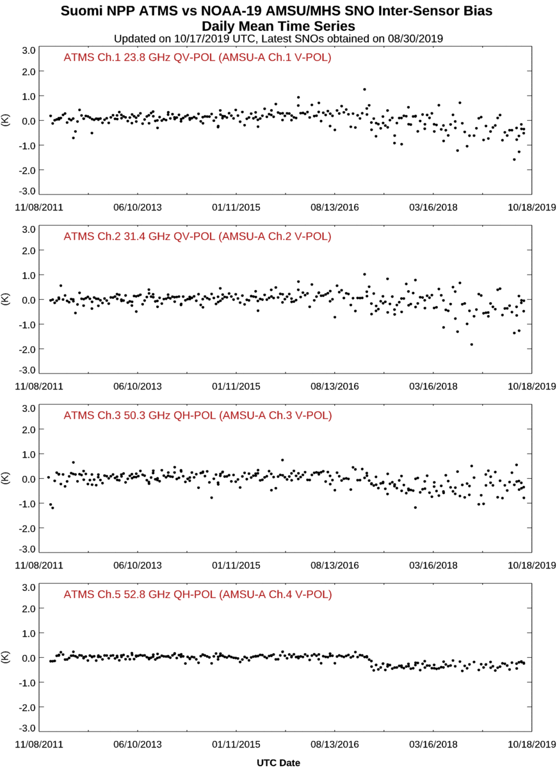
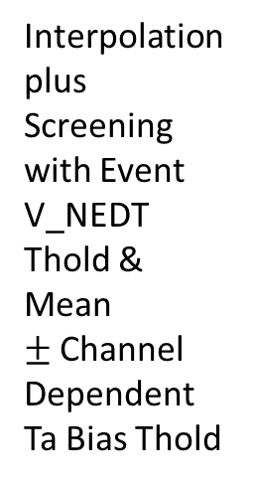
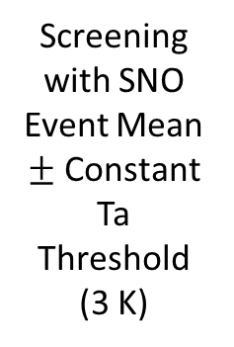
S-NPP ATMS and NOAA-19 AMSU-A/MHS Band 1 Inter-Comparison
Screening with SNO Event Mean $±$ Constant Ta Threshold (3 K)
Interpolation plus Screening with Event V_NEDT Thold & Mean $±$Channel Dependent Ta Bias Thold

Slide 21
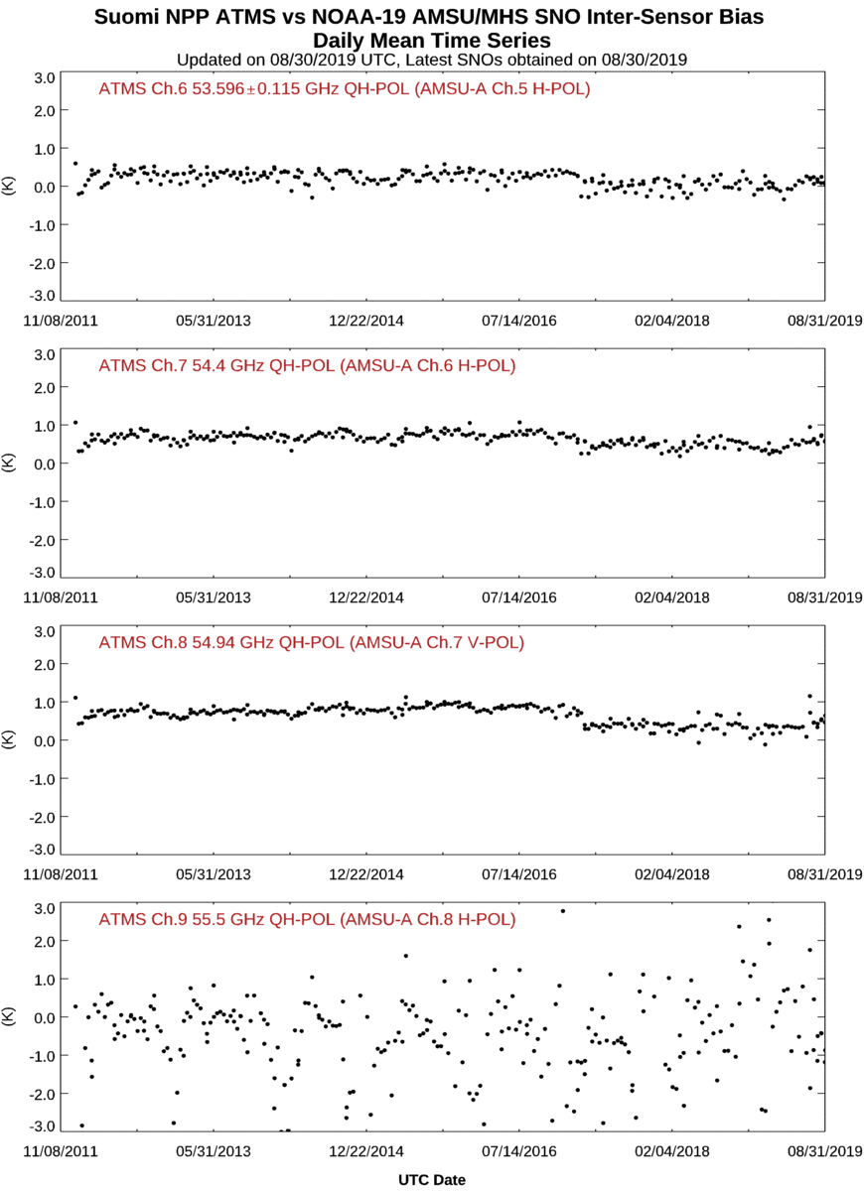
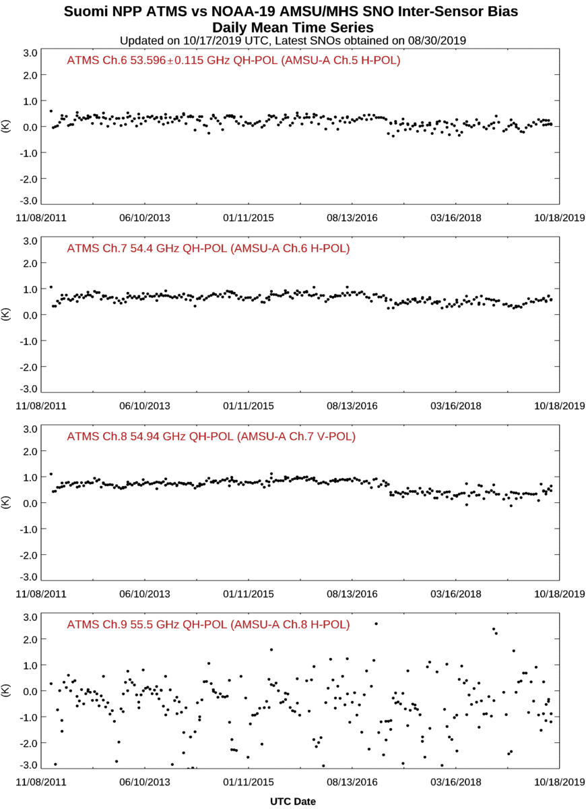
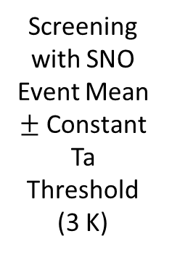
S-NPP ATMS and NOAA-19 AMSU-A/MHS Band 2 Inter-Comparison
Screening with SNO Event Mean $±$ Constant Ta Threshold (3 K)
Interpolation plus Screening with Event V_NEDT Thold & Mean $±$Channel Dependent Ta Bias Thold

Slide 22
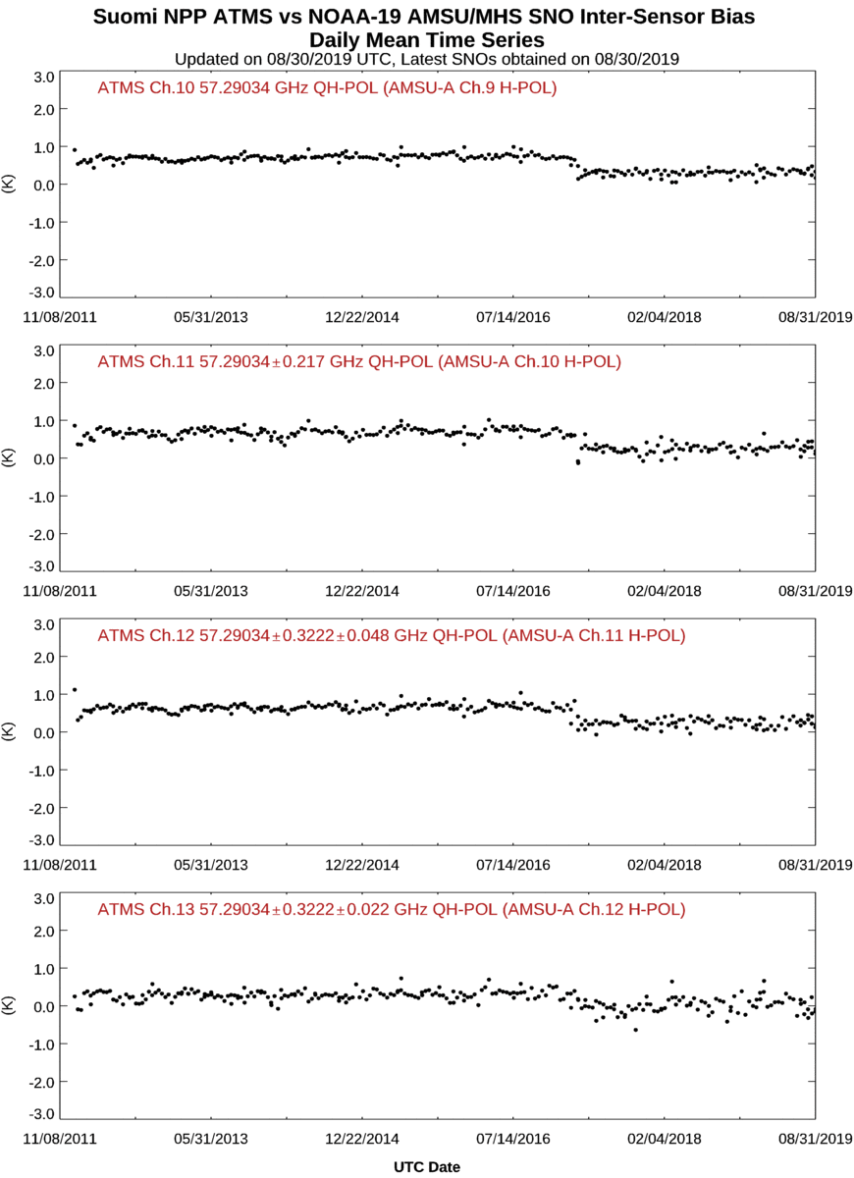
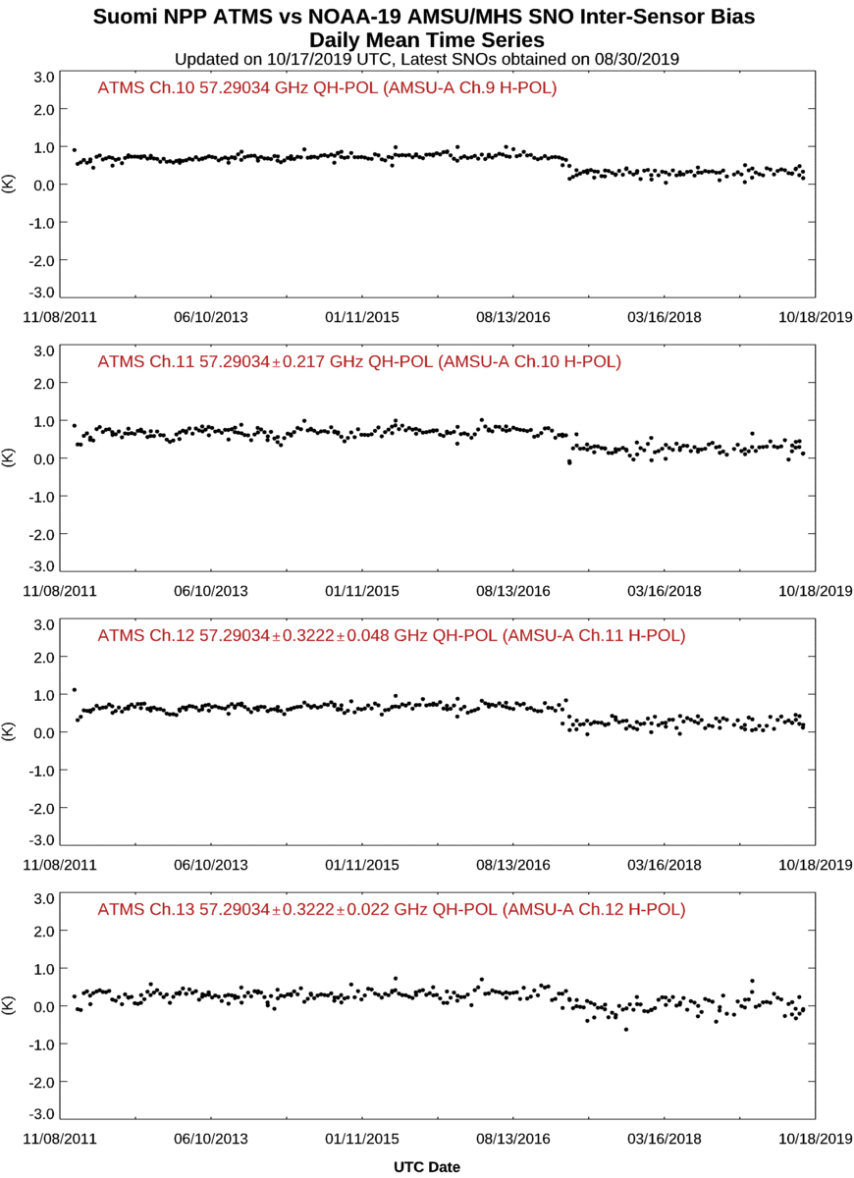
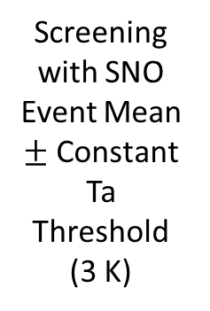
S-NPP ATMS and NOAA-19 AMSU-A/MHS Band 3 Inter-Comparison
Screening with SNO Event Mean $±$ Constant Ta Threshold (3 K)
Interpolation plus Screening with Event V_NEDT Thold & Mean $±$Channel Dependent Ta Bias Thold

Slide 23
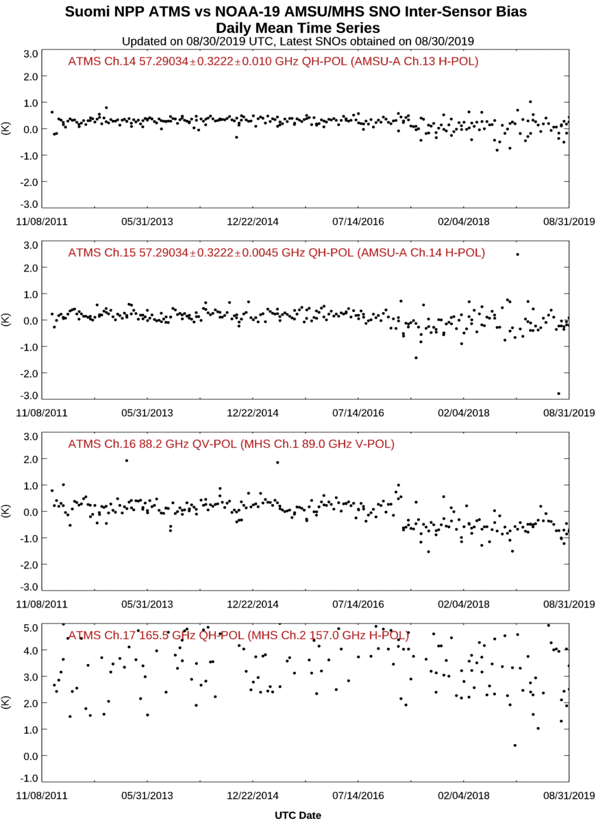
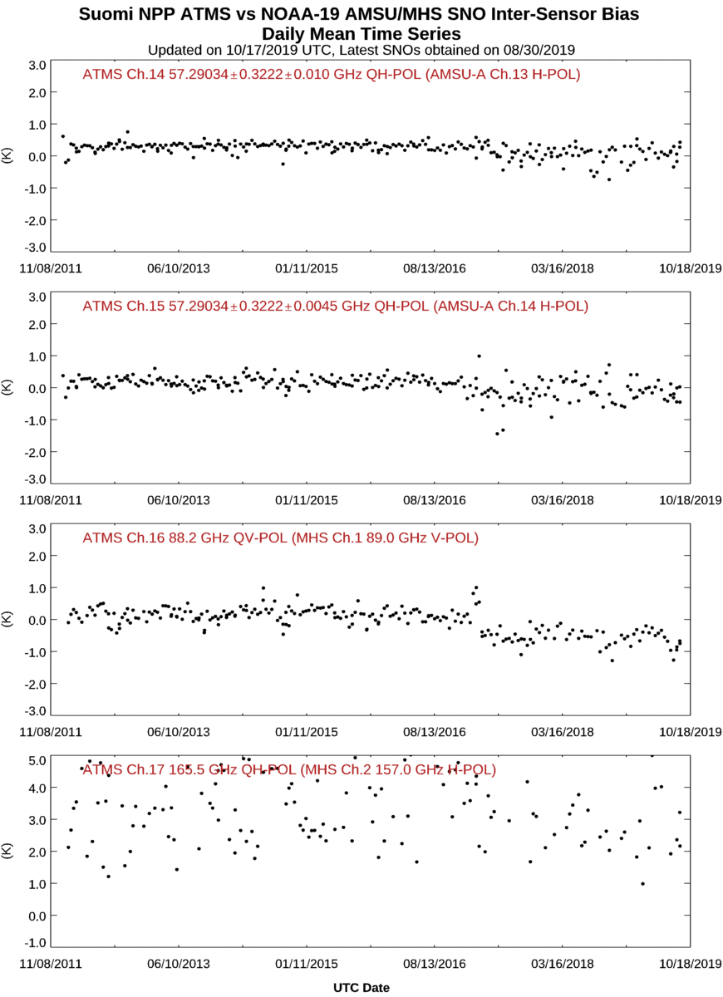
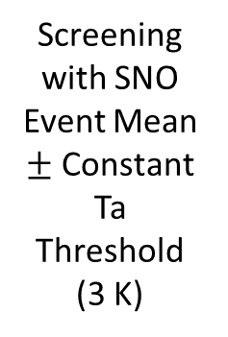
S-NPP ATMS and NOAA-19 AMSU-A/MHS Band 4 Inter-Comparison
Screening with SNO Event Mean $±$ Constant Ta Threshold (3 K)
Interpolation plus Screening with Event V_NEDT Thold & Mean $±$Channel Dependent Ta Bias Thold

Slide 24
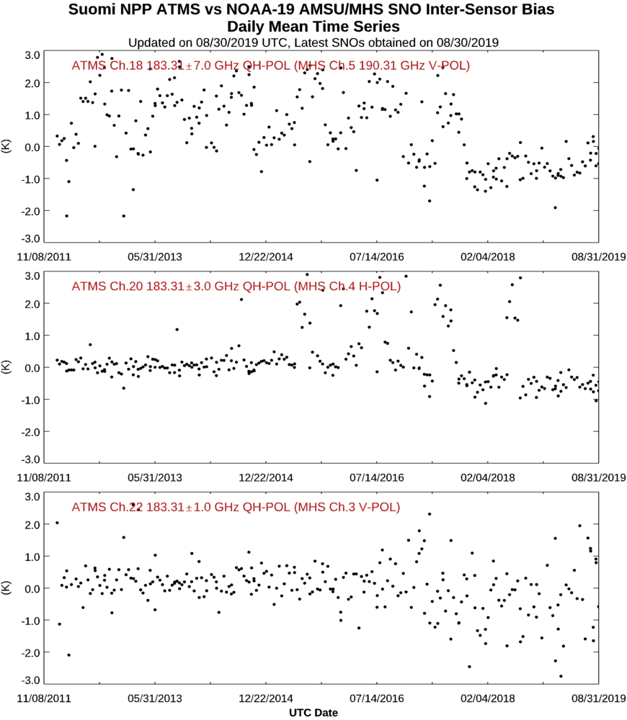
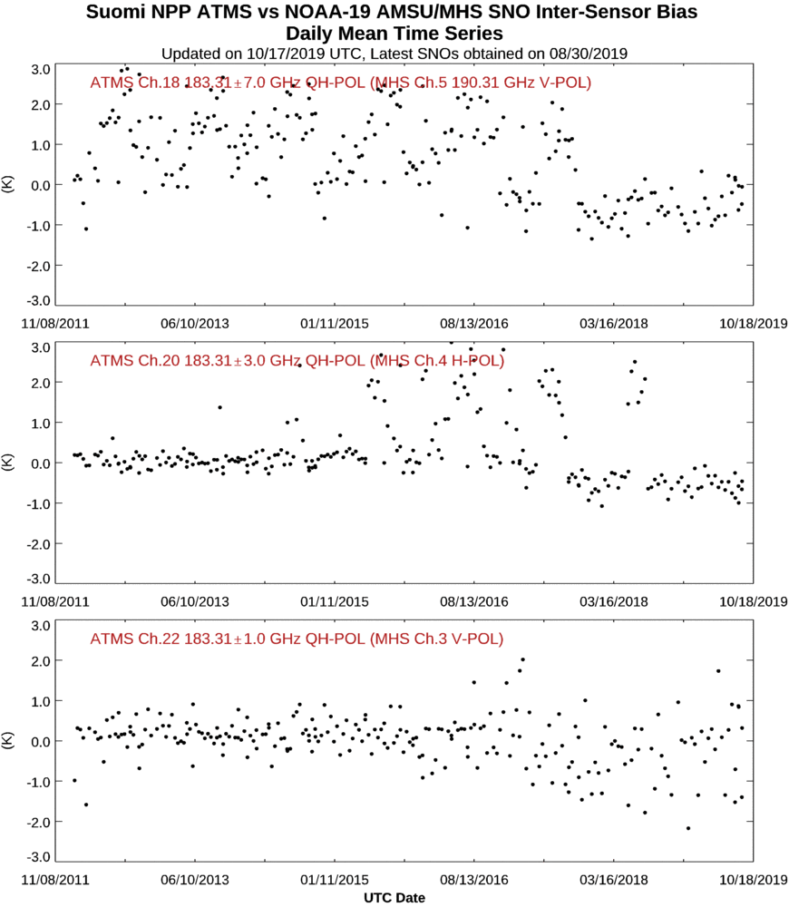
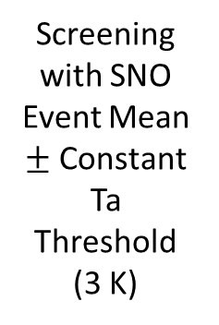
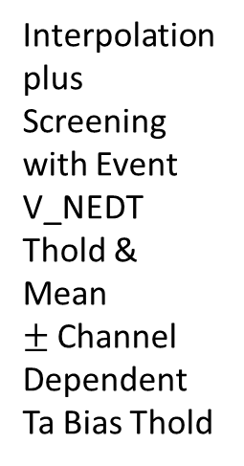
S-NPP ATMS and NOAA-19 AMSU-A/MHS Band 5 Inter-Comparison
Screening with SNO Event Mean $±$ Constant Ta Threshold (3 K)
Interpolation plus Screening with Event V_NEDT Thold & Mean $±$Channel Dependent Ta Bias Thold

Slide 25
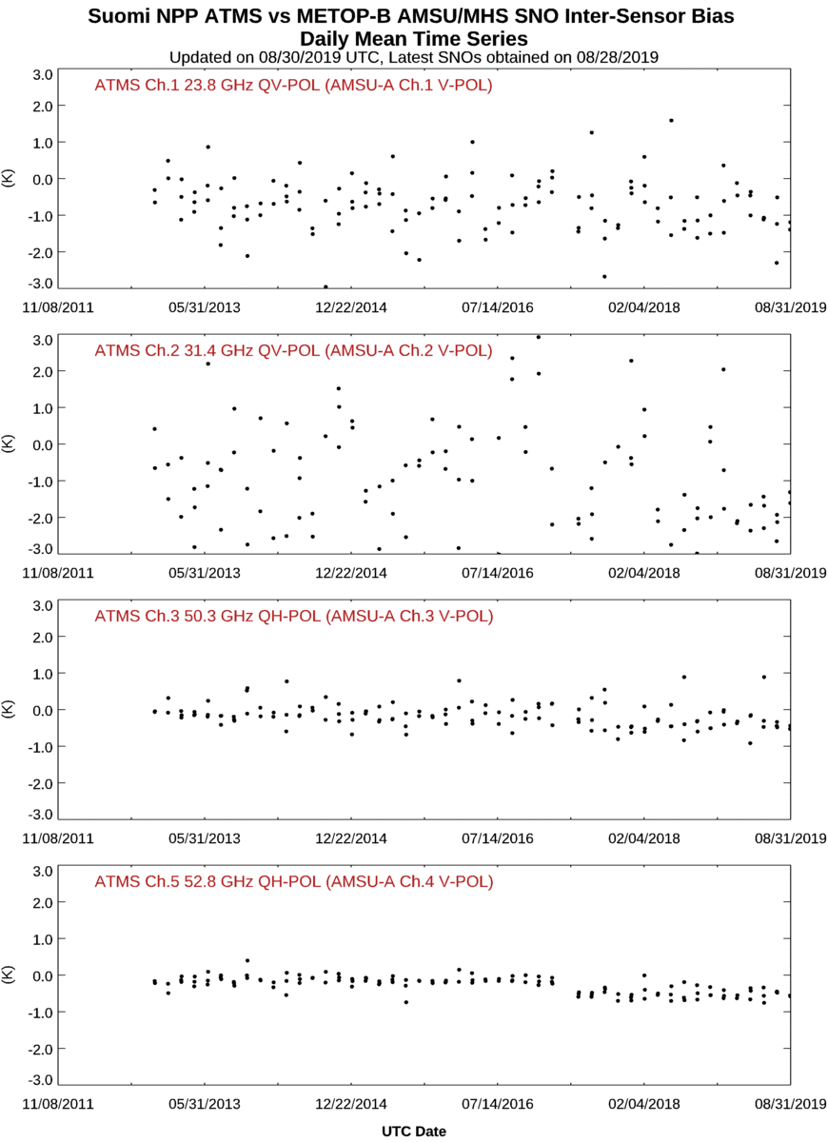
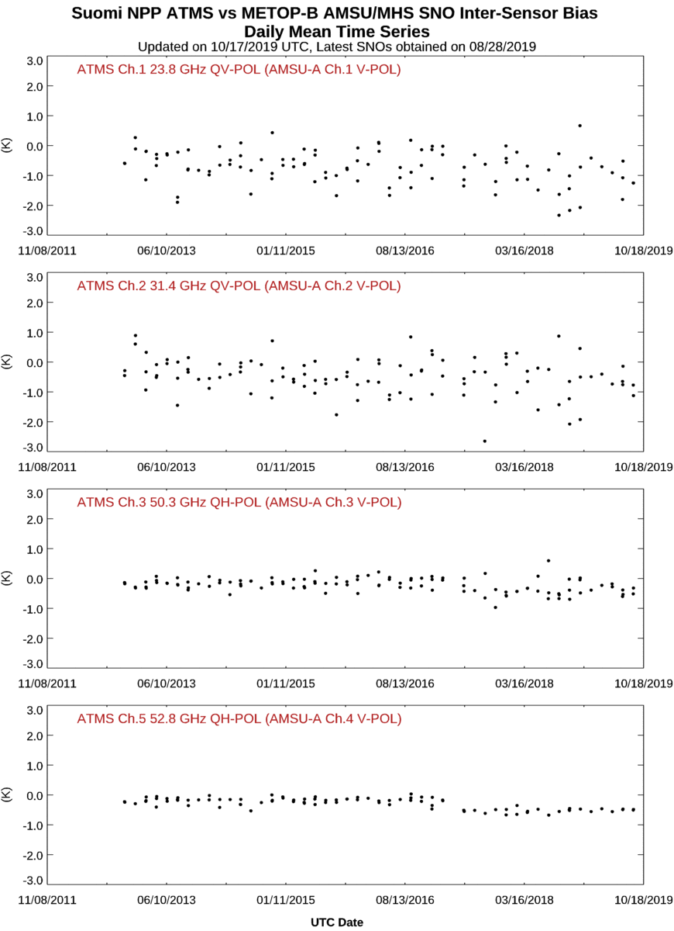
S-NPP ATMS and Metop-B AMSU-A/MHS Band 1 Inter-Comparison
Screening with SNO Event Mean $±$ Constant Ta Threshold (3 K)
Interpolation plus Screening with Event V_NEDT Thold & Mean $±$Channel Dependent Ta Bias Thold

Slide 26
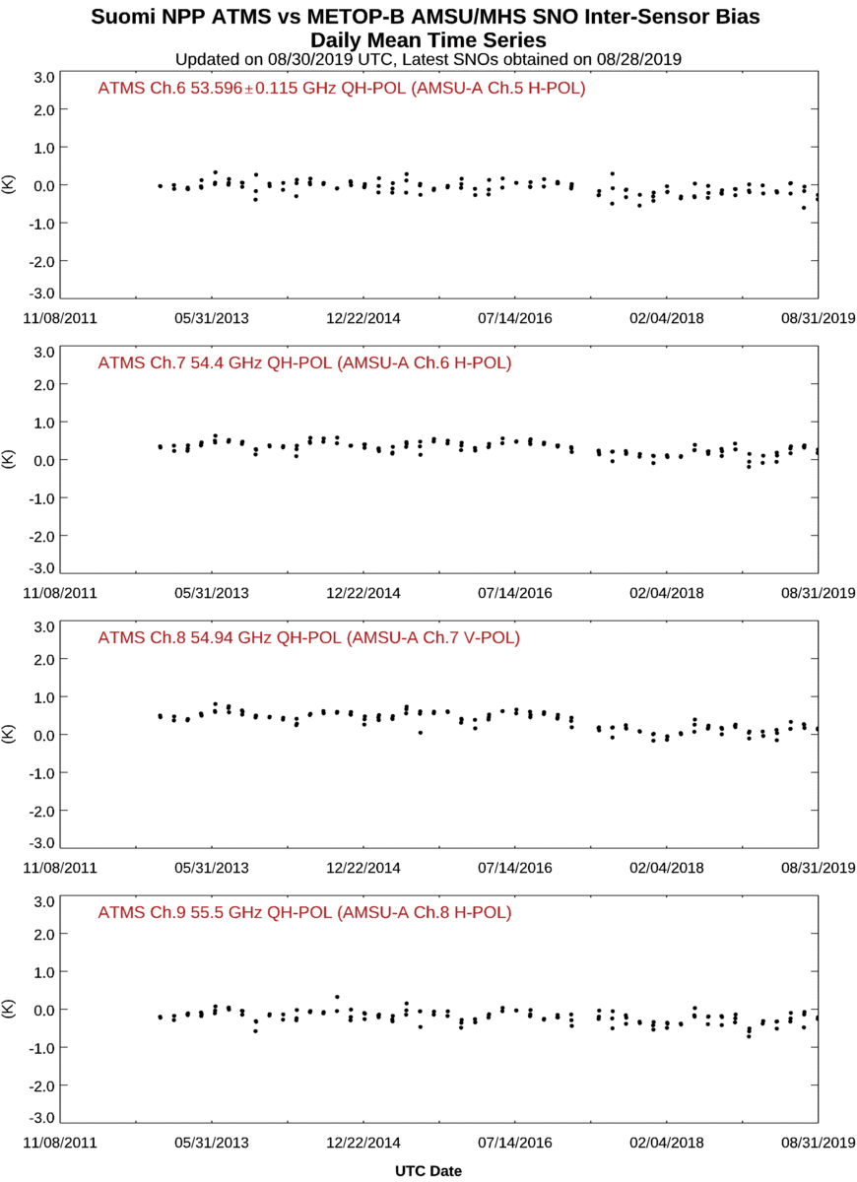
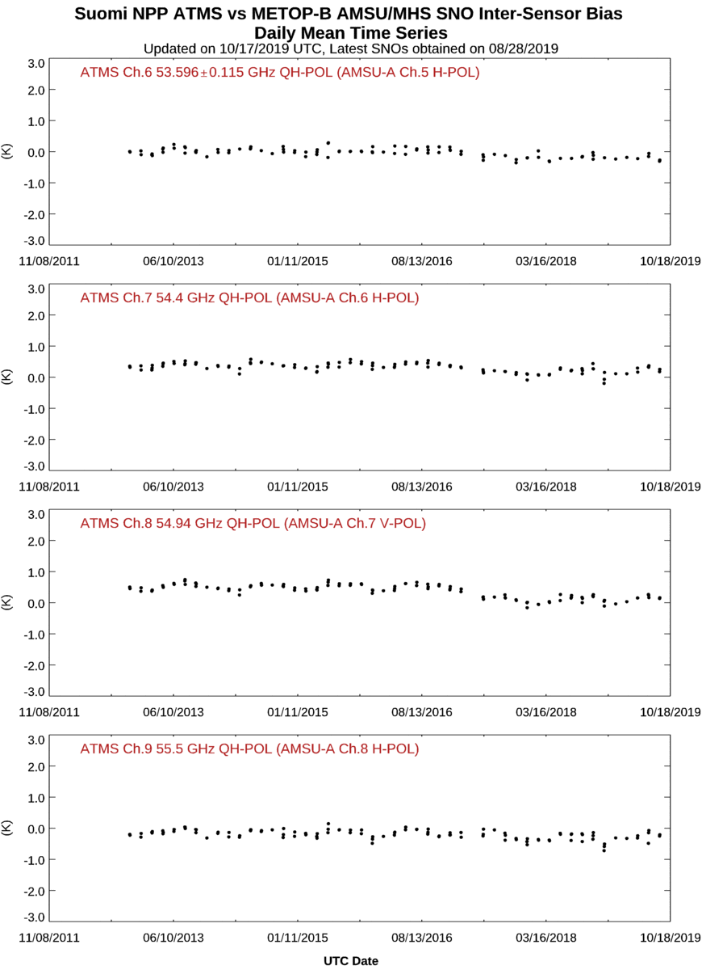
S-NPP ATMS and Metop-B AMSU-A/MHS Band 2 Inter-Comparison
Screening with SNO Event Mean $±$ Constant Ta Threshold (3 K)
Interpolation plus Screening with Event V_NEDT Thold & Mean $±$Channel Dependent Ta Bias Thold

Slide 27
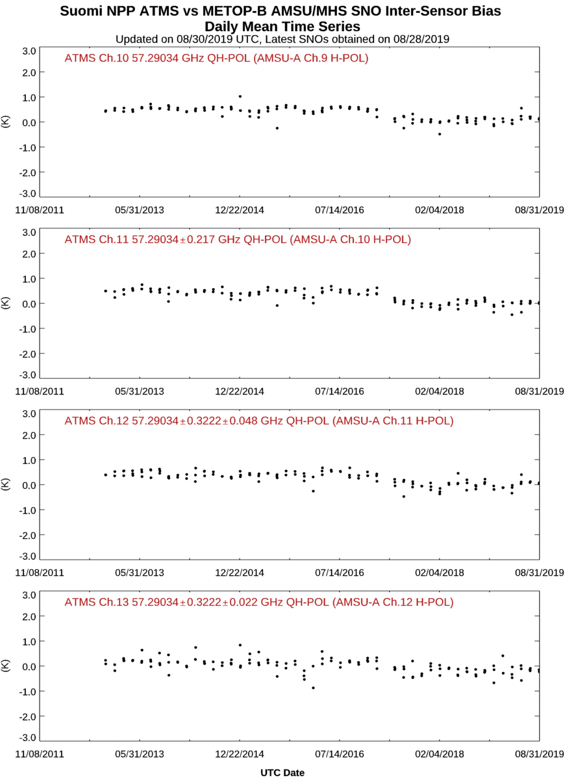
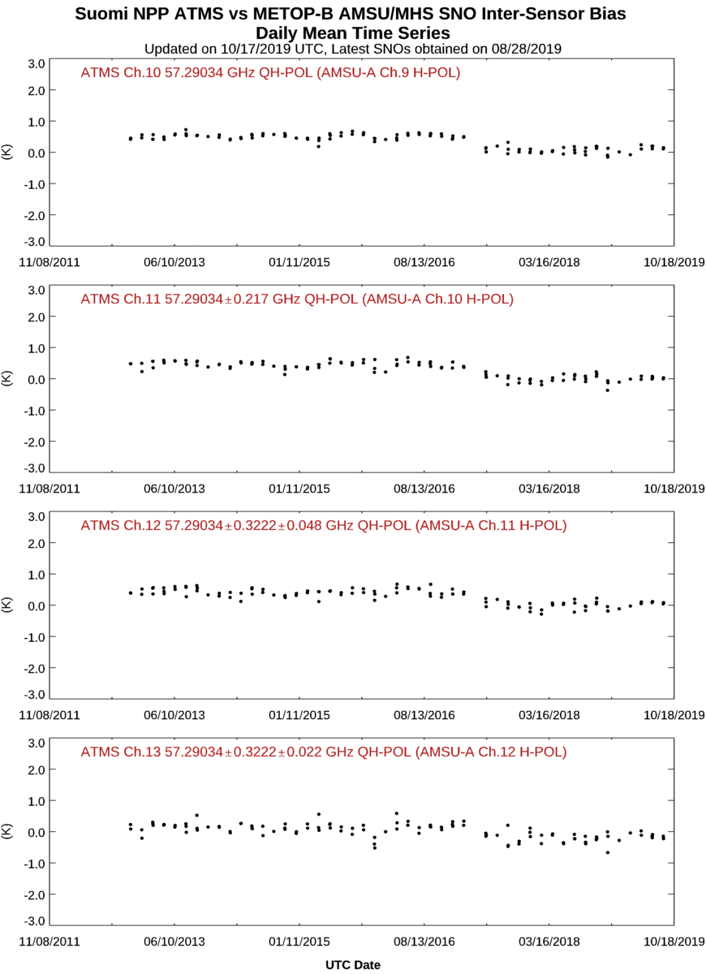
S-NPP ATMS and Metop-B AMSU-A/MHS Band 3 Inter-Comparison
Screening with SNO Event Mean $±$ Constant Ta Threshold (3 K)
Interpolation plus Screening with Event V_NEDT Thold & Mean $±$Channel Dependent Ta Bias Thold

Slide 28
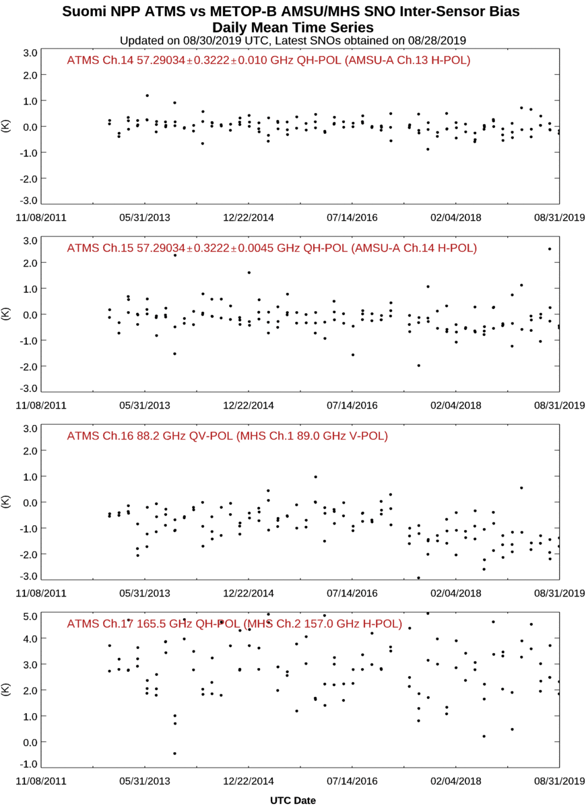
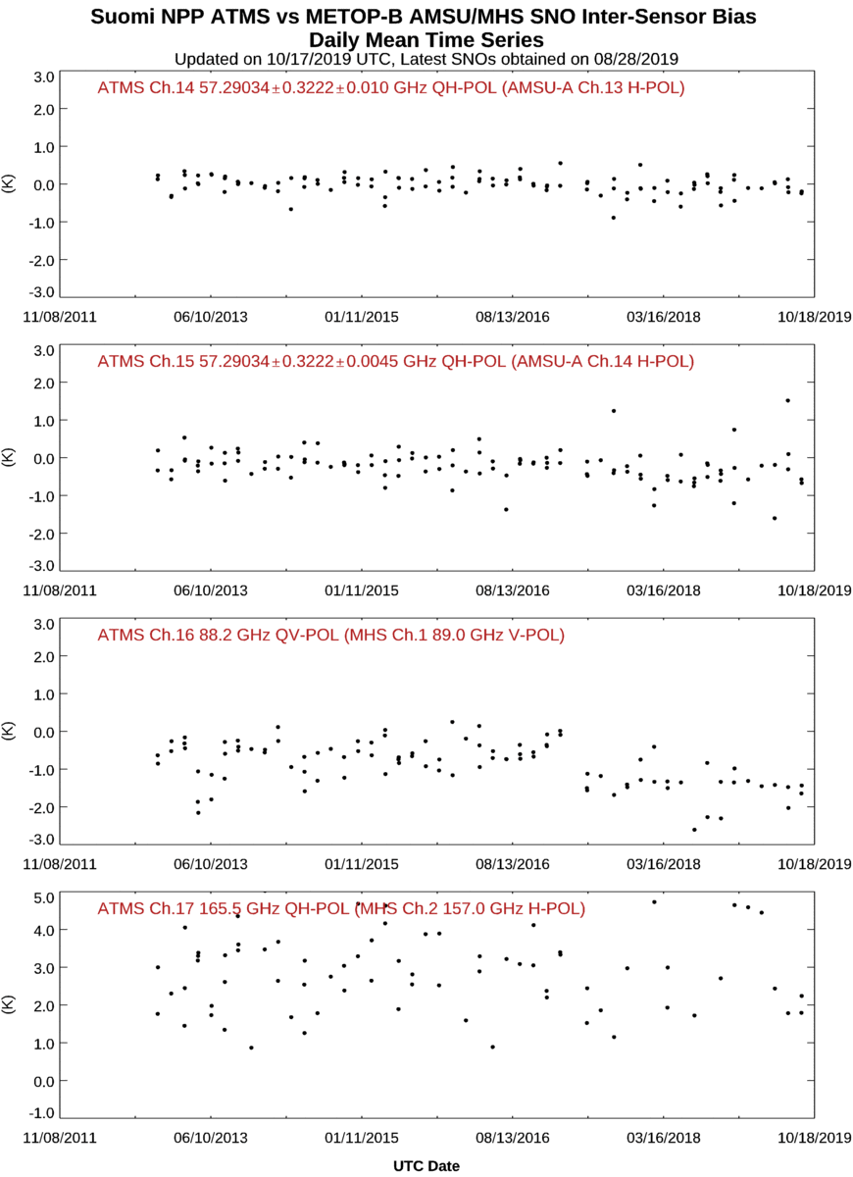
S-NPP ATMS and Metop-B AMSU-A/MHS Band 4 Inter-Comparison
Screening with SNO Event Mean $±$ Constant Ta Threshold (3 K)
Interpolation plus Screening with Event V_NEDT Thold & Mean $±$Channel Dependent Ta Bias Thold

Slide 29
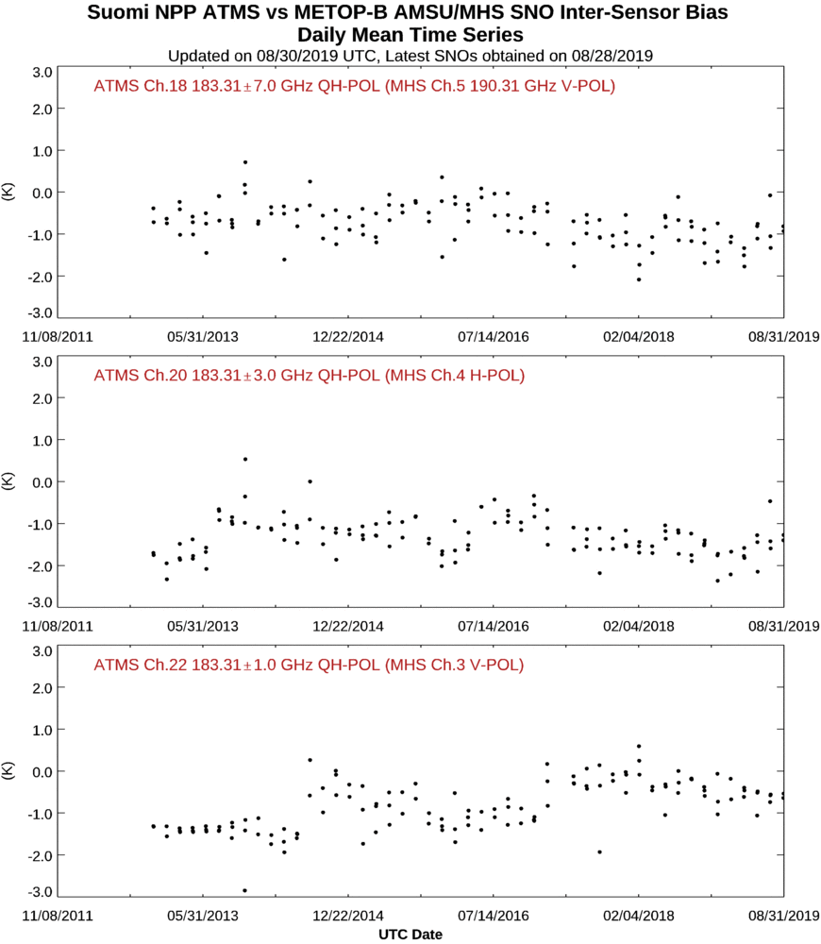
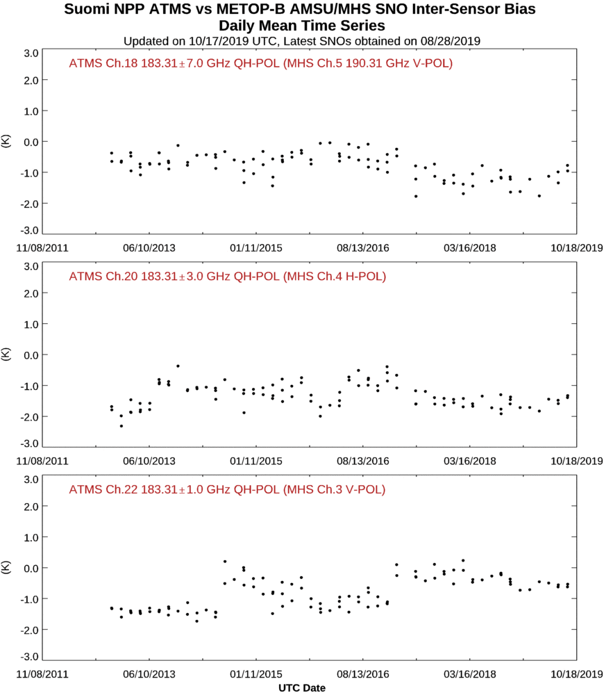
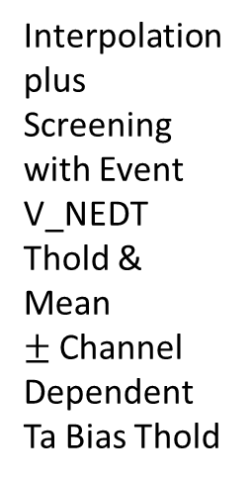
S-NPP ATMS and Metop-B AMSU-A/MHS Band 5 Inter-Comparison
Interpolation plus Screening with Event V_NEDT Thold & Mean $±$Channel Dependent Ta Bias Thold
Screening with SNO Event Mean $±$ Constant Ta Threshold (3 K)

Slide 30
Results Summary: Surface Channels
Impacts of implementing data interpolation and screening techniques on SNO method Ta bias uncertainties relative to using no techniques
  Current Technique: Screen outlier individual match-up Ta biases with a constant threshold about the mean bias. Reductions by over 36 % on average for individual SNO events, and by about 5 % for a time series of SNO events.
  Implementing Interpolation and New Screening Techniques Individually
    Interpolating AMSU-A data to ATMS locations for matchup data pairs: Reductions by over 15 % on average for individual SNO events, and by about 10 % for a time series of SNO events.
    Interpolating and screening out large individual match-up Ta biases: Reduces uncertainty by over 5 % on average for individual SNO events, and by about 3 % for a time series of SNO events, compared to interpolating alone.
    Interpolating and screening out Ta scene inhomogeneity: Reduces uncertainty by over 5 % on average for individual SNO events, and by about 15 % for a time series of SNO events, compared to interpolating alone.
  Combining Interpolation and All New Screening Techniques: Reductions by over 38 % on average for individual SNO events, and by about 17 % for a time series of SNO events.
    Channel 2 has the largest uncertainty reductions when implementing interpolation, where SNO Ta bias uncertainty for a given SNO event on average is reduced by 45 %, and for a SNO Ta bias time series of all events is reduced by about 60 %.
Change in SNO Ta bias mean value is typically between 5 % and 15 % and is usually negative. There are large average values of the change of the SNO mean value between S-NPP ATMS and Metop-A ATMS/MHS (< - 250 %).
Percent of SNO events that are rejected by the combined method ends up to be about 7%, compared to the rejection rate for the current screening method of about 3 %.
Percent of matched data pairs per SNO that are screen out is 21 % to 26 % for the combined screening method, compared to about 16 % for the current method.

Slide 31
Results Summary: Sounding Channels
Impacts of implementing data interpolation and screening techniques on SNO method Ta bias uncertainties relative to no interpolation or screening are on average less than 6 % regardless of the technique or combination thereof.
Change in SNO Ta bias mean value is typically less than 15 % in all cases.
Percent of SNO events that are rejected all methods is 3 % or less for all cases.
Percent of matched data pairs per SNO that are screen out is 7 % or less for all cases.

Slide 32
APPENDIX

Slide 33
SNO Event Data Interpolation Method

Slide 34
Determine θ From Along Track Geolocation Data
ΔLon_{s(at)} = Lon_{s(at2)} - Lon_{s(0)}
Need to reconcile ΔLon_{s(at)} at the date line. (see last slide)
Δd_{Lon}=πr_{e} cos(Lat_{s(0)})|ΔLon_{s(at)}|/180.0
ΔLat_{s(at)} = Lat_{s(at2)} - Lat_{s(0)}
Δd_{Lat}=πr_{e} |ΔLat_{s(at)}|/180.0
R_{e}=6372 km
Ratio(at)=(Δd_{Lat})/((Δd_{Lat})²+(Δd_{Lon})²)^{1/2}
α(at)=arccos(Ratio)
Determine θ From Cross Track Geolocation Data
ΔLon_{s(xt)} = Lon_{s(xt2)} - Lon_{s(0)}
Need to reconcile ΔLon_{s(xt)} at the date line. (see last slide)
Δd_{Lon}=πr_{e} cos(Lat_{s(0)})|ΔLon_{s(xt)}|/180.0
ΔLat_{s(xt)} = Lat_{s(xt2)} - Lat_{s(0)}
Δd_{Lat}=πr_{e} |ΔLat_{s(xt)}|/180.0
Ratio(xt)=(Δd_{Lat})/((Δd_{Lat})²+(Δd_{Lon})²)^{1/2}
α(xt)=arccos(Ratio)
Determine Lat/Lon Directions of Along- and Cross-Track Vectors
Find Sign Along-Track
sgn_{Lon(at)}= ΔLon_{s(at)} / |ΔLon_{s(at)}|
sgn_{Lat(at)}= ΔLat_{s(at)} / |ΔLat_{s(at)}|
Find Sign Cross-Track
sgn_{Lon(xt)}= Δlon_{s(xt)} / |Δlon_{s(xt)}|
sgn_{Lat(xt)}= Δlat_{s(xt)} / |Δlat_{s(xt)}|
North
s
o
o
o
s(at2)
α_{at}
s
α_{xt}
s(xt2)
(0)o
o
β
o
s(0)
East
s(xt1)
s
o
o
o
s(at1)
s

Slide 35
Determine Gradient and its Zonal and Meridional Components
Along Track
Δd_{at}=GreatCircleDist(s(at2),s(at1))
ΔTa_{at}=Ta_{s(at2)}-Ta_{s(at1)}
Grad_{at}=ΔTa_{at}/Δd_{at}
Grad_{at}(Lat)= sgn_{Lat(at)} Grad_{at} cos(α_{at})
Grad_{at}(Lon)= sgn_{Lon(at)} Grad_{at} sin(α_{at})
North
s
o
o
o
s(at2)
α_{at}
s
α_{xt}
s(xt2)
(0)o
o
β
o
Cross Track
Δd_{xt}=GreatCircleDist(s(xt2),s(xt1))
ΔTa_{xt}=Ta_{s(xt2)}-Ta_{s(xt1)}
Grad_{xt}=ΔTa_{xt}/Δd_{xt}
Grad_{xt}(Lat)= sgn_{Lat(xt)} Grad_{xt} cos(α_{xt})
Grad_{xt}(Lon)= sgn_{Lon(xt)} Grad_{xt} sin(α_{xt})
s(0)
East
s(xt1)
s
o
o
o
s(at1)
s
Determine Full Gradient Zonal and Meridional Components
Grad_{tot}(Lat)=Grad_{at}(Lat)+Grad_{xt}(Lat)
Grad_{tot}(Lon)=Grad_{at}(Lon)+Grad_{xt}(Lon)

Slide 36
Determine Lat/Lon Coordinates of the Satellite 2 Sample Point
ΔLon_{o(0)} = Lon_{o(0)} - Lon_{s(0)}
Δd_{Lon}=πr_{e} cos(Lat_{s(0)}) ΔLon_{o(0)}/180.0
Need to reconcile difference at the date line. (see last slide)
ΔLat_{o(0)} = Lat_{o(0)} - Lat_{s(0)}
Δd_{Lat}=πr_{e} |ΔLat_{o(0)}|/180.0
R_{e}=6372 km
North
s
o
o
o
s(at2)
α_{at}
s
α_{xt}
s(xt2)
(0)o
o
β
o
Apply Gradient to find the Ta perturbation between the sample location of the first satellite instrument to the location of second satellite instrument
ΔTa_{(sat1-to-sat2)} = Grad_{tot}(Lon) Δd_{Lon(o(0))} + Grad_{tot}(Lat) Δd_{Lat(o(0))}
Ta_{(sat2)} = Ta_{(s0)} + ΔTa_{(sat1-to-sat2)}
s(0)
East
s(xt1)
s
o
o
o
s(at1)
s

Slide 37
Reconciling the Date Line in Determining Zonal Difference
360º or +180º
0º or -180º
o₁
o₂
Case 1
o₂
o₁
Case 2
Find ΔLon(o)= Lon(o₂) - Lon(o₁)
At a date line, expect* that values of ΔLon(o) << -180º (Case 1) or ΔLon(o) >> 180º (Case 2) are due the footprints being on opposite sides of the date line, and that they need to be reconciled.
Longitude values right of the date line need to be augmented by 360º.
Case 1: ΔLon(o) << -180º
ΔLon(o) = (Lon(o₂) + 360.0) - Lon(o₁) = 360.0 + ΔLon(o)
Case 2: ΔLon(o) >> 180º
ΔLon(o) = Lon(o₂) – (Lon(o₁)+360.0) = ΔLon(o) – 360.0
*At about 80 degrees latitude, where most SNO events are, |ΔLon(o)| will always be less than 7.8º between odd or even pairs of ATMS Ch1 and Ch2 footprints in a scan line. This will be smaller than all other channels for ATMS and AMSU/MHS.

Slide 38
SNO Event Data Screening Methods

Slide 39
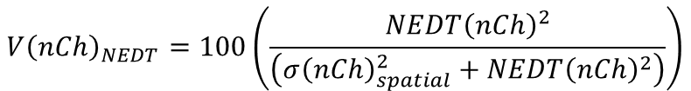
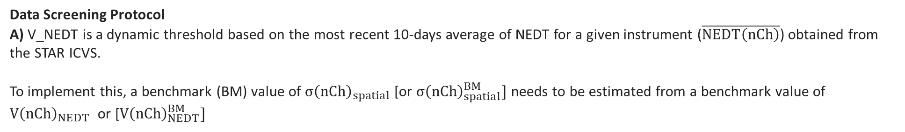
Screening Techniques for SNO Individual ATMS-AMSU/MHS Data Matchups
1) Local AMSU/MHS Scene T_{A} Inhomogeneity
Parameter) Instrument Noise Equivalent Delta Temperature (NEDT) to Scene Ta Variability Ratio (V_NEDT) Threshold [Units = %]
The percentage of inferred scene variance due to instrument noise. When V_NEDT is 100%, then the scene is completely homogeneous and all scene variability results from instrument noise. Decreasing values of V_NEDT are due to increasing scene antenna temperature variance resulting mainly from temperature, surface emissivity, and/or atmospheric scattering variability. In this application, this threshold discards data match-ups when AMSU/MHS have locally small V_NEDT values, which represents locally inhomogeneous environments. The expression for V_NEDT is given by:
$${V\left(nCh\right)}_{NEDT}=100\left(\frac{{NEDT\left(nCh\right)}^{2}}{\left({σ\left(nCh\right)}_{spatial}^{2}+{NEDT\left(nCh\right)}^{2}\right)}\right)$$
nCh is the channel number 1-15 for ATMS and 1-5 for MHS.
In this equation, ${σ\left(nCh\right)}_{spatial}^{2}$ and ${NEDT\left(nCh\right)}^{2}$ are the channel-dependent Ta variance due to 1) variability resulting from scene temperature, surface emissivity, and/or atmospheric scattering variability, and 2) NEDT.
Data Screening Protocol
A) V_NEDT is a dynamic threshold based on the most recent 10-days average of NEDT for a given instrument ($\overline{NEDT\left(nCh\right)}$) obtained from the STAR ICVS.
To implement this, a benchmark (BM) value of ${σ\left(nCh\right)}_{spatial}$ [or ${σ\left(nCh\right)}_{spatial}^{BM}]$ needs to be estimated from a benchmark value of ${V\left(nCh\right)}_{NEDT}$ or [${V\left(nCh\right)}_{NEDT}^{BM}]$

Slide 40
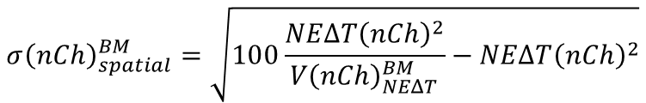
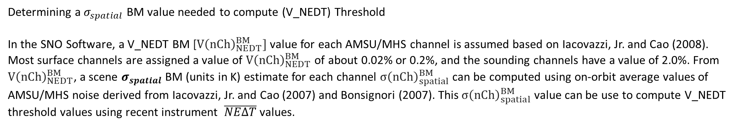
Screening Techniques for SNO Individual ATMS-AMSU/MHS Data Matchups
Determining a $σ_{spatial}$ BM value needed to compute (V_NEDT) Threshold
In the SNO Software, a V_NEDT BM [${V\left(nCh\right)}_{NEDT}^{BM}]$ value for each AMSU/MHS channel is assumed based on Iacovazzi, Jr. and Cao (2008). Most surface channels are assigned a value of ${V\left(nCh\right)}_{NEDT}^{BM}$ of about 0.02% or 0.2%, and the sounding channels have a value of 2.0%. From ${V\left(nCh\right)}_{NEDT}^{BM}$, a scene $σ_{spatial}$ BM (units in K) estimate for each channel ${σ\left(nCh\right)}_{spatial}^{BM}$ can be computed using on-orbit average values of AMSU/MHS noise derived from Iacovazzi, Jr. and Cao (2007) and Bonsignori (2007). This ${σ\left(nCh\right)}_{spatial}^{BM}$ value can be use to compute V_NEDT threshold values using recent instrument $\overline{NEΔT}$ values.
$${σ\left(nCh\right)}_{spatial}^{BM}=\sqrt{100\frac{{NEΔT\left(nCh\right)}^{2}}{{V\left(nCh\right)}_{NEΔT}^{BM}}−{NEΔT\left(nCh\right)}^{2}}$$
Instrument |-------------------------------------- AMSU ------------------------------------------|------------ MHS ---------|
Channel Number 1 2 3 4 5 6 7 8 9 10 11 12 13 14 15 1 2 3 4 5
V_NEDT BM 0.02 0.02 0.02 2.0 2.0 2.0 2.0 2.0 2.0 2.0 2.0 2.0 2.0 2.0 0.02 0.2 2.0 2.0 2.0 2.0
SD_SPATIAL BM 10.6 10.6 10.6 1.0 1.0 1.0 1.0 1.0 1.0 1.0 1.4 2.1 3.5 4.2 10.6 4.5 2.4 3.5 2.8 2.8
Roberto Bonsignori, "The Microwave Humidity Sounder (MHS): in-orbit performance assessment," Proc. SPIE 6744, Sensors, Systems, and Next-Generation Satellites XI, 67440A (17 October 2007); DOI: 10.1117/12.737986
Robert A. Iacovazzi, Jr. and C. Cao, 2008: Reducing Uncertainties of SNO-Estimated Intersatellite AMSU-A Brightness Temperature Biases for Surface-Sensitive Channels, Journal of Atmospheric and Ocean Technology, Vol. 25, 1048-1054; DOI:10.1175/2007/JTECHA1020.1
Robert A. Iacovazzi, Jr. and C. Cao, 2007: Quantifying EOS Aqua and NOAA POES AMSU-A Brightness Temperature Biases for Weather and Climate Applications Utilizing the SNO Method, Journal of Atmospheric and Ocean Technology, Vol. 24, 1895-1909; DOI:10.1175/JTECH2095.1

Slide 41

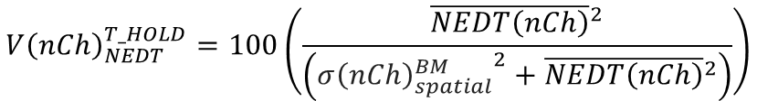
Screening Techniques for SNO Individual ATMS-AMSU/MHS Data Matchups
B) Computing the (V_NEDT) Threshold
The V_NEDT Threshold (${V\left(nCh\right)}_{NEDT}^{T_HOLD}$) can be computed for each instrument channel based on ${σ\left(nCh\right)}_{spatial}^{BM}$, well as the most recent 10-day average instrument noise ($\overline{NEDT\left(nCh\right)}$) for that channel. This can be expressed as:
$${V\left(nCh\right)}_{NEDT}^{T_HOLD}=100\left(\frac{{\overline{NEDT\left(nCh\right)}}^{2}}{\left({{σ\left(nCh\right)}_{spatial}^{BM}}^{2}+{\overline{NEDT\left(nCh\right)}}^{2}\right)}\right)$$
C) Computing the Actual Scene V_NEDT
The local* V_NEDT value (${V\left(nCh\right)}_{NEDT}^{local}$) can be computed for each instrument channel based on $\left(σ_{local}\right)$, well as the most recent 10-day average instrument noise ($\overline{NEΔT\left(nCh\right)}$) for that channel. This can be expressed as:
$${V\left(nCh\right)}_{NEDT}^{local}=100\left(\frac{{\overline{NEDT\left(nCh\right)}}^{2}}{{σ_{local}\left(nCh\right)}^{2}}\right)$$
D) If ${V\left(nCh\right)}_{NEDT}^{local}$ is greater than ${V\left(nCh\right)}_{NEDT}^{T_HOLD}$ then the SNO event matchup pair is retained
*The definition of “local” is that for a given matchup pair of ATMS-AMSU/MHS antenna temperature data (S(0),O(0)), the nine AMSU/MHS field of view measurements comprised of the matched field of view, O(0), and its eight nearest-neighbor AMSU/MHS field of views. This can be visualized with the aid of the figure to the right.
S
S
S
O(0)
S
S(0)
S
S
S
S

Slide 42
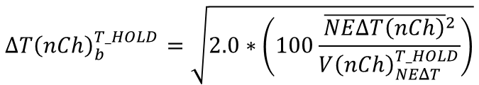
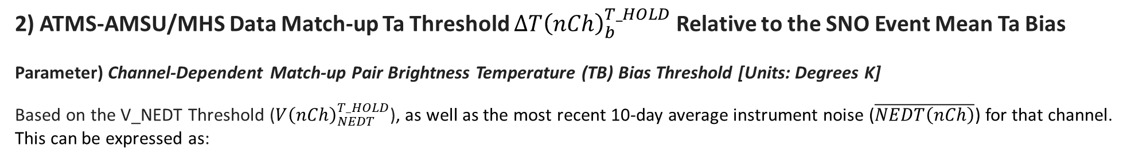
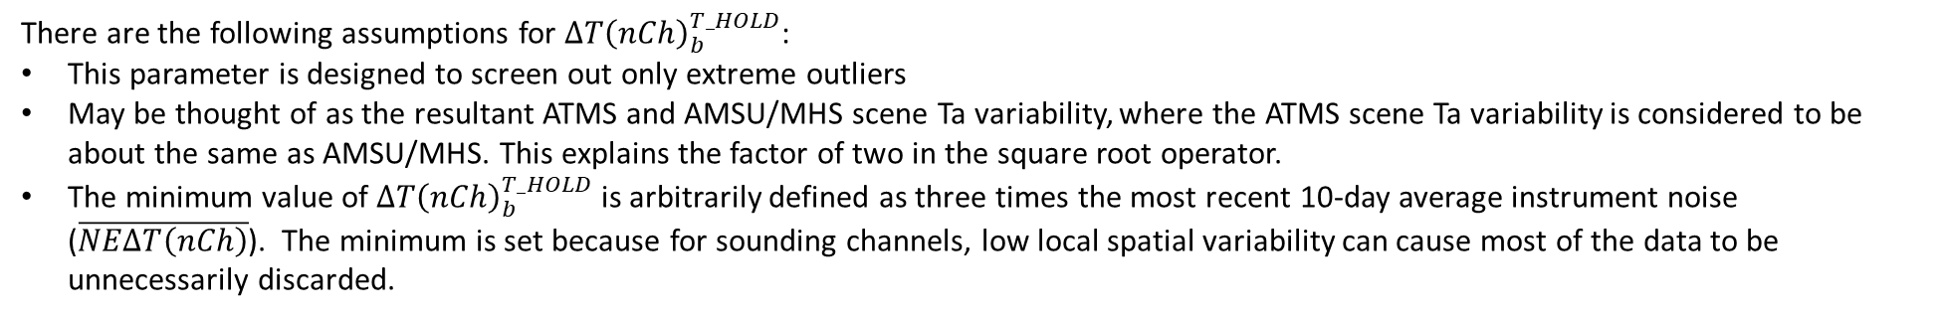


Screening Techniques for SNO Individual ATMS-AMSU/MHS Data Matchups
2) ATMS-AMSU/MHS Data Match-up Ta Threshold ${ΔT\left(nCh\right)}_{b}^{T_HOLD}$ Relative to the SNO Event Mean Ta Bias
Parameter) Channel-Dependent Match-up Pair Brightness Temperature (TB) Bias Threshold [Units: Degrees K]
Based on the V_NEDT Threshold (${V\left(nCh\right)}_{NEDT}^{T_HOLD}$), as well as the most recent 10-day average instrument noise ($\overline{NEDT\left(nCh\right)}$) for that channel. This can be expressed as:
$${ΔT\left(nCh\right)}_{b}^{T_HOLD}=\sqrt{2.0∗\left(100\frac{{\overline{NEΔT\left(nCh\right)}}^{2}}{{V\left(nCh\right)}_{NEΔT}^{T_HOLD}}\right)}$$
nCh is the channel number 1-15 for ATMS and 1-5 for MHS.
For
$${ΔT\left(nCh\right)}_{b}^{T_HOLD}>3.0∗\overline{NEΔT\left(nCh\right)}$$
Else
$${ΔT\left(nCh\right)}_{b}^{T_HOLD}=3.0∗\overline{NEΔT\left(nCh\right)}$$
There are the following assumptions for ${ΔT\left(nCh\right)}_{b}^{T_HOLD}$:
This parameter is designed to screen out only extreme outliers
May be thought of as the resultant ATMS and AMSU/MHS scene Ta variability, where the ATMS scene Ta variability is considered to be about the same as AMSU/MHS. This explains the factor of two in the square root operator.
The minimum value of ${ΔT\left(nCh\right)}_{b}^{T_HOLD}$ is arbitrarily defined as three times the most recent 10-day average instrument noise ($\overline{NEΔT\left(nCh\right)}$). The minimum is set because for sounding channels, low local spatial variability can cause most of the data to be unnecessarily discarded.

Slide 43
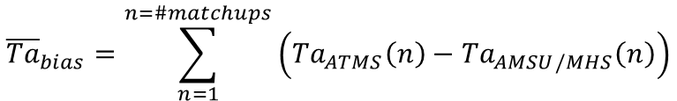
Screening Techniques for SNO Individual ATMS-AMSU/MHS Data Matchups
$${\overline{Ta}}_{bias}=\sum_{n=1}^{n=\#matchups}{\left({Ta}_{ATMS}\left(n\right)−{Ta}_{AMSU/MHS}\left(n\right)\right)}$$
SNO Event Mean Ta Bias
Data Screening Protocol
A) Compute high and low range of the threshold as
${Ta}_{bias}^{T_HOLD}\left(high\right)={\overline{Ta}}_{bias}+{ΔT\left(nCh\right)}_{b}^{T_HOLD}$ and ${Ta}_{bias}^{T_HOLD}\left(low\right)={\overline{Ta}}_{bias}−{ΔT\left(nCh\right)}_{b}^{T_HOLD}$
B) If a given SNO event Ta bias value, ${Ta}_{ATMS}\left(n\right)−{Ta}_{AMSU/MHS}\left(n\right)$, lies in between${Ta}_{bias}^{T_HOLD}\left(low\right)$ and ${Ta}_{bias}^{T_HOLD}\left(high\right)$ then it passes the data screen.
3) Number of Samples Needed to Compute Statistics for a Given SNO Event
Parameter) nBIAS_THOLD=10 ; Assume a minimum of 10 AMSU/MHS-ATMS match-up samples to create meaningful statistics for a given SNO.

Slide 44
Side-by-side plots trending Ta biases produced when implementing the SNO method with
Event Mean ± Constant Ta Bias Threshold (3K)
Combination of interpolation and data screening using 1) Event V_NEDT Threshold and 2) Mean ± Channel Dependent Ta Bias Threshold

Slide 45
J01 ATMS versus NOAA-19 and Metop-B AMSU-A

Slide 46
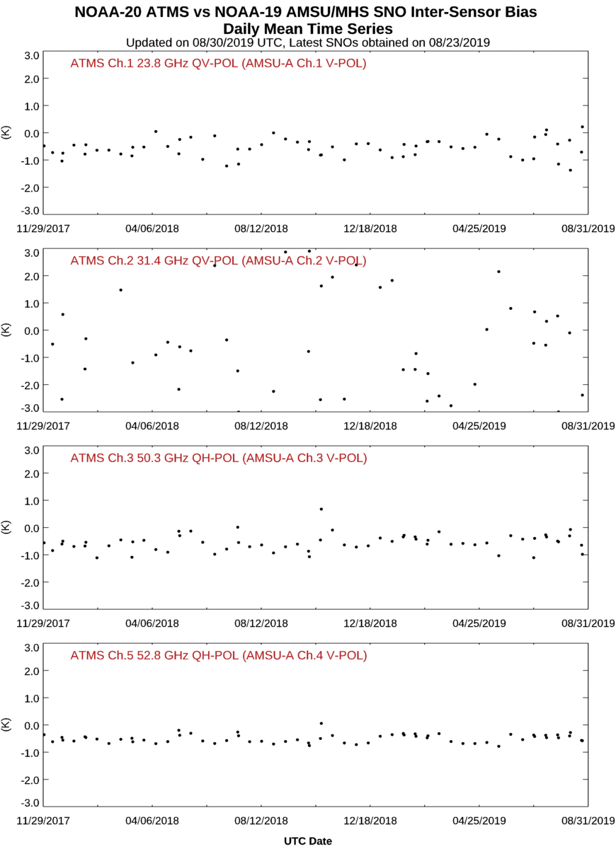
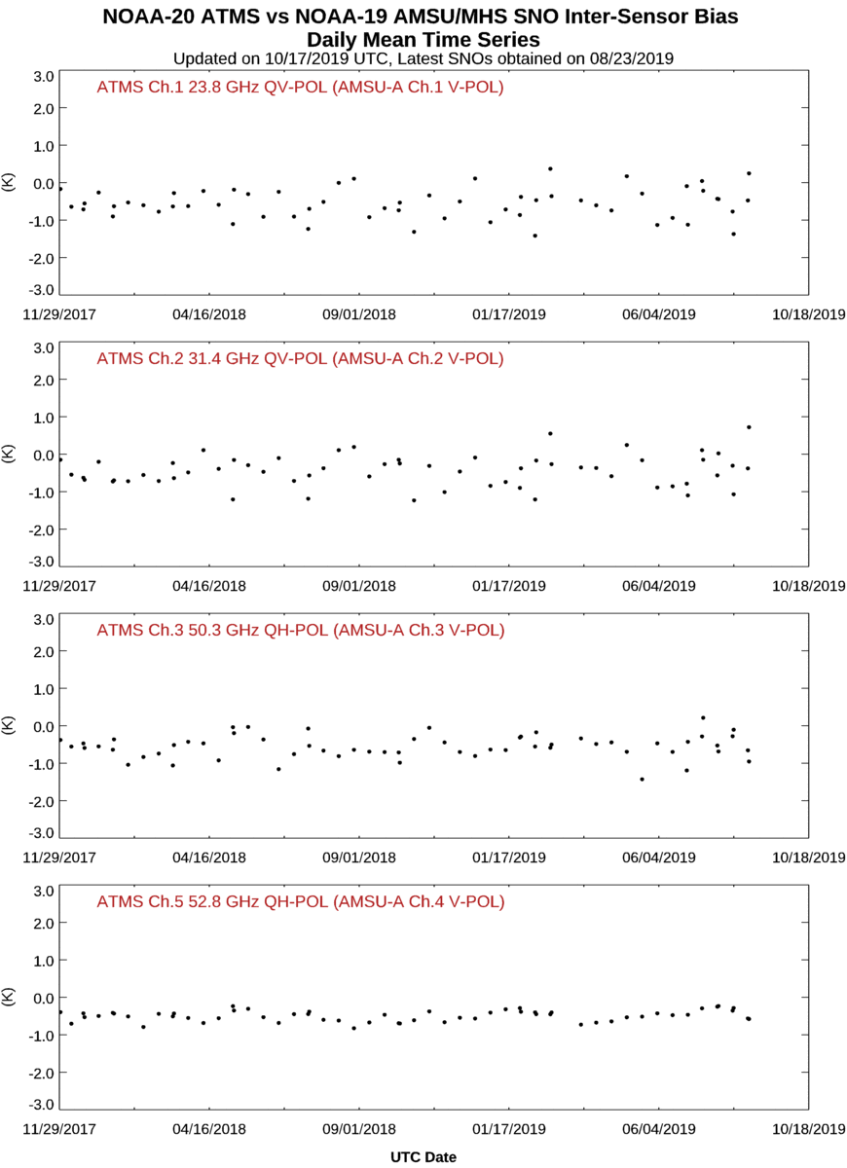
J01 ATMS and NOAA-19 AMSU-A/MHS Band 1 Inter-Comparison
Screening with SNO Event Mean $±$ Constant Ta Threshold (3 K)
Interpolation plus Screening with Event V_NEDT Thold & Mean $±$Channel Dependent Ta Bias Thold

Slide 47


J01 ATMS and NOAA-19 AMSU-A/MHS Band 2 Inter-Comparison
Screening with SNO Event Mean $±$ Constant Ta Threshold (3 K)
Interpolation plus Screening with Event V_NEDT Thold & Mean $±$Channel Dependent Ta Bias Thold

Slide 48


J01 ATMS and NOAA-19 AMSU-A/MHS Band 3 Inter-Comparison
Screening with SNO Event Mean $±$ Constant Ta Threshold (3 K)
Interpolation plus Screening with Event V_NEDT Thold & Mean $±$Channel Dependent Ta Bias Thold

Slide 49


J01 ATMS and NOAA-19 AMSU-A/MHS Band 4 Inter-Comparison
Screening with SNO Event Mean $±$ Constant Ta Threshold (3 K)
Interpolation plus Screening with Event V_NEDT Thold & Mean $±$Channel Dependent Ta Bias Thold

Slide 50



J01 ATMS and NOAA-19 AMSU-A/MHS Band 5 Inter-Comparison
Screening with SNO Event Mean $±$ Constant Ta Threshold (3 K)
Interpolation plus Screening with Event V_NEDT Thold & Mean $±$Channel Dependent Ta Bias Thold

Slide 51


J01 ATMS and Metop-B AMSU-A/MHS Band 1 Inter-Comparison
Screening with SNO Event Mean $±$ Constant Ta Threshold (3 K)
Interpolation plus Screening with Event V_NEDT Thold & Mean $±$Channel Dependent Ta Bias Thold

Slide 52


J01 ATMS and Metop-B AMSU-A/MHS Band 2 Inter-Comparison
Screening with SNO Event Mean $±$ Constant Ta Threshold (3 K)
Interpolation plus Screening with Event V_NEDT Thold & Mean $±$Channel Dependent Ta Bias Thold

Slide 53


J01 ATMS and Metop-B AMSU-A/MHS Band 3 Inter-Comparison
Screening with SNO Event Mean $±$ Constant Ta Threshold (3 K)
Interpolation plus Screening with Event V_NEDT Thold & Mean $±$Channel Dependent Ta Bias Thold

Slide 54


J01 ATMS and Metop-B AMSU-A/MHS Band 4 Inter-Comparison
Screening with SNO Event Mean $±$ Constant Ta Threshold (3 K)
Interpolation plus Screening with Event V_NEDT Thold & Mean $±$Channel Dependent Ta Bias Thold

Slide 55



J01 ATMS and Metop-B AMSU-A/MHS Band 5 Inter-Comparison
Interpolation plus Screening with Event V_NEDT Thold & Mean $±$Channel Dependent Ta Bias Thold
Screening with SNO Event Mean $±$ Constant Ta Threshold (3 K)

