Slide 1
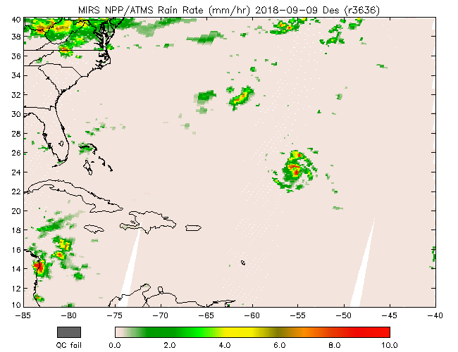
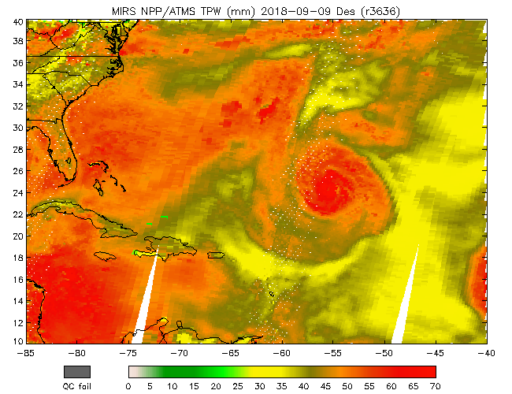
Microwave Integrated Retrieval System (MiRS): Overview, Recent Activities, and Applications
Hurricane Florence N20 and SNPP ATMS RR and TPW, 9-17 Sept 2018
Chris Grassotti (NOAA/STAR and U. Md. ESSIC/CICESS)
Quanhua (Mark) Liu (NOAA/STAR), Shuyan Liu (NOAA/STAR and CSU/CIRA),
Yong-Keun Lee (NOAA/STAR and U. Md. ESSIC/CICESS), Ryan Honeyager (NOAA/STAR and JCSDA)

Slide 2
Outline
Algorithm Overview
Assessments of NOAA-20 and SNPP
Radiometric and geophysical comparisons: operational product examples, cal/val activities
New Activities/Science Improvements/Applications
TC Applications: intensity estimation, warm core anomaly retrieval
Dynamic radiometric bias correction using machine learning
Blended/Advected Layer PW
Summary and Path Forward

Slide 3
Algorithm Overview
Satellite Microwave (TB) Measurements (INPUTS)
MiRS Components
Geophysical State Vector
(OUTPUTS)
MiRS
Postprocessing
~ 20 channels (multispectral)
Forward RT Model (CRTM):
TB= F(Geophysical State Vector)
(2) Jacobians (dTB/dX)
MiRS
1D
Variational
Retrieval
Temp. Profile (100 layers)
TB (Channel 1)
Water Vapor Profile (100)
Derived Products
(OUTPUTS)
TB (Channel 2)
A Priori Background:
Mean and Covariance of
Geophysical State (Dyn Climatol)
Cloud Water Profile (100)
TB (Channel 3)
TPW
Graupel Water Profile (100)
CLW
Basis Functions for State Vector:
Reduce degrees of freedom
in geophysical profile (~20 EOFs)
RWP
Rain Water Profile (100)
GWP
TB (Channel Ntot)
Uncertainty of satellite radiances:
Instrument NEDT + Fwd Model
uncertainty
Emissivity Spectrum
(~ 20 channels)
RR
SFR
Skin Temperature (1)
SIC/SIA
Sensor Noise
SWE/GS
MW Only, Variational Approach: Find the “most likely” atm/sfc state that: (1) best matches the satellite measurements, and (2) is still close to an a priori estimate of the atm/sfc conditions.
“Enterprise” Algorithm: Same core software runs on all satellites/sensors; facilitates science improvements and extension to new sensors.
Initial capability delivered in 2007. Currently running on SNPP/ATMS, N18, N19, MetopA, MetopB, F17, F18, GPM/GMI, Megha-Tropiques/SAPHIR. (eventually MetopC…)
Delivery of v11.3 (extended to NOAA-20/ATMS) to operations on June 2018. V11.4 delivered in July 2019, and is currently running in operations.
External Users/Applications: TC Analysis/Forecasting at NHC, Blended Total/Layer PW Animations at NHC and WPC (CSU/CIRA, U. Wisconsin/CIMSS), CSPP Direct Broadcast (U. Wisconsin), NFLUX model (NRL, Stennis), Global blended precipitation analysis at NOAA/CPC (CMORPH),…

Slide 4
MiRS Users
Many users use MiRS products for operational applications and research.
Operational users, who have subscriptions on PDA, are:
NWS NHC, NESDIS_VIZLAB, CLASS, STAR, NASA GPM, NAVO, FNMOC, 557TH, NASA JPL, GNC-A, NWC, CHINA CMA, NWS AWIPS, NWS NCO, CIRA, NASA SPORT, SSEC/CIMSS, NESDIS operational applications: eTRaP, blended TPW, blended RR, and IMS
NHC TC intensity (POC: Galina Chirokova (CIRA))
International Arctic Research Center, Alaska (POC: Carl Dierking, NOAA Liaison)
NOAA Climate Prediction Center (POC: Pingping Xie)
National Ice Center
NWS Weather Forecast Offices
CSPP generates MiRS products for direct broadcasting
Users also download MiRS from CSPP and generate MiRS products locally

Slide 5
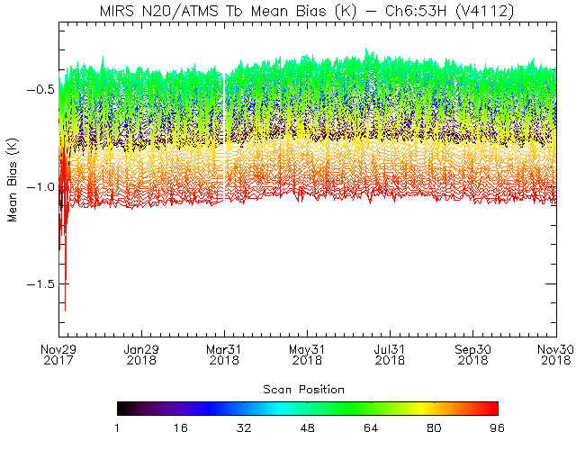
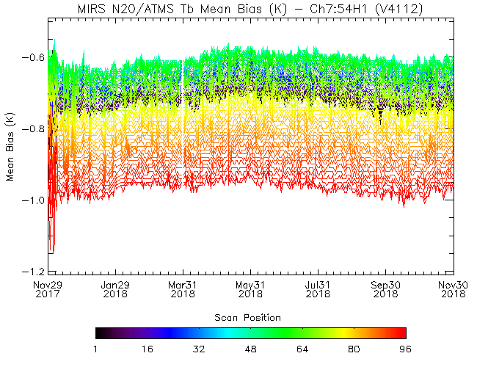
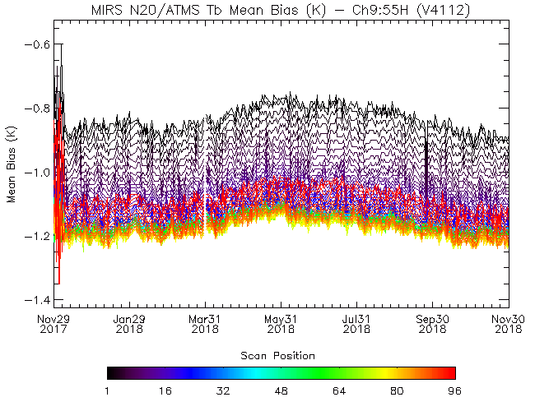
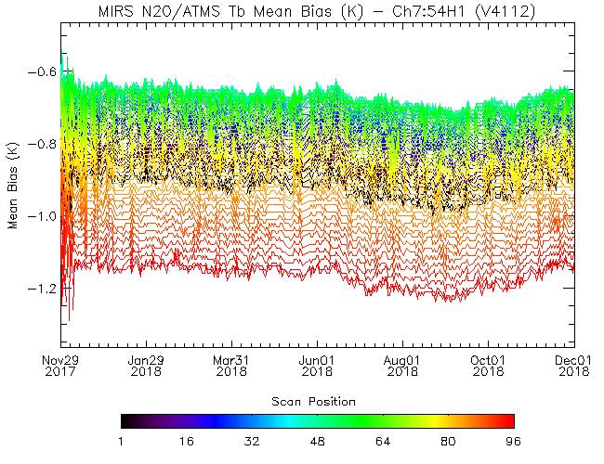
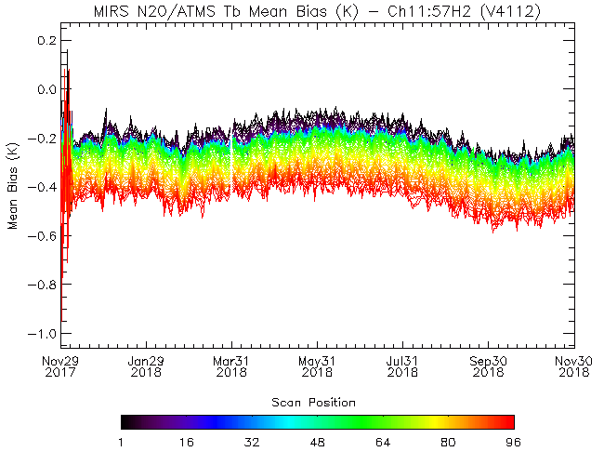
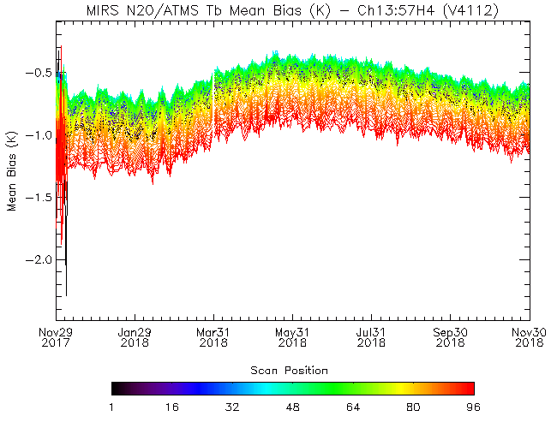
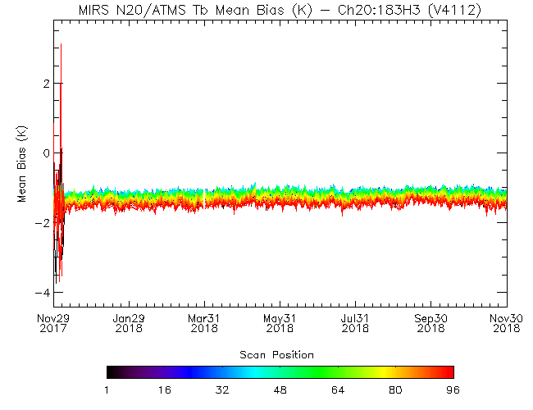
N20 Radiometric Biases: Time Series TDR Obs-Sim (29 Nov 2017 – 30 Nov 2018)
Chan 6 (53.6 ± 0.12 GHz)
Chan 7 (54.4 GHz)
Chan 9 (55.5 GHz)
ECMWF + CRTM
Scan Position
Scan Position
Chan 11 (57.29 ± 0.22 GHz)
Chan 13 (57.29 ± 0.32 GHz)
Chan 20 (183.31 ± 3 GHz)
GDAS + CRTM
Scan Position
Scan Position
Scan Position
Simulated TBs: ECMWF + CRTM (v2.1.1), clear ocean

Slide 6
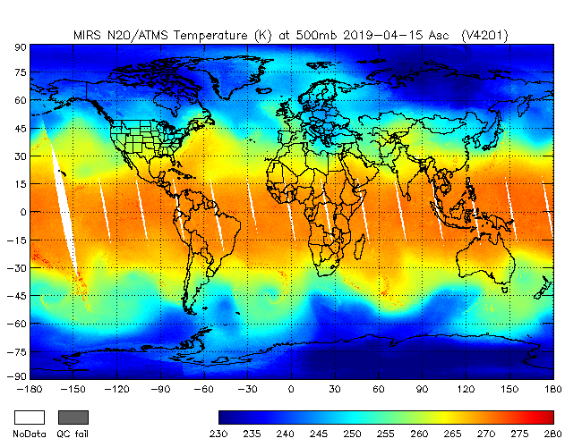
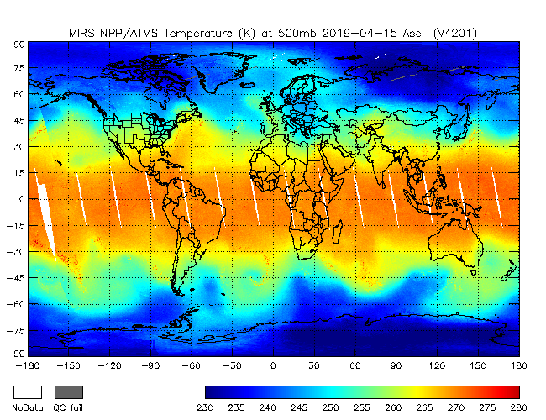
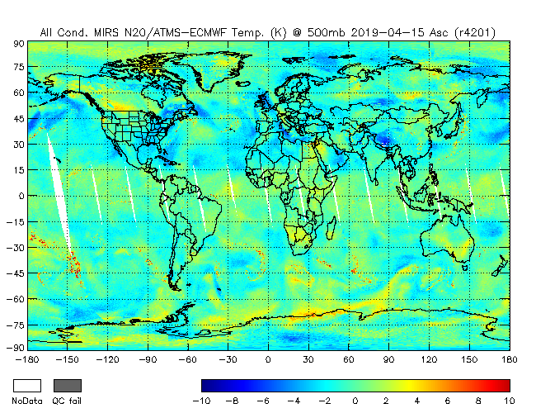
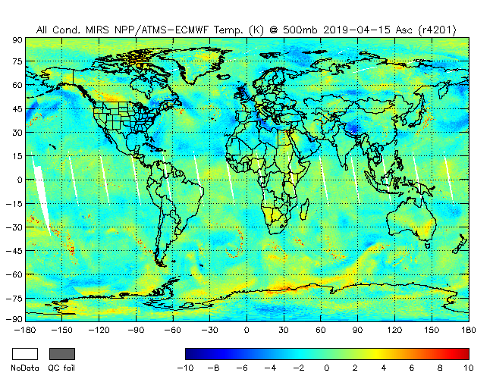
Temperature Profile Validation
N20 500hPa Temperature
NPP 500hPa Temperature
Same instrument: ATMS
50 minute apart
N20-ECMWF 500hPa Temp. Diff.
NPP-ECMWF 500hPa Temp. Diff.

Slide 7
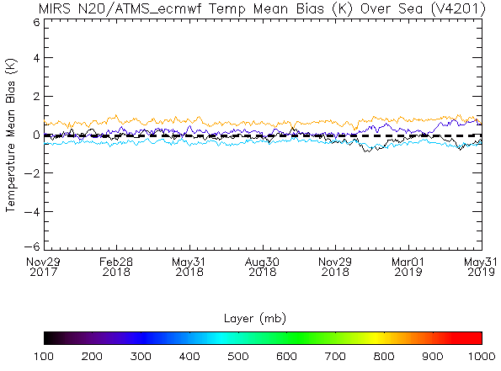
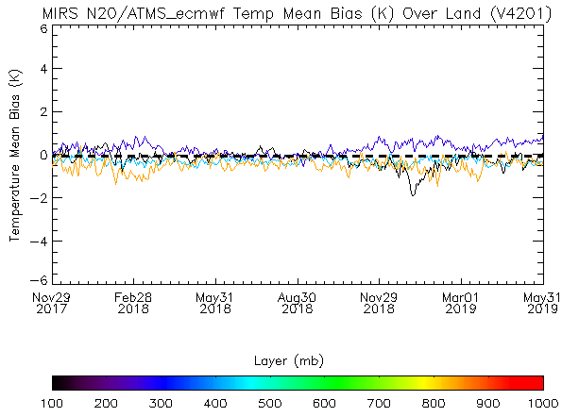
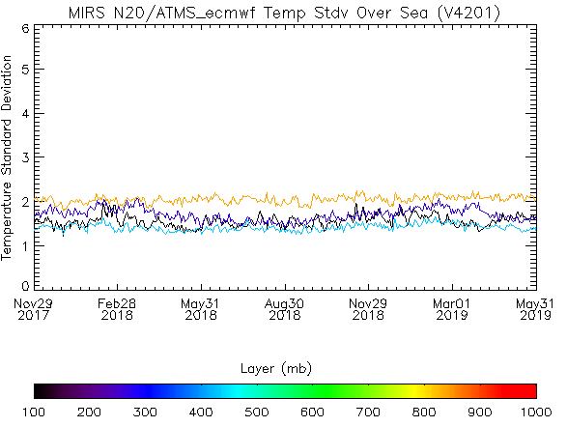
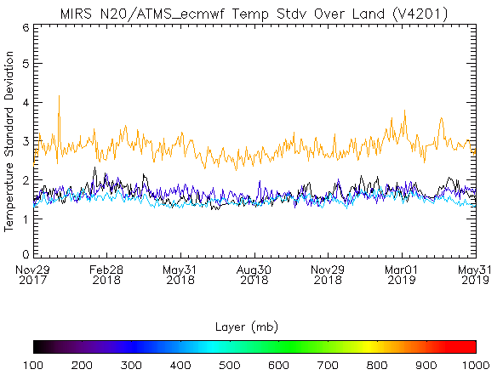
Temperature Profile Validation based on ECMWF data: Time Series (Nov 2017 – May 2019)
Bias Sea N20
Bias Land N20
100, 300, 500, and 900 hPa
Std Dev Sea N20
Std Dev Land N20

Slide 8
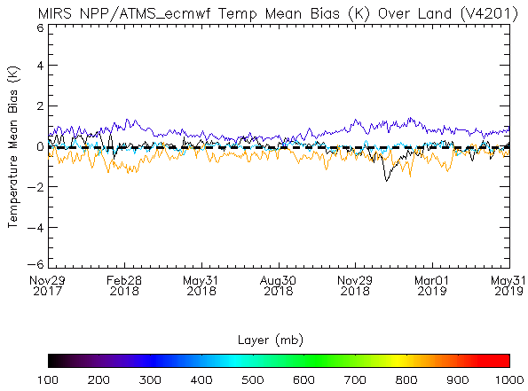
Temperature Profile Validation based on ECMWF data: Time Series (Nov 2017 – May 2019)
Bias Sea NPP
Bias Land NPP
100, 300, 500, and 900 hPa
Std Dev Sea NPP
Std Dev Land NPP

Slide 9
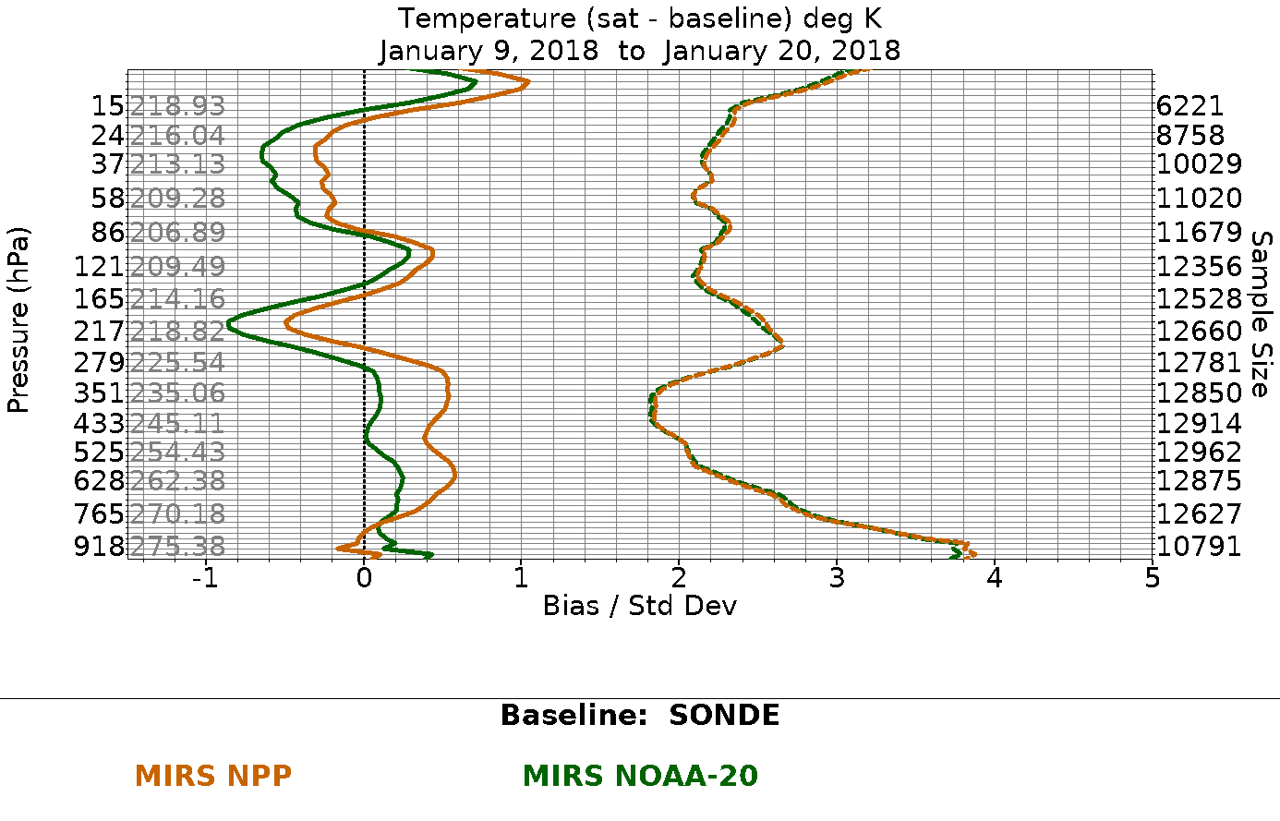
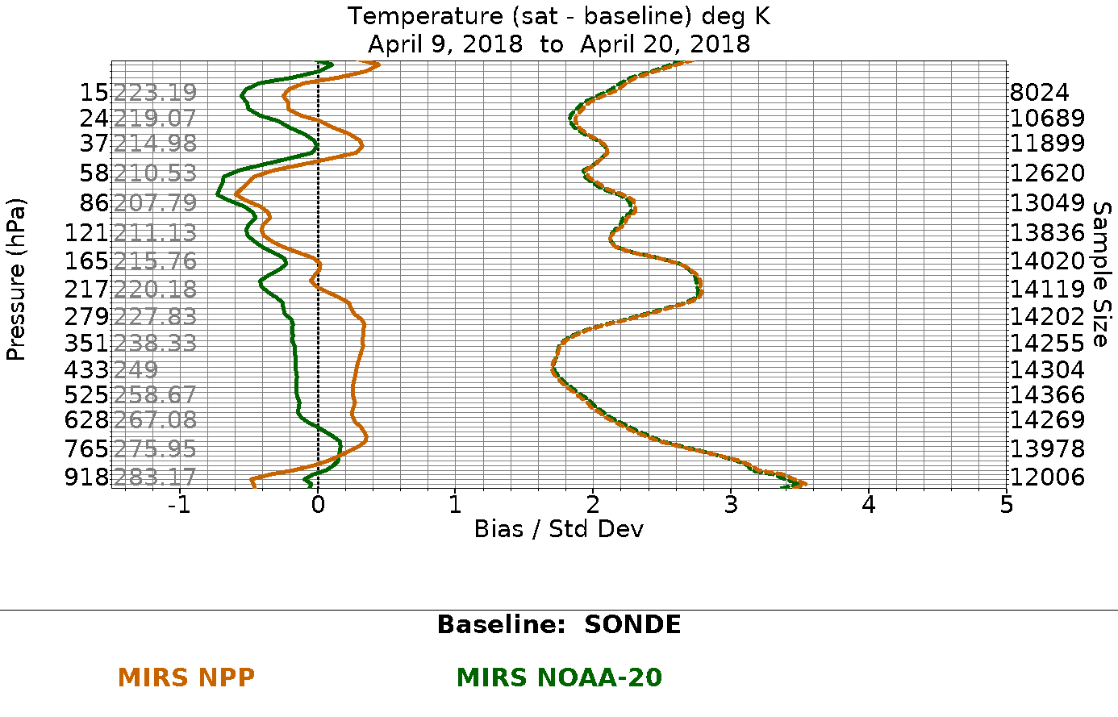
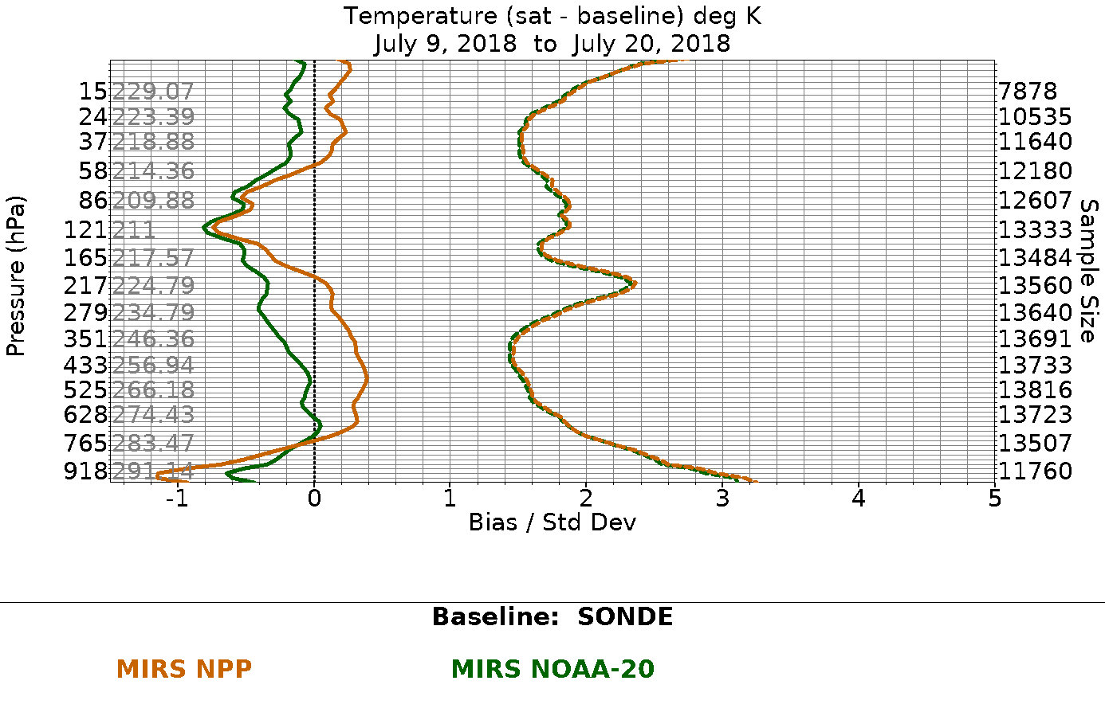
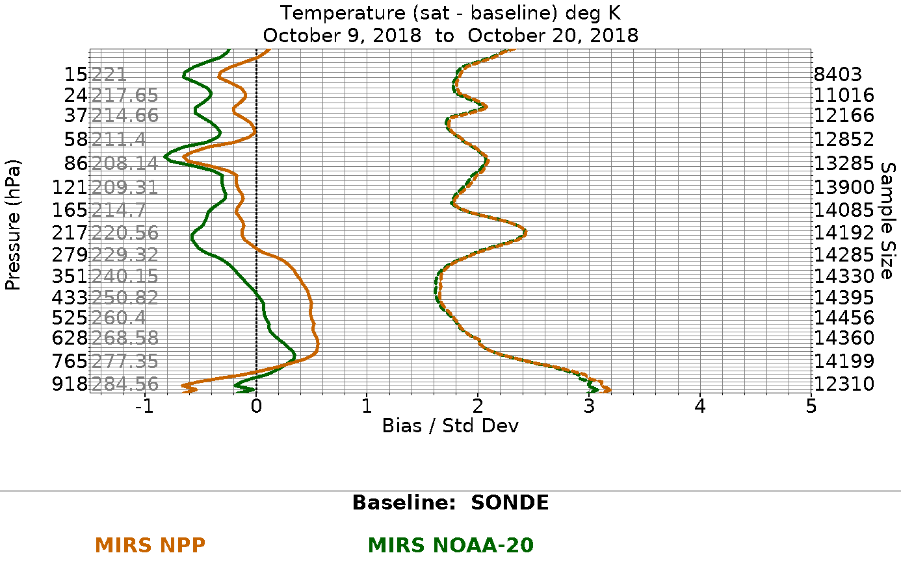
Temperature Profile Validation Using Radiosondes
9-20 Jan 2018
9-20 Apr 2018
Green thick: N20 bias
Brown thick: NPP bias
Green dotted: N20 std
Brown dotted: NPP std
9-20 Jul 2018
9-20 Oct 2018

Slide 10
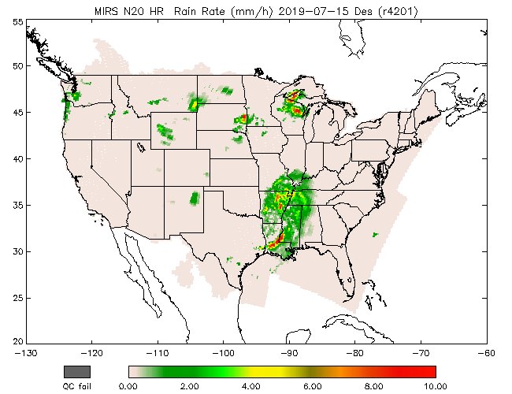
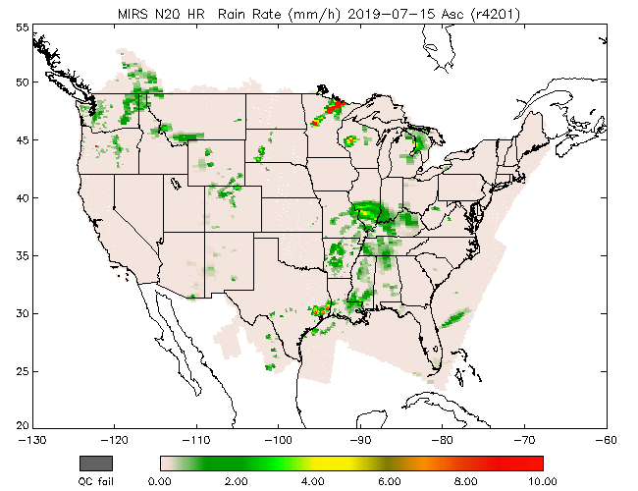
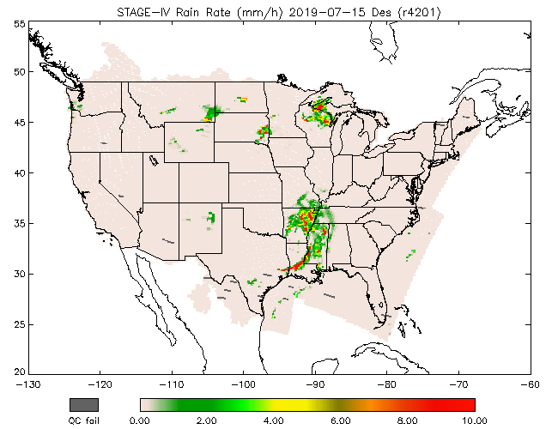
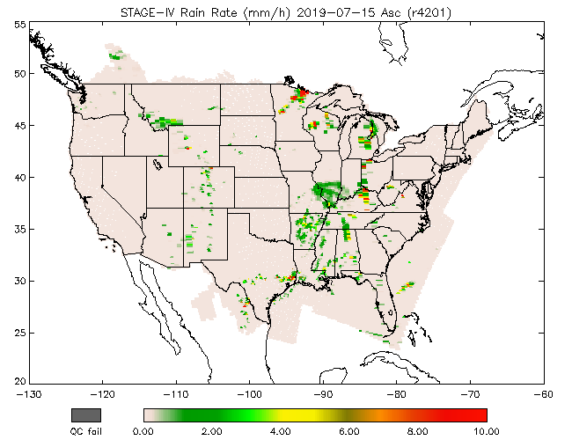
Precipitation Validation Using Stage IV
MiRS
Stage IV

Slide 11
Time Series: N20 and NPP vs. Stage IV Dec 2017 – Jun 2019
Req
Req

Slide 12
Time Series: N20 and NPP vs. Stage IV Dec 2017 – Jun 2019
False Alarm Rate
Req
Req
Req

Slide 13
Developing a TC-Specific Version of MiRS
Motivation:
MiRS data currently used in the operational TC Intensity Algorithm (HISA, developed at CIRA). Utilizes T and WV sounding to estimate warm core structure combined with statistical/dynamic model to predict future intensification.
Challenge: (1) retrieval of warm core structure complicated due to presence of hydrometeors; scattering signal in TBs can interfere with retrievals (2) hurricane warm core structure is anomalous relative to “global climatology” currently used as a priori constraint in MIRS.
Development of MiRS-TC, a version of MiRS optimized for tropical cyclones, adapting several components:
Modify use of higher frequency channels in scenes likely to have large amounts of scattering
Test varying sources of First Guess/Background constraints (developing updated background mean/covariance based on observed TCs)
Vary number of EOF basis functions for T and WV profiles
Testing ongoing with multiple TC cases
Dorian (2019), Florence (2018), Joaquin (2016), Matthew (2015), Edouard (2014)
Planned collaboration with CIRA to determine impact on TC intensity estimates

Slide 14
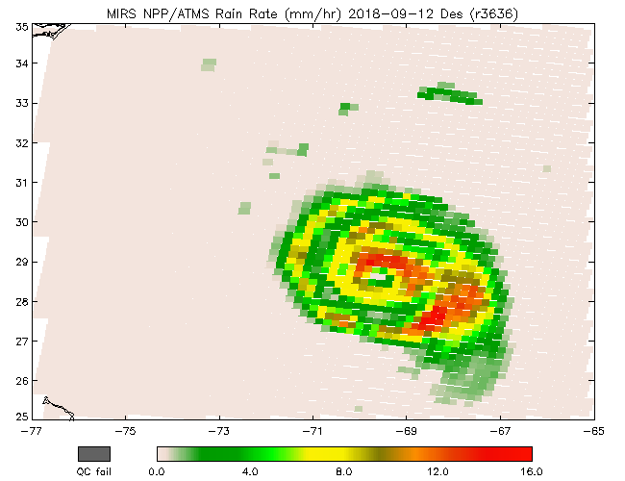
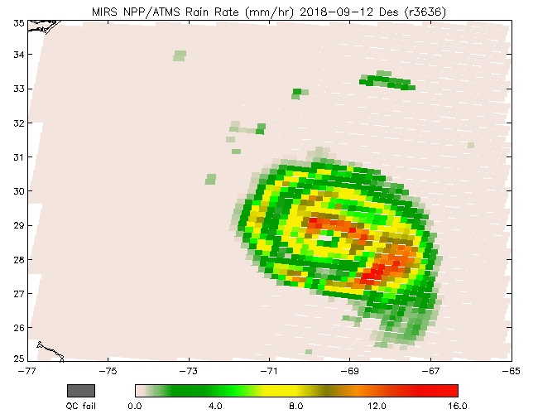
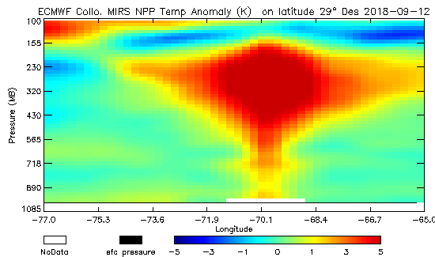
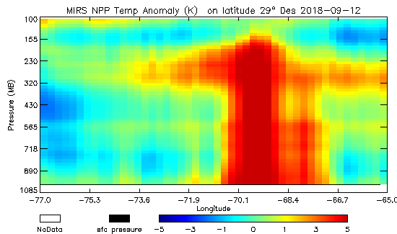
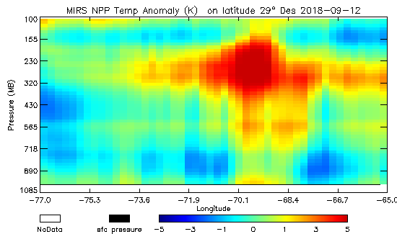
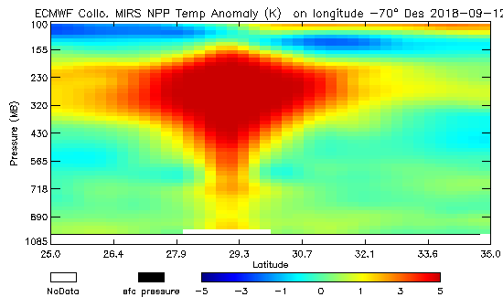
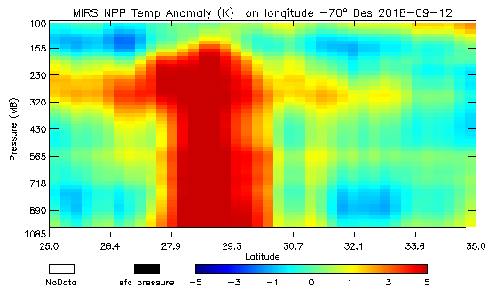
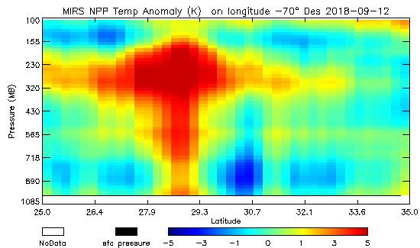
Hurricane Florence Precipitation and Temperature Anomaly
Rain rate and Temperature Anomaly Cross-sections
Florence: 2018-09-12
NPP Des
ECMWF
Oper
Test
Hurricane Bonnie, 1998
Kidder at al. (2000)

Slide 15
TC Florence and Dorian NPP and N20 Temperature Bias: MiRS-ECMWF (Rainy, dist <= 100km)
NPP Asc
NPP Des
N20 Asc
N20 Des
TC Florence
TC Dorian

Slide 16
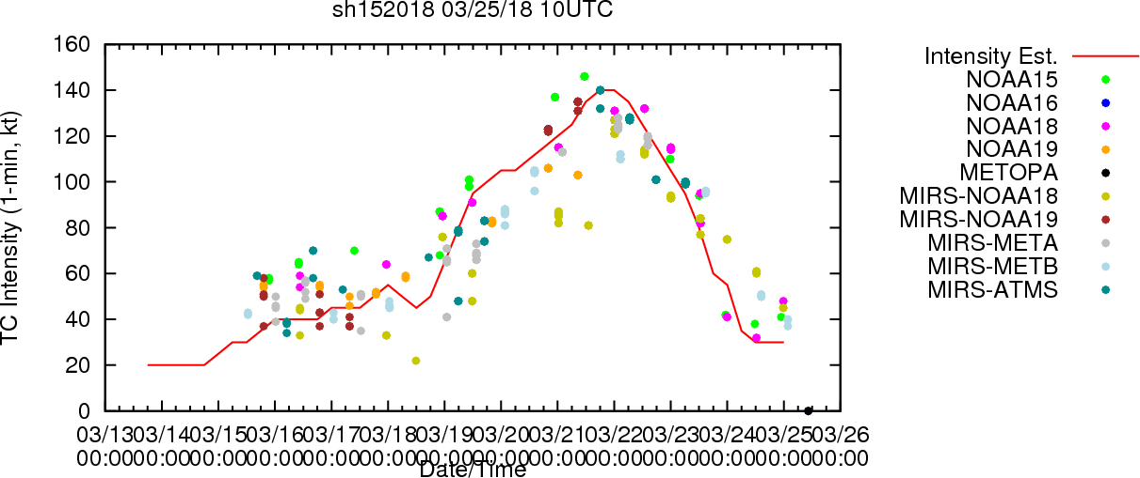
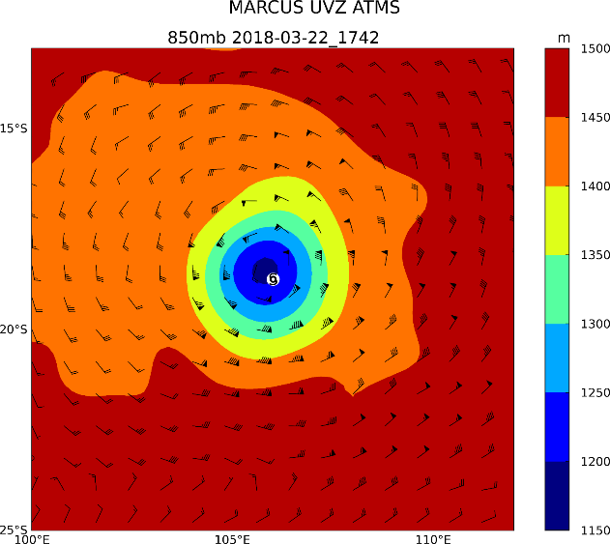
Application Using MiRS Data: Hurricane Intensity and Structure Algorithm (HISA)
HISA provides MW-based TC Intensity estimates:
Global
Objective
Independent of Dvorak
Input:
Temperature profile, CLW from AMSU/ATMS-MiRS or statistical retrievals
GFS boundary conditions
ATCF TC track data
Output:
1) Intensity estimates, provided via f-deck
Maximum sustained wind (Vmax, kt)
Minimum Sea Level Pressure (MSLP, hPa)
2) Surface Wind Radii Estimates (nmi), provided via f-deck
R34, R50, R64 for NE, NW, SE, and SW TC quadrants
3) Azimuthally-averaged gradient winds as a function of geopotential height and distance from TC center.
4) Horizontal 2-D balanced winds (kt) for the local TC environment
Operational on ATMS and AMSU on 7 satellites, is upgraded to work with NOAA20 ATMS
Users: NHC, CPHC, JTWC
Vmax
TC Marcus 2018 (SH15)
 | ATMS-MIRS MAE | AMSU-MIRS MAE
Vmax (kts) | 11.1 (1565) | 13.2 (4346)
Pmin (hPa) | 7.0 (1565) | 8.4 (4347)
R34 (nmi) | 20.0 (344) | 24.9 (1044)
R50 (nmi) | 12.0 (215) | 10.6 (601)
R64 (nmi) | 12.0 (134) | 8.9 (336)
TC Marcus 2018 (SH15)
2-D Winds ATMS-MiRS S-NPP
Galina Chirokova (CIRA), John Knaff (NOAA/NESDIS), Scott Longmore (CIRA), Mark DeMaria (NOAA/NWS/NHC), Jack Dostalek (CIRA)

Slide 17
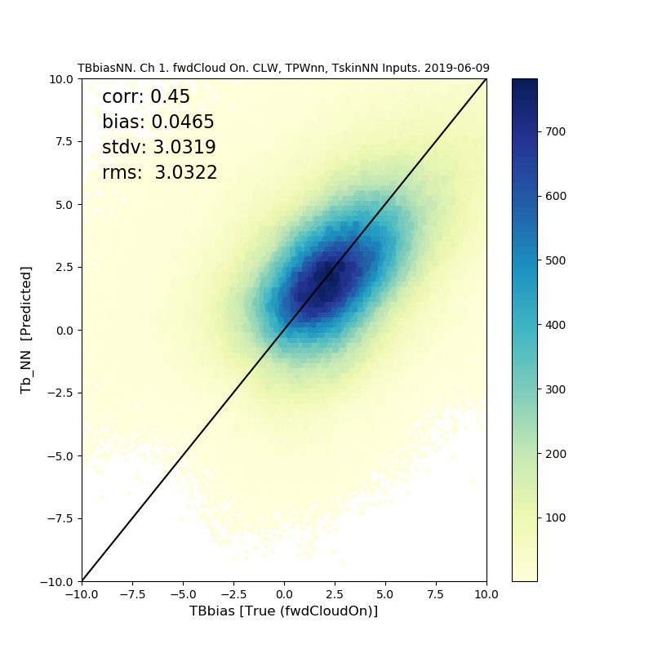
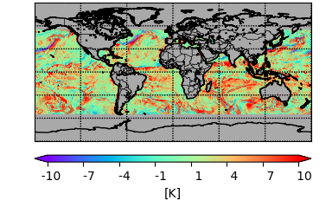
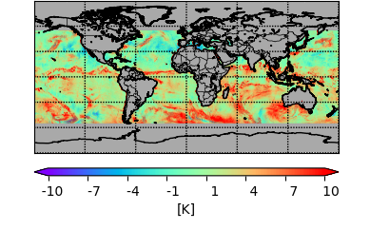
Development of a Neural Network for MiRS Radiometric Bias Correction
Why bias correction?
To remove potential systematic bias between the measurements and the CRTM simulations.
Current bias correction (static):
statistics of bias over oceanic and clear scenes. The bias is channel and scan position dependent. Local variations are not accounted for.
A machine learning-based bias correction: Neural Network (NN)
NN was trained to learn the bias structure. Inputs are:
Brightness temperature (TB) of the measurements,
Satellite viewing angle,
latitude,
other geophysical parameters including cloud liquid water (CLW), total precipitable water (TPW), and Tskin.
Neural Network Schematic
NN TB_bias [K] ATMS CH1
True TB_bias [K] ATMS CH1
True TB_bias [K] ATMS CH1
NN TB_bias [K] ATMS CH1

Slide 18
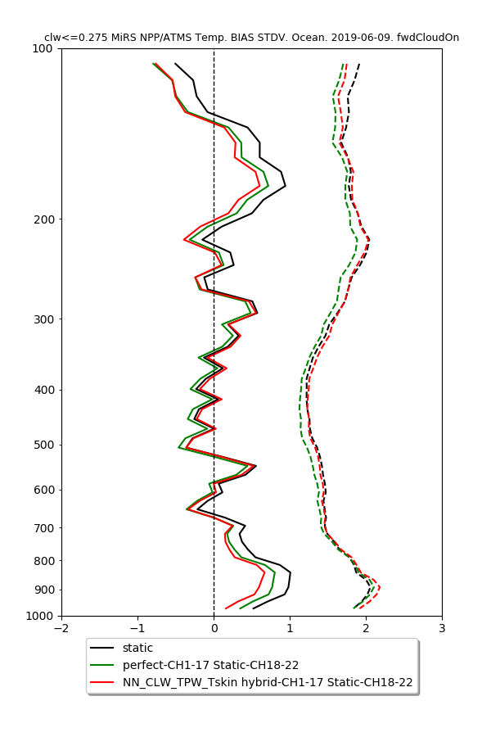
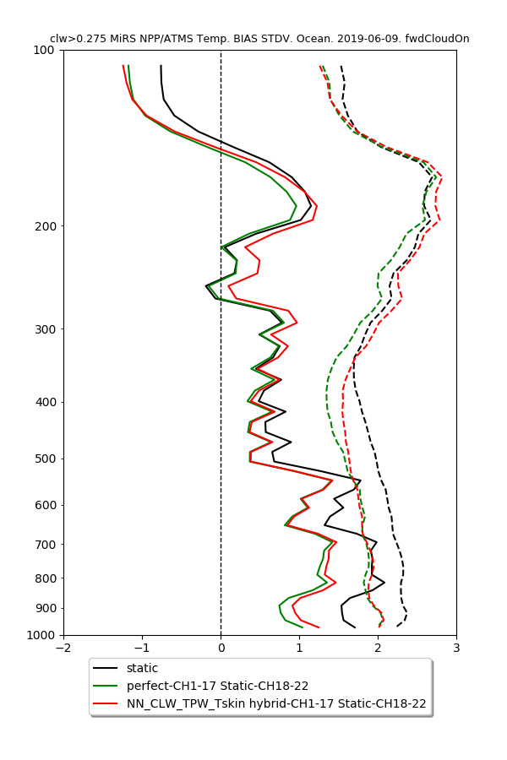
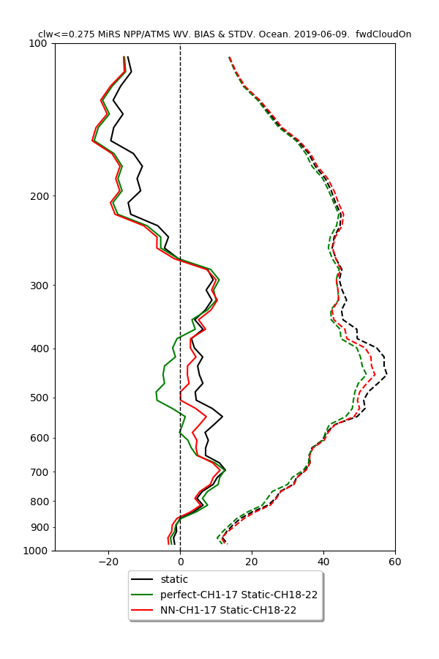
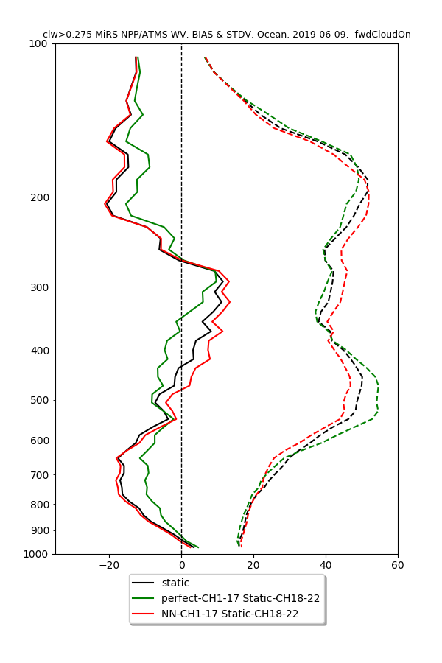
NN TB Bias Applied in MiRS
T (CLW<=0.275)
T (CLW>0.275)
WV (CLW<=0.275)
WV (CLW>0.275)

Slide 19
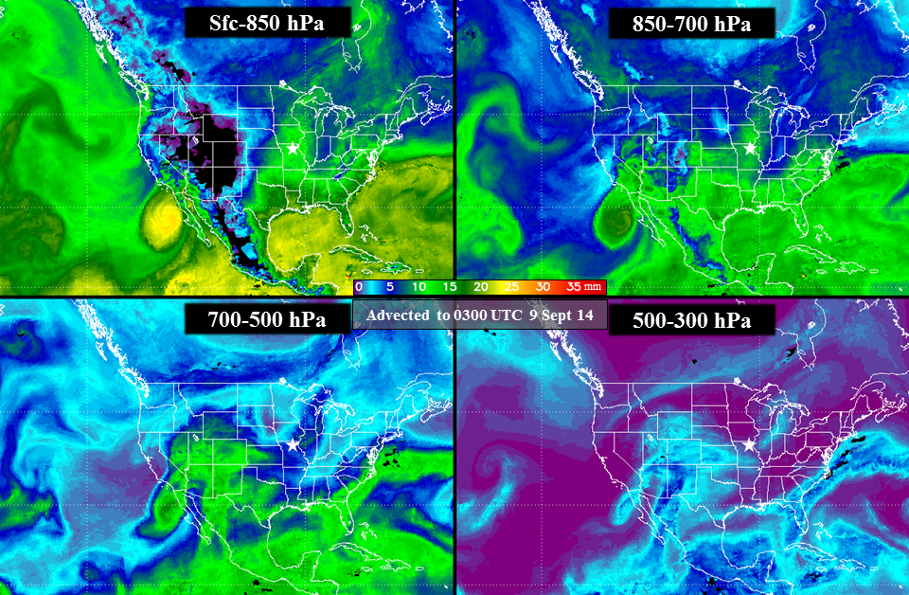
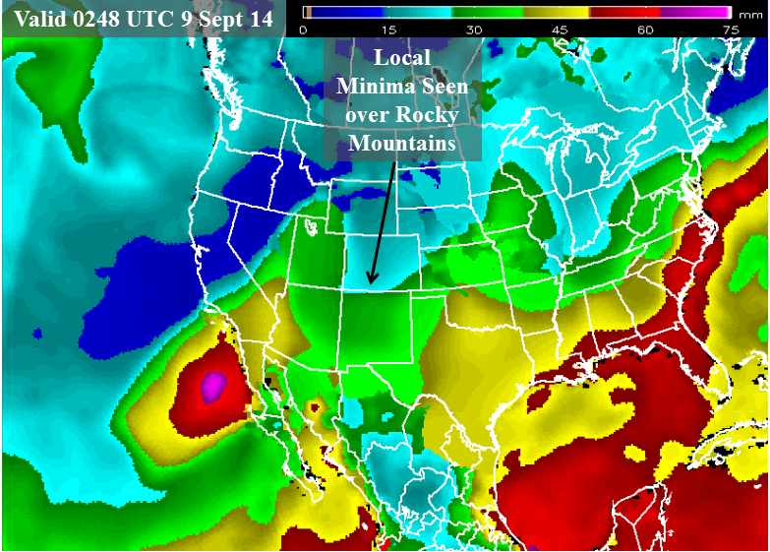
Application: Blended Layer Precipitable Water
Combines MiRS WV from up to 7 Polar Satellites
for Rapid Refresh and Advection (NWP-based winds)
To be implemented at NHC and WPC
Courtesy of John Forsythe
Sept 2014 case of extreme precipitation over Central US
Layer PW provides detail not present in TPW retrievals.
Gitro et al., 2018: Using the multisensor advected layered precipitable water product in the operational forecast environment. J. Operational Meteor., 6 (6), 59-73, doi: https://doi.org/10.15191/nwajom.2018.0606

Slide 20
Path Forward
Improvements implemented
Snowfall rate integration for N20
Hydrometeors (CLW over land for light rain detection)
Snow cover/amount (vegetation correction)
Updated sea ice climatology mask (finer temporal/spatial resolution) ➔ Great Lakes ice detection
Planned further improvements
Air mass-dependent bias corrections (machine learning)
Rainy condition sounding (update a priori constraints)
Experimenting with MiRS version adapted for tropical cyclones (MiRS-TC)
Hydrometeors: precharacterization of precip type, improvements to CRTM i.e. scattering, particle size/shape distribution in CRTM)
Applications/user feedback
Planned/ongoing activities
N20/ATMS validation: Continued daily assessments (as posted to MiRS website) including comparisons with radiosondes, and other in situ data (e.g. for rain rate and land surface temperature)
Reprocessing of NPP and N20 mission data (Spring/Summer 2020)
Metop-C to operations (Spring 2020)
Plan for JPSS-2 (Q1 2022), and EPS-SG A1 (Q4 2022), [SmallSats?]
MiRS data available at CLASS, and STAR ftp (S-NPP/ATMS, NOAA-20/ATMS, GPM/GMI), CSPP_MIRS
Software package available for download https://www.star.nesdis.noaa.gov/mirs

