Slide 1
Summary of the Lunar Calibration Workshop
Xi’an 2017
Preparation of LCWS 3 – 10.12.2019
S. Wagner

Slide 2
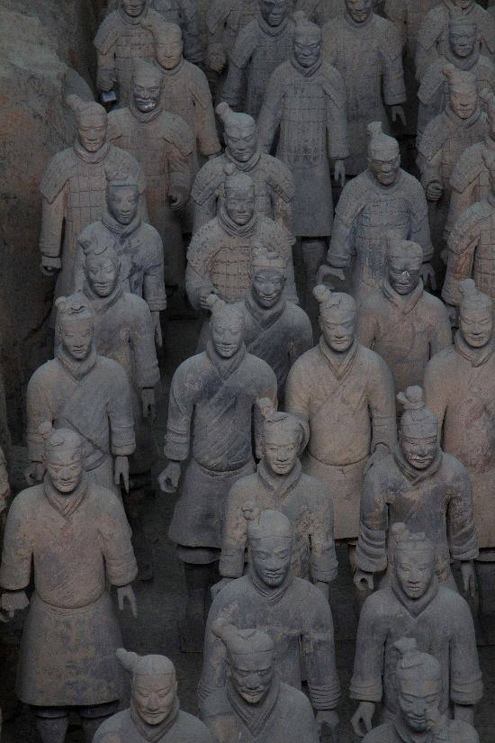
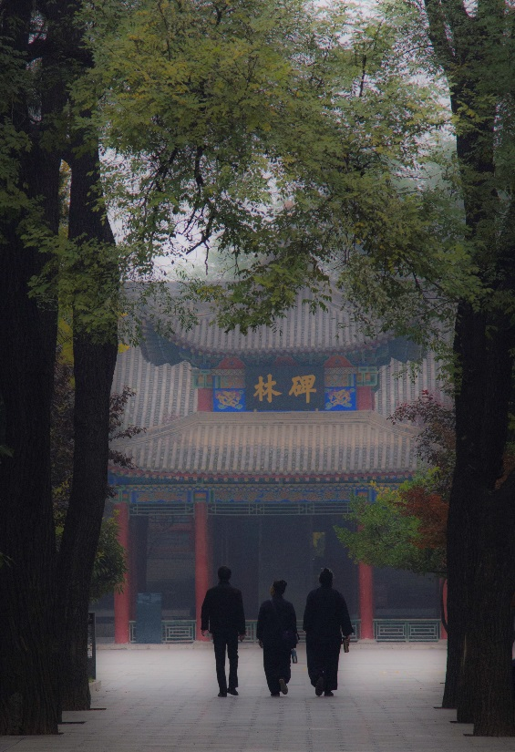
2nd Joint GSICS/IVOS Lunar Calibration Workshop
Second workshop after the meeting organised in 2014 at EUMETSAT
Organisation: CMA and Xi’an Institute of Optics and Precision Mechanics, in
partnership with EUMETSAT, USGS, NOAA and NASA
Venue: Xi’an (China) 13-16 November 2017

Slide 3
2nd Joint GSICS/IVOS Lunar Calibration Workshop
Objectives
To share knowledge and expertise on the latest dedicated ground-based lunar observation campaigns, and space-based lunar datasets ➔ NEW
To share knowledge and expertise in the preparation of lunar irradiance measurements from observations by the instruments to be monitored ➔ Initiated at LCWS#1
To work jointly on algorithms to compare and inter-calibrate instruments with lunar observation capabilities ➔ NEW
To explore further alternative applications of lunar observations for calibration purposes or post-launch assessments, such as geometric and MTF characterization ➔ NEW``
Notes:
I would like to highlight the fact that new topics have been addressed in the 2nd LCWS with respect to the 1st LCWS.

Slide 4
Topics and participation
22 agencies + departments
More than 60 scientists (including remote attendees)
4-day long
Topics:
Monday: Measurements and Moon Observations
Tuesday: Using the ROLO and the GIRO + Lunar Model Developments
Wednesday:
Inter-calibration and Inter-band Calibration
Alternative uses of lunar measurements (MTF post-launch characterisation)
Thursday:
Alternative uses of lunar measurements (ghost, cross-talk, infrared, microwave, etc.)
Discussions, Review of actions/recommendation/way forward + Conclusions of the workshop

Slide 5
Main actions (total = 8)
LCWS.2017.1t.1: EUMETSAT to contact the participants to get updates on the lunar data for the GLOD ➔ The GIRO is being now distributed but GLOD will be first consolidated…
LCWS.2017.1t.3: CMA to consider a similar plan to ESA to schedule ground measurements in the future (e.g. instruments, calibration, sites, measurement strategy) ➔ new measurements in coordination with partners from the Lunar Calibration Community
LCWS.2017.2p.1: EUMETSAT/USGS to report at the next GSICS annual meeting on the traceability of the GIRO to the ROLO using the benchmark
LCWS.2017.5h.1: MTF post-launch estimation using lunar imagery. Points of Contact to coordinate and provide details about the algorithm implemented in their agency as listed in EUMETSAT's presentation on MTF (slide 30, point 4) ➔ Topic for discussion within GSICS, in coordination with IVOS?

Slide 6
Main recommendations (total = 22)
LCWS.2017.2k.1: Agencies operating geostationary instruments to work together to investigate the possible non-linearity impact on the phase angle dependence of the ratio between measured irradiance and the modeled irradiance.
LCWS.2017.2o.1: agencies to investigate further their calculation of the oversampling factors and to make use of the operational scan rate and corresponding time when available.
LCWS.2017.4d.1: NOAA/NASA to interact on calibration dataset (VIIRS) and report back at the next GSICS annual meeting to provide advice on what to use for inter-calibration ➔ impact not only lunar calibration but GSICS VNIR products in general
LCWS.2017.6a.2: the Lunar Calibration Community is invited to contribute to the development of a polarisation model for the Moon light. This model would complement the ROLO/GIRO and could be a separate model.
LCWS.2017.6d.3: NOAA to liaise with IVOS regarding MTF estimation (contacts: Francoise Viallefont - Francoise.Viallefont - AT - onera.fr , or Dennis Helder - Dennis.Helder - AT - sdstate.edu) ➔ GSICS can benefit from IVOS experience

Slide 7
Some additional points…
Workshop Format:
2014 : workshop with home work preparation + activities during the WS ➔ focus was ROLO/GIRO
2017 : some coordinated home work preparation (MTF), but more topics covered by the workshop
All participants agreed on the need to organize another Lunar Calibration Workshop within the next two years
All recommendations + actions + decisions + minutes ➔ http://gsics.atmos.umd.edu/bin/view/Development/20171106

