Slide 1
GSICS for Space Weather Instruments
X. Wu
NOAA/NESDIS/STAR and GOES-R CWG
2020-03-17
Photo courtesy GOES-R Program

Slide 2
Background
Space weather instruments have been part of the instrument suite since the beginning of GOES.
These instruments need inter-calibration to ensure, for example, measurement continuity.
These include instruments for in-situ measurements (charged particles, magnetometer) and measurements of common target (Sun), each poses different challenges.

Slide 3
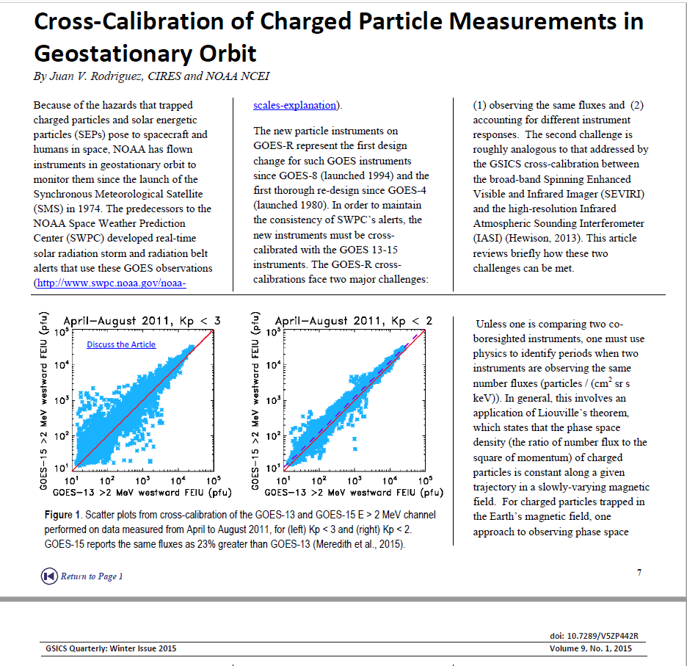
J. Rodriguez of NOAA inter-calibrated some of these sensors.
Rodriguez et al. 2014.
Rodriguez 2015.
He was interested in continuing this work within GSICS in 2015.
No response at the time.
In 2019, KMA expressed interest in bringing GSICS to space weather instruments.
Juan is now re-assigned. New lead (R. Redmon) is currently on detail. Again no response.
Recommend to postpone further.

