Slide 1
Validation of the TEMPEST-D CubeSat Radiometer Calibration
Wesley Berg and the TEMPEST-D Team
Colorado State University, NASA Jet Propulsion Laboratory and Blue Canyon Technologies

Slide 2
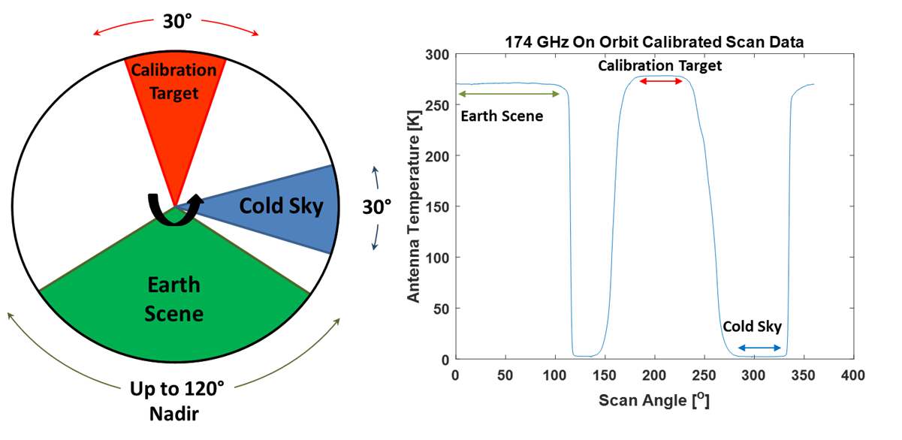
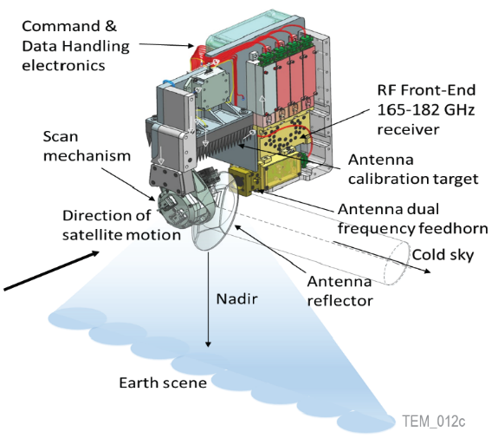
TEMPEST-D Instrument Performs End-to-End Radiometric Calibration
Observing Profile
Time Series of Output Data
TEMPEST-D Instrument
Scanning 5-frequency (87, 164, 174, 178 & 181 GHz) millimeter-wave radiometer measures Earth scene over ±60° angles from a nominal orbit altitude of 400 km.
TEMPEST-D performs a two-point end-to-end calibration measuring cosmic microwave background (“cold sky”) and ambient blackbody calibration target each revolution (30 RPM).
Calibration requirements are 4 K absolute accuracy and 2 K precision, but goal is to demonstrate utility of data for science applications.

Slide 3
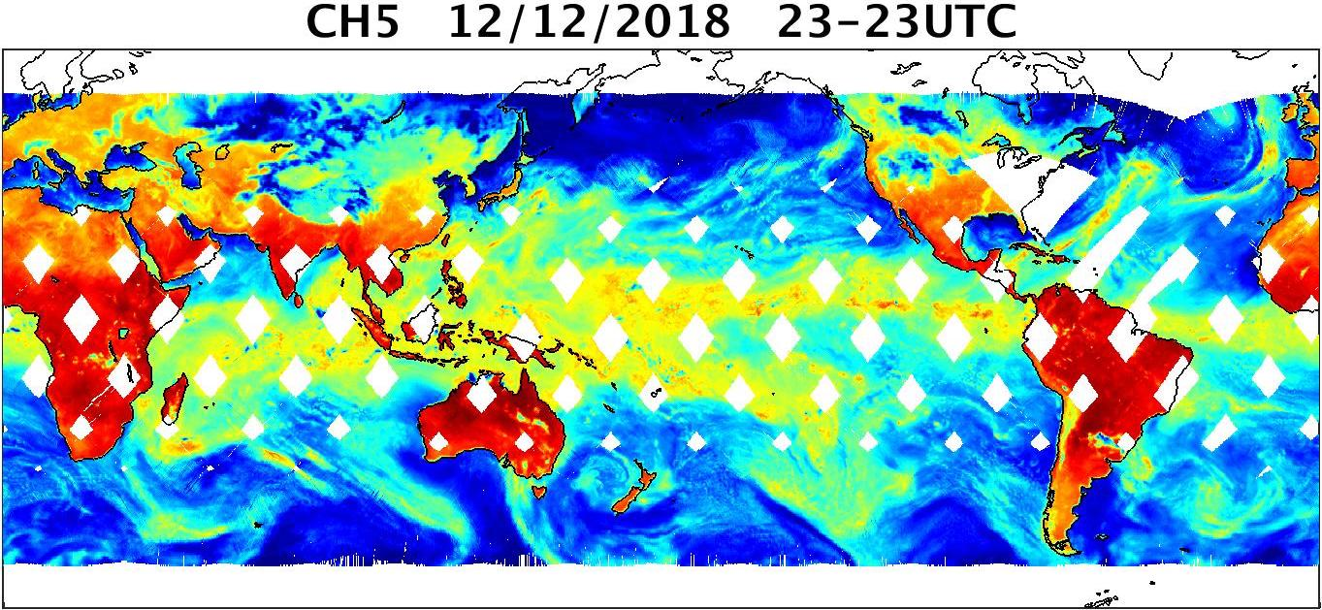
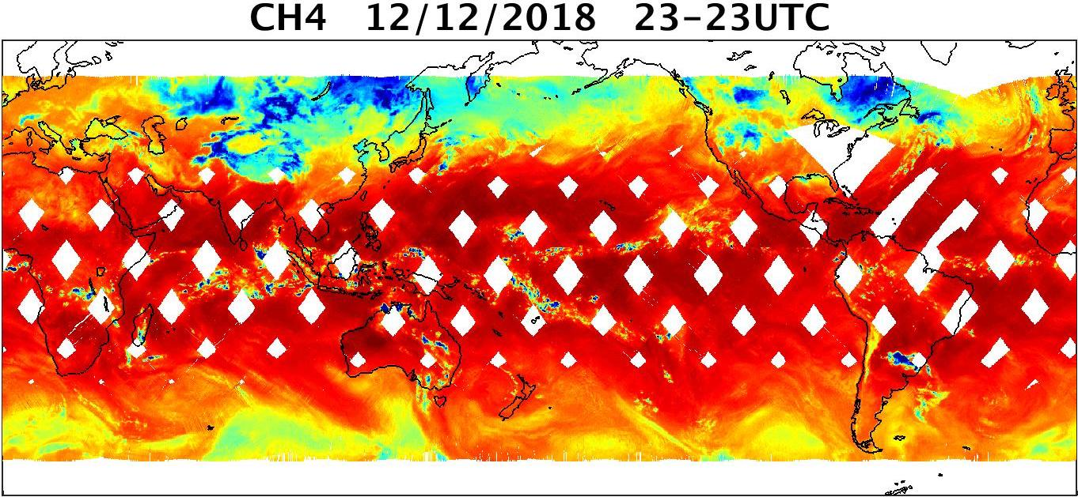
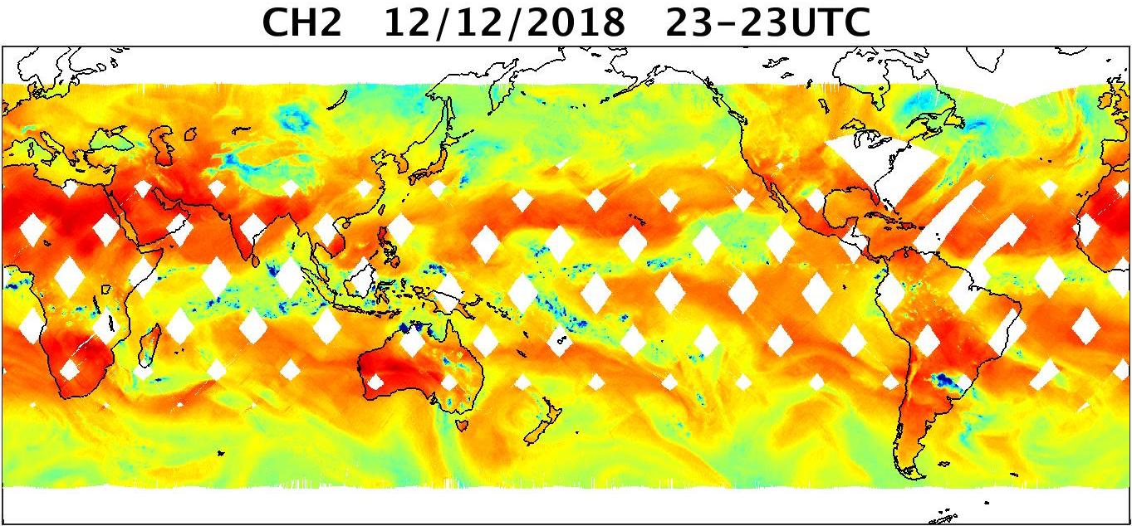
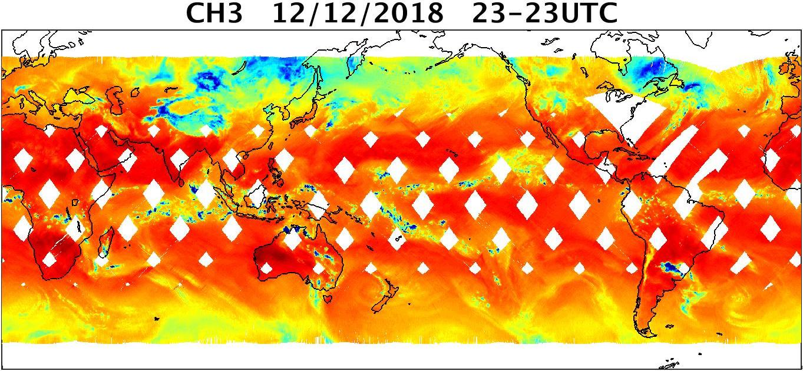
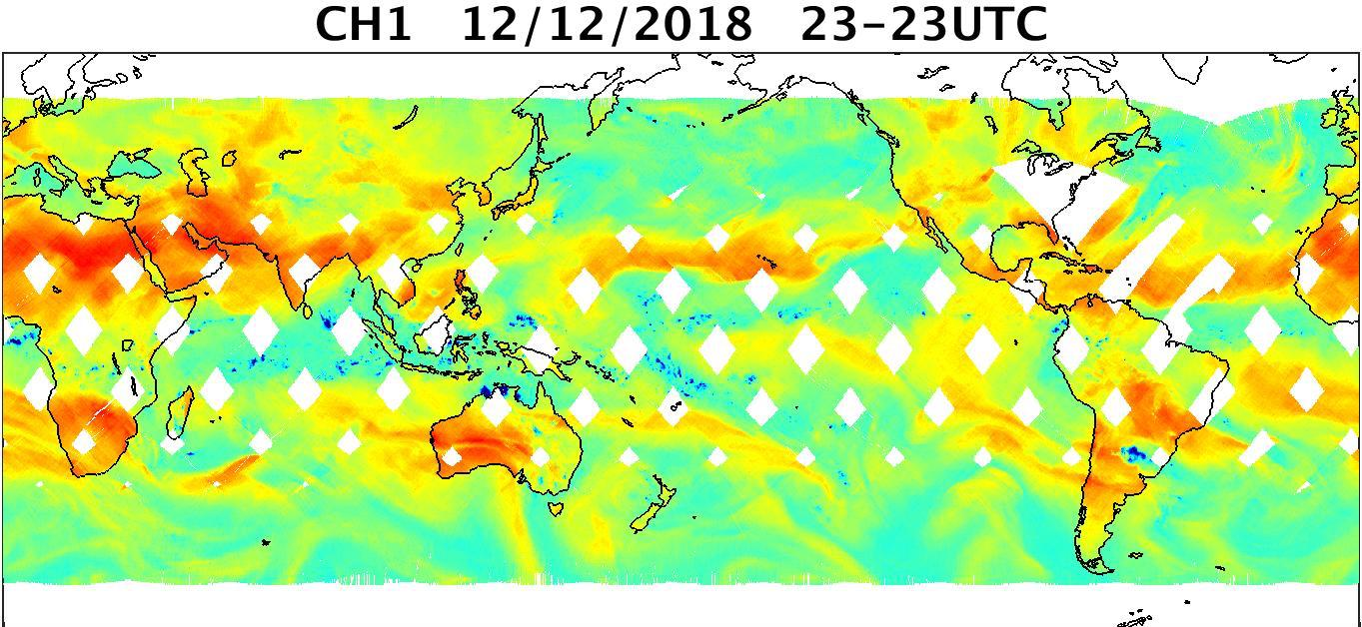
87 GHz
TEMPEST-D Observations
(12 Dec 2018)
TEMPEST-D brightness temperatures are shown for all five channels for a full day on 12 December 2018.
164 GHz
178 GHz
174 GHz
181 GHz

Slide 4
TEMPEST-D compared to Operational Sensors
Specification | TEMPEST-D | MHS | ATMS
Number of channels | 5 | 5 | 22
Channel Freq. (GHz) | 87, 164, 174, 178, 181 | 89, 157, 190, 183±3, 183±1 | 88, 166, 183±7, 183±3, 183±1
Mass | 3.8 kg | 63 kg | 75 kg
Power | 6.5 W | 74 W | 100 W
Altitude | 400 km | 820 km | 820 km
Resolution at nadir | 12.5 km (25 km@87 GHz) | 15.9 km | 15.8 km
NE∆T (K) | 0.2, 0.3, 0.4, 0.4, 0.7 | 0.22, 0.34, 0.46, 0.40, 0.51 | 0.29, 0.46, 0.38, 0.54, 0.73
Integration Time | 5 ms | 18.5 ms | 18 ms
Mass, power and cost of TEMPEST-D are a small fraction of those of the operational sensors
While noise values are comparable to operational sensors, TEMPEST-D has a 5 ms integration time, vs. 18+ ms for MHS/ATMS indicating lower noise for equivalent sampling time.

Slide 5
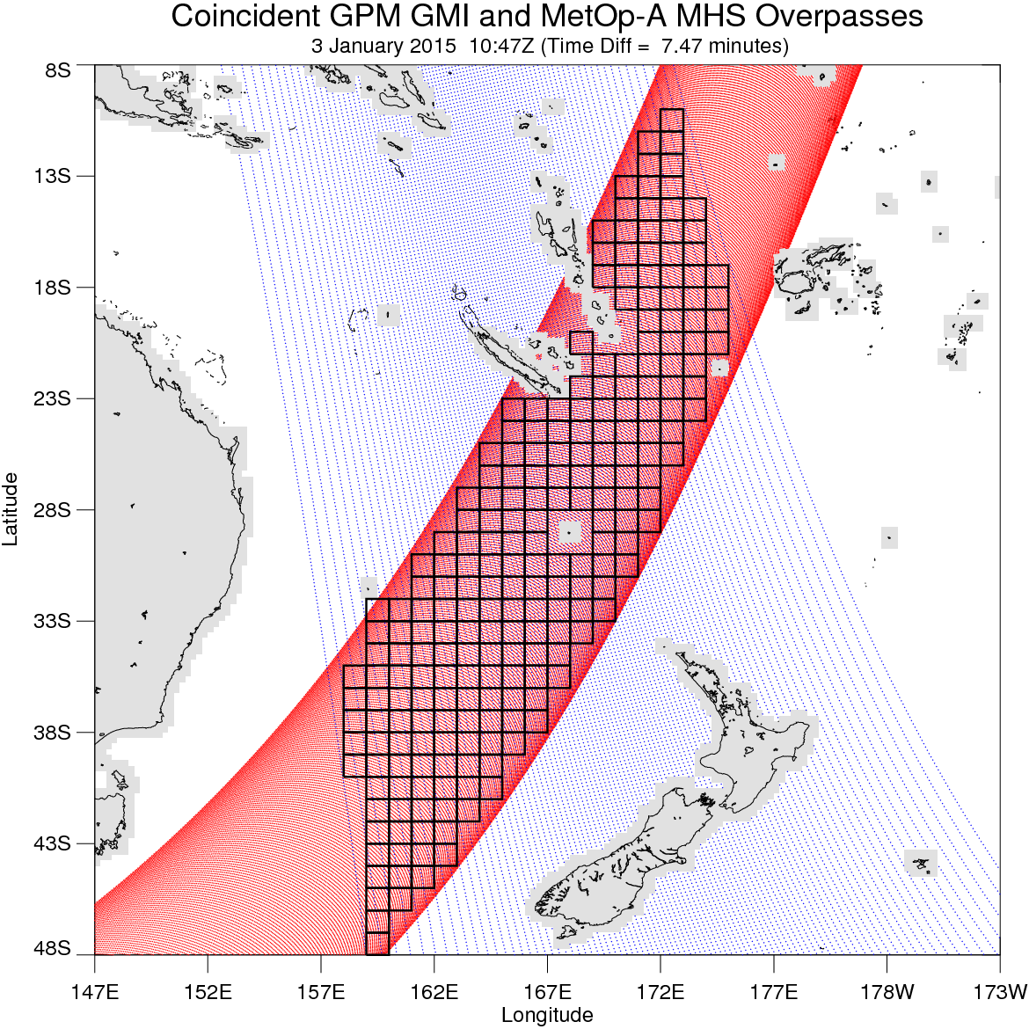
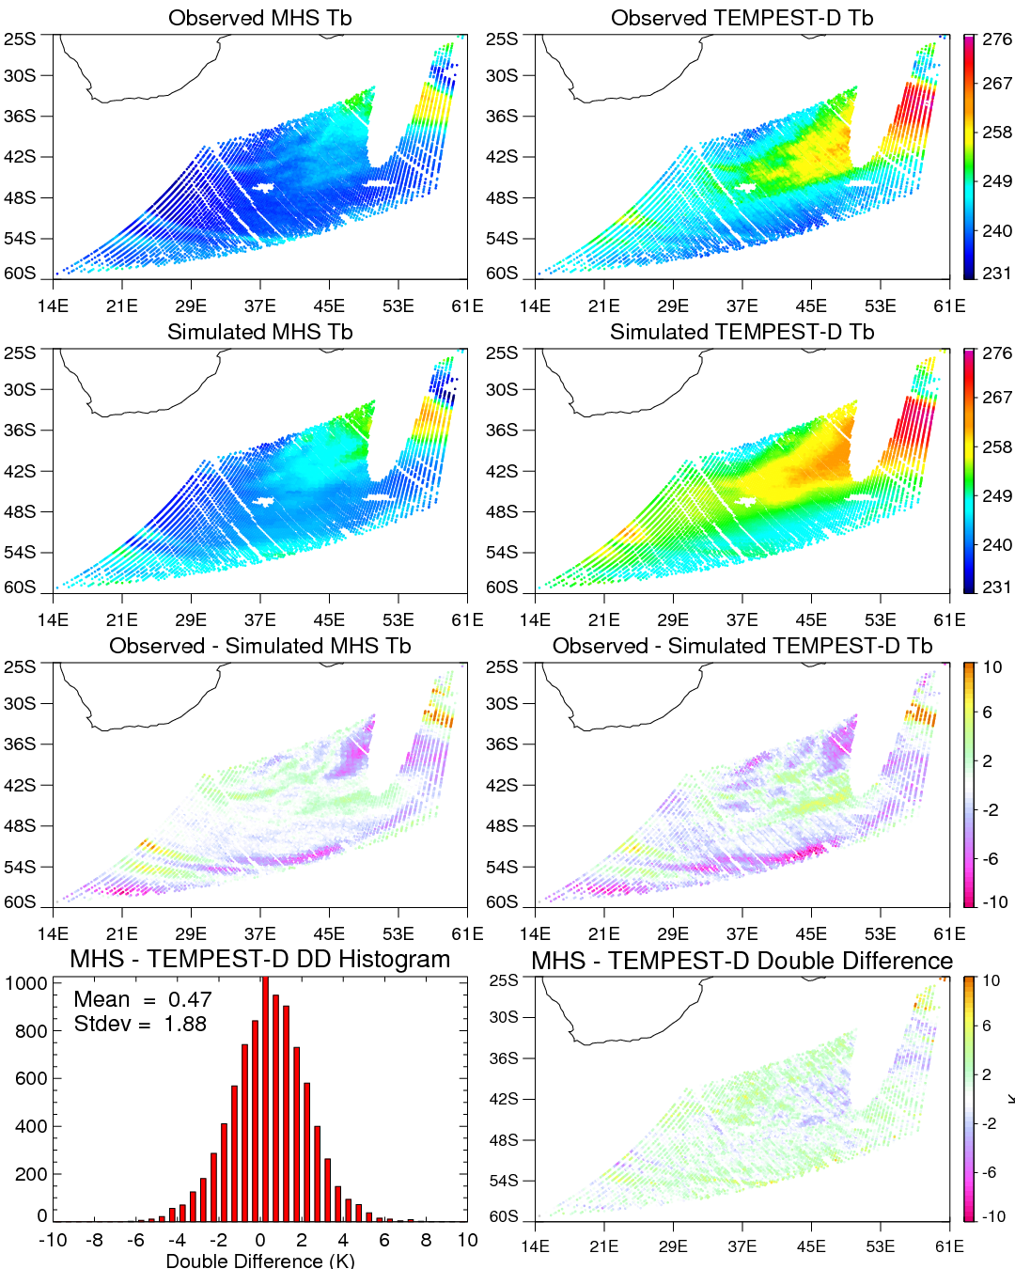
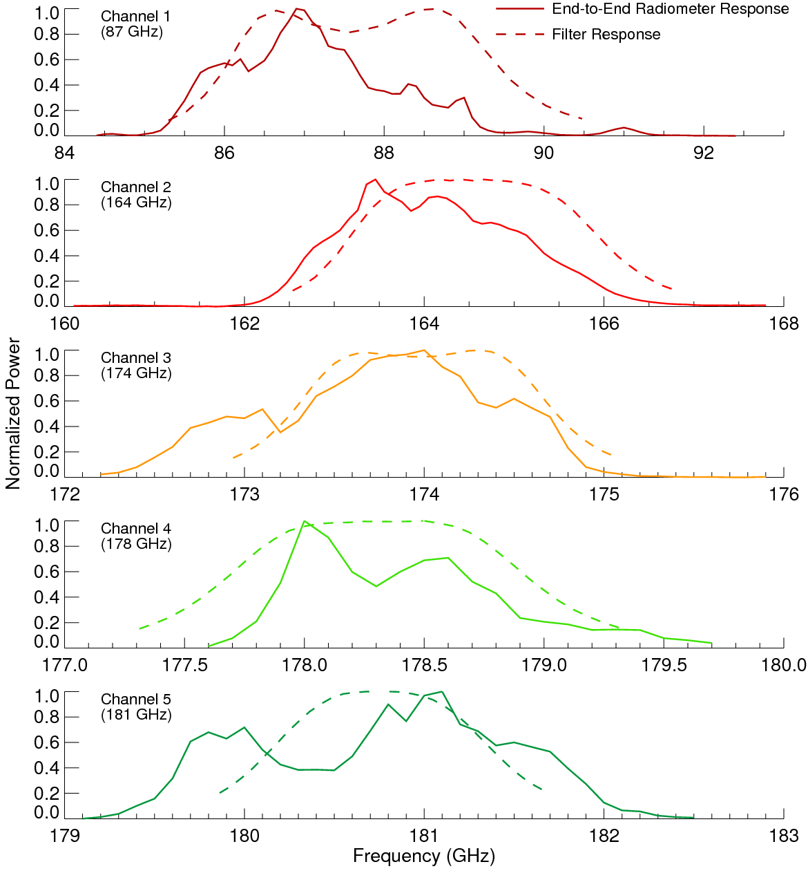
Validation: Double Difference Approach
Observations between TEMPEST-D and the reference sensors are matched in space and time.
Radiative transfer simulations using geophysical parameters from the NASA GEOS5 global data assimilation model are performed for coincident pixel observations, accounting for differences in channel frequencies, spectral response (see figure on right), polarization and view angle.
The difference between observed and simulated (i.e. expected) differences are averaged over 1°x1° boxes and screened for land, precipitation, significant inhomogeneity, etc. (see above figure).
Spectral response functions for the TEMPEST-D channels. The dashed line indicates the filter response, while the solid line shows the end-to-end radiometer response.

Slide 6
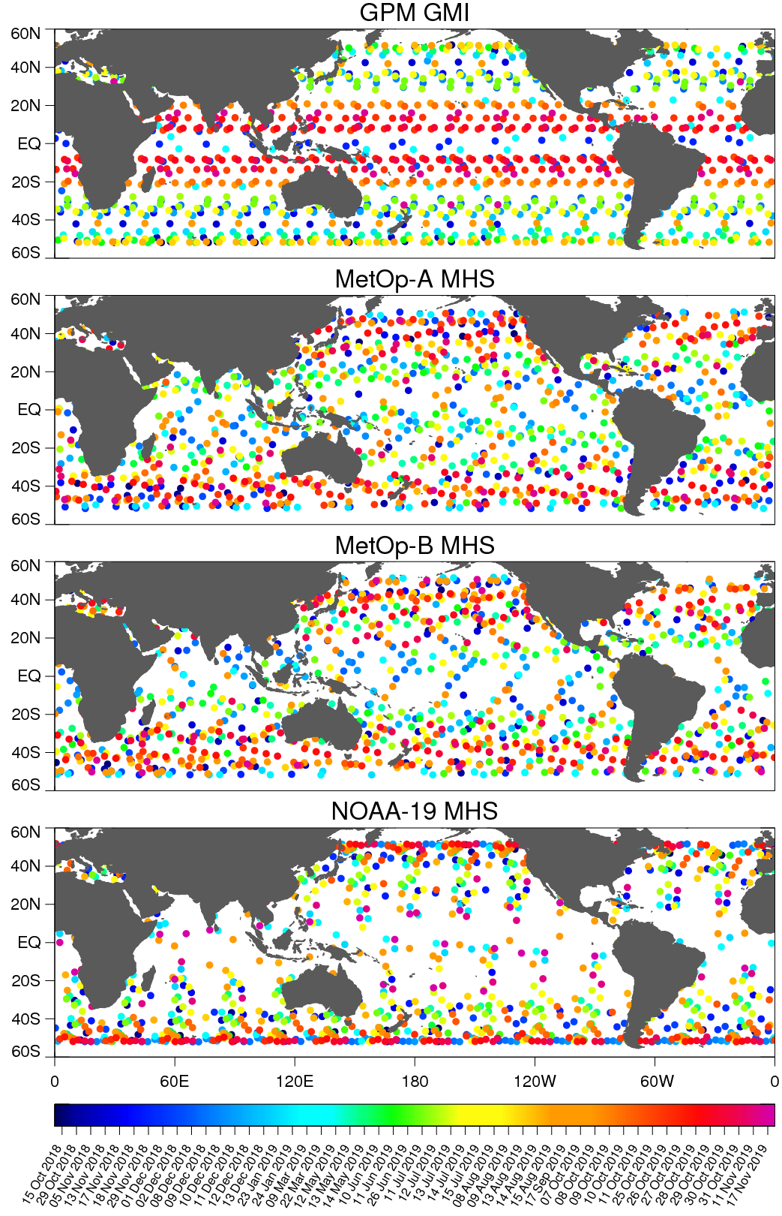
Satellite Reference Sensors
Coincident overpasses with TEMPEST-D
TEMPEST-D observations from a total of 50 days over a ~13-month period from October 15th, 2018 to November 17th, 2019 are matched with simultaneous observations from multiple satellite reference sensors.
Intercalibration analysis performed by the GPM XCAL team indicates that GMI and the MHS sensors are extremely well calibrated and stable (< 0.5 K).
Comparisons are made with data from 4 different reference sensors including GPM GMI and MHS on board NOAA-19, MetOp-A and MetOp-B.

Slide 7
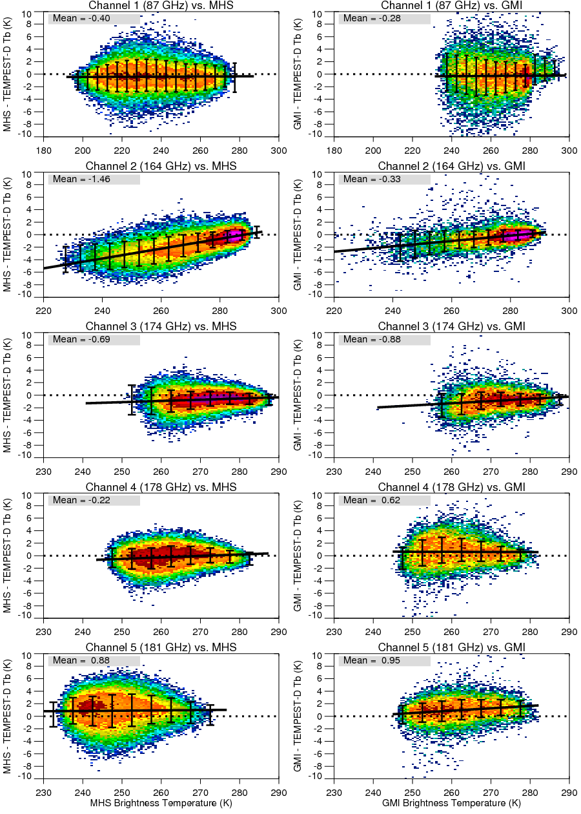
Double Difference Results
(Reference – TEMPEST-D)
Individual double difference estimates are very noisy, requiring many coincident observations to obtain stable estimates of calibration differences.
With the exception of the 164 GHz channel, the comparisons are relatively flat (i.e. no significant scene-temperature dependence) with mean values < 1 K.
Results for the 164 GHz channel show a significant scene-temperature dependence, although less for GPM GMI using 1DVar retrieved geophysical parameters. The GPM XCAL team found issues with the RT simulations in this frequency range likely due to the ocean emissivity model. More investigation is needed, but it likely that a significant portion of these differences is due to RT modeling errors.

Slide 8
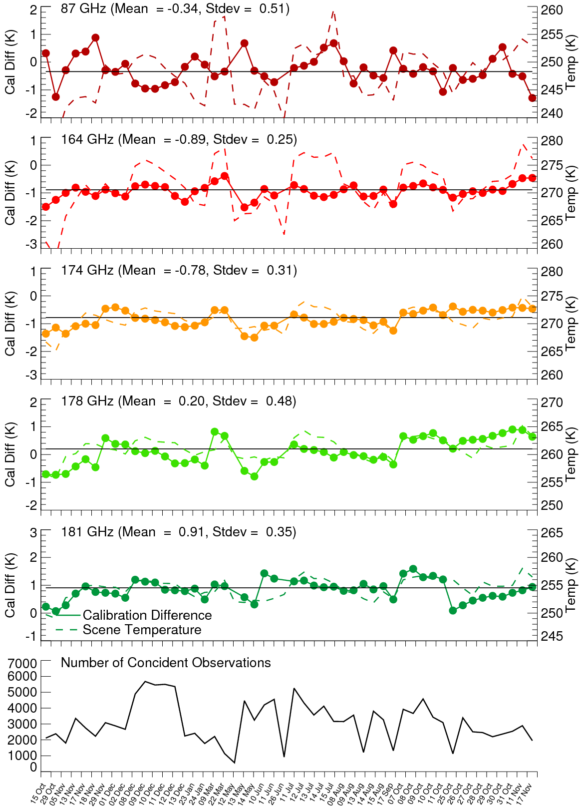
Validation of TEMPEST-D Calibration
(Reference Sensor – TEMPEST-D)
Sensor calibration difference estimates using double difference technique for coincident observations between TEMPEST-D and reference sensors.
Results are based on ~50 days of data. The calibration differences are <1 K, well below the TEMPEST-D requirement of 4 K for absolute calibration. Variability in daily mean values (see figure on the left) is also relatively small with no discernable long-term trends.
Consistency in daily-mean calibration estimates over the 13-month period of available data indicates a stable TEMPEST-D calibration with a standard deviation < 0.5 K for all channels.
These results indicate a very well calibrated and stable radiometer with very low noise, rivaling that of much larger and more expensive operational instruments.
Reference Sensor | 87 GHz | 164 GHz | 174 GHz | 178 GHz | 181 GHz
GPM GMI | -0.28 | -0.33 | -0.88 | 0.62 | 0.95
MetOp-A MHS | -0.38 | -0.94 | -0.36 | 0.12 | 1.41
MetOp-B MHS | -0.37 | -1.26 | -0.82 | -0.29 | 1.21
NOAA-19 MHS | -0.45 | -1.88 | -0.77 | -0.33 | 0.35
Mean (MHS Only) | -0.40 | -1.46 | -0.69 | -0.22 | 0.91
Mean Difference | -0.34 | -0.89 | -0.78 | 0.20 | 0.91
Standard Deviation | 0.07 | 0.65 | 0.23 | 0.44 | 0.46

Slide 9
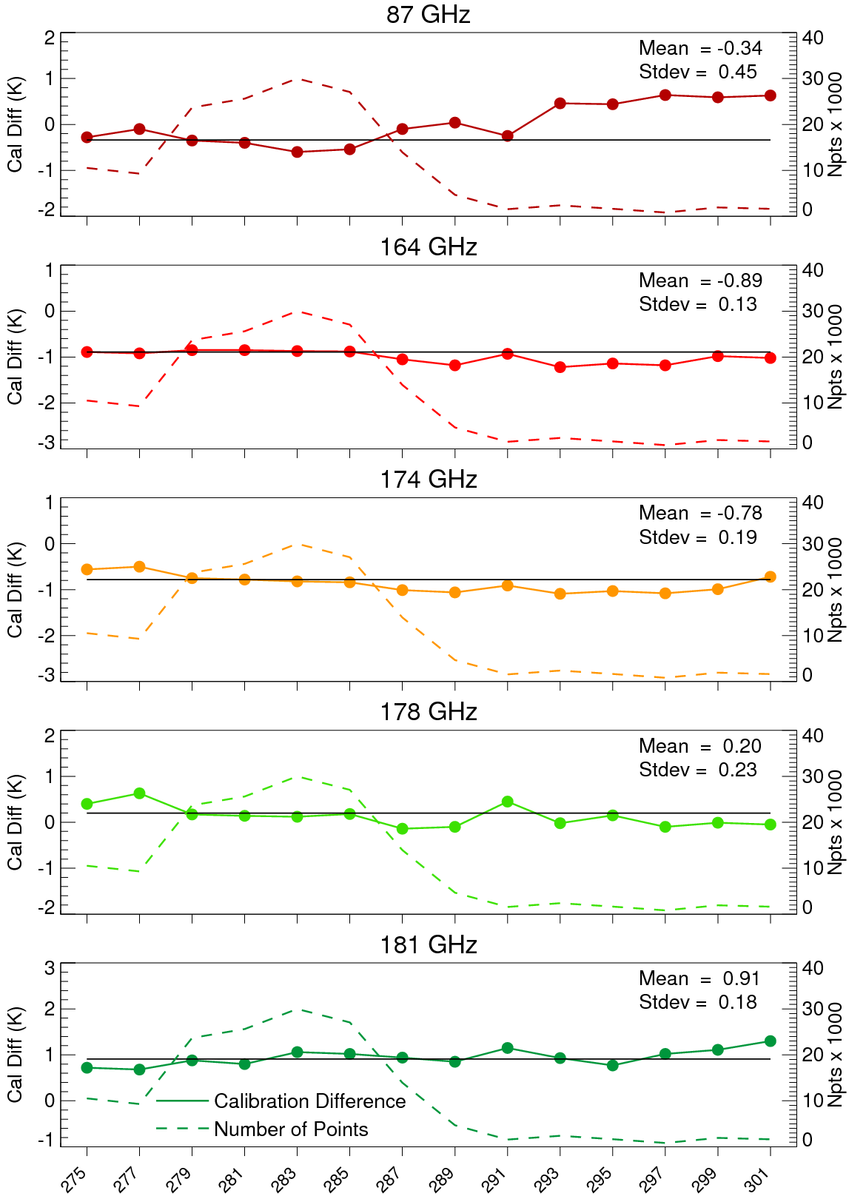
Validation of TEMPEST-D Calibration
(Double Differences vs. Instrument Temperature)
Results on the left show variations in double difference estimates as a function of the instrument physical temperature.
Dashed line indicates number of observations for each instrument temperature bin. Very few observations available for temperatures below 279 K or above 287 K.
Results look very stable with temperature. Slight rise for 87 GHz channel for warm instrument temps corresponds to very few coincident observations.
Reference Sensor | 87 GHz | 164 GHz | 174 GHz | 178 GHz | 181 GHz
Mean Difference | -0.34 | -0.89 | -0.78 | 0.20 | 0.91
Standard Deviation | 0.45 | 0.13 | 0.19 | 0.23 | 0.18

Slide 10
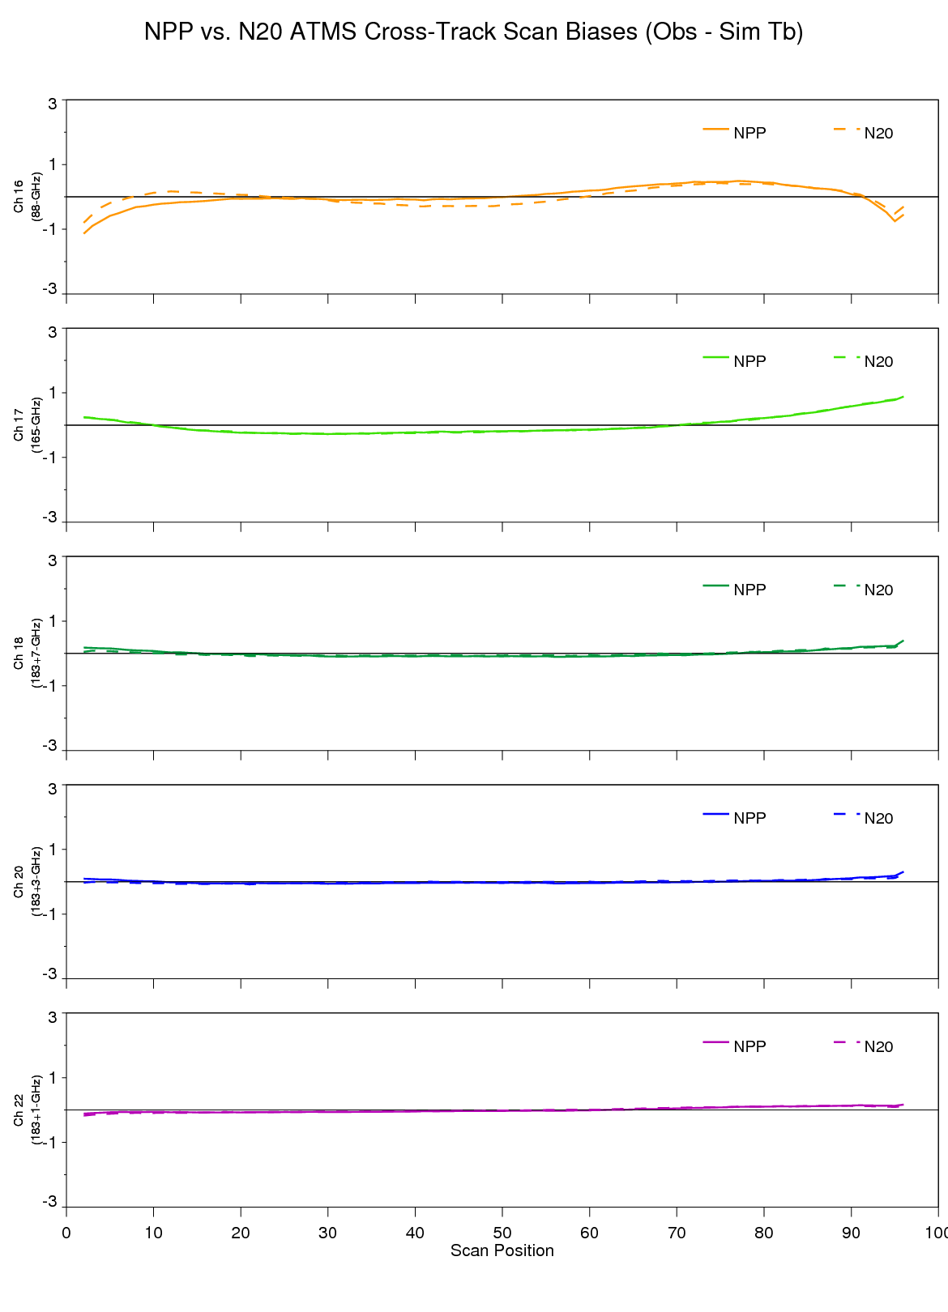
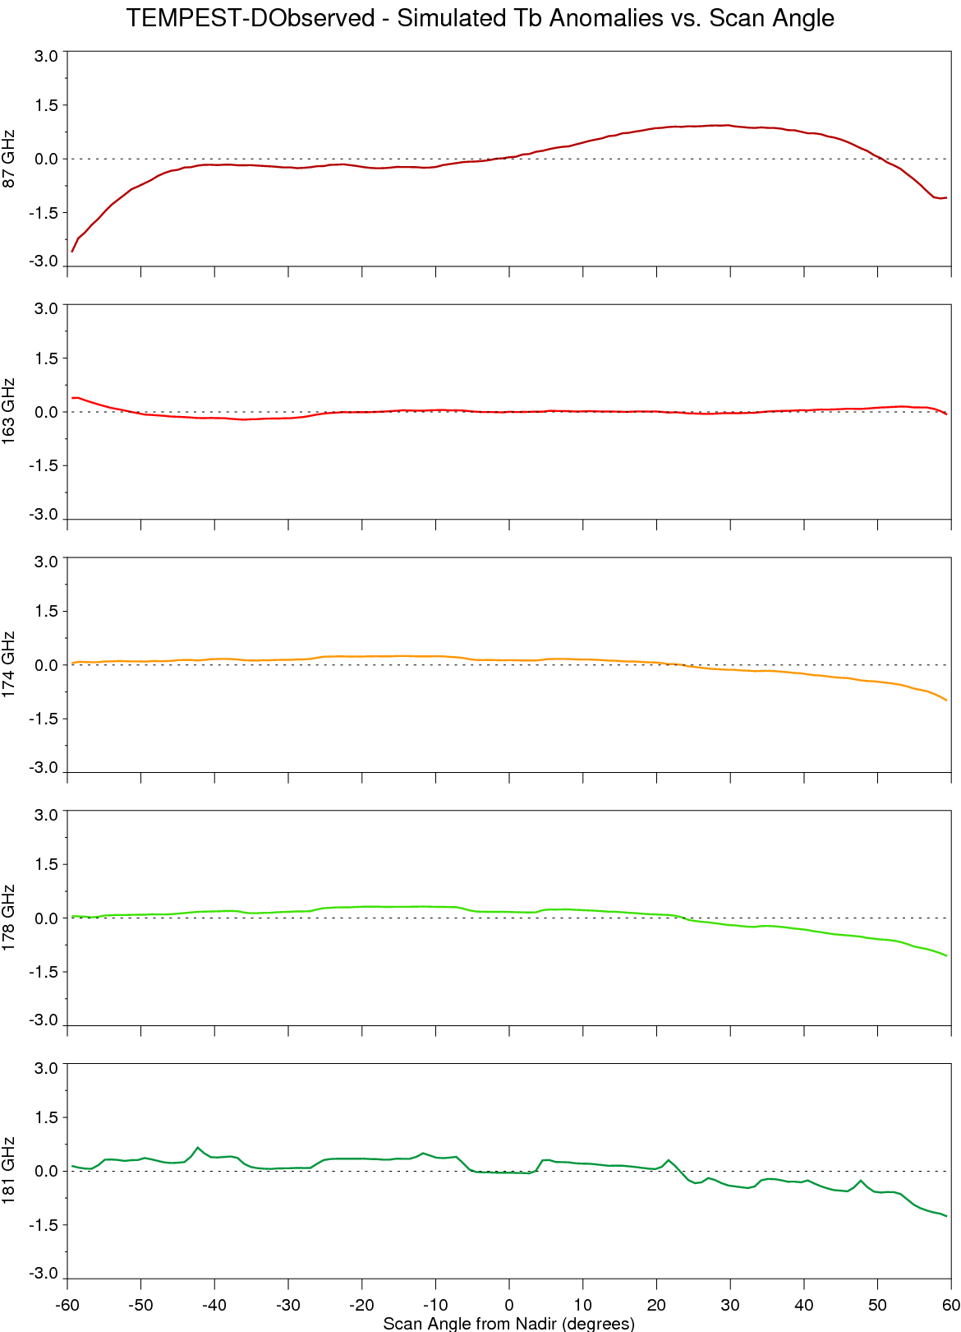
Validation of TEMPEST-D Calibration
(Single Differences vs. Scan Angle)
TEMPEST-D Tb Anomalies vs. Scan Angle
ATMS Tb Anomalies vs. Scan Angle
Single difference anomalies (i.e. observed minus simulated Tb) are shown TEMPEST-D on the left, and for the similar NPP and NOAA-20 ATMS channels on the right.
ATMS results are for the current operational SDRs, which are a significant improvement in cross-scan biases over the previous operational calibration version.
Variations with scan angle are largest at relatively extreme angles for the 87 GHz channel, which is most sensitive to ocean emissivity.

Slide 11
Summary
TEMPEST-D Calibration/Validation:
Calibration of the TEMPEST-D radiometer is consistent with reference sensors (i.e. GMI & MHS) with absolute calibration errors < 1 K and precision < 0.5 K for all channels.
The TEMPEST-D calibration is stable over time and shows no significant calibration changes due to instrument temperature
Cross-scan biases are slightly larger than those for ATMS, with some asymmetry, but errors in radiative transfer modeling are likely to contribute to at least some of this
These results indicate a very well calibrated and stable radiometer with low noise, rivaling that of much larger and more expensive operational instruments
Instrument continues to operate 24/7 with no issues, although downlink limitations result in only ~1-2 days of data being downloaded each week
TEMPEST-D data is publicly available at http://tempest.colostate.edu.
Registration required
Data is stored in daily HDF5 files
Public data includes observations from special yaw maneuvers done for along-track scanning
Journal article on the TEMPEST-D Calibration and Validation has been submitted for publication to IEEE Transactions on Geoscience and Remote Sensing (TGARS)

