Slide 1
Microwave Subgroup Achievements in 2019 and Future Plan
Qifeng Lu, Quanhua (Mark) Liu, and Ralph Ferraro
March 18, 2020

Slide 2
Outline
1. Achievements summary from last year
2. Actions of MW Sub-group from last year's annual meeting and high-lights
3. Plan for MW Sub-Group activities
4. Other urgent topics that need to be addressed as soon as possible

Slide 3
Recent Meetings of Microwave Sub-Group
17 January 2019 (Web meeting)
06 March 2019 (Annual meeting)
07 May 2019 (Web meeting)
23 July 2019 (Web meeting)
19 November 2019 (Web meeting)

Slide 4
General progress (1)
The fifth MW subgroup meeting was held on 19th NOV, 2019
The outcome on the gap analysis of MWI was report to CGMS-47 as an plenary talk
The MWS FCDR is coming and looking for the user feedback: EUMETSAT Fundamental Climate Data Records (FCDR) for the microwave humidity sounders provide detailed quality and uncertainty data. The first version (for evaluation) of CMA FCDR for MWRI/MWHS/MWTS has been released in the end of 2019.
The planned documentation of XCAL for GSICS MW is good starting to initialize the cooperation
Instrumental performance monitoring and uncertainty characterization based on SNO and RTM simulation is more evidential and methodological

Slide 5
General progress (2)
SNPP and NOAA-20 ATMS reprocessing are completed and the latest calibration has been operational since October 15, 2019, significantly reduced the difference between SNPP and NOAA-20 ATMS.
CubeSAT TEMPEST-D microwave SDR are now available at (https://tempest.colostate.edu/data) and have been used in studying tropical cyclones.
AI May enhance the spatial resolution of microwave measurements.
COSMIC-2 launched on June 25, 2019 and the data are operationally used for MW sensor monitoring.

Slide 6
Action Items
Action Id | Summary | Status
CGMS-46-EUM-WP-14 | On passive microwave observations:GSICS is requested to organise an expert meeting on the intercalibration of operational PMW sensors to meet the WIGOS 2040 targets for a coordinated effort to share information on current and future PMW instruments and report to CGMS-47 | Closed, GSICS Microwave Sub-group to consider strategy to mitigate risk of gaps in microwave imager constellation
R.GMW.2019.5j.1 | Shengli Wu (CMA) to analyse SNOs as a function of radiance and latitude | Closed. Shengli reported that this work has been completed.
A.GMW.2019.5n.2 | Shengli Wu (CMA) to attempt to apply X-Cal algorithms to MWRI and report on completeness of algorithm description (by 2019-09) and results (by 2020-03) | Open. Shengli reported that they have done the similar work like X-Cal using MWRI and GMI.
A.GMW.20190507.1 | Rachel Kroodsma and Shengli Wu to work out details in order for CMA to apply X-Cal corrections to MWRI | Closed. SNO and Double Difference have been done base on Era5 and RTTOV using MWRI and GMI.
A.GMW.2019.5m.1 | Bomin Sun (NOAA) to repeat analysis of time series with regular operational RS92 radiosondes and report comparison of results with those from GRUAN sondes. (Some of this was shown in Tony's presentation, at least the start of the study) | Closed. Email from Bomin on March 13, 2020: We did the analysis using the data at GRUAN station at Lindenberg, Germany. Our result indicates that (1) GRUAN and MW match well with each other in the interannual and trends scale (2008-2017); (2) discrepancy is noticed between MW and conventional radiosonde data for long-term trends (1980 - 2019).
A.GMW.2019.5o.1 | Isaac Moradi (UMD) to address large differences between N20 & SNPP WV channels with LBL model and compare the massive ensemble over the tropics. (Progress noted in minutes above; Isaac will report on in next meeting) | Closed. Isaac has further studied the difference and presented the results at CISESS science meeting: https://www.dropbox.com/s/nz102uzgqnlbb1u/moradi_rt.pdf?dl=0. Using the reprocessed SNPP and NOAA-20 ATMS data, he found that the difference is small ( < 0.25 K ) even for WV channels. The new ATMS calibration used in the reprocessing has been operational since October 15, 2019. Resolved.
A.GMW.2019.5n.1 | Rachel Kroodsma (NASA) to contact Wes Berg about sharing ATBD and university code with CMA | Closed. Wes discussed the issue at the 4th MW meeting on 11/19/19. The issue (sharing code and data) is more about different policy beyond GSICS control. The action item is resolved within GSICS.
A.GMW.2019.5n.3 | Ralph Ferraro (NOAA) to re-send details of GPM X-Cal LUT deliverable to MWSG members for comment | Closed. The action was completed and approved by EP
A.GMW.2019.5t.1 | Manik Bali (NOAA) to circulate white paper on microwave imager inter-calibration to all agencies for review/contribution. (Manik mentioned he will get this distributed in the near future) | Open. In progress. Manik may present the white paper at GSICS meeting in Seoul 2020.
A.GMW.2019.5x.1 | MWSG Chair to coordinate the development of a summary of the current status of MW sensor calibration methods (by sensor and frequency type), needs by product type, and provide a 3-year roadmap for developing GSICS MW calibration products | Open. In progress. Ralph mentioned he will reinvigorate the MW group "work space" to update information related to MW calibration and use this as a starting point. Ralph has received inputs from several MW folks and has begun to update the MW workspace .

Slide 7
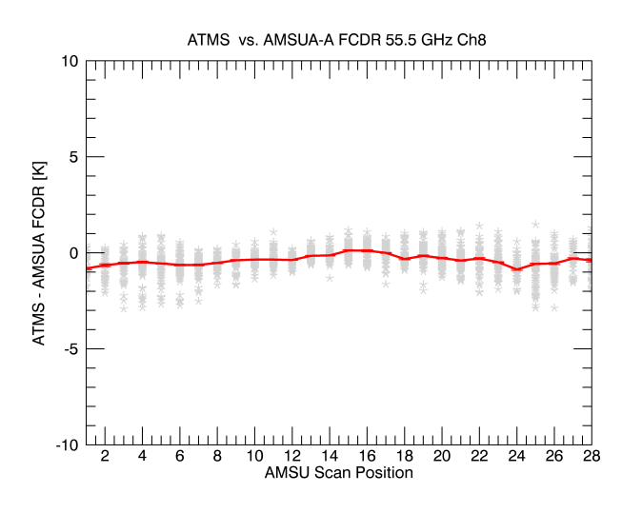
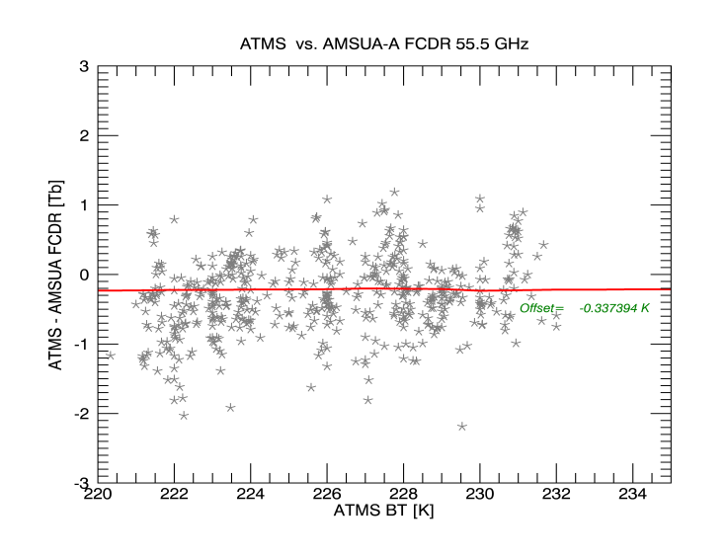
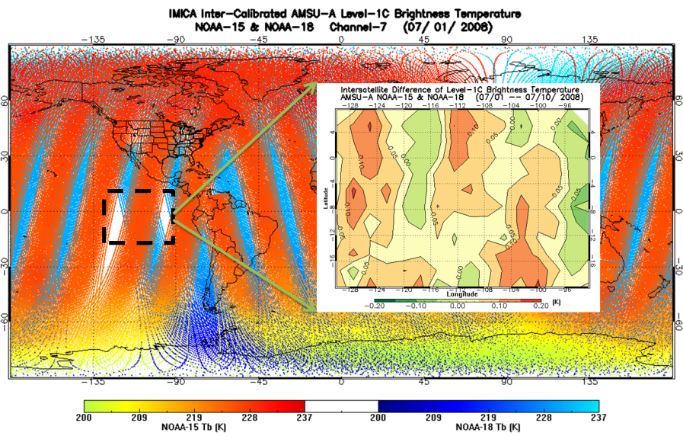
In-orbit reference records for monitoring Microwave Instruments
Manik Bali, Lawrence E Flynn, Cheng-zhi Zou and Ralph Ferraro
Introduction
For the first time an in-orbit reference record for monitoring Microwave instruments has been proposed. The record is the Fundamental Climate Data Record (FCDR) constructed by tying together AMSU-A/MSU series of instruments since its launch. This record is highly stable ( within 0.1K per decade ) and overlaps channels of most of the microwave sensors currently in-orbit.
GSICS Style Simultaneous Nadir Overpass (SNO) inter- comparison of the FCDR with concurrently flying instruments such as AMTS can reveal the full scale of bias ( scan angle, temperature, temporal bias) in an in-orbit Monitored instrument.
We present here results of one such comparison of AMSU-A (N18 FCDR and Aqua ) with ATMS-CDR.
Figure above shows FCDR’s ability to detect scan angle(left) dependence and temperature dependence (right) of ATMS in-orbit bias. The FCDR is nearly as stable as pre-launch reference
AMSU/MSU
FCDR
AMSR (2/E)
JAXA
SSMI
DOD
GMI
NASA
ATMS
NOAA
MTVZA
ROSCOSMOS/Ukraine
MWTS-2
China
Results
A in-orbit reference for monitoring Microwave instrument has been proposed.
This reference is the Fundamental Climate Data Record produced by tying together AMSU-A instruments thus producing a long time series of reference record.
The reference record has the ability to reveal temporal, scan angle and temperature dependence bias in in-orbit monitored instruments this helping in re-calibration.
Figure above shows the instruments that have channels similar to FCDR and can be monitored using FCDR
Figure above shows difference between AMSU-A FCDR from N15 and N18 . They match to better than 0.1K. FCDR is highly stable ( Zou et al )
Manik Bali (NOAA) to circulate white paper on microwave imager inter-calibration to all agencies for review/contribution
https://docs.google.com/document/d/1AVRA06WmgMygMUj1LQUAdxZynpyoy1rIdJ4HM_QUO1w/edit#heading=h.t9f3wa5d6gzv
Response Requested

Slide 8
CGMS-47 Background and requirements for MW
CGMS actions from discussions in CEOS SIT
  WMO WGIII/ 5.1.1 A45.02 Update the risks assessment and gap analysis of implementation against the CGMS baseline; include the potential risk of gaps in the capability for passive microwave imaging in this update
  H.2 A45.20 CGMS to endorse the gap analysis report and the coordinated action plan in writing prior to CEOS 2017 plenary meeting, to the Joint CEOS-CGMS WG Climate
    CEOS endorsed the ECV gap analysis report and the coordinated action plan
    Will be forwarded now to CGMS 46 for endorsement - expected first week of June
    Important recommendation from GSICS PoV:
    CEOS and CGMS agencies to add the delivery of FCDRs for each individual satellite instrument (linked to relevant precursor instrument series) to their agency remit.
Triggered AGU special session on potential ECV gaps (SST, precip., ice, snow, etc.)
CGMS-46 recommendation:
“On passive microwave observations:GSICS is requested to organise an expert meeting on the intercalibration of operational PMW sensors to meet the WIGOS 2040 targets for a coordinated effort to share information on current and future PMW instruments and report to CGMS-47 (CGMS-46-EUM-WP-14) → GSICS Microwave Sub-group to consider strategy to mitigate risk of gaps in microwave imager constellation

Slide 9
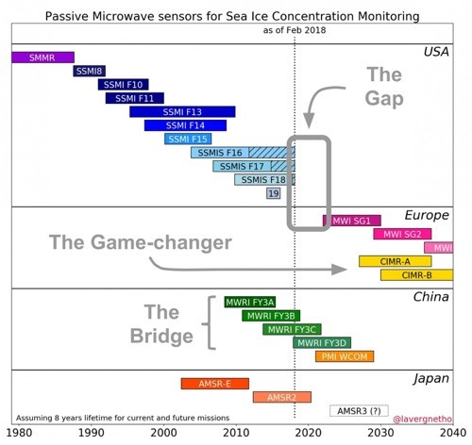
Constellation of low frequency Microwave Imagers
Notes:
Caption: Timeline of past, present and future microwave satellite radiometer missions relevant for sea ice concentration mapping for the period 1980s to 2030s highlighting a gap in capability and the use of Chinese missions to bridge the gap.
However, these missions do not include the low-frequency channels or high-spatial resolution offered by the proposed European CIMR mission concept. Directly responding to the Integrated European Policy for the Arctic, CIMR will be a unique
mission providing complementary low frequency and high-spatial resolution measurements: a game changer for Arctic monitoring (courtesy T. Laverne, Met.No)

Slide 10
Status on the CGMS-46 action
Coordination took place with GSICS MW SG and CEOS-WGCV MWSG
  At CEOS WGCV MWSG meeting in Darmstadt, August 2018
  At GSICS Annual Meeting, Frascati, March 2019
  Through email and phone
Start development of best practises in GSICS for MW cross-calibration → How will GSICS apply existing inter-calibration algorithms to range of microwave imagers for NRT applications? Who is interested in participating? Coordinating?

Slide 11
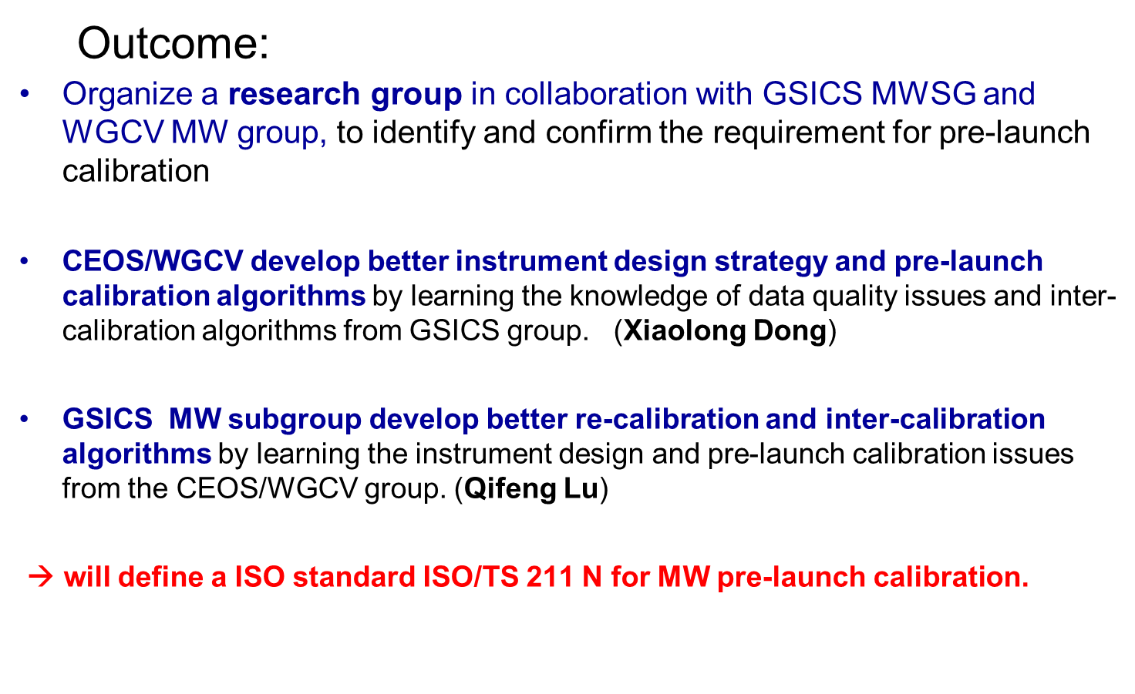
Coordinate with CEOS-WGCV MWSG

Slide 12
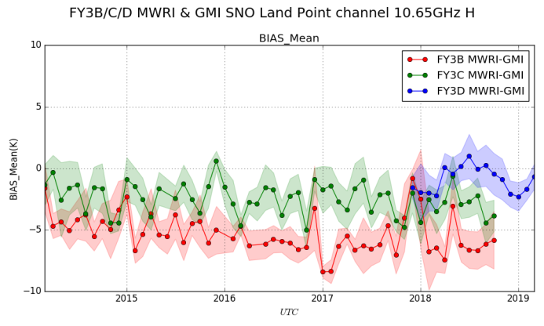
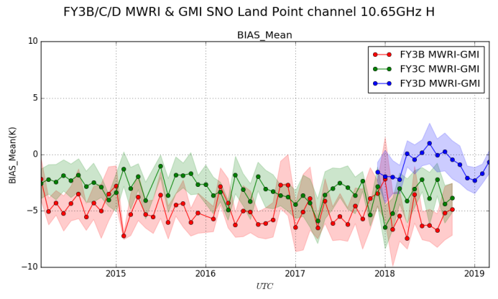
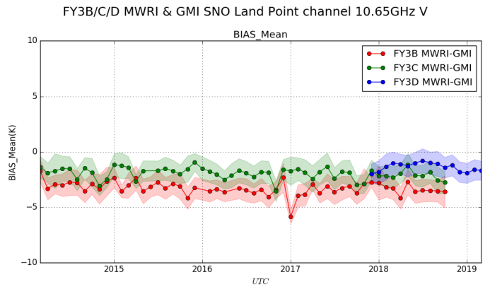
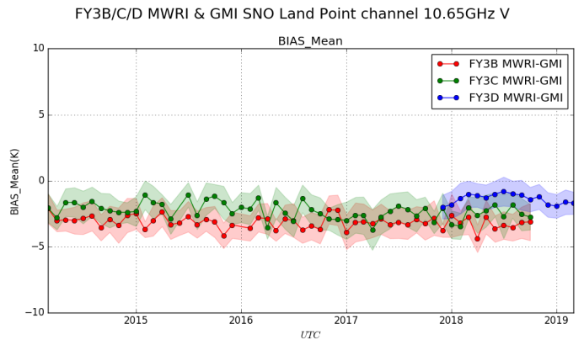
First version (for evaluation) of CMA FCDR for MWRI(FY-3B\C\D)
SNO with GMI
Operational
FCDR V 1.0
10V
10H
Apply the latest calibration algorithm of FY-3D/MWRI to FY-3B/MWRI and FY-3C/MWRI

Slide 13
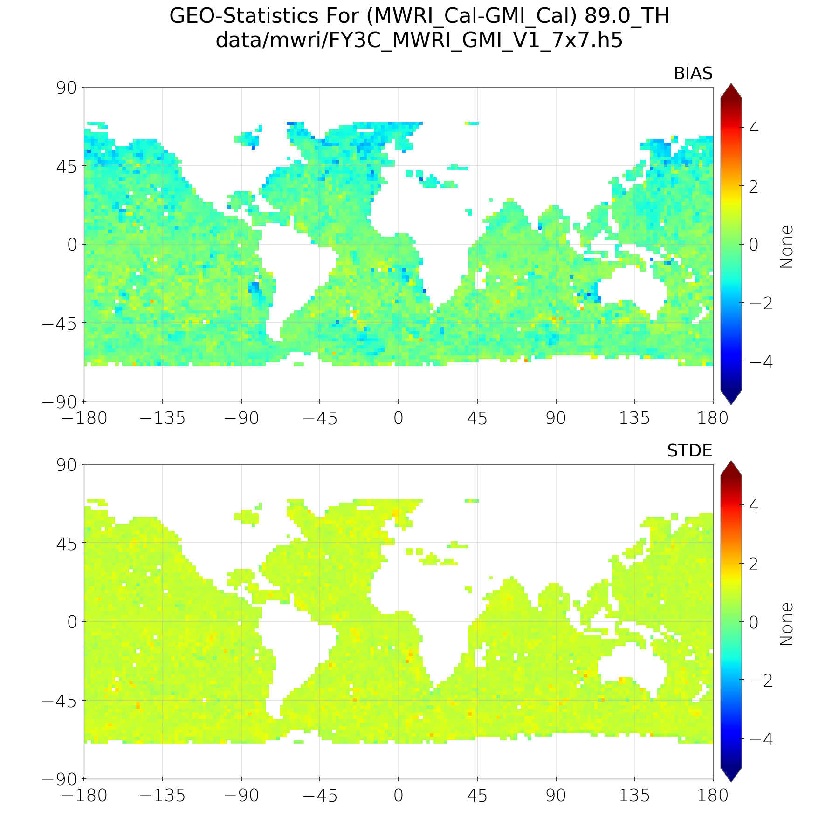
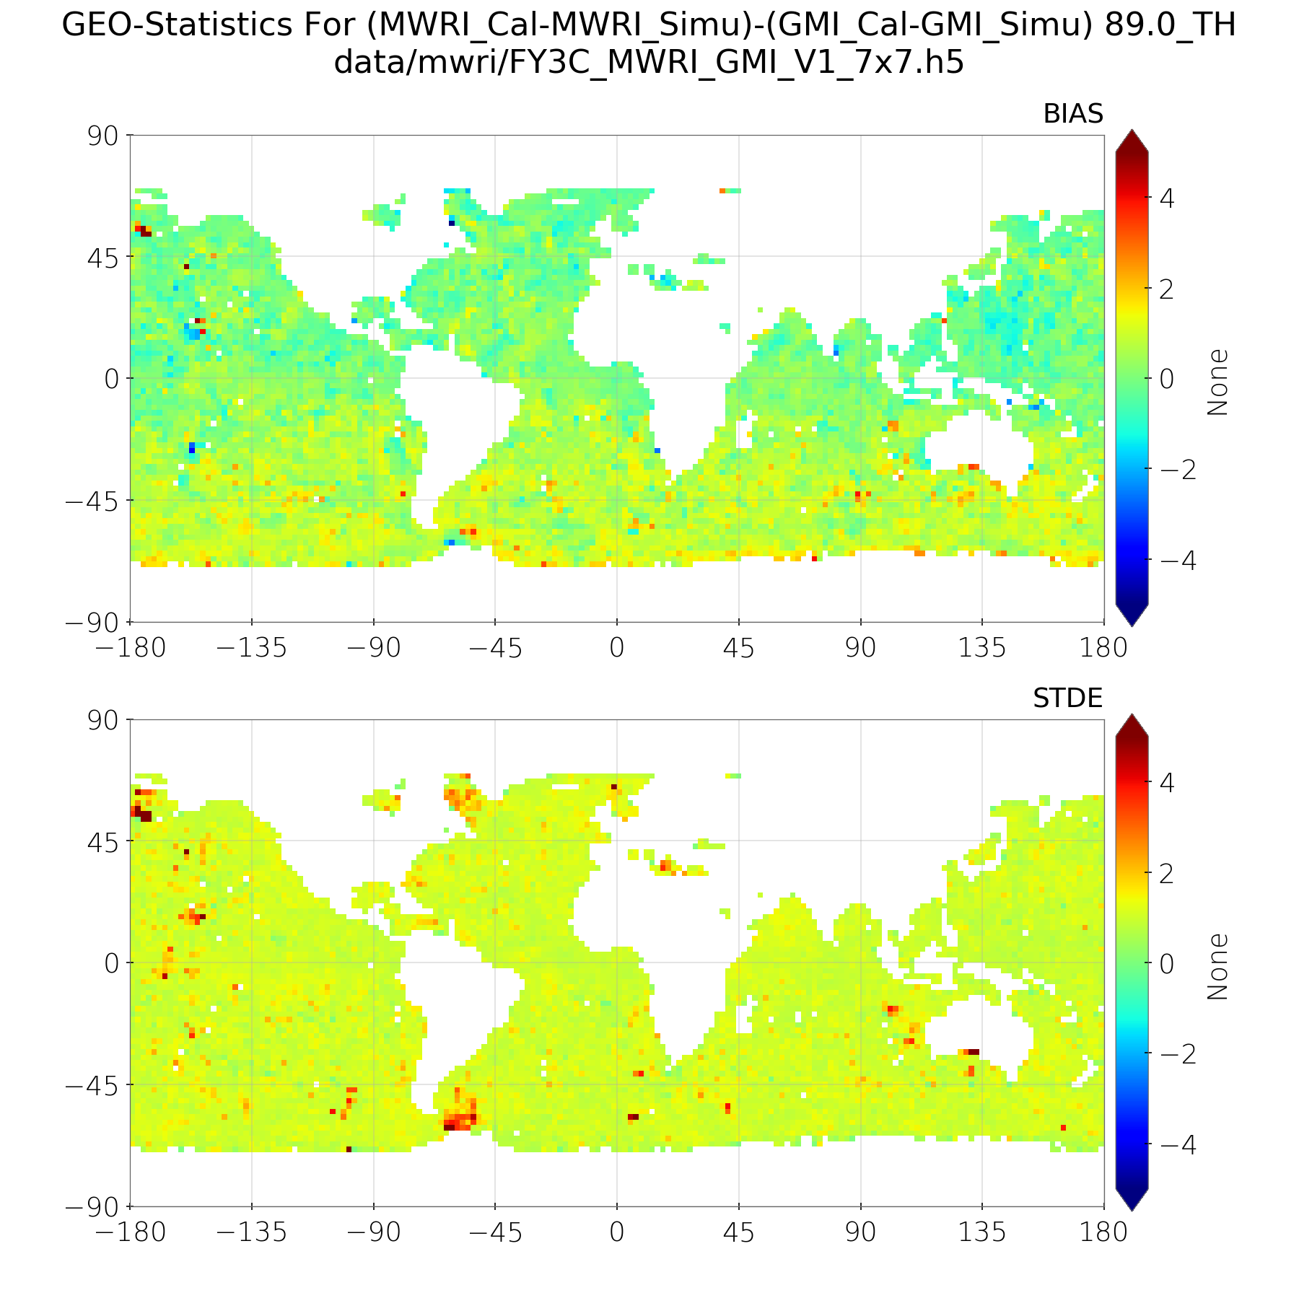
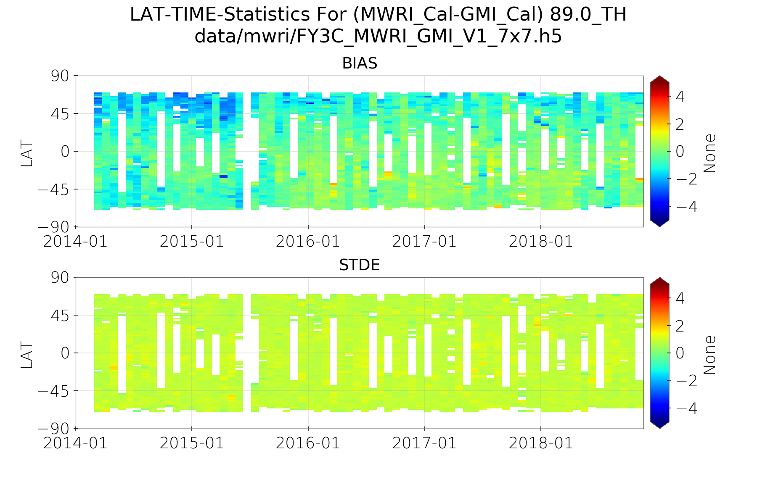
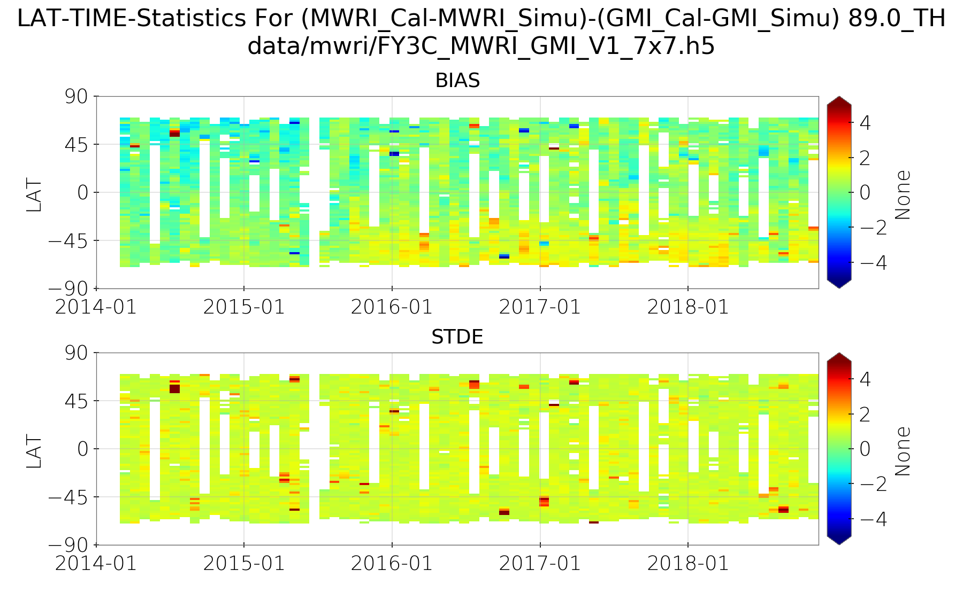
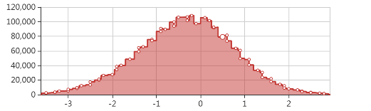
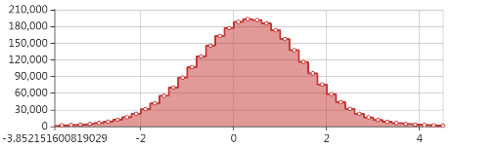
SNO and DD Between MWRI and GMI
SNO
DD

Slide 14
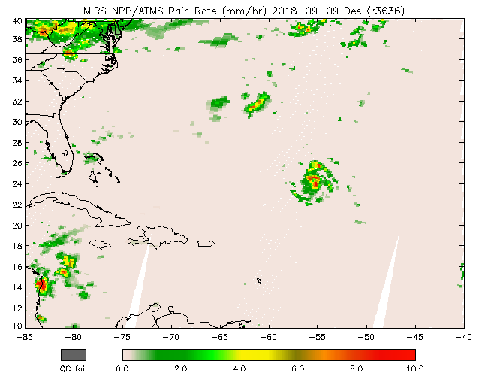
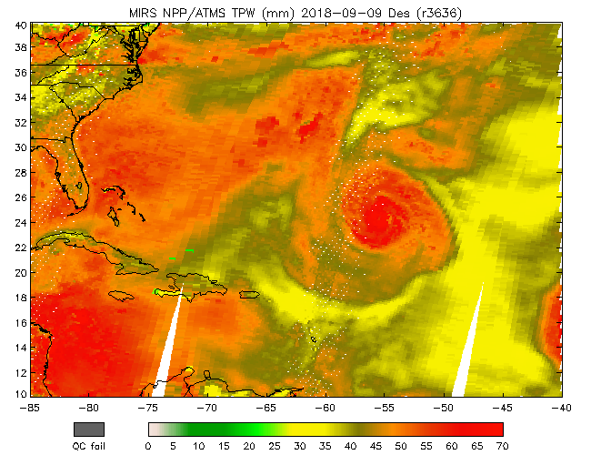
Meeting Highlights (System) Grassotti 11/19/2019
Microwave Integrated Retrieval System (MiRS):
Overview, Recent Activities, and Applications
Hurricane Florence N20 and SNPP ATMS RR and TPW, 9-17 Sept 2018
New Activities/Science Improvements/Applications
TC Applications: intensity estimation, warm core anomaly retrieval
Dynamic radiometric bias correction using machine learning
Blended/Advected Layer PW

Slide 15
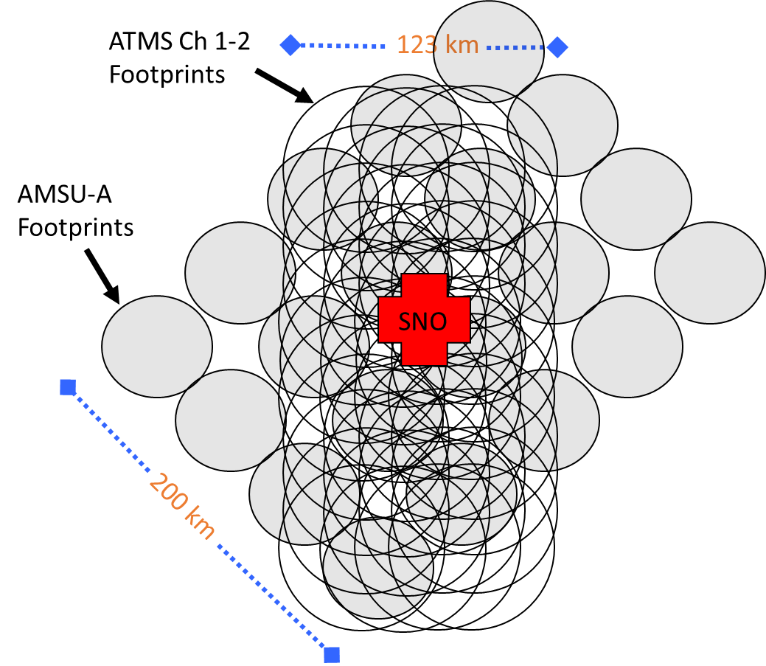
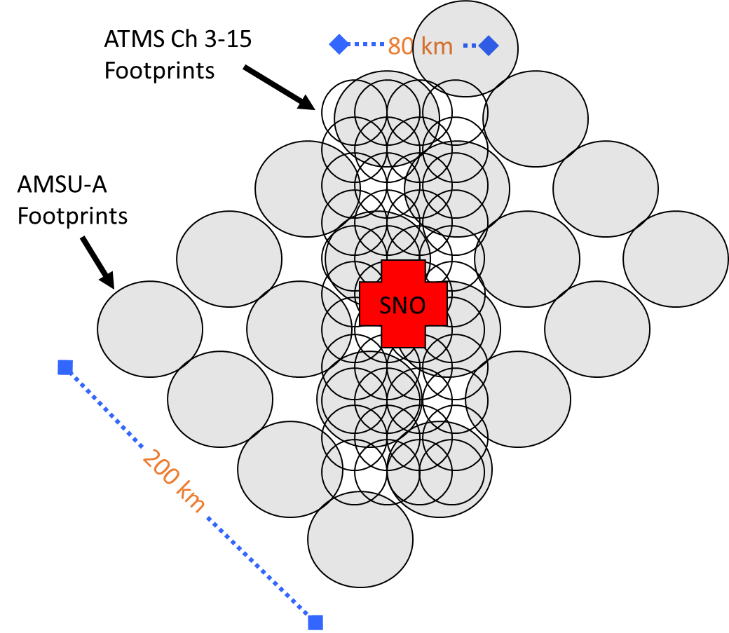
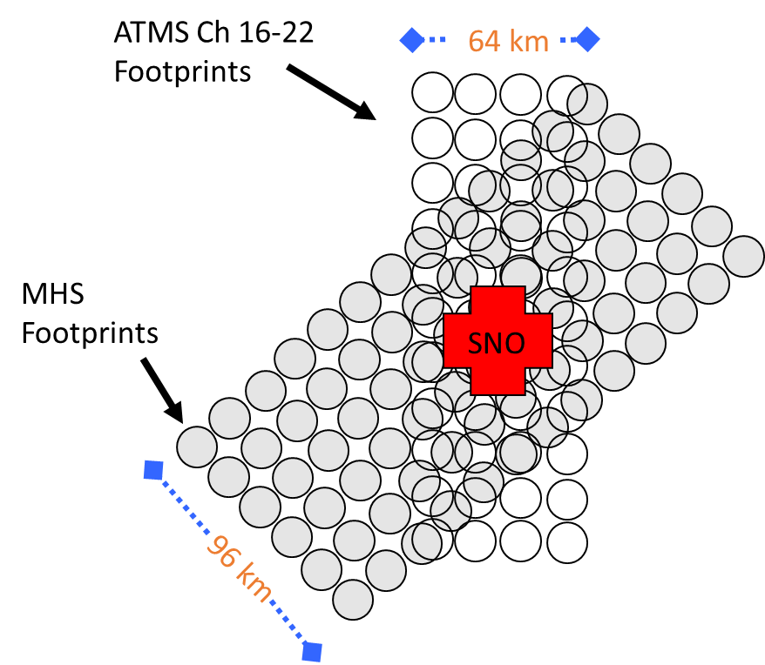
Meeting Highlights (SNO) Iacovazzi 11/19/2019
ATMS versus AMSU/MHS Simultaneous Nadir Overpass Ta Bias Time Series Results from 12 Data Analysis Methods
K and Ka Band
V Band
W and G Band
Baseline SNO analysis can result in large uncertainties, especially for window channels. SNO events can be infrequent (<= 3/month on average), so large uncertainties reduces confidence in microwave sounder Ta biases and trends. The goal of this study is to reduce the uncertainties associated with SNO method data analyses.

Slide 16
Meeting Highlights (FCDR)
Lizzie Good 07/23/2019
Evaluation of the EUMETSAT 183GHz FCDRs
Channel |  | 183.31±7 GHz |  | 183.31±3 GHz |  | 183.31±1 GHz |  | BT Res. | Time Var. | Loc
Sensor Pair |  | Mean (K) | StDev (K) | Mean (K) | StDev (K) | Mean (K) | StDev (K)
MetOp-A | FY-3A | 0.6 | 3.2 | 1.9 | 2.3 | 1.7 | 1.5 | M | W | G
MetOp-B | FY-3A | 1.1 | 1.9 | 1.8 | 1.8 | 1.8 | 1.1 | M | - | G
SAPHIR | FY-3A | 0.9 | 3.1 | -0.4 | 2.3 | 2.0 | 1.8 | W | W | T
S-NPP | FY-3A | 1.1 | 2.0 | 2.5 | 1.5 | 1.4 | 1.3 | M | - | P
FY-3C | FY-3B | 0.8 | 2.6 | 3.9 | 1.4 | 0.8 | 1.2 | M | M | P
MetOp-A | FY-3B | 3.6 | 3.0 | 3.1 | 1.9 | 2.7 | 1.3 | S | M | P
MetOp-B | FY-3B | 3.7 | 2.9 | 3.2 | 1.9 | 2.8 | 1.3 | S | M | P
SAPHIR | FY-3B | -0.8 | 4.3 | 0.0 | 3.1 | 2.6 | 2.3 | M | N | T
S-NPP | FY-3B | 4.1 | 3.7 | 4.4 | 2.5 | 3.6 | 2.5 | S | M | P
MetOp-A | FY-3C | 2.7 | 1.4 | -0.7 | 1.4 | 1.7 | 1.0 | W | W | P
MetOp-B | FY-3C | 2.7 | 2.0 | -0.6 | 1.7 | 1.8 | 1.0 | W | W | P
SAPHIR | FY-3C | 2.1 | 3.5 | -1.9 | 2.5 | 2.3 | 1.7 | W | N | T
S-NPP | FY-3C | 2.1 | 3.7 | -0.5 | 2.3 | 1.9 | 3.5 | W | M | P
SAPHIR | MetOp-A | -0.3 | 2.4 | -0.9 | 1.7 | 0.9 | 1.5 | W | N | T
S-NPP | MetOp-A | 0.0 | 1.2 | 0.8 | 1.0 | 0.7 | 1.2 | W | N | P
SAPHIR | MetOp-B | -0.2 | 2.6 | -0.8 | 2.0 | 0.9 | 1.8 | W | N | T
S-NPP | MetOp-B | 0.0 | 1.2 | 0.8 | 1.1 | 0.6 | 1.2 | N | W | P
SAPHIR | S-NPP | -1.0 | 2.7 | -2.1 | 2.1 | -0.1 | 1.7 | N | N | T
Mean ≤1 K
StDv ≤1.5 K
Mean ≤1.5 K
StDv ≤2 K
Mean ≤2 K
StDv ≤2.5 K
Mean ≤2.5 K
StDv ≤3 K
Mean >2.5 K
StDv >3 K

Slide 17
Meeting Highlights (Resolution)
Likun Wang 07/23/2019
Using Convolutional Neural Network (CNN) to Enhance Spatial Resolution of ATMS Images
Preliminary results indicate that the model works well for ATMS image resolution enhancement (2X).
•The model seems to work well for other surface channels also.
•Future workQuantitatively assess signal-to-noise ratio
Quantitatively and Mathematically compare with Backus-Gilbert (B-G) method
Build model for 4X resolution enhancement
How does Enhanced ATMS data impact on precipitation retrievals?

Slide 18
Meeting Highlights (Lunar calibration)
Hu Yang 07/23/2019
Developing vicarious calibration for microwave
sounding instruments using lunar radiation

Slide 19
Meeting Highlights (Joint activities)
Qifeng 06/03/2019
Joint activities with NWP community: Initial progress and example from FY3C
The progress of FY-3 data in NWP
 | FY-3B MWHS | FY-3C MWTS2 | FY-3C MWHS2 | FY-3C MWRI | FY-3C IRAS | FY-3C GNOS
ECMWF | Op DA | Evaluation Now dead | Op DA | Monitoring | Monitoring | Op DA
UKMO | Op DA | Evaluation Now dead | Op DA | Monitoring |  | Evaluation
CMA NWPC | Evaluation | Evaluation Now dead | Op DA | Evaluation |  | Op DA
FY3C MWHS-2 has been operationally assimilated and monitored in the Met Office global model on 15 March 2016, and in ECMWF IFS system on 4 April 2016 .
Operational assimilation of MWHS-2 with 183 GHz channels globally and GNOS in CMA/GRAPES have been activated in April 2016.
The transmittance of bufrized data by GTS started since 2017.
The GNOS wad operationally assimilated by ECMWF since March 2018.
The FY-4A and FY-3D data have been cooperatively evaluated by CMA and ECMWF, UKMO etc. The CMA/NWPC has operationally assimilated the FY-4A GIIRS in DEC 2018.
The regular teleCON was held in 2019 to exchange the experience from FY3D and FY-4A

Slide 20
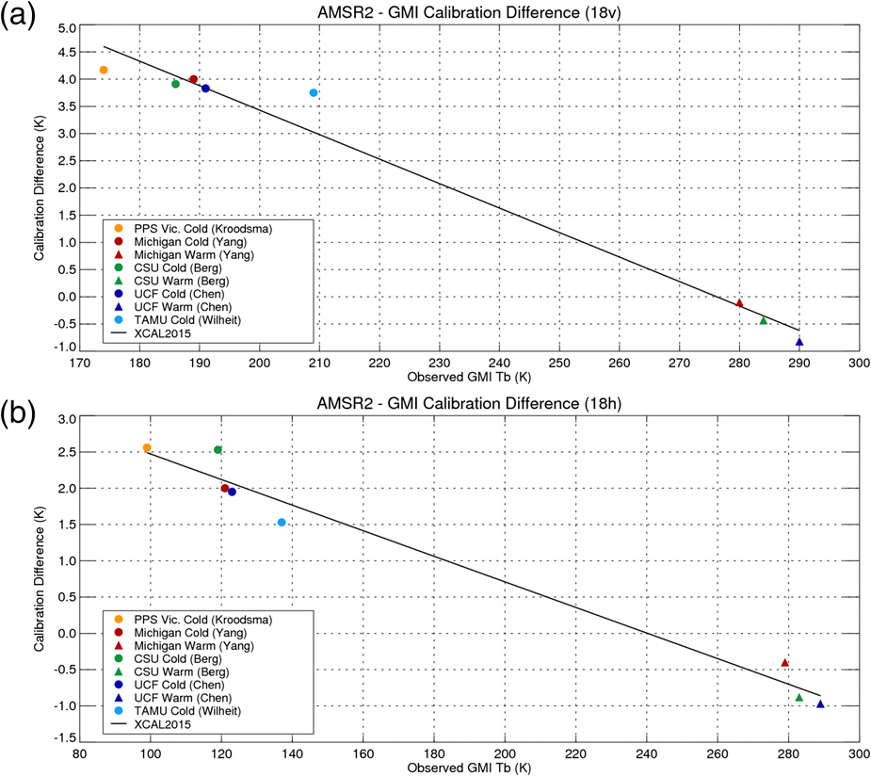
Meeting Highlights (Bt Correction)
Rachael 06/03/2019
GPM X-Cal LUT’s as MW Deliverable

Slide 21
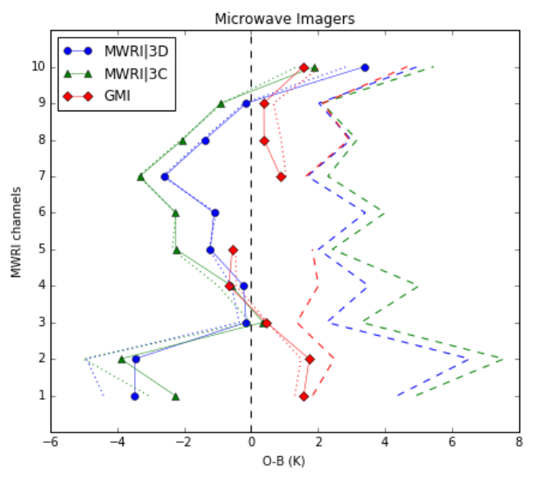
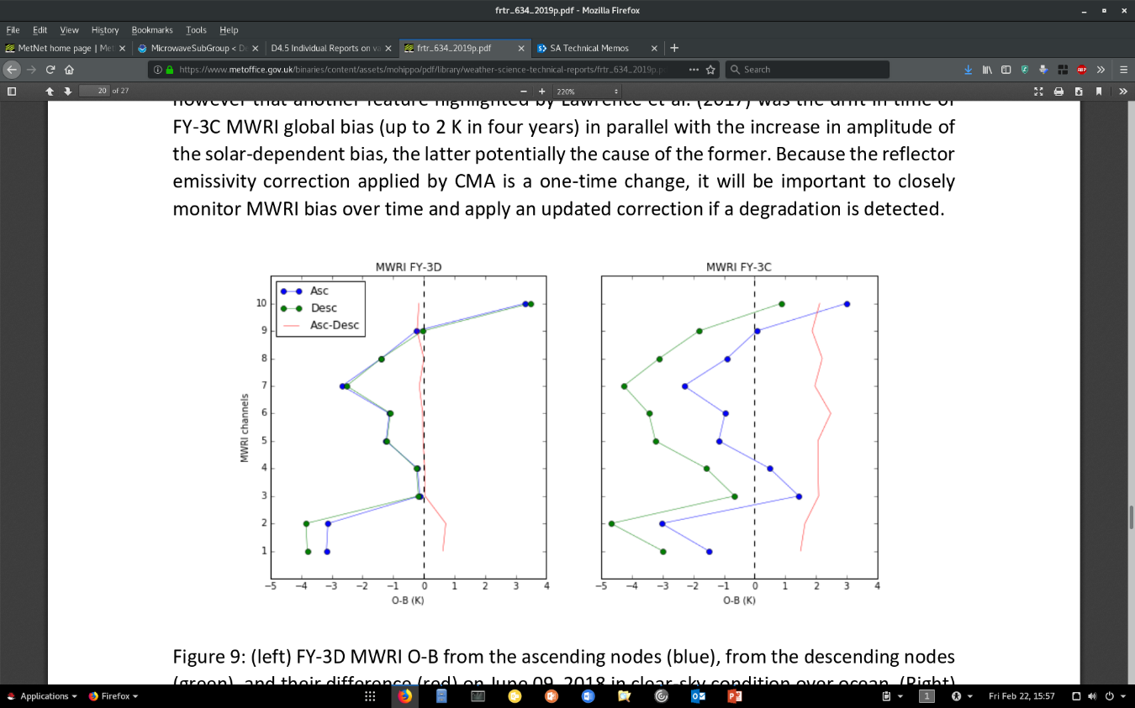
Meeting Highlights (MW in NWP)
Fabien 06/03/2019
Current and future use of microwave imager observations in the Met Office NWP system
MWRI (FY-3D)
FY-3D MWRI (blue), FY-3C MWRI (green), and GPM GMI (red) O-B mean (solid), mode (dotted), and standard deviation (dashed), June 09, 2018, over clear sky ocean.
A preliminary study has been conducted on 24h of MWRI FY-3D observations. It suggests:
A reduction of global mean O-B and standard deviation compared to the FY-3C version.
Close agreement with GMI at 18, 23, and 89 GHz.
The OA bias reduced to less than 0.2 K on FY-3D.
Those findings are consistent with the bias correction developed by CMA aimed at reducing the noise in the warm target used for the calibration and an emissivity
correction for the warm and cold reflectors.
It is planned to further evaluate MWRI FY-3D for a possible assimilation late 2019.
FY-3D MWRI (left) and FY-3C MWRI (right) O-B from the ascending nodes (blue), descending nodes (green), and their difference (red), June 09, 2018, over clear sky ocean.
Xie et al., 2018 https://ieeexplore.ieee.org/abstract/document/8566165
Carminati et al., 2019 https://www.metoffice.gov.uk/binaries/content/assets/mohippo/pdf/library/weather-science-technical-reports/frtr_634_2019p.pdf

Slide 22
Meeting Highlights (RTM)
Isaac 06/03/2019
Performance of fast radiative transfer models in the
microwave spectrum
Chan 1: 23.8 GHz,
Chan 10: 55.5,
Chan 15: 57.29
Chan 22: 183.311
FY-3D MWRI (left) and FY-3C MWRI (right) O-B from the ascending nodes (blue), descending nodes (green), and their difference (red), June 09, 2018, over clear sky ocean.
Xie et al., 2018 https://ieeexplore.ieee.org/abstract/document/8566165
Carminati et al., 2019 https://www.metoffice.gov.uk/binaries/content/assets/mohippo/pdf/library/weather-science-technical-reports/frtr_634_2019p.pdf

Slide 23
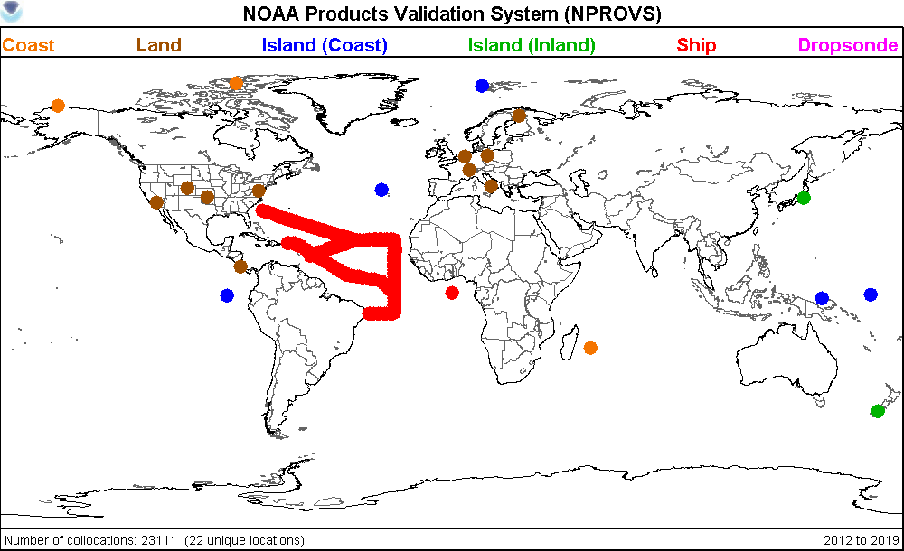
Meeting Highlights (GRUAN)
Bomin 06/03/2019
Progress with GRUAN observations in comparisons with
satellite microwave measurements: Preliminary result
FY-3D MWRI (left) and FY-3C MWRI (right) O-B from the ascending nodes (blue), descending nodes (green), and their difference (red), June 09, 2018, over clear sky ocean.
Xie et al., 2018 https://ieeexplore.ieee.org/abstract/document/8566165
Carminati et al., 2019 https://www.metoffice.gov.uk/binaries/content/assets/mohippo/pdf/library/weather-science-technical-reports/frtr_634_2019p.pdf

Slide 24
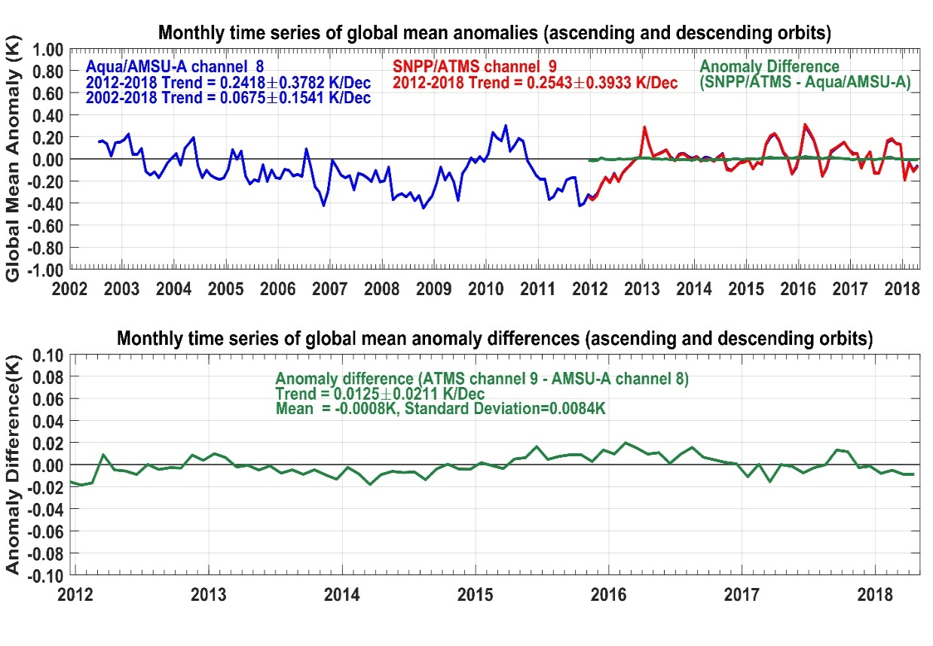
Meeting Highlights (MW reference)
Cheng-Zhi 06/03/2019
Possible Microwave Sounder References and Their Use for Re-Calibration of Other Satellites
FY-3D MWRI (left) and FY-3C MWRI (right) O-B from the ascending nodes (blue), descending nodes (green), and their difference (red), June 09, 2018, over clear sky ocean.
Xie et al., 2018 https://ieeexplore.ieee.org/abstract/document/8566165
Carminati et al., 2019 https://www.metoffice.gov.uk/binaries/content/assets/mohippo/pdf/library/weather-science-technical-reports/frtr_634_2019p.pdf

Slide 25
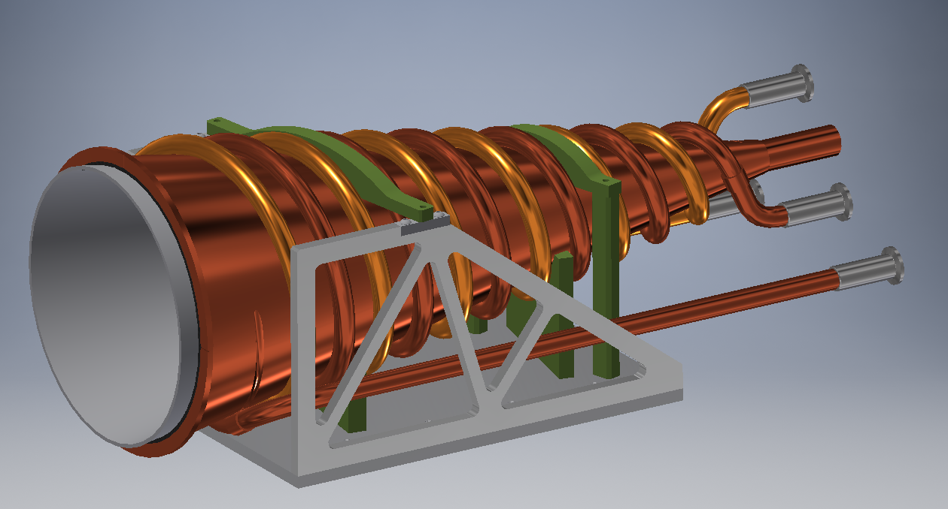
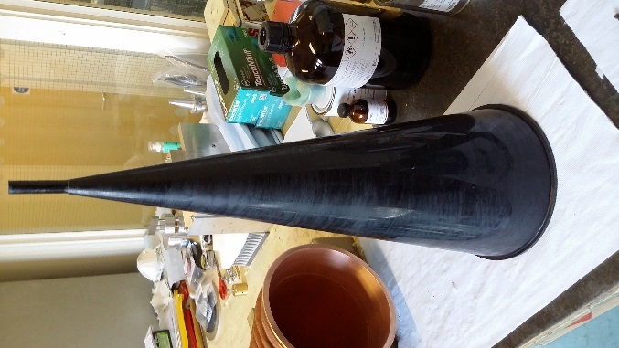
Meeting Highlights (SI)
Edward 06/03/2019
SI-Traceable Calibration of
Satellite Microwave Radiometers
Variable temp conical NIST
standard target
Cold BB target
Antenna/main reflector
(rotates)
Hot BB target
FY-3D MWRI (left) and FY-3C MWRI (right) O-B from the ascending nodes (blue), descending nodes (green), and their difference (red), June 09, 2018, over clear sky ocean.
Xie et al., 2018 https://ieeexplore.ieee.org/abstract/document/8566165
Carminati et al., 2019 https://www.metoffice.gov.uk/binaries/content/assets/mohippo/pdf/library/weather-science-technical-reports/frtr_634_2019p.pdf

Slide 26
The focuses in 2020
1. Observing Systems
  Active MW Sensor Status and Cal/Val (e.g., DPR, ASCAT)
  Passive MW Sensor Status and Cal/Val (e.g., ATMS, AMSU, MHS; AMSR; SSMI; GPM-x; and MW Sensor vs NWP)
2. MW Sensor Pre-Launch Calibration and characterization
3. Microwave Instrument Fundamental Climate Data Records
4. Inter-operability Between Observing System and User Forum (GRUAN, WIGOS, COSMIC, NWP Requirements and Feedback, etc)

Slide 27
Originally planned potential talks
NOAA will have at least 5 talks on the MWS/I and FCDR
NASA will have talks on ATMS characterization(Ed Kim) and XCAL
EUMETSAT is expecting 3 talks on FCDR and Instrument performance
ESA is expecting a talk on MWI
KMA is expecting a talk on the monitoring the MWS
JAXA/JMA is expecting the talks on AMSR-2/3 and monitoring MWS/I
NWP users will have talks on the requirements and feedbacks (ECMWF, UKMO, NCEP, KMA, CMA, etc)
CMA will give at least 4 talks on the MWS/I, RTM and DPR
Wes can give a talk on XCAL at the Annual Meeting remotely
A dedicated workshop to explore the implementation of the GPM XCAL algorithms to inter-calibrate other microwave imagers is planned and potentially implemented in Q4 after the 2020 EUMETSAT Conference.

Slide 28

Plan for MW Sub-Group activities (1/2)
Understanding the users’ requirements for inter-calibration long time series products or NRT products(within 3h) for microwave instruments
  Imagers + sounders – passive (30+years/10+sensors)
  Reference Sensor(s)?
  PR and WindRad – active (GPM/FY-3P/FY-3E)
  Calibration algorithm exchange between JAXA and CMA?
  Retrospective calibration (FCDR’s, focus on Geolocation/Recalibration/Better QC)
  New version of FY series FCDR will be released in the end of the year.
  Forward looking calibration (near-real time uses, maneuver/lunar etc.)
  Discuss in web meetings within this year.

Slide 29
Plan for MW Sub-Group activities (2/2)
Identifying existing products that could meet those requirements, but first….
  Calibration algorithm standard?
  Correction algorithm standard?(Like XCal)
  And then a process that adheres to GSICS principles
We should also focus on tools/algorithms like SNO, Double Difference, RTM, etc.
  Make the SNO method as a reference standards for imager and sounder separately;
  Input data of RTM and the RTM model should be open to GSICS users and easy to access.
Define data standards (jointly with GDWG)
  First of all is the data type standard (HDF? NetCDF? Bin?)
Continue coordination with other groups (e.g., CEOS WGCV MW, GPM X-Cal) would also be required to generate standards and best practices
Address special requests/actions from CGMS

Slide 30
Other urgent topics that need to be addressed as soon as possible
X-Cal Algorithm and document cooperation.
  Analyze the difference between CMA algorithm and X-Cal algorithm.
  A dedicated workshop to explore the implementation of the GPM XCAL algorithms to inter-calibrate other microwave imagers is planned and potentially implemented in Q4 after the 2020 EUMETSAT Conference.
Manik Bali (NOAA) to circulate white paper on microwave imager inter-calibration to all agencies for review/contribution
  In progress. Manik may present the white paper at GSICS meeting in the near future.
MWSG Chair to coordinate the development of a summary of the current status of MW sensor calibration methods (by sensor and frequency type), needs by product type, and provide a 3-year roadmap for developing GSICS MW calibration products
……

Slide 31
Discussion on Future Planning
Early morning orbit to provide global data in every 4 hours (also with Wind Radar )
The first ATMS Active Geolocation
Preparing AMSR-3 and EPS-SG MWS, MWI, JPSS-2 ATMS, and ICI
Precipitation Radar (PR) for Chinese FY-3G satellite is being developed, the prototype phase will be completed soon in 2020, and to be launched at 2022
Closer collaboration with NWP community for improved understanding in user requirements and feedback

