Slide 1
2020 Annual GSICS Calibration Report - GEO
KMA

Slide 2
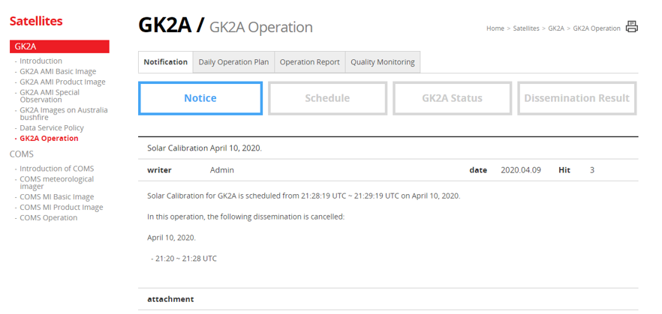
GK2A,COMS Calibration Events in 2019
http://planet.rssi.ru
Satellite (status) |  | Current Location | Launch date | Operation Date
COMS | Back-up Since 2020-04-01 | 128.2E | 2010-06-26 | 2011-04-11
GK2A | (OP) | 128.2 E | 2018-12-04 | 2019-07-25
COMS/GK2A Calibration Events https://nmsc.kma.go.kr/enhome/html/bbs/listNotice.do?bbsCd=00026
Provide calibration events and schedule : can check in Notice item
Major Calibration Related Events | COMS | GK2A
IR133 (13.3um) channel SRF update |  | 09/27/2019

Slide 3
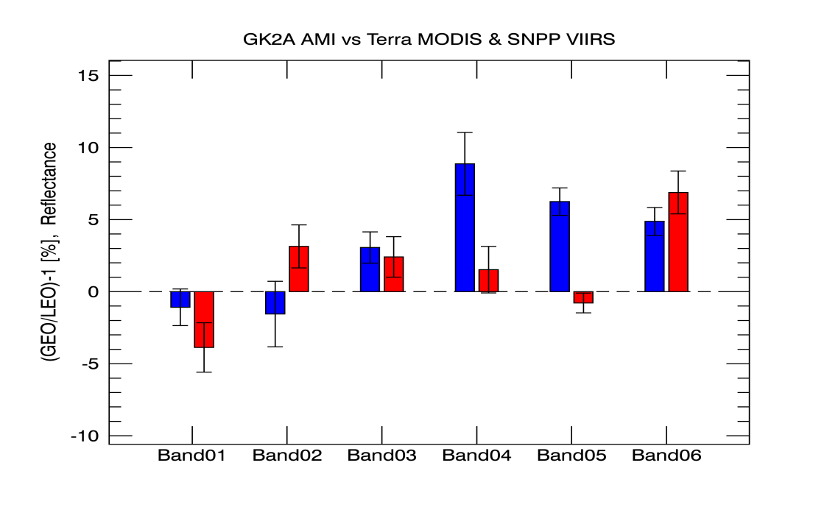
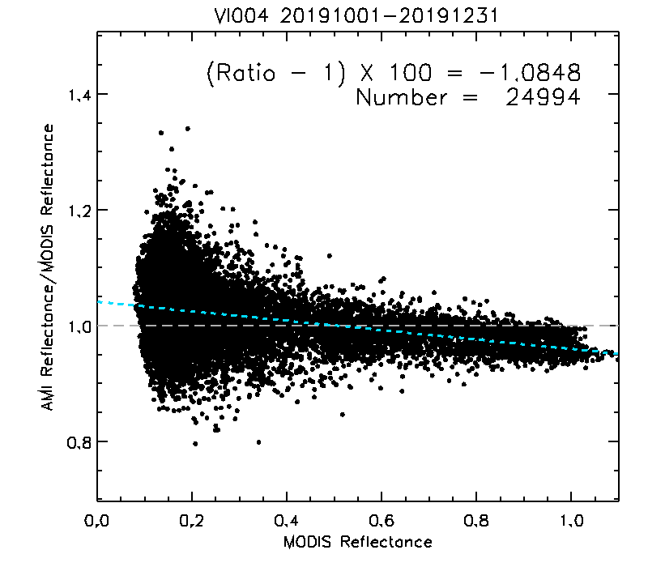
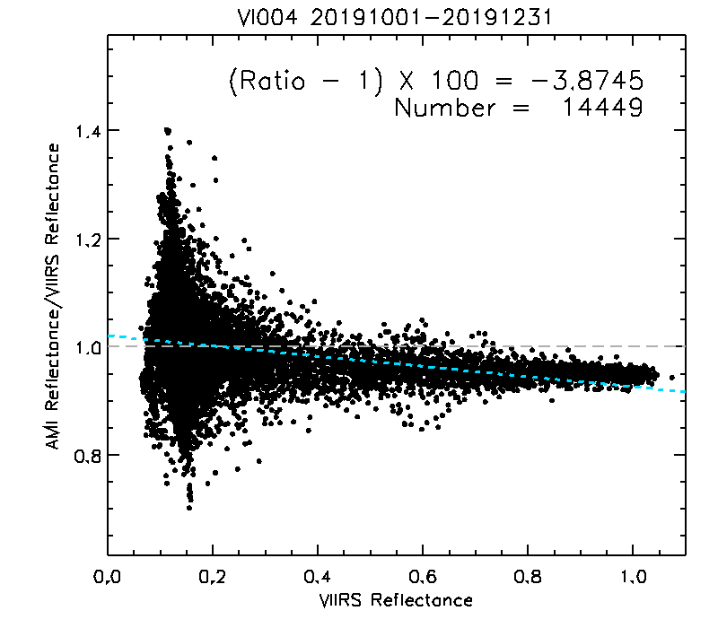
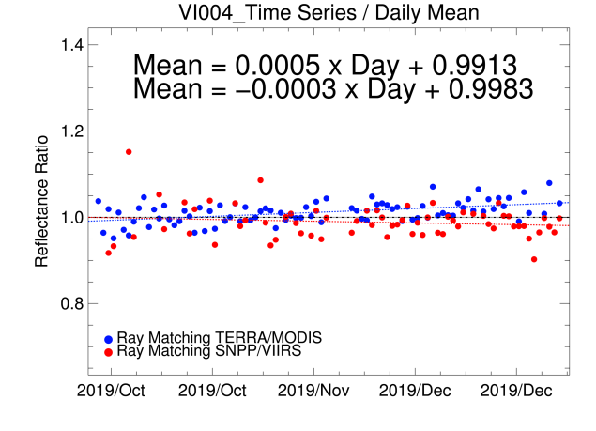
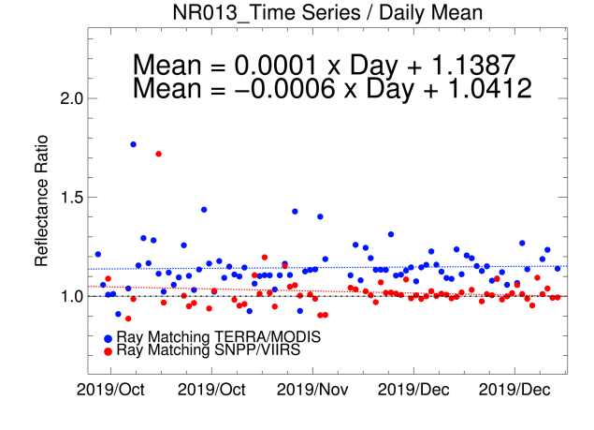
GK2A AMI VNIR Cal. Performance
The mean calibration difference between GK2A AMI and Terra/MODIS, SNPP/VIIRS from Oct. 1, 2019 – Dec. 31, 2019 (unit: %, all uncertainties k=1)
GEO | Reference Instr. | B01 (0.47 μm) | B02 (0.51 μm) | B03 (0.64 μm) | B04 (0.86 μm) | B05 (1.37 μm) | B06 (1.61 μm)
GK2A AMI | Terra/MODIS | -1.08(±1.27) | -1.55(±2.27) | 3.06(±1.08) | 8.87(±2.18) | 6.45(±0.95) | 4.87(±0.97)
 | SNPP/VIIRS | -3.87(±1.71) | 3.14(±1.49) | 2.41(±1.41) | 1.53(±1.62) | -0.78(±0.69) | 6.88(±1.49)
AMI vs MODIS
AMI vs VIIRS
MODIS
VIIRS
We are testing ray matching method using SNPP/VIIRS.
All the AMI Visible and Near-Infrared (VNIR) channels has very high bias and uncertainty.
That caused by seasonal variation.
We have to keep watching since over 1 year operations.

Slide 4
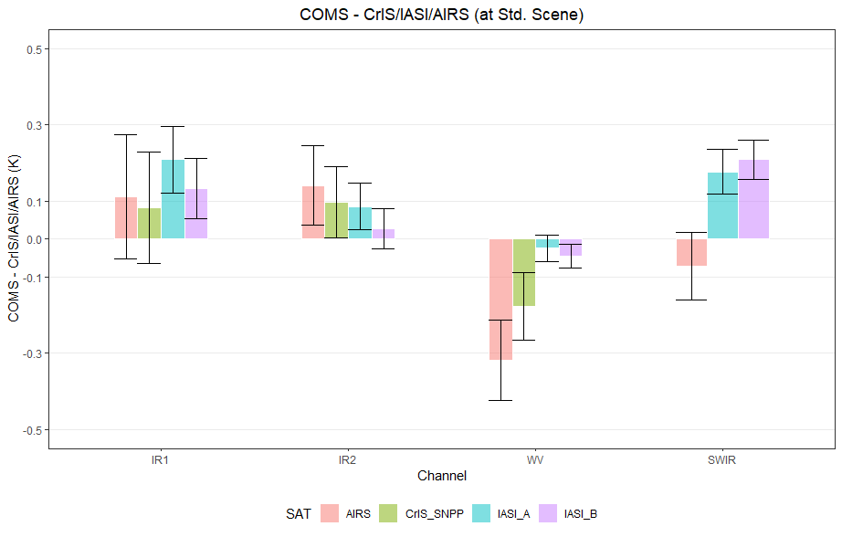
COMS IR Calibration Performance: Bias
Summary Statistics of COMS/MI IR Calibration Performance in 2019 (all uncertainties are k=1)
 | Channel Name (Central Wavelength in μm) | SWIR (3.8) | WV (6.8) | IR1 (10.8) | IR2 (12.0)
 | Std. Scene Tb (K) | 285.9 | 237.6 | 286.3 | 285.1
Metop-A/ IASI | Bias at Std. Scene radiance (K) | 0.17 (±0.05) | -0.02 (±0.03) | 0.20 (±0.08) | 0.08 (±0.06)
Metop-B/ IASI | Bias at Std. Scene radiance (K) | 0.21 (±0.05) | -0.04 (±0.03) | 0.13 (±0.07) | 0.02 (±0.05)
AQUA/ AIRS | Bias at Std. Scene radiance (K) | -0.07 (±0.08) | -0.31 (±0.10) | 0.11 (±0.16) | 0.14 (±0.1)
S-NPP/ CrIS | Bias at Std. Scene radiance (K) | - | -0.17 (±0.08) | 0.08 (±0.14) | 0.09 (±0.09)
The mean Tb bias at standard Tb is within 0.21K except for WV(6.8µm) channel as reference AIRS.

Slide 5
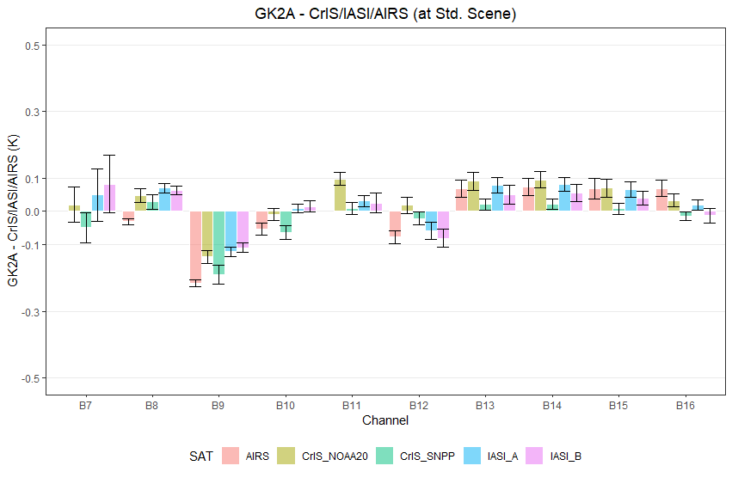
GK2A IR Calibration Performance: Bias
Summary Statistics of GK2A/AMI IR Calibration Performance in August-December 2019 (All uncertainties are k=1)
 | Channel Name (Central Wavelength in μm) | BAND07 (3.8) | BAND08 (6.3) | BAND09 (6.9) | BAND10 (7.3) | BAND11 (8.7) | BAND12 (9.6) | BAND13 (10.5) | BAND14 (11.2) | BAND15 (12.3) | BAND16 (13.3)
 | Std. Scene Tb (K) | 285.9 | 234.9 | 244.1 | 254.5 | 283.7 | 259.1 | 286.1 | 286.0 | 283.8 | 269.4
Metop-A/ IASI | Bias at Std. Scene radiance (K) | 0.04 (±0.07) | -0.06 (±0.01) | -0.12 (±0.01) | 0.01 (±0.01) | 0.03 (±0.01) | -0.05 (±0.02) | 007 (±0.02) | 008 (±0.02) | 0.06 (±0.02) | 0.01 (±0.01)
Metop-B/ IASI | Bias at Std. Scene radiance (K) | 0.08 (±0.08) | 0.06 (±0.01) | -0.10 (±0.01) | 0.01 (±0.01) | 0.02 (±0.03) | -0.08 (±0.02) | 0.04 (±0.02) | 0.05 (±0.02) | 0.03 (±0.02) | -0.01 (±0.02)
AQUA/ AIRS | Bias at Std. Scene radiance (K) | - | -0.03 (±0.01) | -0.21 (±0.01) | -0.05 (±0.01) | - | -0.07 (±0.01) | 006 (±0.02) | 007 (±0.02) | 006 (±0.02) | 0.06 (±0.02)
S-NPP/ CrIS | Bias at Std. Scene radiance (K) | -0.04 (±0.04) | 0.02 (±0.02) | -0.19 (±0.02) | -0.06 (±0.02) | 0.01 (±0.01) | -0.02 (±0.02) | 0.02 (±0.01) | 0.02 (±0.01) | 0.01 (±0.01) | -0.01 (±0.01)
NOAA-20/ CrIS | Bias at Std. Scene radiance (K) | 0.01 (±0.05) | 0.04 (±0.02) | -0.13 (±0.01) | -0.01 (±0.01) | 0.09 (±0.01) | -0.01 (±0.02) | 009 (±0.03) | 0.09 (±0.03) | 0.06 (±0.03) | -0.03 (±0.01)
GK2A AMI IR channels are in general well calibrated
GK2A AMI has relatively large bias around -0.1K~-0.2K for 6.9µm (WV level)
SRF(13.3µm) updated (shifted by -0.8cm⁻¹) on 27 Sep. 2019

