Slide 1
Annual GSICS Calibration Report on the State of the Observing System
Masaya Takahashi (JMA), Xiuqing Hu (CMA) and Dohyeong Kim (KMA) with great supports of GRWG members of GEO operating agencies

Slide 2
Background/Progress
Action at GSICS-EP-18 (2017)
Reports for operational GEO imagers
  Draft was developed by GRWG/GDWG and endorsed at 2019 GRWG/GDWG Annual Meeting (Mar 2019, Frascati)
  To be submitted by GSICS-EP to CGMS-47 as “First Annual State of Global Observing System” (CGMS-47-GSICS-WP-02)
Reference | Action Description | Actionee | Due date
EP-18.A03 | GDWG and GRWG to develop an approach for an Annual GSICS report on the State of the Observing System with respect to Instrument Performance and Inter-comparisons with GSICS Reference Instruments | GDWG and GRWG | EP-19 (Jun 2018)

Slide 3
Concepts of Annual Report
Target audience: satellite data users + operators (incl. non calibration experts)
Keeping report contents SIMPLE
  Satellite/Instrument events on calibration: 1 page for agency
  Radiometric calibration performance for GEO imagers (at this stage)
  1-2 page / instrument using GSICS inter-calibration approaches
  Table summarizing bias/unc for one year (shorter period in special cases)
  Time series chart of bias/unc for days since operation start (or one year)
  Performance of reference instruments by Double Difference
  Agencies responsible for the instruments are expected to do the validation
  Detailed information: to be navigated to Calibration Landing Page
Adopting existing formats as possible
  Color chart on NOAA satellite status, visualization tools (e.g. GSICS Plotting Tool)

Slide 4
The following slides: reports for operational GEO imagers for 2018
EUMETSAT (Tim Hewison and Sebatien Wagner)
JMA (Masaya Takahashi and Yusuke Yogo)
KMA (Dohyeong Kim, Minju Gu, and Eunkyu Kim)
NOAA (Fred Wu, Fangfang Yu, and Hyelim Yoo)
ROSHYDROMET (Alexey Rublev and Alexander Uspensky)

Slide 5
EUMETSAT Annual GSICS Calibration Report for 2018
Tim Hewison, Sebastien Wagner
EUMETSAT

Slide 6
Satellite/Instrument Summary - GEO
Hyperlinks on instrument names navigate to the Calibration Landing Page
Satellite (status) |  | Location | Launch date | EO instruments
Meteosat-8 | Op | 41.5 E | 2002-08-28 | SEVIRI | GERB
Meteosat-9 | B | 3.5 E | 2005-12-21 | SEVIRI | GERB
Meteosat-10 | RSS | 9.5 E | 2012-07-05 | SEVIRI | GERB
Meteosat-11 | Op | 0.0 E | 2015-07-15 | SEVIRI | GERB
Satellite Status
 | Op = Operational
 | P = Pre-operational
 | B = Back-up, secondary
 | L = Limited availability
Instrument Status
 |  | Operational (or capable of)
 |  | Operational with limitations (or Standby)
 |  | Operational with Degraded Performance
 |  | Not Operational
 |  | Functional, Turned Off
Major calibration relevant events in 2018
  2018-02-05/13 Meteosat-11 moved 3.4°W to 0°E
  2018-02-08/27 Meteosat-10 moved 0°E to 9.5°E
  2018-02-21/03-05 Meteosat-9 moved 9.5°E to 3.5°E
  2018-02-20 Meteosat-11 Operational 0° prime
  2018-03-13 Meteosat-10 Operational 9.5°E RSS
  2018-03-13 Meteosat-9 to Backup
  2018-12-03/08 Meteosat-10 Decontamination
  UNS Technical Bulletin

Slide 7
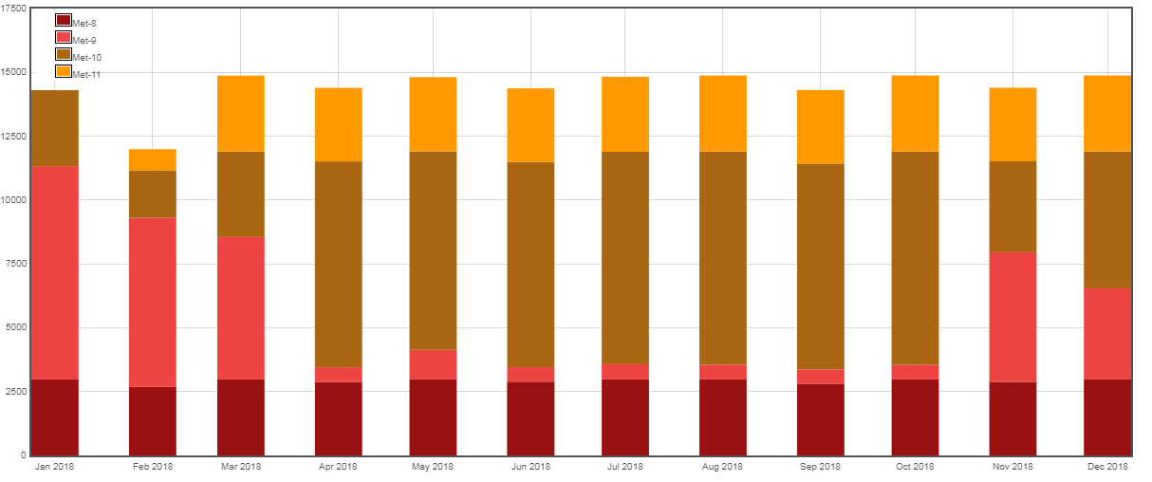
Meteosat Data Availability

Slide 8
Calibration Performance: Meteosat/SEVIRI Visible Bands
Summary Statistics of Meteosat/SEVIRI VIS/NIR Calibration Performance (All Uncertainties are k=1)
Channel Name |  | VIS0.6 | VIS0.8 | NIR1.6 | HRV | Units
Meteosat-8 | Mean Bias (DCC-SSCC) | +13.6 ± 2.5 |  |  |  | %
 | Annual Drift (DCC) | -0.54 ± 0.08 |  |  |  | %/yr
 | Annual Drift (SSCC) | -0.56 ± 0.03 | -0.55 ± 0.03 | -0.04 ± 0.03 | -0.52 ± 0.03 | %/yr
 | Annual Drift (LCS) | -0.57 ± 0.01 | -0.53 ± 0.01 | -0.02 ± 0.02 | -0.55 ± 0.02 | %/yr
Meteosat-9 | Annual Drift (SSCC) | -0.54 ± 0.08 | -0.57 ± 0.07 | -0.04 ± 0.07 | -0.55 ± 0.08 | %/yr
 | Annual Drift (LCS) | -0.57 ± 0.01 | -0.52 ± 0.01 | -0.06 ± 0.03 | -0.52 ± 0.03 | %/yr
Meteosat-10 | Annual Drift (SSCC) | -0.66 ± 0.14 | -0.63 ± 0.11 | -0.02 ± 0.11 | -0.71 ± 0.12 | %/yr
 | Annual Drift (LCS) | -0.84 ± 0.03 | -0.71 ± 0.02 | -0.01 ± 0.08 | -0.98 ± 0.08 | %/yr
Meteosat-11 | Mean Bias (DCC-SSCC) | +10.0 ± 0.8 |  |  |  | %
 | Annual Drift (DCC) | -0.13 ± 0.11 |  |  |  | %/yr
 | Annual Drift (SSCC) | -0.30 ± 0.38 | -0.25 ± 0.36 | -0.08 ± 0.34 | -0.32 ± 0.36 | %/yr
 | Annual Drift (LCS) | -0.60 ± 0.07 | -0.42 ± 0.05 | +1.18 ± 0.20 | -0.75 ± 0.08 | %/yr
Mean Bias: Mean and SD of difference of DCC from operational (SSCC) calibration for all 2018 pentad results
Annual Drift: Mean gain drift and uncertainty calculated from DCC and operational (SSCC) over each satellite life
DCC: Demonstration GSICS Deep Convective Cloud inter-calibration, with respect to Aqua/MODIS
SSCC: SEVIRI Solar Channel Calibration System = vicarious calibration used operationally for SEVIRI

Slide 9
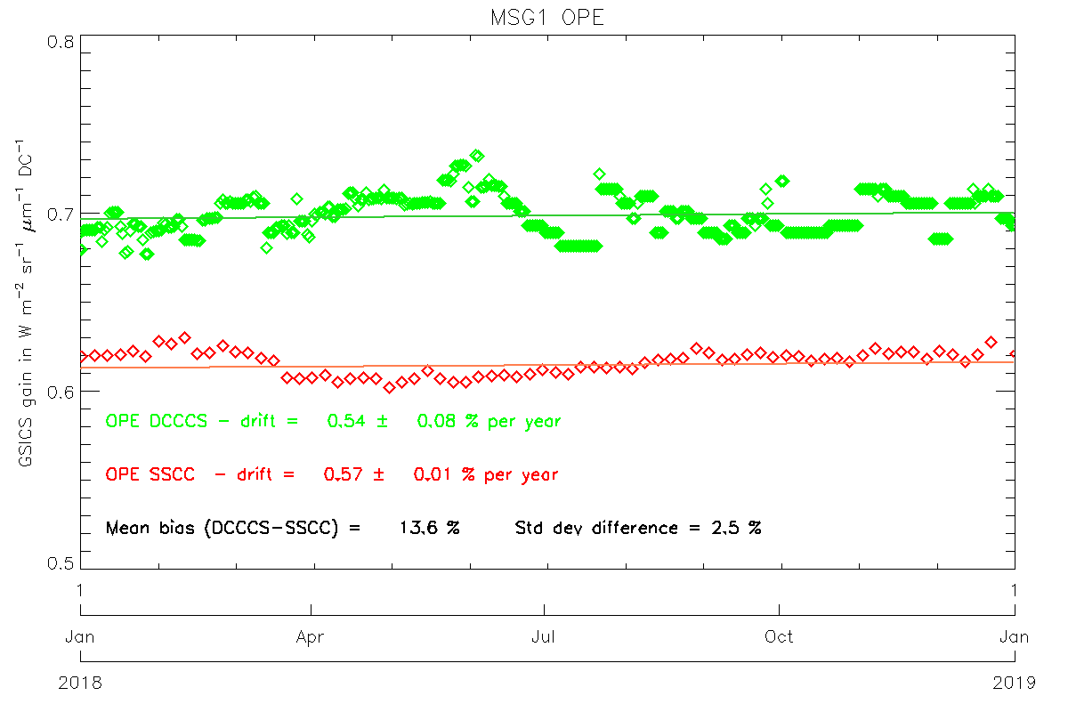
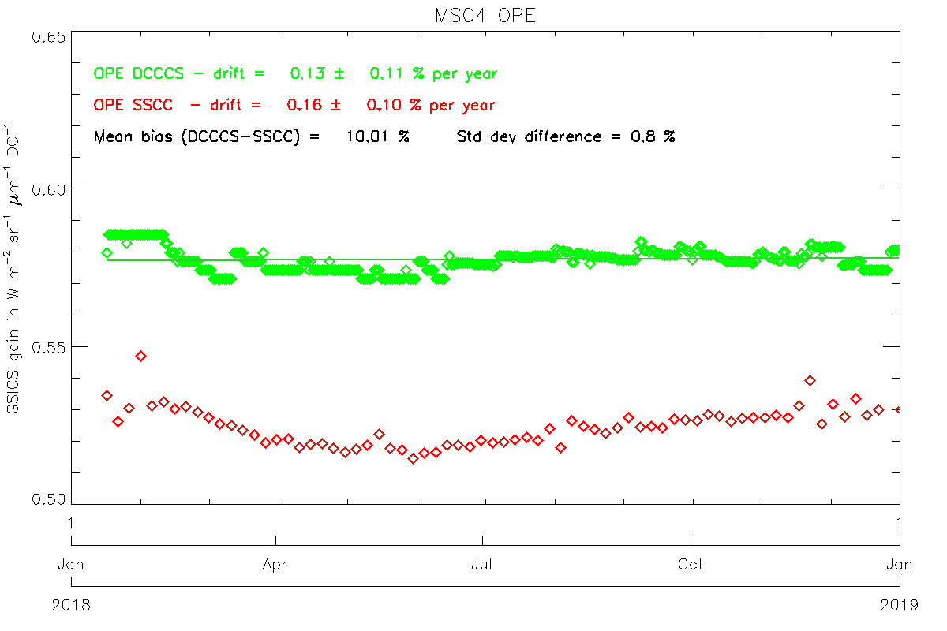
Calibration Performance: Meteosat/SEVIRI Visible Bands
Mean Bias: Mean and SD of difference of DCC from operational (SSCC) calibration for all 2018 pentad results
Annual Drift: Mean gain drift and uncertainty calculated from DCC and operational (SSCC) over each satellite life
DCC: Demonstration GSICS Deep Convective Cloud inter-calibration, with respect to Aqua/MODIS
SSCC: SEVIRI Solar Channel Calibration System = vicarious calibration used operationally for SEVIRI
Time Series of gains derived for Meteosat-8 (MSG1) and -11 (MSG4) VIS0.6 channel SSCC (red), DCC (green).

Slide 10
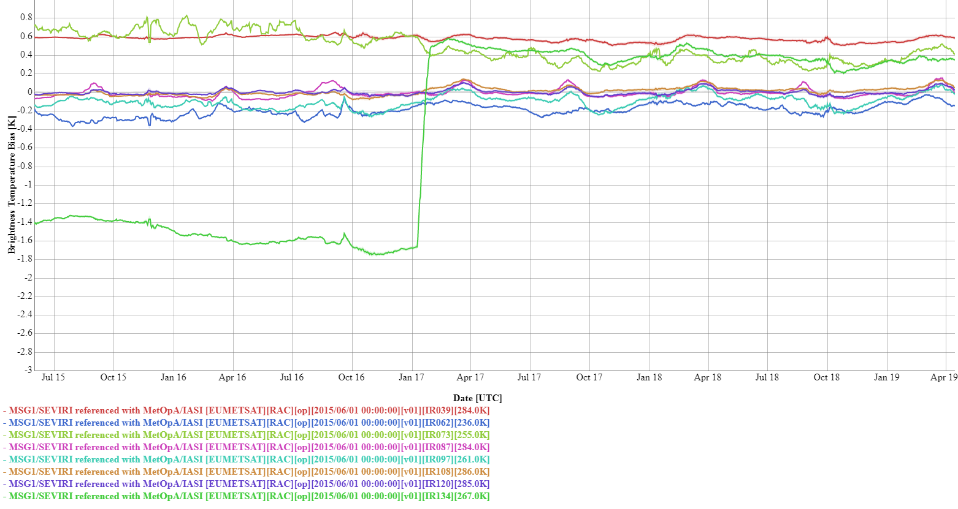
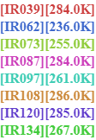
Calibration Performance: Meteosat-8/SEVIRI IR Bands
Summary Statistics of Meteosat-8/SEVIRI IR Calibration Performance in 2018 (All uncertainties are k=1)
Channel Name | IR3.9 | IR6.2 | IR7.3 | IR8.7 | IR9.7 | IR10.8 | IR12.0 | IR13.4
Standard Radiance as Tb (K) | 284 | 236 | 255 | 284 | 261 | 286 | 285 | 267
Mean Bias (K) | +0.57 | -0.16 | +0.35 | +0.00 | -0.07 | +0.04 | +0.01 | +0.37
Standard Deviation of Bias (K) | 0.03 | 0.05 | 0.06 | 0.05 | 0.07 | 0.03 | 0.03 | 0.08
Mean Drift Rate of Bias (K/yr) | -0.05 | -0.11 | -0.12 | -0.05 | -0.18 | -0.05 | -0.05 | -0.21
The statistics are derived from Meteosat-8/SEVIRI Operational GSICS Re-Analysis Correction vs. Metop-A/IASI
Biases defined for Standard Radiance: typical scene for easy inter-comparison of sensors’ inter-calibration biases
Decontaminations introduce calibration jumps – most obvious in the IR13.4 channel due to ice contamination
Time series of Meteosat-8/SEVIRI Tb biases w.r.t. Metop-A/IASI at standard radiance

Slide 11
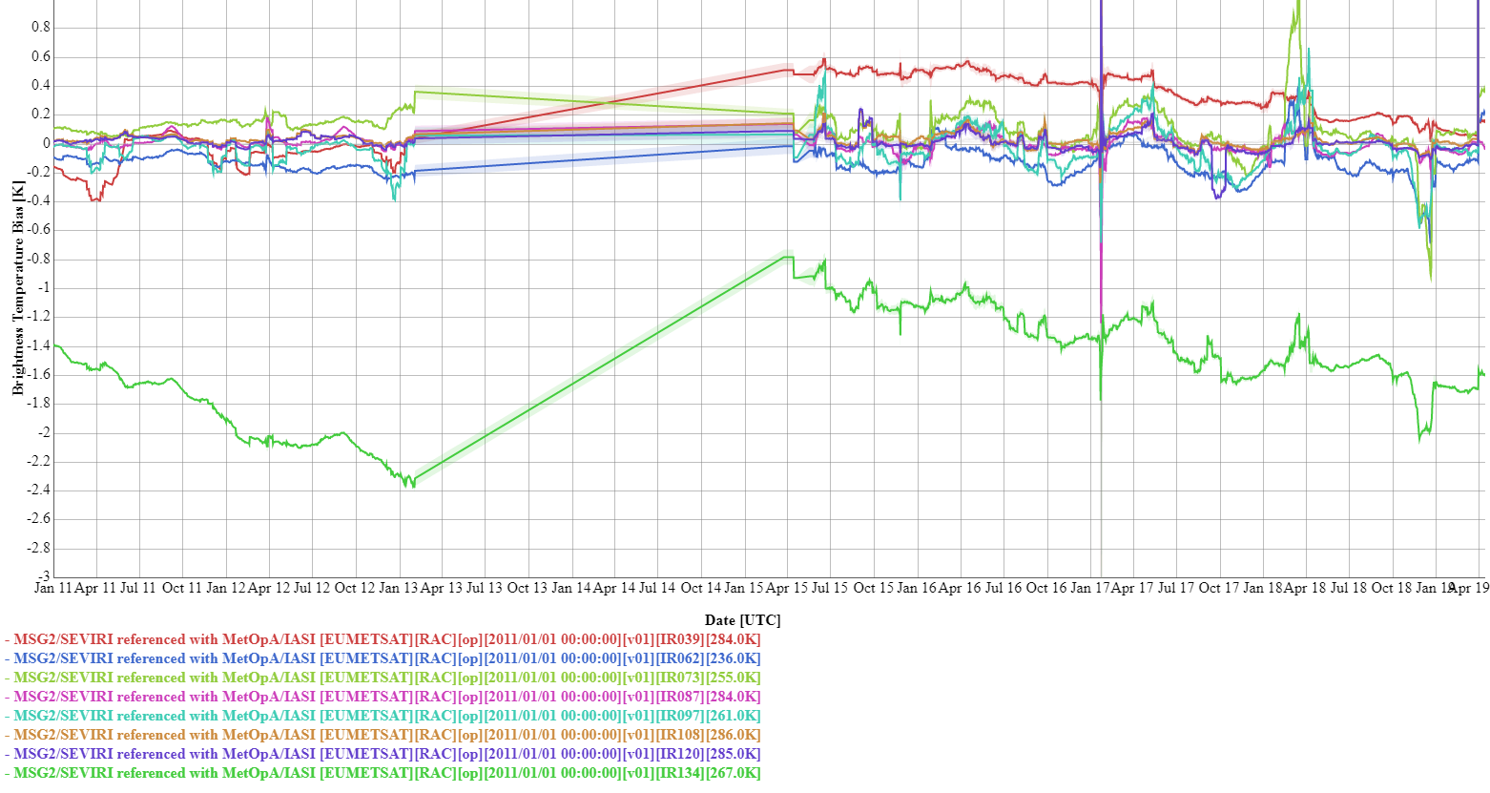
Calibration Performance: Meteosat-9/SEVIRI IR Bands
Summary Statistics of Meteosat-9/SEVIRI IR Calibration Performance in 2018 (All uncertainties are k=1)
Channel Name | IR3.9 | IR6.2 | IR7.3 | IR8.7 | IR9.7 | IR10.8 | IR12.0 | IR13.4
Standard Radiance as Tb (K) | 284 | 236 | 255 | 284 | 261 | 286 | 285 | 267
Mean Bias (K) | +0.21 | -0.14 | +0.07 | -0.01 | -0.03 | +0.02 | +0.00 | -1.55
Standard Deviation of Bias (K) | 0.08 | 0.17 | 0.30 | 0.07 | 0.20 | 0.04 | 0.05 | 0.16
Mean Drift Rate of Bias (K/yr) | -0.21 | -0.42 | -0.63 | -0.09 | -0.40 | -0.07 | -0.08 | -0.35
The statistics are derived from Meteosat-9/SEVIRI Operational GSICS Re-Analysis Correction vs. Metop-A/IASI
Biases defined for Standard Radiance: typical scene for easy inter-comparison of sensors’ inter-calibration biases
Meteosat-9 operated in Rapid Scan Service during most of this period, which increases the bias uncertainties
Time series of Meteosat-9/SEVIRI Tb biases w.r.t. Metop-A/IASI at standard radiance

Slide 12
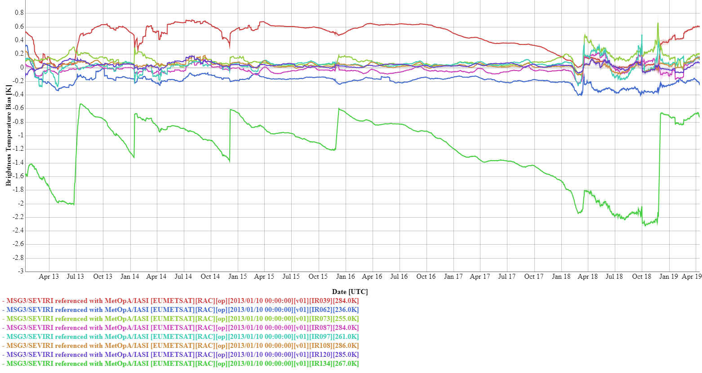
Calibration Performance: Meteosat-10/SEVIRI IR Bands
Summary Statistics of Meteosat-10/SEVIRI IR Calibration Performance in 2018 (All uncertainties are k=1)
Channel Name | IR3.9 | IR6.2 | IR7.3 | IR8.7 | IR9.7 | IR10.8 | IR12.0 | IR13.4
Standard Radiance as Tb (K) | 284 | 236 | 255 | 284 | 261 | 286 | 285 | 267
Mean Bias (K) | +0.10 | -0.30 | +0.21 | +0.04 | +0.05 | +0.01 | +0.02 | -1.94
Standard Deviation of Bias (K) | 0.10 | 0.05 | 0.13 | 0.12 | 0.15 | 0.06 | 0.05 | 0.41
Mean Drift Rate of Bias (K/yr) | +0.07 | -0.07 | +0.11 | +0.05 | -0.02 | -0.00 | -0.05 | +0.22
The statistics are derived from Meteosat-10/SEVIRI Operational GSICS Re-Analysis Correction vs. Metop-A/IASI
Biases defined for Standard Radiance: typical scene for easy inter-comparison of sensors’ inter-calibration biases
Decontaminations introduce calibration jumps – most obvious in the IR13.4 channel due to ice contamination
Time series of Meteosat-10/SEVIRI Tb biases w.r.t. Metop-A/IASI at standard radiance

Slide 13
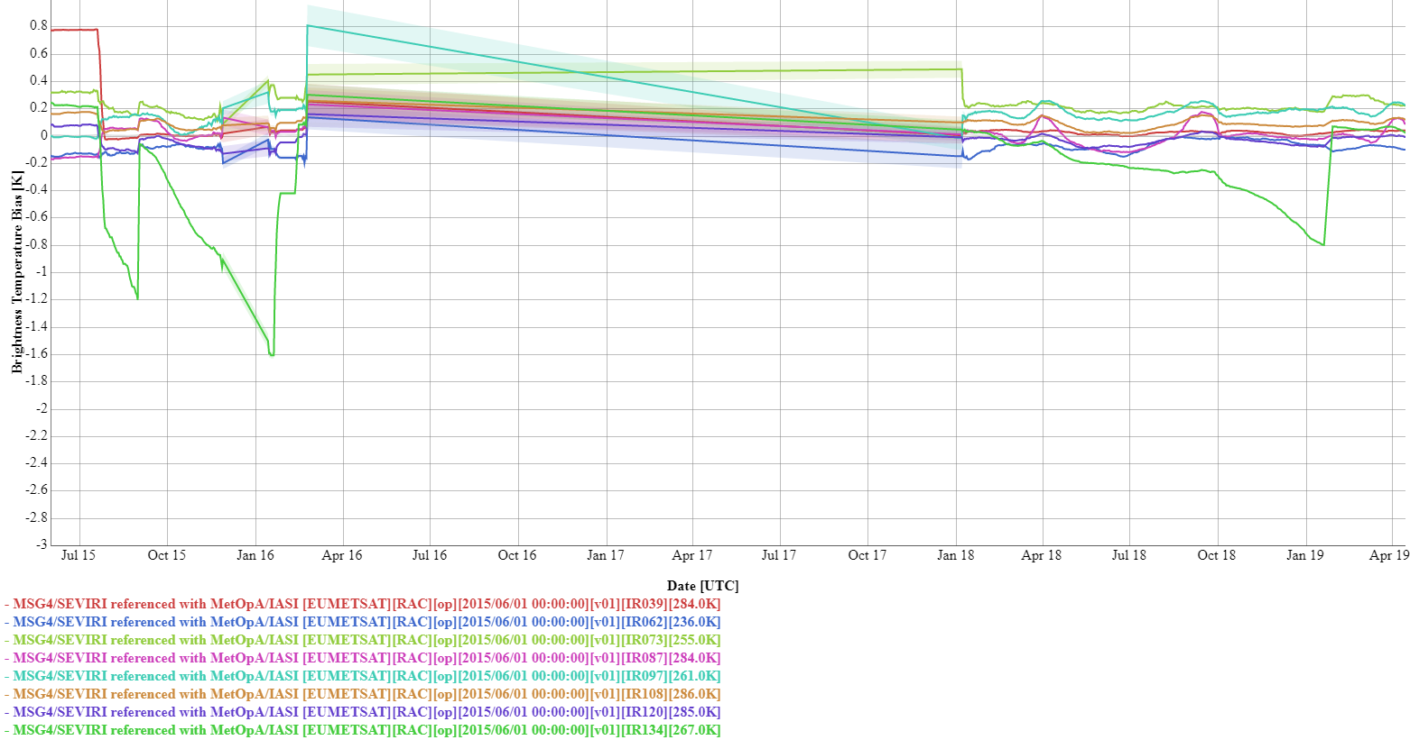
Calibration Performance: Meteosat-11/SEVIRI IR Bands
Summary Statistics of Meteosat-10/SEVIRI IR Calibration Performance in 2018 (All uncertainties are k=1)
Channel Name | IR3.9 | IR6.2 | IR7.3 | IR8.7 | IR9.7 | IR10.8 | IR12.0 | IR13.4
Standard Radiance as Tb (K) | 284 | 236 | 255 | 284 | 261 | 286 | 285 | 267
Mean Bias (K) | +0.03 | -0.06 | +0.22 | +0.00 | +0.17 | +0.09 | -0.03 | -0.22
Standard Deviation of Bias (K) | 0.01 | 0.05 | 0.04 | 0.07 | 0.04 | 0.04 | 0.03 | 0.17
Mean Drift Rate of Bias (K/yr) | -0.01 | +0.11 | -0.05 | +0.01 | +0.04 | -0.01 | -0.01 | -0.58
The statistics are derived from Meteosat-11/SEVIRI Operational GSICS Re-Analysis Correction vs. Metop-A/IASI
Biases defined for Standard Radiance: typical scene for easy inter-comparison of sensors’ inter-calibration biases
Decontaminations introduce calibration jumps – most obvious in the IR13.4 channel due to ice contamination
Time series of Meteosat-11/SEVIRI Tb biases w.r.t. Metop-A/IASI at standard radiance

Slide 14
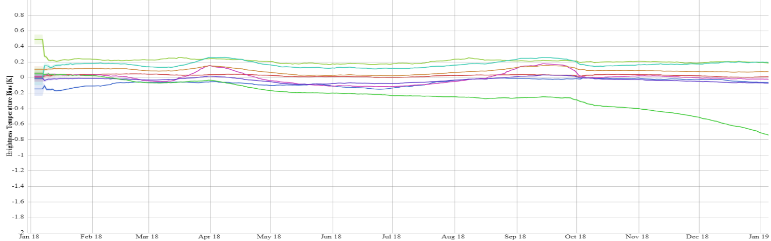
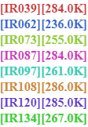
Calibration Performance: Meteosat-11/SEVIRI IR Bands
Summary Statistics of Meteosat-10/SEVIRI IR Calibration Performance in 2018 (All uncertainties are k=1)
Channel Name | IR3.9 | IR6.2 | IR7.3 | IR8.7 | IR9.7 | IR10.8 | IR12.0 | IR13.4
Standard Radiance as Tb (K) | 284 | 236 | 255 | 284 | 261 | 286 | 285 | 267
Mean Bias (K) | +0.03 | -0.06 | +0.22 | +0.00 | +0.17 | +0.09 | -0.03 | -0.22
Standard Deviation of Bias (K) | 0.01 | 0.05 | 0.04 | 0.07 | 0.04 | 0.04 | 0.03 | 0.17
Mean Drift Rate of Bias (K/yr) | -0.01 | +0.11 | -0.05 | +0.01 | +0.04 | -0.01 | -0.01 | -0.58
The statistics are derived from Meteosat-11/SEVIRI Operational GSICS Re-Analysis Correction vs. Metop-A/IASI
Biases defined for Standard Radiance: typical scene for easy inter-comparison of sensors’ inter-calibration biases
Decontaminations introduce calibration jumps – most obvious in the IR13.4 channel due to ice contamination
Time series of Meteosat-11/SEVIRI Tb biases w.r.t. Metop-A/IASI at standard radiance

Slide 15
JMA Annual GSICS Calibration Report for 2018
Masaya Takahashi, Yusuke Yogo
Japan Meteorological Agency

Slide 16
Satellite/Instrument Summary - GEO
Satellite (status) |  | Location | Launch date | EO instruments
Himawari-8 | (Op) | 140.7 E | 2014-10-07 | AHI
Himawari-9 | (B) | 140.7 E | 2016-11-02 | AHI
Hyperlinks on instrument names navigate to the Calibration Landing Page
Major calibration relevant events in 2018
  2018-02-14: Himawari-8 maintenance (backup operation by Himawari-9 for about 2 days)
Satellite Status
 | Op = Operational
 | P = Pre-operational
 | B = Back-up, secondary
 | L = Limited availability
Instrument Status
 |  | Operational (or capable of)
 |  | Operational with limitations (or Standby)
 |  | Operational with Degraded Performance
 |  | Not Operational
 |  | Functional, Turned Off

Slide 17
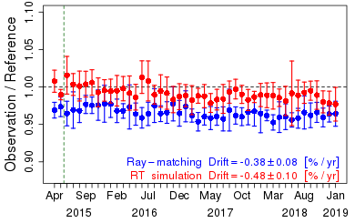
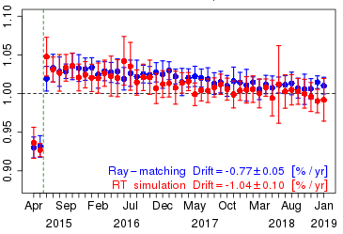
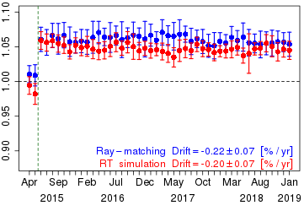
Calibration Performance: Himawari-8/AHI VIS/NIR Bands
Summary Statistics of Himawari-8/AHI VNIR Calibration Performance (All Uncertainties are k=1)
Channel Name (Central Wavelength in μm) |  | BAND01 (0.47) | BAND02 (0.51) | BAND03 (0.64) | BAND04 (0.86) | BAND05 (1.6) | BAND06 (2.3) | Units
Ray-matching w/ S-NPP/VIIRS | Mean Bias | -3.6 ± 2.6 | -2.0 ± 1.6 | +1.1 ± 2.1 | -0.4 ± 1.8 | +5.8 ± 1.2 | -5.5 ± 1.5 | %
 | Annual Drift | -0.38 ± 0.08 | -0.50 ± 0.07 | -0.77 ± 0.05 | -0.57 ± 0.04 | -0.22 ± 0.07 | -0.23 ± 0.05 | %/yr
Vicarious Cal. using Aqua/MODIS + RTM | Mean Bias | -1.1 ± 1.6 | -2.3 ± 1.6 | +0.51 ± 1.7 | +1.6 ± 1.6 | +4.4 ± 0.9 | -4.1 ± 1.0 | %
 | Annual Drift | -0.48 ± 0.10 | -0.68 ± 0.10 | -1.04 ± 0.10 | -0.86 ± 0.10 | -0.20 ± 0.07 | -0.17 ± 0.10 | %/yr
Mean Bias: monthly average and standard deviation of the daily results in January 2018
Annual Drift: calculated using Mean Bias from July 2015 to January 2019
Ray-matching: Spectral Band Adjustment Factors on NASA Langley website compensates Spectral diff. (ATBD)
Vicarious calibration uses optical parameters retrieved from Aqua/MODIS C6 L1B (Reference)
Trend of the ratio of observation to reference computed using Ray-matching / Vicarious calibration approaches
BAND01 (0.47 μm)
BAND03 (0.64 μm)
BAND05 (1.6 μm)

Slide 18
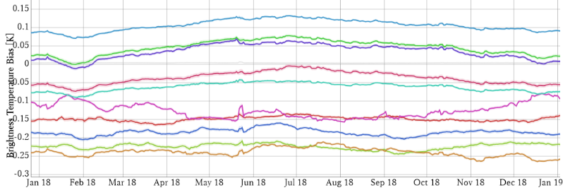

Calibration Performance: Himawari-8/AHI Infrared Bands
Summary Statistics of Himawari-8/AHI IR Calibration Performance in 2018 (All uncertainties are k=1)
 | Channel Name (Central Wavelength in μm) | BAND07 (3.9) | BAND08 (6.2) | BAND09 (6.9) | BAND10 (7.3) | BAND11 (8.6) | BAND12 (9.6) | BAND13 (10.4) | BAND14 (11.2) | BAND15 (12.4) | BAND16 (13.3)
 | Std. Radiance as Tb (K) | 286.0 | 234.6 | 243.9 | 254.6 | 283.8 | 259.5 | 286.2 | 286.1 | 283.8 | 269.7
Metop-A/ IASI | Mean Bias (K) | -0.149 | -0.184 | -0.223 | -0.127 | -0.062 | -0.239 | 0.036 | 0.047 | -0.036 | 0.106
 | Stdv. of Bias (K) | 0.006 | 0.009 | 0.008 | 0.020 | 0.012 | 0.012 | 0.020 | 0.020 | 0.017 | 0.016
S-NPP/ CrIS | Mean Bias (K) | -0.114 | -0.165 | -0.248 | -0.157 | N/A | -0.249 | -0.019 | -0.012 | -0.099 | 0.036
 | Stdv/ of Bias (K) | 0.177 | 0.011 | 0.014 | 0.028 | N/A | 0.010 | 0.017 | 0.017 | 0.016 | 0.013
The statistics are derived from Himawari-8/AHI GSICS Re-Analysis Correction (ATBD)
Standard Radiance: typical scene defined by GSICS for easy inter-comparison of sensors’ inter-calibration biases
Time series of Himawari-8/AHI Tb biases w.r.t. Metop-A/IASI at std. radiance

Slide 19
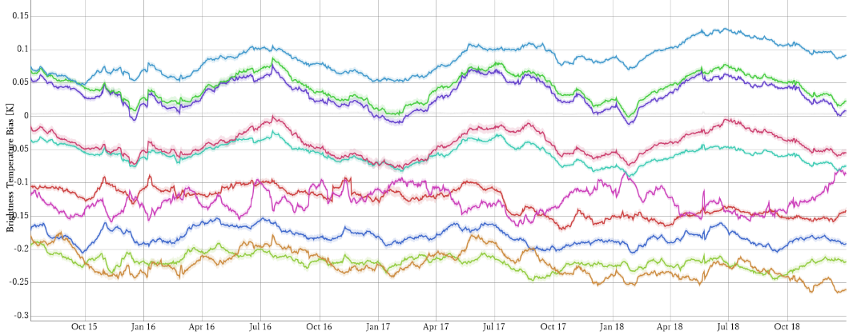
Calibration Performance: Himawari-8/AHI Infrared Bands
Summary Statistics of Himawari-8/AHI IR Calibration Performance in 2018 (All uncertainties are k=1)
 | Channel Name (Central Wavelength in μm) | BAND07 (3.9) | BAND08 (6.2) | BAND09 (6.9) | BAND10 (7.3) | BAND11 (8.6) | BAND12 (9.6) | BAND13 (10.4) | BAND14 (11.2) | BAND15 (12.4) | BAND16 (13.3)
 | Std. Radiance as Tb (K) | 286.0 | 234.6 | 243.9 | 254.6 | 283.8 | 259.5 | 286.2 | 286.1 | 283.8 | 269.7
Metop-A/ IASI | Mean Bias (K) | -0.149 | -0.184 | -0.223 | -0.127 | -0.062 | -0.239 | 0.036 | 0.047 | -0.036 | 0.106
 | Stdv. of Bias (K) | 0.006 | 0.009 | 0.008 | 0.020 | 0.012 | 0.012 | 0.020 | 0.020 | 0.017 | 0.016
S-NPP/ CrIS | Mean Bias (K) | -0.114 | -0.165 | -0.248 | -0.157 | N/A | -0.249 | -0.019 | -0.012 | -0.099 | 0.036
 | Stdv/ of Bias (K) | 0.177 | 0.011 | 0.014 | 0.028 | N/A | 0.010 | 0.017 | 0.017 | 0.016 | 0.013
The statistics are derived from Himawari-8/AHI GSICS Re-Analysis Correction (ATBD)
Standard Radiance: typical scene defined by GSICS for easy inter-comparison of sensors’ inter-calibration biases
Time series of Himawari-8/AHI Tb biases w.r.t. Metop-A/IASI at std. radiance (2015-07-07 to 2018-12-31)

Slide 20
KMA Annual GSICS Calibration Report for 2018
Dohyeong Kim, Minju Gu, and Eunkyu Kim
Korea Meteorological Administration

Slide 21
Satellite/Instrument Summary - GEO
Satellite (status) |  | Location | Launch date | EO instruments
COMS | (Op) | 128.2E | 2010-06-26 | MI
GK-2A | (P) | 128.2 E | 2018-12-04 | AMI
Hyperlinks on instrument names navigate to the Calibration Landing Page
Major calibration relevant events in 2018
  2018-08-31 : relocation of COMS for preparation of GK-2A/2B collocation
  2018-12-04 : launch and start of commissioning GK-2A
Satellite Status
 | Op = Operational
 | P = Pre-operational
 | B = Back-up, secondary
 | L = Limited availability
Instrument Status
 |  | Operational (or capable of)
 |  | Operational with limitations (or Standby)
 |  | Operational with Degraded Performance
 |  | Not Operational
 |  | Functional, Turned Off

Slide 22
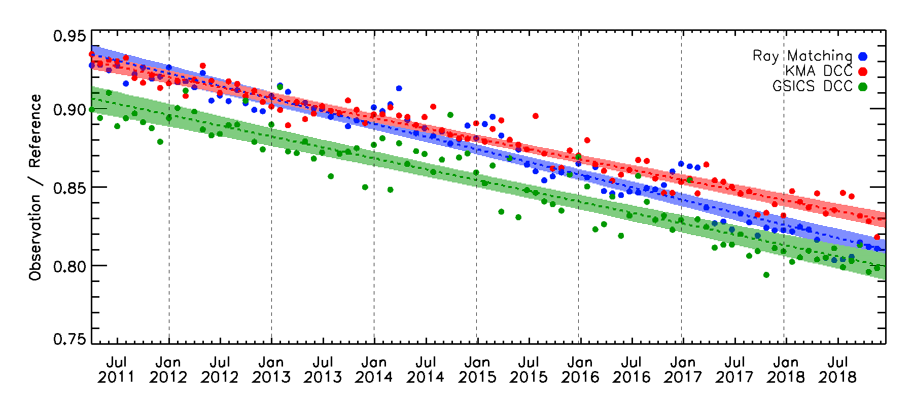
Calibration Performance: COMS/MI Visible Band
Summary Statistics of COMS/MI VIS Calibration Performance from 2011 to 2018 (All uncertainties are k=1)
Mean Bias: monthly average and standard deviation of the daily results from April 2011 to December 2018.
Annual Drift: calculated using Mean Bias from April 2011 to December 2018.
Ray-matching: GEO-LEO Inter-calibration method using MI(COMS) and MODIS(Terra) based on DCC condition
KMA DCC: Comparison MI and RTM(SBDART).
GSICS DCC: Using Hu BRDF Model.
Channel Name |  | Visible (0.675μm)
Ray-matching (DCC) / MODIS(Terra) | Mean Bias[%] | -12.7 ± 5.5
 | Annual Drift[%/yr] | -1.60 ± 0.12
KMA DCC / RTM(SBDART) | Mean Bias[%] | -12.0 ± 6.5
 | Annual Drift[%/yr] | -1.30 ± 0.10
GSICS DCC / MODIS(Aqua) | Mean Bias[%] | -14.7 ± 9.2
 | Annual Drift[%/yr] | -1.38 ± 0.16
Trend of the ratio of observation to reference computed using Ray-matching / KMA DCC / GSICS DCC approaches

Slide 23
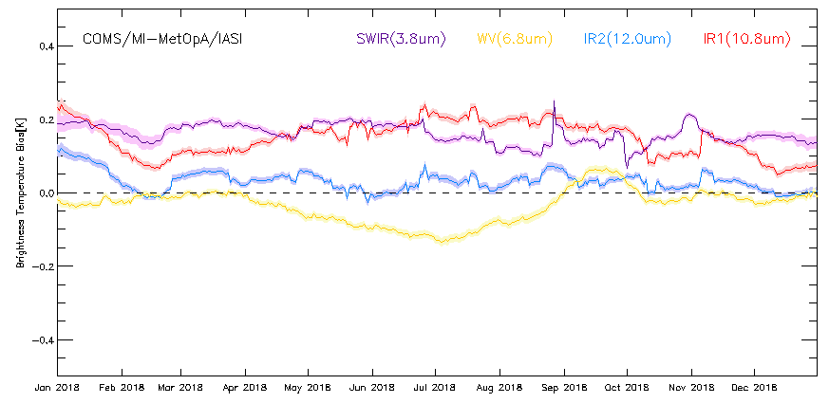
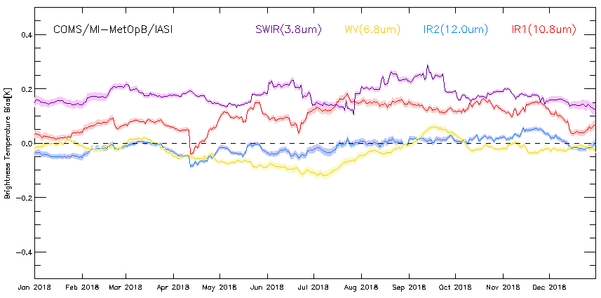
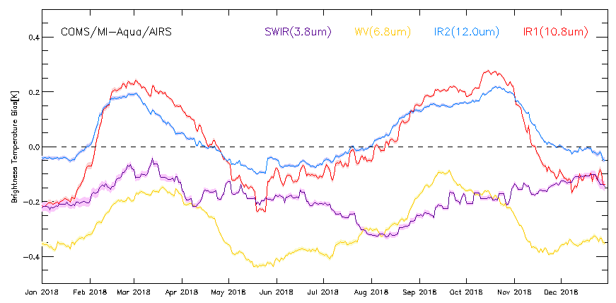
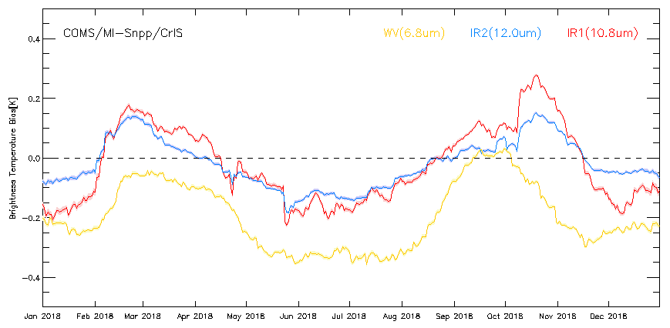
Calibration Performance: COMS/MI Infrared Bands
Summary Statistics of COMS/MI IR Calibration Performance in 2018 (All uncertainties are k=1)
 | MetOp-A/IASI |  |  |  | MetOp-B/IASI
Channel Name | IR3.8 | IR6.8 | IR10.8 | IR12.0 | IR3.8 | IR6.8 | IR10.8 | IR12.0
Std Rad as Tb (K) | 286 | 238 | 286 | 285 | 286 | 238 | 286 | 285
Mean Bias (K) | 0.16 | -0.03 | 0.15 | 0.03 | 0.18 | -0.03 | 0.10 | -0.01
Stdv of Bias (K) | 0.03 | 0.05 | 0.05 | 0.03 | 0.03 | 0.04 | 0.05 | 0.03
Mean Drift Rate of Bias (K/yr) | +0.18 | -0.05 | +0.16 | +0.05 | +0.17 | -0.04 | +0.05 | -0.04
 | Snpp/CrIS |  |  |  | Aqua/AIRS
Channel Name | IR3.8 | IR6.8 | IR10.8 | IR12.0 | IR3.8 | IR6.8 | IR10.8 | IR12.0
Std Rad as Tb (K) | 286 | 238 | 286 | 285 | 286 | 238 | 286 | 285
Mean Bias (K) | - | -0.20 | -0.02 | -0.02 | -0.19 | -0.29 | 0.02 | 0.04
Stdv of Bias (K) | - | 0.10 | 0.13 | 0.08 | 0.06 | 0.09 | 0.15 | 0.09
Mean Drift Rate of Bias (K/yr) | - | -0.19 | -0.04 | -0.03 | -0.18 | -0.29 | -0.01 | +0.02
The statistics are derived from COMS/MI Operational
GSICS Re-Analysis Correction vs. Metop-A/IASI, Metop-B/IASI, Aqua/AIRS, SNPP/CrIS
Biases defined for Standard Radiance: typical scene for easy inter-comparison of sensors’ inter-calibration biases

Slide 24
NOAA Annual GSICS Calibration Report for 2018
Fred Wu, Fangfang Yu, and Hyelim Yoo
NOAA

Slide 25
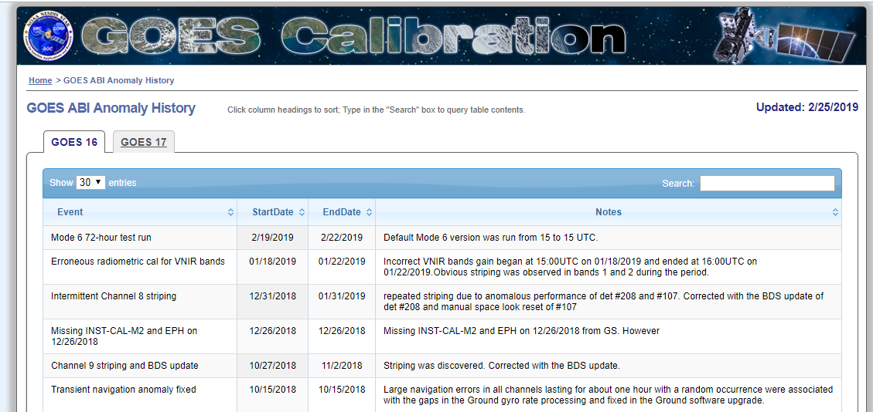
Satellite/Instrument Summary - GEO
http://planet.rssi.ru
Satellite (status) |  | Current Location | Launch Date | Operation Date
GOES-15* | (Op) | 128W | 2010-03-04 | 2011-12-06
GOES-16 | (Op) | 75.2W (GOES-East) | 2016-11-19 | 2017-12-18
GOES-17 | (Op) | 137.2W (GOES-West) | 2018-03-01 | 2019-02-12
* GOES-15 drifted from 135W on 2018-10-23 and arrived the new operating location of 128W on 2018-11-07. GOES-17 and GOES-15 will operate in tandem for 6 months from their respective locations of 137.2W and 128W.
GOES-16/17 ABI Calibration Event Log:
https://www.star.nesdis.noaa.gov/GOESCal/goes_SatelliteAnomalies.php

Slide 26
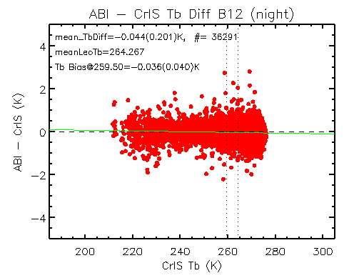
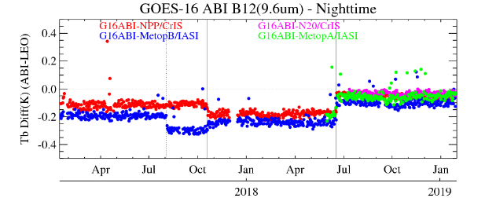
Calibration Performance: GOES16/ABI Infrared Bands
Summary Statistics of GOES-16/ABI IR Calibration Performance in December 2018 (All uncertainties are k=1)
 | Channel Name (Central Wavelength in μm) | BAND07 (3.9) | BAND08 (6.2) | BAND09 (6.9) | BAND10 (7.3) | BAND11 (8.6) | BAND12 (9.6) | BAND13 (10.4) | BAND14 (11.2) | BAND15 (12.4) | BAND16 (13.3)
 | Std. Scene Tb (K) | 286.0 | 234.5 | 244.0 | 254.5 | 284.0 | 259.5 | 286.0 | 286.0 | 283.5 | 269.5
Metop-A/ IASI | Bias at Std. Scene(K) | -0.03 | -0.11 | -0.12 | -0.05 | -0.05 | -0.05 | -0.03 | 0.04 | 0.03 | -0.10
 | Stdv. of Bias (K) | 0.08 | 0.06 | 0.07 | 0.08 | 0.11 | 0.08 | 0.12 | 0.12 | 0.12 | 0.12
Metop-B/ IASI | Bias at Std. Scene(K) | -0.00 | -0.12 | -0.14 | -0.07 | -0.04 | -0.10 | -0.02 | 0.05 | 0.03 | -0.12
 | Stdv. of Bias (K) | 0.18 | 0.13 | 0.08 | 0.09 | 0.19 | 0.13 | 0.21 | 0.21 | 0.22 | 0.20
S-NPP/ CrIS | Bias at Std. Scene(K) | - | - | -0.14 | -0.09 | - | -0.05 | -0.07 | -0.01 | -0.03 | -0.15
 | Stdv of Bias (K) | - | - | 0.03 | 0.04 | - | 0.04 | 0.06 | 0.06 | 0.07 | 0.06
NOAA-20/ CrIS | Bias at Std. Scene(K) | - | - | -0.11 | -0.06 | - | -0.04 | -0.01 | 0.05 | 0.03 | -0.11
 | Stdv of Bias (K) | - | - | 0.03 | 0.03 | - | 0.04 | 0.06 | 0.06 | 0.06 | 0.07
GOES-16 ABI IR calibration is very stable.
The mean Tb bias to CrIS/IASI less than 0.15K after the operational update on 06/19/2018.
No significant scene dependent Tb bias to the reference instruments for all the IR channels
Metop-B/IASI update
G16 ABI updates

Slide 27
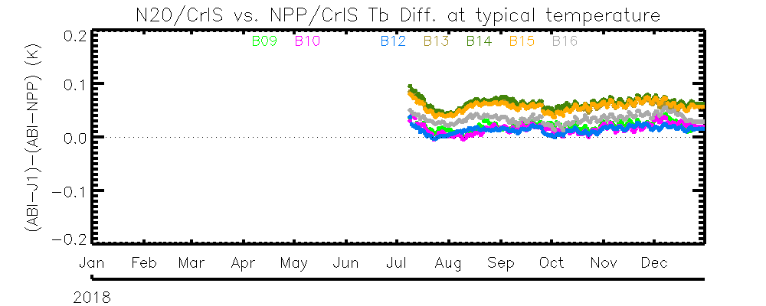
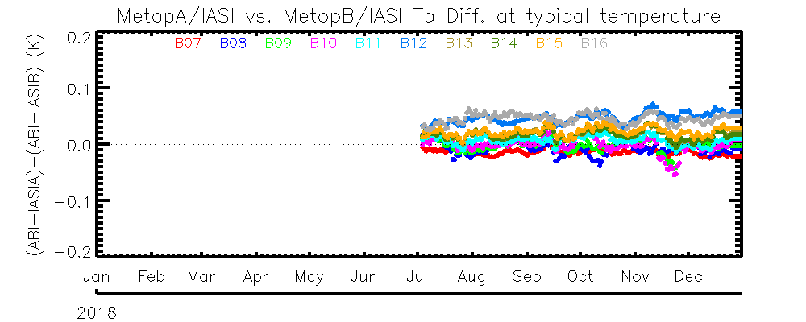
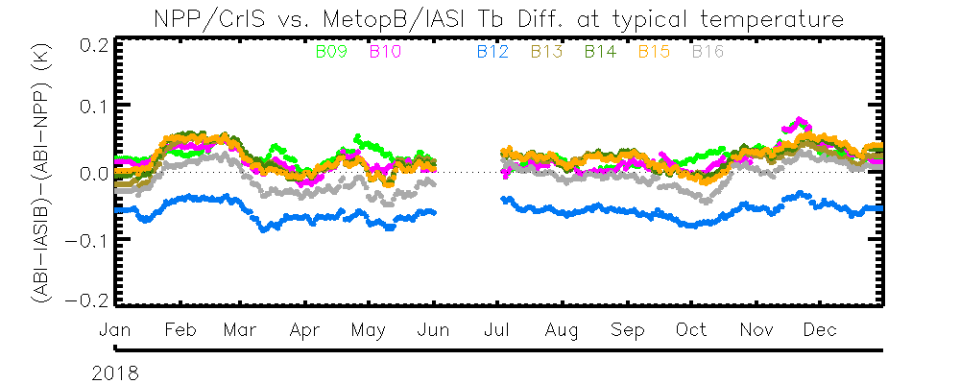
Reference Instrument Performance: Double Difference Using G16 ABI as the Transfer
N20/CrIS, NPP/CrIS, Metop-A/IASI and Metop-B/IASI are all stable within the study period.
The calibration difference is less than 0.1K among the four reference instruments
N20/CrIS is slightly warmer than NPP/CrIS.
N20/CrIS is slightly warmer than NPP/CrIS
Double Difference between N20 and NPP CrIS
Double Difference between IASIA and IASIB
Metop-A/IASI and Metop-B/IASI is in general within ~±0.05K
Double Difference between NPP/CrIS and IASI-B
Metop-B/IASI and SNPP/CrIS is in general within ~±0.1K

Slide 28
ROSHYDROMET Annual GSICS Calibration Report for 2018
Alexey Rublev, Alexander Uspensky
ROSHYDROMET

Slide 29
Satellite/Instrument Summary - LEO

Slide 30
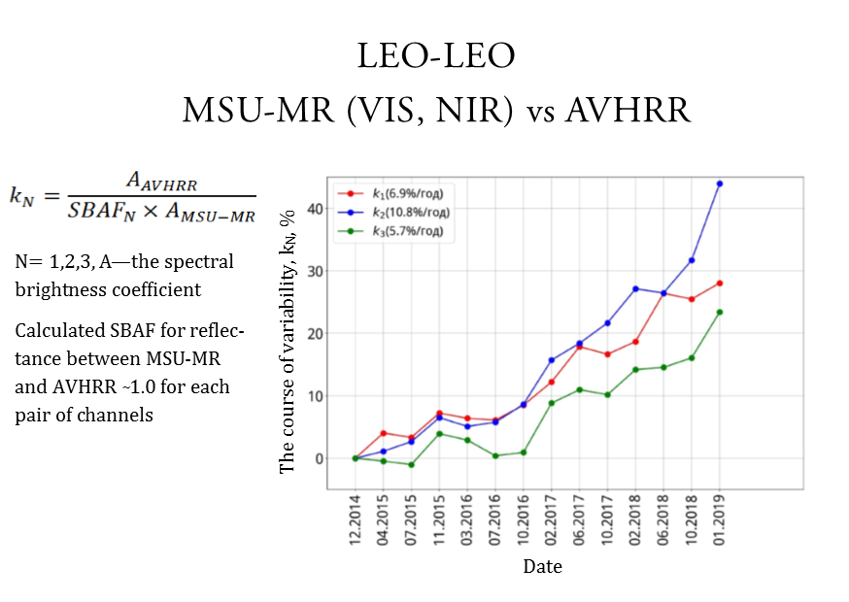
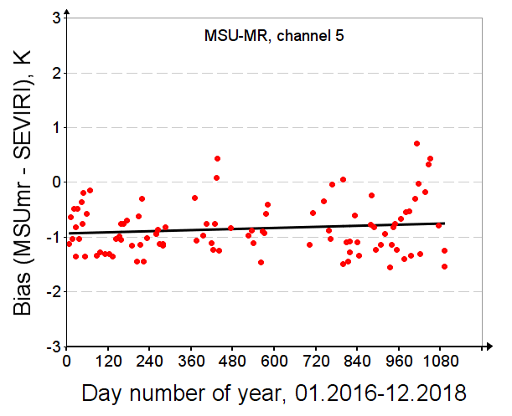
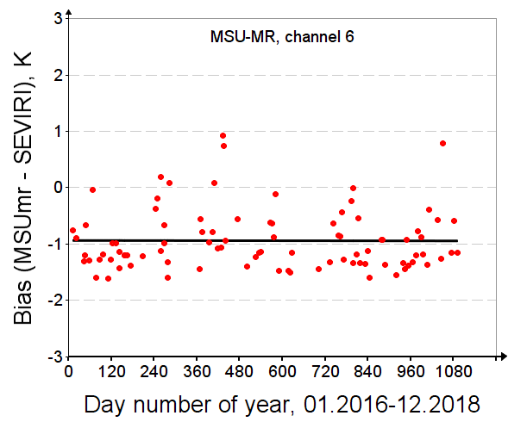

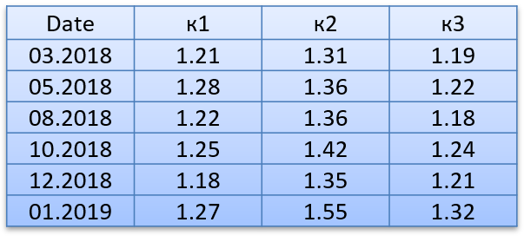
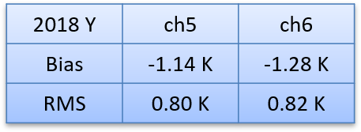
Calibration Performance: MSU-MR
Shortwave channels vs AVHRR/Metop-A
IR channels vs SEVIRI/Meteosat-10 (-11)
N= 1,2,3, A—the spectral brightness coefficient
Calculated SBAF for reflectance between MSU-MR and AVHRR ̴1.0 for each pair of channels

Slide 31
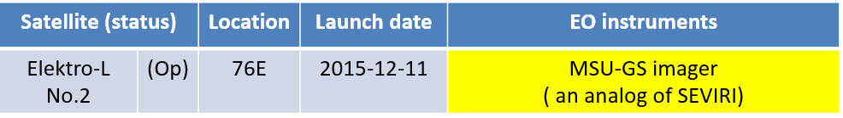
Satellite/Instrument Summary - GEO
The MSU-GS instrument is functional with limitations (12 μm channel is absent).
Absolute calibration is completing.

Slide 32
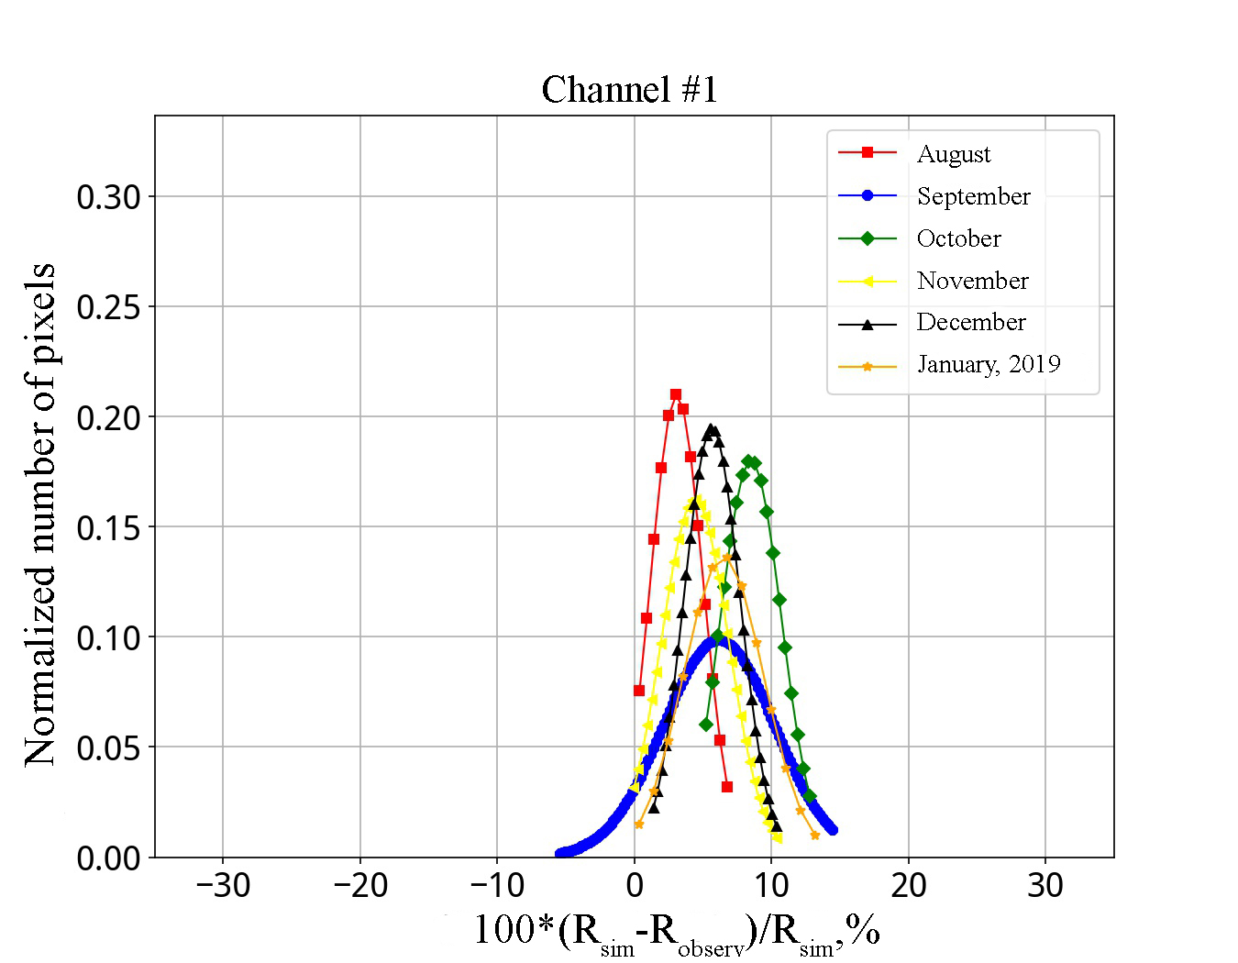
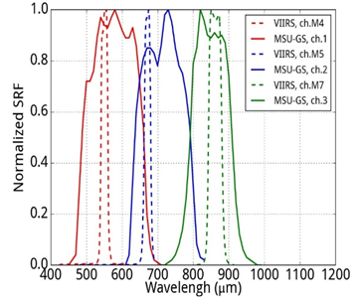
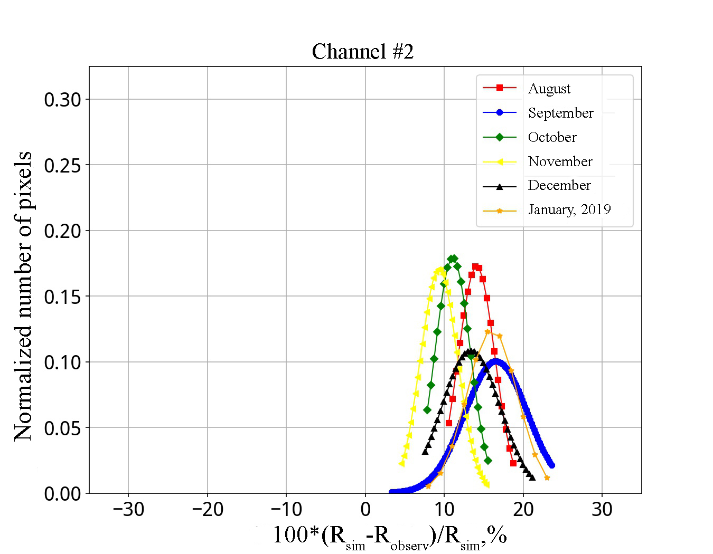
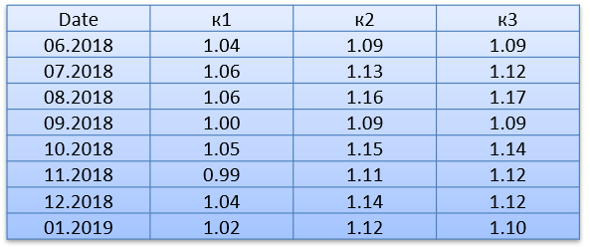
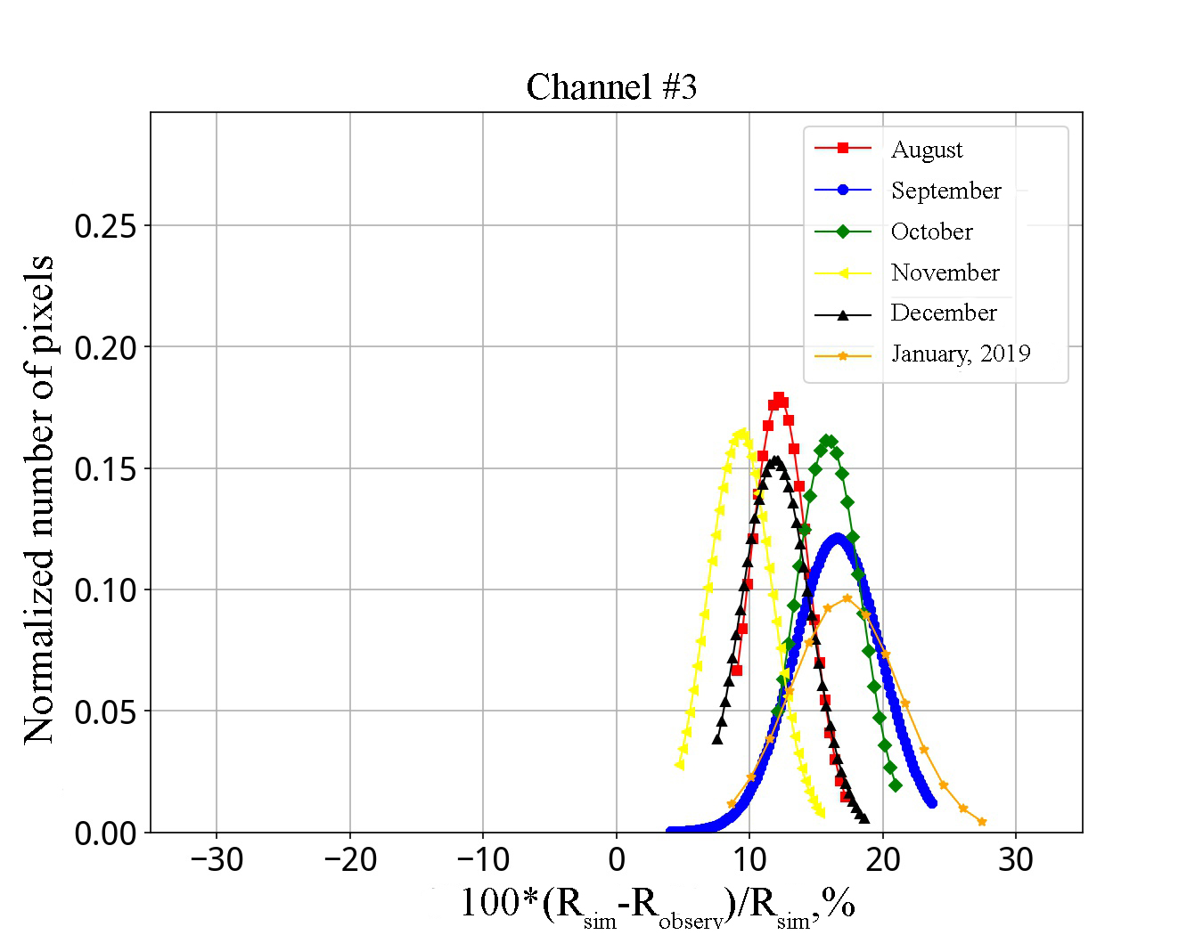
Calibration Performance of MSU-GS: Visible/Near-Infrared Channels
Inter-calibration of MSU-GS shortwaves channels
versus the VIIRS/Suomi NPP
Comparison above
deep convective clouds
over the Indian Ocean
± 20° North/South and East/West of Elektro-L #2 sub-satellite point (76 °E)
Calculated SBAF between
MSU-GS and VIIRS ~1.0
for each pair of channels

