Slide 1
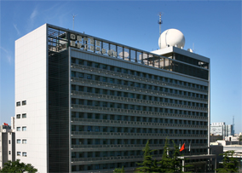
空白演示
HIRAS status update and IR recalibration for FY-3/IRAS and VIRR
Chengli Qi, Lu Li , Hanlie Xu
Chunqiang Wu, Xiuqing Hu, Na Xu
National Satellite Meteorological Center(NSMC), CMA
Mingjian Gu, Dekun Yin
Shanghai Institude of Technical Physics(SITP), CAS
GSICS IR Group web meeting, 24 Jun 2020

Slide 2
Outline
FY-3D/HIRAS status updates
Recalibration for FY-3/IRAS
Recalibration for FY-3/VIRR
Future work plan

Slide 3
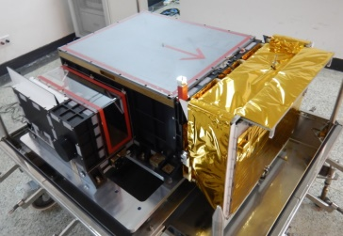
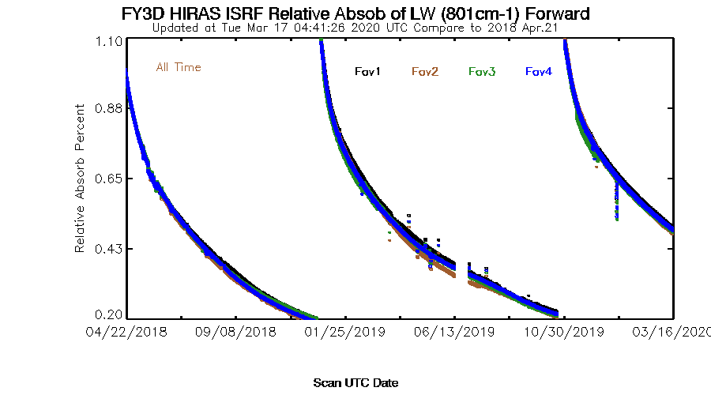
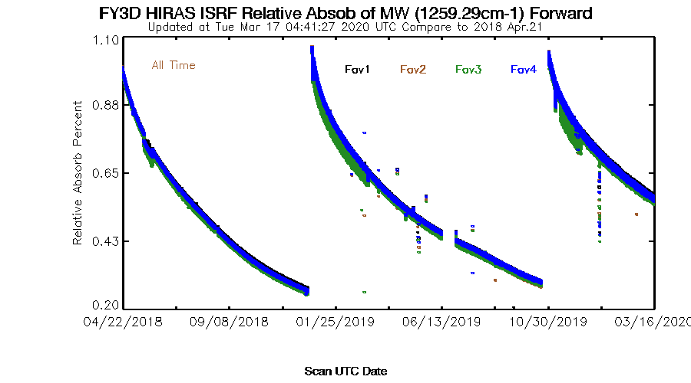
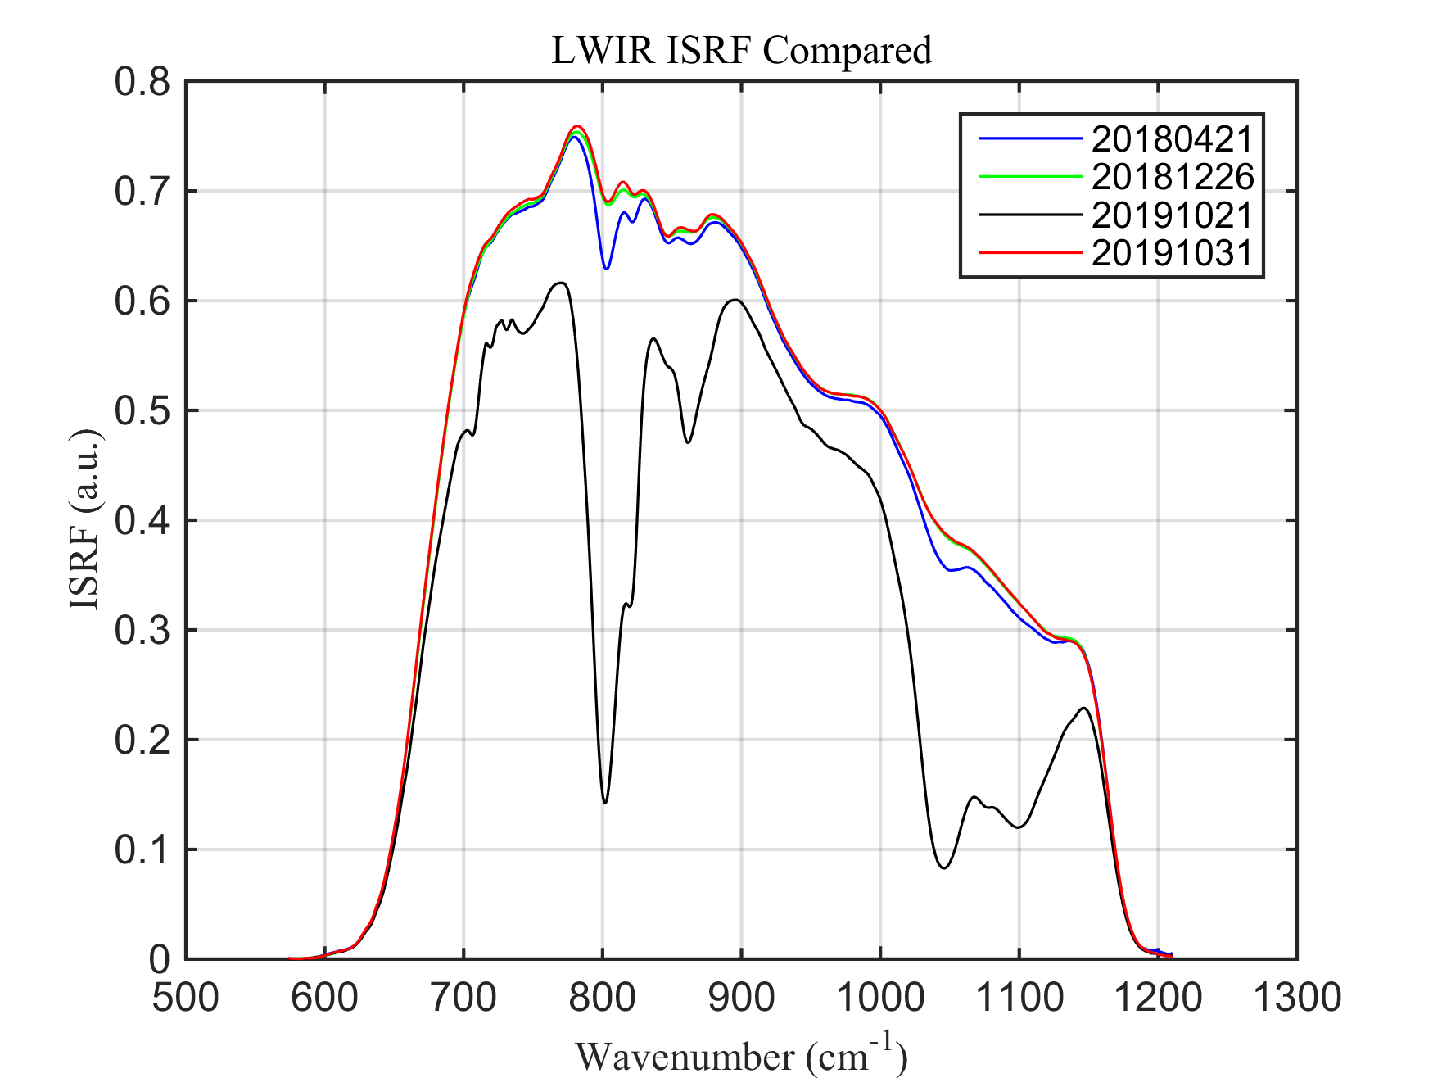
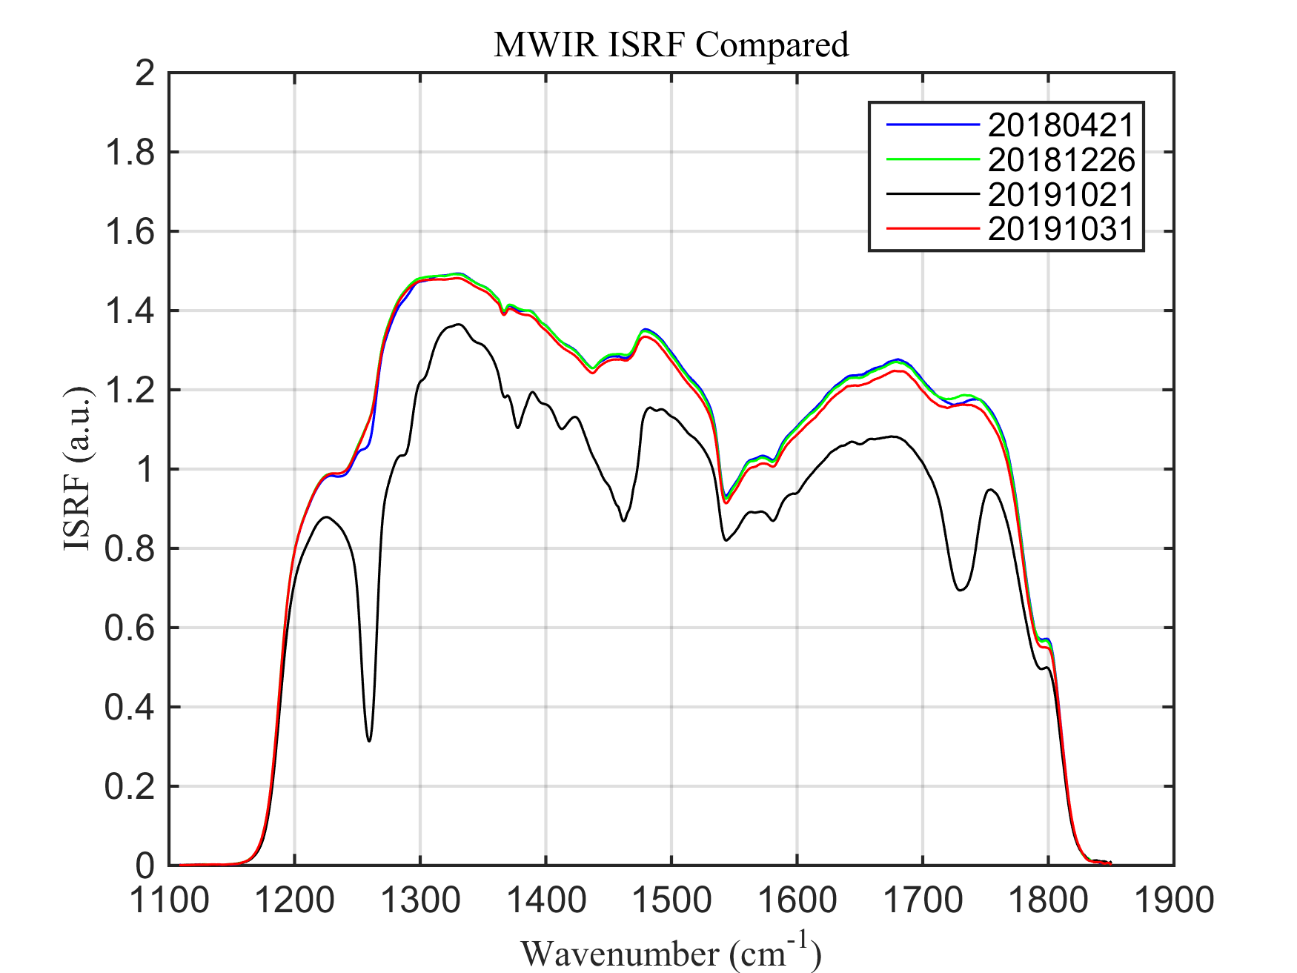
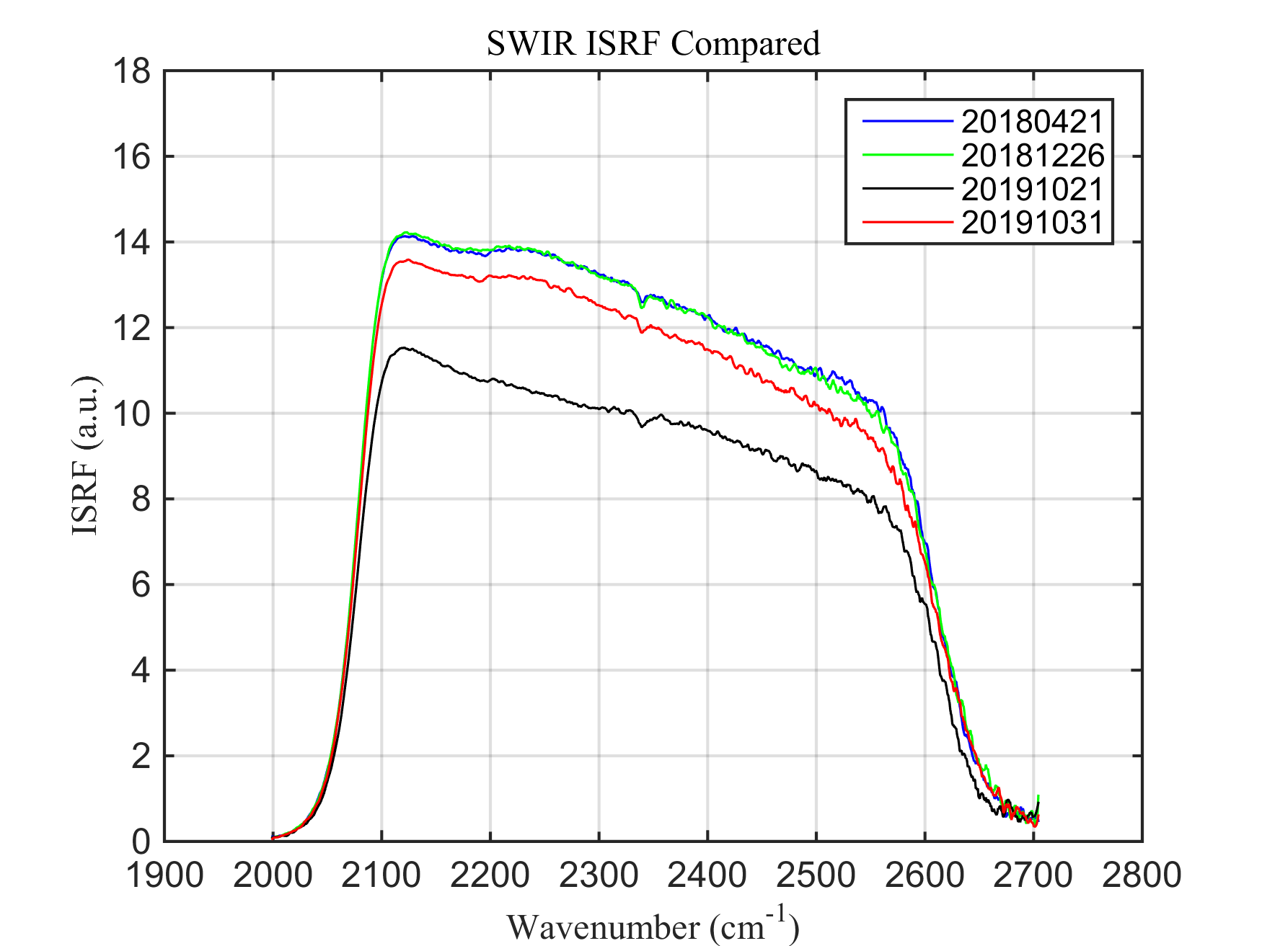
1. FY-3D/HIRAS status updates -1
Instrument heating and decontamination
1st-Dec, 2018
2nd-Oct, 2019
Heating operation on Oct 21, 2019
ISRF compared with best signal status
LW and MW bands signal are nearly recovered.
SW band is slight weaker in signal

Slide 4
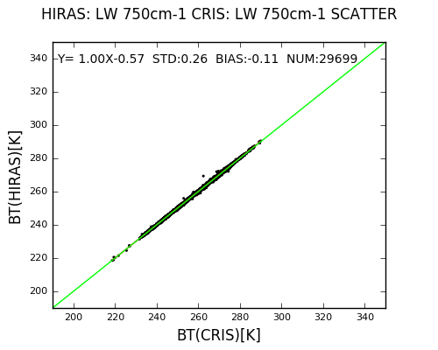
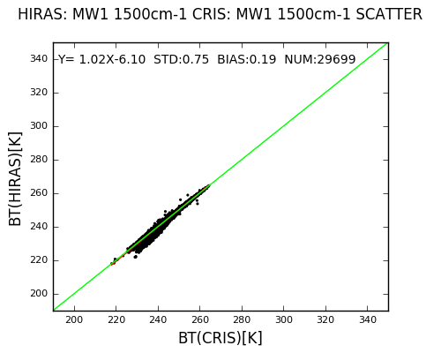
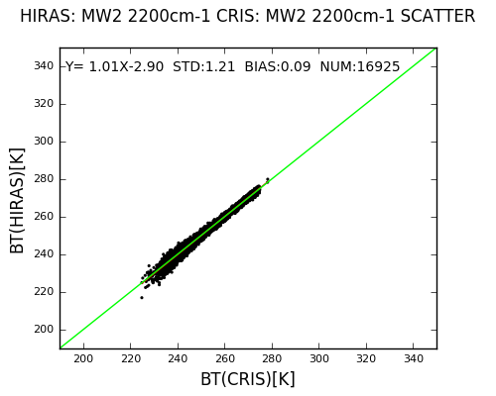
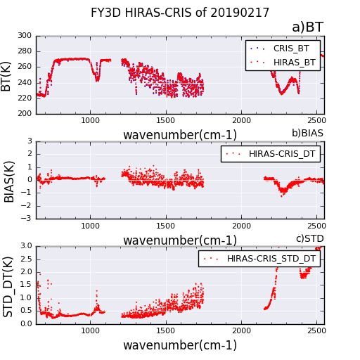
SNO BT comparison with JPSS-1/CrIS
general less than 0.3, 0.7 and 1.0 K in the LWIR, MWIR and SWIR bands, respectively.
Consistent with the accuracy of before heating.

Slide 5
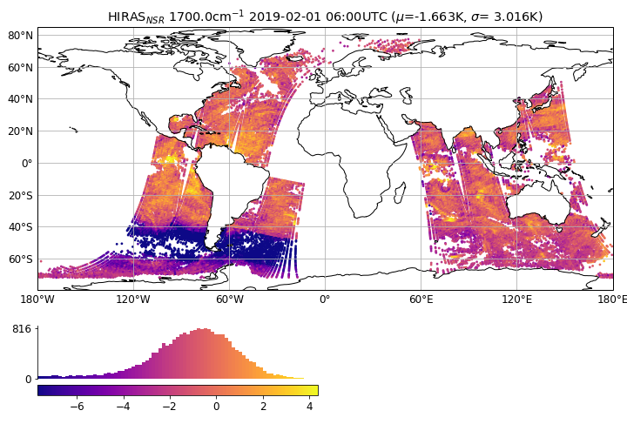
1. FY-3D/HIRAS status updates -2
Cold space view angle adjustment
Assessment from Met Office
abnormal negative deviations of Detector 3 in the middle wave band in some areas
Carminati. F, Xiao. X, Lu.Q, et al. Assessment of the Hyperspectral Infrared Atmospheric Sounder (HIRAS)，Remote Sens, 2019, 11, 2950, doi: 10.3390/rs11242950

Slide 6
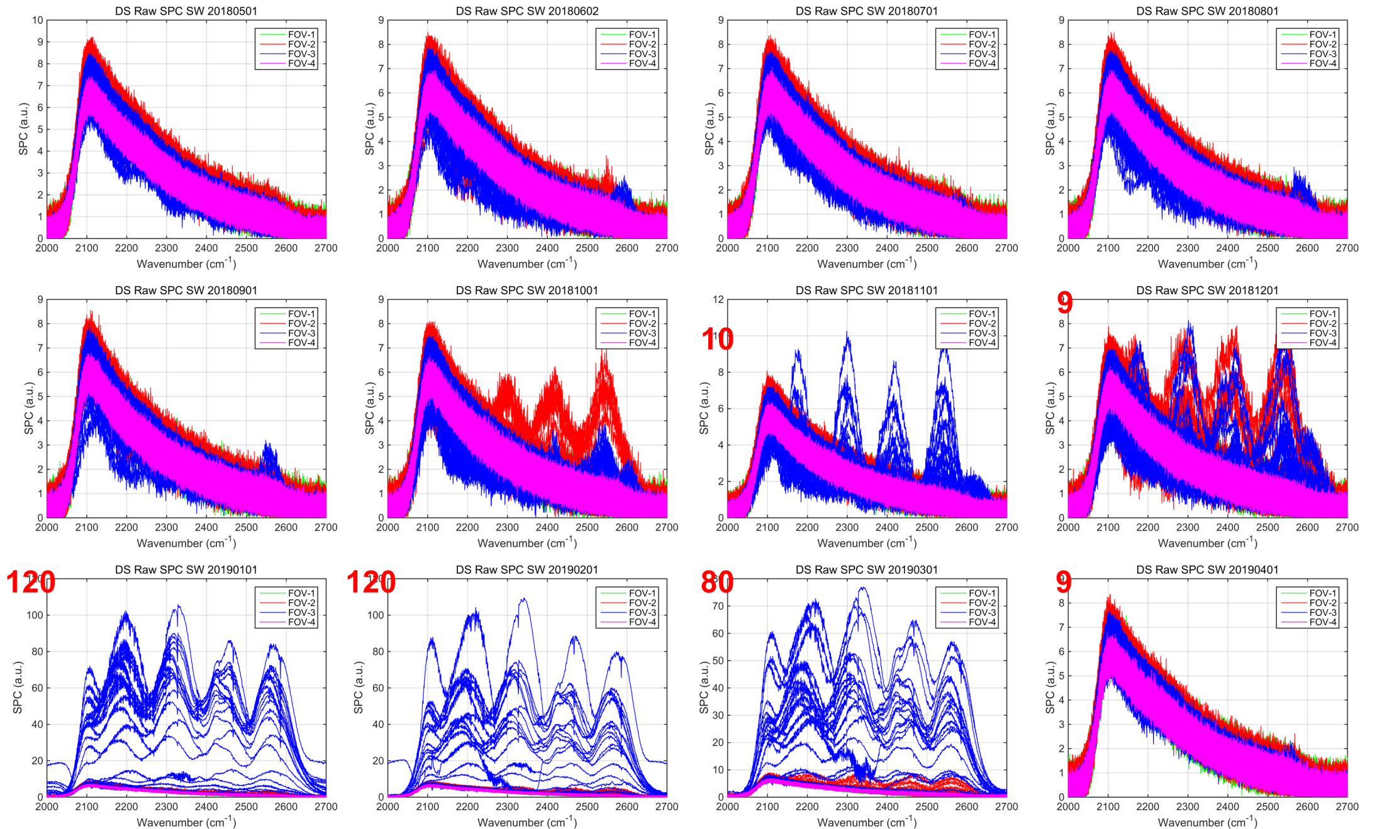
Monthly analysis of the deep space and blackbody observation spectra
Deep space spectra of FOV3 in the middle wave (MW) and short wave (SW) bands were abnormal: they rose sharply during Oct to March of next year.
May
Jun
Jul
Aug
Sep
Oct
Nov
Dec
Raw DS spectra of 4 Fovs in SW band
Jan
Feb
Mar
Apr

Slide 7
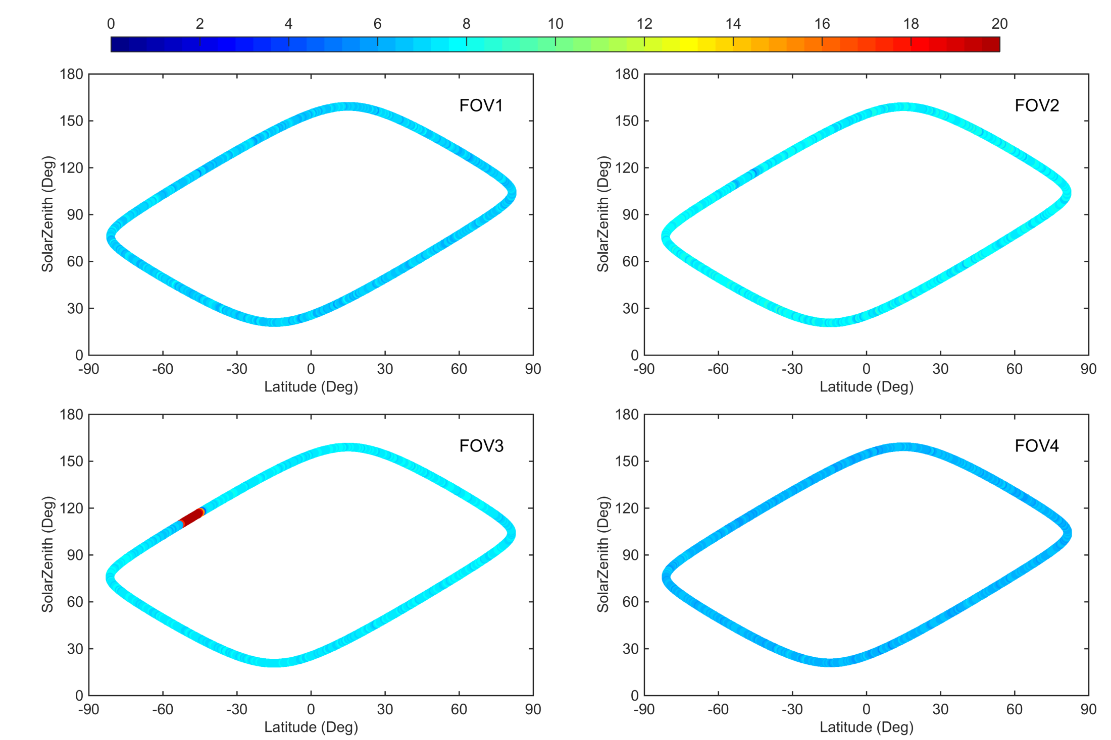
correlation analysis of anomalous spectra with latitude, and solar zenith angle with typical channels : LWIR: 778cm⁻¹; MWIR: 1300cm⁻¹; SWIR: 2108cm⁻¹. (Data on 20190201 )
SW Detector 3 is abnormally high in deep space observation in the range of 90-120 ° of the solar zenith angle, which leads to the abnormal deviation in calibration bias.

Slide 8
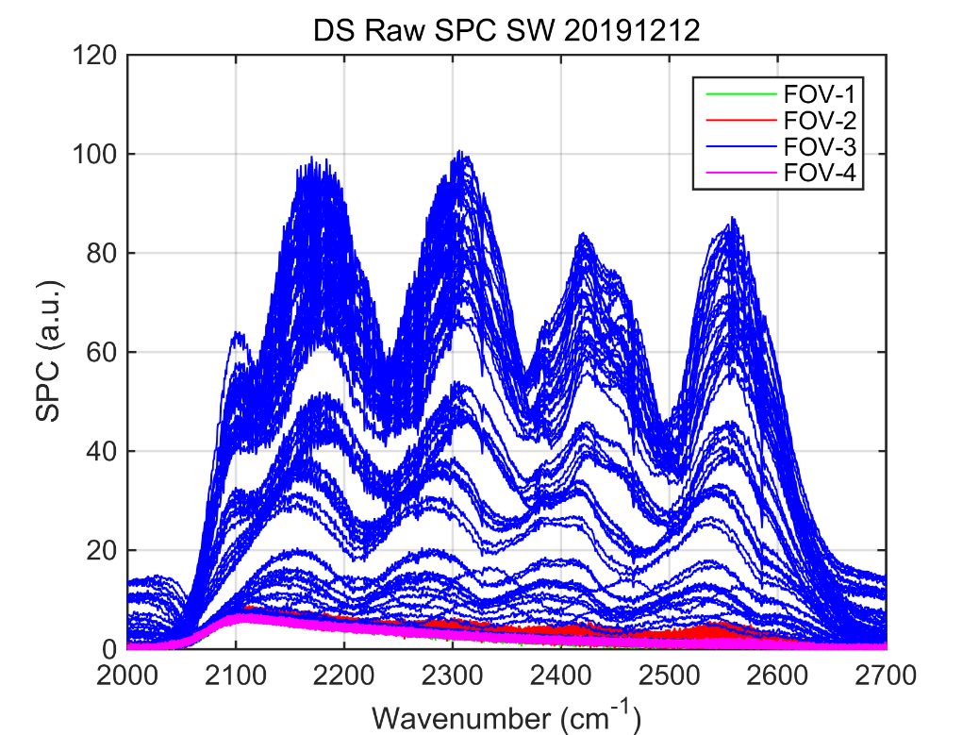
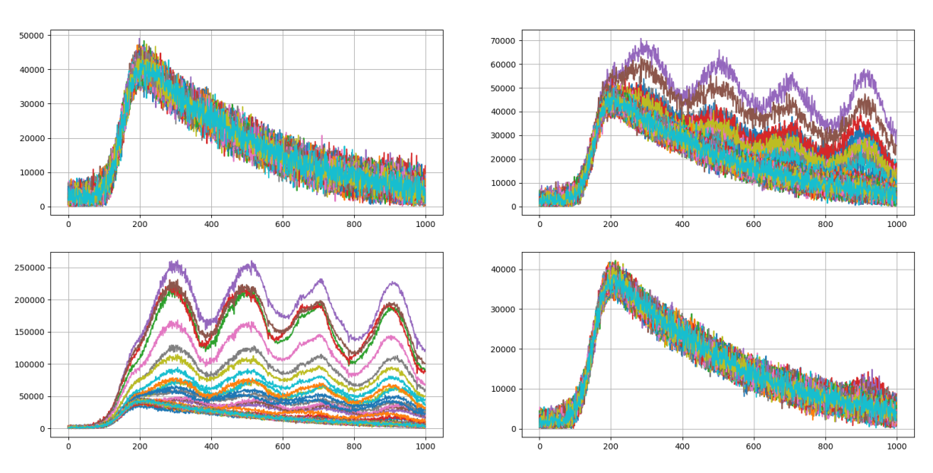
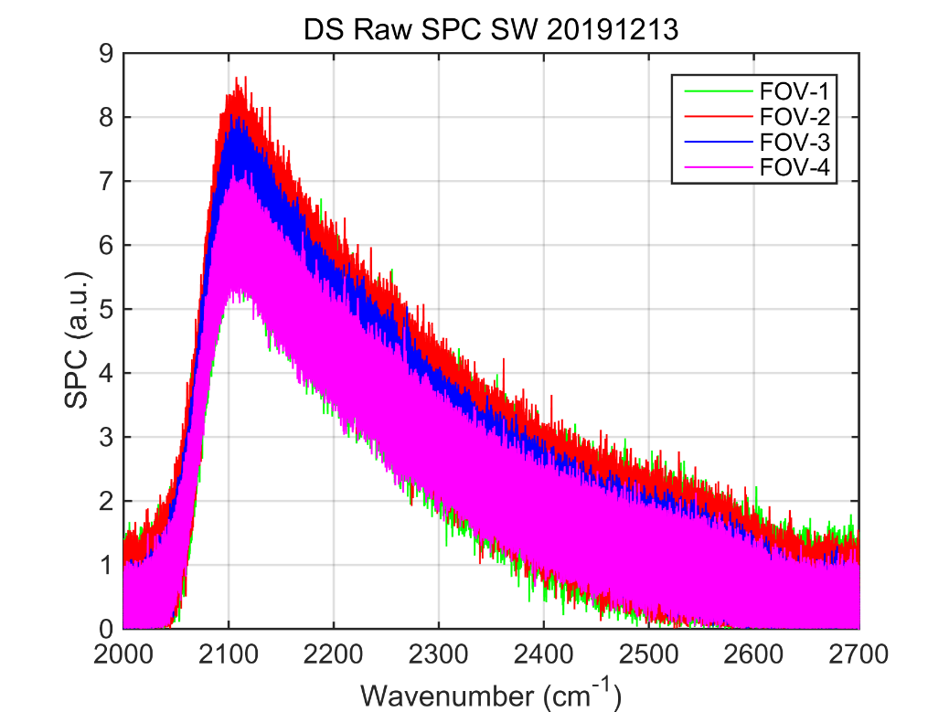
Cold Space observation spectra : 10 view angles, -94.93°,-91.30°,-87.69°,-84.09°,-80.48°,-76.89°,-73.29°,-69.70°,-66.10°,-62.50°
nominal CS angle at -71°
DS spectra at angles of -94.93 °, -91.30 °, -87.69 °, -84.09 °were not affected by solar contamination
Deep space pointing angle was decided to set from -71 ° to -87 °
Before adjustment
FOV1
FOV2
After adjustment
FOV3
FOV4
CS spectra when pointing angle at -71°

Slide 9
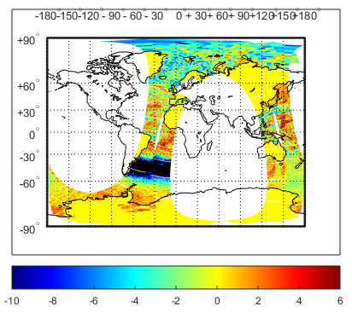
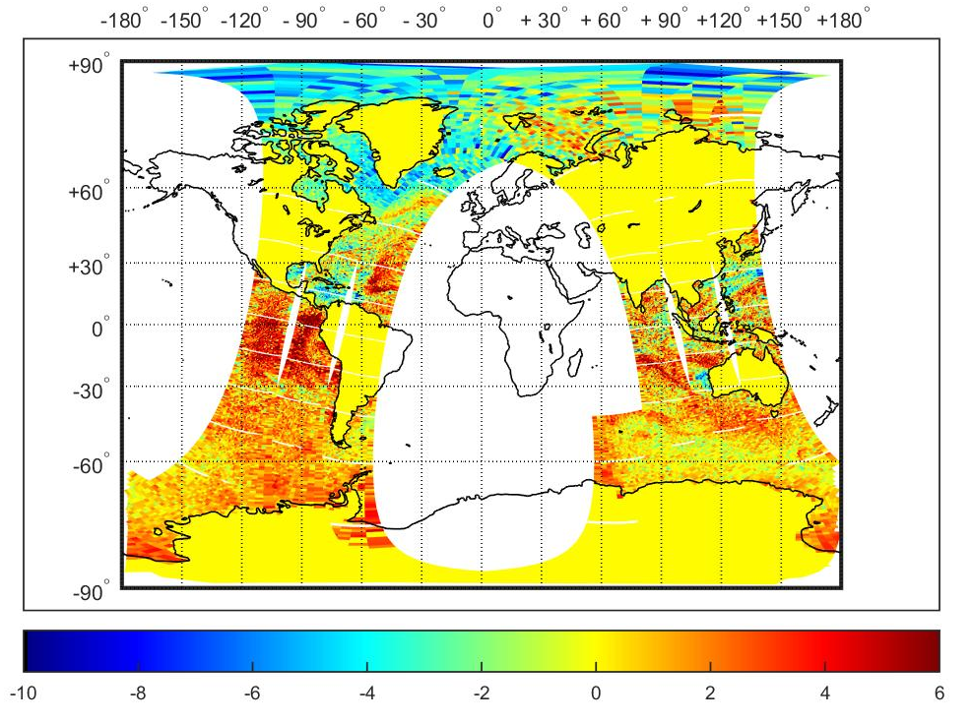
Distribution of RTTOV simulations and observed brightness temperature deviations (O-B) before and after the adjustment of deep space scan angle, respectively
After the DS observation angle adjustment, O-B deviation in area of the solar is consistent with that in other areas, the O-B bias abnormal is basically eliminated,
Global Distribution of Deviations between Observed and RTTOV Simulation (FOV3) Before and after Deep space scan Angle Adjustment

Slide 10
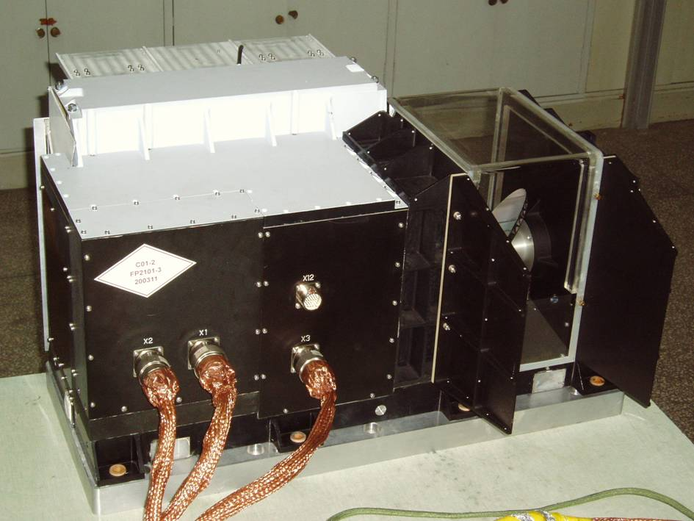
2. Recalibration for FY-3/IRAS
IRAS instrument:
Infrared Atmospheric Sounder
Onboard FY-3A/B/C since 2008.
20 thermal infrared channels of observation in range of 3.7~15 um , 6 NIR and VIS channels between 0.69~1.64 um.
Atmospheric temperature and water vapor retrieval .
NWP & Climate research.
Recalibration program object:
Build 10-year infrared sounder recalibration datasets (IRAS).
FY-3A 0.5 year, FY-3B 7 year, FY-3C 5 year
3 versions, V1, V2 and V3.
V1: system bias corrected. V2: calibrated data using fine recalibration model. V3: FCDR dataset, platform difference removed and grided products.

Slide 11
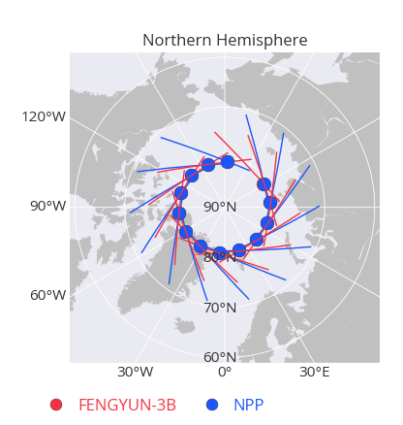
Calibration accuracy evaluation method and data
SNO method: FY-3B/C cross with Metop-A/IASI
SNO Pairing Method
Time Constrains:
10 minutes
Air Path Constrains
FOV 26-31 for iras
Distance constrains
5 km
Scene uniformity
IRAS: std/btm < 0.001
dataset
FY3B/IRAS 2012-2018 7 years
FY3C/IRAS 2014-2018 5 years

Slide 12
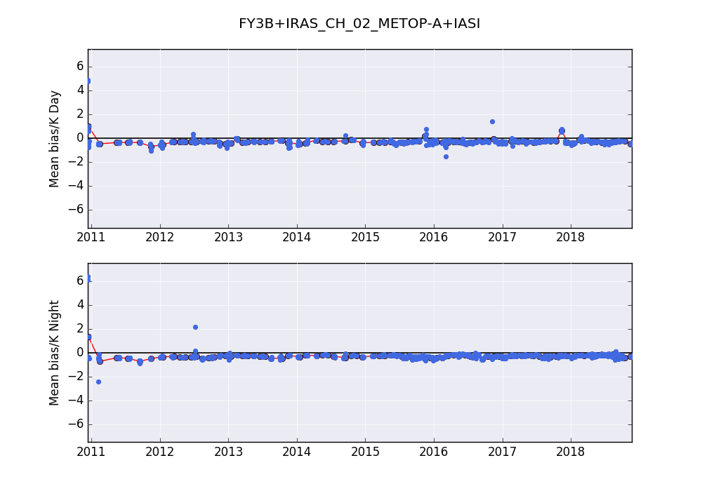
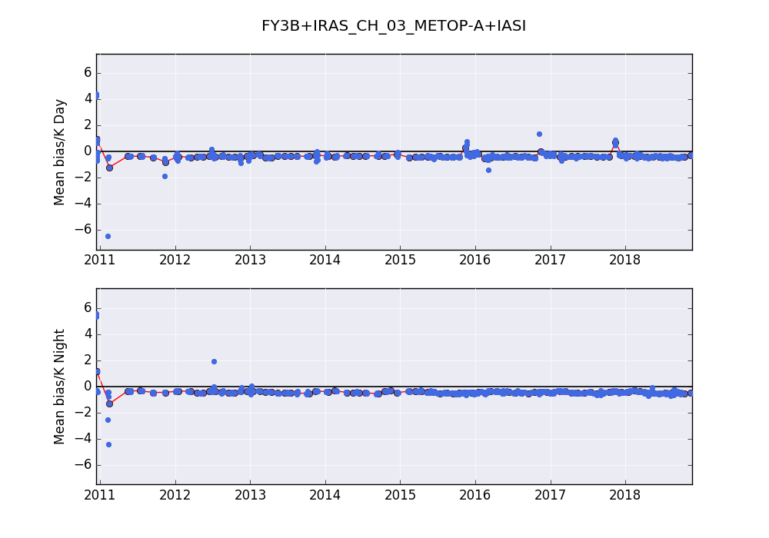
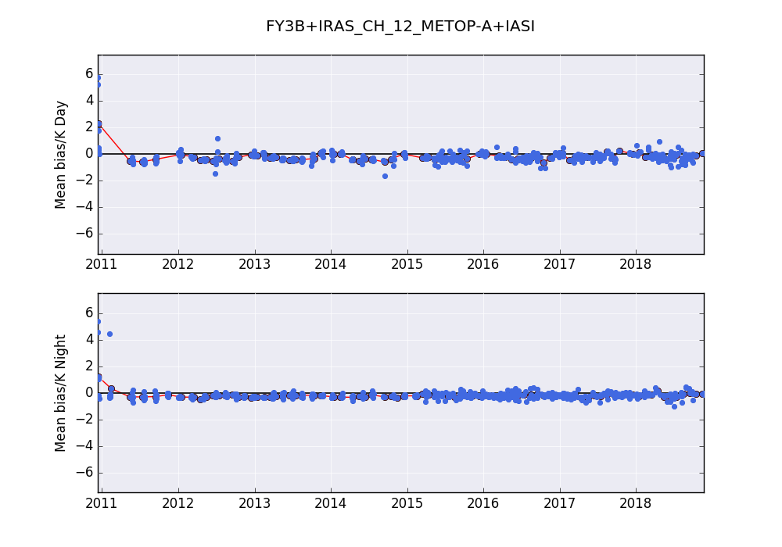
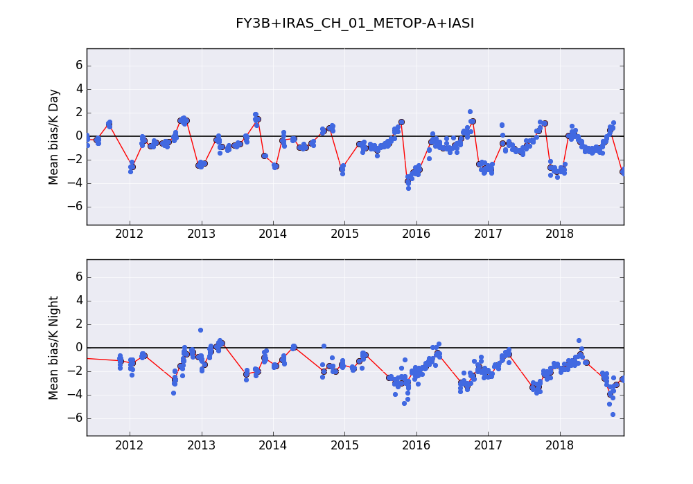
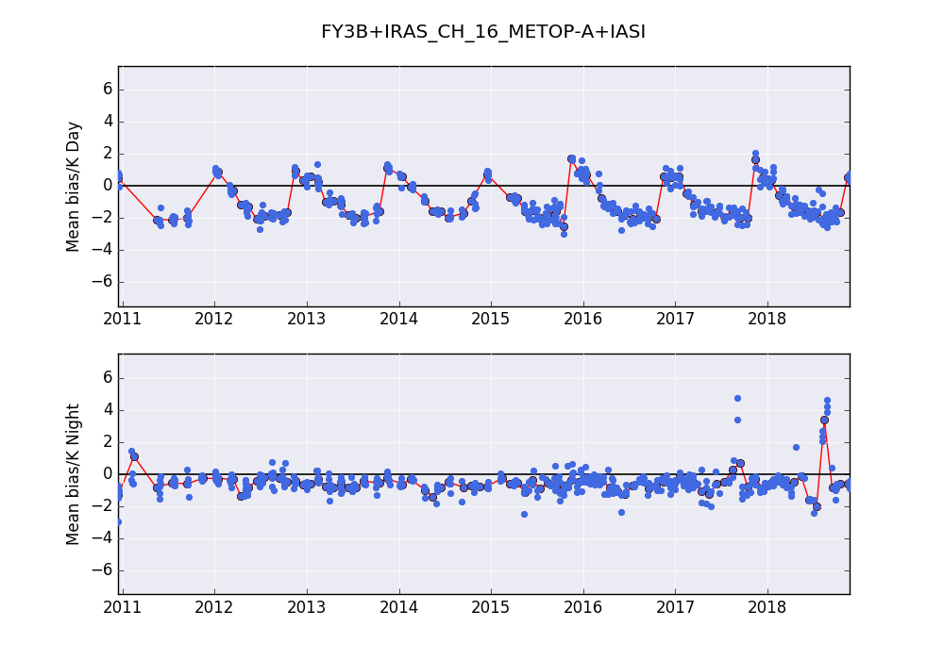
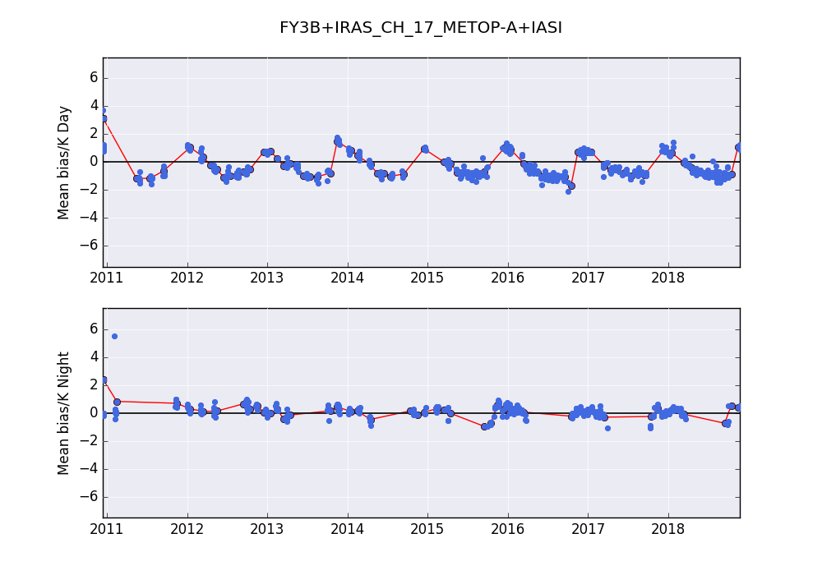
Most of channels bias within 1.0 K.
Absorptive channels show seasonal variation. Different characteristics in day and night time samples.
FY-3B/IRAS time series bias characteristics
Ch2 14.71um
Ch3 14.49um
Ch12 7.33um
Day time samples
Night time samples
Ch1 14.95um
Ch16 4.47um
Ch17 4.45um

Slide 13
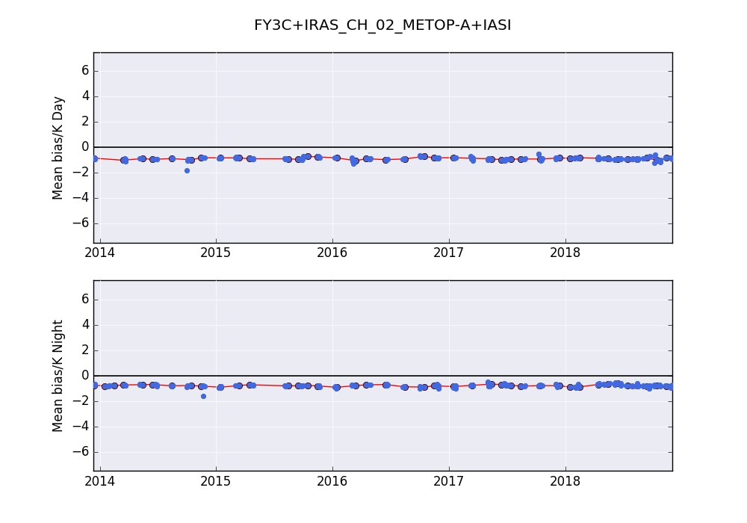
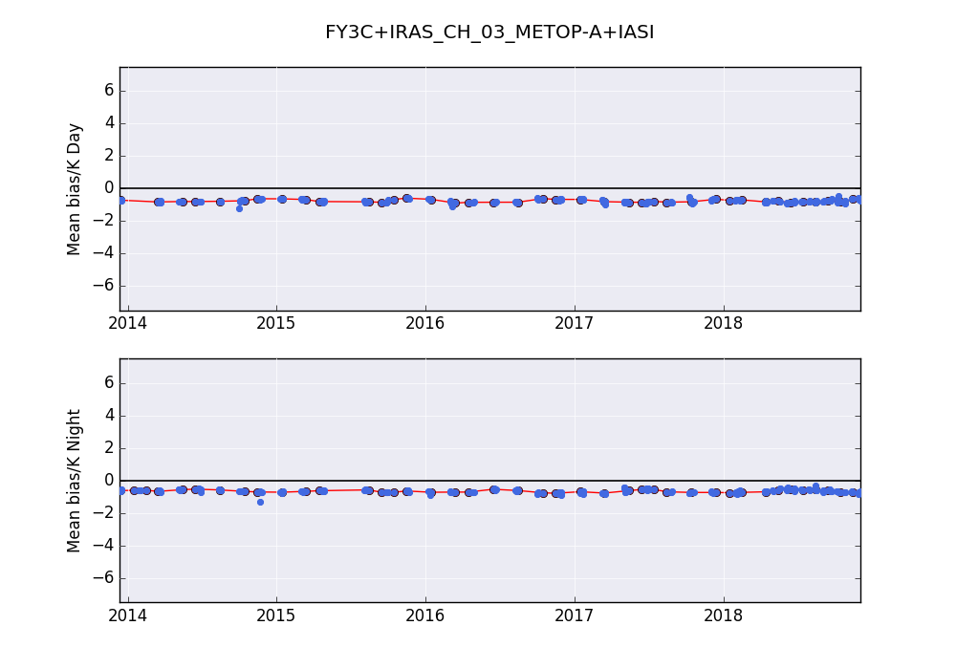
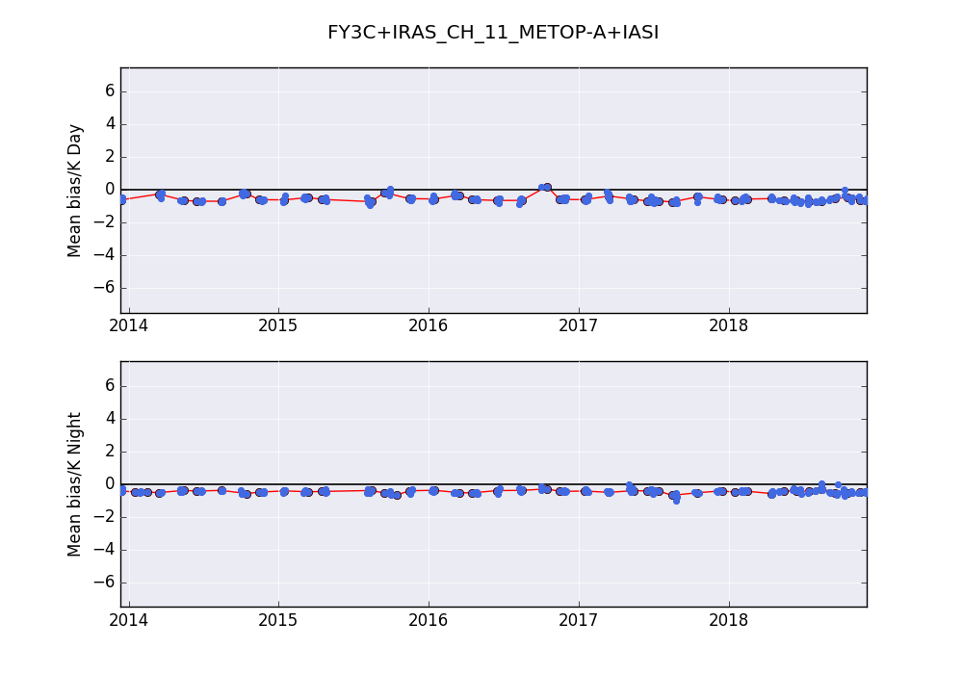
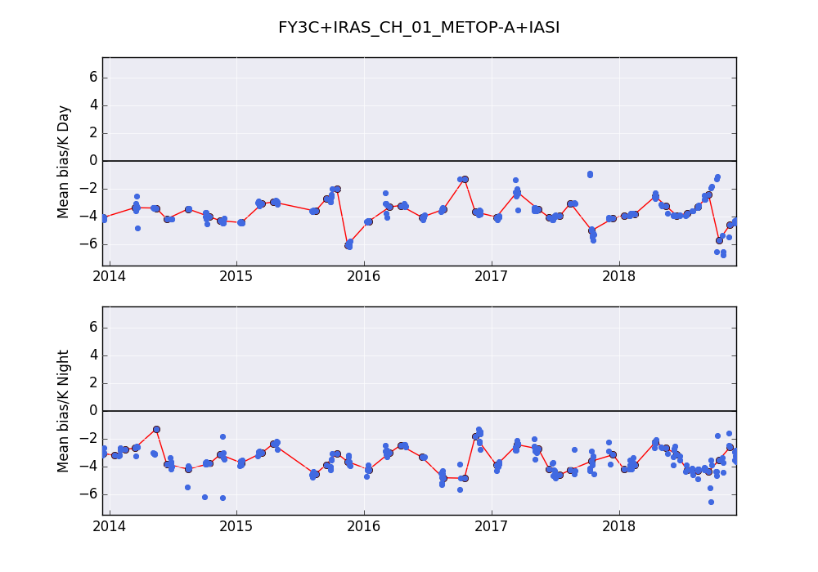
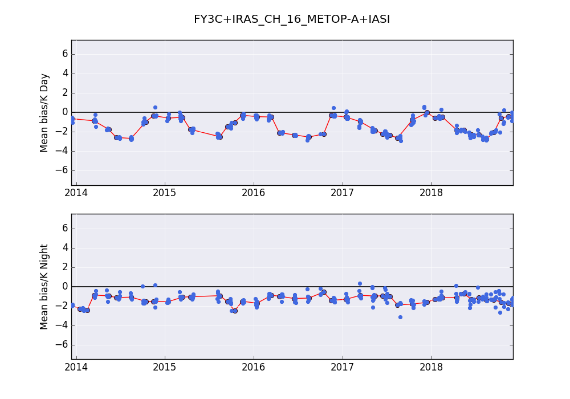
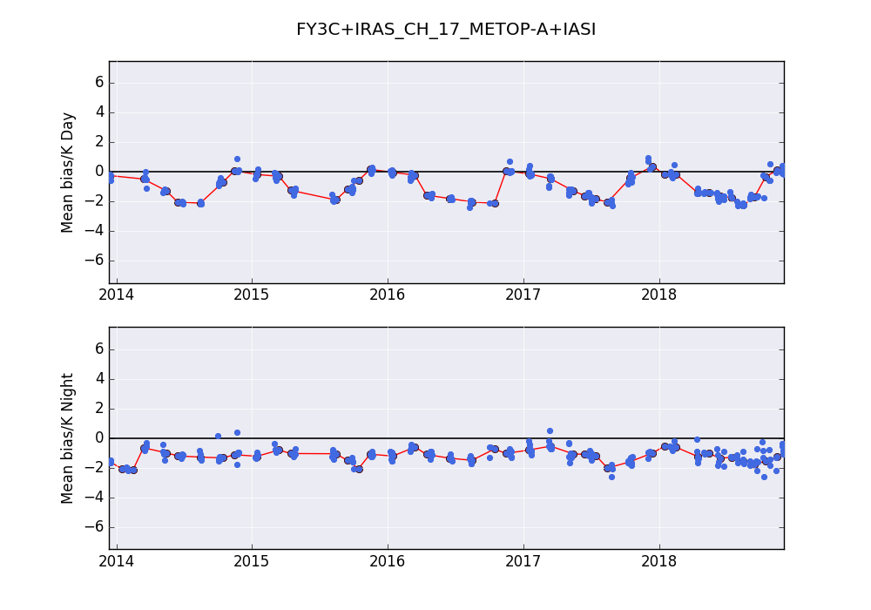
FY-3C/IRAS time series bias characteristics
Ch2 14.71um
Ch3 14.49um
Ch11 7.43um
Ch1 14.95um
Ch16 4.47um
Ch17 4.45um

Slide 14
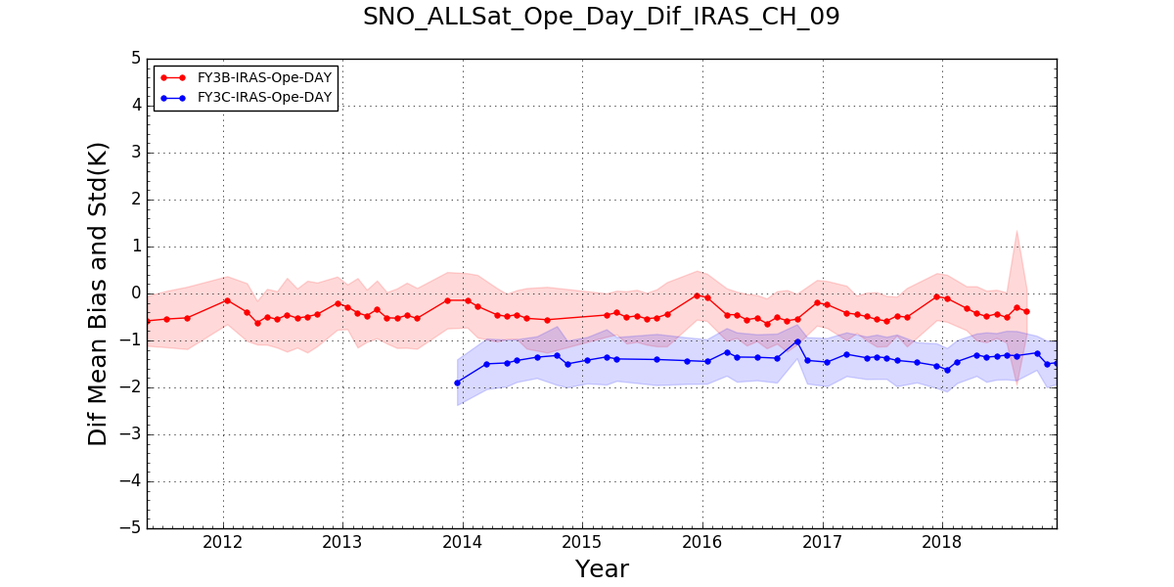
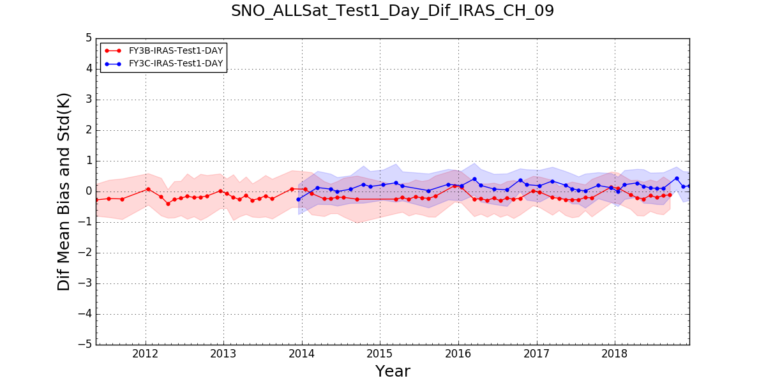
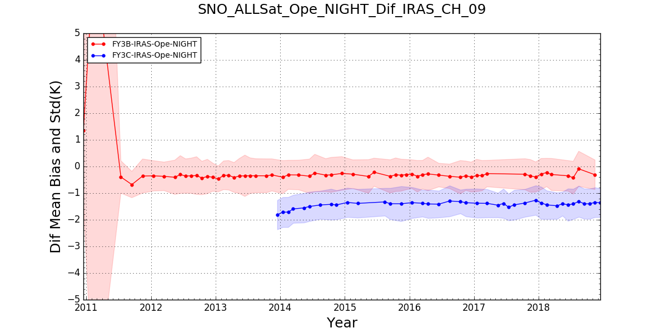
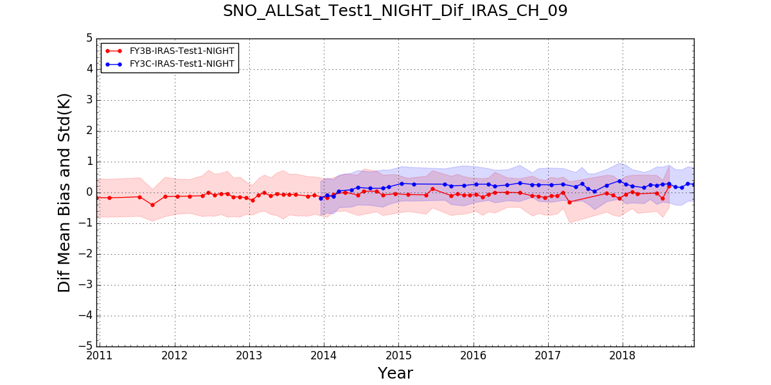
Operational Version
Test V1
Day time samples
Night time samples
Test version V1: system bias corrected based on IASI measurement, abnormal bias corrected due to code bugs.
Bias std are almost same from operational to test version datasets.

Slide 15
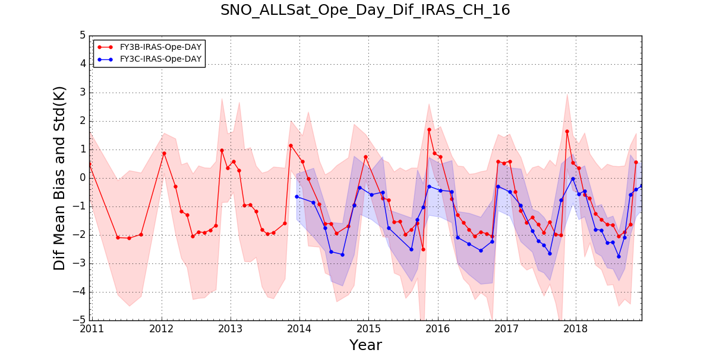
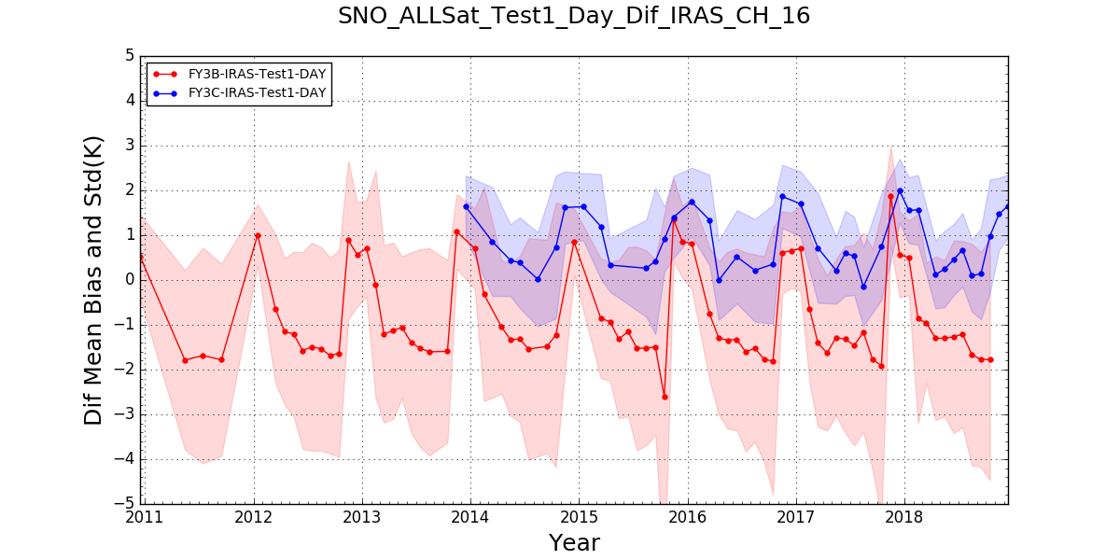
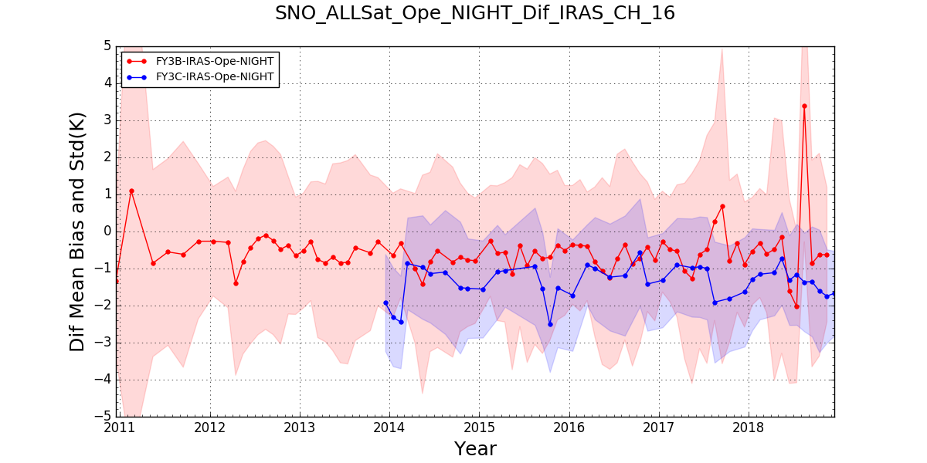
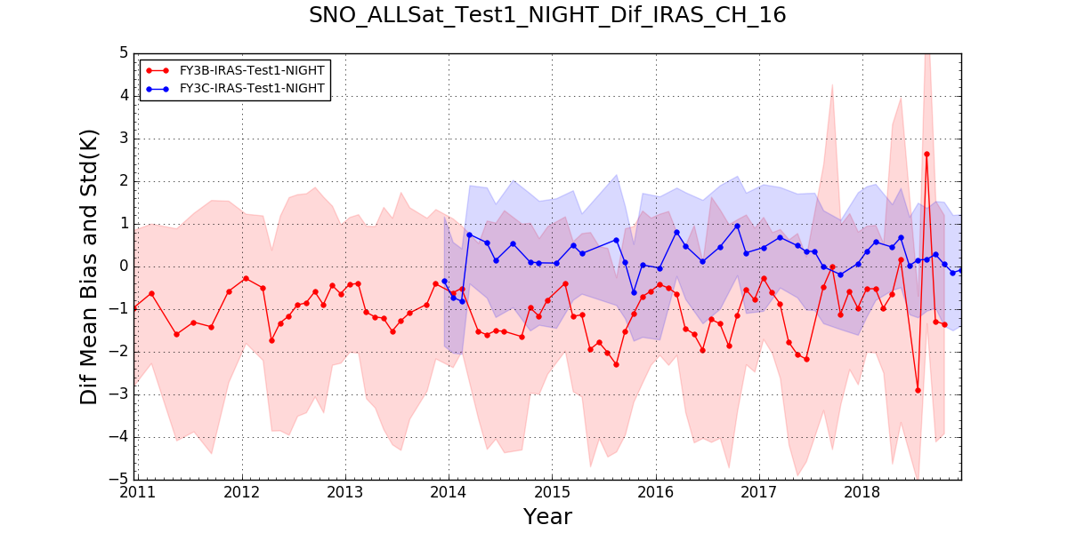
Operational Version
Test V1
Day time samples
Night time samples
Test version V1: Absorbing channels large system bias slightly corrected .
Bias std are almost same from operational to test version datasets.

Slide 16
3. Recalibration for FY-3/VIRR Thermal channels
Using Metop-A/IASI as reference, the historical bias of TE channels (@ 250K) are assessment based on SNO inter-calibration method.
10.8 um
VIRR-IASI
12 um
Systematic bias are showed on all VIRRs；
Inconsistency between different series;
Inconsistency between two channels on the same satellite ；
Strong seasonal variation;
Especially on FY-3A

Slide 17
Scene dependence of FY-3/VIRR
The bias's scene dependence of FY-3A/B (Jul. 2012) and FY-3C/VIRR (Dec. 2015)
FY-3A
Strong nonlinearly in FY-3A/VIRR:
10.8 um: on low temperature, VIRR is much cooler than IASI;
12um: on low temperature, VIRR is much warmer than IASI;
FY-3B
In-flight calibration method: Linear calibration and nonlinear correction
Nonlinear correction coefficients maybe changed in orbit, so the nonlinearity of TE bands is not described exactly, leading to bias’s scene dependence and seasonal variation;
FY-3A/VIRR: nonlinear correction based on GSICS
FY-3BC/VIRR: systematic correction based on GSICS
FY-3C

Slide 18
Nonlinear coefficient correction of FY-3A/VIRR based on GSICS
Ref.
Radiation
New nonlinear correction
Sample selection
Quadratic regression
New nonlinear coefficients
New FY Radiation
FY linear Radiation
Using new nonlinear coefficients on other sample data:
(Xu et al., 2014)
(Xu et al., 2014)
Before
10.8um
After
12 um
Before
After

Slide 19
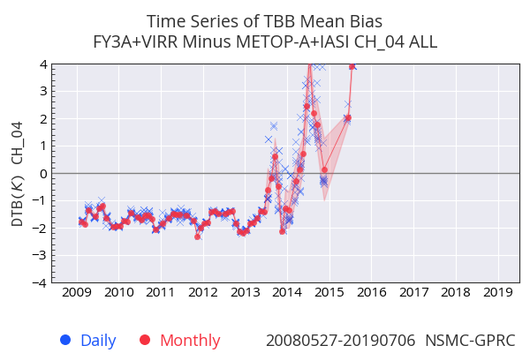
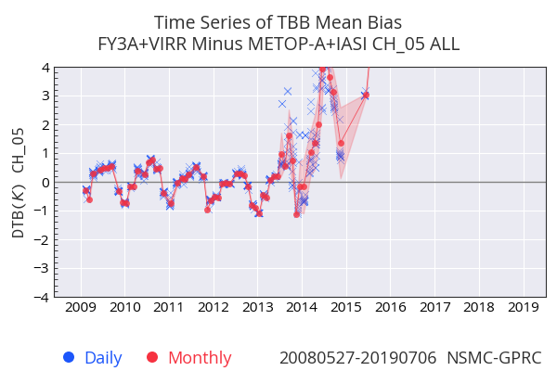
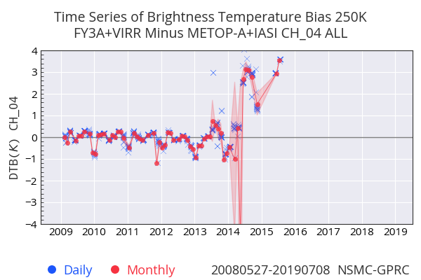
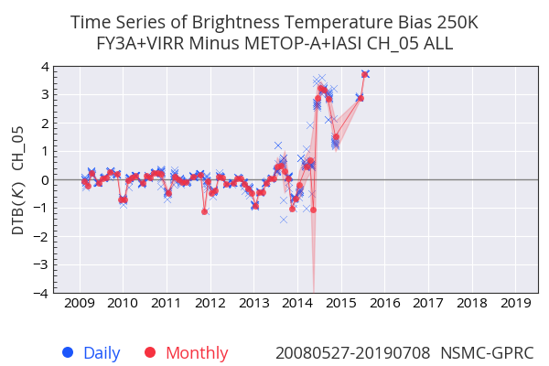
Correction result of FY-3A/VIRR
Before
10.8um
After
12 um

Slide 20
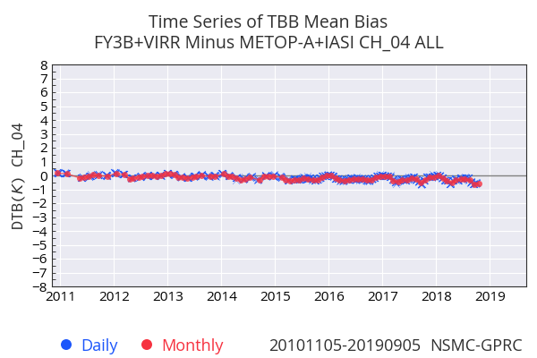
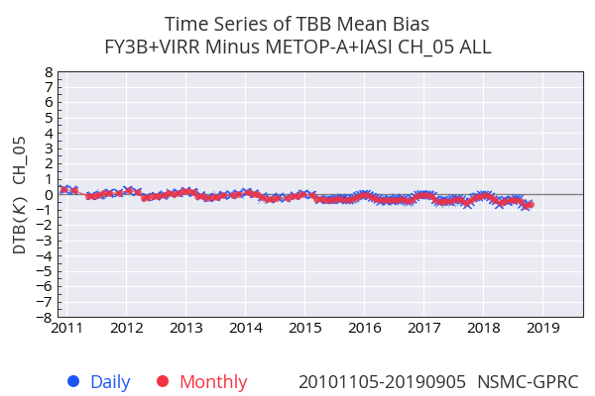
Systematic correction results of FY-3B/VIRR
Seasonal variation and nonlinearity are not strong at FY-3B;
Using SNO collocation samples to do systematic correction;
10.8um
Samples: using 2012 and 2013 SNO samples based on GSICS, Metop-A/IASI as reference;
Regression: Calculating corrected coefficients using linear regression;
After correction, the consistency between two TE channels are much more better;
12 um

Slide 21
Conclusion and future work
FY-3D/HIRAS is in stable operational status.
HIRAS MW and SW bands FOV3 solar contamination was eliminated by adjustment of cold space viewing angle from -71° to -87 °.
Long-term accuracy evaluation results are stable for much of channels of IRAS, except for strong absorbing ch1,13,14,15,16,17,18 and they present different seasonal variations for day and night time samples.
V1 IRAS and VIRR recalibration datasets generated and validated.
Future work will focus on the development of refined physical infrared recalibration model and V2 datasets.

