Slide 1
Monitoring SLSTR calibration using IASI: Updates
A. Burini I. Tomazic, T. Hewison

Slide 2
Introduction
Aim
To verify if SLSTR IR is meeting the performance requirements:
The absolute radiometric accuracy for data acquired by the IR channels shall be smaller than 0.2K, traceable to ITS-90.
As a minimum, this requirement shall be met in the blackbody temperature range (~250K - ~300K)
Objectives
To intercompare SLSTR with a stable and characterized reference sensor:
IASI is the GSICS reference sensor due to its stability and chracterisation
To follow GSICS methodology (Hewison, 2013)
Based on EUMETSAT study by University of Leicester: Radiometric Intercomparison of AATSR and IASI, 2013, C. Whyte, D. Moore and J. Remedios
Collaboration with FIDUCEO project (H2020), Merchant et al.

Slide 3
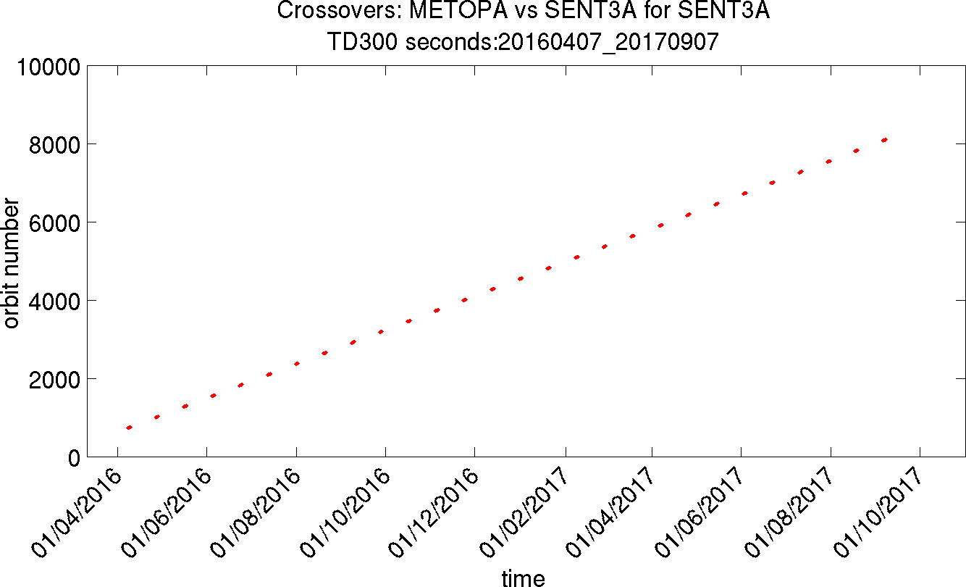
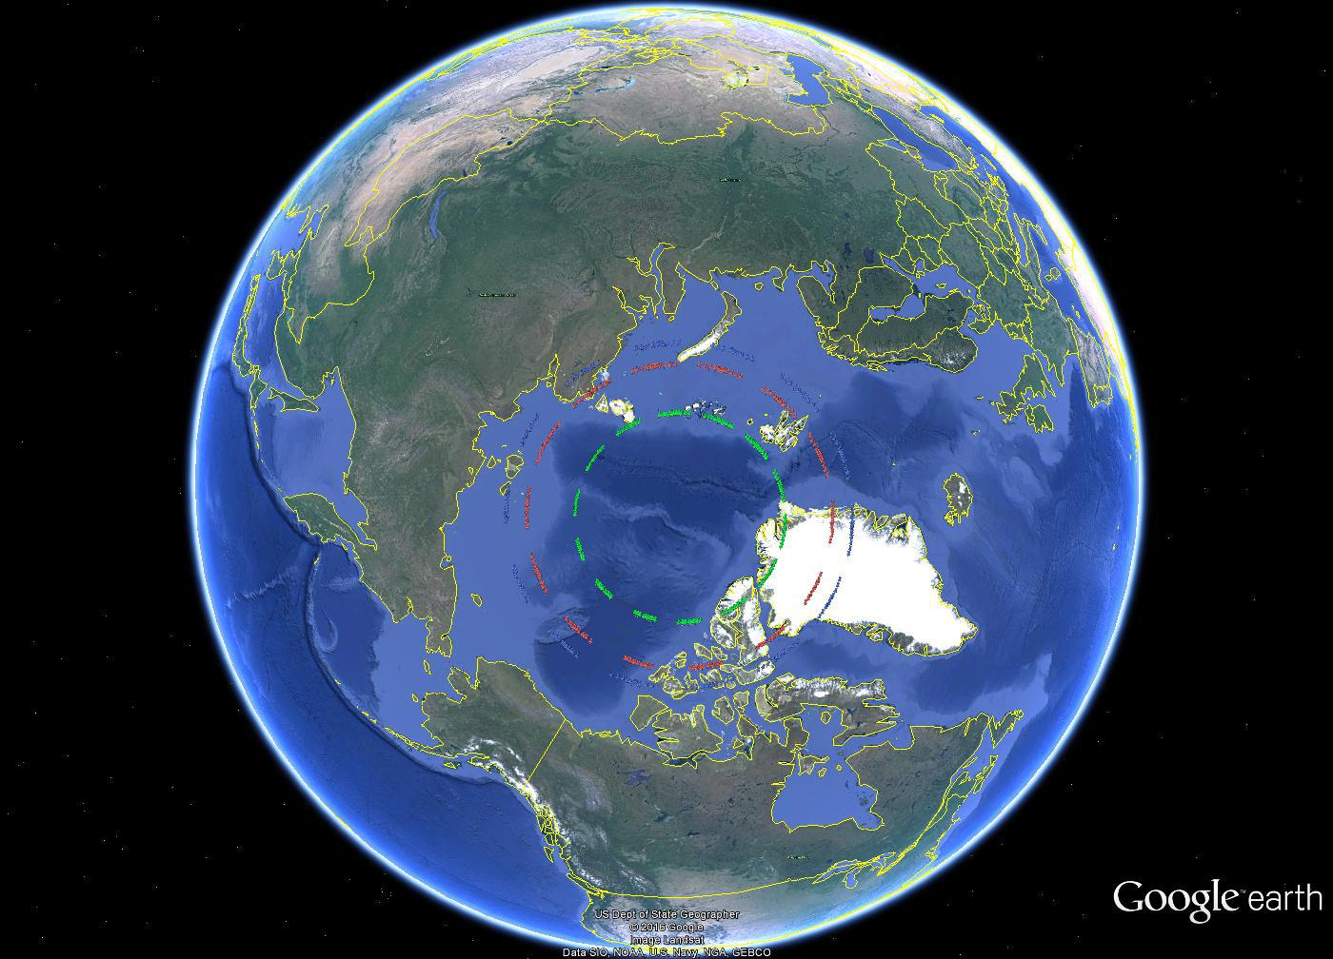
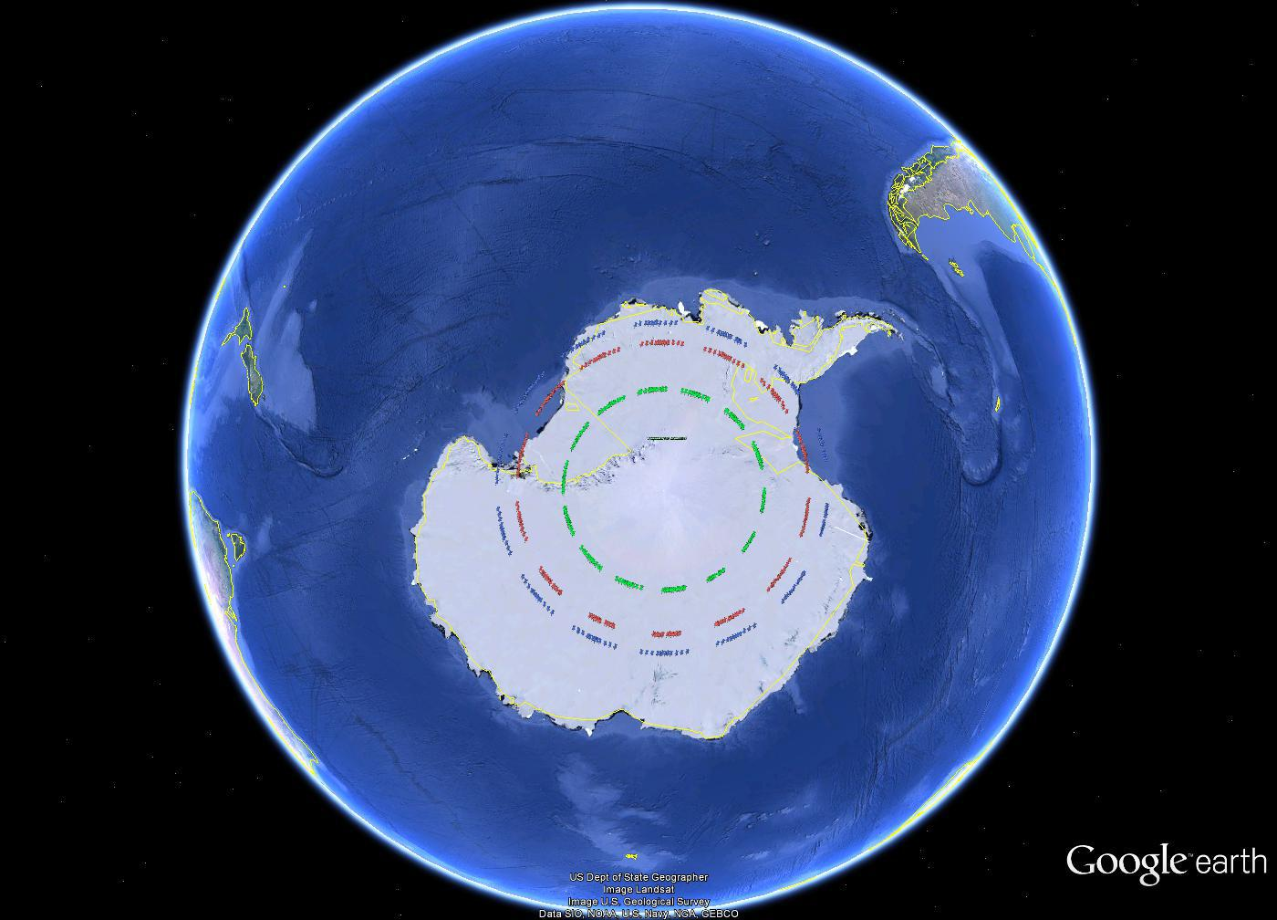
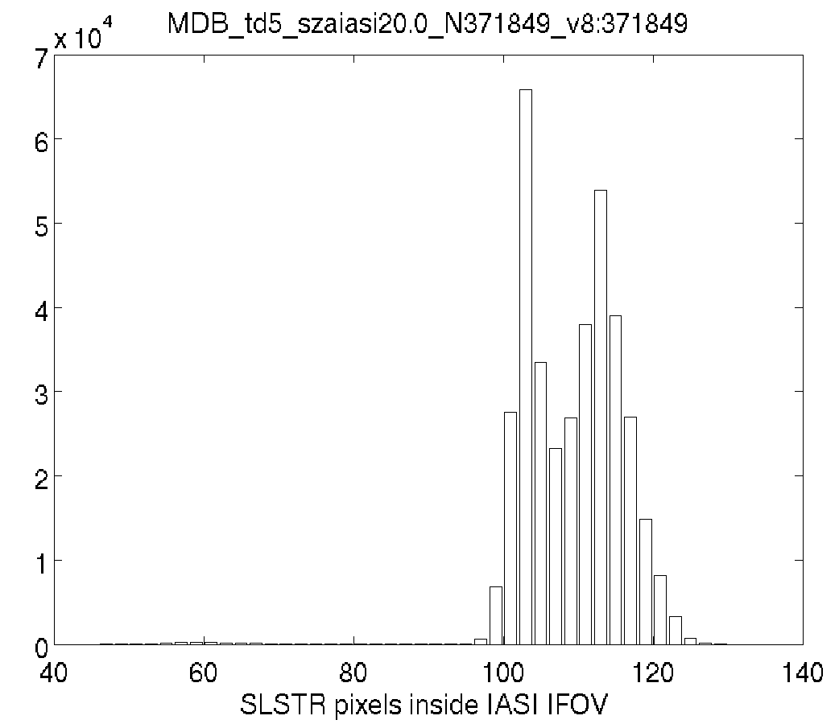
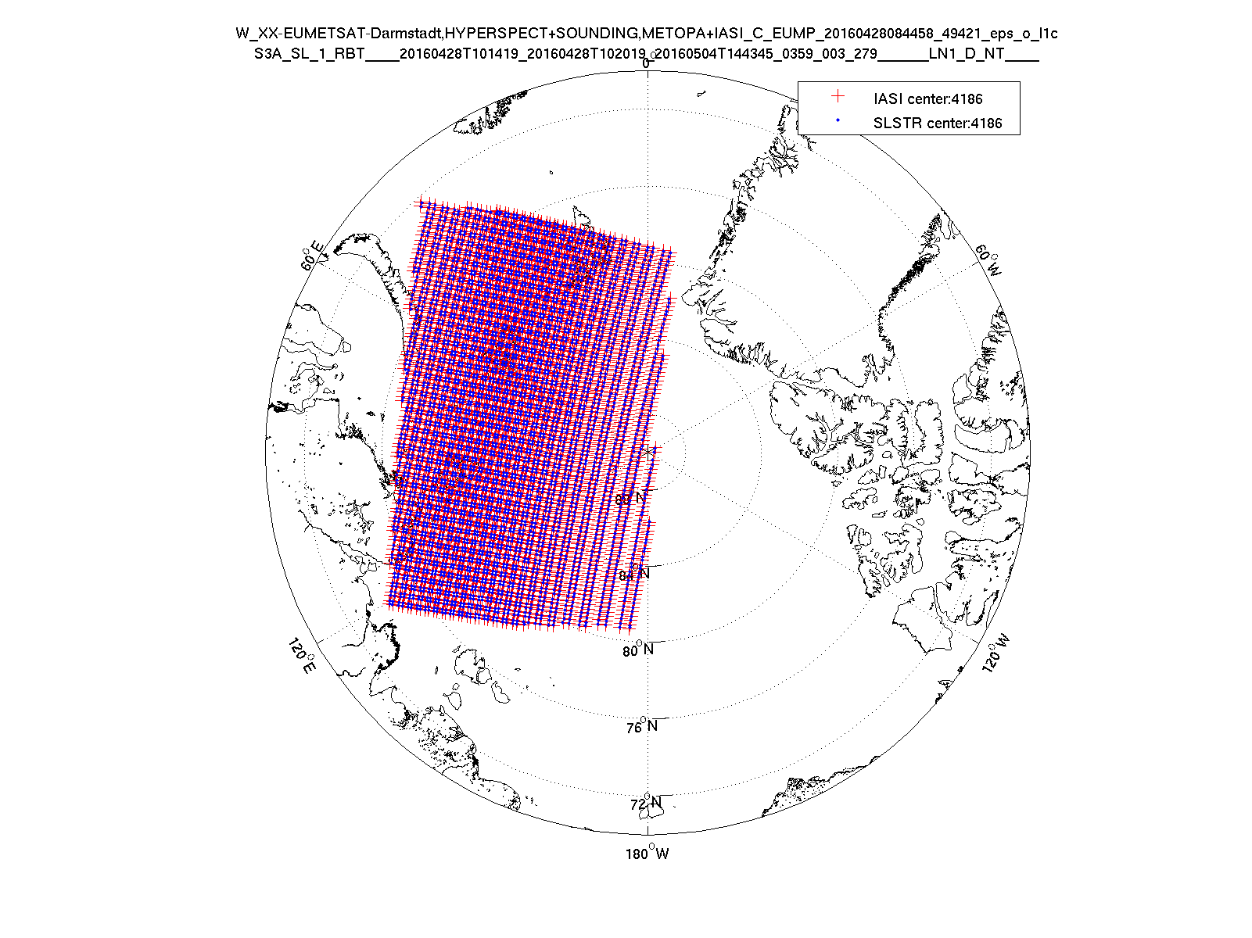
Previous Methodology
Crossovers (SNO)
SNO = simultaneous nadir overpasses
based on orbital model prediction
Each event last ~2 days with ~50 crossovers per SNO
Collocations (matchups)
spatio/temporal/geometry
Time: 5 min pixel time difference
Spatial: within pixel
Viewing angle: |Δsec(ϑ)/sec(ϑ)|<1% or |IASI SZA| < 20°
IASI IFOV estimated as ellipse
Spectral convolution
Convolve IASI radiance spectra with SLSTR SRF
SLSTR SRF v2014
S7 (3.7 µm) requires gap filling approach – incomplete IASI spectral coverage
Aggregate (average)
SLSTR pixels in IASI FoV
Green – true collocation; blue – time of collocation + 3 min; red – time of collocation – 3 min
Limited to pole regions → temperature range ~200 K - 280 K

Slide 4
SLSTR – IASI: MIMICS Development
EUM started to prototype a new multi-mission environment for the calibration and monitoring of Level1 products. MICMICS
SLSTR-IASI is the first branch to be prototyped and integrated in the new environment, where data access, processing and reporting are fully integrated
Objective:
To solve the collocation problem in a general and fast way
To create an infrastructure for the operational monitoring of IR sensor with IASI
To extend the collocation criteria outside the polar region
To ready for future missions
To identify and test a “gap filling” method for S7 (extends beyond IASI shortwave limit of 2760cm-1)

Slide 5
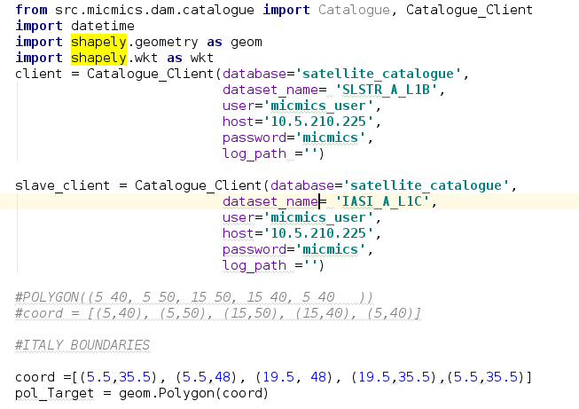
Data Access as a Service in MICMICS
Mysql
IASI-C
MYSQL is doing the actual job of handling the temporal and geographical data type
IASI-B
IASI-A
OLCI-B
DAM has 2 main options:
--init-catalogue: initiate the mysql tables
--update-catalogue: harvest and update the fbf repository
OLCI-A
DAM is running 4 times a day
Python DAM API
SLSTR-B
SLSTR-A
Working Code for querying SLSTR data from fbf overpassing a user defined Region of Interest

Slide 6
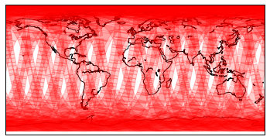
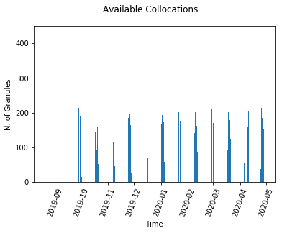
Data Access as a service - MICMICS
Cataloguing of data
Daemon tool to perform cross query:
Identification of Potential Candidates
Overlap Criteria can be customized (percentage of overlapping polygons)
Tool Completely de-coupled from the processing:
To speed up the pre-collocation process
It can be re-used for other processes
Collocation Archive for SLSTR-A/ IASI-B

Slide 7
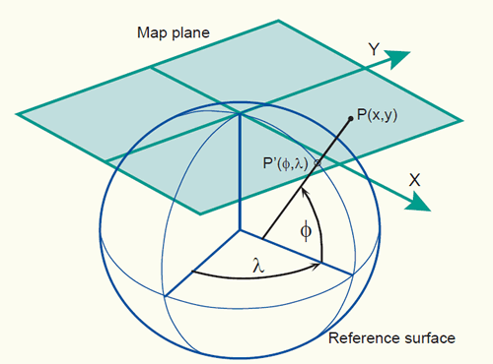
A Generic Collocation Approach
Orthographic projection
To make re-use of well tested and broadly accepted libraries for geographic projection, aiming to minimize the distortion of data
Collocation between sounding sensors and Imaging sensor is then automatically achieved (same reference system) = DATA CUBE
The collocation is done at “granule” level (or at scenario level ) in order to be easily parallelized over several nodes. (it can still be applied in the GEO disk)
Projection in a common reference grid.
Oblique Mercator
Transversal Mercator

Slide 8
Example: SLSTR-IASI [LEO-LEO]
Through the DAM, two overlapped granules of SLSTR and IASI have been selected (no true SNO, only geographical match)
IASI FOV is calculated (~2 sec/granule). Each FOV can be considered a “shape” in the GIS terminology.
For this particular case, the collocation problem can be summarized as “finding an efficient way of overlapping a shape (fov) over a raster (image). (this is a typical GIS application )
The first step is to have a common reference system between the two product
The processing steps can be summarized as:
IASI FOV Computation (~2s)
Projection of Master (SLSTR) [PROJ4 + pyresample] (~5s for 2500x2500 image)
Projection of Slave (IASI) [PROJ4 + shapely] (~1 s)
Rasterisation of Indices [rasterio] (~20s)
Extraction of statistics [numpy] (~10s)

Slide 9
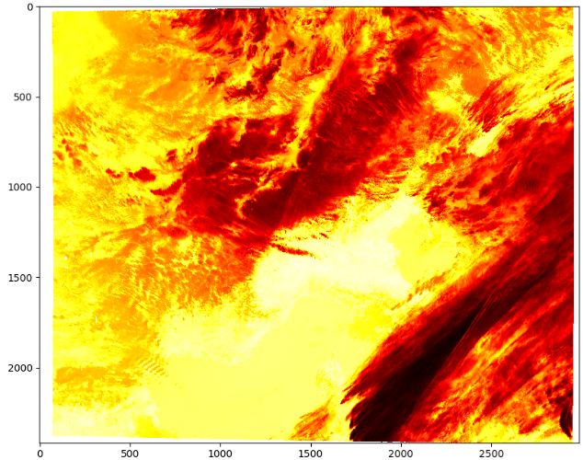
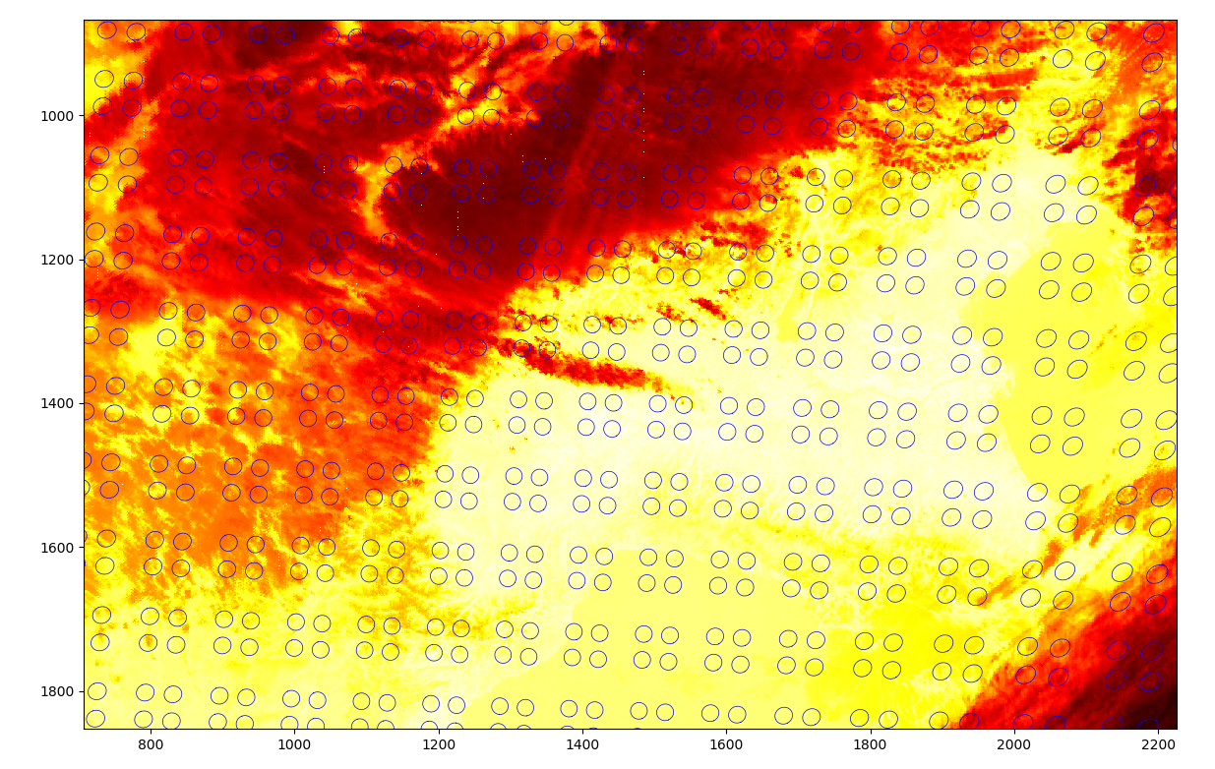
Example: SLSTR-IASI [LEO-LEO]
Target Scenario Projection [Oblique Mercator | Ortographic]
Once SHAPE and RASTER are projected onto a common reference space, it is easy to work directly in IMAGE COORDINATES (indices).
Based on [PROJ4 – Shapely (intersection)]
This process takes less than 10s.

Slide 10
Example: SLSTR-IASI [LEO-LEO]
SLSTR Pixels within IASI FOV
SLSTR Pixels Mean Value within IASI FOV
SLSTR Pixels StdDev Value within IASI FOV
Original Indices are kept, so in principle it is still possible to perform the collocation directly in the original L1 grid. Tests are still on going.

Slide 11
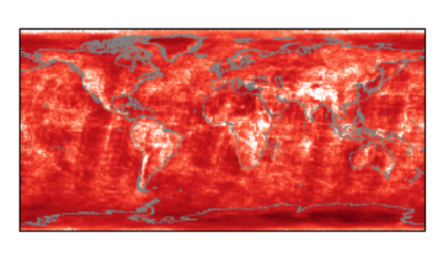
Analysis of Results
Status:
Thresholds on several combination of parameters being tested
Uncertainty-based metrics are being defined to optimise them
Possibility of analysis of data over land/sea and during night/day overpass
Collocations can be retrieved outside the tropical areas.
Filtering by land/sea mask is possible

Slide 12
Status on the Analysis
dataset.reset_filter()
dataset.filter_data(field='solzen', operator='<', value=90)
dataset.filter_data(field='fov_stdev_bt', operator='<', value=0.4)
dataset.filter_data(field='time_diff', operator='<', value=600)
dataset.filter_data(field='ref_zen', operator='<', value=20)

Slide 13
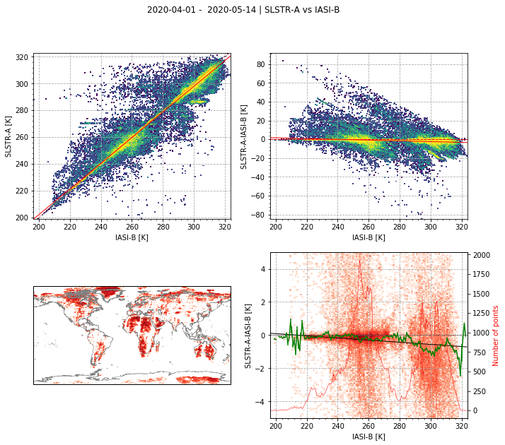
Status on the Analysis
dataset.reset_filter()
dataset.filter_data(field=land_sea_mask', operator=‘=', value=1)
dataset.filter_data(field='solzen', operator='<', value=90)
dataset.filter_data(field='fov_stdev_bt', operator='<', value=0.4)
dataset.filter_data(field='time_diff', operator='<', value=600)
dataset.filter_data(field='ref_zen', operator='<', value=20)

Slide 14
Status on the Analysis
dataset.reset_filter()
dataset.filter_data(field=land_sea_mask', operator=‘=', value=0)
dataset.filter_data(field='solzen', operator='<', value=90)
dataset.filter_data(field='fov_stdev_bt', operator='<', value=0.4)
dataset.filter_data(field='time_diff', operator='<', value=600)
dataset.filter_data(field='ref_zen', operator='<', value=20)

Slide 15
Conclusions
Prototype for monitoring SLSTR calibration with IASI as reference has been developed.
Analysis of results is still on-going, several filtering parameters are being evaluated
Analysis of Oblique view is possible, but not being assessed for the moment
Software is stable and producing results for SLSTR A/B vs IASI/A/B/C
Once a metric for results will be consolidated, the monitoring will be put into operations.
Future plans:
to include the Geo Scenario
Gap Filling to include S7 channel – The software has been designed to be used with gap filling method, once this will be consolidated.

