Slide 1
Issues with use of IASI to inter-calibration 3.9µm band
Tim Hewison (EUMETSAT)
Ali Mousivand
Alessandro Burini
Dorothée Coppens

Slide 2
Overview
Radiance – BT conversion issues
Comparison of IASI inter-calibration results for SLSTR 3.7µm v SEVIRI 3.9µm
Linearity – towards a v2 GSICS algorithm?
IASI noise for cold scenes
“Gap-filling” to Extend IASI spectra
Hot Land bias issue

Slide 3
Use of Radiance/BT
Best to do all processing of IASI data as radiances
and only convert to BT at the last step
to communicate the results to users.
If radiometric noise on cold scenes causes some observations to have negative radiances,
these will be cancelled out by others with positive noise
This would not be possible if converting to BT first

Slide 4
Application of GEO-LEO IR v1 to Cold Scenes
We have not optimised the current GSICS inter-calibration algorithms for very cold scenes
Typically infrared imagers are calibrated in radiances, rather than brightness temperature.
cold scenes have very little energy in, but Planck function amplifies small radiance changes when converting to BT
This results in much higher noise and quantisation issues for very cold scenes (e.g. DCCs) in BT
The quantisation effects may not always be obvious in BT-space depending on how the calibration is applied
Most infrared imagers use deep space as a cold calibration reference and an on-board black body as a warm reference
As DCCs have IR radiances close to zero, their calibration should be good…
…. unless there is some contamination of the space view (e.g. stray light, stars, …)
Through GSICS we seek to check for potential biases by performing routine inter-comparisons with other instruments (e.g. IASI, CrIS,…) –
although, again this is more difficult for these cold scenes due to the sparsity of collocation data and its high variability (see Hewison, 2013)
nonlinearity is typically characterised on ground pre-launch
but may be checked on orbit (e.g. by heating the black body)
Can we further optimise current GSICS GEO-LEO IR inter-calibration algorithm for cold scenes?
e.g. using the BT-slicing analysis method to give more uniform coverage over the dynamic range

Slide 5
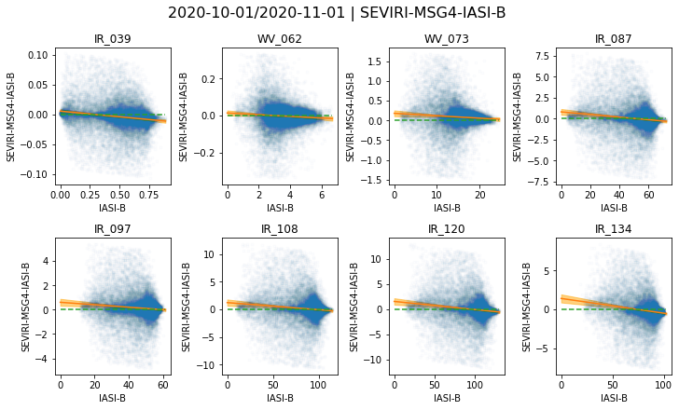
Example SEVIRI & IASI radiance regression
Night-time only
No hot land issue
No 3.9µm solar
Many channels show non-zero Offset term
Few + noisy cold collocations
Non-physical
Not seen in operational GSICS processor
Ongoing investigation
Only 3.9µm channel provides many collocations at very low radiance scenes
Scatterplots of collocated radiances from new prototype MICMICS processor for SEVIRI-IASI.
Blue points show collocated radiances (mW/m²/sr/cm⁻¹)
Orange lines show weighted radiance regression, following GSICS GEO-LEO algorithm v1
Orange Shaded areas show uncertainty on weighted regression, amplified by 10 (k=10)

Slide 6
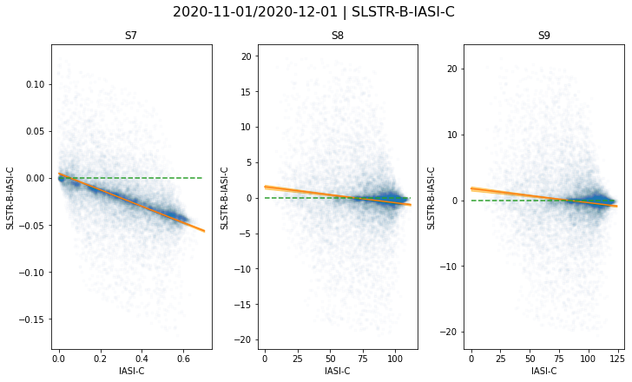
Example SLSTR & IASI radiance regression
Night-time only
No hot land issue
No 3.7µm solar
10-12µm channels show non-zero Offset term
Few + noisy cold collocations
Non-physical
Ongoing investigation
Only 3.7µm channel provides many collocations at very low radiance scenes
Scatterplots of collocated radiances from new prototype MICMICS processor for SLSTR-IASI.
Blue points show collocated radiances (mW/m²/sr/cm⁻¹)
Orange lines show weighted radiance regression, following GSICS GEO-LEO algorithm v1 (max_sec_zen<0.05)
Orange Shaded areas show uncertainty on weighted regression, amplified by 2 (k=2)

Slide 7
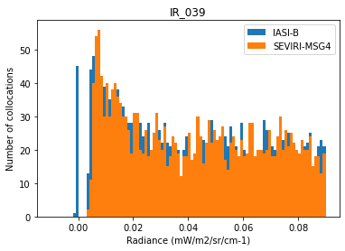
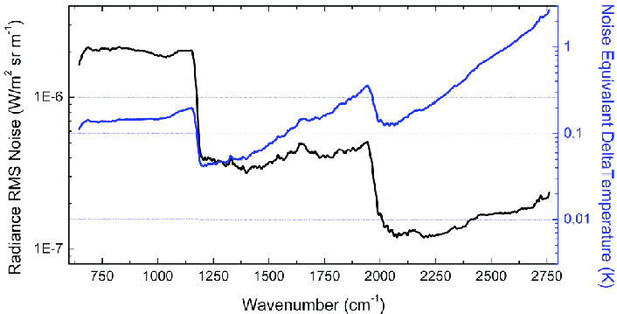
Example SEVIRI-IASI 3.9µm cold radiances
Zoom on 3.9µm Collocations for cold scenes:
Few pixels with small negative radiance
with low SD (<0.001 mW/m2/sr/cm-1)
Probably residual from gap-filling zeros
IASI Noise
Usually expressed at 280K BB
SW: ~2e-7 W/m2/sr/m-1 ~0.022 mW/m2/sr/cm-1
SD(L[IR3.9])= 0.017 mW/m²/sr/cm⁻¹ (next slide)
Divided by ~√1452 channels: ~0.00055 mW/m2/sr/cm-1 cf Hewison, 2013: ~0.00076 mW/m2/sr/cm-1
Is it lower for Cold scenes?
collocated radiances SD<<0.001 mW/m2/sr/cm-1
individual channels can have negative radiance
But average over the ~1500 channels that cover the SEVIRI IR3.9 SRF is unlikely to be negative
From Clerbaux et al 2009:
DOI: 10.5194/acp-9-6041-2009

Slide 8
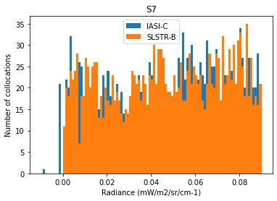
Example SLSTR-IASI 3.7µm cold radiances
Zoom on 3.7µm Collocations for cold scenes:
Few pixels with small negative radiance
with low SD (<0.001 mW/m2/sr/cm-1)
Probably residual from gap-filling zeros
IASI Noise
Usually expressed at 280K BB
SW: ~2e-7 W/m2/sr/m-1 ~0.022 mW/m2/sr/cm-1
Divided by ~√1452 channels: ~0.00055 mW/m2/sr/cm-1 cf Hewison, 2013: ~0.00076 mW/m2/sr/cm-1
Is it lower for Cold scenes?
collocated radiances SD<<0.001 mW/m2/sr/cm-1
individual channels can have negative radiance
But average over the ~1000 channels that cover the SLSTR S7 SRF is unlikely to be negative
Negative radiance in convolved IASI collocations
Likely to be due to PCA gap-filling
Applied to erroneous zero radiance collocations

Slide 9
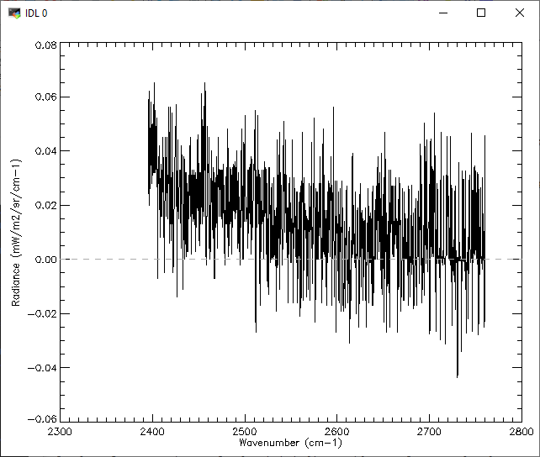
Take the lowest IR3.9 radiance collocation
Plot portion of IASI radiance spectrum covered by SEVIRI IR3.9
For coldest collocation
Without any gap-filling
Average NEdL across IR3.9 band:
SD(L[IR3.9])= 0.017 mW/m²/sr/cm⁻¹
Convolved with SRF
ΣLS= 0.0162 mW/m²/sr/cm⁻¹
If negative radiances set to zero:
Σ(L>0)S= 0.0178 mW/m²/sr/cm⁻¹
(10% higher)
Negative IASI radiances should not be filtered before convolution!

Slide 10
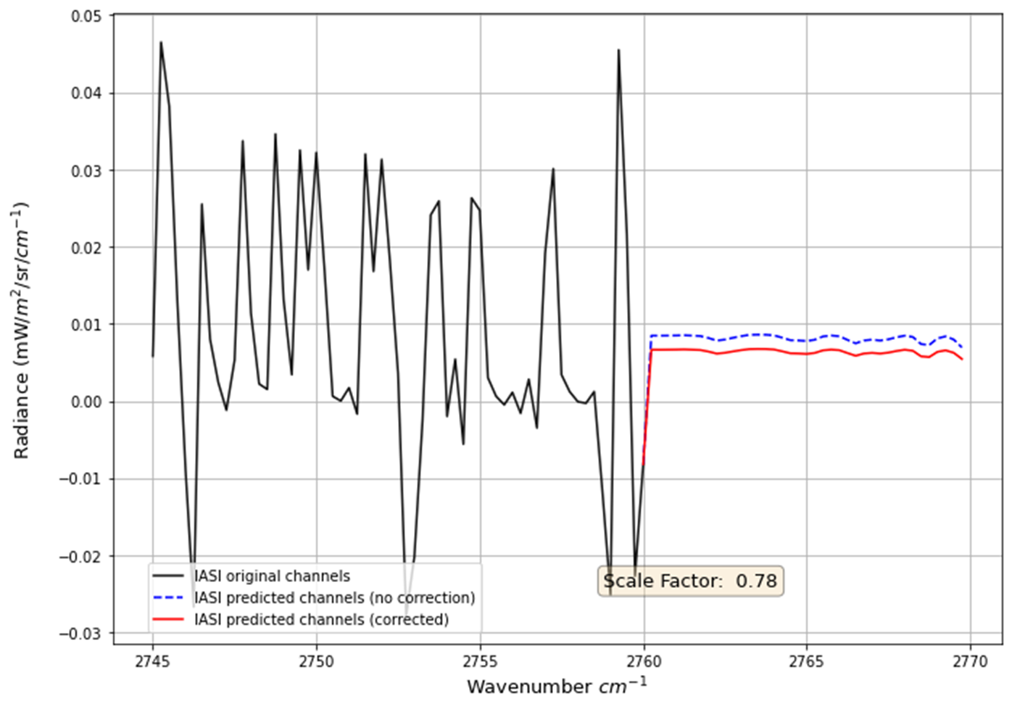
PCA-based Gap-filling applied to cold scene
How does PCA-based gap-filling work for noisy cold scenes?
Method acts like a smoothing function on the gap channels
peaks and dips are filtered out
Seemingly, in such cases the scale factor correction is not necessary

Slide 11
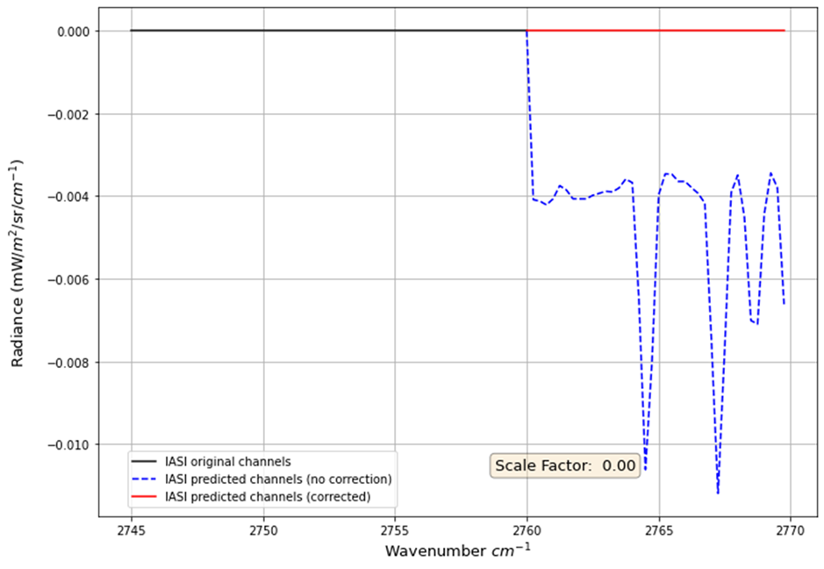
PCA-based Gap-filling applied to zero radiance
What happens when PCA-based gap-filling applied to zero radiance scenes?
Method introduces small negative bias
May explain negative collocation radiances

Slide 12
Overview
Radiance – BT conversion issues
Comparison of IASI inter-calibration results for SLSTR 3.7µm v SEVIRI 3.9µm
Linearity – towards a v2 GSICS algorithm?
IASI noise for cold scenes
“Gap-filling” to Extend IASI spectra
Hot Land bias issue

Slide 13
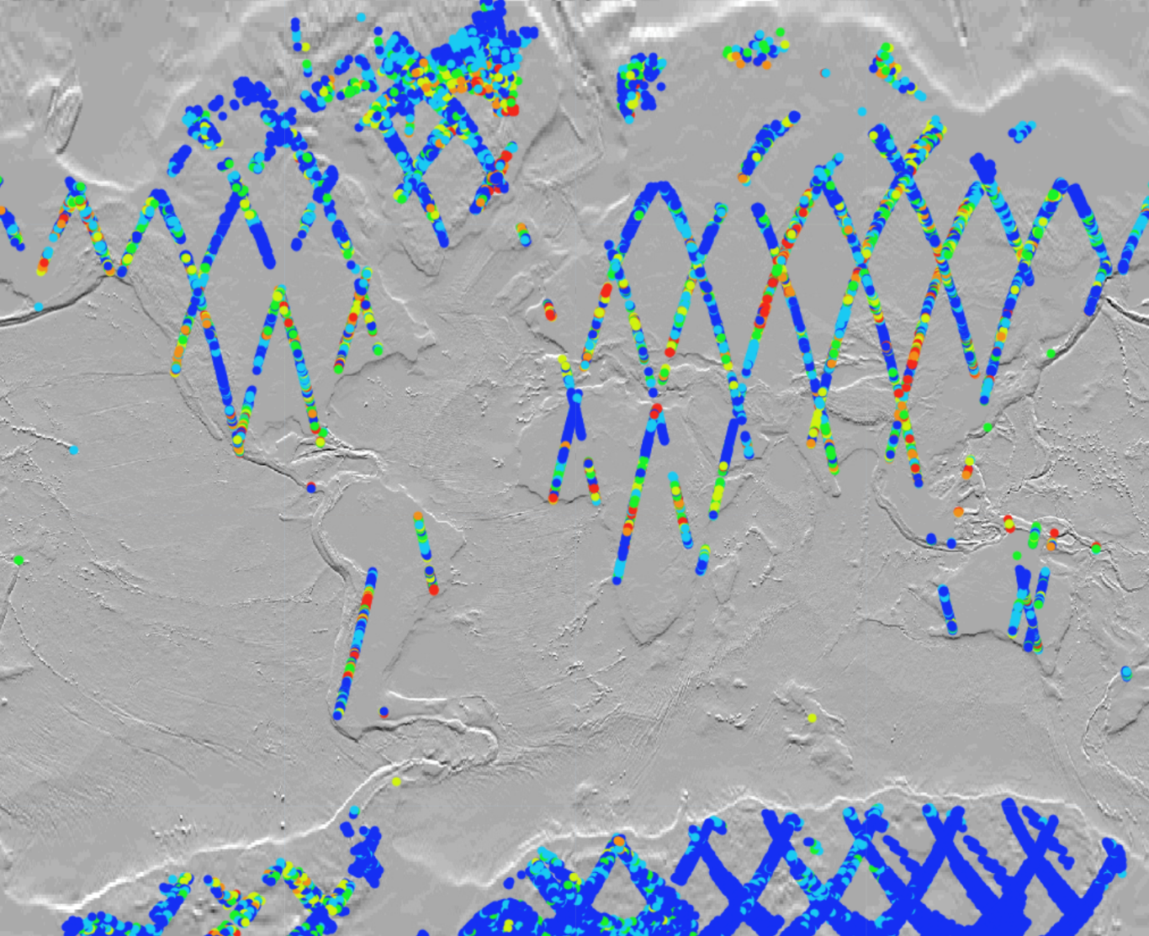
Hotland bias problem
Significant bias (up to 5K) is seen between IASI and SLSTR collocated points over land
Seemingly, the bias is larger over high lands
Bias (K)
0-1
1-2
2-3
3-5
5-8
>8
Notes:
optically homogeneous areas: areas that show no significant change in their reflectance over time

Slide 14
Hotland bias problem
IASI-SLSTR collocation points from 2020-06-11
Total of 16,860 points over land selected, given that:
Time difference between IASI and SLSTR < 300
Secant of zenith angle difference between IASI and SLSTR < 0.010
NDVI, Elevation, Slope and aspect are examined

Slide 15
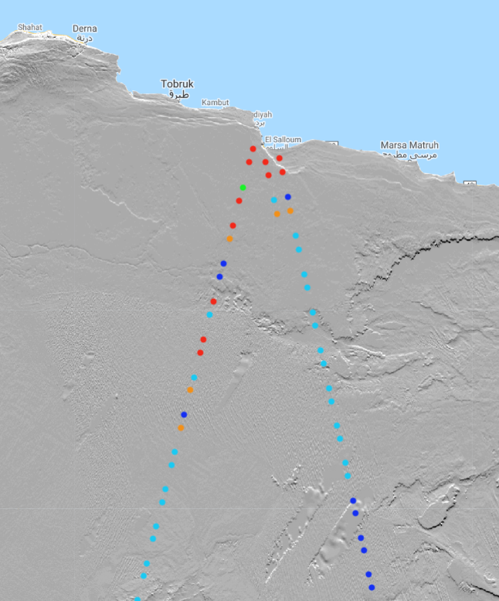
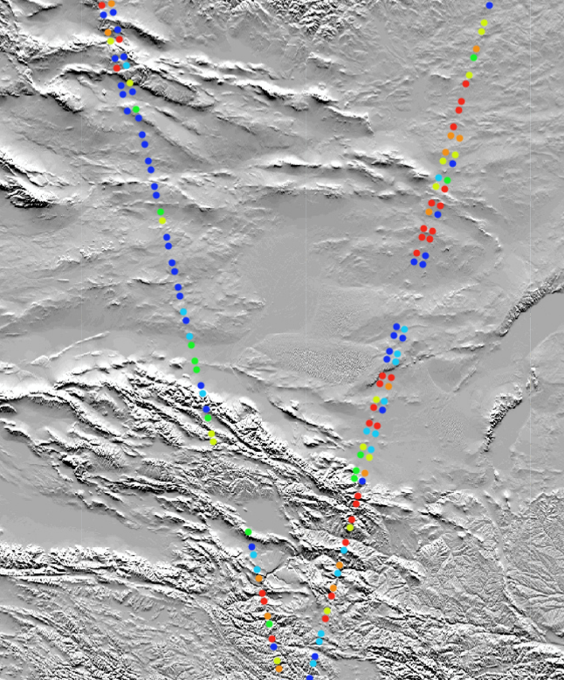
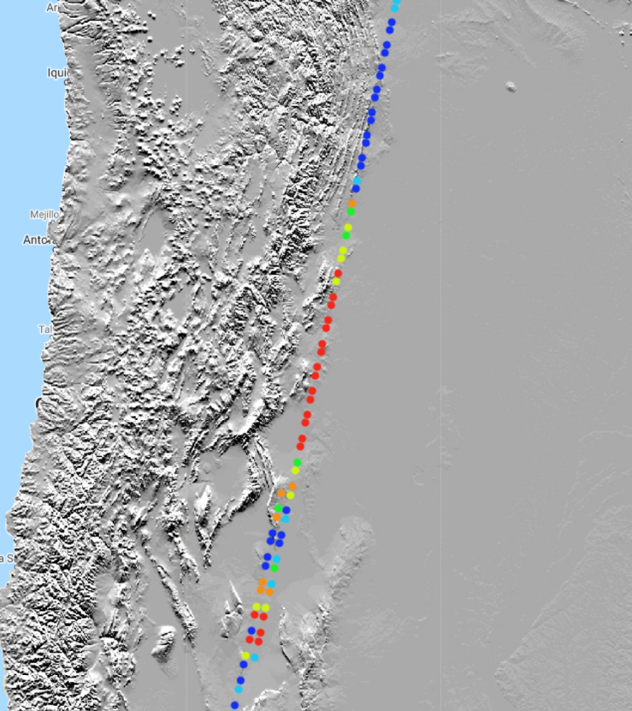
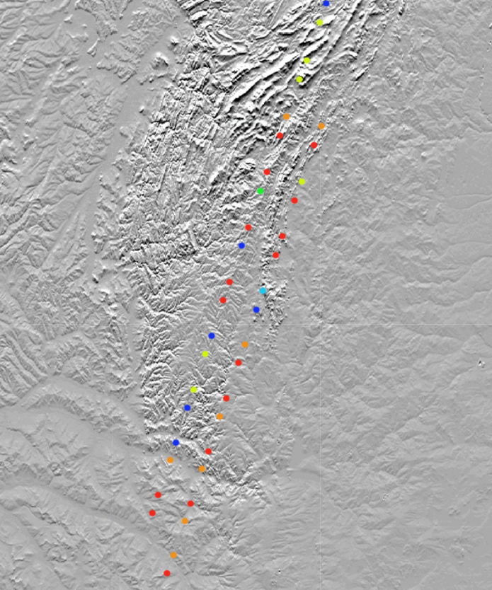
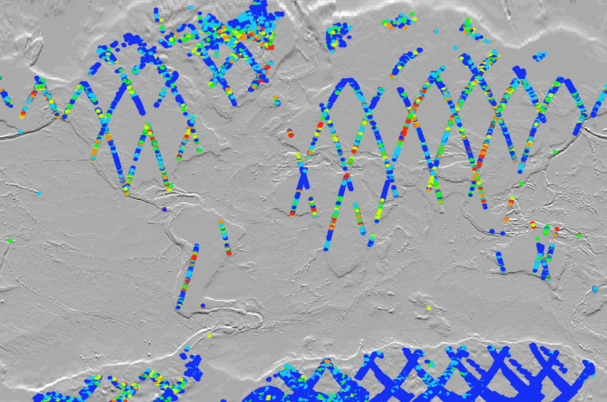
Close-up of some areas with large bias
Bias (K)
0-1
1-2
2-3
3-5
5-8
>8

Slide 16
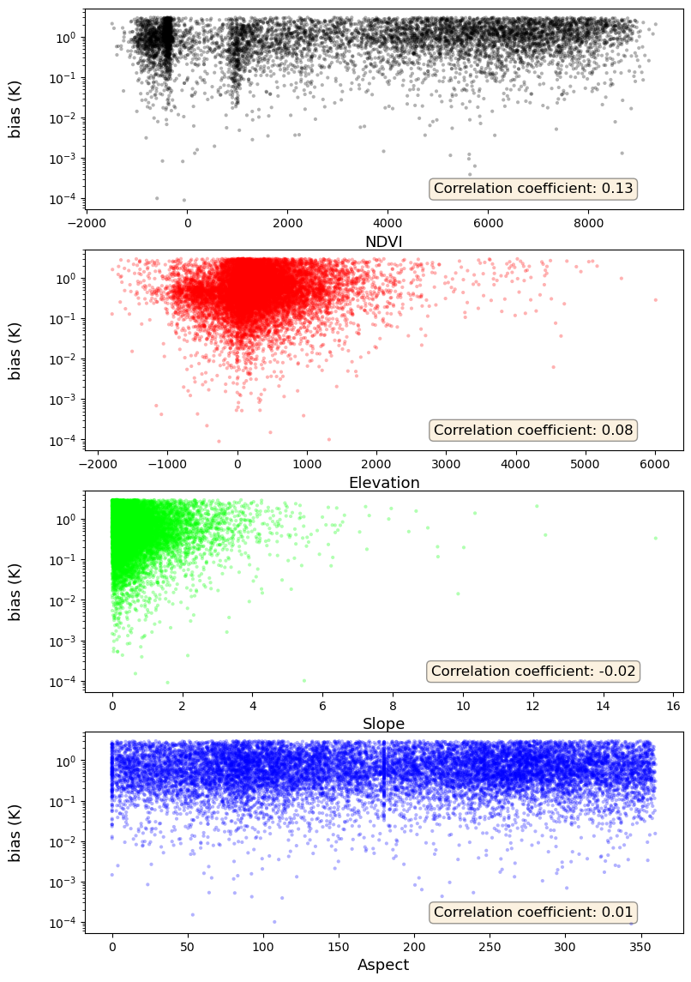
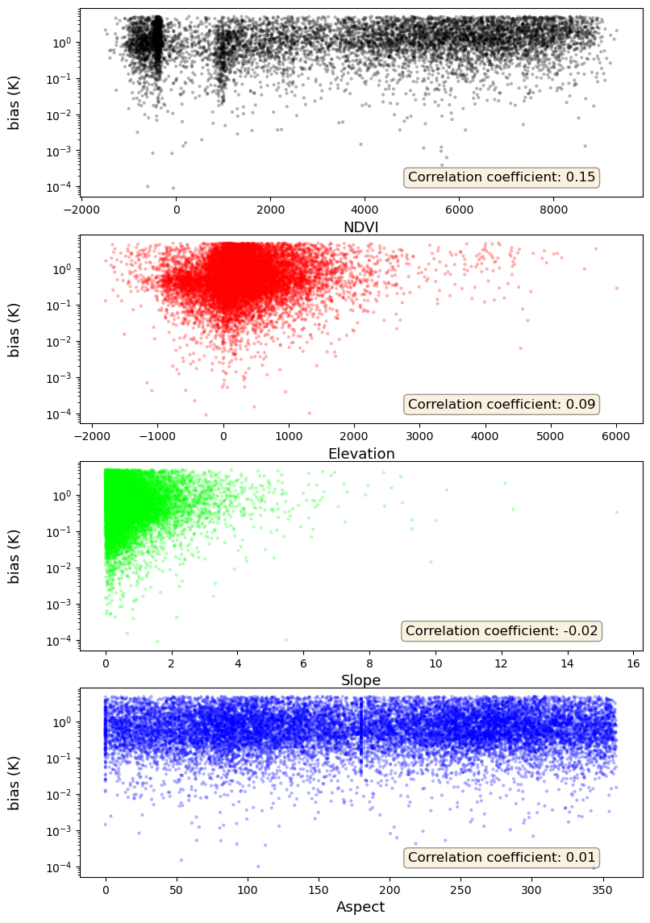
Results
NDVI CorrCoeff = 0.13
NDVI CorrCoeff = 0.15
Elevation CorrCoeff = 0.08
Elevation CorrCoeff = 0.09
Slope CorrCoeff = 0.02
Slope CorrCoeff = - 0.02
Aspect CorrCoeff = 0.01
Aspect CorrCoeff = 0.01
Limited to Biases < 3k
Limited to Biases < 5k

