Slide 1
GRWG IR Subgroup Activities and Plan
Likun Wang, ESSIC/UMD
GSICS IR Subgroup Chair
04/01/2021

Slide 2
Key Activities
Investigation of the bias at 3.9µm channel when comparing IASI with GEO imagers
Common practice has been proposed on how to handle the IASI negative radiance values during inter-calibration
Continuing monitoring the stability and accuracy of reference instrument (AIRS, CrIS, and IASI)
Develop and validation of the spectral filling method
Extend the IASI spectra to cover SW band
CrIS Spectral gap filling method
Efforts are made to improve and refine GEO-LEO and LEO-LEO IR inter-calibration to meet the new challenges
Collocation, Gap filling, Regression, Scene selection, correction…
GEO-LEO inter-calibration products are continuously generated by all the agency to monitor the GEO and LEO instrument
Interaction with other community (ISSCP-NG and NWP)
Applying and improving the GEO-GEO inter-calibration algorithm
Explore the possibility of using the Moon for IR Inter-calibration
Five (5) Web meetings have been organized and covered general topics on IR inter-calibrations

Slide 3
Discussion for Future Plans
New IR chair is needed (2018-now, three years’ term is full)
Plan monthly or bi-monthly web meeting
Plan on Thursday for the first week of each Month
Support more cross-community efforts,
Dialogue between GSICS with ISSCP-NG, NWP community, CEOS WGVS
Encourage more experts involved in the IR group
Updates on new instrument, methods, and datasets for the IR group
Share the tools and codes, knowledge Exchange memo
GitHub or GSICS wiki may be the best host place
Other missed Item?

Slide 4
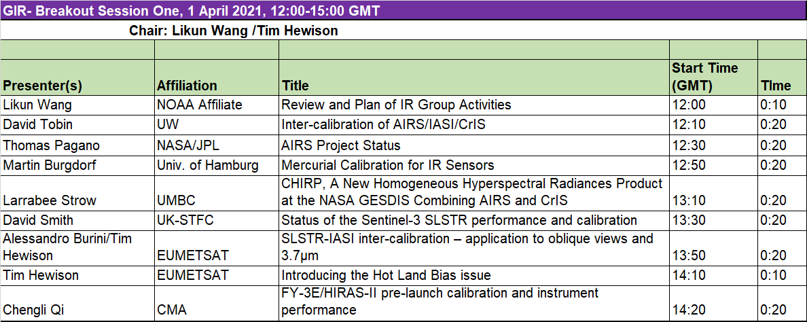
Session I – General Topics for IR Inter-calibration
Webex Meeting Information
https://noaa-nesdis-star.webex.com/noaa-nesdis-star/j.php?MTID=ma9cae25c6027a894bcda5b6d727d8b4b
Join by meeting number
Meeting number (access code): 199 013 7531
Meeting password: STAR

Slide 5
Session II – GEO-LEO inter-calibration
Webex Meeting Information
Meeting link:
https://umd.webex.com/umd/j.php?MTID=md5ceff07826ddde62513bf6f7171b858
Meeting number: 120 304 4075
Password: gsics

