Slide 1
Updates on inter-calibration results at 3.9 µm band as a response to R.GIR.20210113.3
Meteorological Satellite Center of JMA
Okuyama Arata, Kodera Kazuki
and Tanaka Hideaki

Slide 2
Tb bias on AHI/B07 (3.9μm)
The IR cal/val based on IASI shows there is a negative Tb bias around a cold scene for AHI/B07 (3.9μm).
The negative Tb bias appears in results using IASI-A and -B. (IASI-C is not implemented yet.)
There is no such the negative bias for the results using AIRS and SNPP/CrIS.
Processing for the negative radiance value of the hyper spectral sounders and GEO data may bring the negative Tb bias.
H8/AHI obs. radiance
IASI-B based radiance
H8/AHI – IASI-B Tb [K]
220
240
260
280
300
IASI-B based Tb [K]

Slide 3
Tb bias on AHI/B07 (3.9μm) vs HSSs
vs Metop-A/IASI
vs Metop-B/IASI
H8/AHI – LEO Tb [K]
H8/AHI – LEO Tb [K]
LEO based Tb [K]
LEO based Tb [K]
vs Aqua/AIRS
vs SNPP/CrIS
H8/AHI – LEO Tb [K]
H8/AHI – LEO Tb [K]
LEO based Tb [K]
LEO based Tb [K]

Slide 4
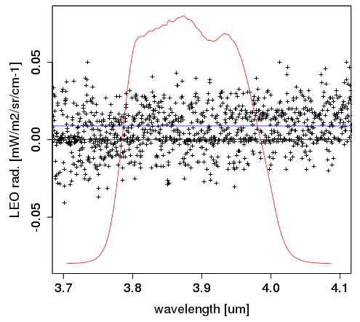
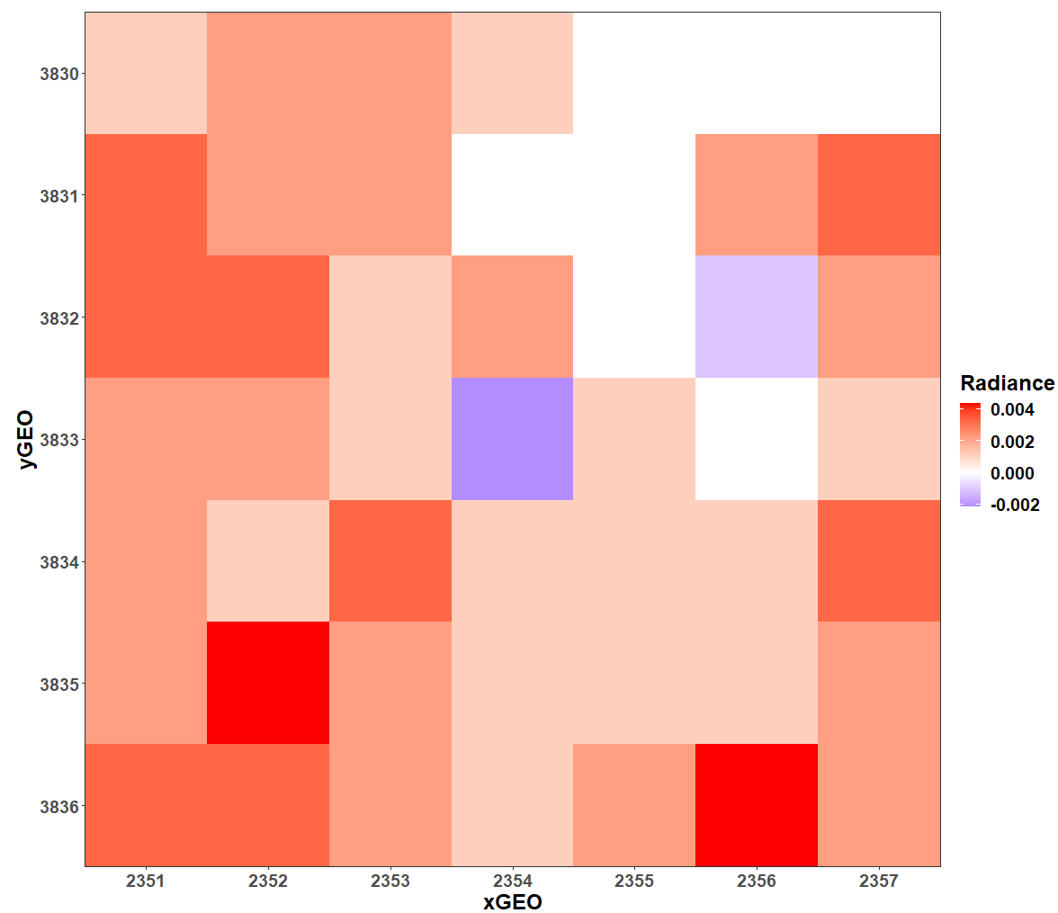
The discussion at the web meeting (13 Jan.)
In JMA’s implementation
The IASI negative radiance values were:
replaced to positive values computed by the gap filling method before the convolution.
The AHI negative radiance values for 3.9um band were:
replaced to zero.
Discussion in the web meeting
The negative IASI radiance values are normal, which are caused by the instrument noise on low radiances often found in the SW spectral region.
If we changes it or replaces it with positive values, it will introduce a false bias into the IASI spectra.
This concept is also applicable to the averaging process of the “FOV” pixels of GEO imager data.
IASI spectra
Negative values were replaced to positive values.
Wavelength [um]
GEO imager 7x7 “FOV” pixels
Negative values were replaced to 0.
From Minju’s slide

Slide 5
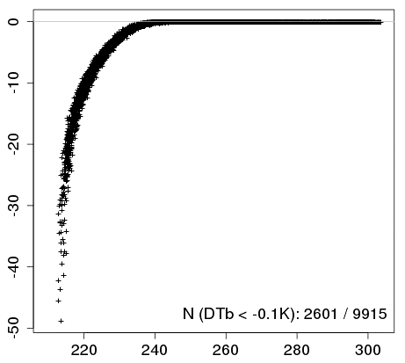
Revision #1: IASI data handling
Questions:
In what Tb range do the negative radiance channel appear?
How large is the effect of the negative radiance channels in the convolution process of IASI data?
We revised the convolution process to include negative radiance channels.
Revised LEO Tb < Old LEO Tb
ΔTb (Revised Tb - Old Tb):
~-20K @220K
~0K @ >240K
There is no negative radiance channels for wavelength of AHI/B08(6.2um) and other bands.
ΔTb[K]: Revised Tb – Old Tb
2601 / 9915
Col. data for AHI/B07 in 01-29 Dec. 2020
-50K
IASI based Tb (Old)
Old
Revised
Negative radiances
Negative radiances
replaced to positive radiances
convolution
convolution
Tb
Tb

Slide 6
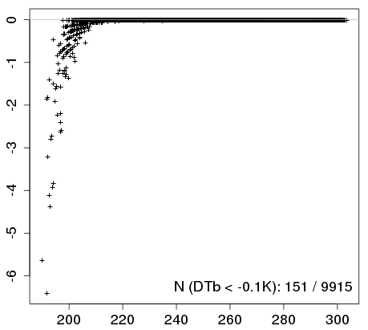
Revision #2: AHI data handling
Similar questions:
In what Tb range do the negative radiance value appear?
How large is the effect of the negative radiance pixels in averaging of AHI/B07 data?
We also revised the averaging process of AHI FOV pixels.
Revised GEO Tb < Old GEO Tb
ΔTb (Revised Tb - Old Tb):
~-2K @200K
~0K @ >220K
Number of the affected pixels is less than IASI’s case.
ΔTb[K]: Revised Tb – Old Tb
151 / 9915
Col. data for AHI/B07 in 01-29 Dec. 2020
-6K
AHI averaged Tb (Old)
Old
Revised
Negative radiances
Negative radiances
replaced to zero
averaging
averaging
Tb
Tb

Slide 7
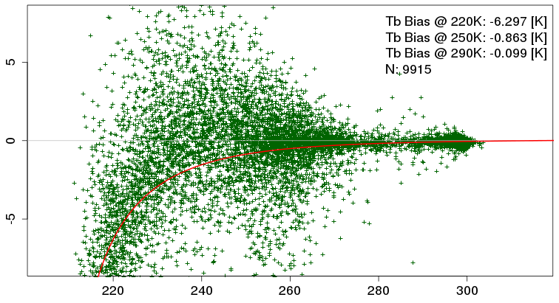
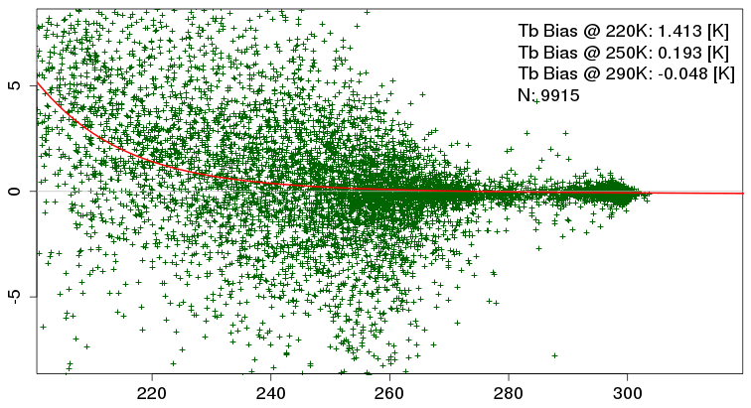
AHI/B07(3.9um) Tb bias, revised
By these two revisions:
(rev. #1) IASI based Tb mmm
(rev. #2) AHI FOV averaged Tb m
The revised result for IASI shows similar scatter plot to the ones for AIRS and SNPP/CrIS, which shows small positive bias in cold scenes.
AHI/B07 – IASIB (Old)
LEO based Tb [K]
AHI/B07 – IASIB (with rev. #1)
LEO based Tb [K]
AHI/B07 – SNPP/CrIS
AHI/B07 – AIRS
AHI/B07 (w. rev. #2) – IASIB (w. rev. #1)
LEO based Tb [K]
LEO based Tb [K]
LEO based Tb [K]

Slide 8
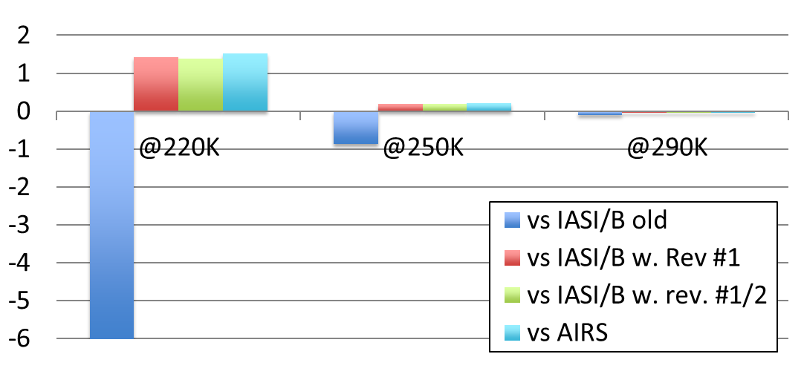
Summary
The IASI channels with the negative radiance values should be integrated as is.
The AHI FOV pixels with the negative radiance values are also averaged as is, although its effect is minor.
Those revisions affect only the Tb bias validation for AHI/B07 (3.7um) not for other IR bands.
Reprocessing of past GSICS Correction for AHI/B07 will be performed in the future.
AHI/B07 Tb bias [K]
IASI/B
AIRS

