Slide 1
Lessons learned from the
transition of IASI-A to IASI-B
Tim Hewison (EUMETSAT)
GSICS IR Web Meeting
2021-10-07

Slide 2
Timeline for GSICS IR Reference Instrument
Timeline
2006-10-19 Metop-A launch
2007-05-15~ IASI-A declared operational
2011-01-01 GSICS corrections using IASI-A
2012-09-17 Metop-B launch
2013-01-10 GSICS corrections using IASI-B
2013-04-24 IASI-B declared operational
2017-08-02 IASI-B onboard calibration update
2019-03-07 Recommended GSICS corrections switch IASI-A➔-B
2020-03-19 Confirmed all agencies switched IASI-A➔-B
2018-11-07 Metop-C launch
2019-07-03 IASI-C declared operational
Previous Discussions:
2019-08-22 | GIR - Likun Wang | Hyperspectral Sounder Inter-Comparison
2019-03-04/08 | GRWG/GDWG | Annual GRWG+GDWG Meeting - Frascati, Italy
2018-11-14 | GIR - T.Hewison | IR Reference Uncertrainty and Traceability Report (IRRefUTable)
2018-03-19/23 | GRWG/GDWG | Annual GRWG+GDWG Meeting - Shanghai, China
2017-12-14 | GRWG IR Subgroup | Migration of IR Reference from IASI-A to -B

Slide 3
Recap Previous Results
Examples from 2017-12-14 GSICS Web Meeting:
Double differencing of IASI-A+B against Meteosat-SEVIRI
Update from 2019-08-22 GSICS Web Meeting on Hyperspectral Sounder Updates and Inter-Comparison:
New analysis of the IASI-A/B double differences wrt SEVIRI
Key Points:
Double-difference of GSICS Corrections with different references instruments
Check relative calibration difference
Check stability in time
Check radiance dependence (nonlinearity)

Slide 4
Checklist for Reference Migration
Generate GSICS products in Parallel
from old + new reference
Ideally for >1yr
Analyse Double Differences
As functions of time & radiance (Check calibration differences, stability, nonlinearity)
Analyse time series
define stable period and identify End Dates
Analyse impact on uncertainties
Publish analysis!
Check decision to switch
Check usage of product
Communicate to users (internal + external)
Change default reference
(e.g. in Plotting Tool, monitoring web pages, …)

Slide 5
Other lessons – Version Changes
2019-09-30 14:45: change to the on-board processing of IASI-A
Introduced small change in calibration
~ uncertainty in GSICS Correction
Strictly a change in the reference instrument IASI-Av1 ➔ IASI-Av2
EUMETSAT incremented GSICS Corrections v1.1.0 ➔ v2.1.0
Created new RAC file v1➔v2
Was this change worthwhile?

Slide 6
Other lessons – Prime Corrections
Outcome of Web Meeting on Reference Migration from IASI-A to IASI-B (2017-12-14):
Possible strategy for migrating GSICS products from IASI-A to IASI-B
Previously, Tim had proposed the concept of the Prime GSICS Corrections,
whereby comparisons with different reference instruments are adjusted by delta corrections, based on double-differences.
Explained in following slides from Workshop on SI-Traceable Space-based Climate Observing System (SITSCOS)

Slide 7
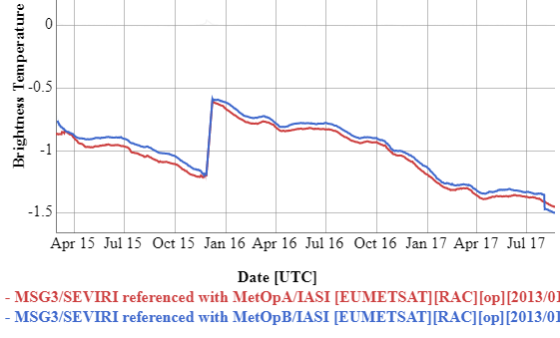
Introduction - Prime GSICS Corrections - Comparison of two IASI references -
GSICS products derived from different reference instruments give slightly different results
Aim to anchor to ONE reference
Check references’ relative stability
Combine results from multiple references
Correct Systematic Differences
Using Delta Corrections
from double differences
Used in Prime GSICS Corrections
Figure: Time-series of bias in 13.4µm channel of SEVIRI on Meteosat-10 relative to Metop-A/IASI and Metop-B/IASI 2015-2017
Notes:
Because the reference instruments show instrument-to-instrument biases or variations in biases over time, GSICS uses as additional step in the calibration procedure the Prime Corrections. This slides gives an example of the biases that were observed between different IASI instruments.

Slide 8
Concept – Prime GSICS Corrections
Prime corrections aim to correct for biases between different reference instruments and combine them
Define one Anchor GSICS Reference
For each spectral band/application
By consensus agreement within GSICS
Use other references as Transfer References
Construct delta corrections from double-differences
Apply to GSICS Corrections from each reference
So they are consistent with the anchor reference
Blend modified corrections, accounting for uncertainties
Ensures long-term continuity without calibration jumps
Traceability back to single Anchor GSICS Reference
Propagate uncertainties from all constituent parts
But how to account for possible drifts outside overlaps?

Slide 9
Other lessons – Prime Corrections
Concept of the Prime GSICS Corrections,
whereby comparisons with different reference instruments are adjusted by delta corrections, based on double-differences.
This is still felt to be a good approach for generating FCDRs.
But adoption of the idea in Near Real-Time Corrections has been slow, so a simpler alternative was proposed:
One idea is to first perform a comparison of the results with all available references.
This could be used to establish a consensus reference,
as a weighted average of the results from all the references that are within the consensus uncertainty.
This would result in jumps in the time series
– but they would be within the consensus uncertainty,
which estimates the absolute uncertainty on the merged GSICS corrections.
This may be larger than the uncertainty derived using a single reference,
and this increase may be critical for some applications.
And we need to establish some values before deciding whether to adopt this approach.
Delta Corrections
D.GWG.2018.3l.1: The group recognized the important role of GSICS to monitor the calibration of different reference instruments. Where these are stable, GSICS should aim to derive delta corrections to allow the traceable transfer of reference instruments for NRT applications.

Slide 10
Other lessons – IRRefUTable
GSICS IR Reference Traceability & Uncertainty Report (“IRRefUTable”)
Good idea – see following slides from Workshop on SI-Traceable Space-based Climate Observing System (SITSCOS)
But need new leadership

Slide 11
GSICS IR Reference Traceability & Uncertainty Report
Aims
To support choice of reference instruments for GSICS
To provide traceability between IR reference instruments (IASI, AIRS, CrIS)
To seek consensus on uncertainties in absolute calibration of reference sensors
By consolidating pre-launch test results and various in-flight comparisons
1. Error Budget & Traceability
Focus on radiometric and spectral calibration – for AIRS, IASI, CrIS
Analysed following common approach [Tobin et al., 2013] – see next slide
To generate directly comparable error budgets for all reference sensors
2. Inter-comparisons
Introduction: Pros and Cons of each method
Direct Comparisons: Polar SNOs, Tandem SNOs (AIRS+CrIS), Quasi-SNOs,
Double-Differencing: GEO-LEO, NWP+RTM, Aircraft campaigns
Bin all results in common spectral/radiance intervals to allow direct comparisons – see following slide
Notes:
So within GSICS we have started to develop a report to …

Slide 12
IR Reference Sensor Inter-Comparisons
 |  |  | Mean Difference dTb [K]
 |  | Pseudo Channel [cm-1] | 200 | 220 | 240 | 260 | 280 | 300
Start date | 2013-08-01 | 655 | -0.11 | -0.10 | -0.08 | NaN | NaN | NaN
End date | 2016-06-30 | 665 | -0.09 | -0.08 | -0.08 | NaN | NaN | NaN
Start time | 21:53 | 675 | -0.06 | -0.07 | -0.06 | NaN | NaN | NaN
End time | 23:21 | 685 | -0.05 | -0.05 | -0.05 | NaN | NaN | NaN
Min Latitude [°] | -74.31 | 695 | -0.05 | -0.05 | -0.04 | NaN | NaN | NaN
Max Latitude [°] | 74.31 | 705 | -0.10 | -0.05 | -0.03 | NaN | NaN | NaN
Min Longitude [°] | -179.87 | 715 | -0.11 | -0.07 | -0.03 | NaN | NaN | NaN
Max Longitude [°] | 180 | 725 | -0.11 | -0.10 | -0.05 | -0.02 | NaN | NaN
Min Scan Angle [°] | 0 | 735 | -0.11 | -0.10 | -0.05 | -0.01 | NaN | NaN
Max Scan Angle [°] | 3.5 | 745 | -0.12 | -0.12 | -0.06 | -0.03 | NaN | NaN
 |  | 755 | -0.11 | -0.12 | -0.08 | -0.04 | -0.01 | NaN
Collocation method: | Big circle SNO | 765 | -0.11 | -0.12 | -0.08 | -0.05 | -0.04 | NaN
Collocation dist [km] | 50 | 775 | -0.11 | -0.12 | -0.08 | -0.04 | -0.04 | -0.50
Collocation time [s] | 1200 | 785 | -0.11 | -0.11 | -0.08 | -0.05 | -0.03 | -0.15
Collocation sec(theta) |  | 795 | -0.11 | -0.11 | -0.07 | -0.04 | -0.04 | NaN
Filtering applied | see ref | 805 | -0.10 | -0.10 | -0.07 | -0.04 | -0.04 | -0.24
 |  | 815 | -0.10 | -0.10 | -0.07 | -0.04 | -0.03 | -0.17
Algorithm Ref | JGR Tobin 2016 | 825 | -0.11 | -0.11 | -0.07 | -0.04 | -0.03 | -0.18
Dataset Ref |  | 835 | -0.11 | -0.11 | -0.07 | -0.04 | -0.03 | -0.18
Monitored Instrument | IASI-A L1C | 845 | -0.11 | -0.10 | -0.06 | -0.04 | -0.03 | -0.16
Processing Version | latest | 855 | -0.11 | -0.11 | -0.06 | -0.04 | -0.03 | -0.16
Form consensus on relative calibration
Re-binning results of existing comparisons
Biases with respect to Metop-A/IASI
With standard uncertainties (k=1)
At common spectral resolution
In 10cm-1 bins within AIRS bands
Or average results over broad-band channels
Converted into Brightness Temperatures
For specific radiance scenes 200-300K
For all viewing angles
and/or for specific ranges - e.g. nadir ±10°
Over specific period
Common 4-year period from IASI-B start
Easy to inter-compare and Calculate Double-Differences
Notes:
For the second part of the report summarises the inter-comparisons between the various reference instruments
On a common scale to form a consensus on their relative calibration

Slide 13
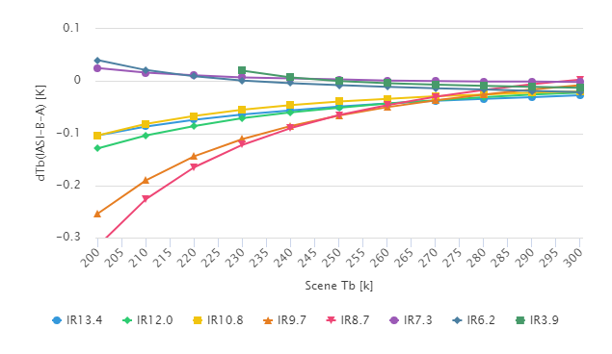
IR Reference Sensor Inter-Comparisons
Form consensus on relative calibration
Re-binning results of existing comparisons
Biases with respect to Metop-A/IASI
With standard uncertainties (k=1)
At common spectral resolution
In 10cm-1 bins within AIRS bands
Or average results over broad-band channels
Converted into Brightness Temperatures
For specific radiance scenes 200-300K
For all viewing angles
and/or for specific ranges - e.g. nadir ±10°
Over specific period
Common 4-year period from IASI-B start
Easy to inter-compare and Calculate Double-Differences
Mean Double Difference IASI B-A – wrt Meteosat/SEVIRI
Plotted where uncertainty < 0.1K
Difference increase for colder scenes in all channels
SWIR: V. small positive differences (<<0.1K)
MWIR: V. small positive differences (<<0.1K)
LWIR window: Small negative differences (<~0.1K)
LWIR absorption: Larger negative differences (<~0.3K)
Notes:
For example results are shown here for the double-differences for all the IR channels of Met-10
as a function of the scene TB with different channels in different colours
Bullets summarise results

Slide 14
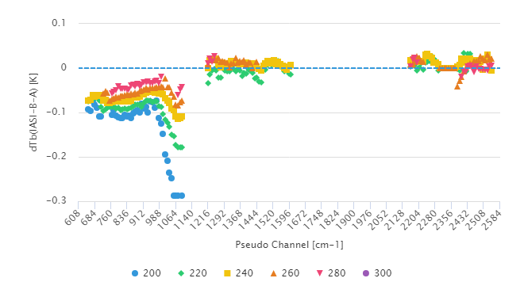
IR Reference Sensor Inter-Comparisons
Form consensus on relative calibration
Re-binning results of existing comparisons
Biases with respect to Metop-A/IASI
With standard uncertainties (k=1)
At common spectral resolution
In 10cm-1 bins within AIRS bands
Or average results over broad-band channels
Converted into Brightness Temperatures
For specific radiance scenes 200-300K
For all viewing angles
and/or for specific ranges - e.g. nadir ±10°
Over specific period
Common 4-year period from IASI-B start
Easy to inter-compare and Calculate Double-Differences
Mean Double Difference IASI B-A – wrt S-NPP/CrIS
Plotted where uncertainty < 0.1K (0.15K for 200K)
Difference increase for colder scenes in all channels
SWIR: V. small positive differences (<<0.1K)
MWIR: V. small positive differences (<<0.1K)
LWIR window: Small negative differences (<~0.1K)
LWIR absorption: Larger negative differences (<~0.3K)
Notes:
And here is the double difference wrt CrIS – this time as a function of channel wavenumber, with different colours corresponding to different scene radiances
- Again we see the same pattern of biases

Slide 15
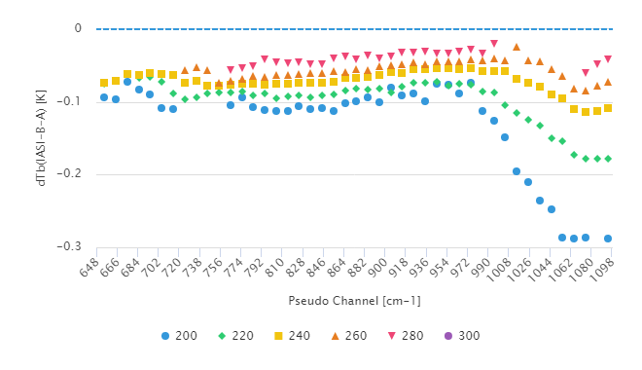
IR Reference Sensor Inter-Comparisons
Form consensus on relative calibration
Re-binning results of existing comparisons
Biases with respect to Metop-A/IASI
With standard uncertainties (k=1)
At common spectral resolution
In 10cm-1 bins within AIRS bands
Or average results over broad-band channels
Converted into Brightness Temperatures
For specific radiance scenes 200-300K
For all viewing angles
and/or for specific ranges - e.g. nadir ±10°
Over specific period
Common 4-year period from IASI-B start
Easy to inter-compare and Calculate Double-Differences
IR13.4
IR12.0
IR10.8
IR9.7 .
SEVIRI-CrIS DD | 200 | 220 | 240 | 260 | 280 | RMSD
IR13.4 | 0.00 | 0.02 | 0.02 | 0.02 | 0.02 | 0.016 | K
IR12.0 | -0.02 | 0.01 | 0.01 | 0.02 | 0.01 | 0.015 | K
IR10.8 | -0.02 | 0.01 | 0.01 | 0.01 | 0.01 | 0.012 | K
IR9.7 | -0.03 | -0.01 | -0.01 | -0.01 | -0.03 | 0.020 | K
IR8.7
IR7.3 |  | 0.02 | -0.01 | -0.01 |  | 0.013 | K
IR6.2 |  | 0.01 | -0.01 | -0.01 |  | 0.010 | K
IR3.9 |  | 0.03 | -0.01 | -0.01 | -0.01 | 0.018 | K
r.m.s. Double Difference IASI-B-A derived from SEVIRI and CrIS |  |  |  |  |  | 0.016 | K
Notes:
We can zoom in on the long-wave end
And show that because of the way the results have been binned it is easy to compare the results of different methods
In this case, the 2 methods to calculate the double difference between IASI-A and –B agree with an RMS difference of 16mK

